Slide 1


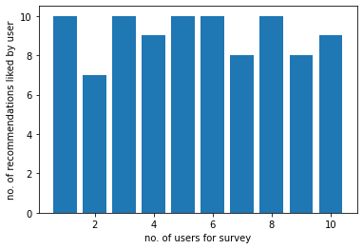
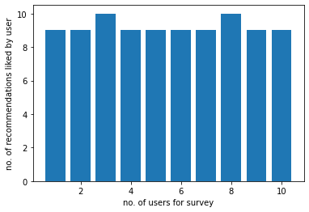
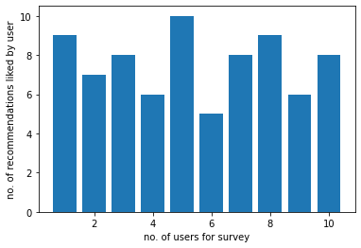
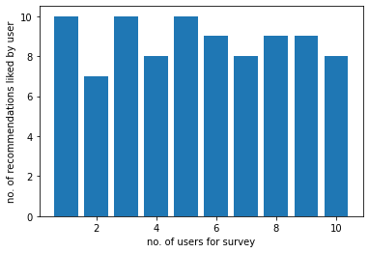
Recommending Movies Using Hybrid Approach
Mounik Patel (1144127)
Computer Science – Lakehead University
Introduction
Results
With the rapid explosion of video streaming platforms on the Internet, the catalog of movies is rising exponentially, leaving viewers overwhelmed with a huge database of movies to choose from. Movie Recommendation Systems come into play, which consider users' preferences and recommend movies to them. This saves users a lot of time and effort that would otherwise be wasted while searching for a movie manually.
Top-N Popular Movies Recommender System
Top-N Similar Movies Recommender System (by Cosine Similarity)
The goal of this research is to build a movie recommendation system which takes a hybrid approach by combining a content-based approach – checking similarity between metadata of movies (i.e., release year, genre, etc.) and a collaborative filtering approach - checking similarity between user-ratings of movies into account to find movies and recommend them to users.
Methods
Content-based recommendation systems analyze movie descriptions in order to recommend movies that are of particular interest to the user. A content-oriented approach has the advantage of not having other users' information or data, and the recommender system will recommend new movies or movies that the user has not yet watched [1]. This approach works best when there is known information about a movie (title, genre, release year, etc.) but not about the user. This method is based on research in information retrieval and information filtering [2].
Top-N Rated Movies Recommender System
Top-N Similar Movies Recommender System (by Pearson Correlation)
Discussion
Top-N Popular Movies Recommender System is far more effective than the Top-N Rated Movies Recommender System.
Individuals prefer to watch movies that are very popular (watched by many) rather than movies that are highly rated.
Top-N Similar Movies Recommender System (by Cosine Similarity) is far more effective than the Top-N Similar Movies Recommender System (by Pearson Correlation).
Both similarity measures are effective at recommending similar movies to the user, but the movies recommended by Cosine Similarity are more effective and better than the movies recommended by Pearson Correlation.
The collaborative filtering system recommends movies based on similarity measures between users and/or movies. The collaborative filtering method tries to find other like-minded users and then recommends the movies that are most liked by them. This is based on a scenario where a person asks his friends, who have similar tastes, to recommend him some movies [3]. While the term "collaborative filtering" has only been around for a little more than a decade, it derives from something humans have been doing for hundreds of years: sharing opinions with others. Collaborative filtering predicts user preferences in movie recommendations based on previously known user-ratings of movies [1].
References
Padti, P. G., Hegde, K., and Kumar, P. (2021). Hybrid Movie Recommender System. Int. J. of Res. In Eng., Sci. and Manage., 4, 311-314.
Kashyap, A., B, S., Sriv.astava, S., PH, A., and Shah, A. J. (2020). A Movie Recommender System: MOVREC using Machine Learning Techniques. Int. J. of Eng. Sci. and Comput., 10, 26195-26200.
Bhatt, B., Patel, J., and Gaudani, H. (2014). A Review Paper on Machine Learning Based Recommendation System. Int. J. of Eng. Develop. and Res., 2, 3955-3961.
mpatel78@lakeheadu.ca
Notes:
Behavioral results: make bar graphs of RT?
fMRI results: labels, figure caption, make blues in graph the same color
References: add marcel 2004, add numbers, rearrange

