Slide 1

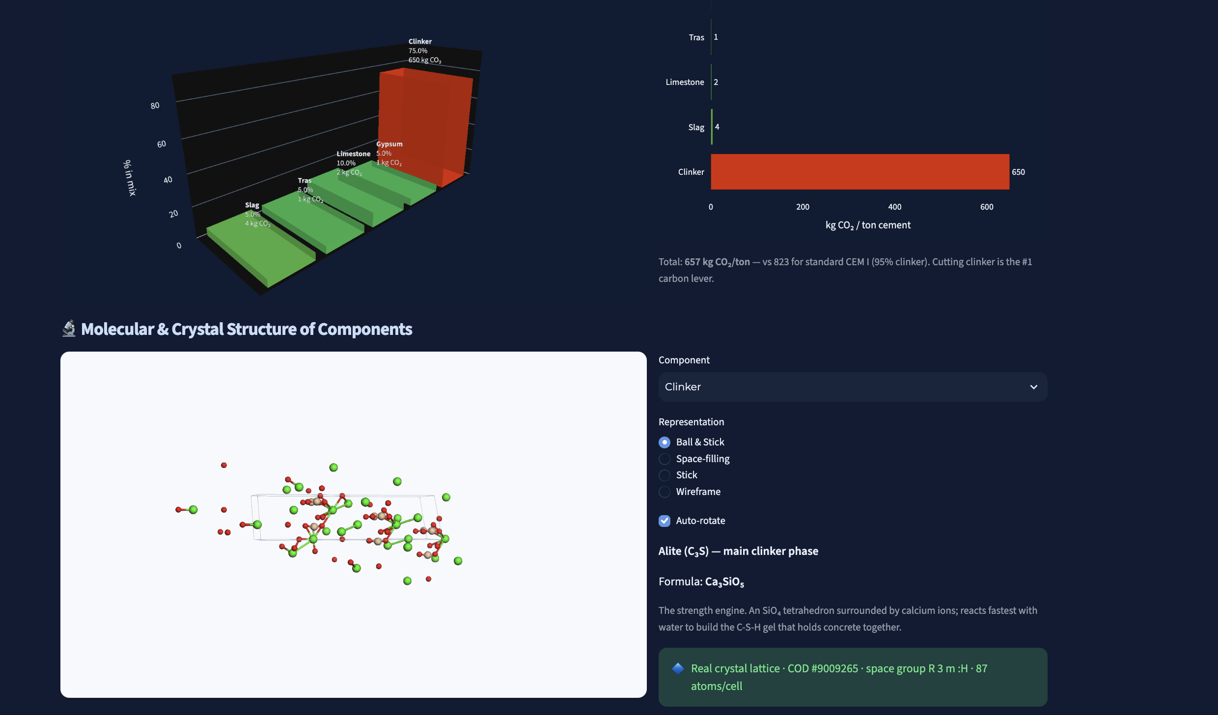
CASE STUDY / 02
SCC Kimya. Cement know-how on tap.
CHALLENGE
Plant chemistry and process knowledge sat with a few experts; engineers waited on them for answers that should have been self-service.
APPROACH
Streamlit assistant on Azure App Service grounded on the plant's own technical corpus, with Turkish/English retrieval and controlled answer sourcing.
IMPACT
A working assistant the team can question directly; expert time is reserved for exceptions rather than routine lookups.
CEMENT & CHEMICALS · TÜRKİYE · PROOF OF CONCEPT

Slide 2
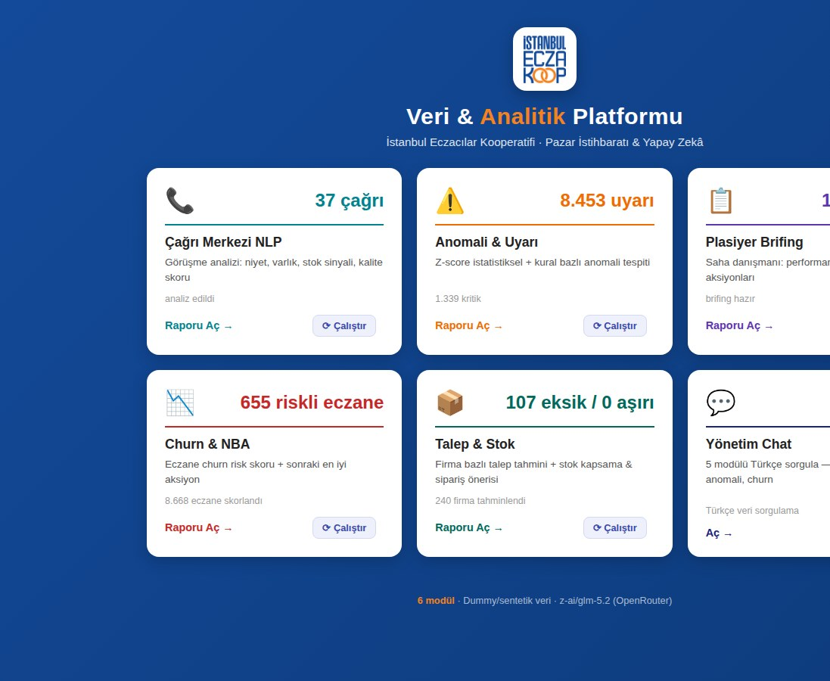
CASE STUDY / 03
İSKOOP. Six AI modules for a pharmacy cooperative.
CHALLENGE
Istanbul's pharmacists' cooperative had call, sales and stock data in silos; churn, anomalies and demand were spotted late, if at all.
APPROACH
Analytics platform with six modules: call-centre NLP, anomaly alerts, field-rep briefings, churn & next-best-action, demand & stock, Turkish chat.
IMPACT
In the demo run: 8,668 pharmacies scored, 655 flagged as churn risk, 8,453 anomaly alerts and 240 suppliers forecast — all queryable in Turkish.
PHARMA DISTRIBUTION · TÜRKİYE · PROOF OF CONCEPT

Slide 3
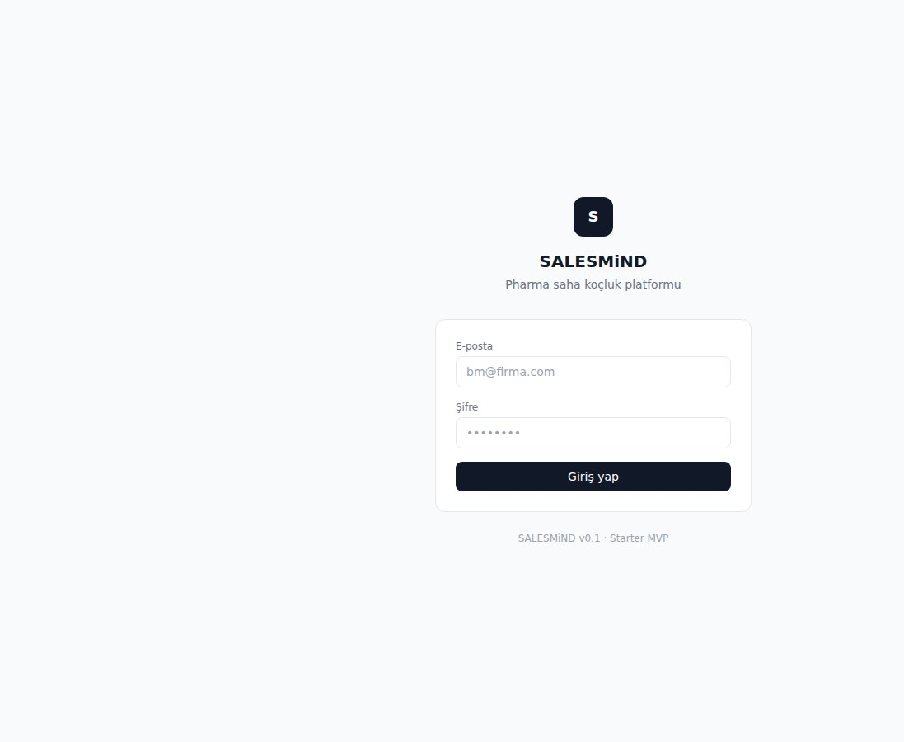
CASE STUDY / 05
SALESMiND. Coaching every pharma field rep.
CHALLENGE
Pharma sales managers could not coach a large field force consistently; visit quality varied and feedback arrived too late to change behaviour.
APPROACH
Starter MVP of a field-coaching platform on Azure Container Apps: rep visit capture, structured coaching feedback and manager dashboards.
IMPACT
A v0.1 platform in the client's hands for pilot feedback; foundation laid for AI-generated coaching notes in the next release.
PHARMA SALES · TÜRKİYE · MVP

Slide 4
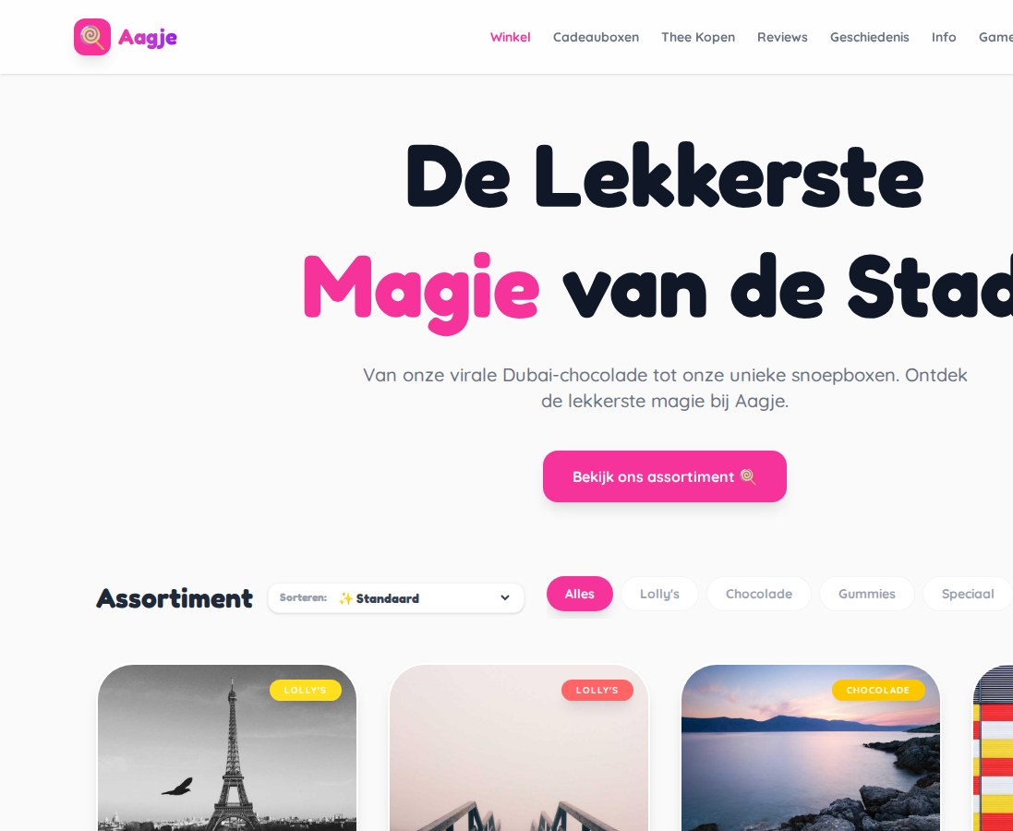
CASE STUDY / 06
Aagje. A candy shop that went online.
CHALLENGE
A popular Dutch sweet shop riding the viral Dubai-chocolate wave had no web presence to capture demand beyond the counter.
APPROACH
Full storefront on Azure App Service: catalogue with filters, gift boxes, tea, reviews, games and an AI 'Snoep-tovenaar' advisor for recommendations.
IMPACT
The shop's range is browsable and orderable online with prices, stock and categories — a foundation for turning social buzz into repeat sales.
RETAIL · NETHERLANDS · 2 WEEKS

Slide 5
CASE STUDY / 07
NEPSE. Nepal's market data, searchable.
CHALLENGE
Nepal Stock Exchange data was scattered across pages with no API; analysts scraped by hand and could not ask questions across history.
APPROACH
Scraper service on an Azure VM feeding an ARiVA assistant, so listings, prices and disclosures become a queryable, grounded corpus.
IMPACT
Continuous collection replaced manual pulls; market questions are answered from live data instead of spreadsheets.
CAPITAL MARKETS · NEPAL · PILOT

Slide 6
CASE STUDY / 08
e-Mükellef. VAT work, automated for accountants.
CHALLENGE
Turkish accounting offices spend hours each month on repetitive KDV (VAT) preparation and client document chasing.
APPROACH
Automation platform for accounting offices: document intake, KDV calculation checks and client-facing status, deployed on Azure App Service.
IMPACT
Routine VAT preparation moved from manual keying to a checked, automated flow; staff time freed for advisory work.
ACCOUNTING · TÜRKİYE · PROOF OF CONCEPT

Slide 7
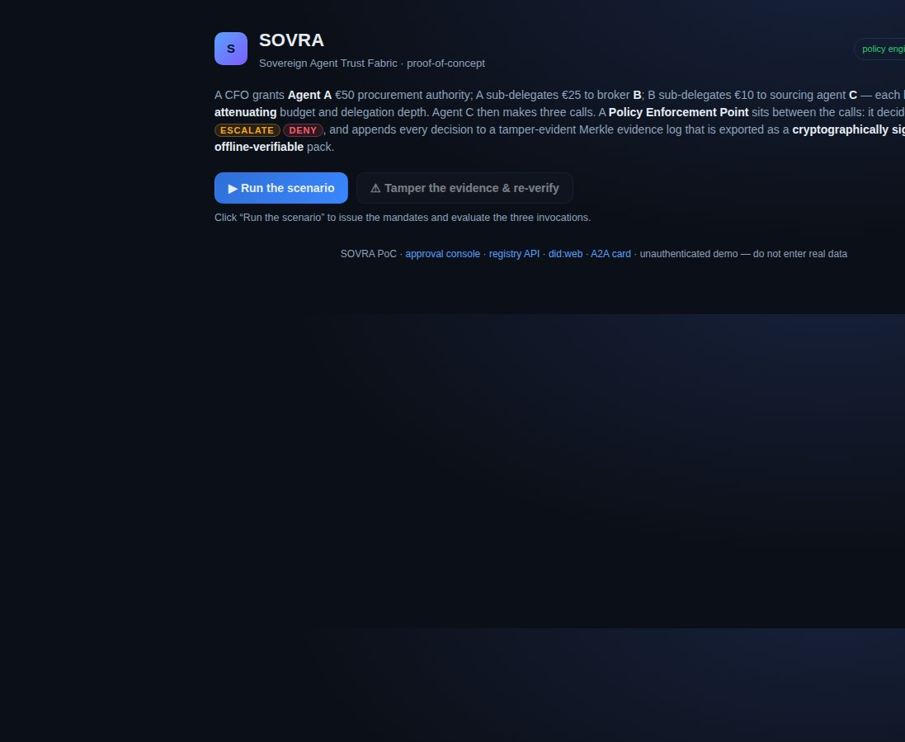
CASE STUDY / 09
SOVRA. Agents you can hold to account.
CHALLENGE
As agents delegate to other agents, nobody can prove who was allowed to do what, with how much budget, and whether the evidence was tampered with.
APPROACH
Trust-fabric PoC: mandates with attenuating budget and depth, a policy enforcement point (PERMIT / ESCALATE / DENY), did:web registry, A2A cards.
IMPACT
Every decision lands in a Merkle evidence log exported as a signed, offline-verifiable pack — tamper it and re-verification fails on demand.
AI GOVERNANCE · EU · IP & PROOF OF CONCEPT

Slide 8
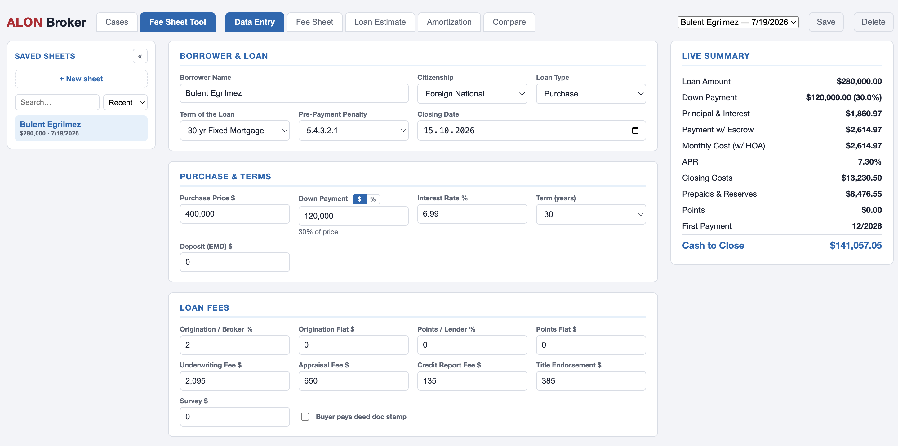
CASE STUDY / 10
Broker fee sheet. One source of truth for fees.
CHALLENGE
Brokerage fee schedules lived in spreadsheets shared by email; versions drifted and clients were quoted inconsistently.
APPROACH
Secure fee-sheet web app on Azure Static Web Apps behind Microsoft sign-in, giving the team a single maintained schedule.
IMPACT
One controlled fee sheet replaces circulating copies; quotes are consistent and changes are auditable.
FINANCIAL SERVICES · EU · 2 WEEKS

Slide 9
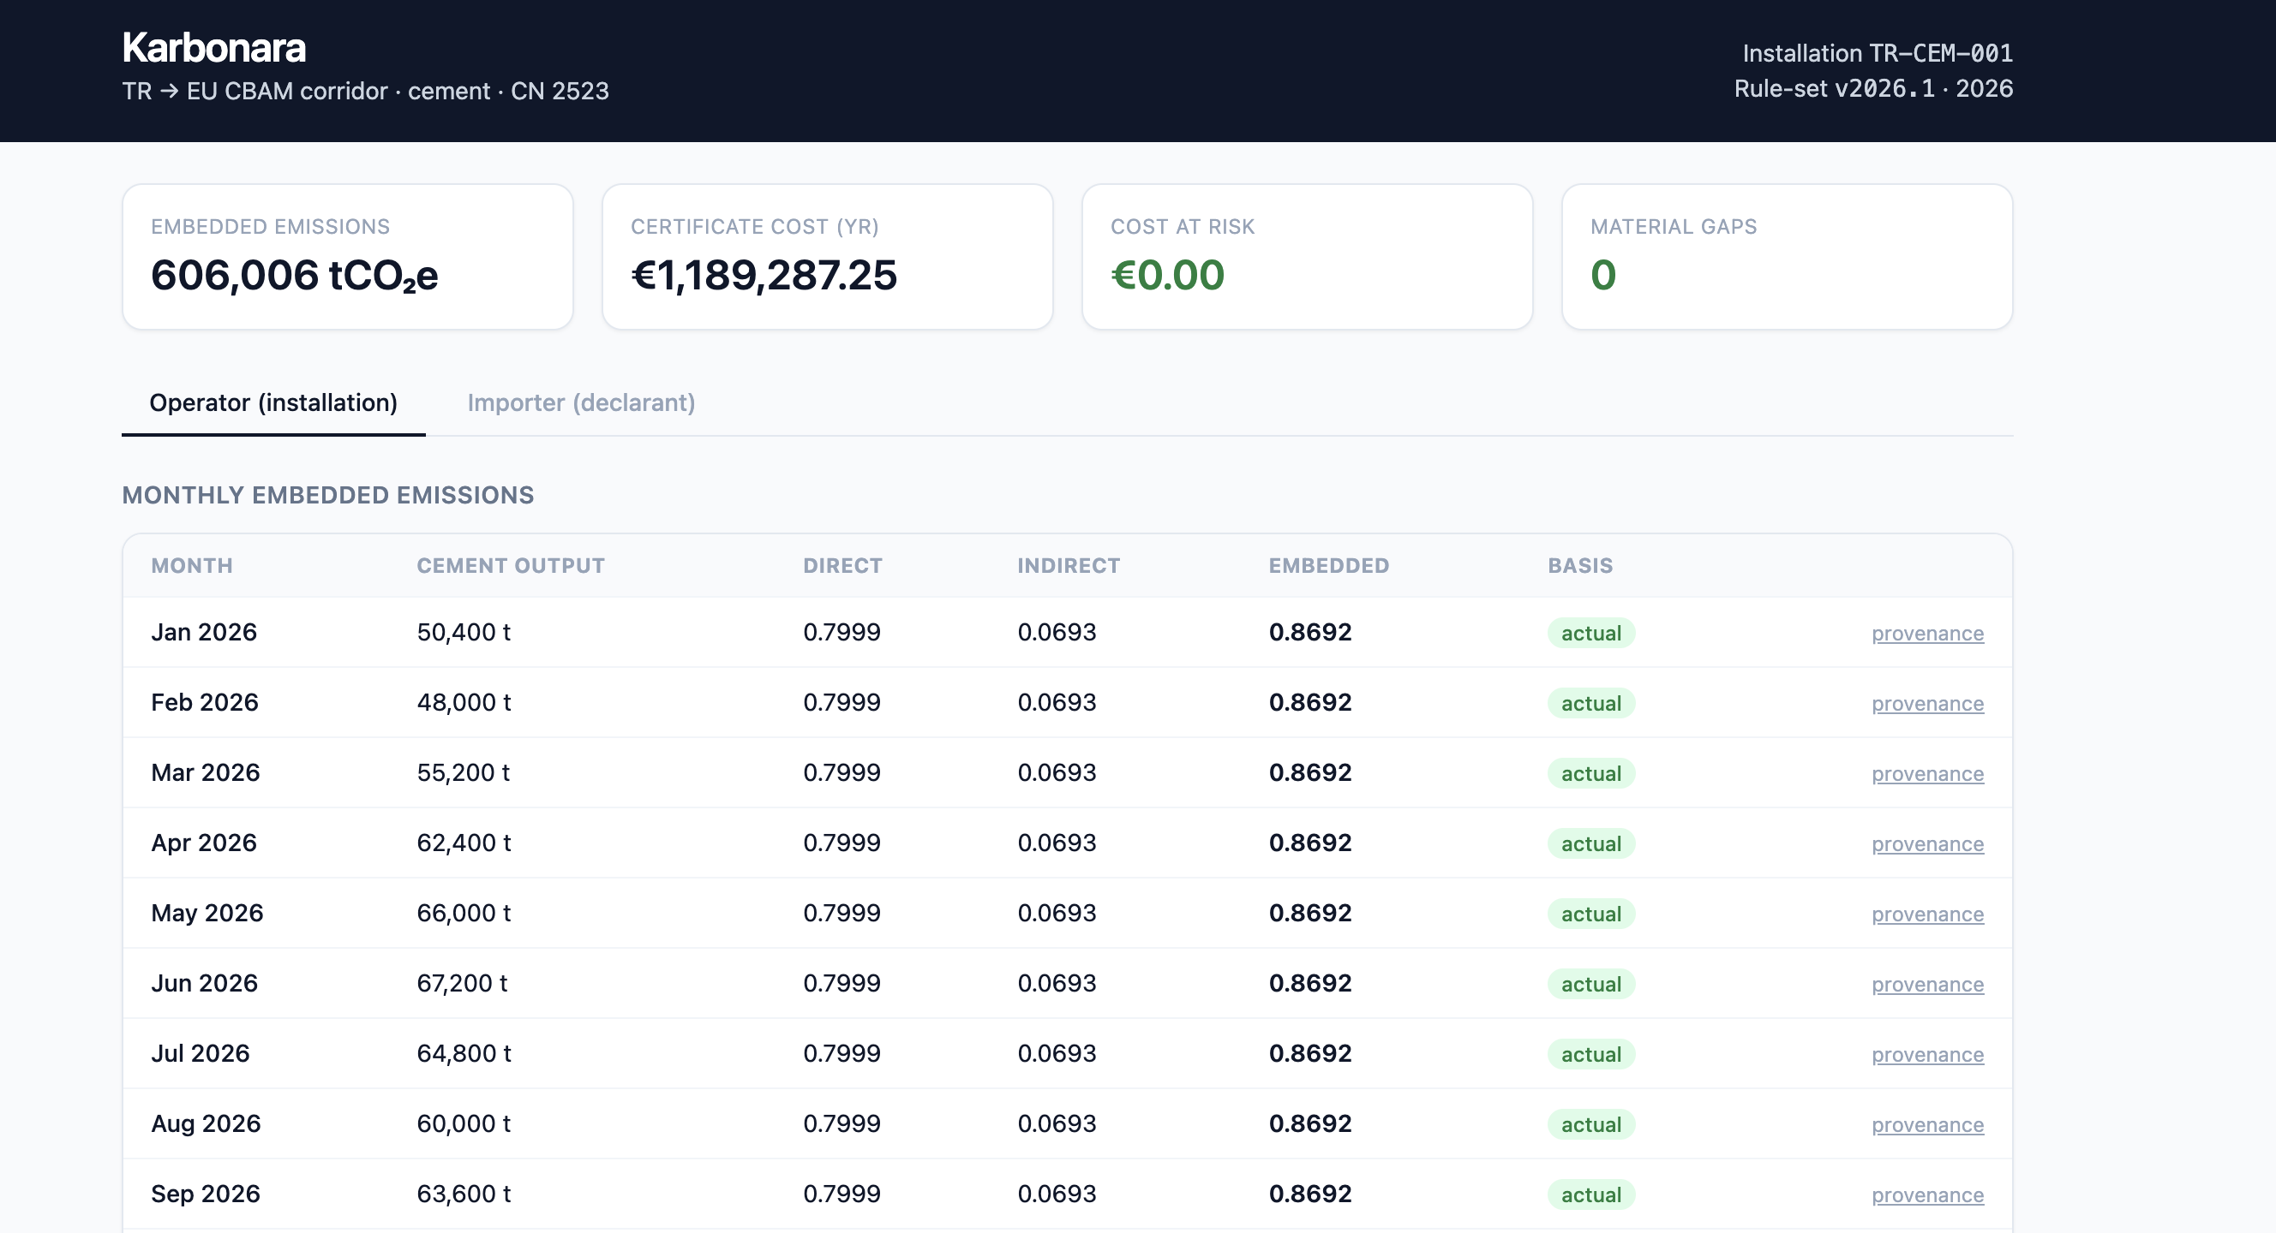
CASE STUDY / 11
Karbonara. CBAM data, corridor-ready.
CHALLENGE
EU CBAM obligations require Turkish exporters to report embedded emissions per shipment — data that sits in ERPs, suppliers and utility bills.
APPROACH
Pipeline on Azure Container Apps: ingest production and energy data, compute embedded CO₂ per product, generate CBAM-ready declaration data.
IMPACT
Exporters can produce declaration data from source systems instead of consultants' spreadsheets; the Turkey–EU corridor case is now demonstrable.
MANUFACTURING & TRADE · TÜRKİYE / EU · CONCEPT

Slide 10
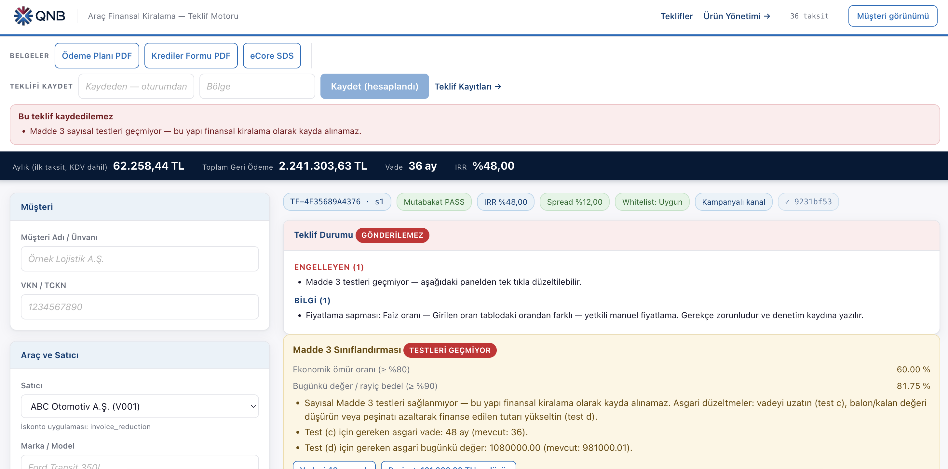
CASE STUDY / 12
QNB Leasing. Vehicle offers, decided by agents.
CHALLENGE
Vehicle-leasing quotes and credit decisions took days of analyst work across SAP, PDFs and BDDK rules, with limited traceability.
APPROACH
Agentic credit decisioning: LangGraph + DMN rules, Flowable, Qdrant, Qwen3 on vLLM; product and offer engine on Azure Container Apps, dev → prod.
IMPACT
Offer plans generated from product rules in seconds; every decision is logged against the BDDK ruleset. Dev and production environments live.
LEASING & BANKING · TÜRKİYE · 3 MONTHS

Slide 11
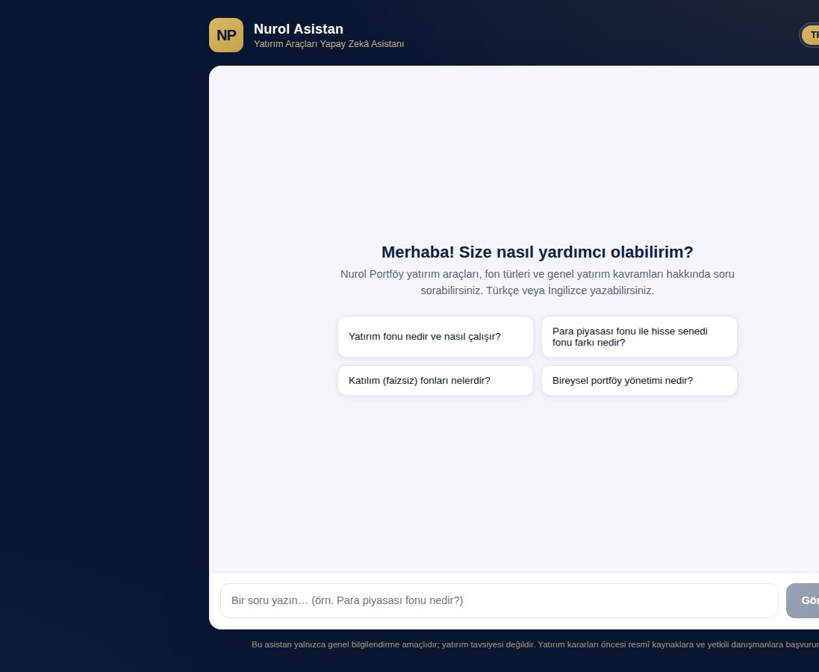
CASE STUDY / 13
Nurol Portföy. An investment assistant that answers.
CHALLENGE
Investor questions about funds and instruments reached call centres and advisors; answers varied and were slow outside office hours.
APPROACH
Nurol Asistan on ARiVA: bilingual TR/EN assistant grounded on fund documents and investment concepts, with disclaimers and guardrails.
IMPACT
General investor questions answered instantly with sourced, non-advisory responses; advisors handle only what needs judgement.
ASSET MANAGEMENT · TÜRKİYE · 4 WEEKS

Slide 12
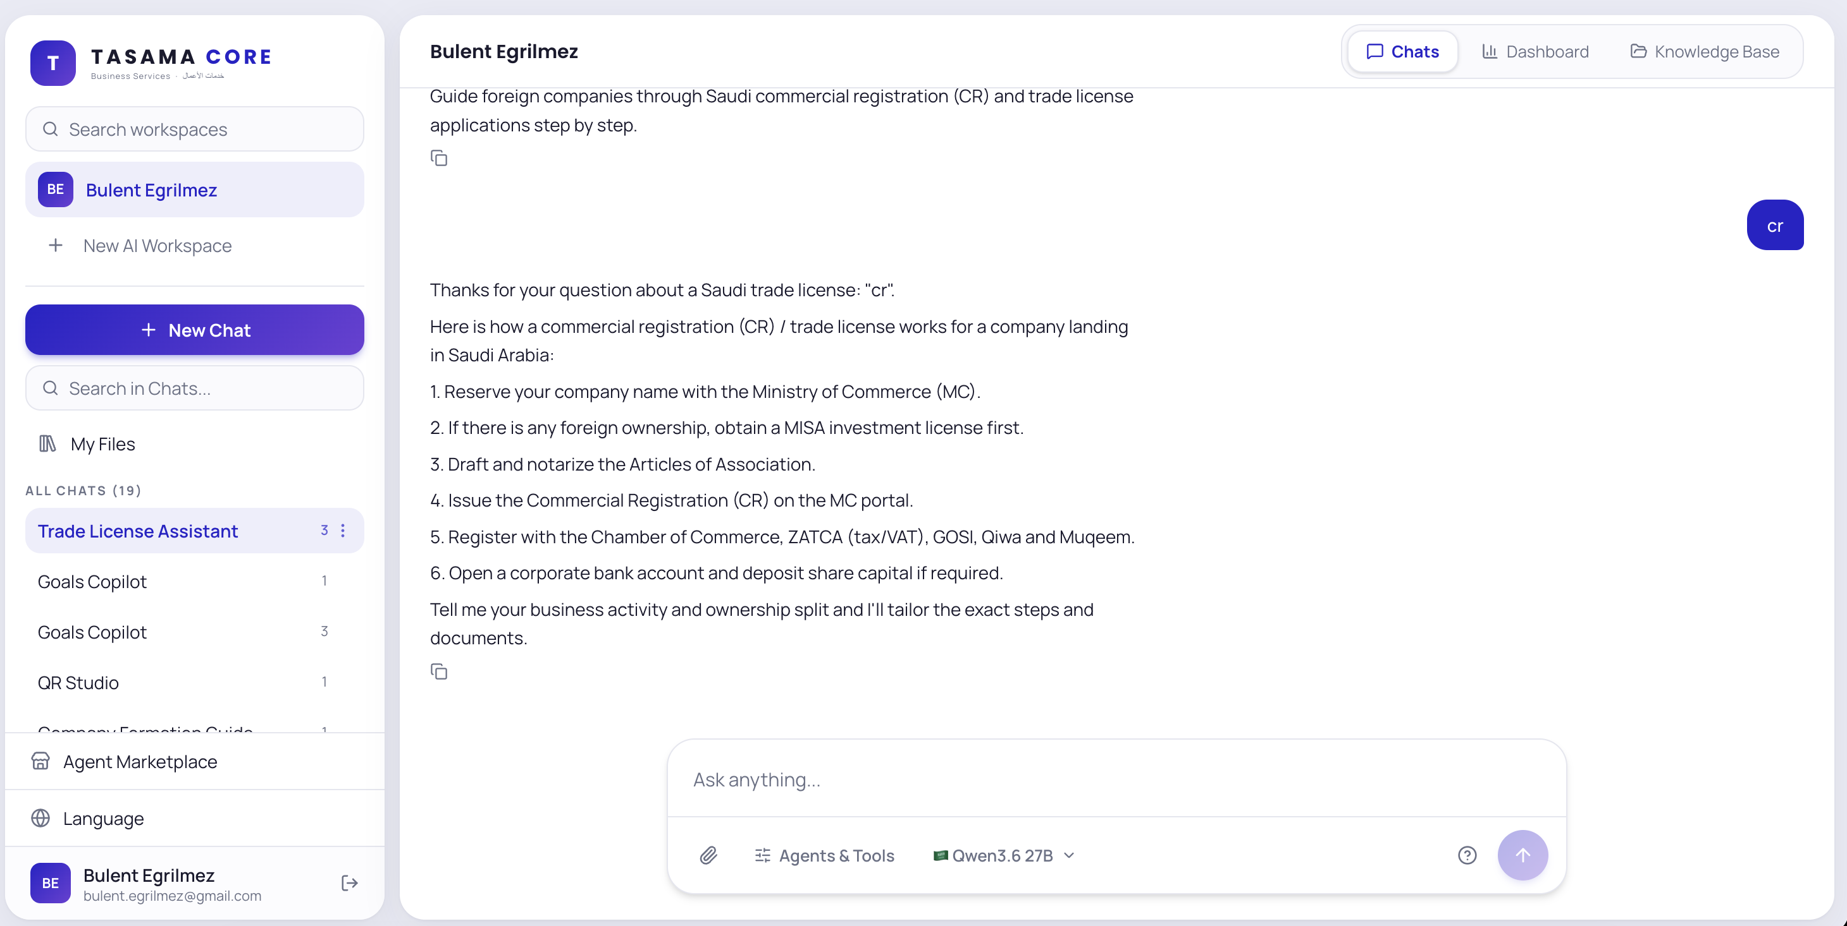
CASE STUDY / 14
TASAMA. An AI workspace for business services.
CHALLENGE
A Gulf business-services firm needed staff to use AI on client documents without exposing them to public tools.
APPROACH
TASAMA Core: enterprise AI workspace with chats, knowledge base and agents, Arabic/English, tenant sign-in, on Azure App Service.
IMPACT
Staff work from one governed workspace; client knowledge stays inside the tenant instead of scattered across personal AI accounts.
BUSINESS SERVICES · GCC · PROOF OF CONCEPT

Slide 13
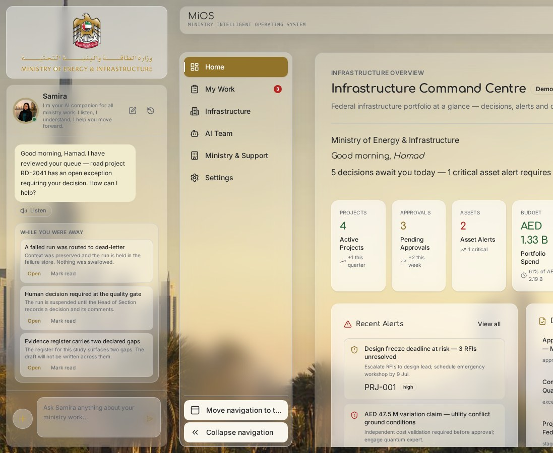
CASE STUDY / 16
MoEI. Agentic services for a ministry.
CHALLENGE
The UAE Ministry of Energy & Infrastructure asked for 19 AI agents across its Infrastructure Development Sector, with no platform to run them.
APPROACH
Agentic Services Platform: avatar assistant, tender-analysis flow, MiOS operating-system UI, n8n flow middleware and human decision gates on Azure.
IMPACT
Live demos of tender review and infrastructure command centre with human-gated quality checks; the basis for the 19-agent proposal.
GOVERNMENT · UAE · 8 WEEKS (PROPOSAL PHASE)

Slide 14
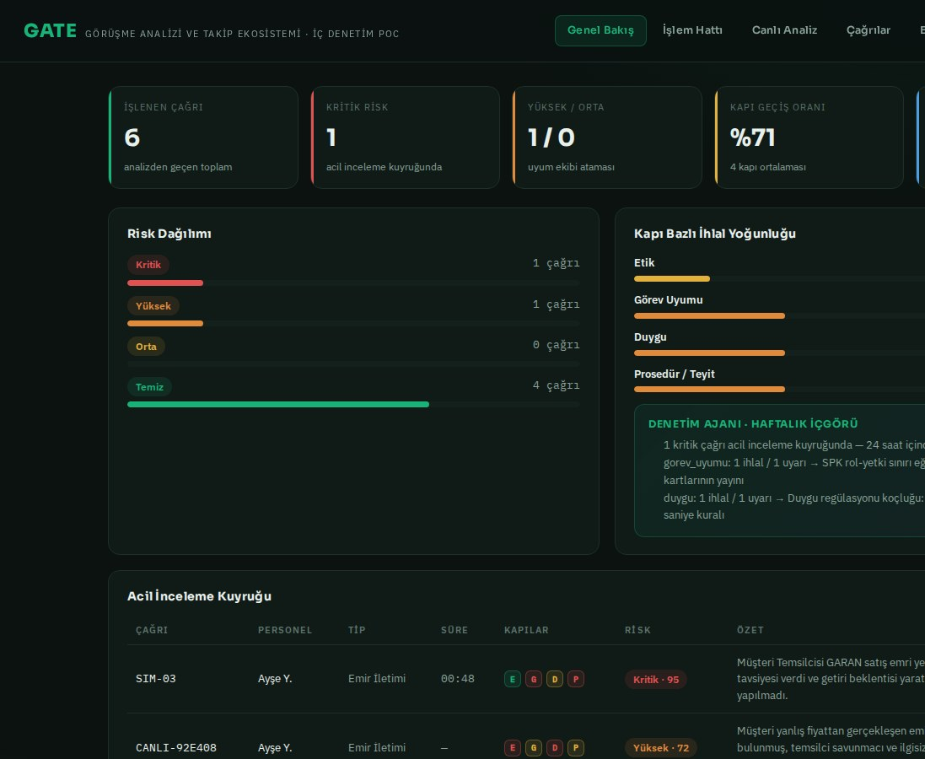
CASE STUDY / 17
Kuveyt Türk Yatırım. Every call checked at four gates.
CHALLENGE
Internal audit could only sample brokerage calls; ethics, mandate, emotion and procedure breaches were found late or not at all.
APPROACH
GATE call-compliance PoC: speech-to-text, four risk gates (ethics, mandate, emotion, procedure), audit agent with weekly insights and coaching queue.
IMPACT
Demo estate: 71% gate pass rate, critical calls routed to a 24-hour review queue, and targeted coaching actions generated per breach type.
CAPITAL MARKETS · TÜRKİYE · PROOF OF CONCEPT

Slide 15
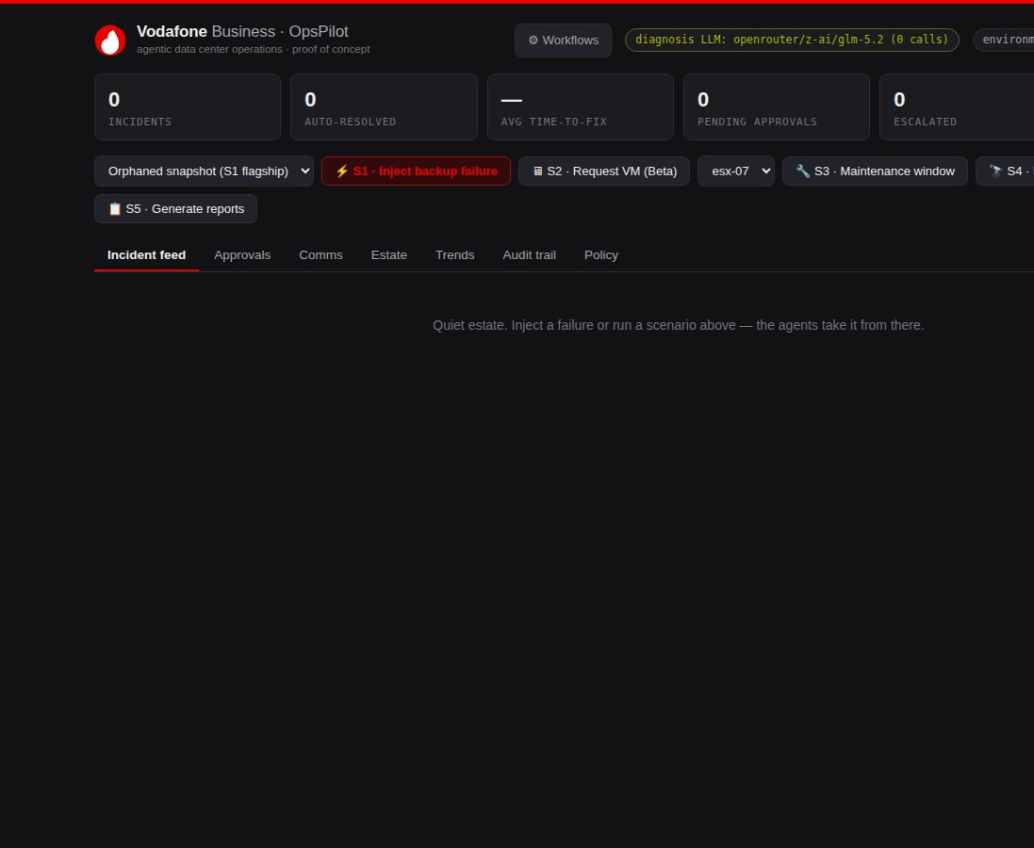
CASE STUDY / 19
Vodafone Business. Data-center incidents, handled by agents.
CHALLENGE
Backup and vSphere incidents in the data centre depended on on-call engineers; time-to-fix and audit evidence varied by shift.
APPROACH
OpsPilot PoC: agentic operations over a simulated Veeam + vSphere estate — incident feed, diagnosis, approvals, comms and full audit trail.
IMPACT
Five scenarios (backup failure, VM request, maintenance, sweep, reporting) run end-to-end with auto-resolution and human approval gates.
TELECOM · TÜRKİYE · PROOF OF CONCEPT

Slide 16
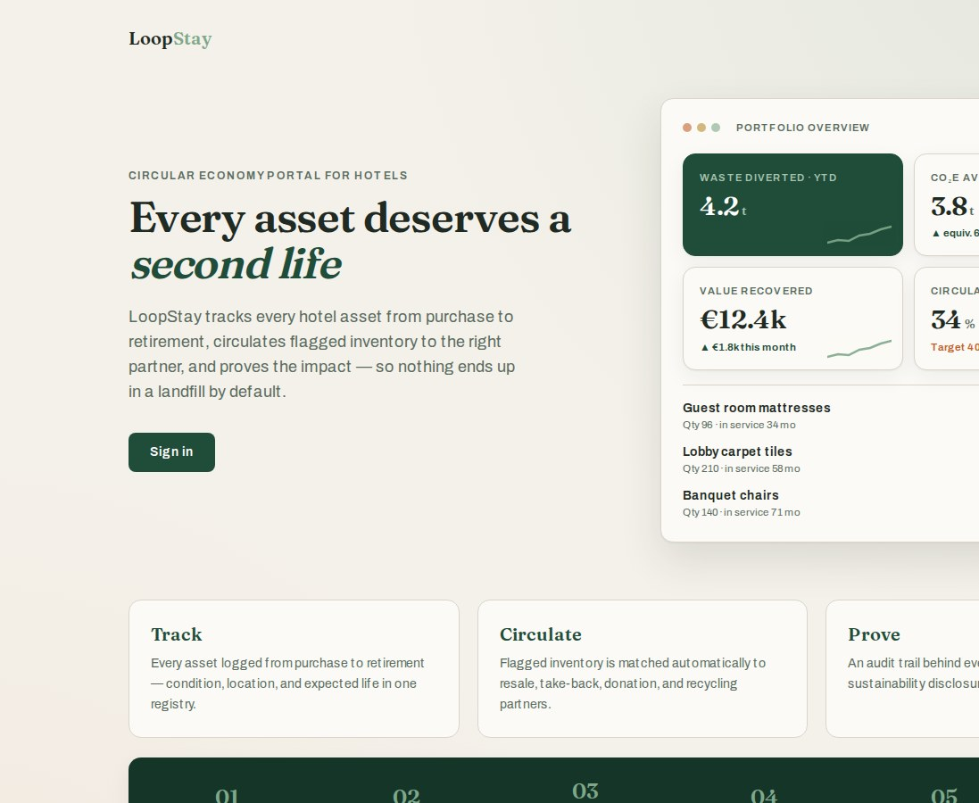
CASE STUDY / 21
LoopStay. Every hotel asset gets a second life.
CHALLENGE
Hotels retire mattresses, carpets and furniture by default to landfill, with no record of value lost or CSRD-grade evidence of what was diverted.
APPROACH
Portal on Azure App Service: asset registry with life-remaining, AI matching to resale, take-back, donation and recycling partners, audit trail.
IMPACT
Demo portfolio shows 4.2t waste diverted, 3.8t CO₂e avoided and €12.4k value recovered, tracked against a 40% circular-procurement target.
HOSPITALITY · NETHERLANDS · CONCEPT PRODUCT

Slide 17
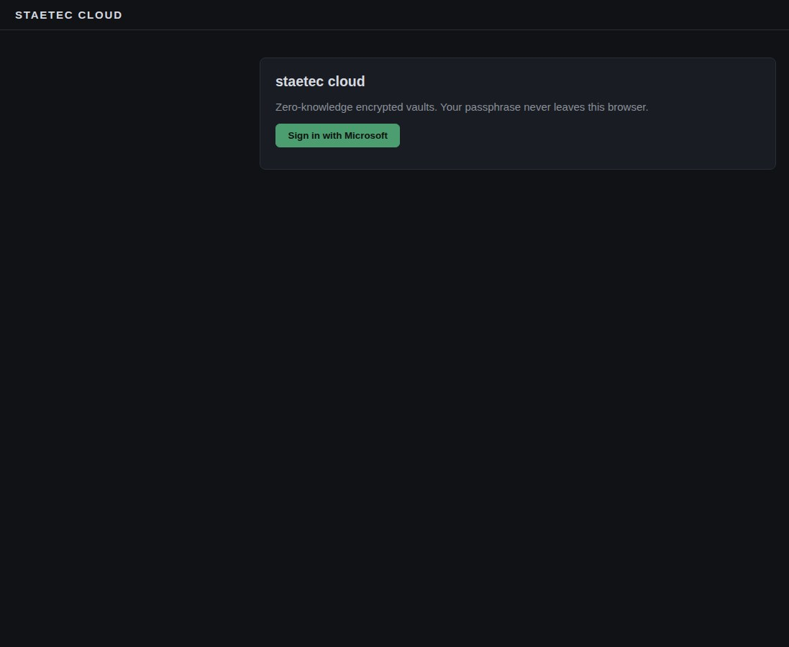
CASE STUDY / 22
STAETEC. Zero-knowledge vaults in the browser.
CHALLENGE
Sensitive files were shared through tools where the provider could read them; the client wanted encryption it could prove, not promise.
APPROACH
staetec cloud: client-side encrypted vaults where the passphrase never leaves the browser, Microsoft sign-in, static front end plus Flex API on Azure.
IMPACT
Encrypted storage the operator itself cannot read; a benchmark service (distbench) validates performance across distributed workloads.
SECURITY · EU · 6 WEEKS

Slide 18
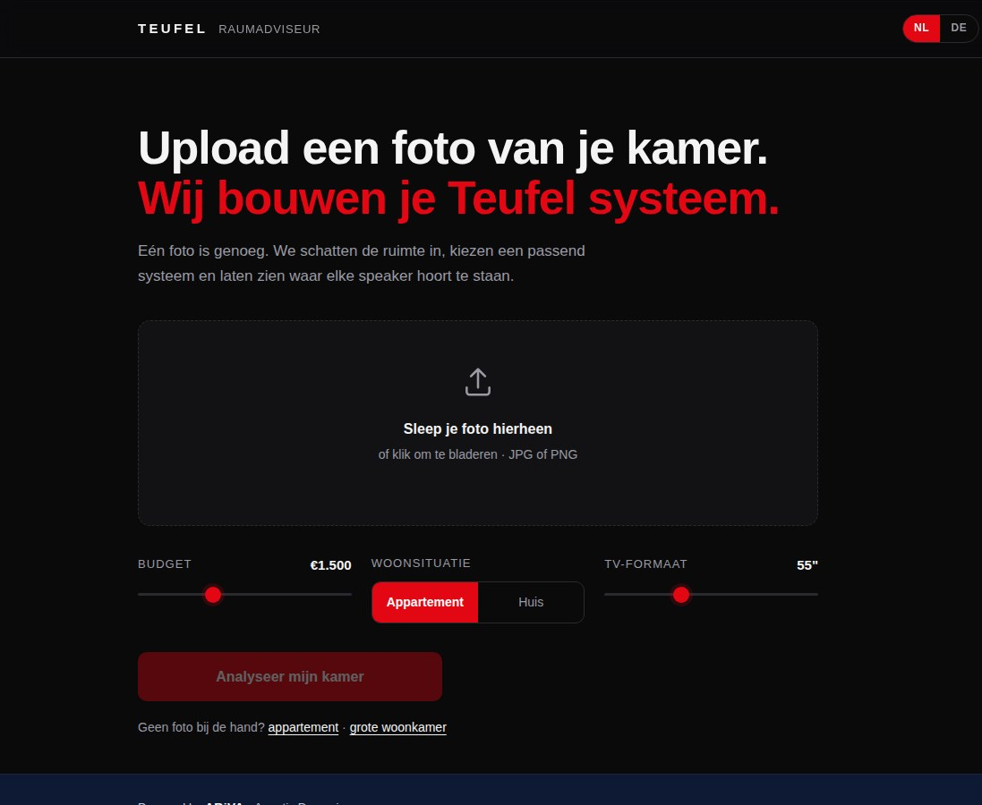
CASE STUDY / 23
Teufel. A photo becomes a speaker system.
CHALLENGE
Shoppers could not translate room size and layout into the right Teufel system; advice needed a store visit or a long call.
APPROACH
Raumadviseur (NL/DE) on Azure Container Apps, powered by ARiVA: upload a room photo, set budget and TV size, get a system plus placement advice.
IMPACT
Room estimated and a recommended plus alternative system proposed from one photo, with a follow-up advisor chat.
CONSUMER ELECTRONICS · NL / DE · PROOF OF CONCEPT

Slide 19
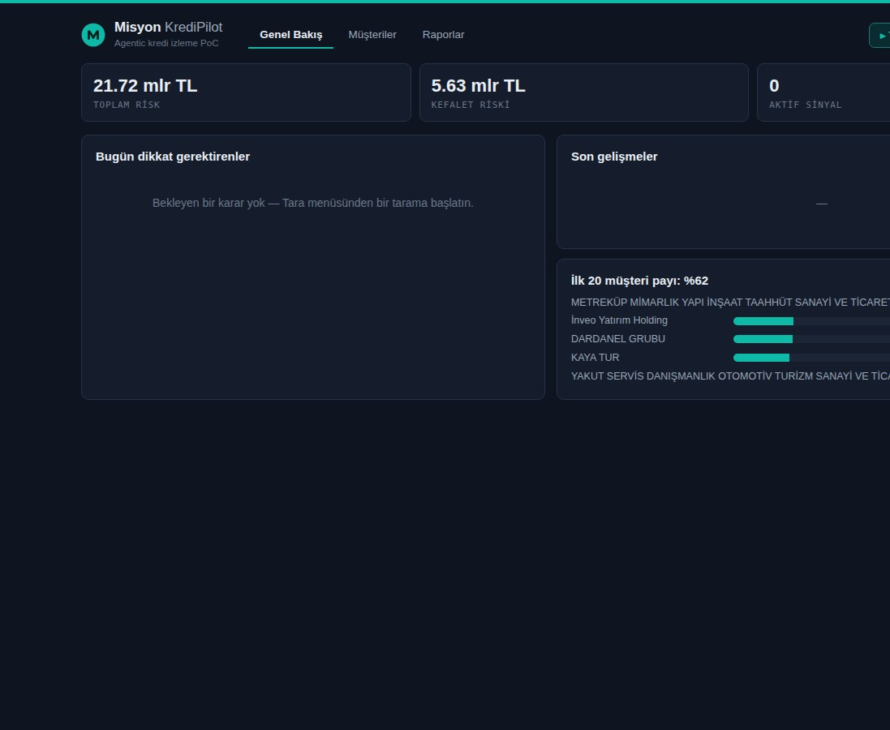
CASE STUDY / 24
Misyon. Credit risk, watched by agents.
CHALLENGE
A bank's credit-monitoring team tracked a 21.7bn TL portfolio manually; KAP disclosures and early-warning signals were reviewed after the fact.
APPROACH
KrediPilot PoC: portfolio early warning, KAP disclosure watch, concentration analysis and human-gated actions, TR/EN, on Azure App Service.
IMPACT
Portfolio concentration (top 20 = 62%), guarantee exposure and signals are visible daily; scans propose actions that analysts approve.
BANKING · TÜRKİYE · PROOF OF CONCEPT

Slide 20
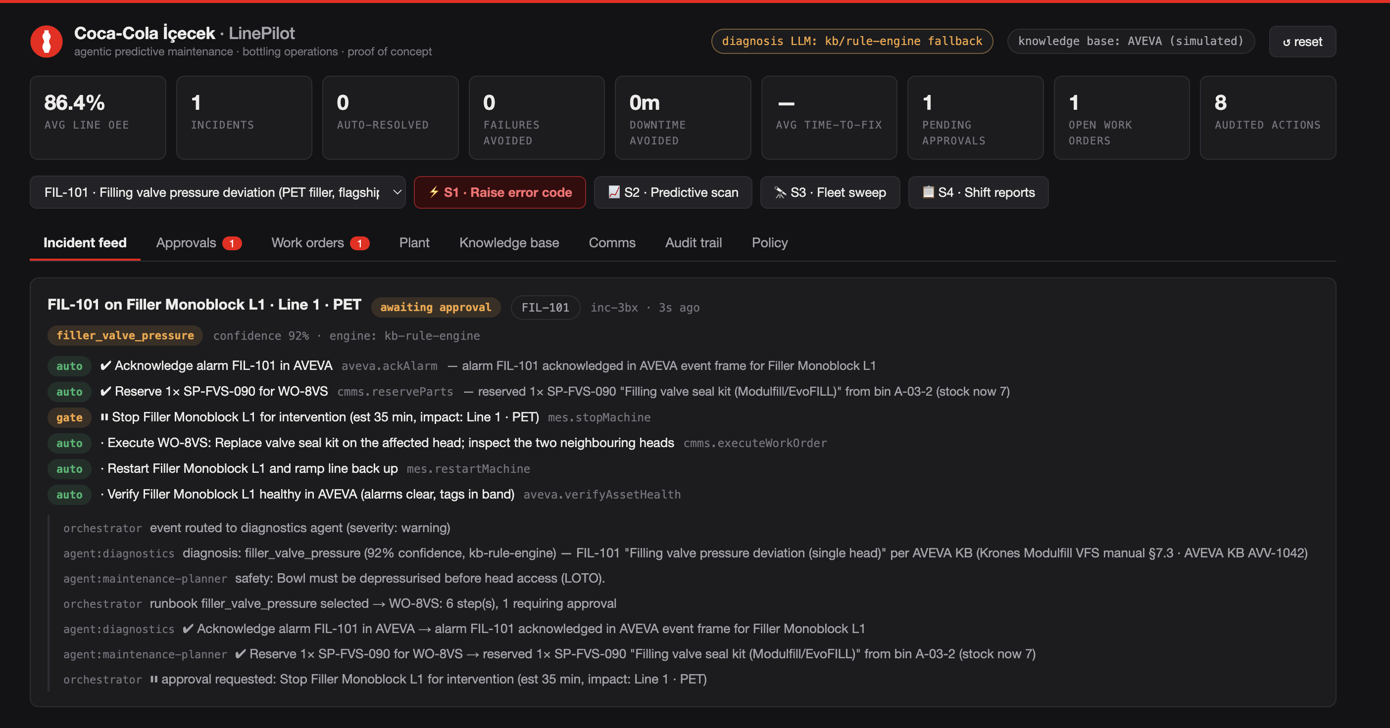
CASE STUDY / 25
Coca-Cola İçecek. Predictive maintenance on the line.
CHALLENGE
Bottling-line faults (fillers, seamers, CO₂ headers) caused unplanned downtime; knowledge lived with senior technicians.
APPROACH
LinePilot PoC: agentic predictive maintenance over AVEVA PI telemetry (simulated) plus a maintenance knowledge base, with work orders and approvals.
IMPACT
15 fault scenarios diagnosed from code to work order; line OEE tracked at 86.4% with failures avoided and downtime saved counted per incident.
BEVERAGE MANUFACTURING · TÜRKİYE · PROOF OF CONCEPT

Slide 21
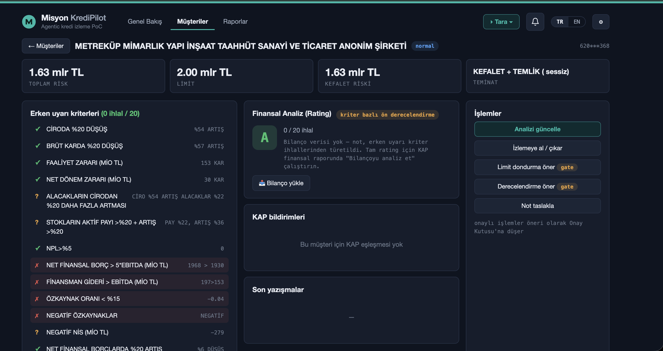
CASE STUDY / 26
Misyon. Provisions on the radar.
CHALLENGE
Loan-loss provision (karşılık) movements were reconciled monthly; drivers were hard to trace to individual exposures.
APPROACH
Karşılık Radar on Azure App Service, behind Microsoft sign-in: exposure-level provision tracking with alerts on threshold changes.
IMPACT
Provision drivers are visible per customer before month-end, giving risk and finance teams a shared view.
BANKING · TÜRKİYE · PROOF OF CONCEPT

