Slide 1
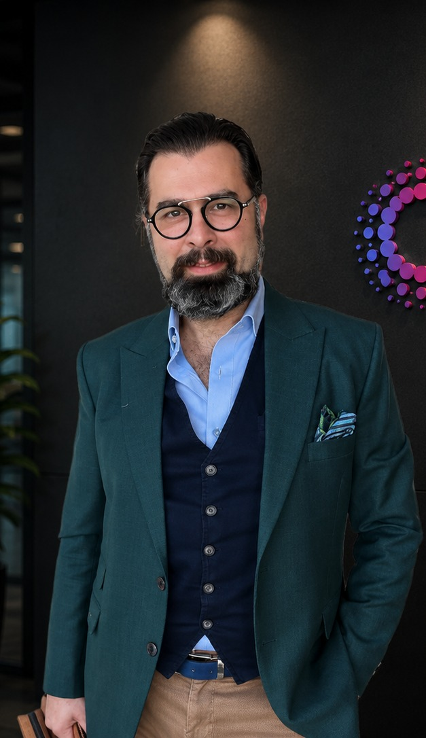

SPEAKER PROFILE
Mounir Ariss
CEO & Co-founder, Cognirise · Dubai
Mounir Ariss is Co-founder and CEO of Cognirise, an AI-native advisory and engineering firm. He has 36 years of experience in data, AI and digital transformation across the Middle East, Africa and Turkey.
He founded the Middle East office of Peppers & Rogers Group and later led its EEMEA region. He was a Partner at Monitor Deloitte, built Accenture's Data & AI practice in the Middle East, and led Strategy & Consulting across MENA at Publicis Sapient.
He has worked with government entities, banks, telecoms, healthcare and retail groups across the UAE, Saudi Arabia and Turkey, including ADCB, Etisalat, Al Rajhi Bank, UAE Prime Minister’s Office, Saudi National Bank, PIF, STC, Dogus Group, Yapi Kredi Bank, and Sabanci Holding.
His current focus is the agentic enterprise: moving organisations from AI pilots to AI agents that run inside core operations, with governance that holds up in production.
36
5
$100m+
years in data, AI and
consulting practices
Annual revenue
digital transformation
built or led
managed
Notes:
Mounir Ariss is Co-founder and CEO of Cognirise, an AI-native advisory and engineering firm. He has 36 years of experience in data, AI and digital transformation across the Middle East, Africa and Turkey.
He founded the Middle East office of Peppers & Rogers Group and later led its EEMEA region. He was a Partner at Monitor Deloitte, built Accenture's Data & AI practice in the Middle East, and led Strategy & Consulting across MENA at Publicis Sapient.
He has worked with government entities, banks, telecoms, healthcare and retail groups across the UAE, Saudi Arabia and Turkey, including ADCB, Etisalat, Al Rajhi Bank, SNB, PIF, STC and Sabanci Holding.
His current focus is the agentic enterprise: moving organisations from AI pilots to AI agents that run inside core operations, with governance that holds up in production.

Slide 2
SPEAKER PROFILE / CAREER
A career in data, AI
and transformation.
2026 – today
2022 – 2026
2018 – 2022
Cognirise
Publicis Sapient
Accenture
Co-founder & CEO
Senior MD, Strategy & Consulting, MENA
MD, Applied Intelligence, Middle East
AI-native advisory and engineering: agentic transformation, data & AI foundations, legacy modernisation
Built a business, data and technology strategy practice; led AI transformation in banking, telecoms and government
Built the Data & AI practice from inception to $100M+ annual revenue and a team of 60+
2016 – 2018
2003 – 2016
1990 – 1998
Monitor Deloitte
Peppers & Rogers Group
Dow Jones
Partner, Middle East
Founder & MD, Middle East
Product & commercial roles
Led Customer and Digital Strategy for government entities and ministries across the GCC
Founded the Middle East office, then led EEMEA across the UAE, KSA, Turkey, Lebanon and South Africa
New product development and market adoption across Lebanon, the UAE, Turkey, Italy and the UK
Education B.Eng., American University of Beirut · Executive education in AI, MIT Sloan and Kellogg · Arabic, English, French, Turkish

