Slide 1
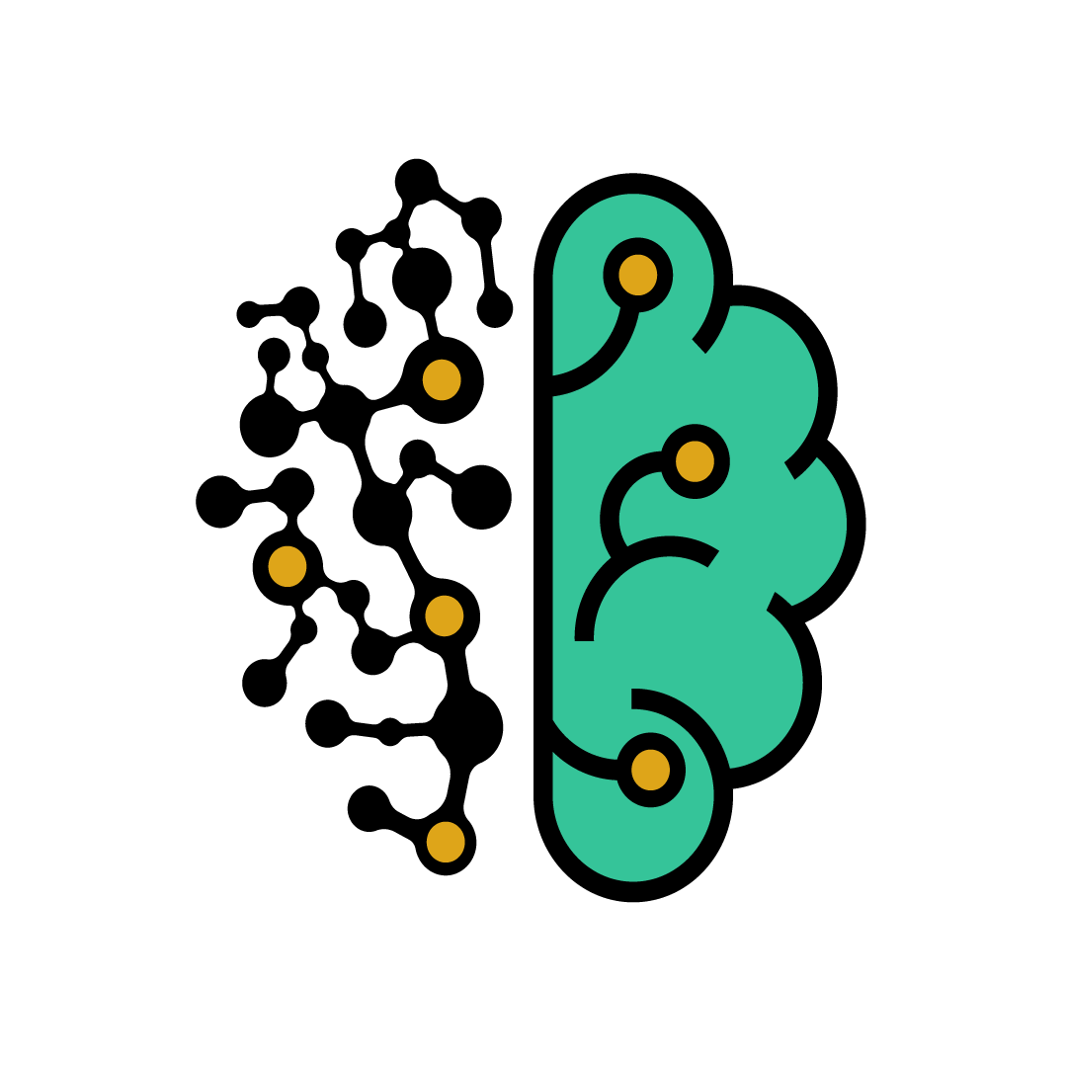
Convolutional Neural Networks

Slide 2
In neural networks, convolutional neural networks (ConvNets or CNNs) is one of the main categories to do image recognition, images classifications due to its efficiency in detecting complicated patterns in large images. Object detections and face recognition are some of the areas where CNNs are widely used.

Slide 3


Slide 4
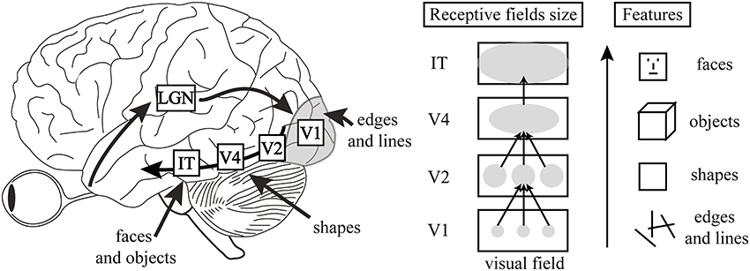
Architecture of the visual cortex:
CNNs are basically inspired from the concept of the human brain, specifically the visual cortex.

Slide 5
What is a CNN?
The name «Convolutional Neural Network» indicates that the network employs a mathematical operation called Convolution.
Convolution is a specialized kind of linear operation.
Convolutional networks are simply neural networks that use convolution in place of general matrix multiplication in at least one of their layers.

Slide 6
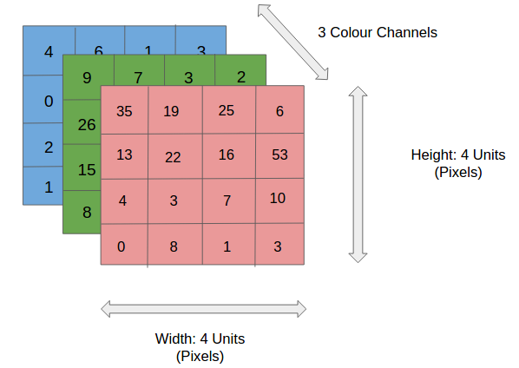
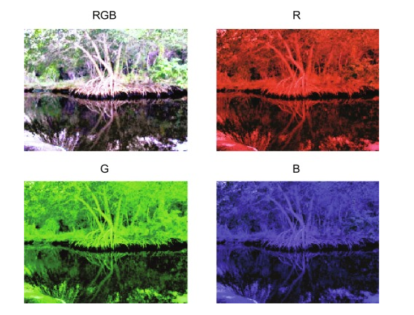
RGB images:
Stands for Red Green Blue, RGB refers to three hues of light that can be mixed together to create different colors.
Combining these colors is the standard method of producing color images on screens like TVs, computers, phones…

Slide 7
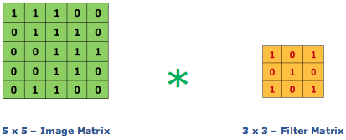
Convolution:
The convolution works like filters that see tiny squares and slide through the whole image and capturing the most striking features.
In other words, with a 5x5x1 image and a filter that covers a 3x3 image area and 1 step motion (called stride), the filter will pass through the entire image, in each one of the channels, creating at the end a 3x3x1 feature map or activation map.

Slide 8
Convolution:
This is how it works:

Slide 9
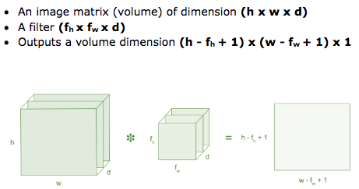
Convolution:
Feature map: it is the output of the convolution operation, and its dimension can be calculated with this operation.

Slide 10
Convolution:

Slide 11
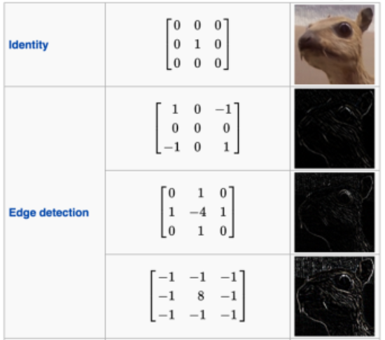
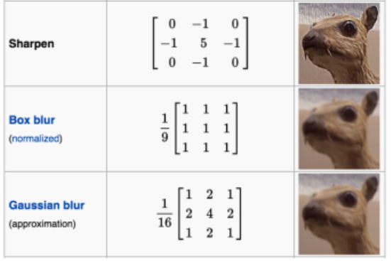
Convolution:
Common Filters/Kernels:

Slide 12
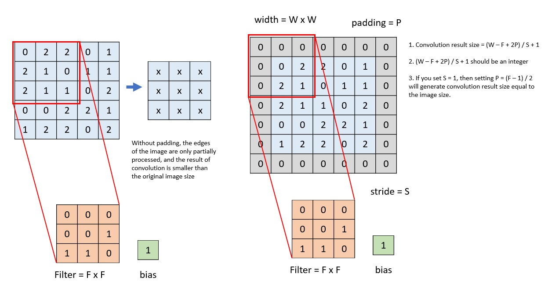
Convolution:
Padding:

Slide 13
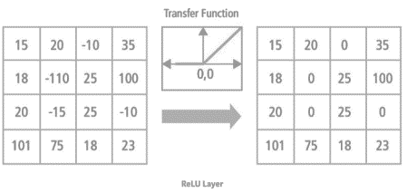
Convolution:
Non-linearity (ReLU): ReLU stands for Rectified Linear Unit, the output is f(x)=max(0,x),
ReLU removes negative values since the real world data would be positive.

Slide 14
Convolution:
Pooling: Pooling layers section would the number of parameters when the images are too large. It can be in different types: sum pooling, average pooling, max pooling.
Max pooling takes the largest element like this:

Slide 15
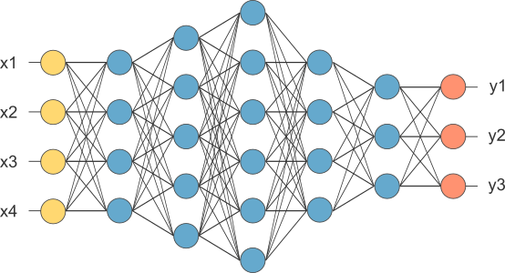
Fully Connected Layer:
The layer we call FC layer, we flattened our last feature map in a vector and feed it into a fully connected layer like a neural network.

Slide 16
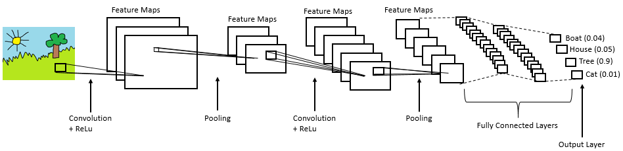
Fully Connected Layer:
This’s an example of a convolutional neural network.

Slide 17
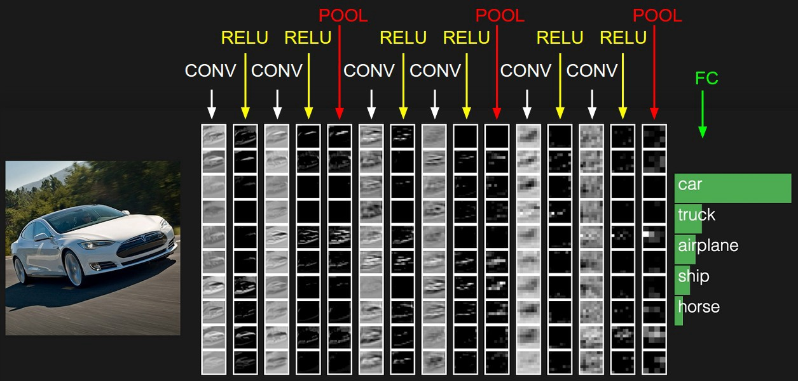
Fully Connected Layer:

Slide 18
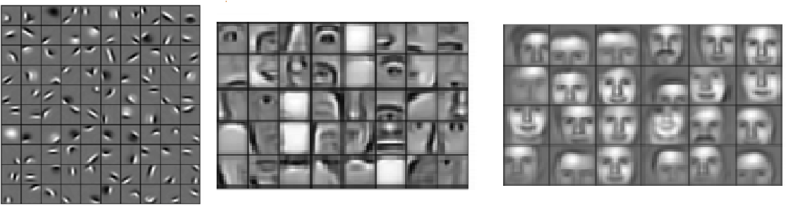
Fully Connected Layer:
The features get more complex as we go deep in the network.
Low level Features
Mid level Features
High level Features

Slide 19
Summary:
Provide input into the convolution layer.
Choose parameters, apply filters with strides, padding if requires. Perform convolution on the image and apply ReLU activation to the matrix.
Perform pooling to reduce dimensionality size
Add as many convolutional layers until satisfied
Flatten the output and feed into a fully connected layer (FC layer)
Output the class using an activation function (Logistic Regression with cost functions) and classifies images.

Slide 20
End of Lecture

