Slide 1
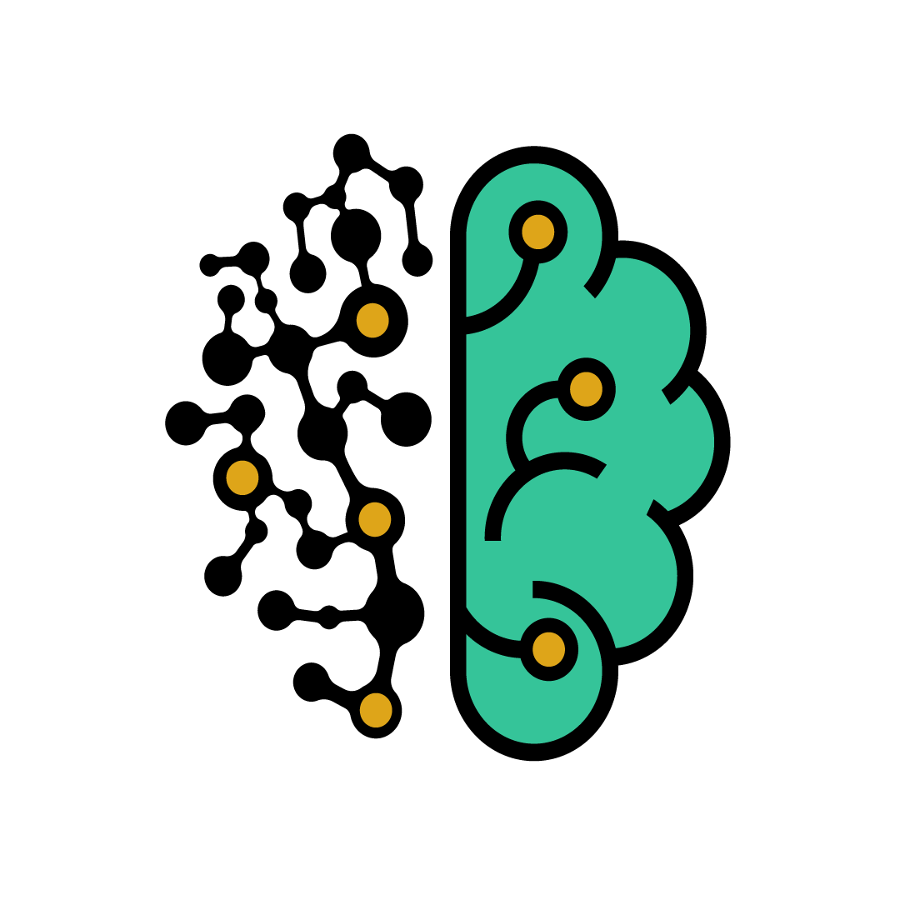
Introduction to Deep Learning and computer vision

Slide 2
Outline:
Introduction to AI & Machine Learning.
Deep learning and neural networks.
Training a neural network.
Convolutional neural network.
Training a convolutional neural network.

Slide 3
Introduction to artificial intelligence:
What is artificial intelligence?
It is the theory and development of computer systems able to perform tasks usually requiring human intelligence, such as visual perception, speech recognition, decision-making, and translation between languages.

Slide 4
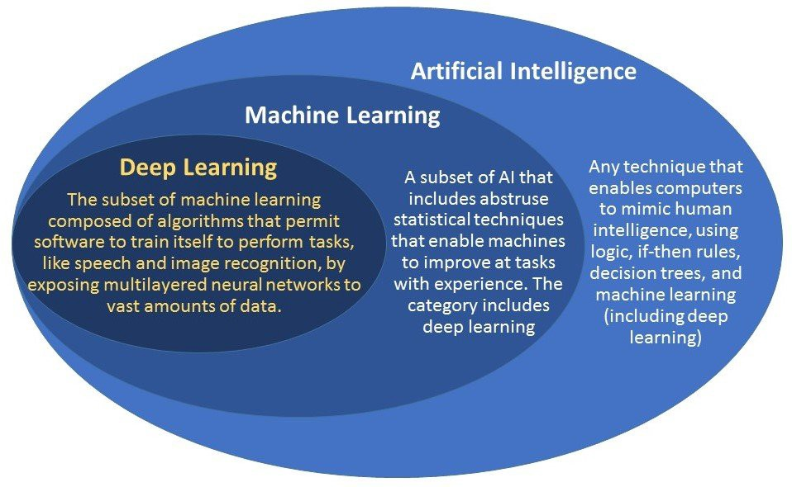
Artificial intelligence ? Machine learning ? deep learning ?

Slide 5
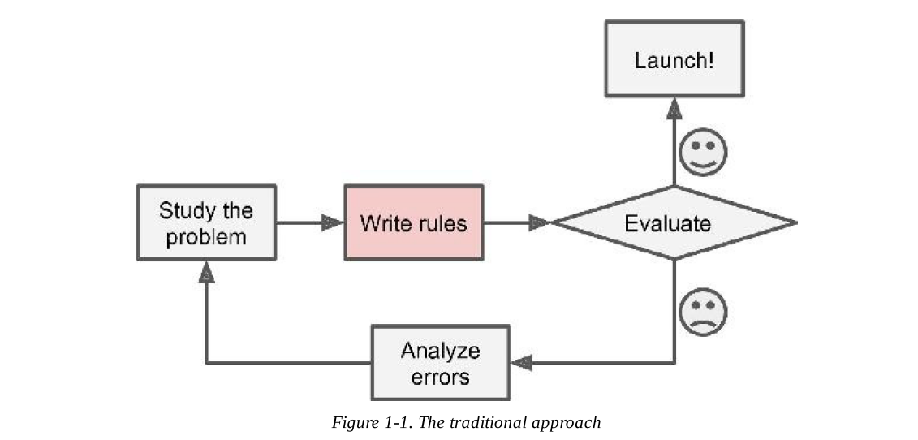
Why use Machine learning:
Traditional approach.

Slide 6
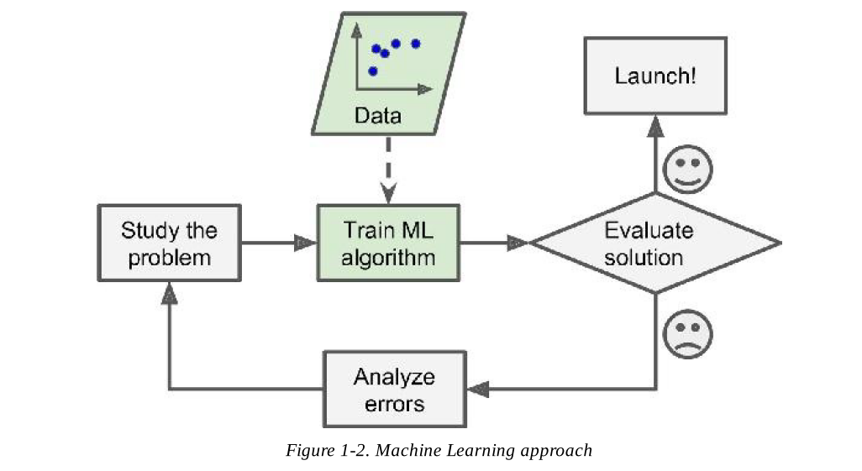
Machine learning approach

Slide 7
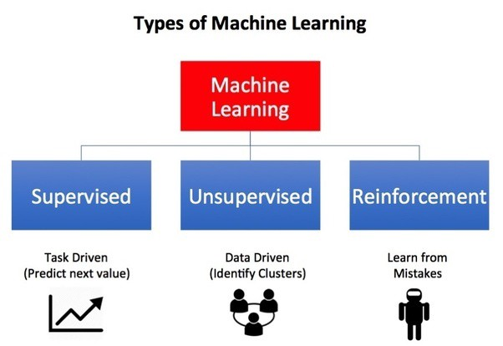
Types of Machine Learning:

Slide 8

Machine learning Map

Slide 9
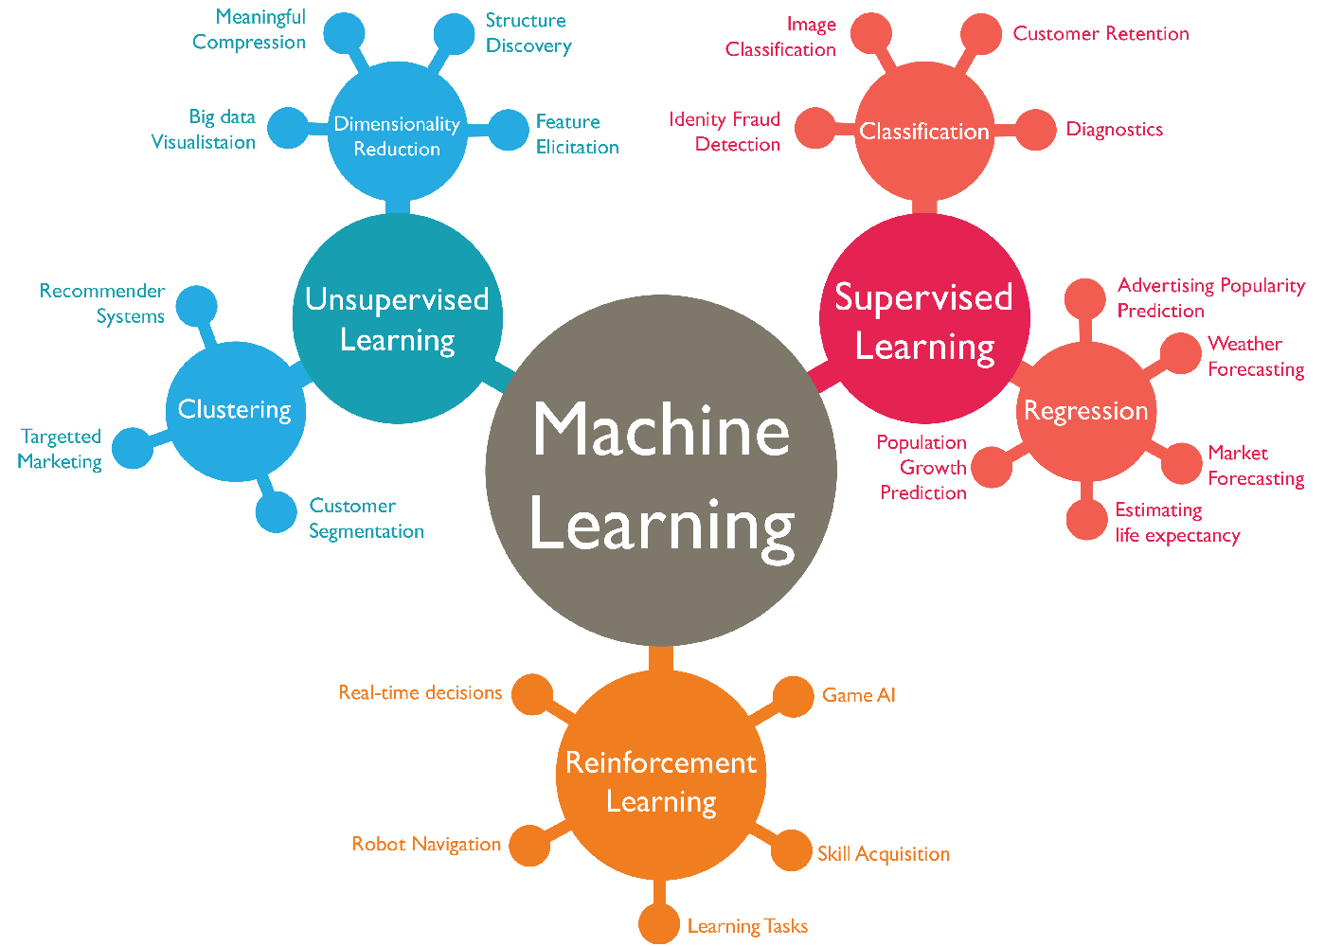
Applications of machine learning

Slide 10
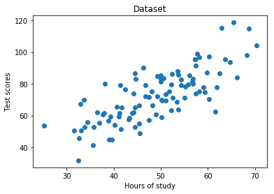

Example Application : Linear regression *.
Suppose we want to predict the students score bases on study hours.
Mathematical model
$$y′=wx+b$$
y : the output (score predicted)
x : the input (study hours).
w : weight
b : bias
* Regression: predict real-valued output.

Slide 11
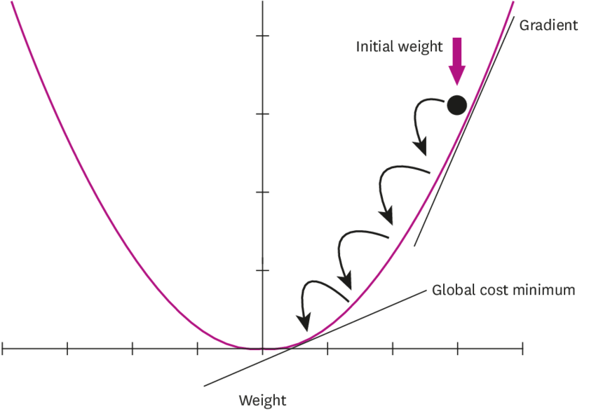
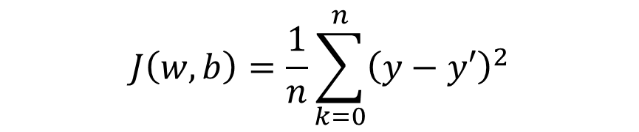
Example Application : Linear regression *.
Defining a cost function
$$J\left(w,b\right)=\frac{1}{n}\sum_{k=0}^{n}{{\left(y−y′\right)}^{2}}$$

Slide 12
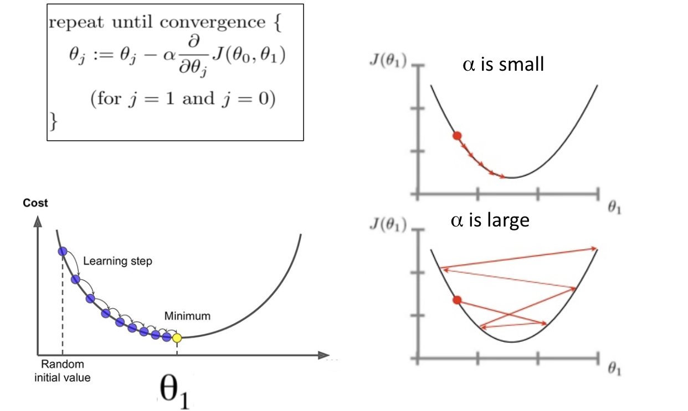
Example Application : Linear regression *.
Updating and minimizing the error
$$w:=w+α\frac{∂}{∂w}J\left(w,b\right)$$
W

Slide 13
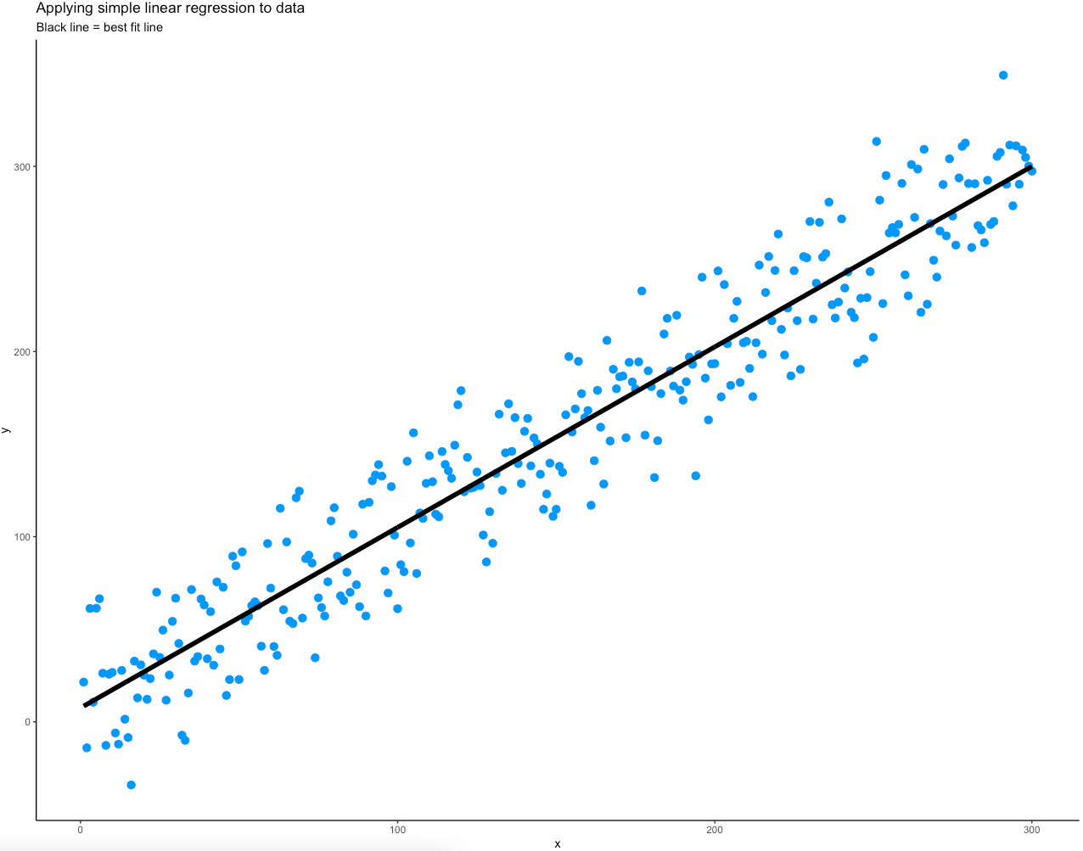
Example Application : Linear regression *.

Slide 14
End of Lecture

