Slide 1
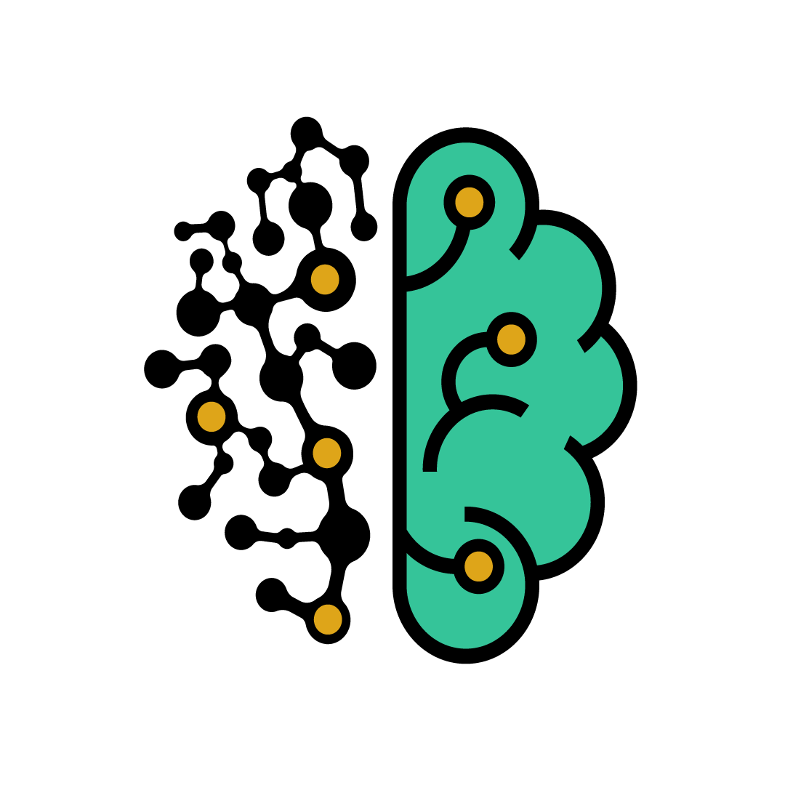
Introduction to Deep Learning and neural networks

Slide 2
What are neural networks?
Neural networks are a set of algorithms, modelled loosely after the human brain, That are designed to recognize patterns.
They interpret sensory data through a kind of machine perception, labelling or clustering raw input.

Slide 3
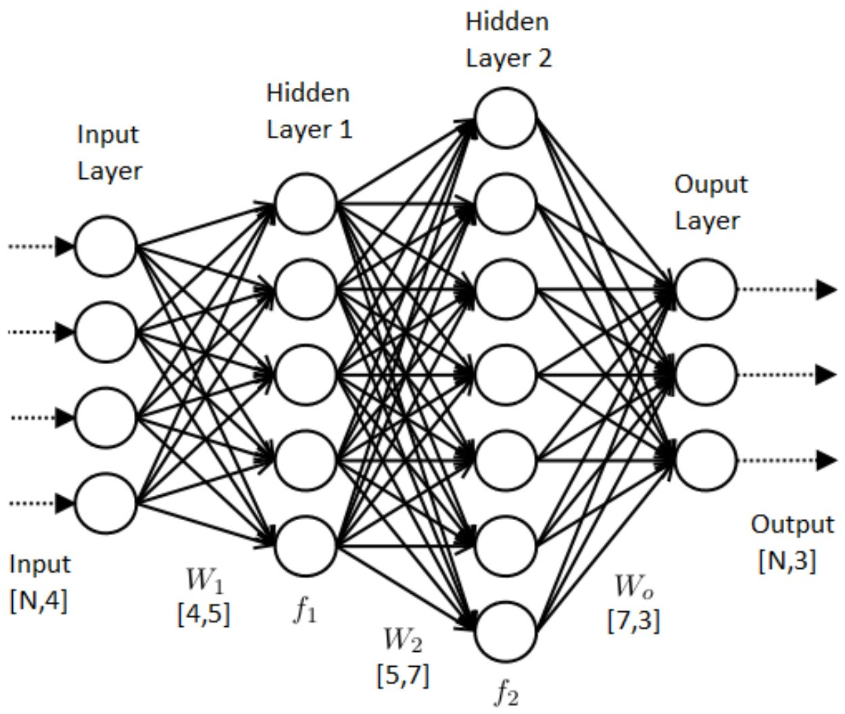
A neural network:

Slide 4
Perceptron:
A neural network is an interconnected system of perceptrons, So it’s safe to say that perceptrons are the foundation of any neural network. Perceptrons can be viewed as the building blocks in a single layer of a neural network made up of different parts like:
Weights and biases
Net sum
Activation function
Input values or one input layer

Slide 5
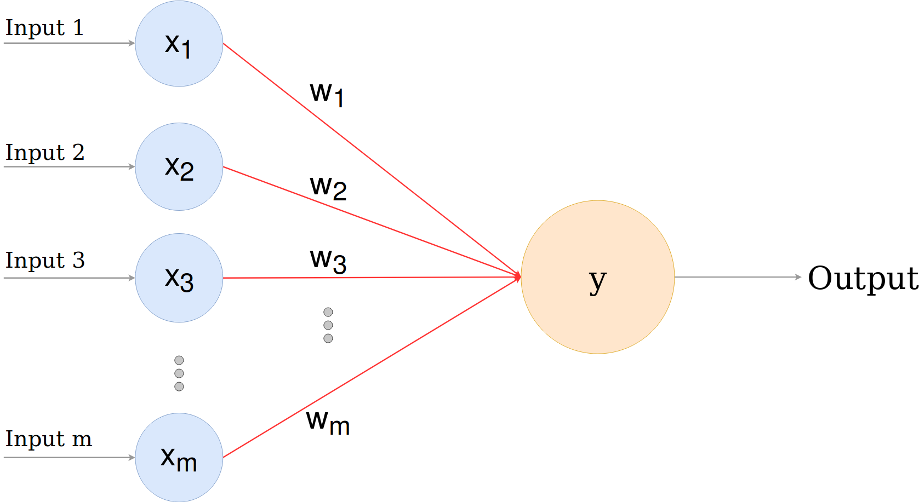
Perception model:

Slide 6
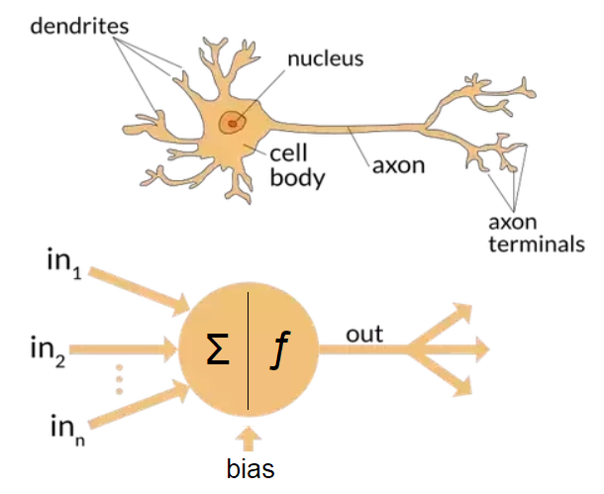
From biological to artificial:

Slide 7
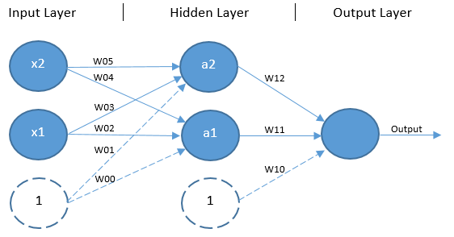
Perception learning example XOR:

Slide 8
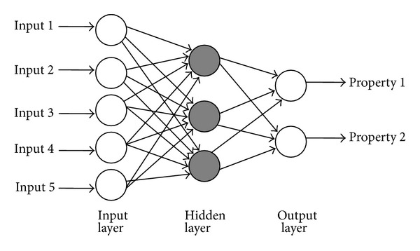
Multi layer perceptron:

Slide 9
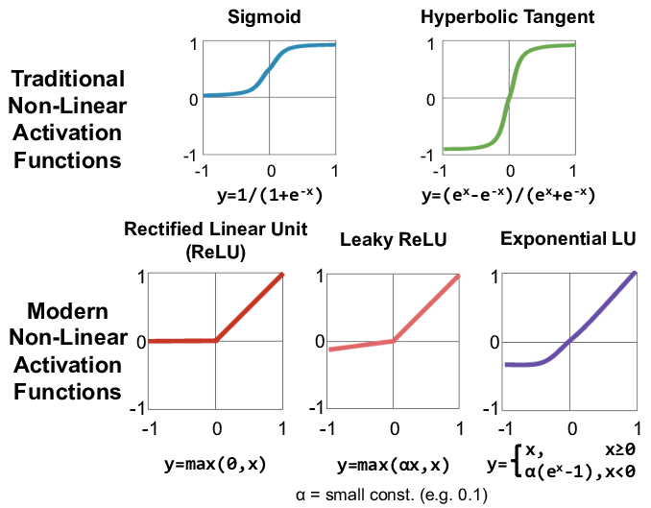
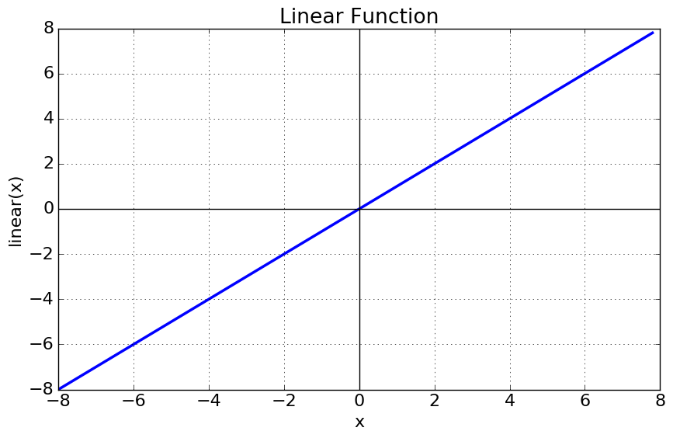
Activation functions table:
Linear and non linear activation functions:

Slide 10
Why we use non linear activation functions?
The purpose of the activation function is to introduce non linearity into
the network.
Without a non linear activation function in the network, a NN, no matter
how many layers it had, would behave just like a single layer perceptron,
because summing these layers would give you just another linear function.

Slide 11
Forward propagation? Backpropagation?
Forward propagation:
Is simply multiplying input with weights and add bias before applying
activation function at each neuron.
Backpropagation:
Is a method used in ANN to calculate the error contribution of each
neuron after a batch of data.
Its concepts (from calculus):
Derivative
Partial derivative
Chain rule

Slide 12
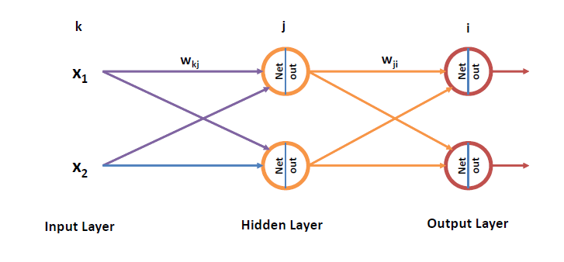
Forward propagation:

Slide 13
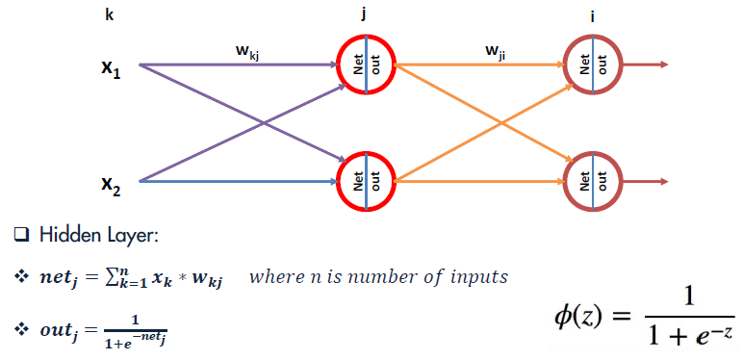
Forward propagation:

Slide 14
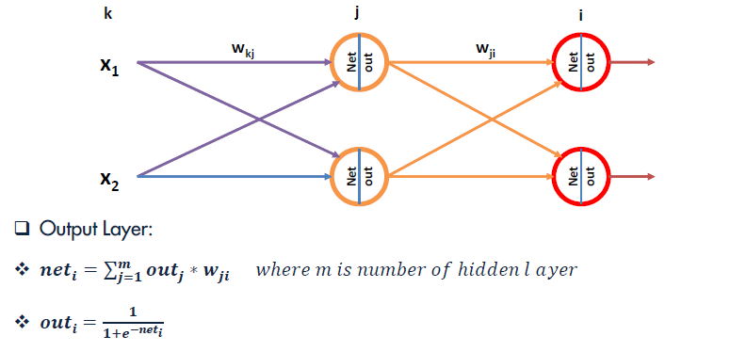
Forward propagation:

Slide 15
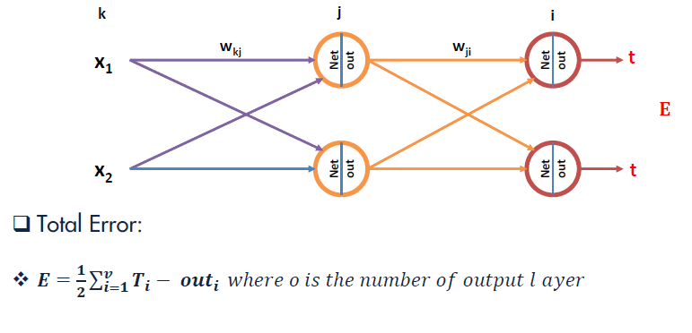
Forward propagation:

Slide 16
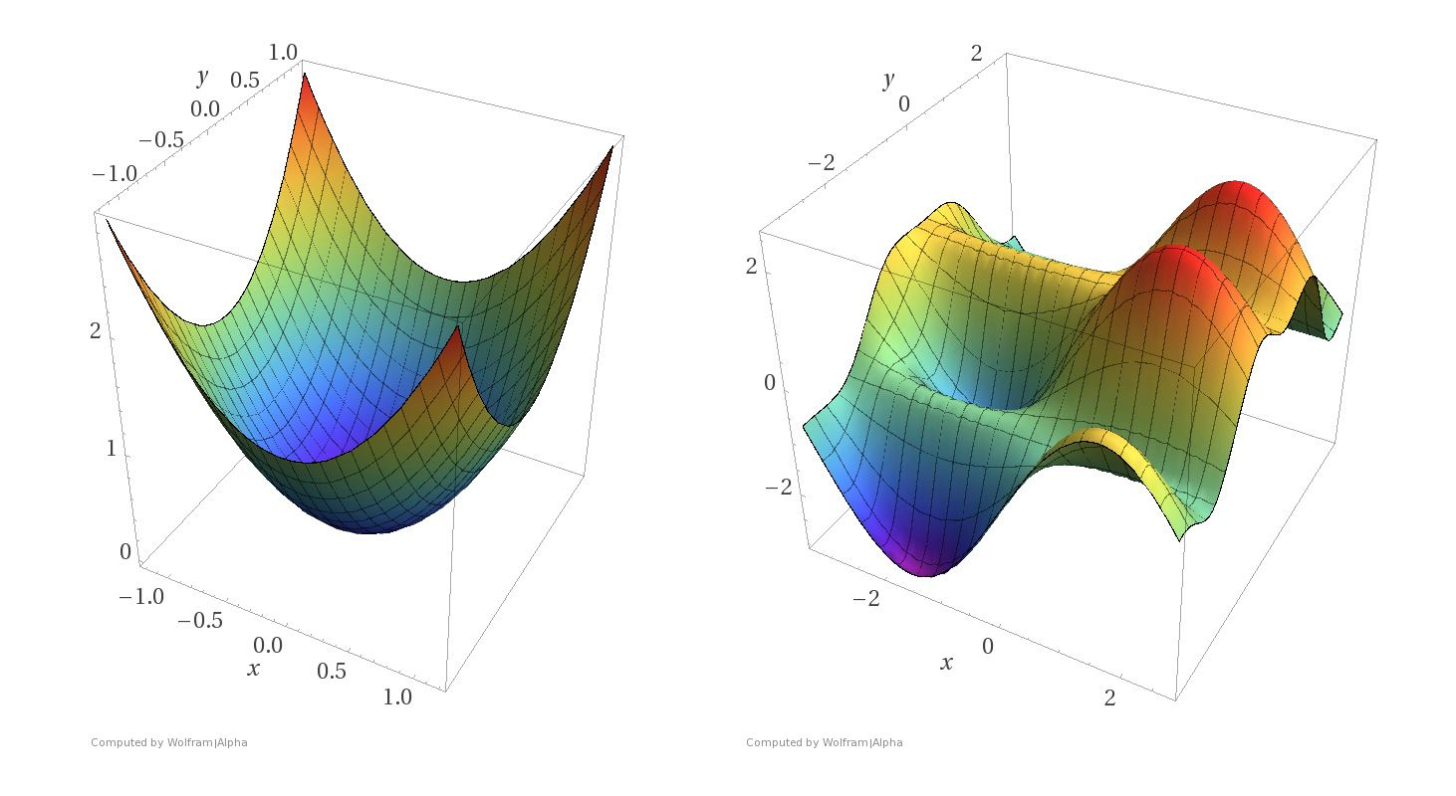
Cost functions:

Slide 17
Backpropagation:
Our goal with backpropagation is to update each of the weights in
The network so that they cause the actual output to be closer to the target Output by minimizing the error for each output neuron and the network as a whole.

Slide 18
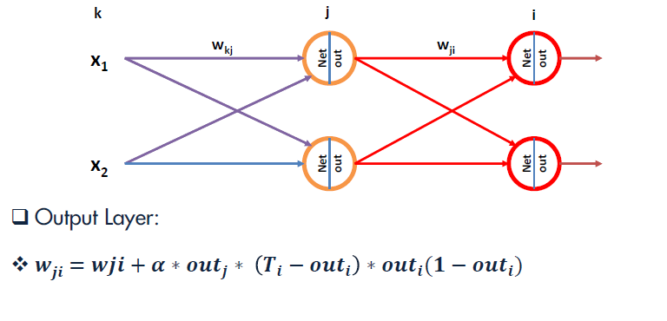
Backpropagation:

Slide 19
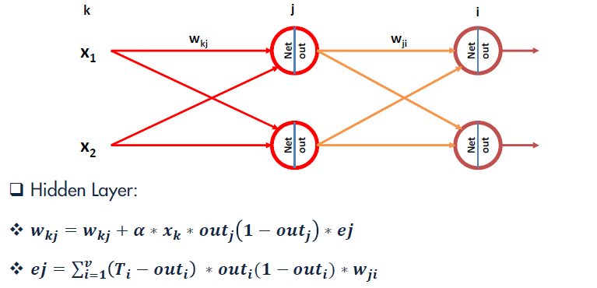
Backpropagation:

Slide 20
End of Lecture

