Slide 1

A Better E-com
Supervised by
Dr. Basheer
TA. Hassan Mourad
Graduation Project
Academic Year 2020-2021
Midyear Short Documentation
ID | Name
20170191 | فارس سيد حسن السيد
20170301 | منير صبري يوسف احمد
20170307 | مينا بطرس فرحات فلتس
20170174 | عمر حسن حسني عبد العال
20170198 | كريم محمد فتحي مسعود

Slide 2
Project Idea
Our project idea is to develop an e-com system that combines the benefits of e-com and e-learning together to best fit the needs of the stakeholders of our system.
Our system will (hopefully) deployed in our faculty, the faculty of computer science and artificial intelligence.
The stakeholders of our system is the student, instructor, dean, system admin, college vice dean for student affairs, and student affairs staff member.

Slide 3

Problem Significance
The students and instructors do not use the E-com for e-learning purposes, they only use it for registering courses and managing and monitoring grades and attendance.
This problem led the stakeholders to use third-party websites (like Acadox and Google Classroom) for exchanging materials and information, these websites do not include e-com features like registering students in courses and monitoring their attendance and time schedules.
For example, we as students had (at some point of time) to use E-com, Acadox, Edmodo and Google Classroom all at the same time, which made it difficult to stay up-to-date with what is added or changed in any of these systems (platforms) which in return made the learning experience overall more difficult.

Slide 4
From the instructor side, the instructor also Must keep track of multiple platforms for the courses he is registered in, on top of that he Must submit the attendance and the grades through the E-com.
Our system offers a better E-com that combines the e-com and the e-learning together, so it become a self-sufficient website for the students and the instructor to use.

Slide 5
Related Work
There exist some system that tried to combine the e-com and the e-learning together, examples.
Old E-com.
New E-com.
Acadox.
Google Classroom.
Blackboard.

Slide 6
Some of these solutions focused on the e-com part like the Old E-com and the New E-com, which lead them to fall on the e-learning.
Others focused on the e-learning like Acadox, Google Classroom, and blackboard, however they did not capture the e-com part well.
Some systems like the Old E-com has many problems, for example, the Old E-com has unimplemented features like the Arabic support and uncomplete GUI, also it suffers from reliability issues and ugly look.

Slide 7
Features Comparison
Feature | Better E-com | Old-bylaw E-com | New bylaw E-com | Acadox | Google Classroom | Blackboard
Department Management | + | + | + | - | - | -
General Feed (posts on your homepage, limited to the staff) | + | + | + | - | - | -
Course Feed | + | - | - | + | + | +
Course Attendance | + | + | + | - | - | -
Course Attendance Complaint | + | + | + | - | - | -
Submit Attendance Excuse | + | - | + | - | - | -
Course Grades | + For each assignment, quiz, etc. | + Only Final and Class’s Work. | + Only Final and Class’s Work. | + Not used often. | + | +
Complain About a Grade (officially) | + | - | - | - | - | -
Course Feedback | + | + | + | - | - | +
Add or Download non-related course materials. (general materials) | + | + | + | - | - | -
Course Materials | + | + | - | + | + | +
Files Materials | + | + | - | + | + | +
Videos and Audio Materials | + Has media player. | - | - | + Only file, no media player. | + Through google drive. | + Has media player.
External Links Materials | + | - No direct link. | - | + | + | +

Slide 8
Calendar | + | - | - | + | + | +
Time Schedule (lectures, labs, and sections time and location) | + Manually generated. Added by Admin. Displayed in Calendar. | - Manually generated. Sent file | - Manually generated. sent file | - | - | -
View all members of a specific course | + | - | - | + | + | +
Check Instructor Profile | + | + On the faculty staff website | + On the faculty staff website | + | - | -
Check Instructor Mail | + In the profile | + On the faculty staff website | + On the faculty staff website | - | - | -
Mange Office Hours and Contact Information | + | - | - | - | - | - But doable
Assignments (add, delete, deliver, view deadline) | + | - | - | + | + | +
Exam | + | - | - | - | + | +
Exam Locations | + | + | + | - | - | - But doable
Online Exam | + | - | - | + | + | +
Polls | + | + | - | - | + Through form. | +

Slide 9

Project Specifications
System Architecture
Stakeholders
Functional Requirements
Non-Functional Requirements
Use Case Diagrams
Class Diagrams
Sequence Diagram
ERD

Slide 10
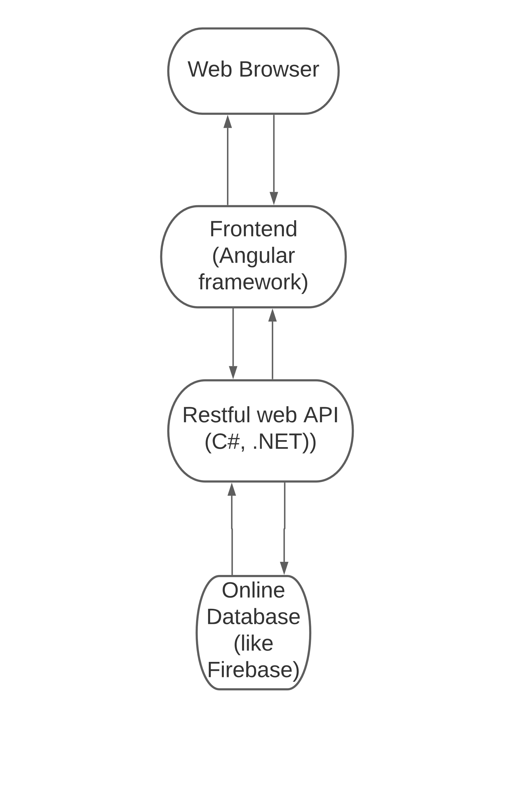
System Architecture
Multi-tier client-server architecture
Web Based System
Online Database for the ease of development and testing

Slide 11
Stakeholders
Student
Instructor
Dean
System Admin
College Vice Dean for Student Affairs
Student Affairs Staff Member

Slide 12

Functional Requirements
Student/Instructor Registration.
Account Management.
Department Management.
Courses (Registration, Deletion).
Course Student/Instructor Registration.
General Feeds.
Course Feeds.
Course Attendance.
Course Attendance Complaints.
Course Attendance Excuses.
Course Grades.
Course Grades Complaints.
Course Feedback.
General Materials.
Course Materials.
Message System.
Calendar Management.
Time Schedule Management.
Search for Student/Instructor.
Student/Instructor contact (view profile, mail, office hours and contact information).

Slide 13
Top 50.
Course Assignments.
Send a confirmation mail after submitting an assignment.
Course Read-only and Archive.
Support Files (file, audio, video, and link).
Exams (offline, online, exam locations).
Course Discussion.
Poll System (Course Poll, General Poll).
Activity Stream.
Event Registration (register to attend a meeting).
Grouping System (Course Groups).
Arabic Support.
Help Guide.
Notification System.
Folder Sync (like git).

Slide 14

Hmm, too many features?
We started by brainstorming what we like to see in our system and which features will benefit the stakeholders of our system.
We ended up with a long list of features, therefore we constructed a priority list to sort the features from the highest to the lowest priority.
The last features was sorted from left to right, from up to down, so that the top left feature is the most important feature to implement first.

Slide 15
Non-Functional Requirements
Usability: System should be easy even for new students that are not tech savvy.
Performance: The system should handle assignment turn-in in workload without a problem.
Consistency: Functions that have similar steps should have similar interfaces.
User Friendly: The design and colors of the interface should be suitable for all ages and for the user’s eyes.
Robustness: The system should be able to handle invalid user input.
Security: The passwords should be hashed before storing them in the database.

Slide 16

Use Case Diagrams
Since we have a lot of requirements in the system, we decided to divide the use case diagram into multiple diagrams.
Accounts Use Case Diagram
Course Internals 1 Use Case Diagram.
Course Internals 2 Use Case Diagram.
Course Internals 3 Use Case Diagram.
Courses Use Case Diagram.
Others 1 Use Case Diagram.
Others 2 Use Case Diagram.
Generals Use Case Diagram.

Slide 17
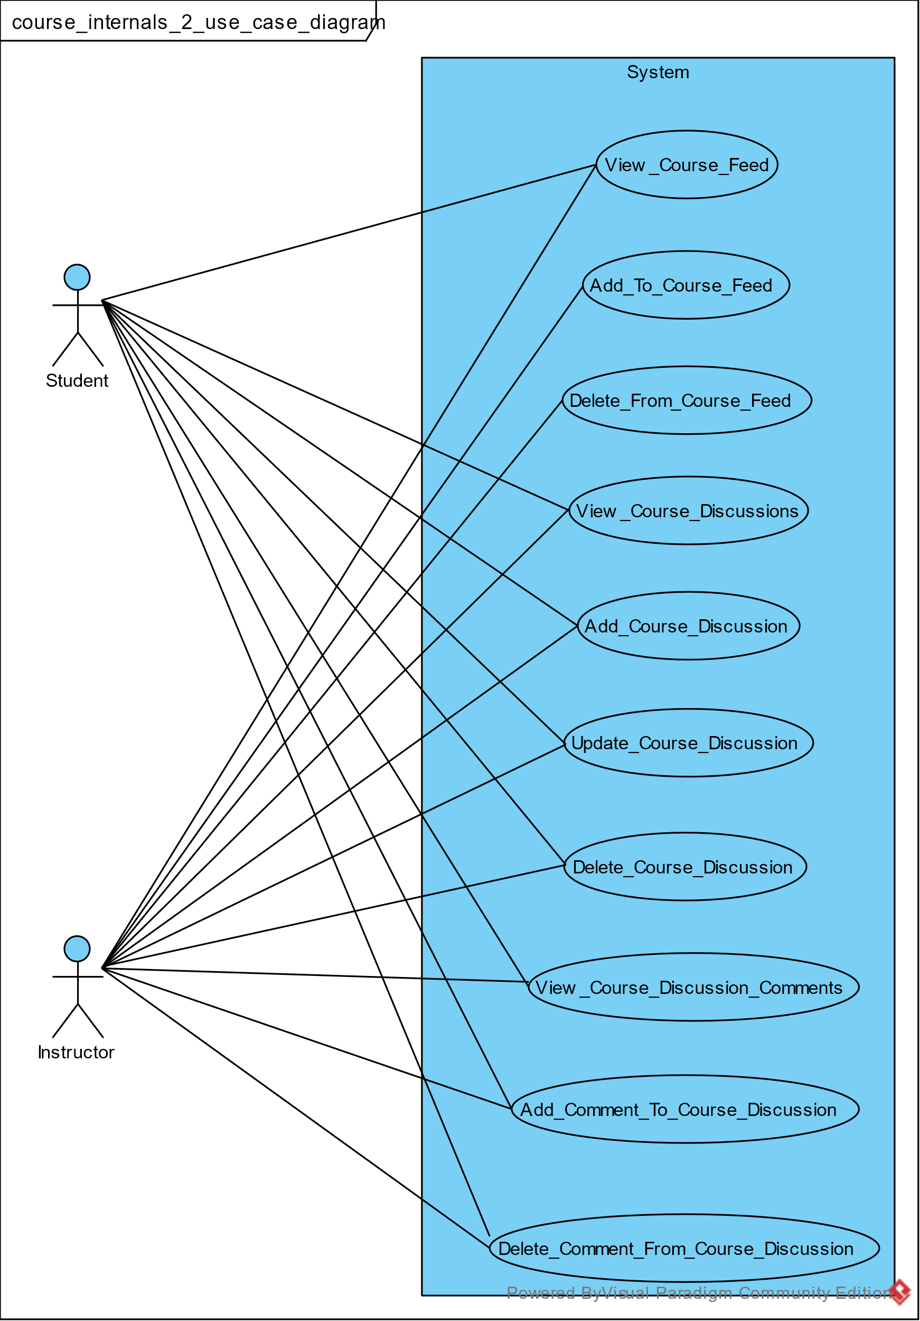
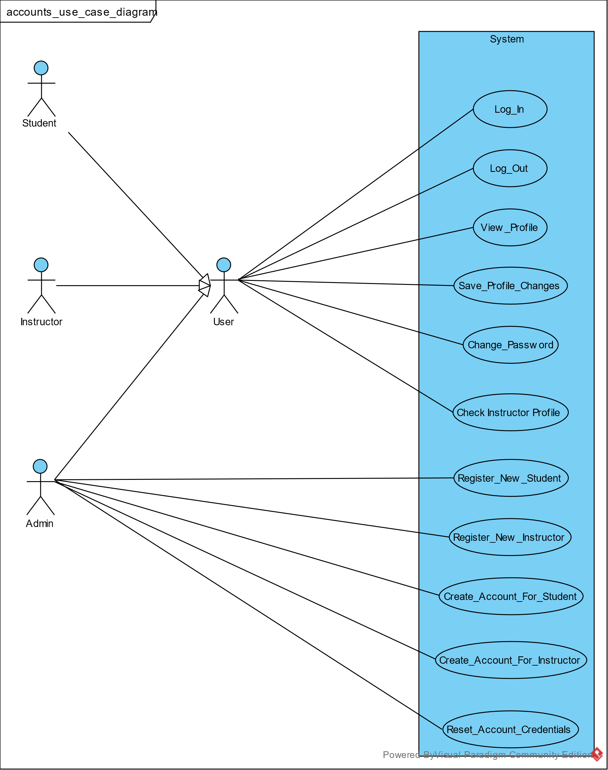

Slide 18

Class Diagrams
We used the vocabulary analysis to discover the potential classes, methods, and attributes from the constructed use case tables.
We started mapping those classes, methods, and attributes into classes and then constructed the relationships between the classes.
We ended up with a lot of classes, so we divided the class diagram into multiple class diagrams to help managing them.
Account Management Class Diagram.
Material Management Class Diagram.
Course Management Class Diagram.
Course Management 2 Class Diagram.
Course Management 3 Class Diagram.
Courses Class Diagram.
Others 1 Class Diagram.
Others 2 Class Diagram.

Slide 19
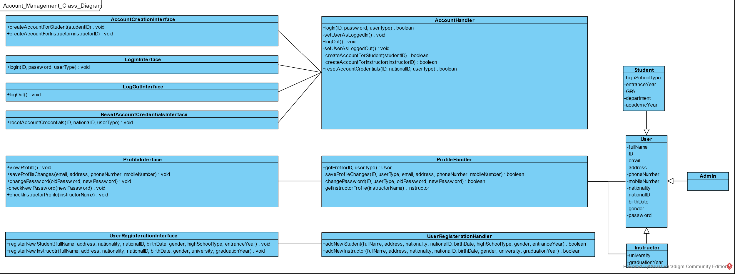

Slide 20
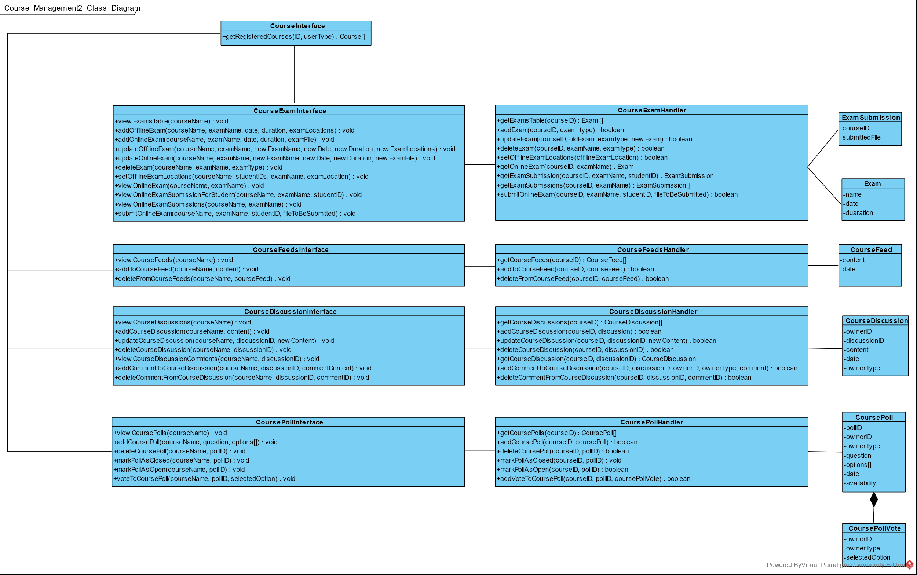

Slide 21
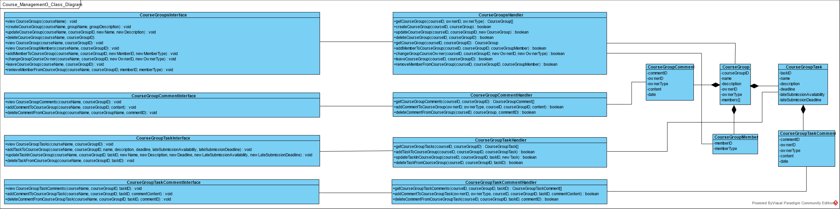

Slide 22

Sequence Diagrams
Sequence diagrams help visualize the flow of events in the system between the different interacting classes, they also help detect any missing classes, methods, or attributes.
We construct 7 sequence diagrams after the use case tables analysis and between start constructing the class diagrams.
Add Course Material Sequence Diagram.
Add Course Material Directory Sequence Diagram.
Add Directory To Course Group Sequence Diagram.
Add Material To Course Group Sequence Diagram.
Add Material To Group Task Sequence Diagram.
Deliver Assignment Sequence Diagram.
Update Course Assignment Sequence Diagram.

Slide 23
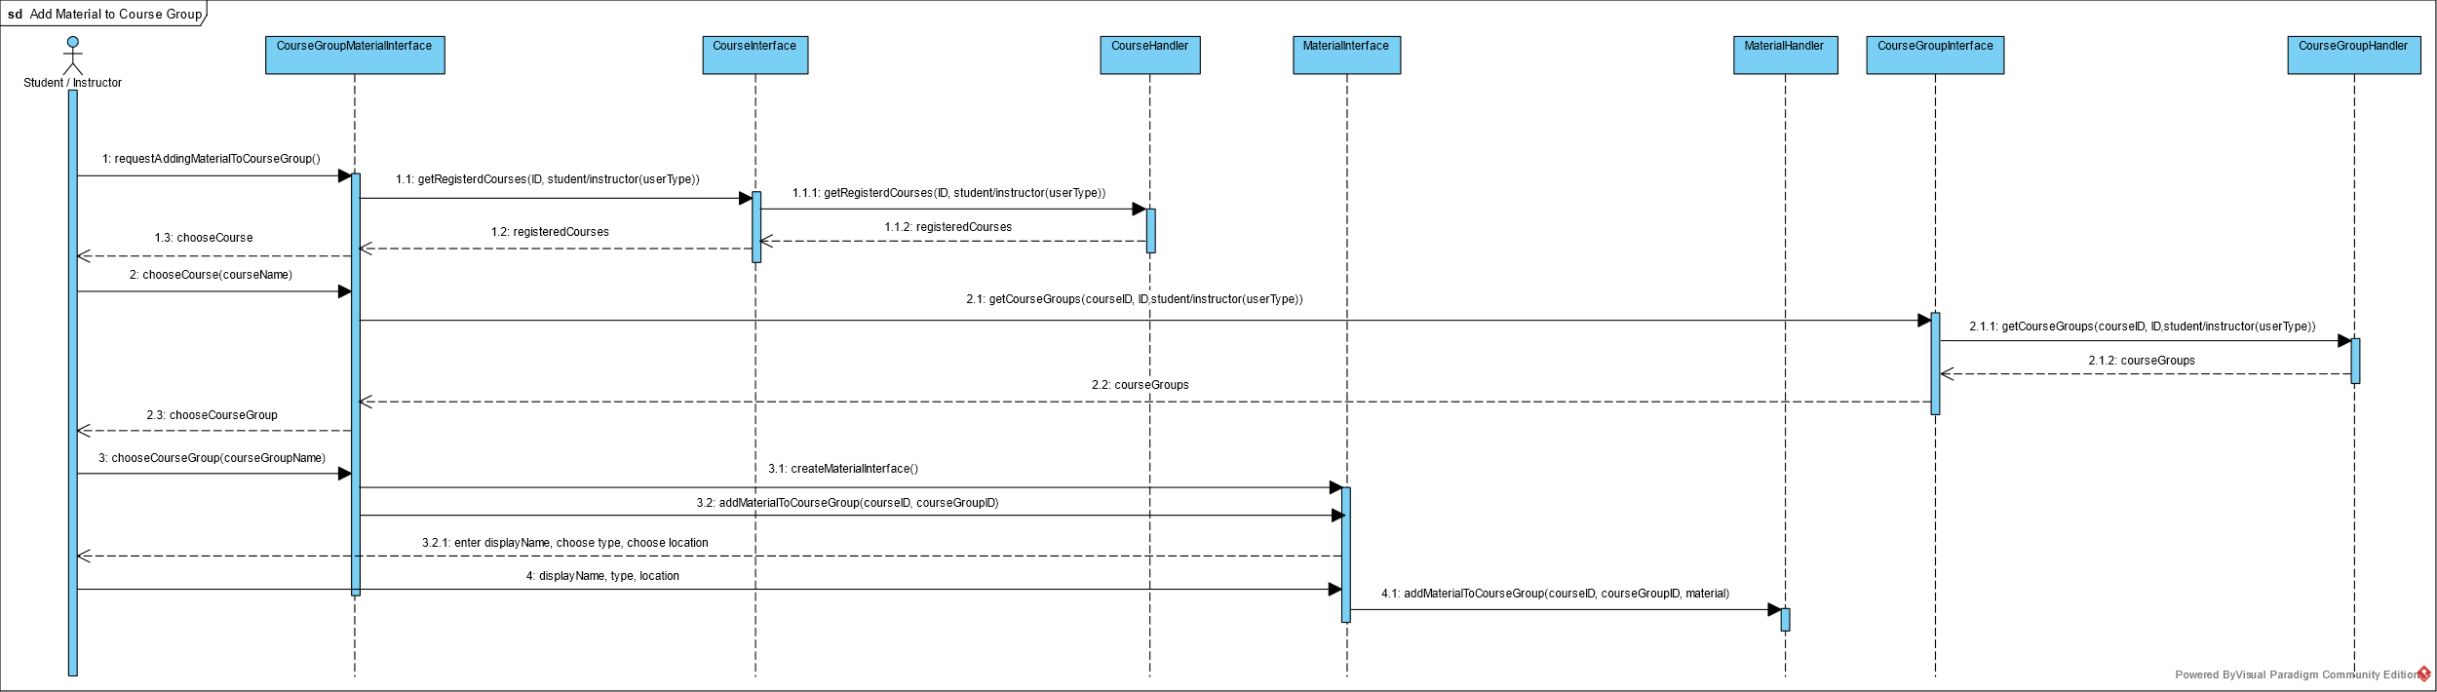

Slide 24
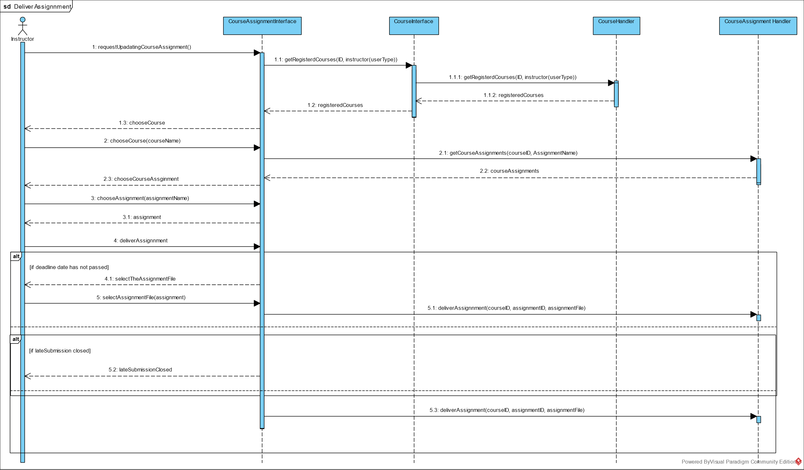

Slide 25
Entity Relationship Diagram (ERD)
ERD is a design diagram that represent how will the entities will be stored in the database.
We constructed the ERD from the class diagrams.
The following ERD is bound to increase, it is complete for the current cycle but not for the whole system

Slide 26
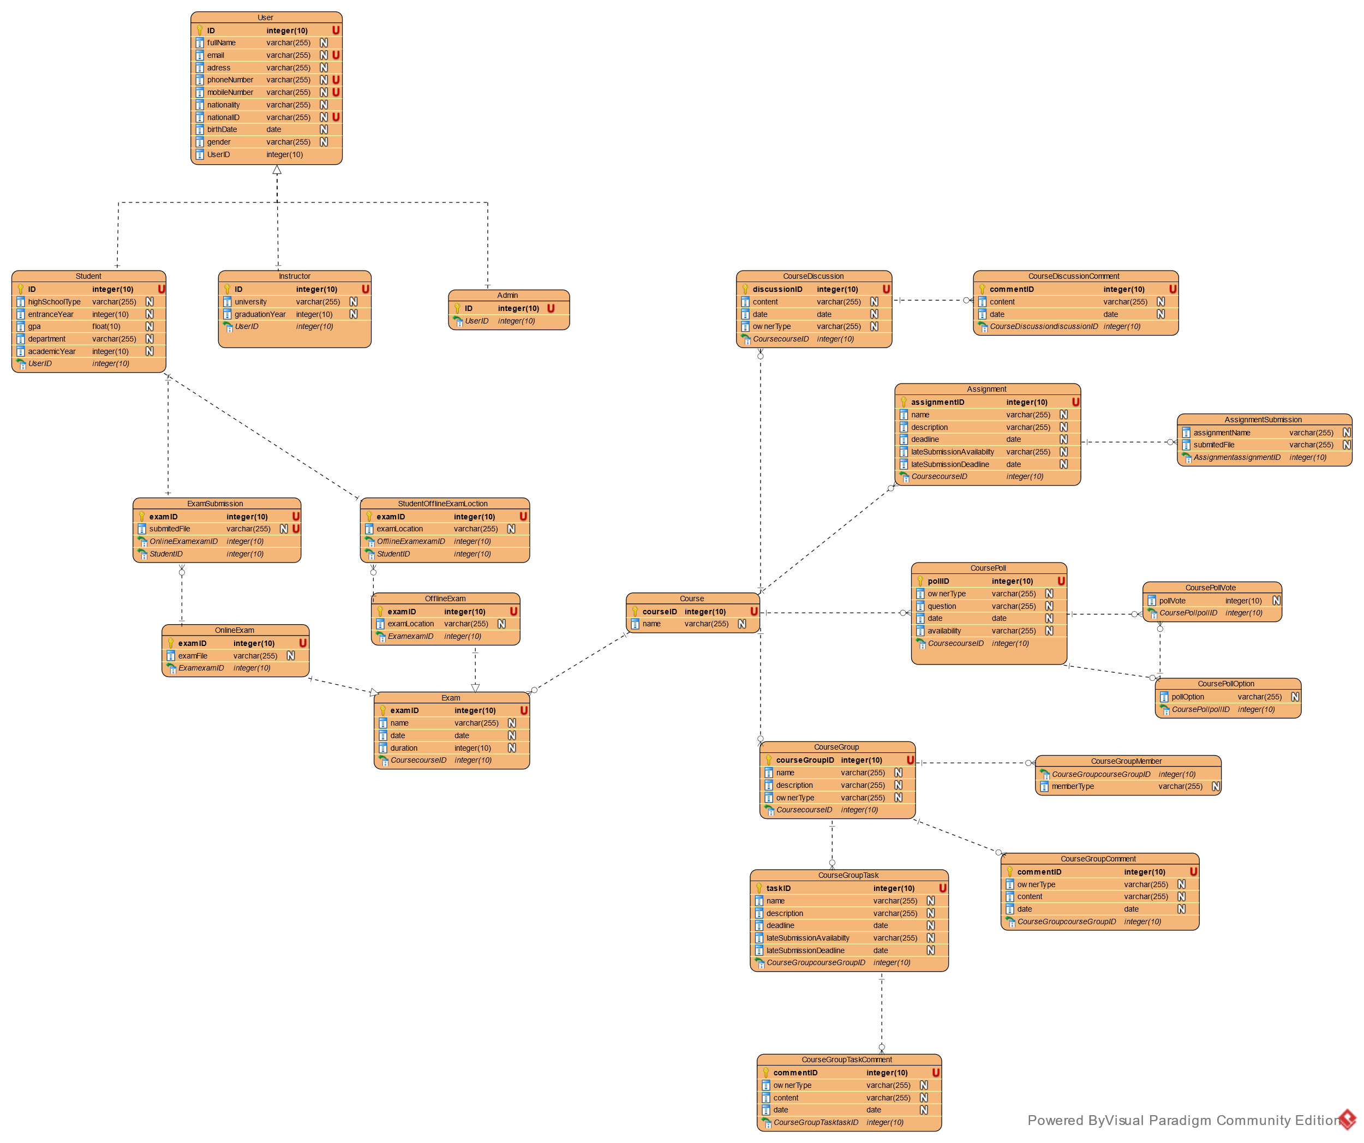

Slide 27
Time Plan
2020
2021
Nov
Dec
Jan
Feb
Mar
Apr
May
Jun
Jul
Aug
2021
Today
Nov 1 - Nov 20
100%
Analyze Websites
Nov 21 - Jan 4
90%
Construct Use Case Diagrams, Construct Use Case Tables
First Semester
Jan 5 - Jan 19
90%
Construct Class Diagrams
Jan 20 - Feb 6
80%
Construct Sequence Diagrams
Feb 7 - Feb 14
90%
Prioritize Compiled Features
Feb 14 - Mar 19
100%
Prepare for The Mid Year Exams
50%
Mar 20 - Mar 23
Construct ERD
Second Semester
100%
Mar 24 - Mar 26
Design Website Prototype
Mar 28 - May 7
0%
Learn Angular Frontend Framework, Learn .NET Framework and C#
Apr 15 - Aug 1
Implementing the System
0%

Slide 28

Conclusion
As you can see from the system specifications, we manged to capture the system requirements and dividing the system into parts.
Now we are in the designing step, we will use Agile SDLC so we implementing the system in manageable incremental steps instead of one big step.
The first agile cycle will include Student/Instructor Registration and Account Management.

Slide 29

The current E-com could be better, that why we decided to develop this system for the next generations of our faculty.
Developing such system is not an easy task, the E-com is a complex system with nearly unlimited number of details.
Developing a complex system requires good management of resources and great communication between the project members.
However, by applying the software engineering concepts that we studied throughout our journey in the faculty and with of our supervisors, we hope that we are able to do it.

Slide 30
References
Old E-com
http://ecom.fci-cu.edu.eg/
New E-com
http://newecom.fci.cu.edu.eg/#/
Acadox
https://www.acadox.com/
Google Classroom
https://classroom.google.com/
Blackboard
https://cu.blackboard.com/

