Slide 1

Building the Supply Chain for COVID-19 Vaccines…Group7
- Sai Mounish Ramisetti.
- Xuyan ZHANG.
- Lakshmi Shreyah Sritha Ediga.
- Sparsha Veerabathini.
- Javeed Shaik.

Slide 2
Introduction
Global Impact and Key Statistics of the COVID-19 Pandemic
Global impact, key statistics, affected regions.
Visual: World map with affected areas marked.
The Critical Role of Supply Chain Management
Critical role during a pandemic.
Challenges in maintaining essential goods and medical resources.
Visual: Supply chain graphic with interconnected elements.
Focus on Vaccine Development and Distribution
Significance in overcoming the pandemic.
Global efforts and urgency in vaccine development.
Visual: Vaccine distribution process flowchart or timeline.
Key Considerations in Vaccine Distribution
Challenges: logistics, temperature control, equitable access.
Visual: Icons/images representing distribution challenges.
Collaborative Efforts and International Cooperation
Examples of global cooperation in vaccine efforts.
Initiatives, partnerships, or involved organizations.
Visual: Flags/logos of collaborating nations or organizations.
Collaborative Efforts and International Cooperation
Summary of key points.
Message of hope and collective efforts for recovery.
Visual: Image symbolizing unity or overcoming challenges.

Slide 3
Aggressive Planning in COVID-19 Vaccine Supply Chain
The Vital Role of Comprehensive
Planning
Introduction to the pivotal role of comprehensive planning in the COVID-19
vaccine supply chain.
Emphasis on the urgency and scale of the vaccination effort.
Proper Management of Vaccine Doses
Importance of meticulous handling and storage to maintain vaccine efficacy.
Logistical Planning
Strategic logistical planning to ensure efficient distribution.
Considerations for transportation, storage, and last-mile delivery.
Visual: Logistics-related imagery or a flowchart depicting the planning process.
Expansion of Refrigerated Warehouse
Capacity
Collaboration with private companies to expand refrigerated warehouse capacity.
Explanation of how this addresses the challenge of maintaining vaccine integrity.
Visual: Image or schematic representation of additional warehouse construction.
Trained personnel for the handling and distribution of vaccines.
Visual: Icons representing careful handling and trained personnel.

Slide 4

Mitigating COVID-19 Vaccine Distribution Shortages
Strategies for Managing Shortages
Introduction to challenges related to shortages of packaging and storage materials.
Strategies to alleviate shortages and ensure continuous vaccine distribution.
Batching Multiple Doses in Individual Vials
Explanation of the solution: Batching multiple doses in individual vials.
Benefits of this approach, such as resource optimization and waste reduction.
Visual: Illustration depicting the batching process.
The Importance of Operational Decisions in Distribution
Emphasis on the critical role of operational decisions in the distribution process.
Examples of operational decisions impacting distribution efficiency and effectiveness.
Visual: Iconography representing decision-making in distribution.

Slide 5
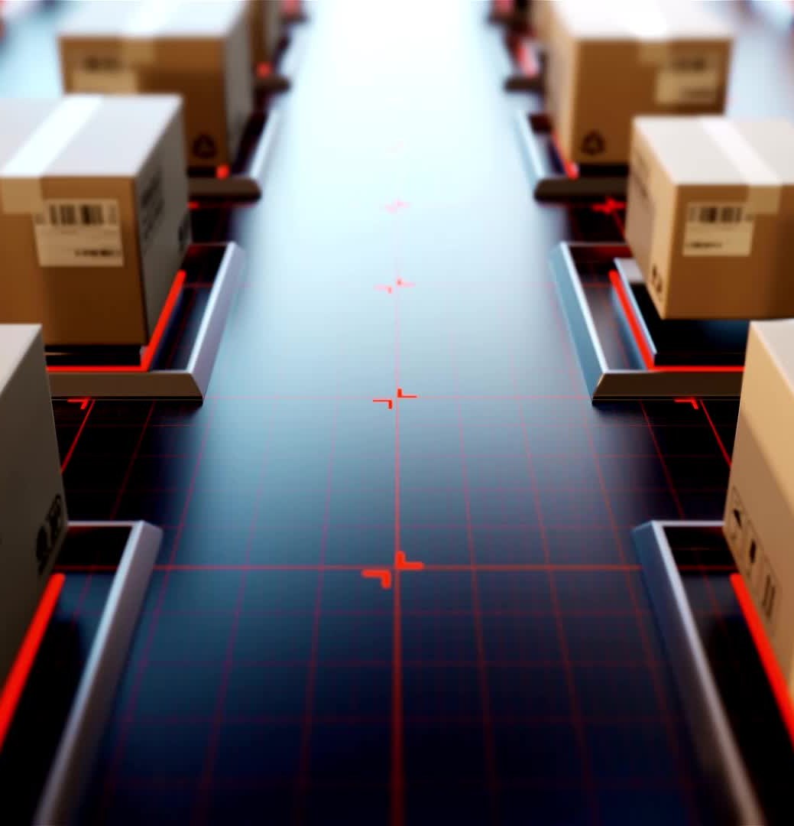
Managing High Volume Shipments for COVID-19 Vaccines
Navigating the High Volume of COVID-19 Vaccine Shipments
Managing the logistical, storage, and distribution challenges posed by the large volume of COVID-19 vaccine shipments.
Impacts on logistics, storage, and distribution networks.
Visual: Illustration showing the scale of vaccine shipments.
Diverse Production and Manufacturing Processes
Highlighting the range of production processes and manufacturing methods used for COVID-19 vaccines.
Challenges associated with different manufacturing techniques.
Visual: Comparative images or icons representing various manufacturing methods.
The Significance of Adaptive Manufacturing and Distribution Systems
Stressing the importance of adaptable systems to accommodate fluctuating production and distribution needs.
Strategies for developing flexible systems.
Visual: Flowchart or diagram illustrating flexible manufacturing and distribution processes.

Slide 6

Understanding the Complex Vaccine Development Process
Introduction to Vaccine Development Complexity
An overview of the intricate stages involved in vaccine development.
Visual: Diagram illustrating the multifaceted vaccine development process.
Three Key Stages: Research, Testing (Phases I-III), and Manufacturing
Research Stage:
Explanation of the initial research phase, including target identification and vaccine concept development.
Testing (Phases I-III):
Overview of the rigorous testing phases, emphasizing safety and efficacy assessments.
Visual: Timeline chart illustrating progression through testing phases.
Manufacturing:
Discussion of the manufacturing phase, where large-scale production is initiated.
Visual: Imagery depicting a factory or production line.
Striking a Balance: Speed, Efficacy, and Safety
Balancing Speed, Efficacy, and Safety
Emphasis on the delicate balance required between speed, efficacy, and safety in vaccine development.
Strategies for Optimization
Strategies for optimizing development timelines without compromising safety.
Visual: Triangle diagram depicting the interplay of speed, efficacy, and safety.

Slide 7

The Pivotal Role of WHO in Global Vaccine Landscape
World Health Organization's Pivotal Role
Introduction to the central and indispensable role played by the World Health Organization (WHO) in the global vaccine landscape.
Visual: WHO logo or global health imagery.
Central Entity for Procurement, Distribution, and International Collaboration
Procurement:
Explanation of WHO's involvement in vaccine procurement, ensuring access to quality vaccines.
Distribution:
Overview of the WHO's role in coordinating the distribution of vaccines on a global scale.
International Collaboration:
Highlighting WHO's function as a hub for international collaboration among nations, organizations, and stakeholders.
Visual: Flowchart representing WHO's involvement in procurement and distribution.
Ensuring Equitable Access and Addressing Healthcare Disparities
Emphasis on WHO's commitment to ensuring equitable access to vaccines, addressing disparities in healthcare.
Strategies employed by WHO to bridge gaps in vaccine distribution.
Visual: Infographic depicting equitable access and healthcare disparities.

Slide 8

Navigating Challenges in Vaccine Supply Chain Management
Challenges in Vaccine Supply Chain Management
Introduction to the inherent challenges faced in managing the supply chain for vaccines, especially during global health crises.
Visual: Graphic illustrating interconnected challenges in the supply chain.
Robust Cold Chain Infrastructure for Temperature-Sensitive Vaccines
Importance:
Explanation of the critical need for a robust cold chain infrastructure, especially for vaccines sensitive to temperature variations.
Infrastructure Requirements:
Overview of the infrastructure needed to maintain the integrity of temperature-sensitive vaccines.
Visual: Diagram depicting a cold chain infrastructure.
Logistical Challenges in Reaching Low- and Middle-Income Countries
Accessibility Issues:
Addressing the logistical challenges associated with reaching low- and middle-income countries.
Strategies and Innovations:
Highlighting strategies and innovations employed to overcome logistical barriers.
Visual: World map indicating challenges and innovative solutions.

Slide 9
Urgency of Achieving Global Equity in Vaccine Distribution
Emphasizing Global Equity
Emphasize the critical importance of achieving global equity in the distribution of vaccines.
Visual: Globe symbolizing global reach and equity.
Fostering Collaboration Among Governments, International Organizations, and Private Entities
Government Collaboration: Highlight the essential role of governments in collaborative efforts for equitable vaccine distribution.
International Organizations: Showcase the involvement of international organizations, such as WHO, in fostering collaboration.
Private Entities: Acknowledge the contribution of private entities in forming partnerships for a collective approach. Visual: Triangular graphic representing collaboration.
Strategies for Overcoming Logistical Challenges in Resource-Constrained Environments
Logistical Challenges: Discuss specific logistical challenges faced in resource-constrained environments.
Strategies: Overview of innovative strategies employed to overcome these challenges. Visual: Infographic illustrating challenges and corresponding strategies.

Slide 10
The Profound Impact of COVID-19 on Vaccine Supply Chains
Far-reaching Implications of the COVID-19 Pandemic
Discuss the profound and lasting impact of the COVID-19 pandemic on vaccine supply chain management.
Visual: Graph depicting the ripple effects of the pandemic.
Lessons Learned and Strategies for Future Pandemic Preparedness
Learning From Challenges:
Highlight key lessons learned from the challenges faced during the pandemic.
Future Preparedness:
Outline strategies to enhance preparedness for future pandemics.
Visual: Comparison of lessons learned and future preparedness.
Importance of Research and Development, Global Collaboration, and Resilient Supply Chain Systems
Research and Development:
Emphasize the crucial role of ongoing research and development in addressing health threats.
Global Collaboration:
Reinforce the significance of global collaboration in responding effectively to emerging health threats.
Resilient Supply Chain Systems:
Stress the importance of building resilient supply chain systems to withstand future challenges.
Visual: Icons representing research, collaboration, and resilience.

Slide 11


