Slide 1

Survey Data Analysis Tool
DATA SCIENCE (24AD3107) Project Review-1
Date& Time
Team Members Raavi Jahnavi – 2420030173 Thirumala Reddy Sagar Mounitha – 2420030330 SriHansika Saraf – 2420030556
 | Under the Guidance of Ms. B Prathusha Assistant Professor, Department of Computer Science and Engineering, KLH CSE Bowrampet Campus

Slide 2
Outline of Project Work
Focus
Introduction
Literature Survey
Challenges
Research Objectives
Conclusion & Future Work
References
Publications Details

Slide 3
Problem Statement
Students use social media platforms extensively, but their usage patterns and behaviour vary significantly in terms of time spent, frequency, purpose, and level of engagement.
Survey responses collected through Google Sheets and existing datasets from platforms such as Kaggle may contain missing values, inconsistent responses, duplicate records, and different data formats.
Manually cleaning and analyzing these datasets is time-consuming, repetitive, and prone to errors.
Existing analysis often focuses mainly on basic statistics and visualization, without combining data preprocessing, exploratory analysis, statistical testing, and machine learning in a single workflow.
It is difficult to identify and classify students based on their social media usage levels, such as Low, Moderate, and Heavy usage, using raw survey data alone.
There is a need to analyze factors such as daily screen time, frequency of social media use, preferred platforms, purpose of usage, sleep patterns, and academic performance to understand student social media behaviour.
Therefore, an automated Python-based platform is proposed to collect and integrate Google Sheets survey responses with suitable public datasets, clean and analyze the data, perform statistical tests, apply machine learning classification, and present the results through interactive visualizations and dashboards.

Slide 4
Objectives
Collect and organize Google Sheets survey responses along with relevant Kaggle datasets on student social media usage.
Clean and preprocess the data by handling missing, duplicate, and inconsistent records.
Perform EDA to analyze social media usage time, frequency, preferred platforms, and user behaviour.
Apply statistical techniques such as correlation, covariance, hypothesis testing, and Chi-square testing.
Build and compare five ML classifiers to classify students as Low, Moderate, or Heavy users
Evaluate models using accuracy, precision, recall, F1-score, and confusion matrix
Present the results through an interactive Power BI dashboard.

Slide 5
Literature Survey
Authors | Title of the Paper | Methodology | Inferences | Limitation/Future work | Links
Ehsan, T. [4] | Machine Learning for Detecting Social Media Addiction Patterns: Analyzing User Behavior and Mental Health Data, Int. J. of Innovations in Science & Technology, 6(4), 2024 | Survey-based dataset combining user behavior, mental-health parameters, and usage stats; Random Forest used to classify addiction into Low/Medium/High | More hours on social media correlate with higher distraction, irritation, and emotional issues; RF separates severity classes well | Relies on self-reported survey data; not validated against real-time behavioral tracking | https://journal.50sea.com/index.php/IJIST/article/view/1070
Mim, Firoz, Islam, Hasan & Habib [5] | A Study on Social Media Addiction Analysis on the People of Bangladesh Using ML Algorithms, Bulletin of Electrical Engineering and Informatics, 13(5), 2024 | Survey of 1,417 individuals; DT, RF, SVC, KNN, and Multinomial NB compared via holdout split | ML effectively segments users by reliance level; addiction linked to depression/frustration indicators | Single-country sample; no explainability (XAI) or interactive dashboard included | https://beei.org/index.php/EEI/article/view/5680
(Author, JSC) [6] | Predicting Digital Addiction Patterns with Machine Learning for Personalised Digital-Wellness Interventions, Journal of Social Computing, 2025 | Predictive modelling + clustering to segment users by addiction risk; causal modelling for personalised recommendations | Combining supervised prediction with clustering supports scalable, non-invasive digital-health interventions | Clinical validation not yet performed; conceptual framework only | https://www.sciopen.com/article/10.23919/JSC.2025.0020
Zarate, Jarrad, Stavropoulos, Conkey-Morrison & Hunt [7] | Mental Health, Personality, and Cross-Addictions as Predictors of Social Media Addiction | 2-year longitudinal design; Random Forest and other classifiers predict problematic social media use (PSMU) | RF outperformed other models; anxiety and disengagement coping predicted future PSMU; baseline symptoms were highly stable | Cross-addictive behaviours were weak predictors once mental health was controlled for; relies on self-report | https://www.sciencedirect.com/science/article/pii/S2352853226000544

Slide 6
Literature Survey
Authors | Title of the Paper | Methodology | Inferences | Limitation/Future work
Kim, Lee & Park [8] | Machine Learning for Mental Health in Social Media: Bibliometric Study | Bibliometric analysis of 565 Scopus/WoS papers (2015–2020); keyword co-occurrence network | 89% of high-citation studies use supervised learning (SVM, Naïve Bayes, DT); field shows continuous growth | Descriptive/bibliometric only — no predictive model built; limited to indexed databases | https://www.jmir.org/2021/3/e24870
Wayahdi & Ruziq [9] | Predicting Smartphone Addiction Levels with K-Nearest Neighbors Using User Behavior Patterns, Jurnal Teknik Informatika (JUTIF), 6(5), 2025 | Dataset of 3,300 behavior entries, 11 features; waterfall framework for preprocessing + KNN + Permutation Feature Importance | KNN achieved 95% accuracy; "App Usage Time" and "Battery Drain" were the strongest predictors | Only one algorithm tested (no ensemble comparison); no dashboard for exploring predictions | https://jutif.if.unsoed.ac.id/index.php/jurnal/article/view/4905
Azeez, H. H. [10] | Machine Learning-Based Prediction of Smartphone Addiction Using Behavioral Usage Features, | Public Kaggle dataset (500 users); RF, SVM, Logistic Regression, DT compared with 80/20 stratified split, 10-fold CV, SMOTE | RF best (Accuracy 88.4%, F1 0.898, AUC 0.923); screen time, notifications, sleep duration were top predictors | Small dataset (500 users) limits generalizability; single-dataset study, no external validation | https://alfarabiuc.edu.iq/Journal/index.php/Farabi-Eng/en/article/view/111
Osorio, Figueroa & Wong [13] | Predicting Smartphone Addiction in Teenagers | Random Forest applied to Big Five Inventory (BFI) + Smartphone Addiction Scale (SAS) data from teenagers | Personality traits (e.g., neuroticism) show significant association with addiction risk; RF captures nonlinear relations | Sample limited to Peruvian teenagers; personality data not combined with actual usage logs | https://www.ijitra.com/index.php/ijitra/article/view/192

Slide 7
Problem Gap Identification
Existing studies often analyze student social media usage using individual datasets without combining multiple data sources.
Most approaches focus on basic statistics and visualizations and do not integrate statistical testing with machine learning.
There is limited use of original student survey responses collected through Google Sheets along with public datasets for a combined analysis.
Existing tools generally do not provide an end-to-end workflow covering data cleaning, EDA, statistical analysis, ML classification, and visualization.
Students are rarely classified into simple usage groups such as Low, Moderate, and Heavy, making behavioural patterns harder to interpret.
A user-friendly Power BI dashboard combining survey insights and ML results can help present the findings in a more accessible way.

Slide 8
Innovation, Creativity, and Novelty
Combines Google Sheets survey responses with suitable Kaggle datasets to analyze student social media usage behaviour.
Integrates statistical analysis and machine learning in one workflow, including correlation, covariance, hypothesis testing, and Chi-square analysis.
Compares five ML algorithms — Logistic Regression, Decision Tree, Random Forest, KNN, and SVM — using accuracy, precision, recall, and F1-score.
Classifies students into three simple categories: Low, Moderate, and Heavy social media users.
Automates the complete Data Science lifecycle from data collection and cleaning to EDA, ML analysis, and visualization.
Uses an interactive Power BI dashboard to present survey findings, usage patterns, and ML results clearly.

Slide 9
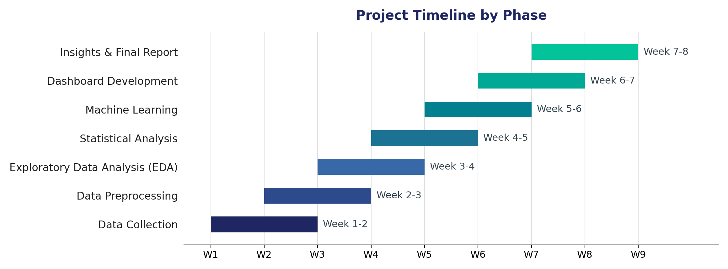
Feasibility and Project Plan
Uses freely available tools (Python, Pandas, NumPy, Scikit-learn, Power BI) and datasets (Google Sheets survey responses, Kaggle datasets), making the project technically and financially feasible.
The workflow is divided into clear phases — Data Collection, Preprocessing, EDA, Statistical Analysis, Machine Learning, Dashboard, and Insights — each with a defined timeline as shown below.
The team's familiarity with Python and Data Science libraries supports on-time completion within the project review timeline.

