Slide 1
AI-BASED SMART FOOD REDISTRIBUTION AND WASTE REDUCTION SYSTEM
TEAM-1

Slide 2
Team
Members
ROLL NUMBERS | NAMES
2420030284 | Shalini . Ch
2420030330 | Thirumala Reddy Sagar Mounitha
2420030441 | S.Tejasree
2420030484 | Kongara Deepthi

Slide 3
Introduction
Food wastage is a major social and environmental problem.
Large quantities of surplus food are discarded by restaurants, hotels, supermarkets, and households.
At the same time, many people face food insecurity and lack access to sufficient food.
Our project provides a digital platform to connect food donors with organizations and people in need.
Artificial Intelligence is used to support demand prediction, donation prioritization, and efficient distribution.

Slide 4
Problem Statement
Surplus food is often wasted because of poor coordination and delayed distribution.
Donors may not know which organizations currently require food.
Manual donation management is time-consuming and inefficient.
Food with short expiry times requires immediate distribution.
Lack of real-time tracking makes donation management difficult.
Transportation and route planning can increase delivery time and food spoilage.

Slide 5
Existing System
Food donations are often coordinated manually.
Communication may depend on phone calls, messages, or separate platforms.
Limited real-time information about available surplus food.
Difficult to prioritize food based on freshness and expiry time.
Manual tracking of donations and deliveries.
Limited demand prediction and route optimization.

Slide 6
Proposed System
The proposed system provides a centralized platform that connects:
Food Donors → Platform → NGOs/Food Banks → People in Need
Key Features
Food donation registration
Real-time food inventory
AI-based demand prediction
Food freshness and expiry prioritization
Donor and receiver management
Donation tracking
Automated notifications
Route optimization
Secure authentication
Scalable cloud-native deployment

Slide 7
Objectives
Reduce unnecessary food wastage.
Connect food donors with NGOs and food banks.
Predict food demand using AI.
Prioritize donations based on freshness and expiry time.
Improve delivery and route efficiency.
Provide real-time donation and inventory tracking.
Improve transparency between donors and receivers.
Build a secure, scalable, and modular application.

Slide 8
Stakeholders
Food Donors
Restaurants
Hotels
Supermarkets
Households
Food Receivers
NGOs
Food banks
Charitable organizations
Delivery Partners
Collect and deliver surplus food.
System Administrator
Manages users, donations, and system activities.
Beneficiaries
People who receive redistributed food.

Slide 9
System Workflow
1. Donor registers/login
↓
2. Donor adds surplus food details
↓
3. System stores food inventory
↓
4. AI analyzes availability and predicted demand
↓
5. System prioritizes donations
↓
6. Suitable NGO/receiver is identified
↓
7. Delivery route is optimized
↓
8. Food is collected and delivered
↓
9. Donation status is updated

Slide 10
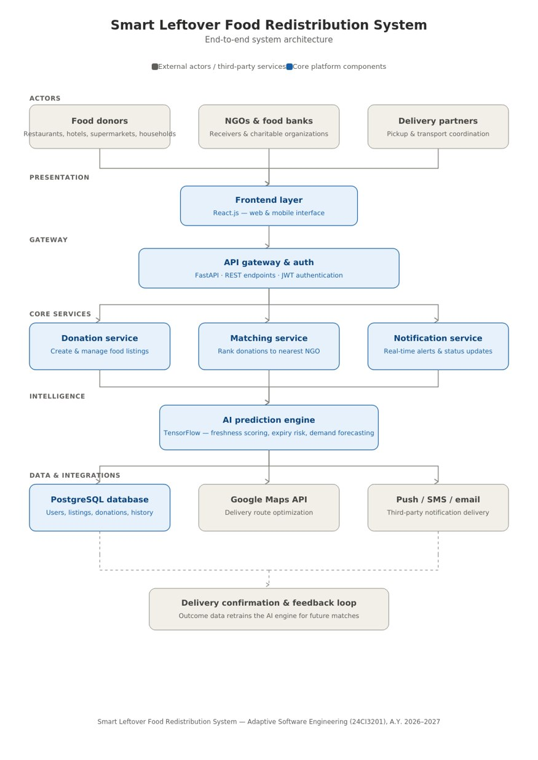
System Architecture

Slide 11
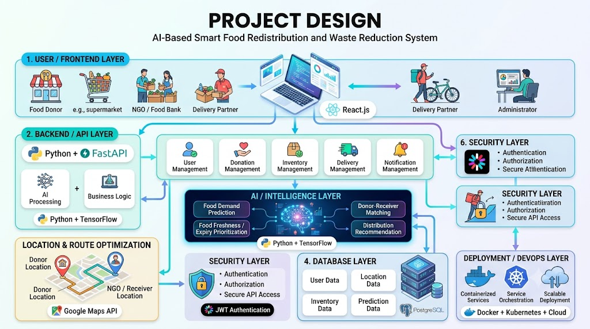
Project Design

Slide 12
Technology Stack
Frontend
React.js
Backend
Python
FastAPI
REST APIs
Database
PostgreSQL
Artificial Intelligence
TensorFlow
Demand prediction
Security
JWT Authentication
Maps & Routing
Google Maps API
DevOps / Deployment
Docker
Kubernetes
Cloud Technologies

Slide 13
AI-Based Features
Demand Prediction
Analyzes previous donation and consumption patterns.
Predicts future food requirements.
Donation Prioritization
Considers freshness.
Considers expiry time.
Considers food quantity and demand.
Route Optimization
Uses location information to identify efficient delivery routes.
Helps reduce transportation time and food spoilage.

Slide 14
System Requirements & Modules
Functional Requirements
User registration and secure login
Food donation and inventory management
AI-based demand prediction and donation prioritization
Donor–NGO matching and delivery tracking
Notifications and route optimization
Non-Functional Requirements
Security: JWT Authentication
Scalability: Docker + Kubernetes + Cloud
Performance: FastAPI + REST APIs
Reliability: Real-time tracking
Maintainability: Modular services
Main Modules
User Management | Donation | Inventory | AI Prediction | Matching | Delivery | Notifications

Slide 15
Testing, Outcomes & Future Scope
Testing
Unit Testing
API Testing
Integration Testing
System Testing
User Acceptance Testing
Expected Outcomes
Reduce food wastage
Faster surplus food redistribution
Better donor–NGO coordination
Efficient delivery and tracking
Scalable and secure platform

Slide 16
Conclusion & Future Scope
AI-based platform helps connect surplus food with organizations in need.
AI supports demand prediction, prioritization, and efficient distribution.
React.js, FastAPI, PostgreSQL, TensorFlow, Docker, and Kubernetes provide a scalable system.
ASE enables iterative development and adaptation to changing requirements.
Future Scope
Mobile application
Live GPS tracking
IoT-based freshness monitoring
Advanced AI prediction
Multi-language support

