Slide 1

SmartRide – Microservices-Based Carpooling Platform
SOA Project Review-1
20-08-2026
 | Under the Guidance of Dr. Navyatha Ravi Professor, Department of Computer Science and Engineering, KLH CSE Bowrampet Campus
Team Members Thirumala Reddy Sagar Mounitha-2420030330 Raavi Jahnavi-2420030173 SriHansika Saraf-2420030556

Slide 2
Outline of Project Work
Focus
Introduction
Literature Survey
Challenges
Research Objectives
Conclusion & Future Work
References
Publications Details

Slide 3
Problem Statement
Many private vehicles travel with unused seats while other commuters travel along similar routes, resulting in poor vehicle utilization, higher individual travel costs, and unnecessary traffic congestion. Coordinating rides informally through calls or messaging groups is inconvenient, lacks verification, and does not scale. There is a need for a centralized, secure platform where drivers can offer available seats and passengers can search, book, and manage rides efficiently, without relying on ad-hoc arrangements.

Slide 4
Objectives
• Design and develop a centralized carpooling platform connecting drivers and passengers travelling similar routes
• Enable drivers to create rides by specifying route, date, time and available seats
• Allow passengers to search, filter and book available ride seats based on their travel needs
• Provide secure user authentication and role-based authorization for drivers and passengers
• Build the backend using a microservices architecture (User, Ride, Booking, Notification services) for scalability and maintainability
• Implement API routing and service discovery using Spring Cloud Gateway and Eureka
• Reduce individual travel costs and improve vehicle utilization through shared rides

Slide 5
Literature Survey
Authors | Title of the Paper | Methodology | Inferences | Limitation/Future work
Kanagasabai et al. [1] | Towards Sustainable Commuting: Development of a Carpool Ride-Sharing Platform with Real-Time Tracking and Safety Features, IJRISS, 2025 | Layered three-tier modular architecture (presentation, business logic, data) for a carpool ride-sharing application | Shows that a modular, tiered architecture improves scalability and maintainability for ride-sharing platforms with real-time tracking and safety features | Uses a monolithic layered design rather than independently deployable microservices, limiting fine-grained scalability of individual features
Zhao et al. [2] | Design of Architecture for Carpooling Based on Flexible Pickup and Delivery Locations, Springer, 2021 | Proposes a carpooling system architecture with added service quality assessment and KPI-based reporting components | Demonstrates that quality-assessment and reporting components help bridge mathematical carpool-matching models and real-world system architecture | Focuses on matching and pickup/delivery flexibility; does not address distributed deployment, authentication or service-to-service communication
IJRAR Survey [3] | Real-time Smart Car Pooling and Ride Sharing System, IJRAR, 2020 | Reviews multiple carpooling and ride-sharing techniques and proposes a mobile-based architecture with admin trip tracking | Finds that most existing carpooling apps focus mainly on inter-city travel and lack robust intra-city, real-time matching support | Aims to extend carpooling to intra-city routes but does not adopt a service-oriented or microservices-based backend for scalability

Slide 6
Problem Gap Identification
• Existing carpooling solutions are often monolithic, making it hard to scale individual features (e.g. booking) independently during peak demand
• Informal carpooling arrangements (calls, chat groups) lack verified user profiles, structured booking, and cancellation handling
• Few academic or open-source carpooling systems apply a true microservices + API gateway + service discovery pattern for modularity
• Existing apps rarely separate ride management, booking, and notification concerns into independently deployable services
• Limited support for real-time seat availability updates and secure role-based access in low-cost or open implementations

Slide 7
Innovation, Creativity, and Novelty
• Applies SOA / microservices principles, not commonly seen in typical academic carpooling projects, to the ride-sharing domain
• Clear separation of concerns into User, Ride, Booking and Notification services, each independently deployable and scalable
• Centralized API Gateway (Spring Cloud Gateway) combined with Eureka-based service discovery for dynamic, scalable routing
• Secure, role-based JWT authentication distinguishing driver and passenger permissions at the gateway level
• Individual services, such as the Booking Service, can scale independently during high-demand periods without affecting others

Slide 8
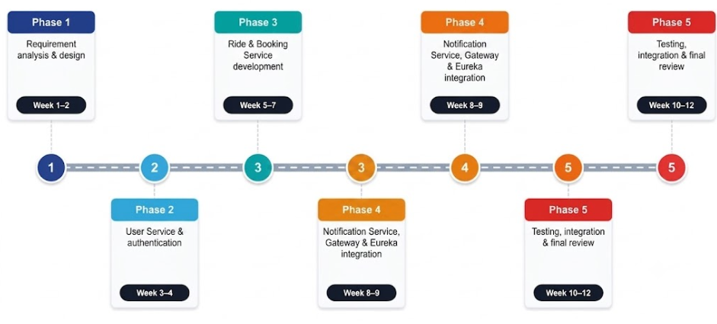
Feasibility and Project Plan
• Technically feasible — open-source, well-documented stack (Java, Spring Boot, Spring Cloud, REST)
• Economically feasible — no licensing cost; deployable on free-tier cloud or campus infrastructure
• Operationally feasible — modular microservices allow incremental, independent development and deployment

