Slide 1

CARPOOLING PLATFORM
Project Review – 2
Project Design, Methodology & Technical Implementation
 | Under the Guidance of Ms.Navyatha Ravi Department of Computer Science and Engineering, KLH CSE Bowrampet Campus
Team Members Raavi Jahnavi — 2420030173 Sagar Mounitha Thirumala Reddy — 2420030330 SriHansika Saraf — 2420030556

Slide 2
Project Overview
Carpooling Platform is a web-based application designed to connect drivers and passengers travelling along similar routes.
The platform supports:
Ride creation and management
Ride search and seat availability
Ride booking and cancellation
User and booking management
Secure authentication and authorization

Slide 3
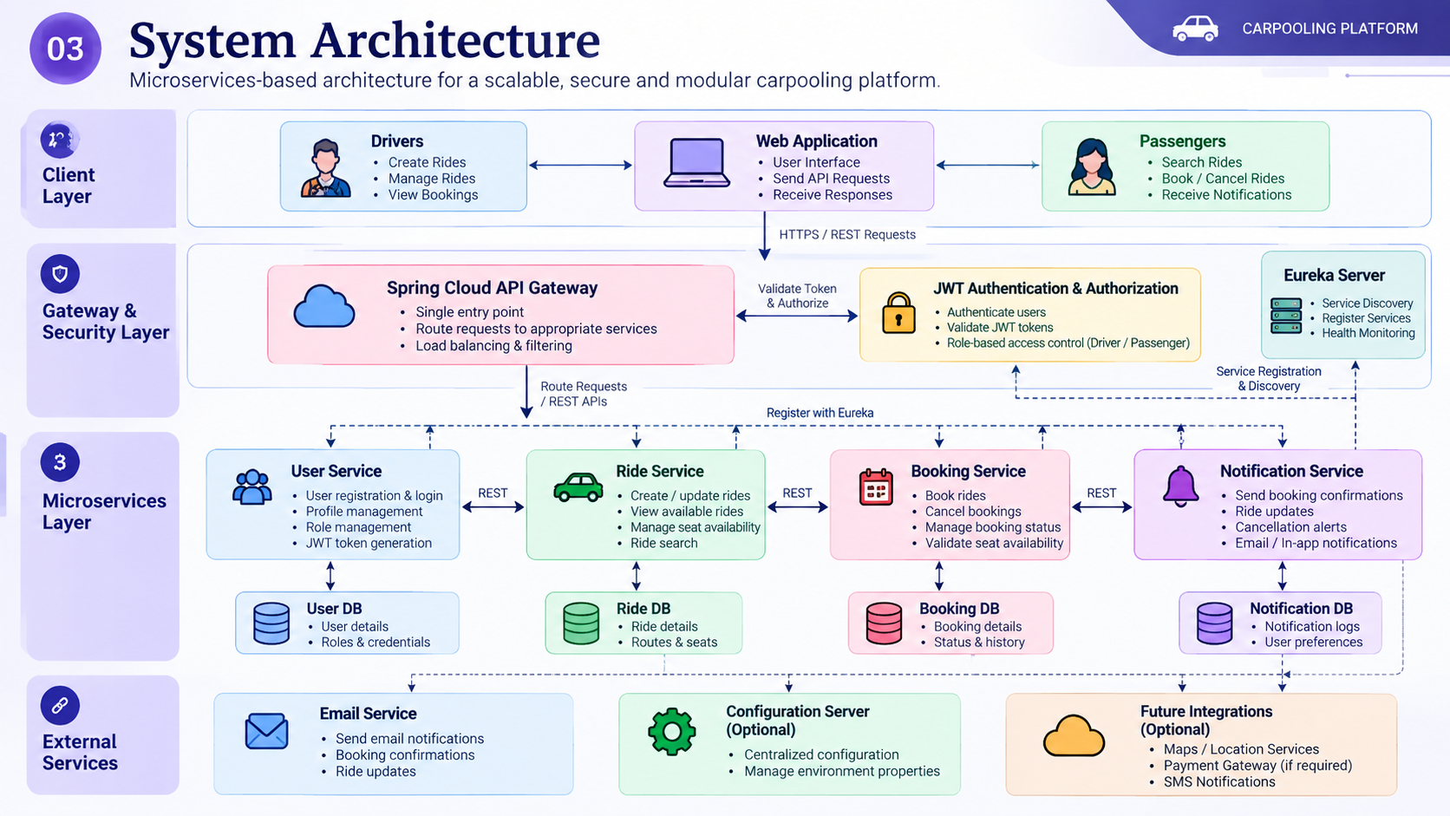

Slide 4
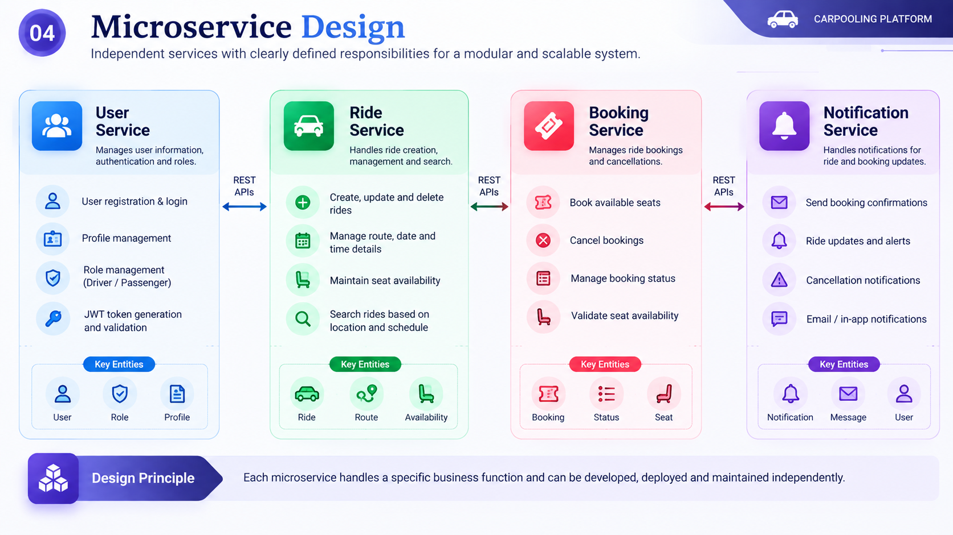

Slide 5
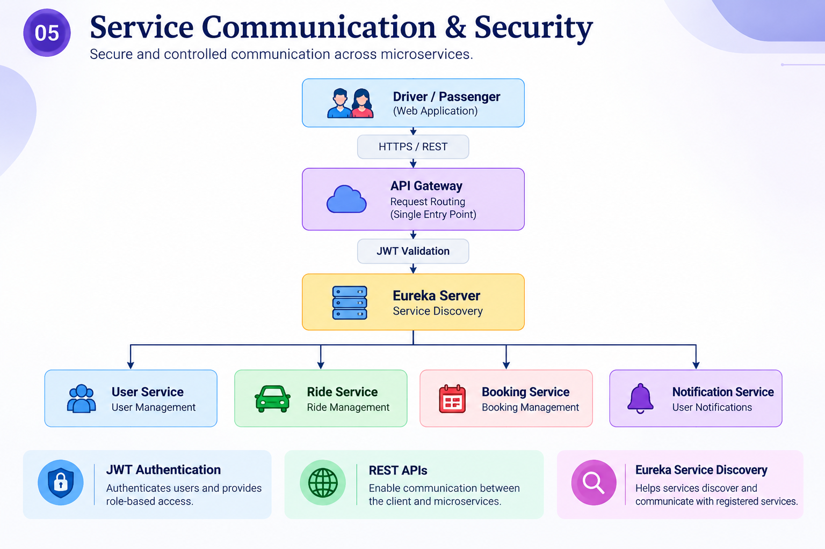

Slide 6
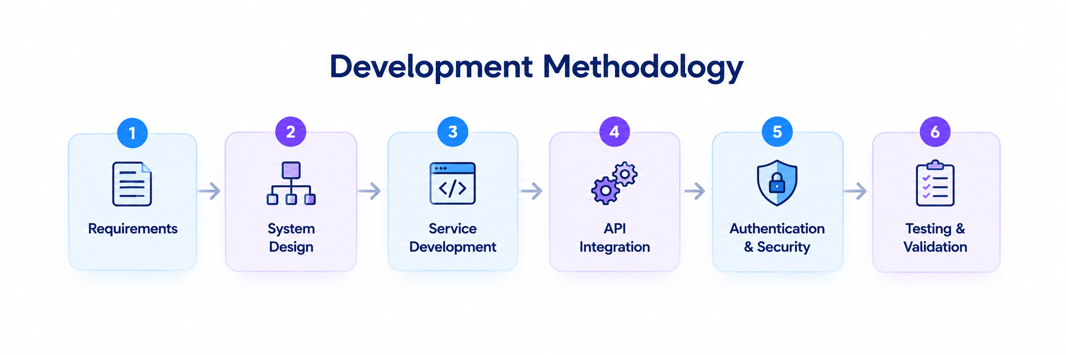
Incremental development of independent microservices
Requirements — Identify user, ride and booking needs.
System Design — Define microservices and architecture.
Service Development — Develop independent services.
API Integration — Connect services using REST APIs.
Authentication & Security — Apply JWT and role-based access.
Testing & Validation — Verify APIs and service communication.

Slide 7
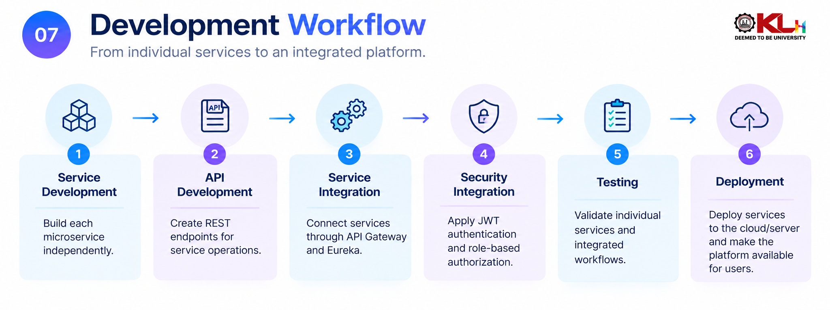

Slide 8
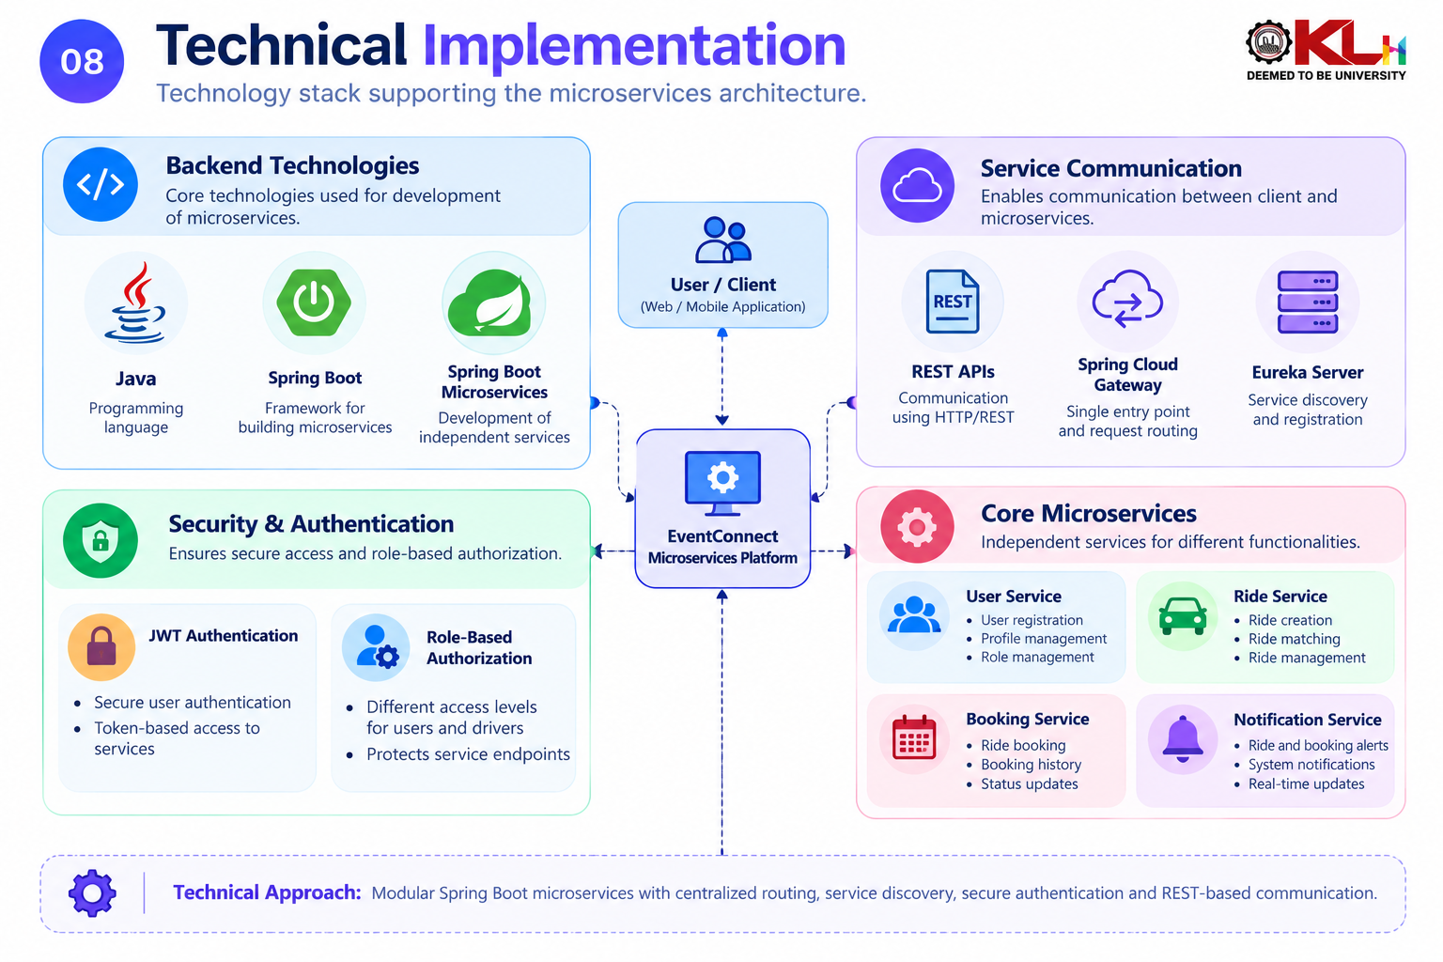

Slide 9
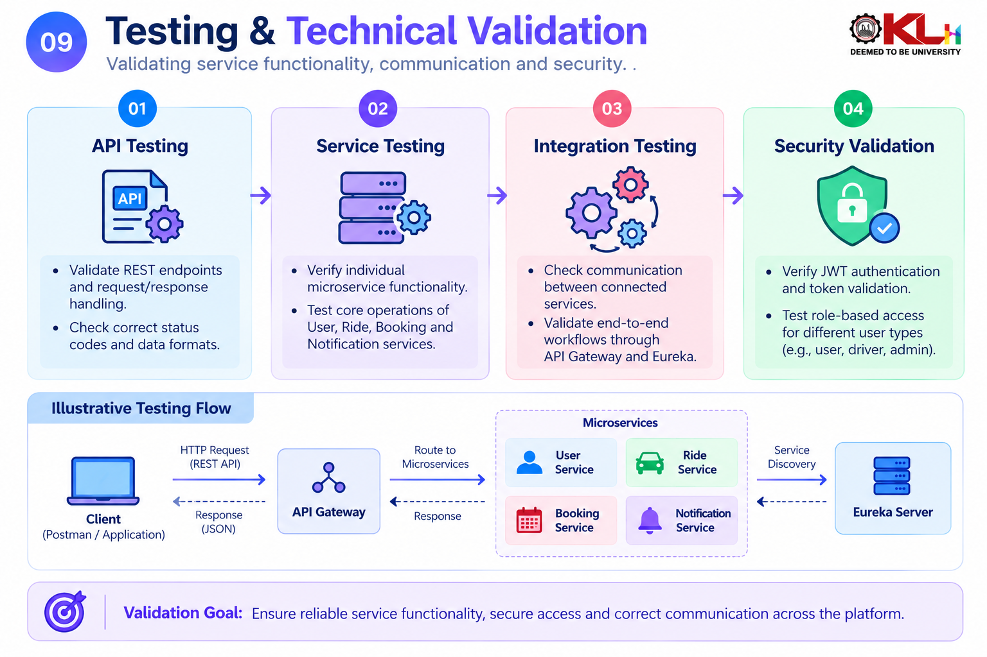

Slide 10
