Slide 2
Design of a
Mobile IoT Device
for Real-time
CH4 Monitoring

Slide 3

State of the art
and on-site board design
Presentation of the project
State of the art
On-site board design

Slide 4
Presentation of the project
Goals and targets
Main checkpoints
( project progress prevision
gantt diagram, … )

Slide 5

Presentation of the project
Design and development a mobile IoT device for real-time monitoring of methane gas levels
The device should be able to :
measure CH4 concentrations
transmit data for real-time monitoring and analysis
This project targets :
agriculture applications

Slide 6
Presentation of the project
Main tasks :
1. Design a portable IoT device equipped with CH4 gas sensors for accurate real-time monitoring.
a. Sensors
b. Device self-sufficiency
2. Develop firmware for data acquisition and wireless transmission to enable remote monitoring.
a. Data acquisition approach
b. Data transmission approach
3. Implement a user-friendly mobile application for real-time data visualization.
4. Ensure the device is power-efficient and capable of wireless connectivity for seamless data transfer.
5. Evaluate the system's performance, accuracy, and reliability in different CH4 monitoring scenarios.
Design a portable IoT device equipped with CH4 gas sensors for accurate real-time monitoring.
Implement a user-friendly mobile application for real-time data visualization.
Develop firmware for data acquisition and wireless transmission to enable remote monitoring.
Ensure the device is power-efficient and capable of wireless connectivity for seamless data transfer and evaluation of performance

Slide 7
State of the art
What is CH4?
Why focus on CH4 instead of other gases?
How can methane levels be measured?
What level of precision is required in agriculture?
What sensors are currently available on the market or being developed by researchers?

Slide 8
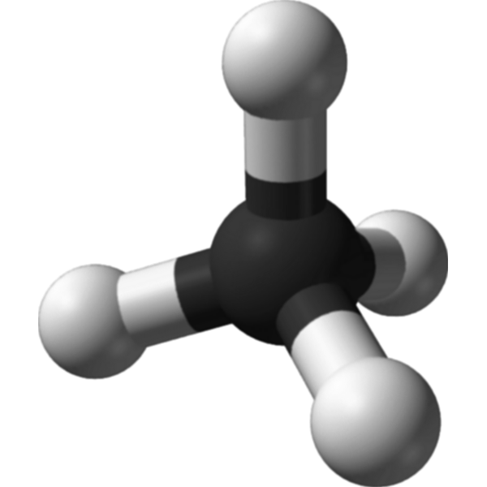
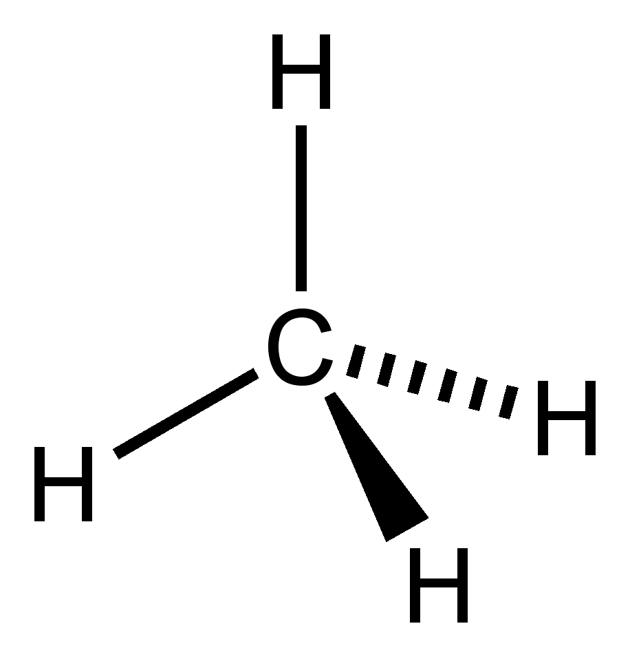
Introduction to Methane (CH4)
Methane Sources:
Naturally present in soil, water, and the atmosphere
Released by human activities (e.g., agriculture, rice paddies)
Constitutes 60% of natural gas fossil deposits
Produced by forced anaerobic fermentation
Uses:
Electricity, heating, automotive fuel
Hazards:
Highly flammable and explosive

Slide 9

Environmental Impact of Methane
Greenhouse Gas Contribution:
Second most important greenhouse gas after water vapor
Absorbs infrared radiation, contributing to global warming
Sources of Emissions:
Anaerobic fermentation in wetlands, rice paddies, hydroelectric dams
Fossil fuels

Slide 10
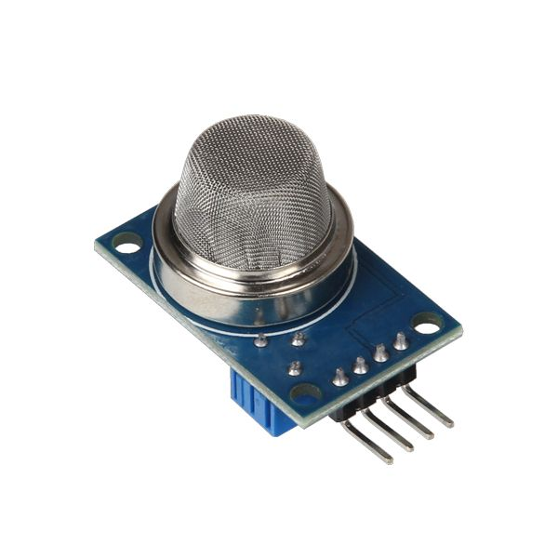
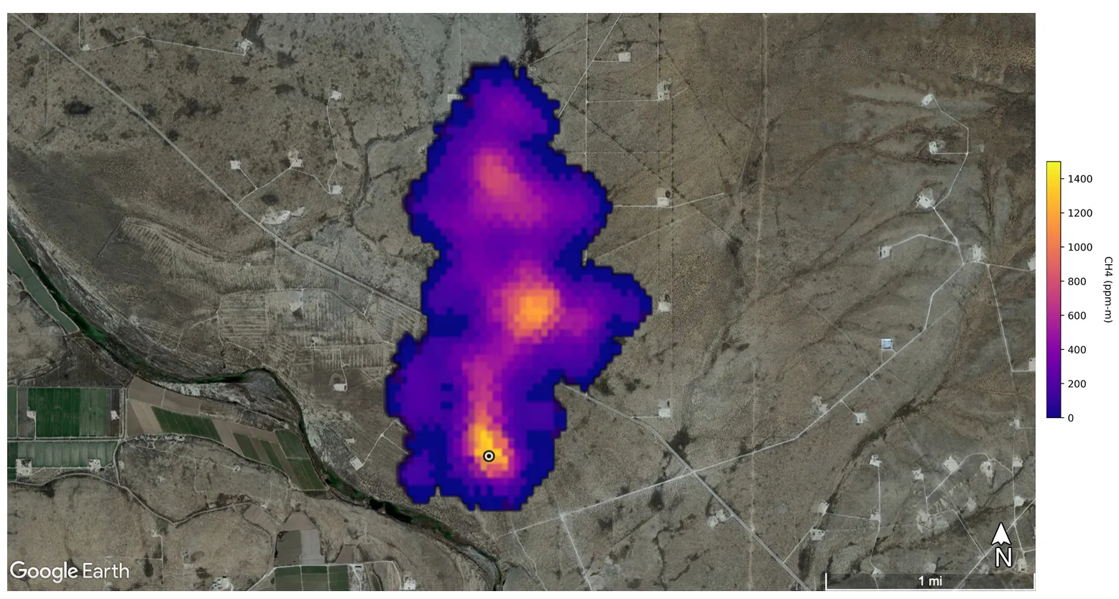
Methane Detection
Detection Methods:
Satellite or on-site sensors
Objective:
Reducing methane emissions is more cost-effective and efficient for mitigating global warming compared to reducing CO2

Slide 11
Mitigation Strategies and Gas Sensor Functionality
Strategies:
Sensors + burning or distillation purification of CH4 emissions => reduction of CO2 emission
Modify cattle diets
Rice cultivation: reduce fertilizer use, combat water turbidity, and reduce methanogenic sediment production
==>
Types of Gas Sensors:
Electrochemical Sensors: Detect CO and SO2
Semiconductor Sensors: Sensitive to a wide range of gases
Infrared Sensors: Detect CH4 and CO2

Slide 12
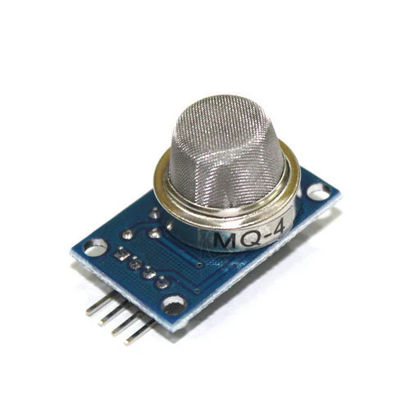
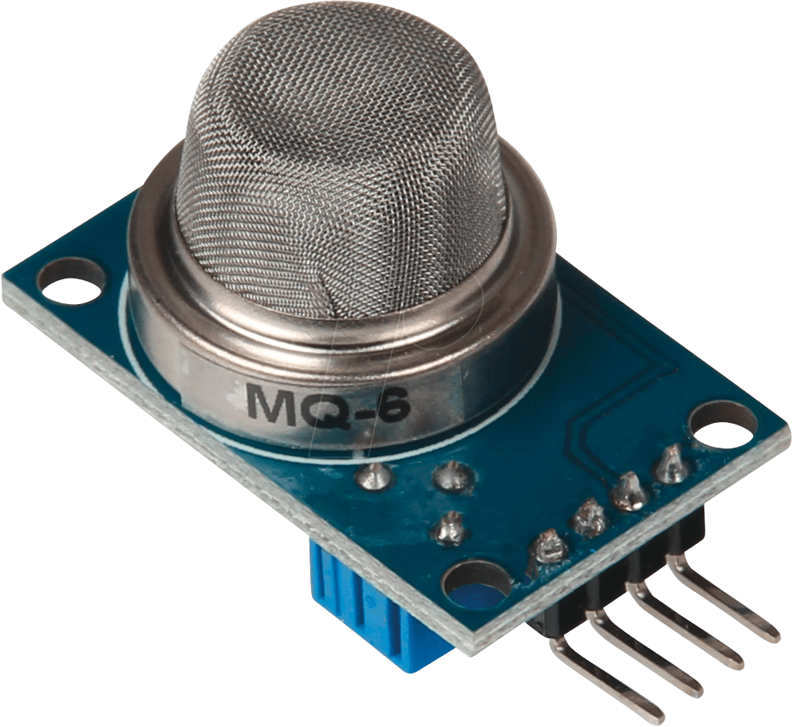

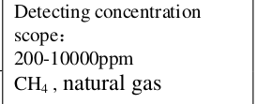
Market-Available Sensors
MQ4 Sensor:
Detection range: 200-10000 ppm CH4
MQ6 Sensor:
Detection range: 300-10000 ppm (Propane and Methane)
MQ Sensor family :
Semiconductor sensor
Long range of sensitivity
Low price
Low consumption
Unrestricted use condition ( high range of temperatures resistance, high resistance from humidity, …)
Extract of MQ4 datasheet

Slide 13
Key Steps for Implementation
Embedded Board:
Find a suitable methane sensor
Use a microprocessor to acquire data
Transmit data to the cloud, stored on platforms like ThingSpeak
User's Phone:
Develop a mobile application to retrieve, process, and display data in real-time

Slide 14
On-site board design
On-site Board Requirements
Power Supply and Autonomy
Component choices

Slide 15
On-site Board Requirements
Components:
Methane sensor
GSM/3G module
Battery and autonomous battery charger
STM32 microcontroller
Communication Options:
Cellular device with SIM card (e.g., SIM800, SIM900)

Slide 16
Power Supply and Autonomy
Power Options:
Battery-powered system for portability
Solar-powered recharging system using an on-board solar cell
Environmental Constraints:
Temperature range: 0°C to 50°C
Humidity resistance: Up to 95%
Energy Autonomy:
Renewable energies: solar and wind power

Slide 17
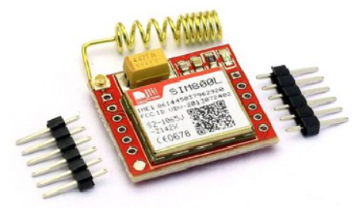
Communication module
Several devices are possible:
- a WiFi device, such as ESP8266 or ESP32
- a low-energy Bluetooth device, such as Nordic nRF52
- a LoRa device, such as RFM95
- a cellular device => self-sufficient
}
not sufficient on their own
require a gateway
A low-cost
Highly functional
Compact
Low-power operation and can be battery powered
GPRS module => TCP/IP protocol => Internet access
BUT
Peak current required = 2 A >> Microcontroller Supply
=> a separate DC/DC regulator

Slide 18
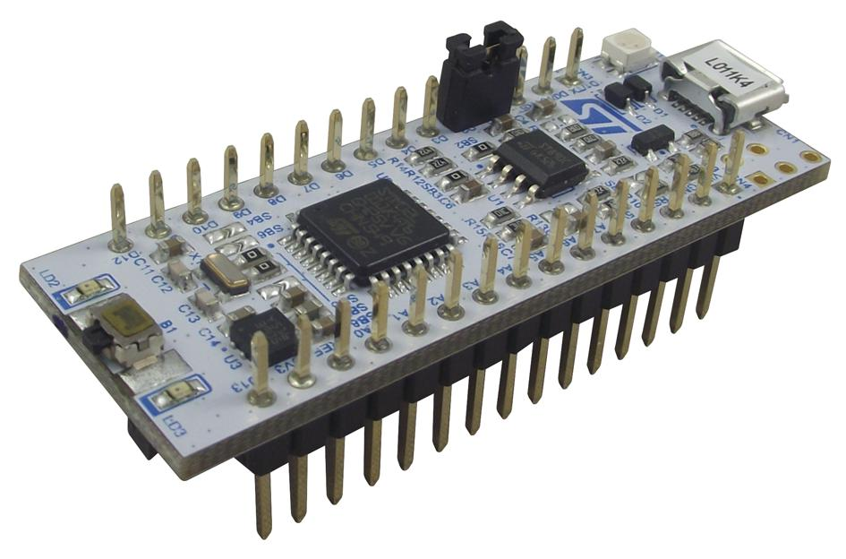
Microcontroller
Key points to decide :
power consumption
portability
resistance to environmental conditions
board autonomy
}
Two categories fit :
STM32L0 and STM32L4
=> Ultra-Low Power microcontrollers
Nucleo-L011K4 with embedded STM32L011K4

Slide 19
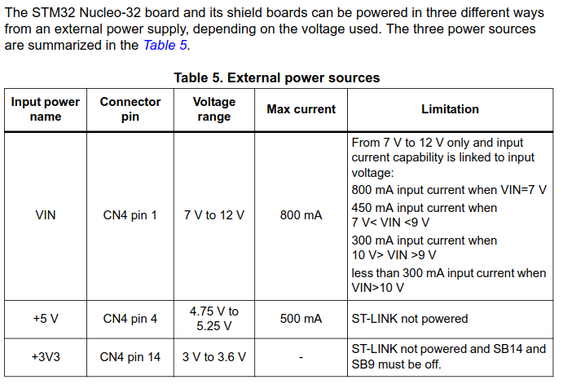
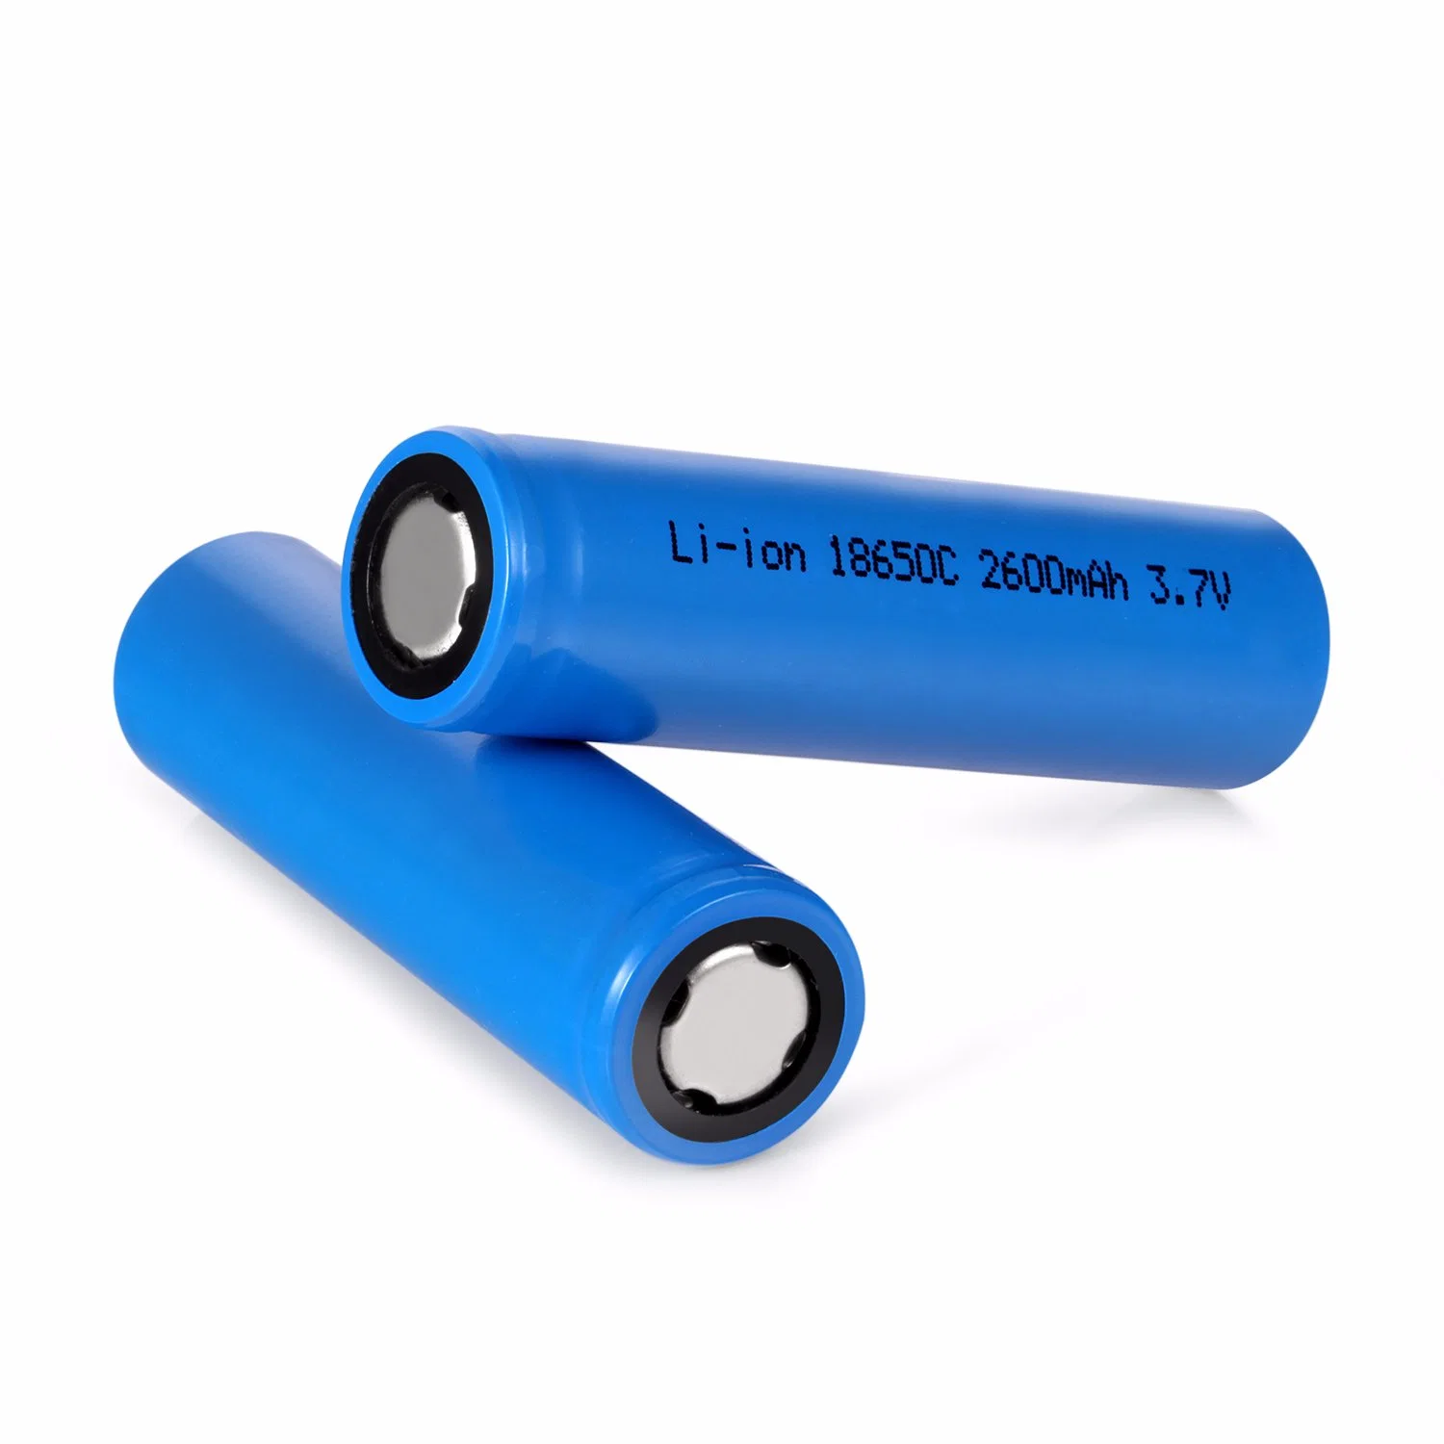
Power supply
Battery-powered system to ensure portability
System should be autonomous
=> solar-powered charging module with on-board solar cell
Battery Li-Ion 3.7V 2600mAh
Extract of Nucleo-32 datasheet

Slide 20
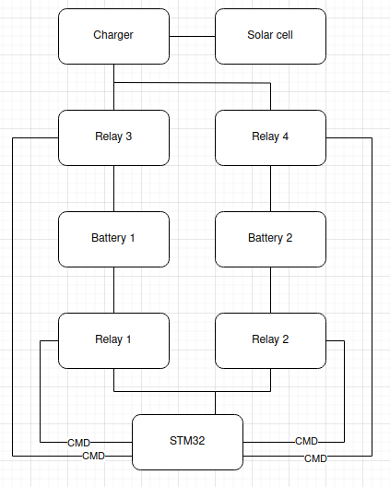
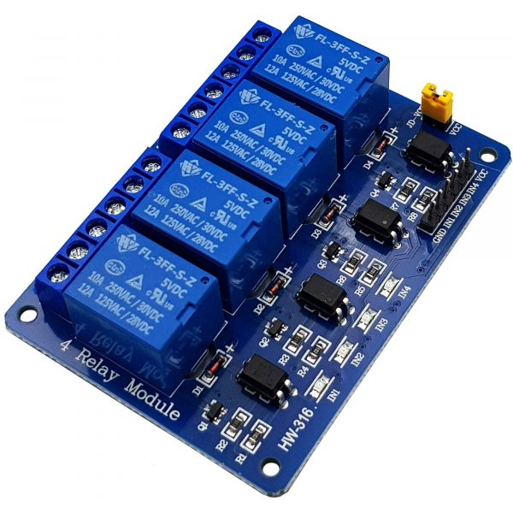
Power supply
Autonomous system => two-batteries relay module
Module 4 Relay 5VDC
Theoric schematic
of charging and supply method

Slide 21
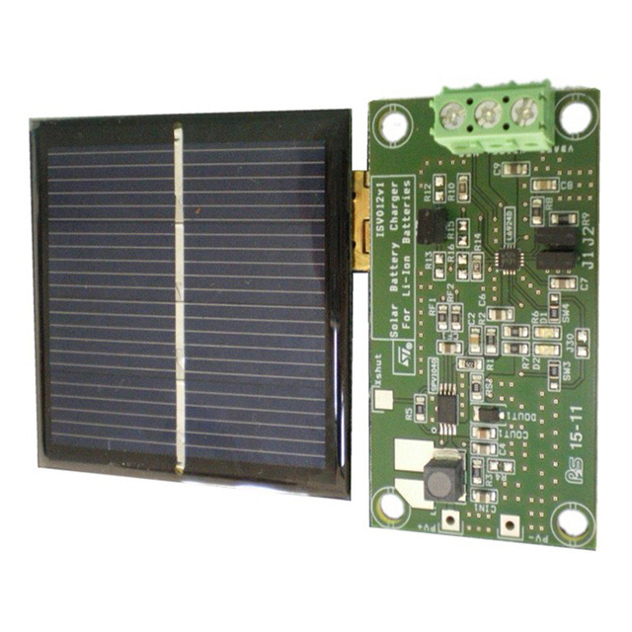
Charger and solar cell
Includes features :
protect the battery against overcharging,
deep discharge,
and other potential problems
Solar Panel + Battery Charger
STEVAL-ISV012V1

Slide 22
Conclusion
Summary:
The project focuses on developing a methane sensor system for rice fields
Emphasis on reducing methane emissions to mitigate global warming
Combination of low-cost, sensitive sensors and renewable energy sources
Next Step:
Design of a detailed schematic of the on-site system

Slide 23
THANK YOU !

