Slide 1

PHYS 375 Final Project
Team Members
J. F. Ducatel
F. H. Khan
G. Ko
A. S. Padawer-Blatt
G. Song
X. Zhang
Nuclear Group
University of Waterloo
Department of Physics and Astronomy
Apr. 13, 2021

Slide 2
Table of Content
Numerically Modeling Stars
Main Sequence
Allowed PP-Chain and CNO-Cycle Parameters
1D Parameter Space
2D Parameter Space
Mass-Luminosity Relation
Mass-Radius Relation
Conclusion

Slide 3

Objectives
Study changes in nuclear processes allowed
Consider Variations in the specific energy generation rates of:
PP-Chain
CNO-Cycle
$$ε=ΛρX^{2}T^{λ}$$
Energy per Reaction
How Many
Atoms
Rate of Reaction

Slide 4
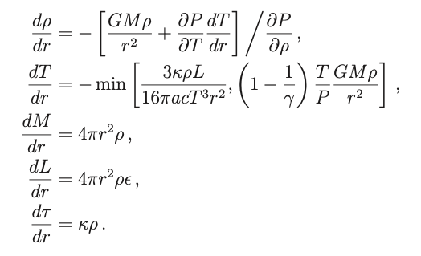
The Stars
Hydrostatic Equilibrium
Energy Transport
Energy Generation
Main Assumptions:
- Star composition is constant
- Use star composition of Sun, a common Main Sequence Star
- Assume Adiabatic Index of an Ideal Gas
- Stars is a Blackbody

Slide 5

Numerical Method
Code in Python
Used an Adaptive Step-Sizing Runge Kutta 45
Initial Conditions: r₀ = 10 μm ~ 0 L_{C} = $\frac{4π}{3}{r_{0}}^{3}ρ_{c}ε(ρ_{c},T_{c})$
M_{C} = $\frac{4π}{3}{r_{0}}^{3}ρ_{c}$ L(R*) = 4π𝜎R*²T*⁴ 𝜏($∞$) - 𝜏(R*) = 2/3
“Infinity” Limits: Stop when δ𝜏 = 0.01 or M = 1000M_{Sun}
Find Radius using a linear interpolation
Shooting Method to find core density
Bisection algorithm until core density saturates
REPEAT for each Star with different core Temperatures!

Slide 6
Coding Challenges
Optimization to reduce runtime
➔ Down to ~10s per Main Sequence
Outlier Stars in Main Sequence
➔ Potential Reason: Bisection did not converge to the right core density
➔ Solution: Assume Continuous Main Sequence and Remove Outliers

Slide 7

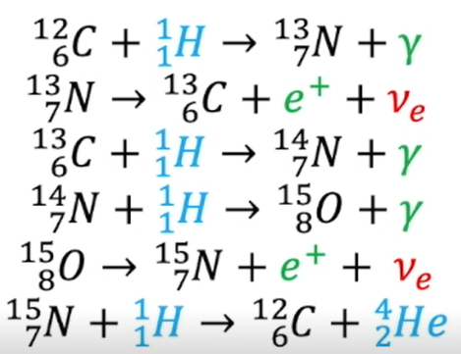
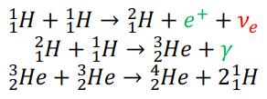







Info on PP-Chain and CNO-Cycle
Overall Reaction
PP Chain (PPI)
CNO Cycle
$$ε_{PP}=\left(1.07×{10}^{−7}\right)X^{2}ρ_{5}{T_{6}}^{4} W/kg$$
$$ε_{CNO}=\left(8.24×{10}^{−26}\right)XX_{CNO}ρ_{5}{T_{6}}^{19.9} W/kg$$
$$Λ_{PP}=1.07×{10}^{−7}$$
$$λ_{PP}=4$$
$$Λ_{CNO}=8.24×{10}^{−26}$$
$$λ_{CNO}=19.9$$

Slide 8
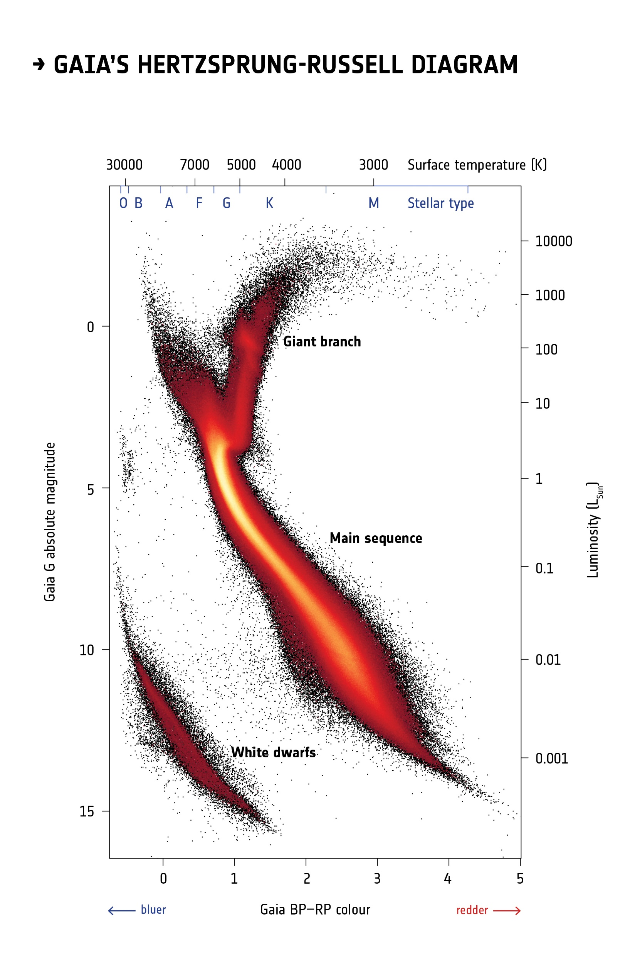
Hertzsprung Russell Diagrams
Can measure:
Brightness vs Color
Equivalent to:
Bolometric Magnitude
Vs
Surface Temperature
Known to 10%

Slide 9
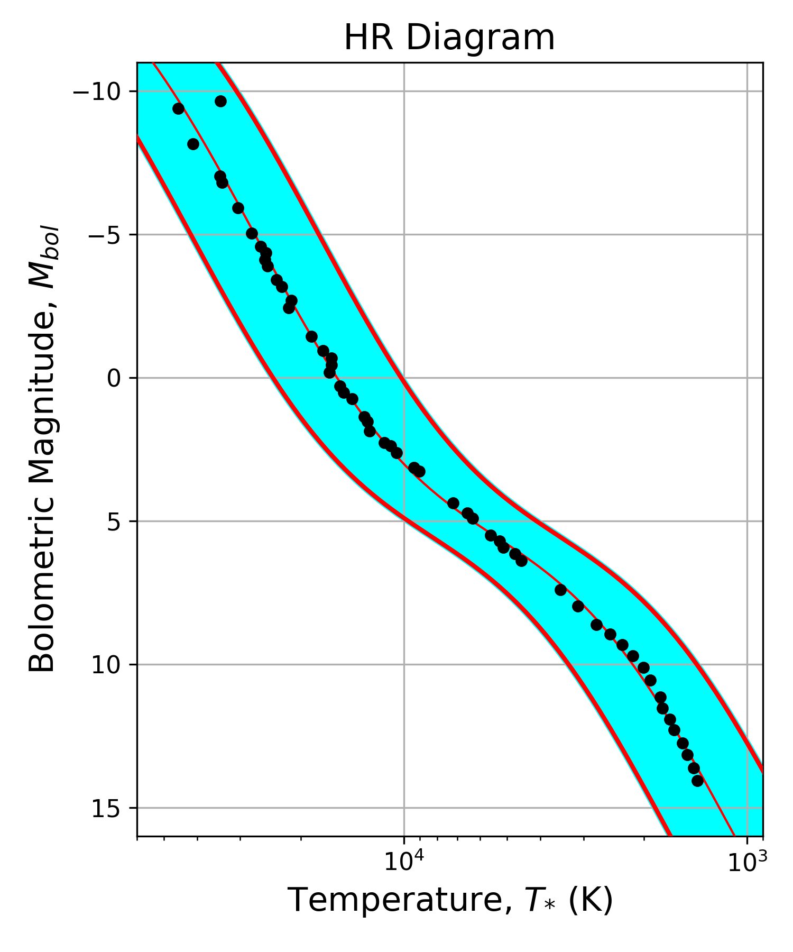
Main Sequence
Plot M_{bol} vs T_{surface} (black dots)
Fit to arbitrary function
(red line)
Main Sequence known within 10%
(blue region)
Permitted Range for 𝛬, 𝜆

Slide 10
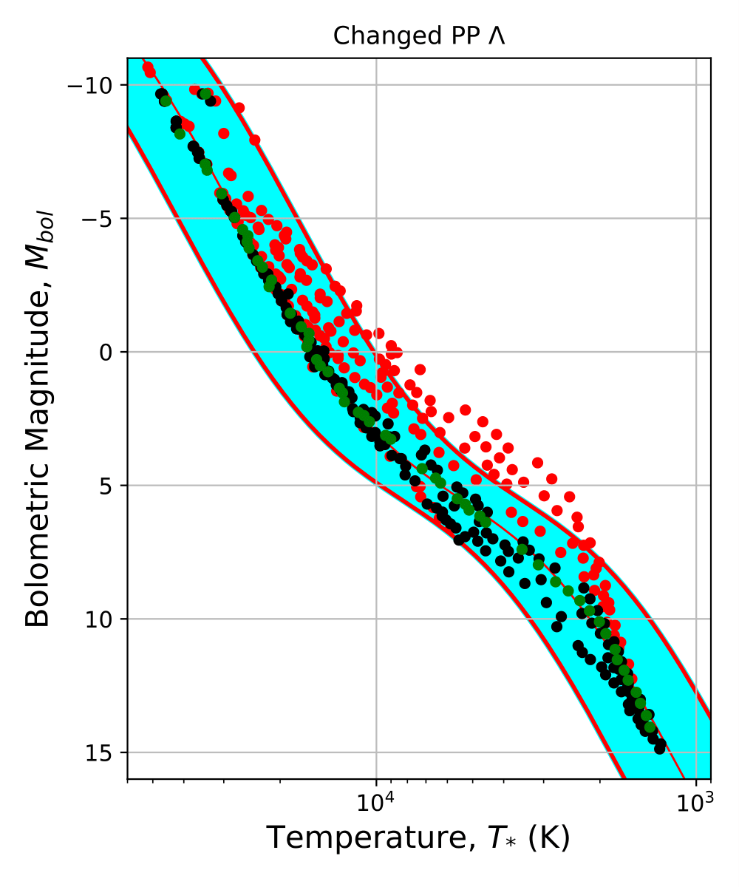
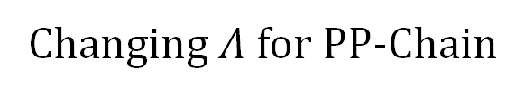

Nuclear Variations to PP-Chain
$$ε= ΛρX^{2}T^{λ}$$
Changing $Λ$ for PP-Chain
Allowed Range of Values:
6.4x10⁻¹⁰ – 2.4x10⁻⁶
Can change by factors of about 1000!
Legend
Blue Region | 10% boundary on the main sequence
Green Dots | Baseline main sequence
Black Dots | Main sequences inside 10% boundary
Red Dots | Main sequences outside 10% boundary

Slide 11
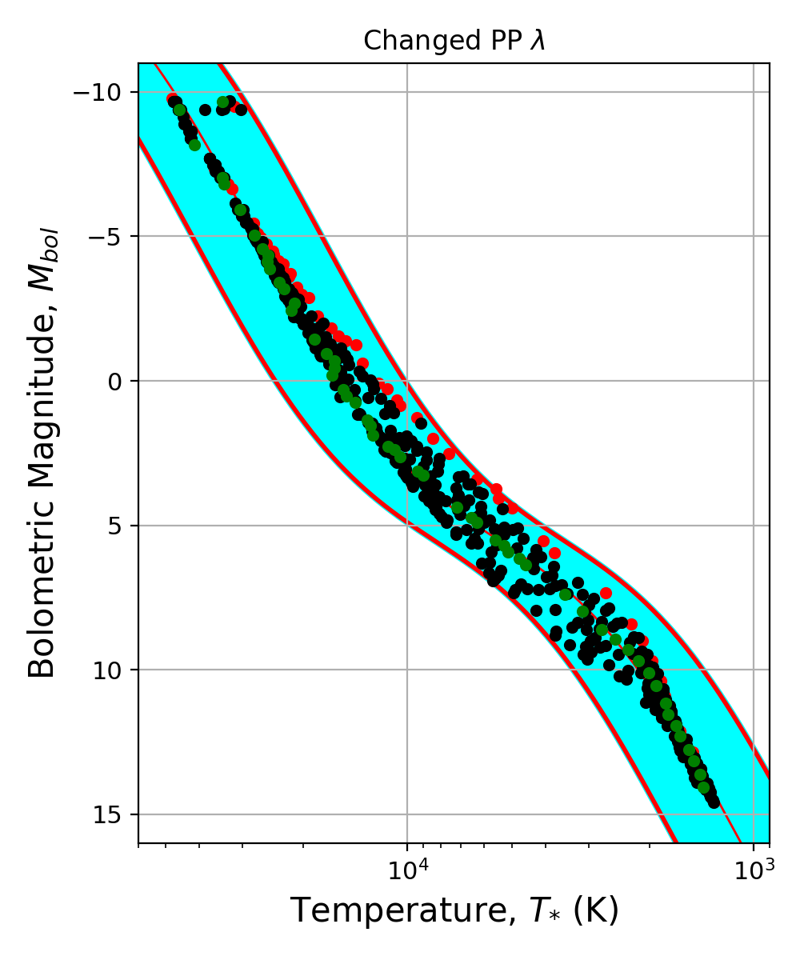
Nuclear Variations to PP-Chain
$$ε= ΛρX^{2}T^{λ}$$
Changing 𝜆 for PP-Chain
Allowed Range of Values:
2 – 5.6 (no lower bound)
Note:
PP-Chain affects low-mid temperature Stars
Legend
Blue Region | 10% boundary on the main sequence
Green Dots | Baseline main sequence
Black Dots | Main sequences inside 10% boundary
Red Dots | Main sequences outside 10% boundary

Slide 12
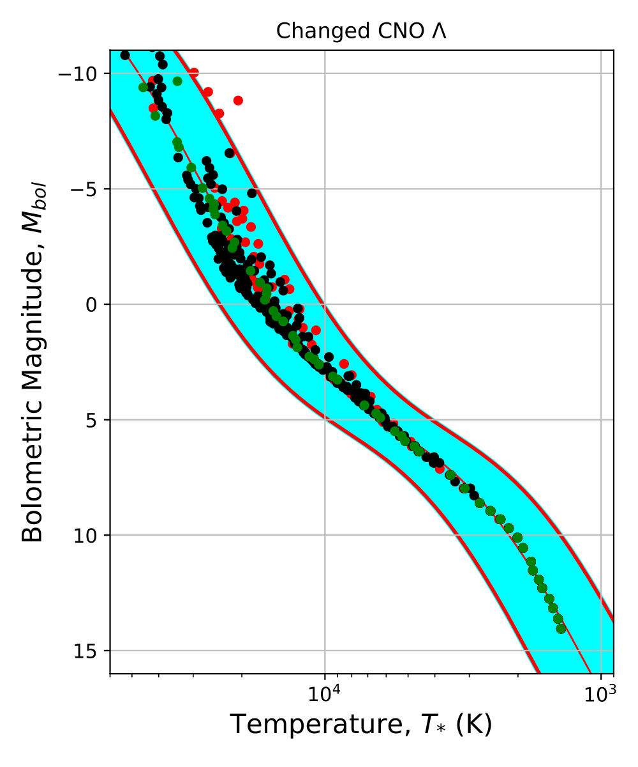
Nuclear Variations to CNO-Cycle
$$ε= ΛρX^{2}T^{λ}$$
Changing 𝛬 for CNO-Chain
Allowed Range of Values:
8.2x10⁻³⁰ – 3.8x10⁻²⁷
Legend
Blue Region | 10% boundary on the main sequence
Green Dots | Baseline main sequence
Black Dots | Main sequences inside 10% boundary
Red Dots | Main sequences outside 10% boundary

Slide 13
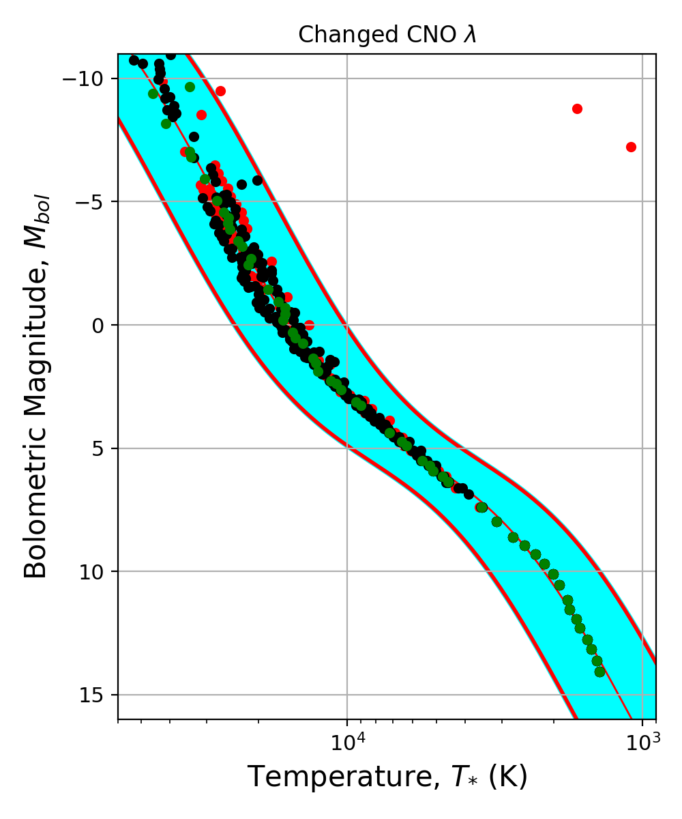
Nuclear Variations to CNO-Cycle
$$ε= ΛρX^{2}T^{λ}$$
Changing 𝜆 for CNO-Chain
Allowed Range of Values:
19.8 - 21.3
Very Sensitive!
Note:
CNO-Cycle affects high temperature Stars
Legend
Blue Region | 10% boundary on the main sequence
Green Dots | Baseline main sequence
Black Dots | Main sequences inside 10% boundary
Red Dots | Main sequences outside 10% boundary

Slide 14
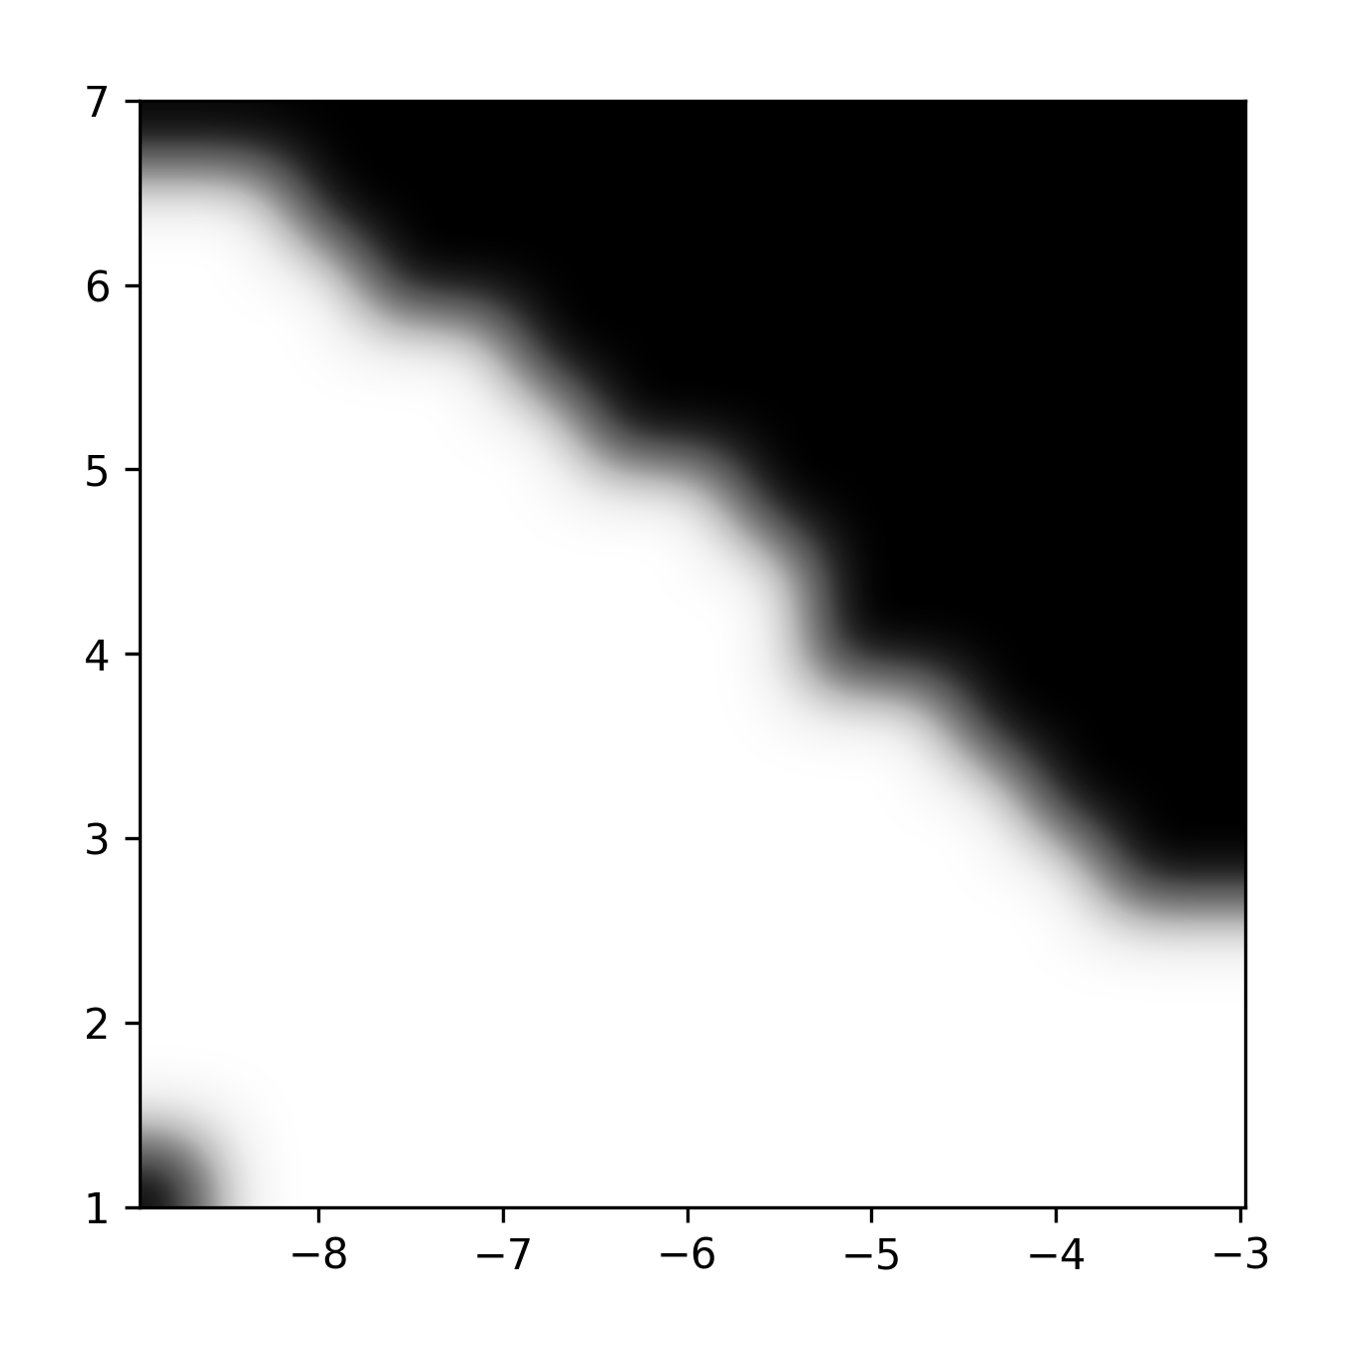
PP-Chain 𝛬, 𝜆 allowed combinations
Map of Allowed Value
(2D Parameter Space)
Each pixel is a Main Sequence
Large Allowed Region
Not very sensitive to changes
Forbidden
Original MS
𝜆
Allowed
Log(𝛬)

Slide 15
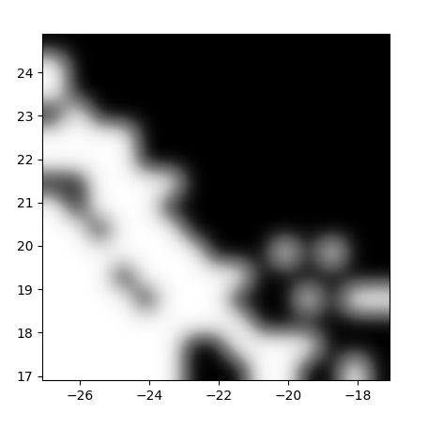
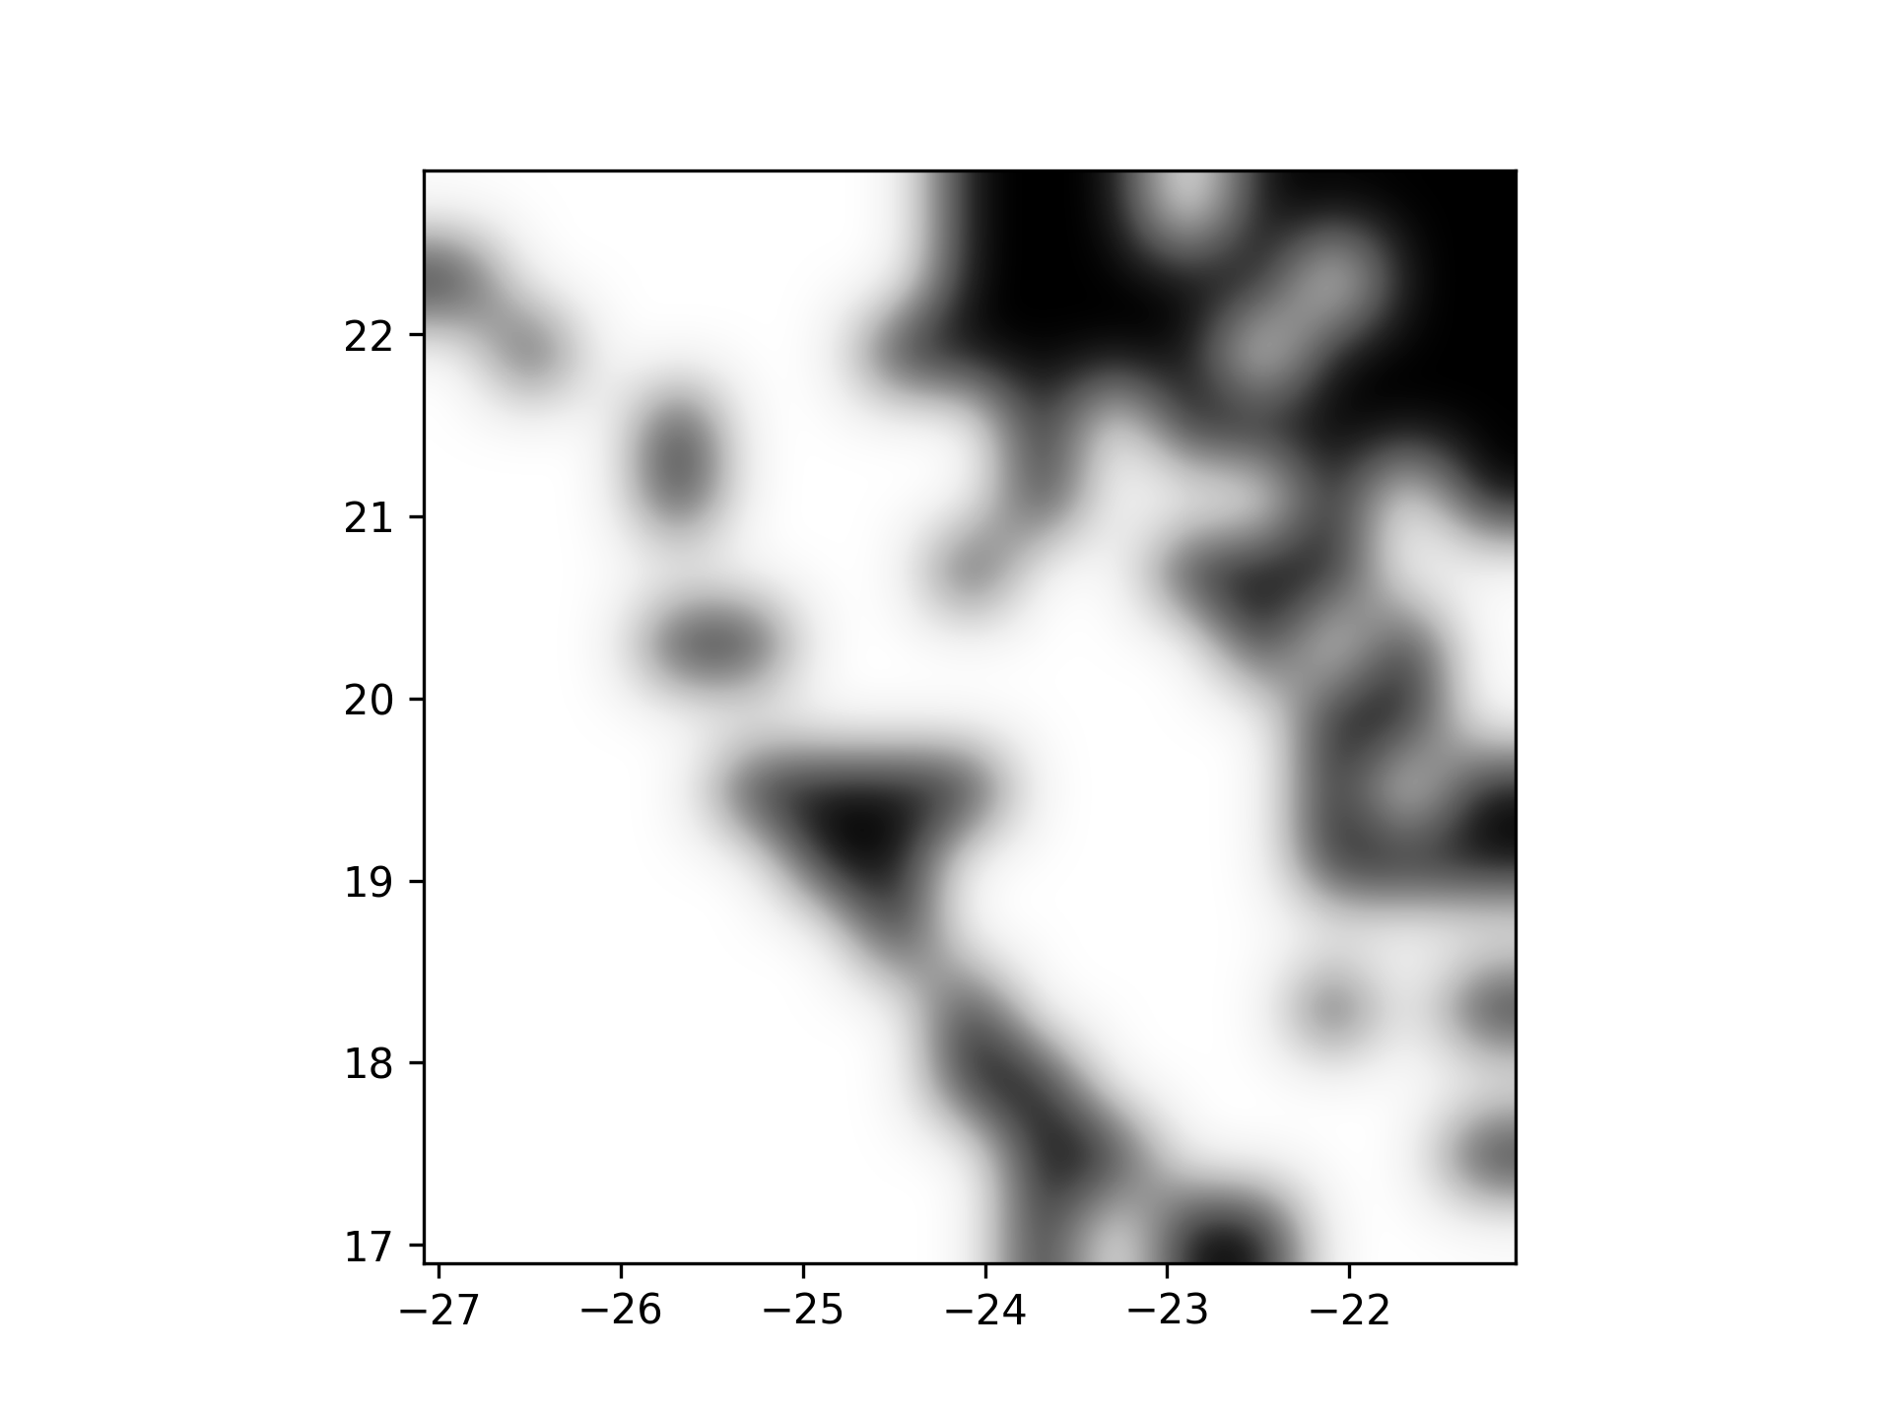
CNO-Cycle 𝛬, 𝜆 allowed combinations
Forbidden
𝜆
Allowed
Log(𝛬)

Slide 16
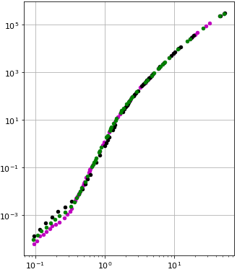
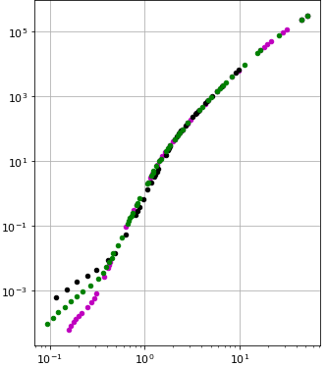




L-M Relation PP Chain
$$Λ_{PP}=2.4×{10}^{−6}$$
$$λ_{PP}=5.6$$
L (L_{sun})
$$λ_{PP}=2$$
Original MS
$$Λ_{PP}=6.4×{10}^{−10}$$
Minimum Bound
Maximum Bound
M (M_{sun})
Note: PP chain parameters affect low mass luminosities

Slide 17
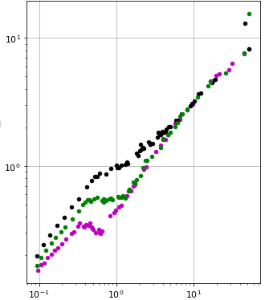
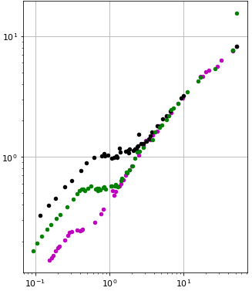


R-M Relation PP Chain
$$Λ_{PP}=2.4×{10}^{−6}$$
$$λ_{PP}=21.3$$
R (R_{sun})
Original MS
$$λ_{PP}=19.8$$
$$Λ_{PP}=6.4×{10}^{−10}$$
Minimum Bound
Maximum Bound
M (M_{sun})
Note: PP chain parameters affect low mass radii

Slide 18
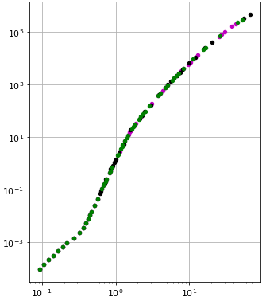
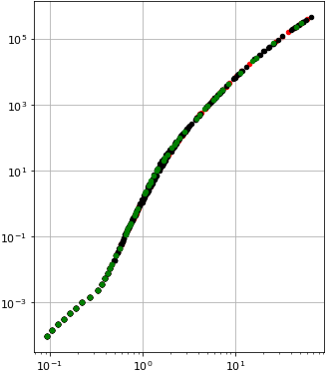


L-M Relation CNO Cycle
$$Λ_{PP}=3.8×{10}^{−27}$$
$$λ_{PP}=21.3$$
L (L_{sun})
$$λ_{PP}=19.8$$
Original MS
$$Λ_{PP}=8.2×{10}^{−30}$$
Minimum Bound
Maximum Bound
M (M_{sun})
Note: CNO cycle parameters affect high mass luminosities

Slide 19
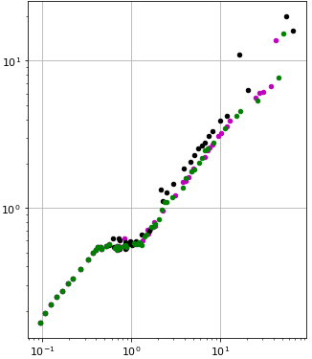
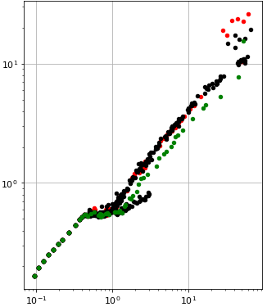
R-M Relation CNO Cycle
$$Λ_{PP}=3.8×{10}^{−27}$$
$$λ_{PP}=21.3$$
R (R_{sun})
$$λ_{PP}=19.8$$
Original MS
$$Λ_{PP}=8.2×{10}^{−30}$$
Minimum Bound
Maximum Bound
M (M_{sun})
Note: CNO cycle parameters affect high mass radii

Slide 20
Conclusion
Question: We considered ‘what if the efficiency and rate of known nuclear reactions (PP and CNO) were different, would we see it in the sky?
Valid solutions were found within 10% of the main sequence
PP chain affects low temperature stars and CNO affects high temperature stars
L-M relationship showed low variation with changing parameters
R-M relationship responded more to parameter variation, with CNO being more chaotic than PP and having few solutions at low mass
More sensitive to CNO changes than PP

Slide 21
END
Thank You

