Slide 1
Data Science Project

Slide 2
Introduction
Introduction - Toronto is consistently named as one of the top worldwide cities for livability, quality of life, scenery, and multiculturalism. Toronto has a wide choice of restaurants. Being a city with vibrant colours one can only expect to find cuisines from all around the world. How does one know where to place another ethnic restaurant? To avoid being in close proximity to the similar cuisine, we will use data analysis and machine learning to find the optimal location for a Eritrean/Ethiopian restaurant in the Toronto area.

Slide 3
Business Problem
The main objective of this project is to analyze the restaurant chains in the Toronto area by neighbourhood. The other objective of the project is to pay special attention to the types of cuisines available in the city and to avoid placing it too close. In abstract, the project aims to analyze the restaurants and the best location for opening a restaurant.

Slide 4
Data
Here are some factors influencing our project: number of existing Eritrean/Ethiopian cuisine restaurants per neighborhood, number of restaurants per neighborhood, type of cuisines. We will use foursquare api to find the venues in Toronto. Geopy will allow us to determine their coordinates in latitudes and longitudes.

Slide 5
Target Audience
The project is beneficial for anyone who is looking to open an Eritrean/Ethiopian restaurant in the Toronto area. The audience can be franchisors or small business owners. The project can also benefit already running restaurants to shift to a better area for their type of restaurant.

Slide 6
Methodology
I got the list of neighborhoods in Toronto, Ontario from this website: https://en.wikipedia.org/wiki/List_of_postal_codes_of_Canada:_M
Using pandas libraries, I did web scraping to pull tabular data directly from a web page into the data frame.
However, it is only a list of neighborhood names and postal codes. I need to get their coordinates to utilize Foursquare to pull the list of venues near these neighborhoods. To get the coordinates, I tried using Geocoder PackHowever, it is only a list of neighborhood names and postal codes. I need to get their coordinates to utilize Foursquare to pull the list of venues near these neighborhoods. To get the coordinates, I tried using Geocoder Package but it was not working so I used the CSV file provided by IBM team to match the coordinates of Toronto neighborhoods. After gathering these coordinates, I visualize the map of Toronto using Folium package to verify whether these are correct coordinates. Next, I use Foursquare API to pull the list of top 100 venues within 500 meters radius. I have created a Foursquare developer account in order to obtain account ID and API key to pull the data. From Foursquare, I am able to pull the names, categories, latitude, and longitude of the venues. With this data, I can also check how many unique categories that I can get from these venues. Then, I analyze each neighborhood by grouping the rows by neighborhood and taking the mean on the frequency of occurrence of each venue category. This is to prepare clustering to be done later.
I decided to look for ideal Eritrean/Ethiopian restaurant locations. I performed the clustering method by using k means clustering. The algorithm identifies k numbers of centroids and then allocates every data point to the nearest cluster while keeping the centroids as small as possible. It’s simple and highly suited for this project. I have clustered the neighborhoods of Toronto into 5 clusters.

Slide 7
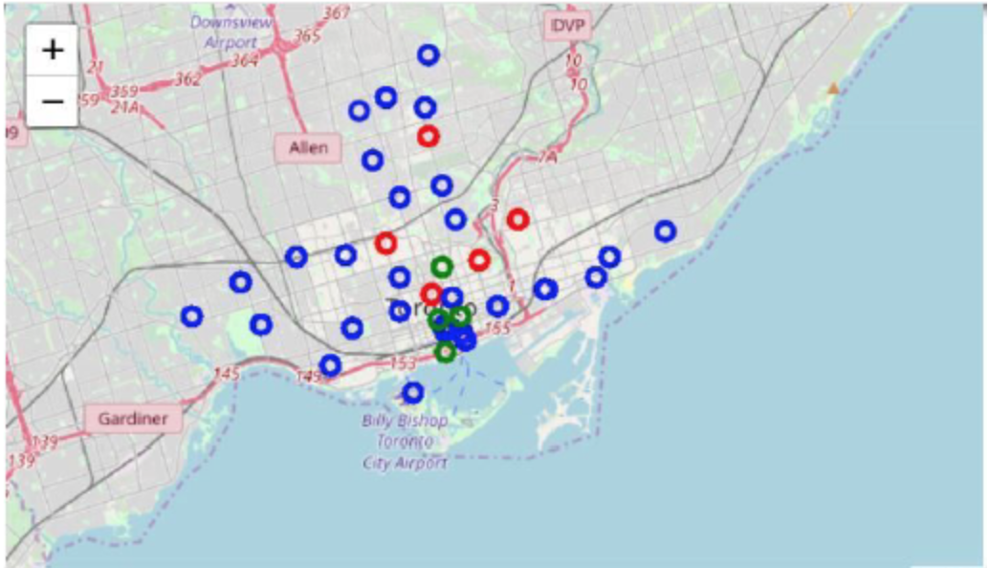
Result

Slide 8
Observations
Most of the restaurants are in Cluster 1 around Church and Wellesley and less in Cluster 2 around Garden District. There aren’t too many restaurants of this cuisine in Toronto, therefore it’s safe to recommend a location in any of these areas.

