Slide 1
SemiA
HOW TO USE

Slide 2
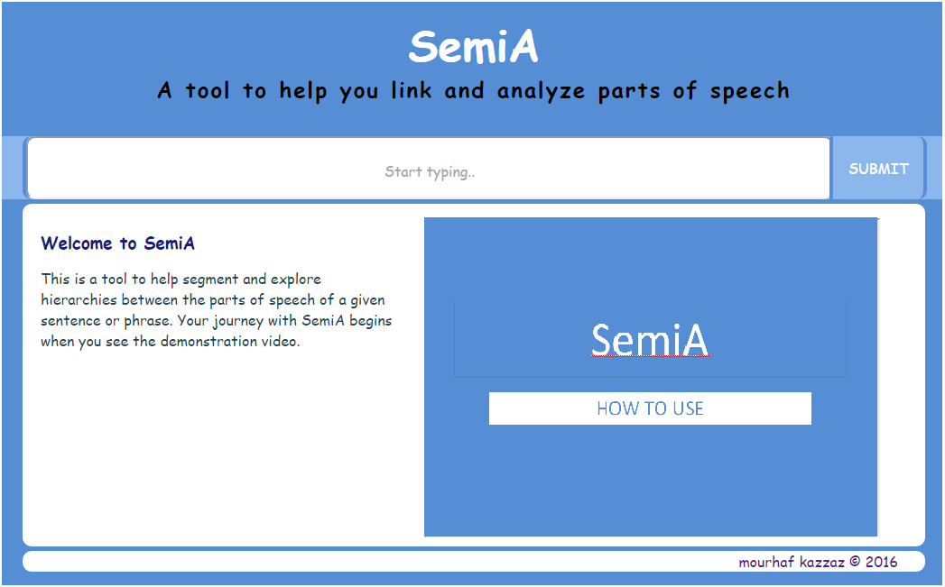
SemiA
HOW TO USE - Introduction
Semi Automatic Recognition is a tool that helps you transform a given sentence into
segmented and bracketed form without the need on your part to deal with the mess
of parent-child relationships or bracket counting and maintaining.
1

Slide 3
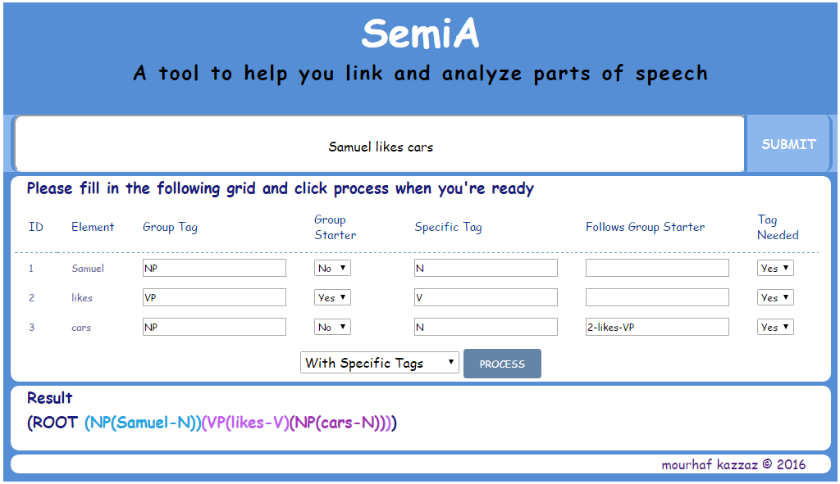
SemiA
HOW TO USE - Introduction
Example :
Input : Samuel likes cars
Output 1 : (ROOT (S (NP(Samuel))(VP(likes)(NP(cars)))))
Output 2 : (ROOT (S (NP(Samuel-N))(VP(likes-V)(NP(cars-N)))))
2

Slide 4
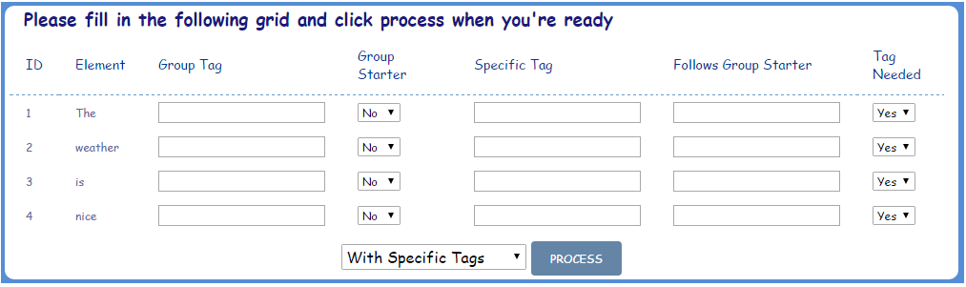
SemiA
HOW TO USE - PRACTICAL EXAMPLE
STEP 1 ENTER A SENTENCE OR PHRASE AND CLICK SUBMIT
SemiA will now generate a table based on your input
The elements of your input will be assigned properties and given
specific ids and tags
3

Slide 5
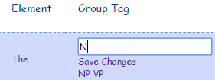
SemiA
HOW TO USE - PRACTICAL EXAMPLE
STEP 2 ENTERING DETAILS
GROUP TAG is an essential part of segmenting an input.
Its values are based on the grammatical function in relation to
other elements of the element e.g. NP nominal phrase, VP verbal phrase …
While you type the desired tag SemiA will try to try to suggest the nearest tags to your purpose and it will learn your choice for future application.
4

Slide 6
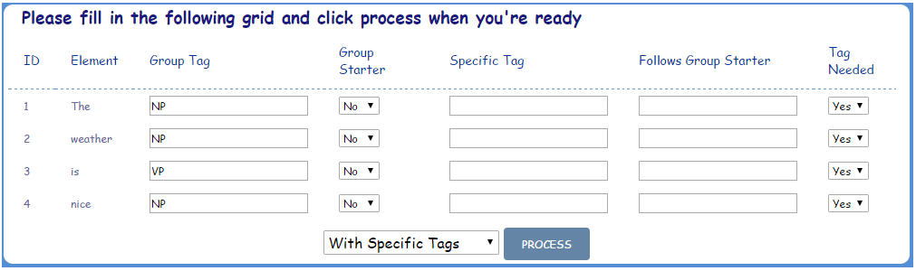
SemiA
HOW TO USE - PRACTICAL EXAMPLE
STEP 2 ENTERING DETAILS
GROUP STARTER is an anchor that related elements attach to. For instance, ‘weather’ is attached to ‘The’ and both of them happen to be in the same group of NP. This could be extended by using many adjectives and pre-modifiers for example.
SemiA has only two values for this property and you need to select ‘Yes’ only to the element that starts the group.
In this example only ‘The’ and ‘is’ are anchors. The user
should select ‘Yes’ accordingly.
5

Slide 7
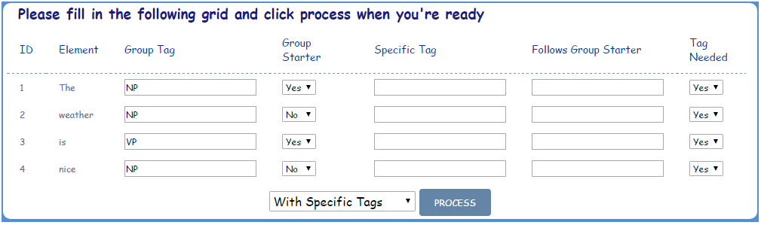
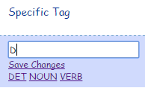
SemiA
HOW TO USE - PRACTICAL EXAMPLE
STEP 2 ENTERING DETAILS
SPECIFIC TAG is an optional part of segmenting an input in this process.
Its values are also based on the specific grammatical function
of the element e.g. Noun ,Verb, ADJ, …
While you type the desired tag SemiA will try to try to suggest the nearest tags to your purpose and it will learn your choice for future application.
6

Slide 8
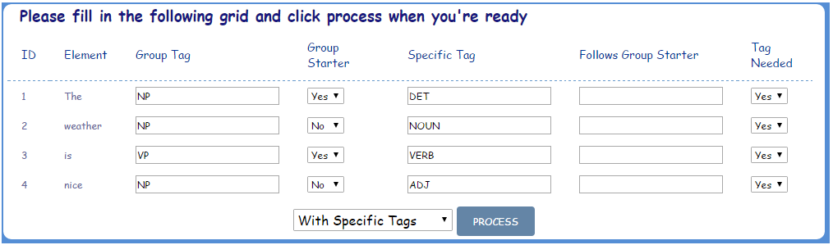
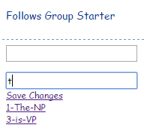
SemiA
HOW TO USE - PRACTICAL EXAMPLE
STEP 2 ENTERING DETAILS
Follows Group Starter is a property that helps SemiA recognize parent-child relationships between elements.
It is important to remember that only anchor elements with a value of ‘Yes’ will show up in the suggestions. Also, SemiA will not recognize an input that is not in the suggestions.
7

Slide 9
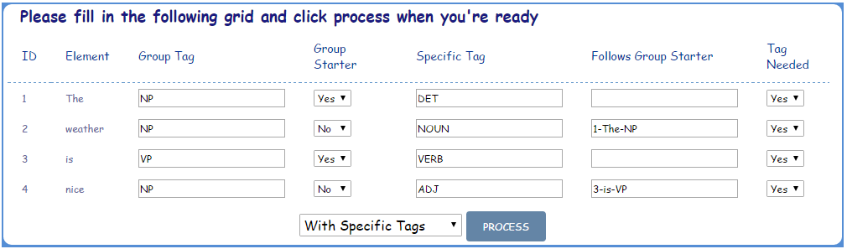
SemiA
HOW TO USE - PRACTICAL EXAMPLE
STEP 2 ENTERING DETAILS
TAG NEEDED is a property that helps reduce redundancy when processing your input.
For example , in “The serene quite weather… “
All of these elements are related and share the same Group Tag i.e. NP.
Thus, a Group Tag is needed only for the first element ‘The’.
In our example, ‘weather’ and ‘The’ are in the same group and share the same tag so a Group Tag for ‘weather’ is not needed and we select ‘No’
It is important to remember that only anchor elements with a value of ‘Yes’ will show up in the suggestions. Also, SemiA will not recognize an input that is not in the suggestions.
8

Slide 10
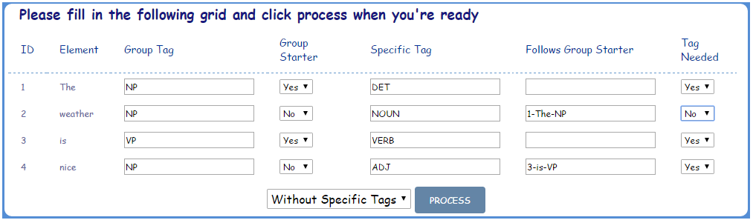
SemiA
HOW TO USE - PRACTICAL EXAMPLE
STEP 3 Processing
The example input now is ready for processing. All we need to do is pressing “PROCESS”
9

Slide 11


SemiA
HOW TO USE - PRACTICAL EXAMPLE
STEP 4 The result
We have two options:
OPTION 1 WITHOUT SPECIFIC TAGS
This is the default and the result of which is more general as it skips the specific tag column altogether.
OPTION 2 WITH SPECIFIC TAGS
A more specific approach and the result of which is useful in educational and introductory classes of linguistics.
10

Slide 12

SemiA
HOW TO USE - FEATURES
FEATURES
SemiA gives you the ability to easily visualize the output using two methods.
1) Random coloring of brackets while maintaining the parent-child relationships.
2) Hovering over an element with the mouse will highlight the element and its closing bracket making it easier to instantly identify it and its child elements.
11

Slide 13


SemiA
HOW TO USE - FEATURES
FEATURES cont’d
For those who are interested in differentiating between what is a fragment and what is a sentence in a given input, SemiA enables you to double click the part that is a fragment and it will wrap it in an additional (FRAG()) Tag. Otherwise it is assumed that the input is a sentence.
Example : A given input “The car” is obviously a fragment and it shows up by default as
Double clicking the first element (NP(THE-DET)
Will make SemiA transform the result into
12

Slide 14
SemiA
HOW TO USE - Final Thoughts
Final Thoughts
SemiA is designed as a first step on the way of machine learning and NLP.
Future features already in the making include:
AutoSuggestion: SemiA will be able to tell the Group Tag and Specific Tag of an
element on its own based on cues from the sentence and
previous user input.
FEEDBACK , BUG REPORTS, and SUGGESTIONS are most welcome .
mourhafkazzaz@gmail.com
www.fb.com/mourhafkazzaz
13

