Slide 1
Test Driven Development
Dr. Mark Lee
University of Birmingham
http://www.cs.bham.ac.uk/~mgl

Slide 2
How do we write good code?
What do we mean by good code?
How do we improve as developers?

Slide 3
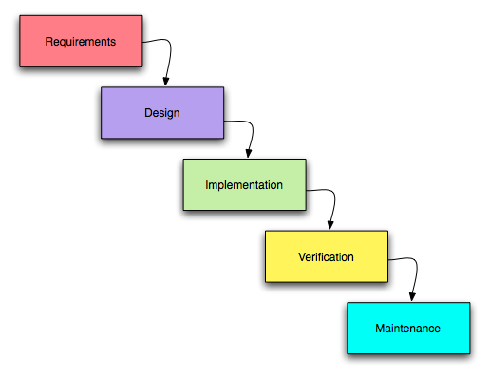
A Traditional view of Software Development

Slide 4
Agile Programming
Individuals and Interactions more than processes and tools
Working Software more than comprehensive documentation
Customer Collaboration more than contract negotiation
Responding to change more than following a plan.
Pair Programming, SCRUM, XP, Kanban …
Test Driven Development

Slide 5
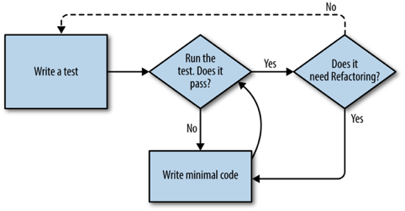
Test Driven Development

Slide 6
Benefits
TDD produces more productive programmers (various studies)
Tests
  Help understand the problem
  Focus on what is essential
  Safer Refactoring
  Fewer bugs
  Living Documentation

Slide 7
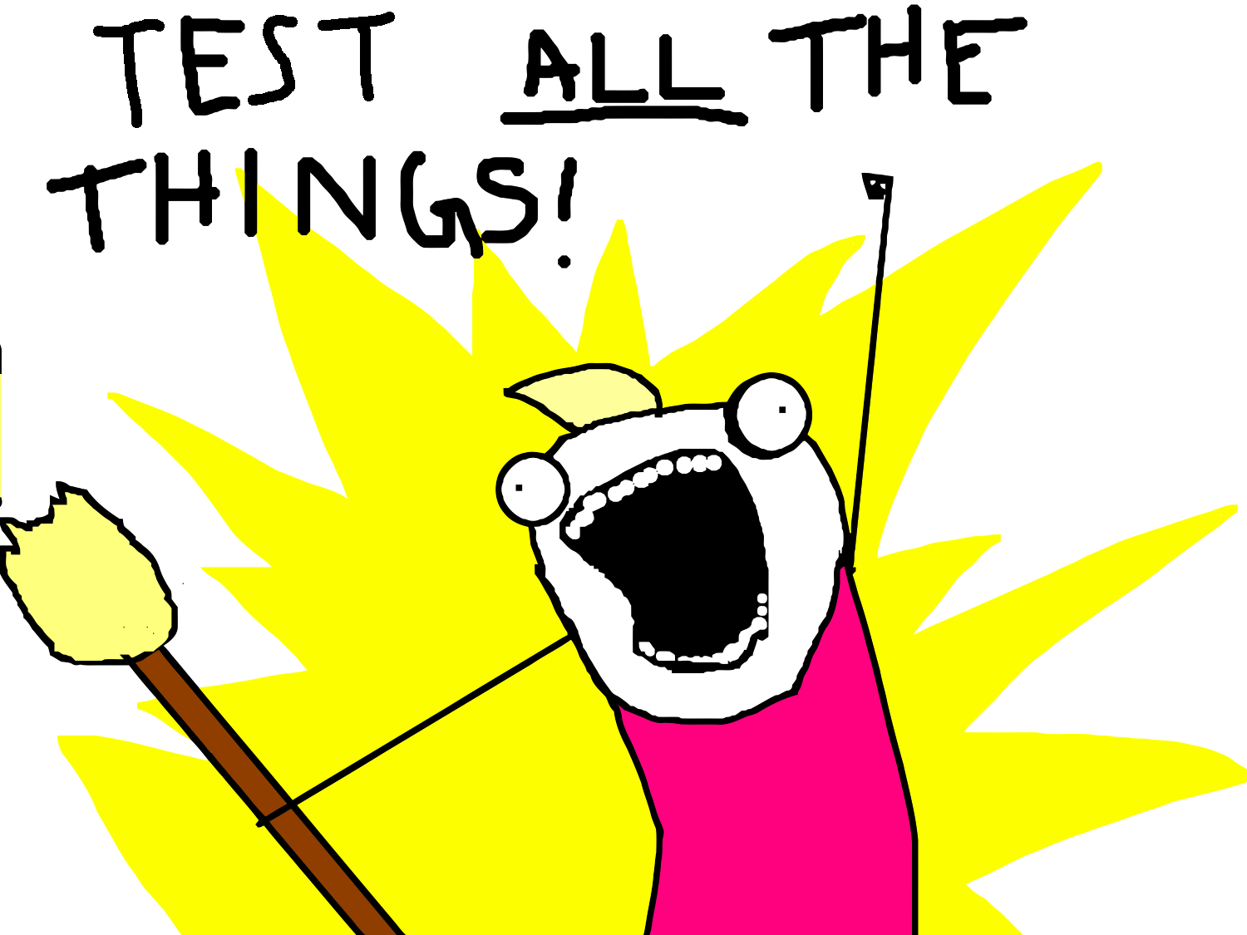
No Magic Bullets!
TDD is sometimes presented as the “one true way”
The internet is full of flame wars pro and against TDD
TDD should not
  Stifle creativity
  Ignore computer science/algorithms
  Get in the way of development
You will either love or hate TDD but give it a chance!

Slide 8
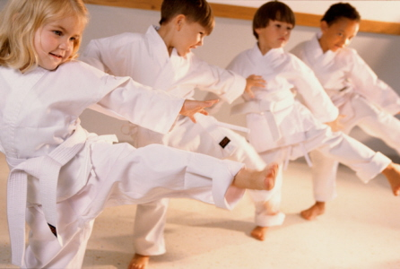
TDD Kata
TDD takes practice
Testing first requires discipline
Everybody likes to build stuff
We are used to rushing into solutions without ever understanding
We unlearn this through kata

Slide 9
Python
Created by Guido van Rossum
Released in 1991.
Current version 3.6 (major changes between 2.7 and 3)
Emphasis on readability
  Easy to learn
  Very simple syntax
Huge library
Dynamic type system
Object oriented, Functional,

Slide 10
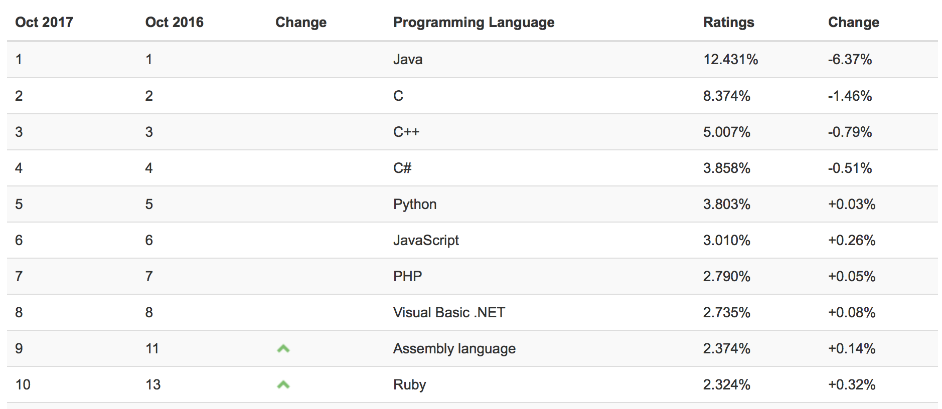
Tiobe Index

Slide 11
TDD & Django
We’re going to need a few tools
Django
Git
Selenium

Slide 12
Django
High level Python web framework
Encourages rapid development and clean, pragmatic design
“For perfectionists with deadlines”
“The web framework with batteries included”
Focus on DRY (don’t repeat yourself)
Widely supported, many deployment options

Slide 13
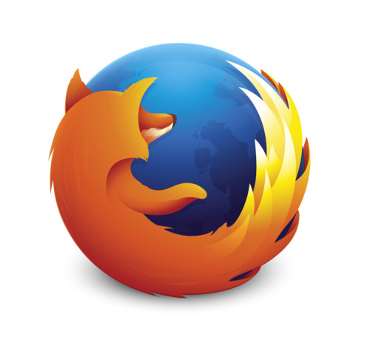
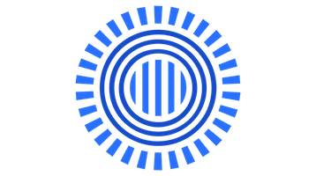

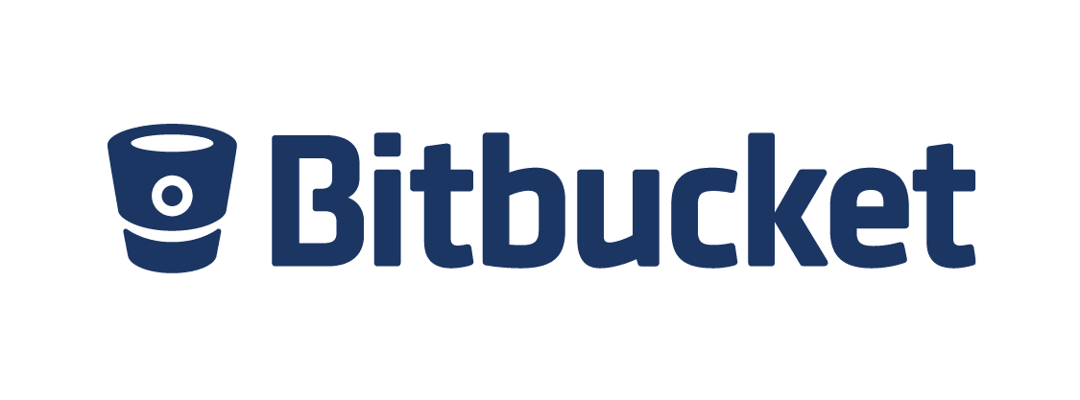
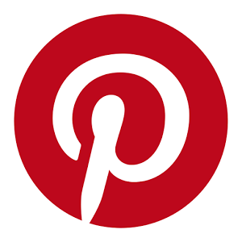
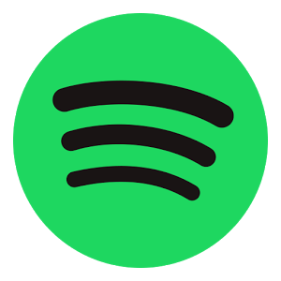

Who uses Django?

Slide 14
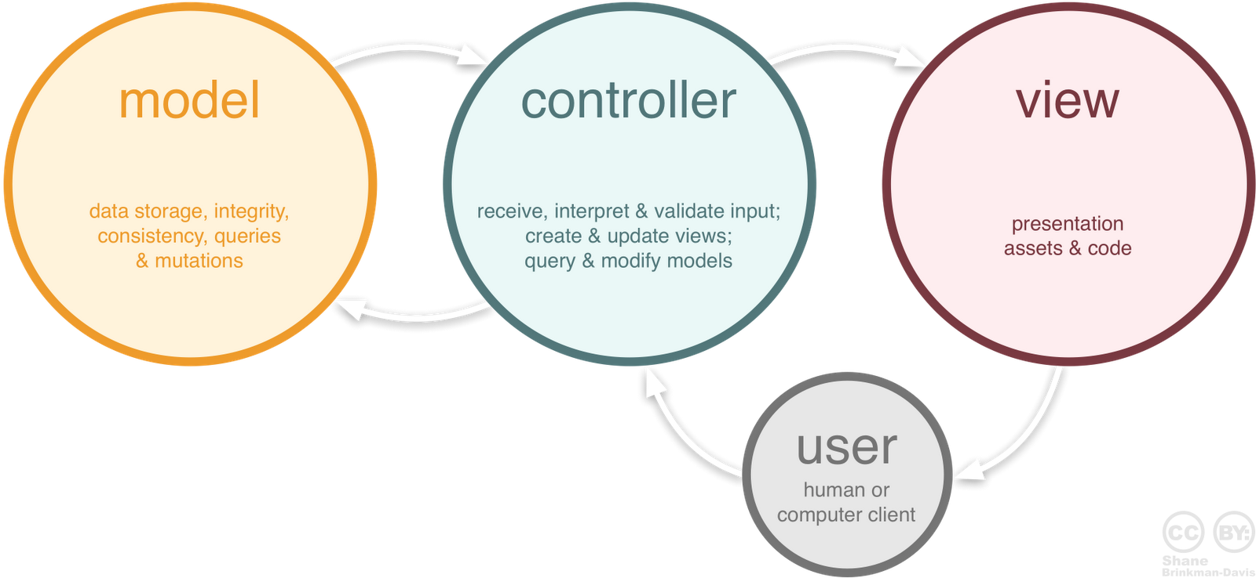
Model View Controller Design Pattern
Model View Controller (MVC)
  Used in interfaces

Slide 15
Django & MVC
Django “sort of” uses MVC as a design pattern
Django’s models are Models
  Database backend
Django’s Views are more like a Controller
  Business logic accesses model and passes data to the …
Django’s templates (which normally we’d call a view)
  Templates are a mix of HTML, CSS & Python

Slide 16
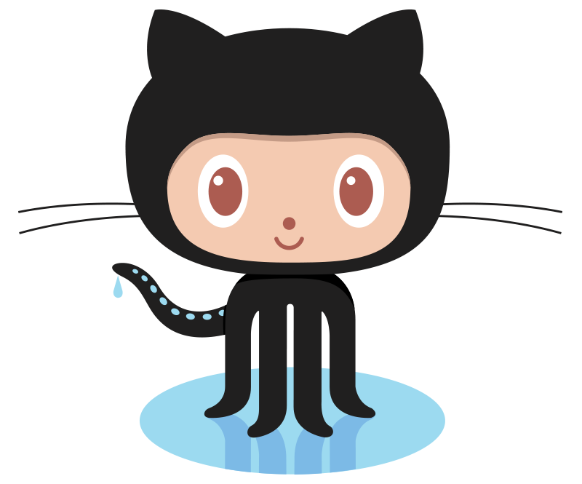
Git
Version control
Tracks changes in source code
Originally developed by Linus Torvalds (2005)
Distributed
Clear explicit workflow
Strong support for non-linear development

Slide 17
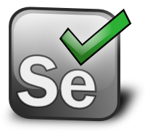
Selenium
Software Testing Framework for web apps
Open source, multi platform/language
Selenium automates browsers
Allows us to run tests against both local host and external webpages

Slide 18
Lesson Plan
Python
TDD Kata
TDD & Django

Slide 19
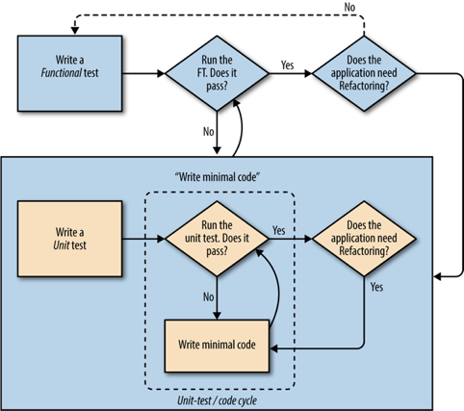
Extending our view of TDD

Slide 20
What you should learn …
Test Driven Development
(if you apply yourself to the exercises seriously)
Python
Git,
Selenium
Bootstrap,
a tiny bit of web deployment

Slide 21
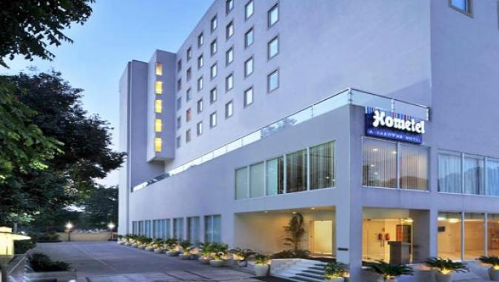
A simple web app
A local hotel wants a web app which allows customers to leave feedback at the end of their stay …

