Slide 1
A SQL Based Data Analytics Project
Library Management System Analysis using SQL

Slide 2
Abstract
This project presents a SQL-based analysis of a Library Management System dataset. The main purpose of this project is to analyze book records, student borrowing activity, pending returns, and fine collection. By using SQL queries, we can identify the most issued books, active students, department-wise borrowing, and unpaid fines. This analysis helps the library manage books, students, and returns more efficiently.

Slide 3
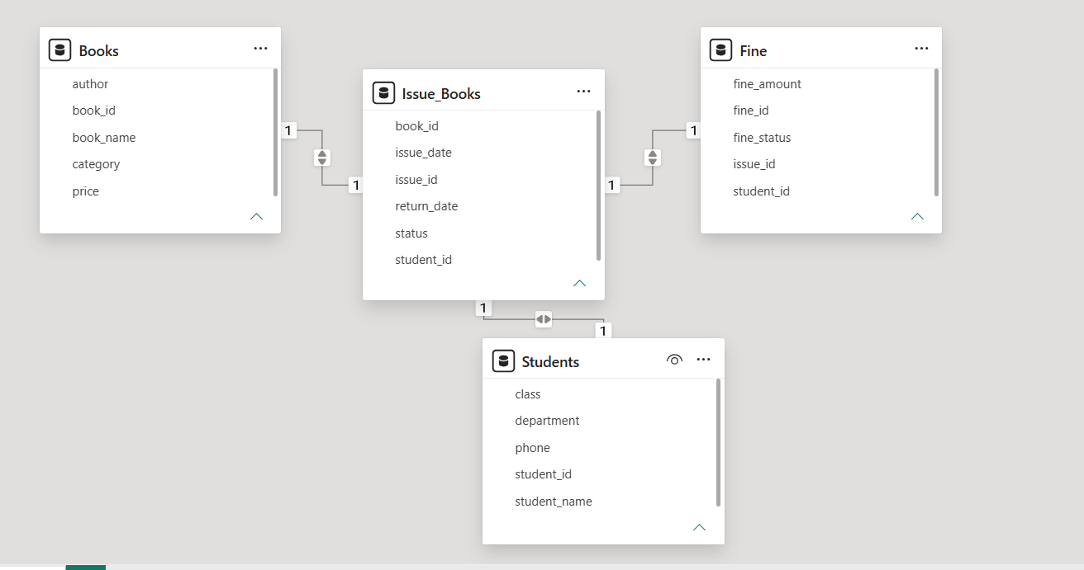

ER Diagram

Slide 4
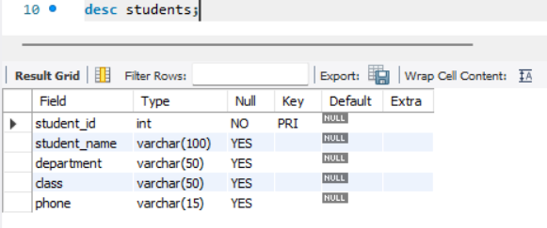
Table structure
1.Students Table
This table stores student details such as student ID, name, department, class, and phone number.

Slide 5
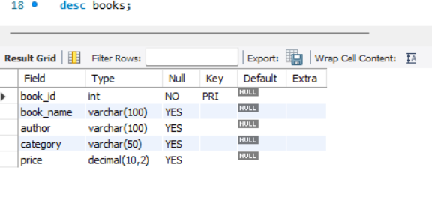
Table Structure
2.Books Table
This table contains book details like book ID, book name, author, category, and price.

Slide 6
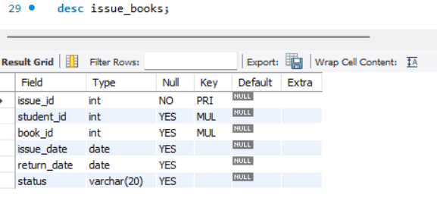
Table Structure
3.Issue Books Table
This table records which student issued which book, along with issue date, return date, and status.

Slide 7
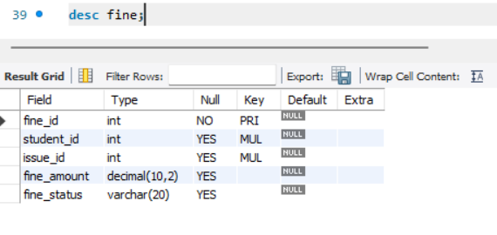
Table Structure
4.Fine Table
This table stores fine details of students, including fine amount and fine payment status.

Slide 8
Assumptions
Only books with status Returned are considered completed transactions.
Books with status Pending are still not returned.
Fine amount is applied only when a student returns the book late.
One student can issue multiple books.
One book can be issued multiple times by different students.

Slide 9
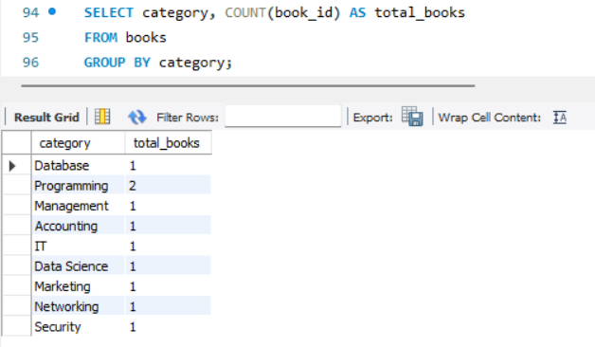
SQL Questions with Insights
1. Show total books by category
Insight:
This shows which category has the highest number of books in the library.

Slide 10
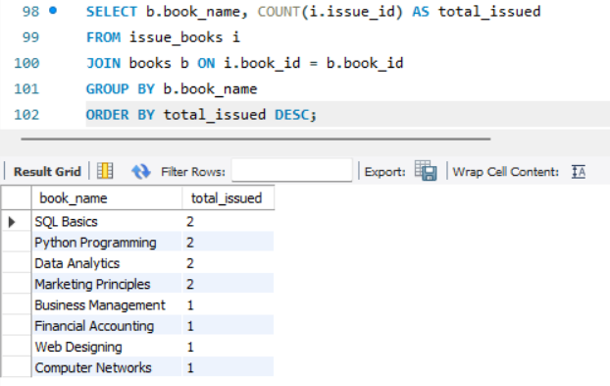
SQL Questions with Insights
2. Show most issued books
Insight:
This helps identify the most popular books among students.

Slide 11
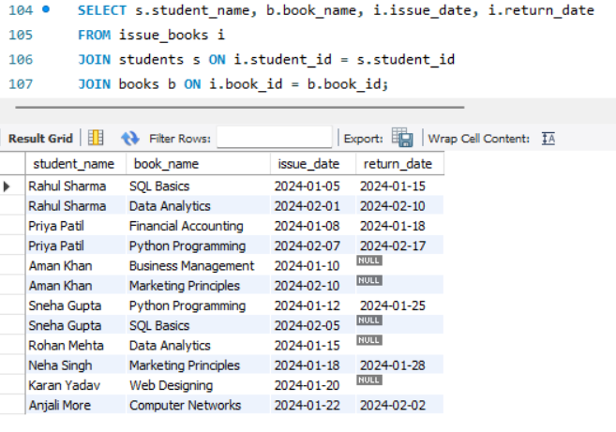
SQL Questions with Insights
3. Show students who borrowed books
Insight:
This shows which student borrowed which book and on what date.

Slide 12
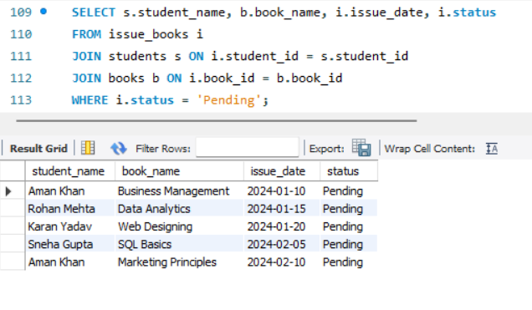
SQL Questions with Insights
4. Find pending book returns
Insight:
This helps the library find students who have not returned books yet.

Slide 13
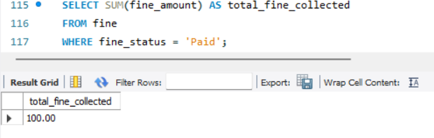
SQL Questions with Insights
5. Calculate total fine collected
Insight:
This shows the total fine amount collected by the library.

Slide 14
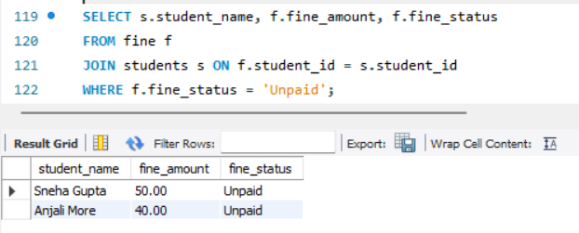
SQL Questions with Insights
6. Show unpaid fine students
Insight:
This helps the library identify students who still need to pay their fine.

Slide 15
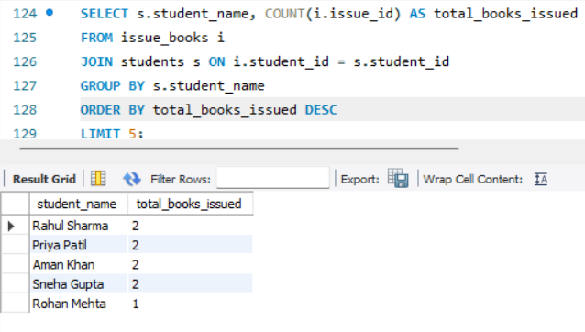
SQL Questions with Insights
7. Find top 5 active students
Insight:
This shows the students who use the library most frequently.

Slide 16
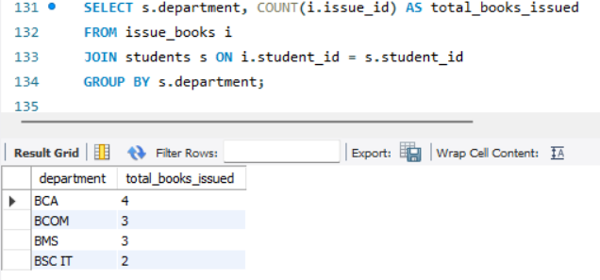
SQL Questions with Insights
8. Show department-wise book issue count
Insight:
This shows which department has the highest library usage.

Slide 17
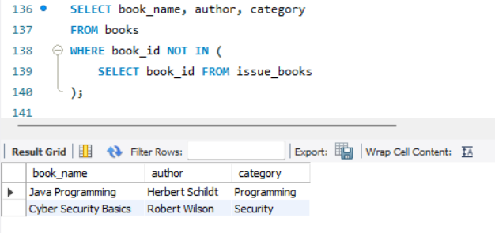
SQL Questions with Insights
9. Find books not issued yet
Insight:
This helps identify books that are available but not used by students.

Slide 18
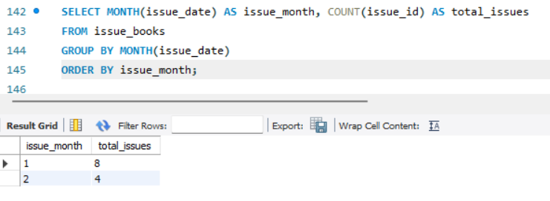
SQL Questions with Insights
10. Show monthly book issue report.
Insight:
This shows in which month the library had the highest book issue activity.

Slide 19
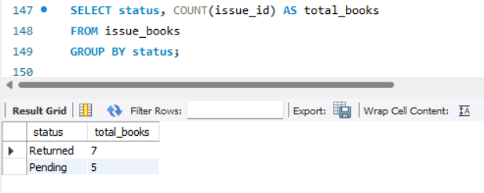
SQL Questions with Insights
11. Show total returned and pending books
Insight:
This shows how many books are returned and how many are still pending.

Slide 20
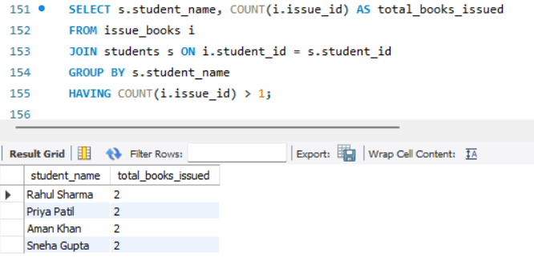
SQL Questions with Insights
12. Find students who issued more than one book
Insight:
This helps identify students who borrow books frequently.

Slide 21
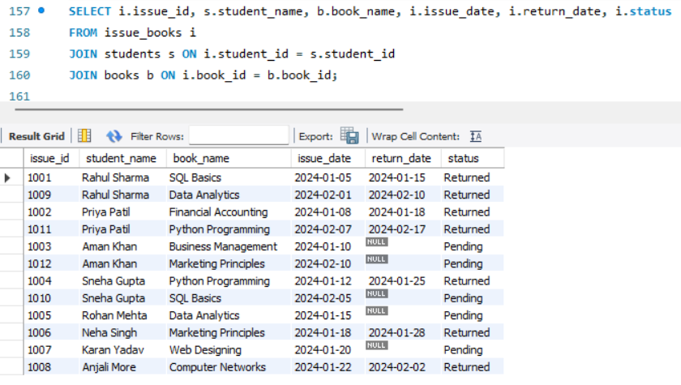
SQL Questions with Insights
13. Show book issue details with student and book name
Insight:
This gives complete issue details with student name and book name.

Slide 22
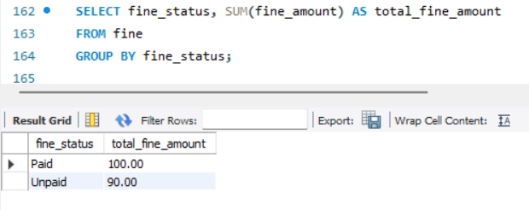
SQL Questions with Insights
14. Find total fine amount by fine status
Insight:
This shows how much fine is paid and how much fine is still unpaid.

Slide 23
Conclusion
This SQL-based Library Management System Analysis helps understand book usage, student activity, pending returns, and fine collection. The analysis provides useful insights for improving library management and tracking student borrowing behavior.

