Slide 1

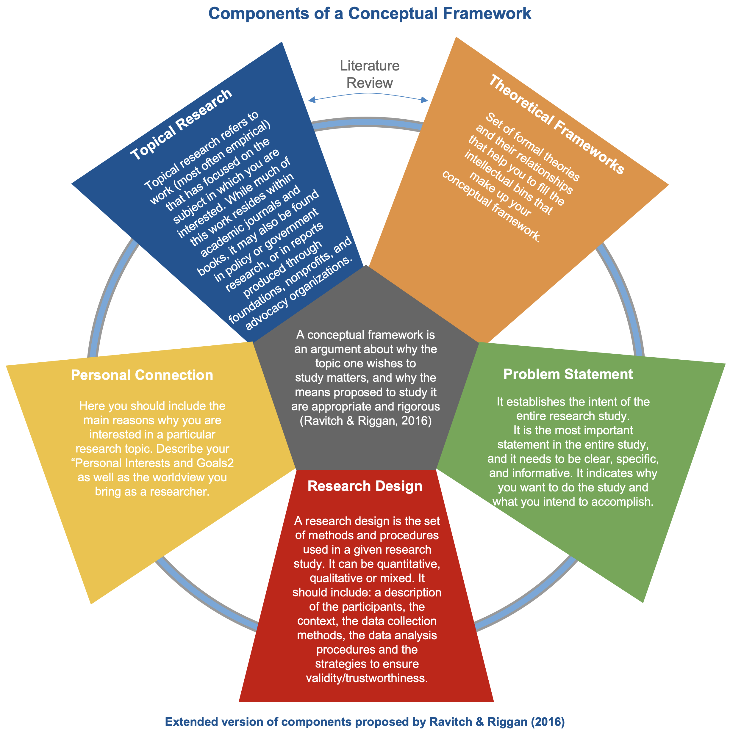
Email: mango@test.com
Date: February 13, 2026
Research Topic: I'm wondering about how high school students use social media for collaborative learning outside the classroom. Specifically, I'm interested in understanding what motivates them to create study groups online, how they share knowledge with peers, and whether these informal learning spaces impact their academic performance and engagement. I've noticed that many students seem to learn from each other on platforms like Discord and Instagram, and I want to explore this phenomenon more deeply.
Topical Research
Literature Review
Theoretical Frameworks
Research shows that collaborative learning can enhance student engagement and achievement (Vygotsky, 1978; Johnson & Johnson, 1999). Recent studies indicate that Generation Z students are "digital natives" who naturally integrate technology into their learning (Prensky, 2001). However, there's limited research on how students self-organize learning communities on social media platforms. Some studies suggest that peer-to-peer learning on social media can increase motivation (Manca & Ranieri, 2016), while others raise concerns about distraction and misinformation. The gap I see is understanding the authentic student experience and perspective on these practices.
Gap/s Found:
Not yet identified
Conceptual Framework: Mango
Personal Interests & Goals
Problem Statement
Not yet defined
Not yet defined
Identity & Positionality
Research Questions
Constructivist
Research Design
How do high school students experience and make meaning of peer collaboration on social media platforms for academic learning purposes?
Sub-questions:
- What motivates students to engage in social media-based study groups?
- How do students describe the benefits and challenges of learning collaboratively on social media?
- In what ways do students believe these experiences influence their academic engagement?
I will use a qualitative methodology because I want to deeply understand students' lived experiences and perspectives. A phenomenological approach will allow me to explore how students make meaning of their collaborative online learning experiences. This aligns with my constructivist worldview, as I'm interested in understanding the subjective reality of participants rather than measuring predefined variables.

Slide 2
Email: mango@test.com
Date: February 13, 2026
Conceptual Framework: Mango
Literature Review
Topical Research
Research Topic: I'm wondering about how high school students use social media for collaborative learning outside the classroom. Specifically, I'm interested in understanding what motivates them to create study groups online, how they share knowledge with peers, and whether these informal learning spaces impact their academic performance and engagement. I've noticed that many students seem to learn from each other on platforms like Discord and Instagram, and I want to explore this phenomenon more deeply.
Theoretical Frameworks
Personal Interests & Goals
Not yet defined
Research shows that collaborative learning can enhance student engagement and achievement (Vygotsky, 1978; Johnson & Johnson, 1999). Recent studies indicate that Generation Z students are "digital natives" who naturally integrate technology into their learning (Prensky, 2001). However, there's limited research on how students self-organize learning communities on social media platforms. Some studies suggest that peer-to-peer learning on social media can increase motivation (Manca & Ranieri, 2016), while others raise concerns about distraction and misinformation. The gap I see is understanding the authentic student experience and perspective on these practices.
Identity & Positionality
<<Describe your positionality and worldview >>
Gap/s Found:
<<Gap/s found in the review of your topical research>>
Problem Statement:
Not yet defined
Research Questions:
How do high school students experience and make meaning of peer collaboration on social media platforms for academic learning purposes?
Sub-questions:
- What motivates students to engage in social media-based study groups?
- How do students describe the benefits and challenges of learning collaboratively on social media?
- In what ways do students believe these experiences influence their academic engagement?
Research Design:
I will use a qualitative methodology because I want to deeply understand students' lived experiences and perspectives. A phenomenological approach will allow me to explore how students make meaning of their collaborative online learning experiences. This aligns with my constructivist worldview, as I'm interested in understanding the subjective reality of participants rather than measuring predefined variables.

Slide 3
Email: mango@test.com
Date: February 13, 2026
Topical Research
Gap/s Found:
<<Gap/s found in the review of your topical research>>
Theoretical Frameworks
Research shows that collaborative learning can enhance student engagement and achievement (Vygotsky, 1978; Johnson & Johnson, 1999). Recent studies indicate that Generation Z students are "digital natives" who naturally integrate technology into their learning (Prensky, 2001). However, there's limited research on how students self-organize learning communities on social media platforms. Some studies suggest that peer-to-peer learning on social media can increase motivation (Manca & Ranieri, 2016), while others raise concerns about distraction and misinformation. The gap I see is understanding the authentic student experience and perspective on these practices.
Personal Interests & Goals
Not yet defined
Research Topic:
I'm wondering about how high school students use social media for collaborative learning outside the classroom. Specifically, I'm interested in understanding what motivates them to create study groups online, how they share knowledge with peers, and whether these informal learning spaces impact their academic performance and engagement. I've noticed that many students seem to learn from each other on platforms like Discord and Instagram, and I want to explore this phenomenon more deeply.
Problem Statement:
Not yet defined
Research Design
I will use a qualitative methodology because I want to deeply understand students' lived experiences and perspectives. A phenomenological approach will allow me to explore how students make meaning of their collaborative online learning experiences. This aligns with my constructivist worldview, as I'm interested in understanding the subjective reality of participants rather than measuring predefined variables.
Identity & Positionality
Constructivist
Research Questions
How do high school students experience and make meaning of peer collaboration on social media platforms for academic learning purposes?
Sub-questions:
- What motivates students to engage in social media-based study groups?
- How do students describe the benefits and challenges of learning collaboratively on social media?
- In what ways do students believe these experiences influence their academic engagement?
Conceptual Framework: Mango
Email: mango@test.com
Date: February 13, 2026

