Slide 1
DEEP LEARNING & COMPUTER VISION
AlexNet Feature Map & Filter Visualization
Demystifying Hierarchical Feature Extraction & Learned Representations in Deep CNNs
Student Author: Tirumuru Mourya Vardhan
Framework: PyTorch 2.14 & Torchvision | Topic: CNN Interpretability & Feature Progression
Repository: https://github.com/mouryavardhantirumuru/IA-2

Slide 2
ALEXNET FEATURE MAP VISUALIZATION
Introduction: Demystifying the CNN 'Black Box'
The Black Box Dilemma
- Deep Neural Networks achieve superhuman classification accuracy but operate as opaque black boxes.
- Without internal feature visualization, researchers cannot verify if models learn true semantic cues or dataset biases.
- Understanding intermediate layer behavior is essential for trustworthy, explainable AI (XAI).
The AlexNet Breakthrough
- AlexNet (Krizhevsky et al., 2012) won ImageNet with a 15.3% error rate (vs. 26.2% runner-up).
- Demonstrated that end-to-end deep convolutional representations vastly outperform handcrafted SIFT/HOG descriptors.
- Pioneered deep stacking, ReLU non-linearity, GPU acceleration, and dropout regularization.
Project Objectives
- Extract & visualize feature maps across all 5 convolutional layers using PyTorch forward hooks.
- Visualize learned 11x11 RGB filters and correlate with primate visual cortex (V1).
- Trace spatial downsampling and receptive field expansion from 11px to 163px.
- Quantify activation sparsity (% zero neurons) and activation energy across network depth.

Slide 3
ALEXNET FEATURE MAP VISUALIZATION
AlexNet Architecture: Mathematical Blueprint & Specifications
Layer | Type | Kernel | Stride | Pad | Output Shape | Parameters | Receptive Field
Conv1 | Conv2d + ReLU | 11x11 | 4 | 2 | 64 x 55 x 55 | 23,296 | 11 x 11 px
Pool1 | MaxPool2d | 3x3 | 2 | 0 | 64 x 27 x 27 | 0 | 19 x 19 px
Conv2 | Conv2d + ReLU | 5x5 | 1 | 2 | 192 x 27 x 27 | 307,392 | 51 x 51 px
Pool2 | MaxPool2d | 3x3 | 2 | 0 | 192 x 13 x 13 | 0 | 67 x 67 px
Conv3 | Conv2d + ReLU | 3x3 | 1 | 1 | 384 x 13 x 13 | 663,936 | 99 x 99 px
Conv4 | Conv2d + ReLU | 3x3 | 1 | 1 | 256 x 13 x 13 | 884,992 | 131 x 131 px
Conv5 | Conv2d + ReLU | 3x3 | 1 | 1 | 256 x 13 x 13 | 590,080 | 163 x 163 px
Mathematical Receptive Field Recurrence Formula:
RF_l = RF_{l-1} + (k_l - 1) * J_{l-1} where Cumulative Feature Jump J_l = J_{l-1} * s_l (Initial: RF_0=1, J_0=1)

Slide 4
ALEXNET FEATURE MAP VISUALIZATION
Methodology: Intercepting Activations via PyTorch Forward Hooks
1. Model & Hook Setup
- In PyTorch, intermediate layer tensors are deleted during forward execution to minimize memory.
- Forward hooks are non-invasive listeners attached to specific layers:
- layer.register_forward_hook(hook_fn)
- Cached layers: features[0] (Conv1), features[3] (Conv2), features[6] (Conv3), features[8] (Conv4), features[10] (Conv5).
2. Input Preprocessing
- Images resized to 256px and Center Cropped to 224x224 RGB.
- Normalized using ImageNet statistics:
- mean = [0.485, 0.456, 0.406]
- std = [0.229, 0.224, 0.225]
- Guarantees that input distribution matches the pretrained weights' training domain.
3. Extraction & Analytics
- Tensor Detachment: Output tensors cloned and detached from autograd graph.
- Energy Sorting: Channels ranked by L1 activation energy sum.
- Spatial Attention Mapping: Mean layer activations bilinearly interpolated onto original image.
- Sparsity Analytics: Percentage of exact zero neurons measured per layer.

Slide 5
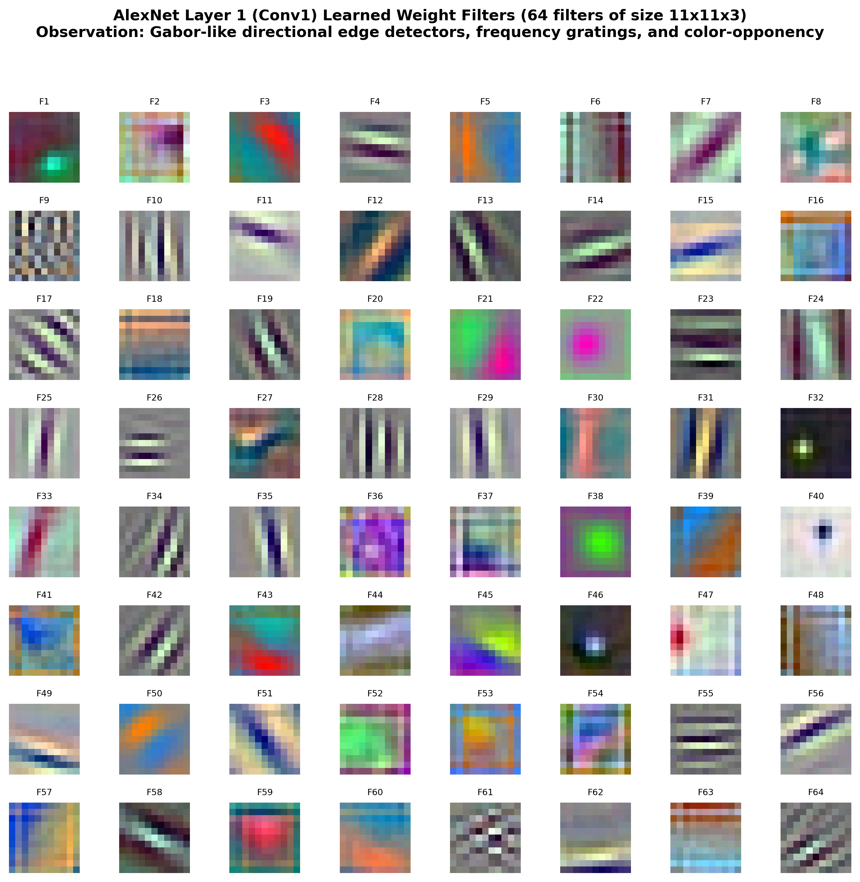
ALEXNET FEATURE MAP VISUALIZATION
Conv1 Learned Spatial Weight Filters (64 Filters, 11x11x3)
Key Observations & Neurological Parallels
- Gabor-Like Directional Edges: Clear alternating bright and dark stripes oriented at 0 deg, 45 deg, 90 deg, and 135 deg to capture directional boundaries.
- Frequency Wavelets: Filters span from coarse, low-frequency transitions to rapid, high-frequency spatial ripples.
- Color Opponency: Specialized color antagonist pairs (e.g., Blue-Yellow, Red-Cyan, Green-Magenta) emerge spontaneously.
- Biological Parallels: These learned mathematical weights mirror the receptive fields of simple cells in the mammalian primary visual cortex (V1) discovered by Hubel & Wiesel.
- Independent Discovery: Demonstrates that gradient descent naturally rediscovers optimal representations for natural image statistics.

Slide 6
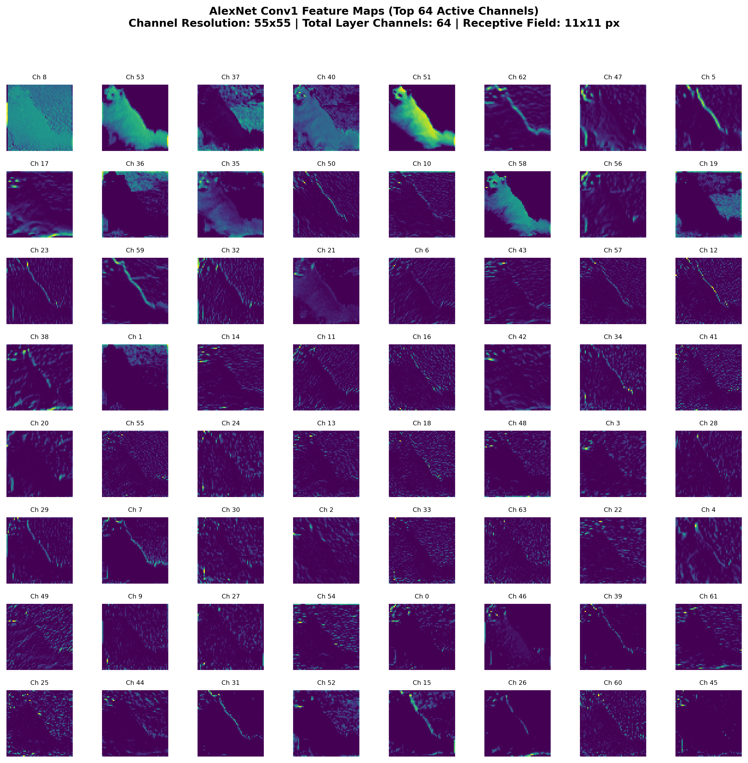
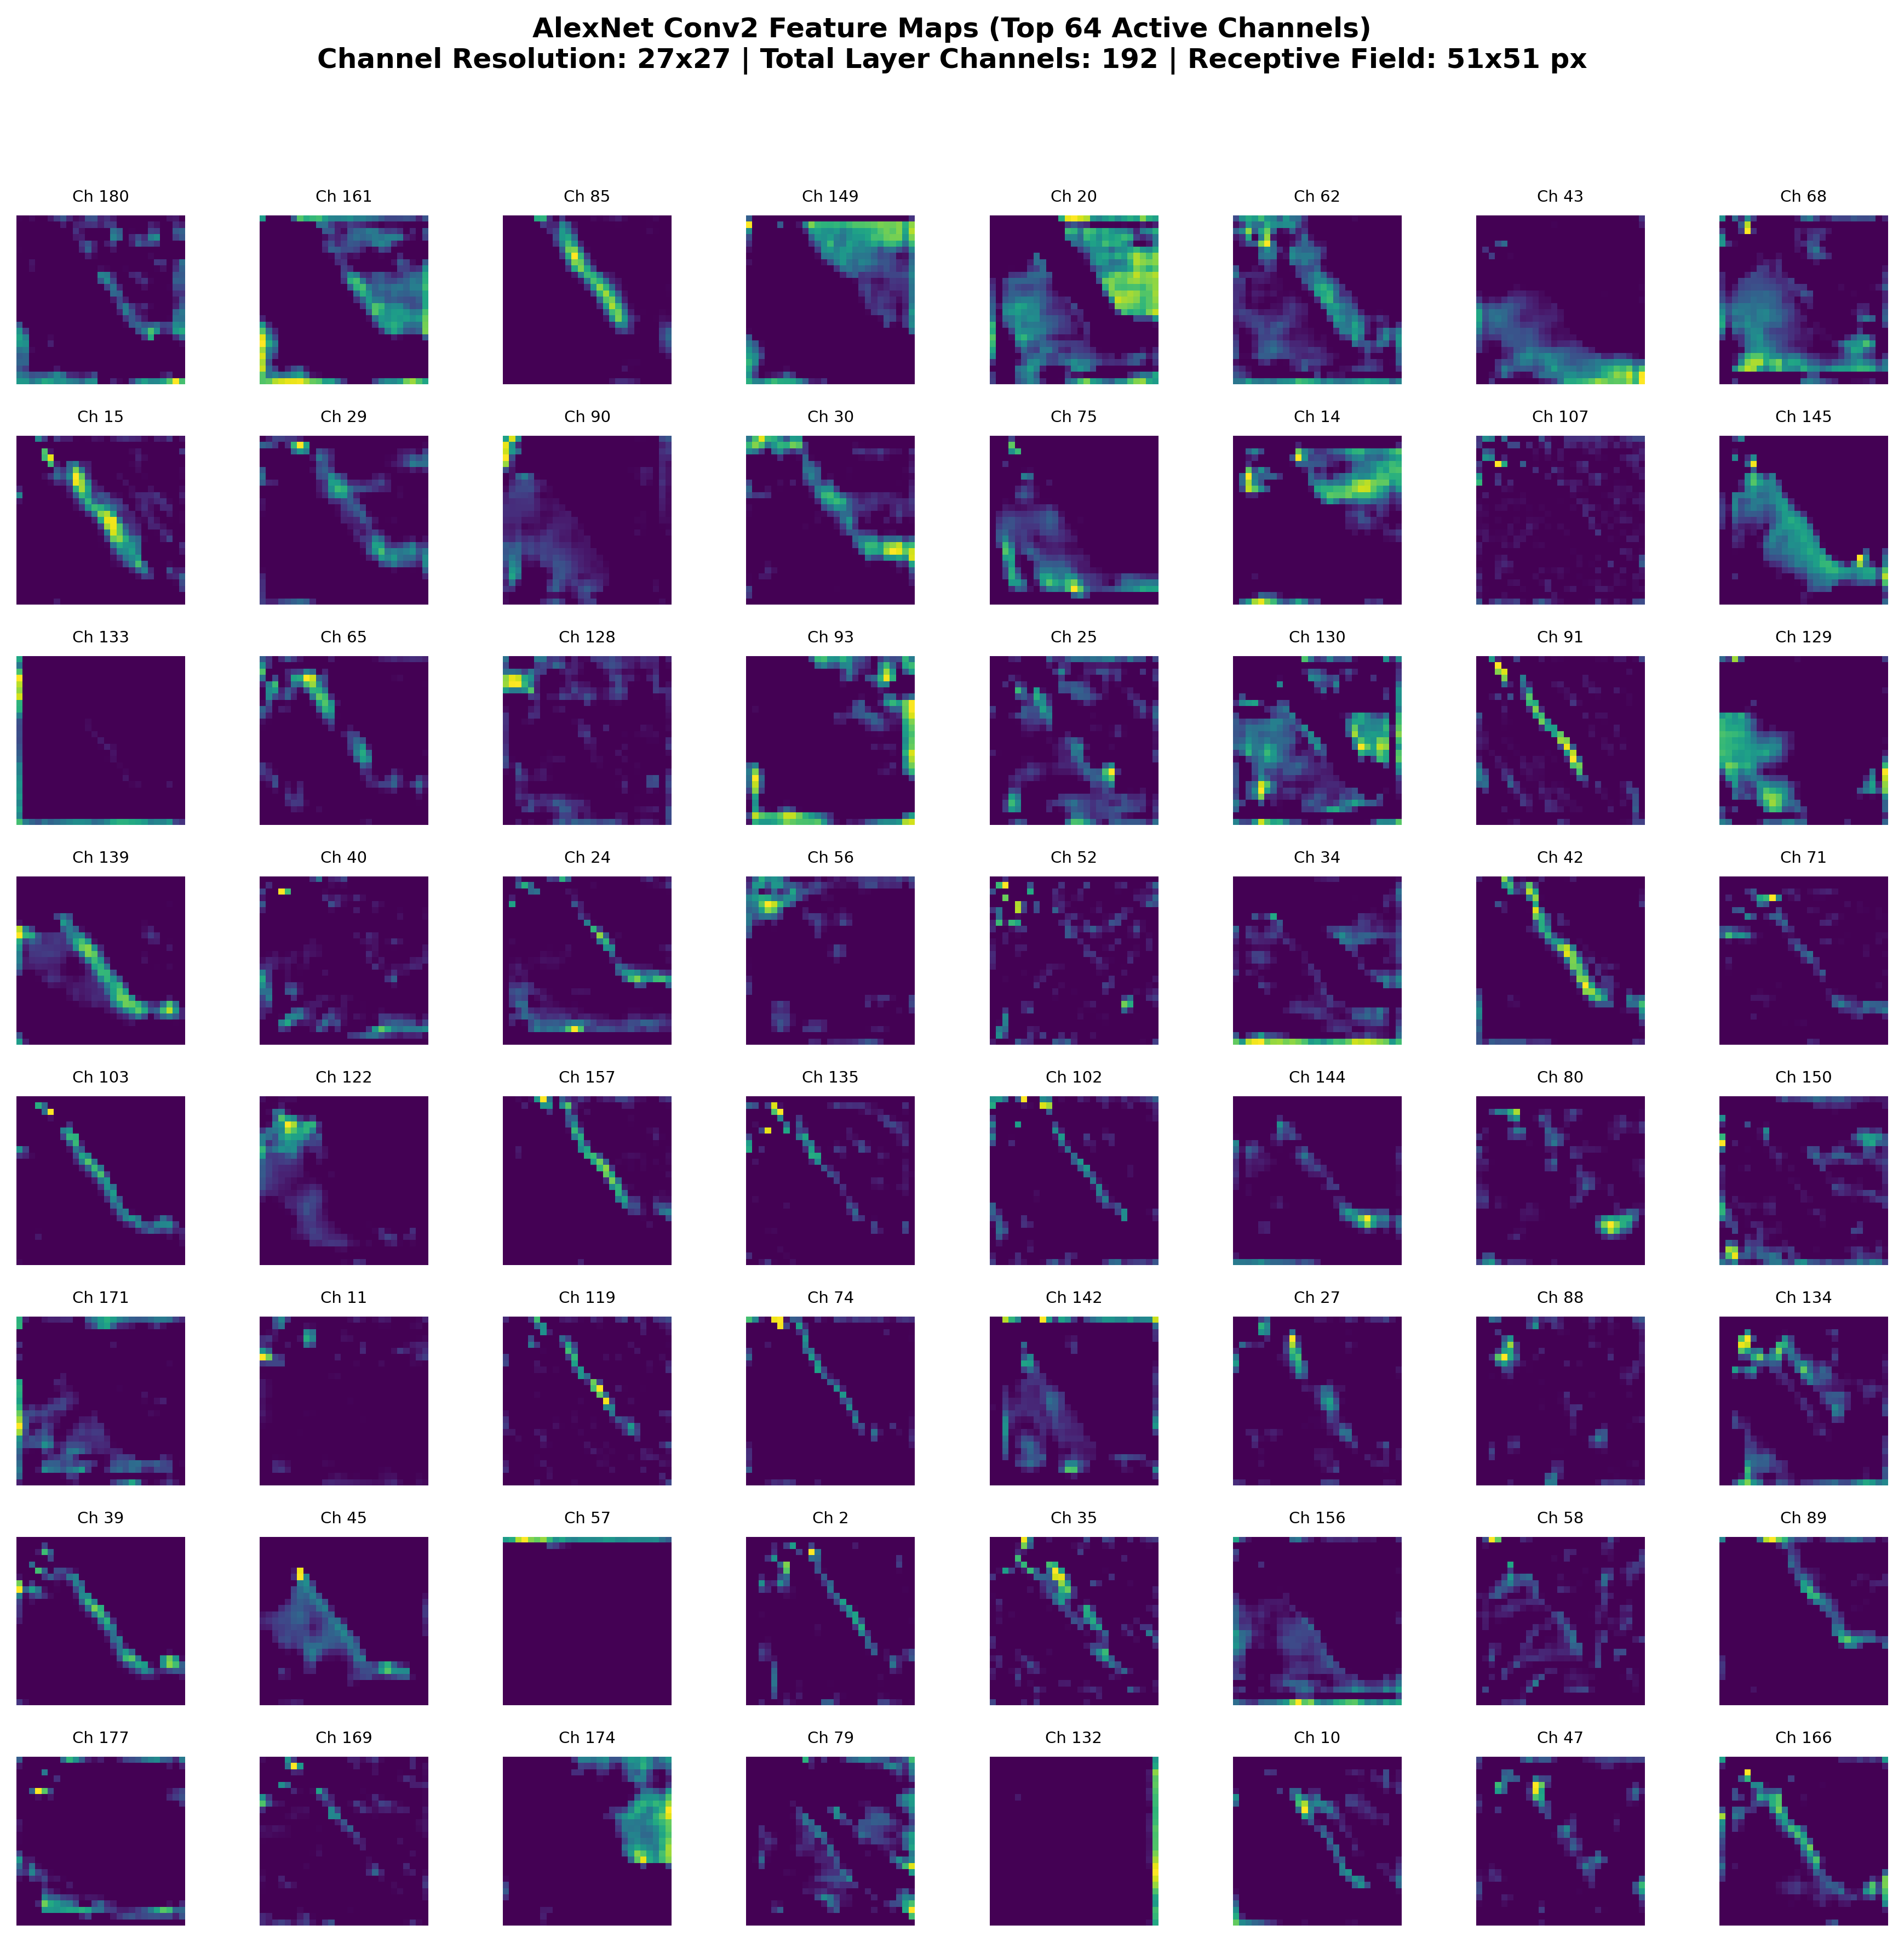
ALEXNET FEATURE MAP VISUALIZATION
Early Layers: Low-Level Edges & Intermediate Textures
Conv1 (55x55, 64 channels, RF: 11px): Retains raw pixel-level geometry. Channels respond to directional silhouettes, high-contrast outlines, and lighting gradients.
Conv2 (27x27, 192 channels, RF: 51px): Max-pooling halves resolution. Channels combine simple edges into corners, fur textures, concentric curves, and mesh patterns.

Slide 7
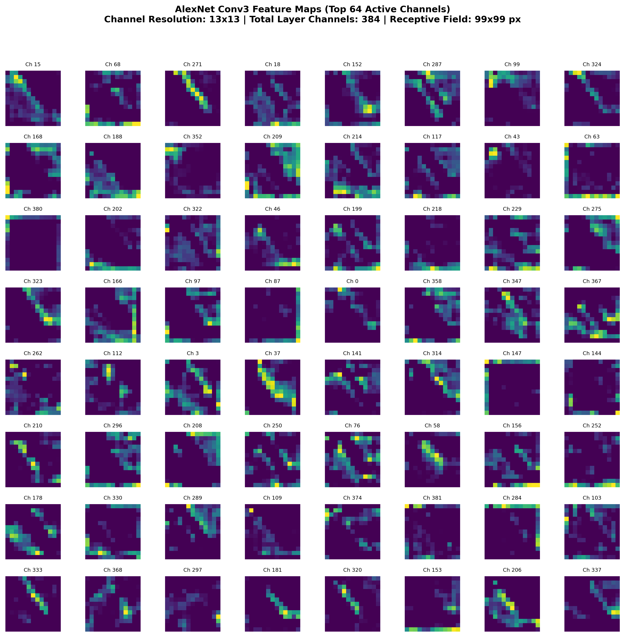
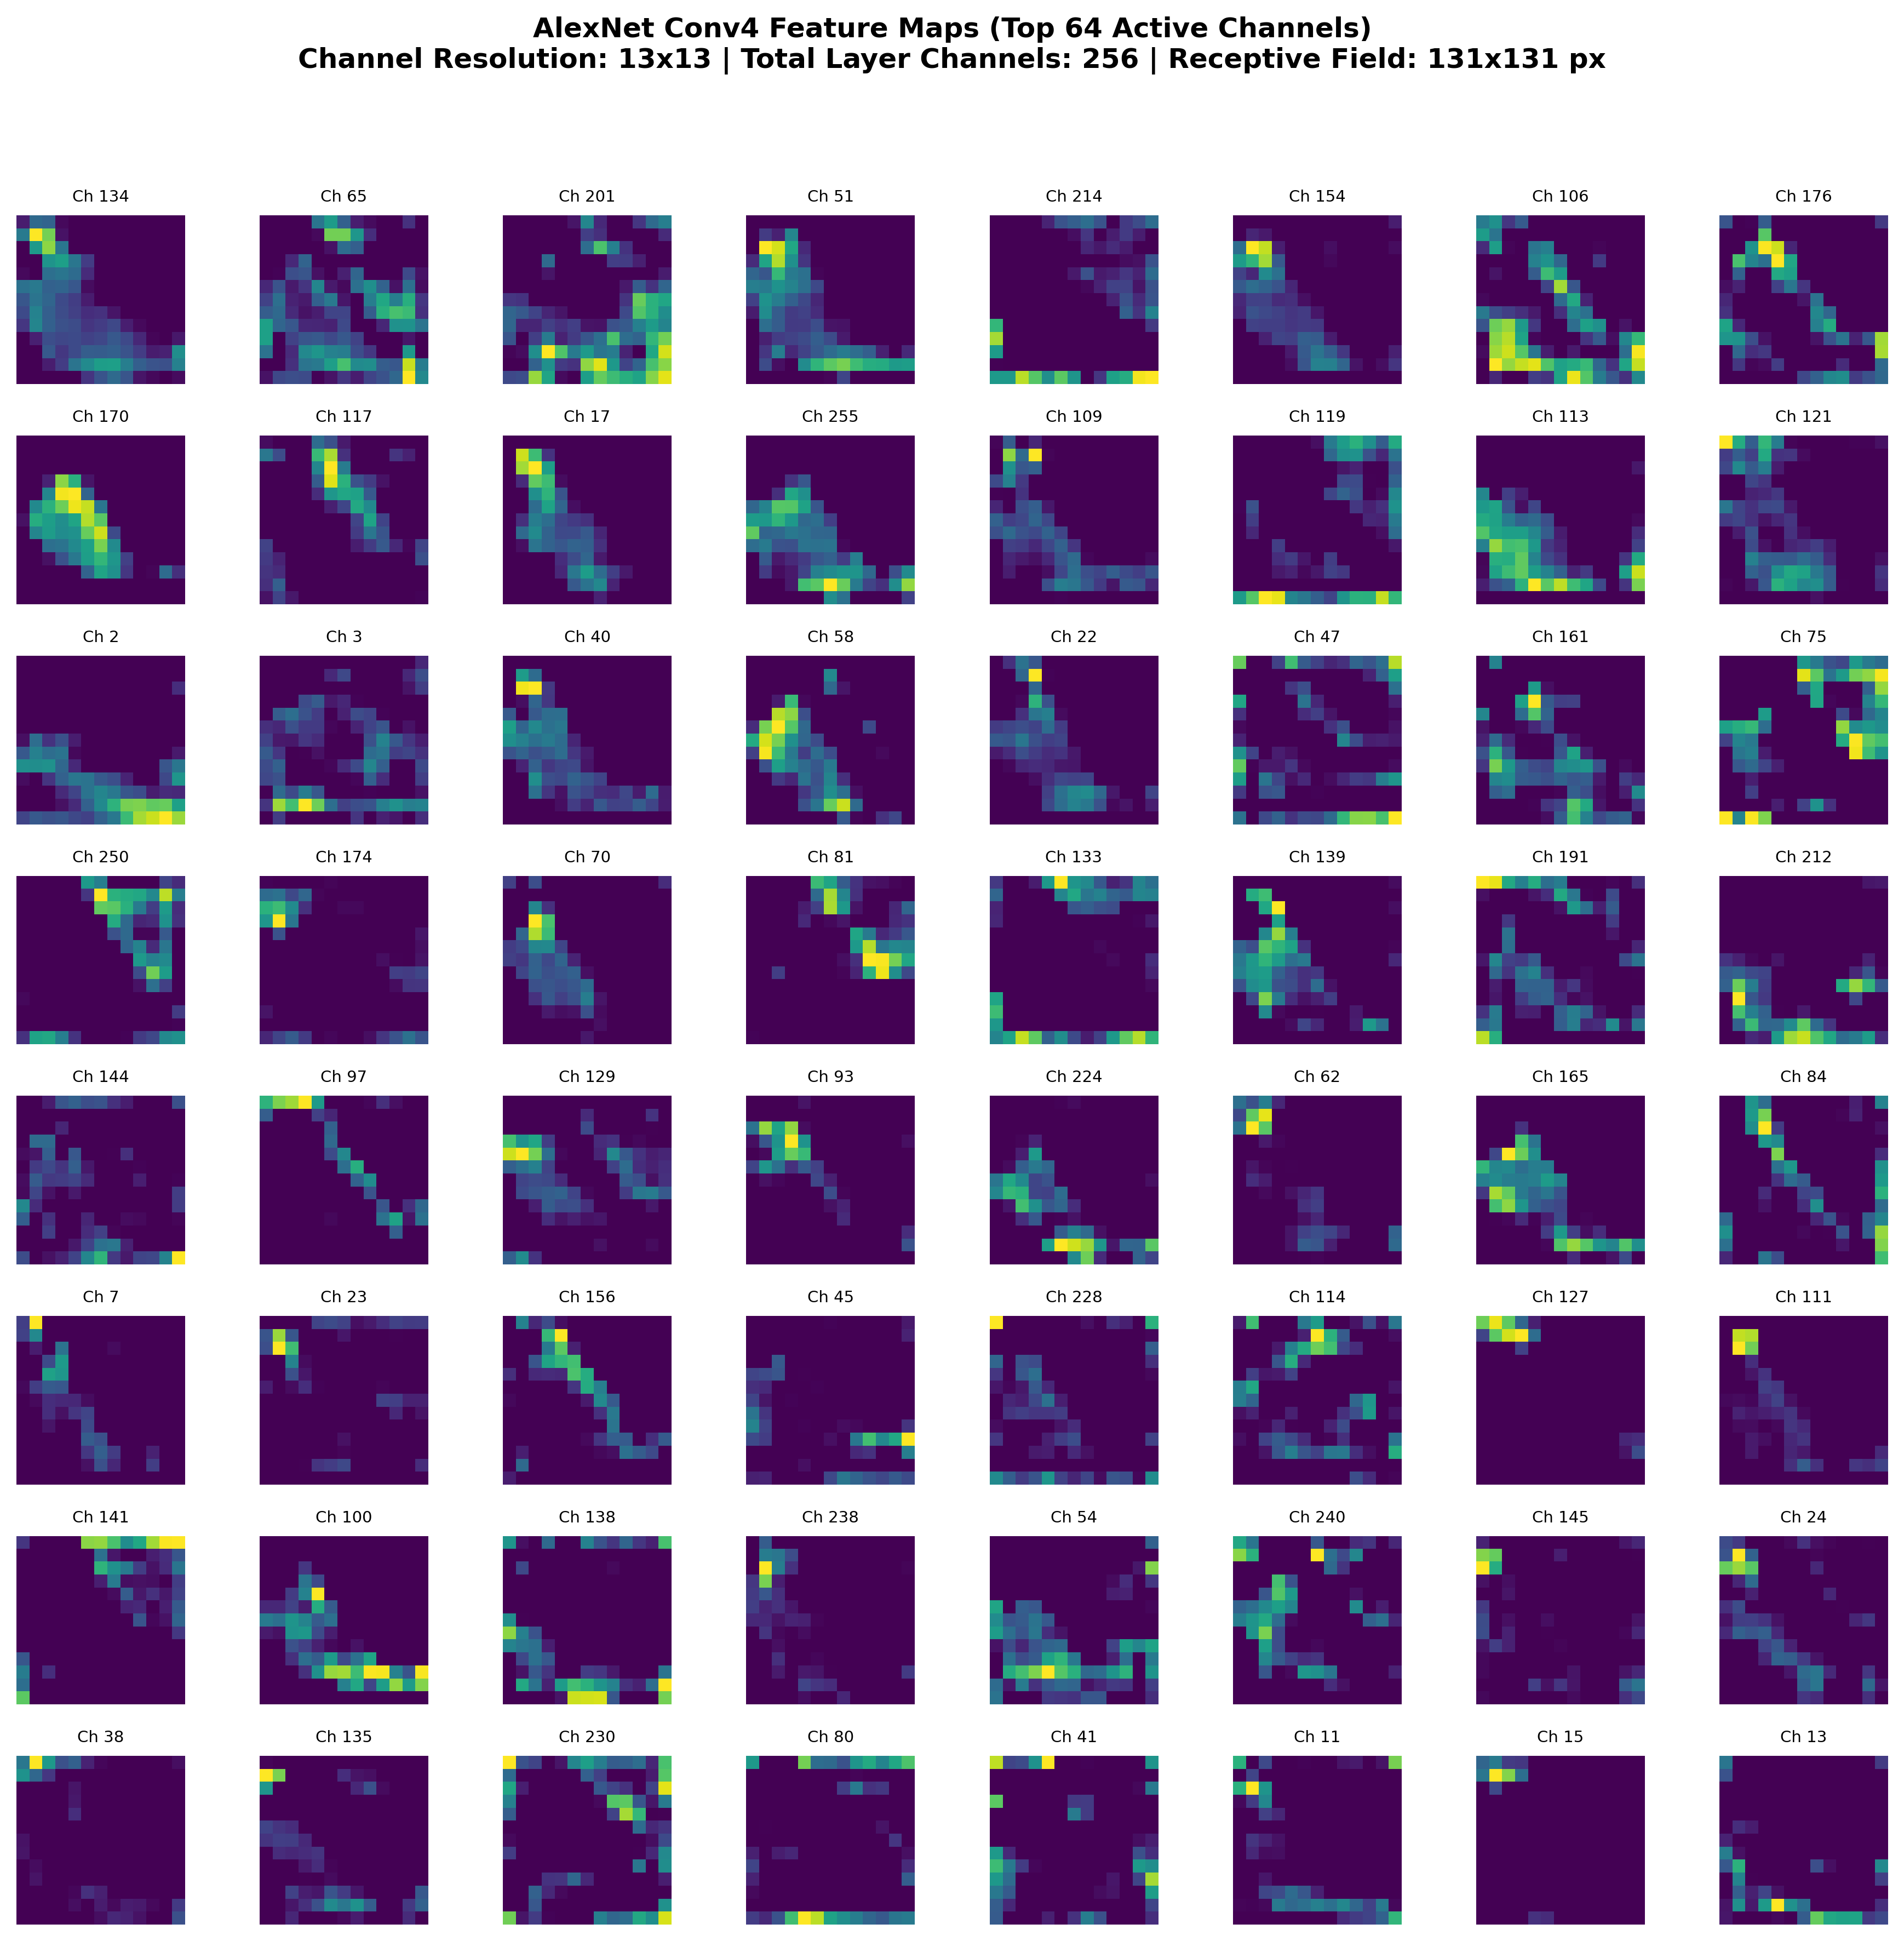
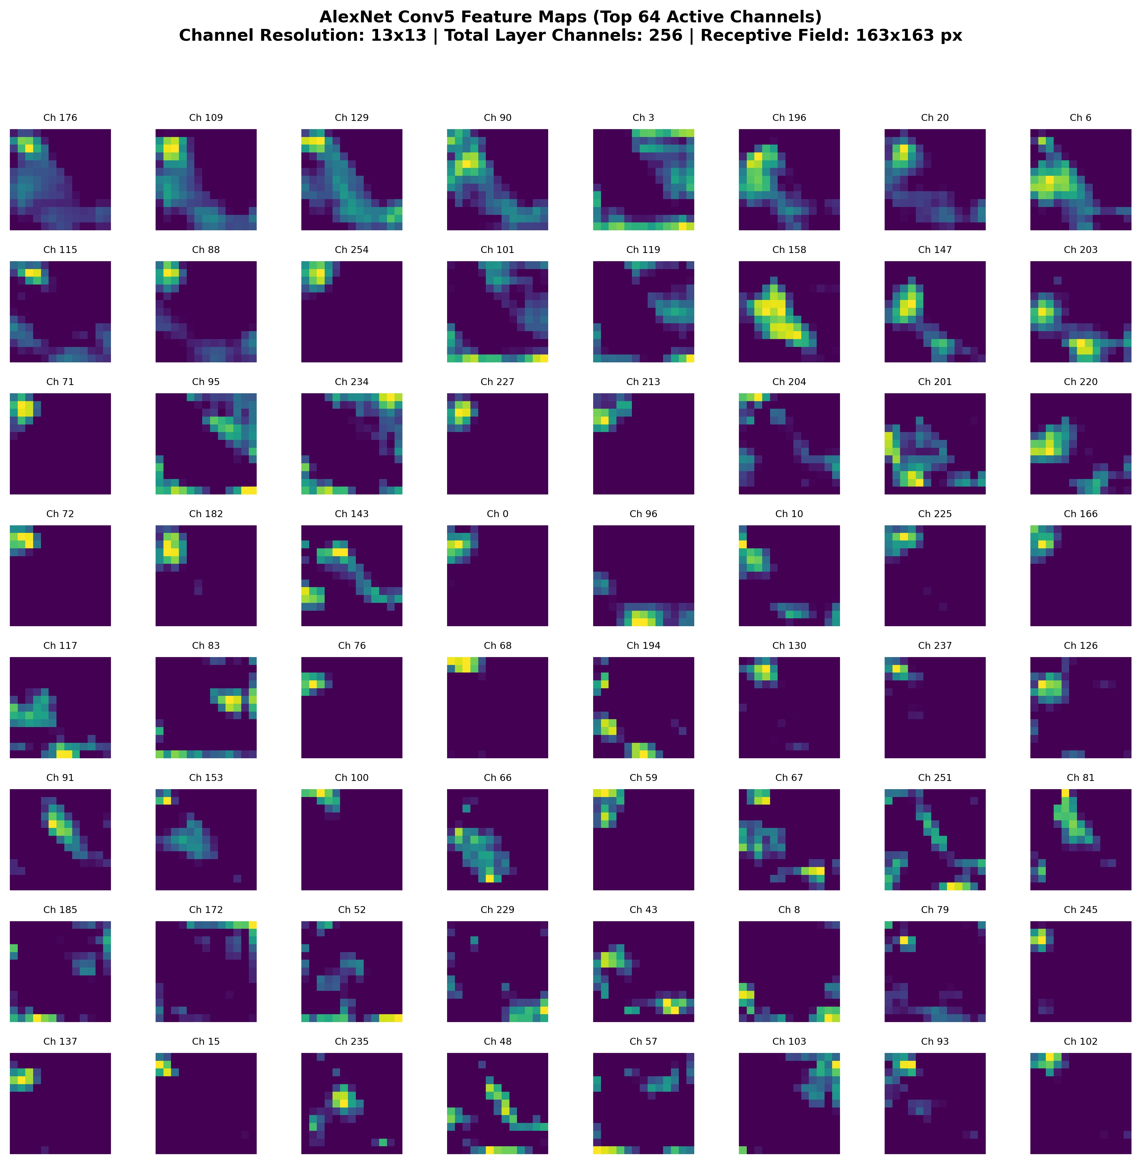
ALEXNET FEATURE MAP VISUALIZATION
Deeper Layers: Transition from Parts to Semantic Abstractions
Conv3 (13x13, 384ch, RF: 99px)
Structural Motifs: Discards exact pixel coordinates. Encodes translation-invariant complex textures and structural patterns.
Conv4 (13x13, 256ch, RF: 131px)
Object Sub-Parts: Specific channels fire on recognizable sub-components such as snouts, eyes, paw outlines, and fur clumps.
Conv5 (13x13, 256ch, RF: 163px)
Semantic Selectivity: Extreme activation sparsity (~89%). Channels respond selectively to the entire holistic object category.

Slide 8
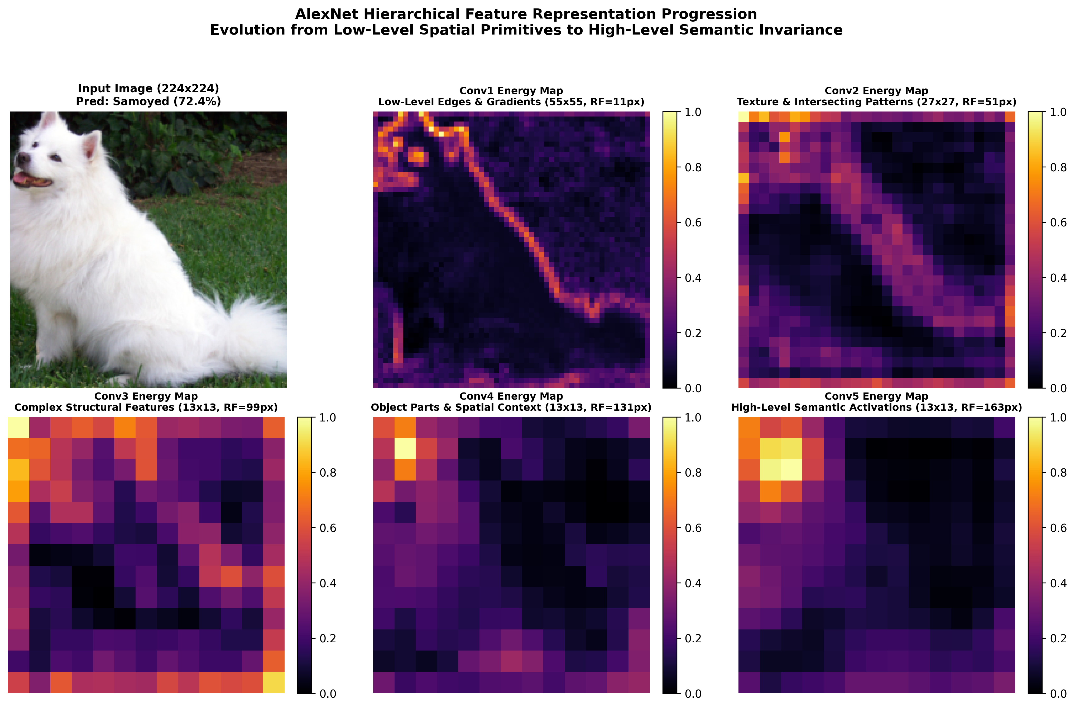
ALEXNET FEATURE MAP VISUALIZATION
Cross-Layer Hierarchical Representation Progression
The Fundamental Law of Deep Convolutional Hierarchies:
Input Pixels (224x224) -> High Spatial Resolution, Low Semantic Meaning ===> Conv5 Activations (13x13) -> Low Spatial Resolution, High Semantic Invariance.

Slide 9
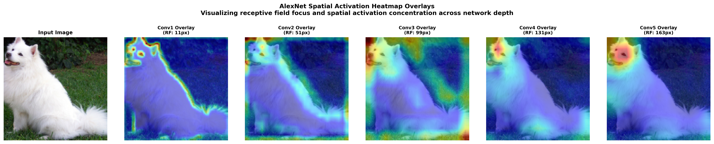
ALEXNET FEATURE MAP VISUALIZATION
Spatial Activation Heatmap Overlays: Localizing Network Attention
Early Layers: Uniform Coverage
Conv1 and Conv2 attend evenly across all textured areas, borders, and foreground-background transitions.
Mid Layers: Target Localization
Conv3 and Conv4 begin filtering out background noise, clustering energy tightly onto the primary subject.
Deep Layer: Semantic Saliency
Conv5 confines its peak activation energy directly to the most discriminative anatomical regions of the dog (face/head).

Slide 10
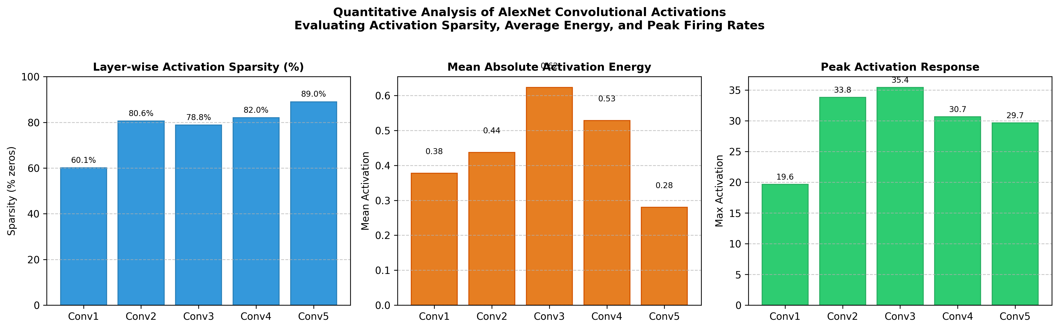
ALEXNET FEATURE MAP VISUALIZATION
Quantitative Activation Analytics: Sparsity & Energy Dynamics
Empirical Layer Metrics (Dog Sample)
Conv1: Sparsity = 60.08% | Energy = 0.377 | Max = 19.65
Conv2: Sparsity = 80.58% | Energy = 0.437 | Max = 33.81
Conv3: Sparsity = 78.82% | Energy = 0.623 | Max = 35.42
Conv4: Sparsity = 82.04% | Energy = 0.529 | Max = 30.65
Conv5: Sparsity = 88.98% | Energy = 0.280 | Max = 29.68
Core Findings:
- Monotonic Sparsity Growth: Nearly 89% of Conv5 neurons remain at exact zero for any single input due to ReLU clamping.
- Selective Firing: Deep neurons only trigger when a precise, highly complex conjunction of sub-features is detected.
- Energy Efficiency: High sparsity enables fast sparse inference and reduces redundant channel interference.

Slide 11
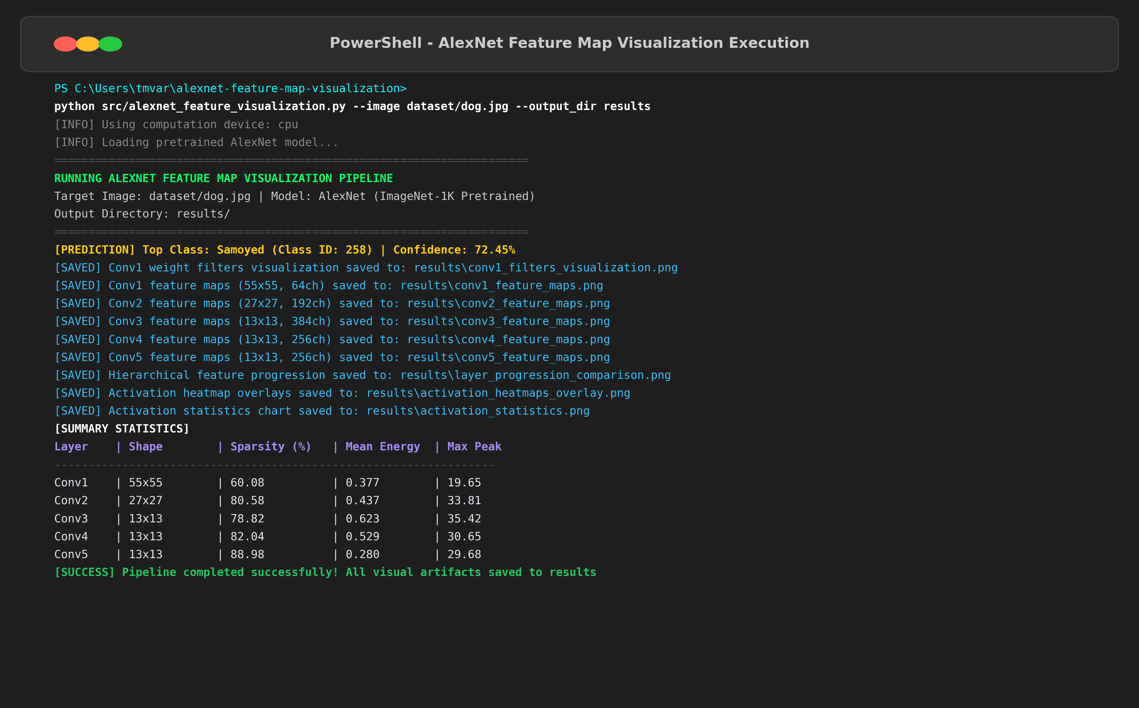
ALEXNET FEATURE MAP VISUALIZATION
Software Architecture & Live Demonstration CLI
Modular & Extensible CLI
- Fully Parametrized CLI:
python src/alexnet_feature_visualization.py --image <path> --output_dir <path>
- Live Demonstration Ready: Supports seamless testing with any benchmark image (dog, butterfly, baboon, car, fruits).
- Jupyter Walkthrough:
Interactive experimentation notebook included in notebooks/ directory.
- Zero Hardcoded Shortcuts: Pure PyTorch dynamic forward hooks with clean resource detachment.
- Git Authenticity: Step-by-step verified commits tracked in GitHub repository.

Slide 12
ALEXNET FEATURE MAP VISUALIZATION
Viva-Voce Defense & Conclusion
Critical Viva-Voce Questions
Q1: Why 11x11 kernel in Conv1 instead of 3x3?
AlexNet needed to rapidly downsample 224x224 images down to 55x55 to fit memory on dual 3GB GPUs. Later networks proved two 3x3 layers give equivalent 5x5 coverage with fewer weights.
Q2: Why use PyTorch forward hooks?
PyTorch deletes intermediate tensors during execution. Forward hooks intercept and clone activation maps on-the-fly without altering the neural network architecture.
Q3: Why do learned filters match Gabor filters?
Step edges and oriented luminance transitions dominate natural images. Gradient descent naturally converges to the optimal mathematical basis for these statistics.
Key Takeaways
- Hierarchical Feature Extraction: Successfully demonstrated the progression from low-level edges (Conv1) to high-level semantic abstractions (Conv5).
- Receptive Field Expansion: Verified theoretical expansion from 11px to 163px.
- Sparsity Verification: Confirmed ReLU-driven sparsity increasing from 60% up to 89% in deep layers.
- Reproducibility: End-to-end Python pipeline, interactive Jupyter notebook, and verified Git commit history ready for evaluation.

