Slide 1

AI reinvention made real
Accenture Innovation Challenge 2026

Slide 2

Team details
TEAM NAME:
Name (Team Leader)
Name
College:
Stream:
Year of graduation:
College:
Stream:
Year of graduation:
Name
Photo
College:
Stream:
Year of graduation:
All fields are mandatory

Slide 3
Factories can only monitor what they instrumented
Problem framing — Track 4, DigitalTwin.ai
THE CONDITION
THE CONSEQUENCE
Assembly lines mix legacy and modern equipment. Some stations are richly instrumented; a meaningful minority run on manual checklists and emit no telemetry at all.
A defect introduced early may not surface until a much later gate, by which time many downstream units carry the same undetected issue.
WHY "ADD SENSORS" IS NOT THE ANSWER
WHERE THE VALUE SITS
Retrofits are limited to a small number of scheduled maintenance windows per year. The constraint is the calendar as much as the capital.
The stations most likely to hide a developing problem are exactly the ones nobody is watching. Inferring their state is the opportunity.
In our simulation, 78% of disturbances at un-instrumented stations never produced a sustained line-level throughput shortfall (n=27). Aggregate monitoring would not have caught them later — it would not have caught them at all.
Quoted conditions are from the official Round 2 brief. The measured figure is a simulated prototype result on synthetic data.

Slide 4
Round 1 proposed the idea. Round 2 tests it.
What changed, and what we had to prove
 | Round 1 — concept | Round 2 — this submission
Shadow-sensing | asserted | two implemented mechanisms: flow physics + defect genealogy
Hidden state | "a live health signal" | cycle time of an unmeasured station, graded against ground truth
Prediction | "predicts, not visualises" | forward flow arithmetic: vehicles lost, minutes to starvation
Differentiation | claimed | 3 baselines at a matched false-alarm rate
Partial sensors | claimed | coverage sweep, 100% → 25% instrumentation
Human in the loop | in the diagram | hash-chained ledger, abstention when ambiguous
Evidence | none | 110 held-out episodes, 216 passing tests
Round 1 argued the idea was worth testing. This is the test — including the parts we failed.

Slide 5
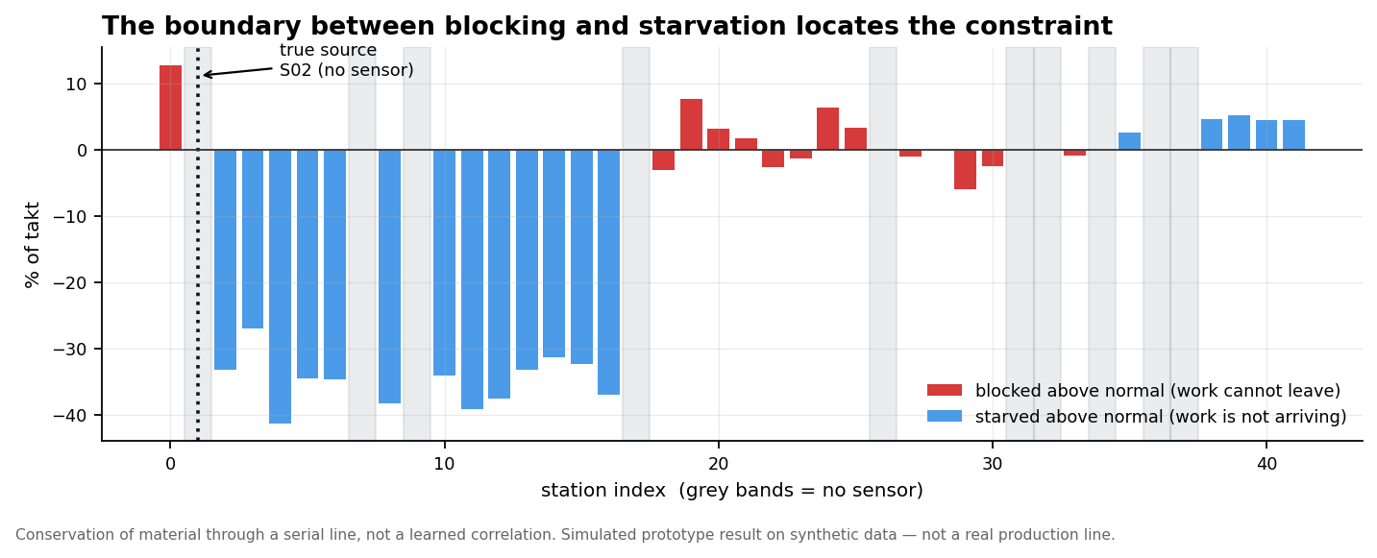
The mechanism: the line measures its own blind spots
Conservation of material, not a learned correlation
When a station slows, material stops arriving downstream and stops leaving upstream. Every station downstream STARVES. Every station upstream BLOCKS. The boundary between them sits exactly at the station causing it — so we never need a sensor AT that station, only sensors on both sides of it.
A correlation model sees S07 blocking and S09 starving and cannot say which caused which. The flow model knows the direction of causation a priori — material moves one way.

Slide 6
This part is not our idea — and we say so
The mechanism is the Turning Point Method, Li, Chang & Ni (2009)
The blockage/starvation boundary is one of the best-established bottleneck-detection methods in manufacturing science. We implement it as a baseline rather than quietly reinventing it. Our contribution is what happens when the boundary falls in a gap with no sensors.
78%
0%
69%
Turning Point Method — detects the disturbance
…but names the right station
RippleTwin names the right station
It is not that the published method is bad. It detects as reliably as we do — better, at 50% coverage. It simply cannot name a station it cannot measure.
 | Published Turning Point / Active Period | RippleTwin
Output space | instrumented stations only | every station, instrumented or not
Decision rule | deterministic scan for a sign change | posterior over candidate positions
Distance | station adjacency | buffer capacity — a 14-slot buffer decouples far more than one
Unidentifiable cases | always returns a station | abstains, and flags it for a sensor
Hidden station state | — | estimates its cycle time (~3% median error)
Baseline implemented in the strengthened deviation-scored form — more favourable to it than the published version — and calibrated to the same false-alarm rate. Full citations in docs/REFERENCES.md.

Slide 7
How RippleTwin works
Every box has an implementation behind it
OBSERVED
BASELINE
INFERRED
PREDICTED
EXPLAINED
HUMAN
telemetry from
instrumented
stations only
mix- and shift-aware
expectations, in
fraction of takt
posterior over ALL
stations, including
un-sensored ones
ripple forecast from
flow arithmetic
evidence tagged
OBS / INF / PRED,
no LLM in the loop
approve / reject
or ABSTAIN
›
›
›
›
›
OUTCOME → hash-chained ledger → per-station precision feeds back
Component | Method chosen | Why not something heavier
Hidden-state estimation | non-negative least squares + Gaussian likelihood over candidate positions | a GNN would learn the propagation we can derive — deriving it is stronger and inspectable
Calibration | empirical null + correlation correction | stations are ~0.4 correlated; assuming independence inflates evidence ~14x
Ripple forecast | serial-line flow arithmetic | an engineer can check it on paper, and it cannot drift
Explanation | templates bound to computed values | an LLM narrator can drift from the evidence; here it structurally cannot
Rule we held to: when a simpler method is equally effective, use the simpler method.

Slide 8
How we made the comparison fair
The design decisions that make the next slide mean something
MATCHED FALSE-ALARM RATE
ONE PHYSICS RUN, MANY SENSOR VIEWS
Every method is calibrated on the same held-out nominal data to the same 1% per-window false-alarm target, then run through an identical detection rule. Without this, a permissive threshold just looks more sensitive.
Coverage levels are views over a single simulation, so differences between them are differences in observability — not different random draws.
B2 IS THE SHARP TEST
DISJOINT DATA THROUGHOUT
B2 is RippleTwin's own model with un-sensored stations removed as candidates. Same physics, same likelihood, same tuning. The only difference is whether a blind station may be named — which isolates shadow-sensing itself.
Baseline fitting, detector calibration and evaluation use separate runs. Tuning and test episodes are split by seed; anything chosen by looking at data was chosen on the tuning half.
Baseline | What it represents
B0 — SPC per station | the control chart most plants already run
B1 — Isolation Forest | modern anomaly detection, given the same features, topology-blind
B2 — observed-only twin | a conventional digital twin: models what it measures, silent about the rest
Simulated prototype evaluation on synthetic data.

Slide 9
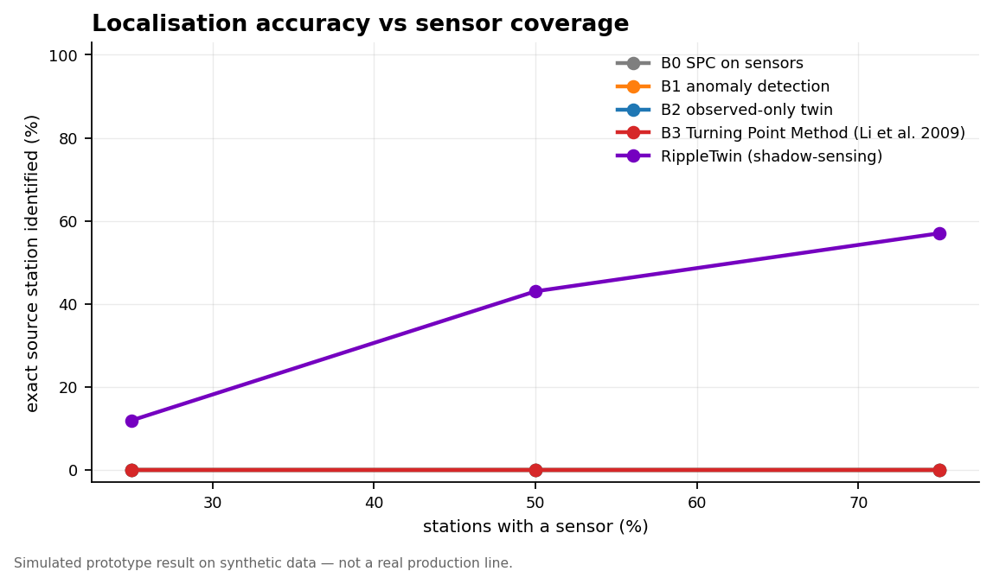
When the faulty station has no sensor, only RippleTwin names it
Held-out episodes · flow faults · source station un-instrumented
69%
0%
0%
0%
RippleTwin — exact station, at 75% coverage
Turning Point Method (Li et al. 2009)
Conventional observed-only twin
SPC on sensors
The baselines do not merely score badly. They score exactly zero — naming an unmeasured station is outside what they can express.
Coverage | RippleTwin | B3 Turning Point | B2 obs-only twin | B1 anomaly | B0 SPC
25% | 12% | 0% | 0% | 0% | 0%
50% | 59% | 0% | 0% | 0% | 0%
75% | 69% | 0% | 0% | 0% | 0%
Exact-station localisation while the fault is active, at a matched 1% per-window false-alarm rate. Simulated prototype result on synthetic data.

Slide 10
The control that convinced us the mechanism is real
At 100% coverage the advantage disappears — exactly as it should
93%
93%
identical
RippleTwin at 100% sensor coverage
Observed-only twin, same conditions
to three decimal places
With every station instrumented there is nothing hidden to infer, so shadow-sensing has nothing to add — and it adds nothing. The advantage appears exactly and only where instrumentation is missing.
That is what should happen if the mechanism is real rather than an artefact of better tuning. A method that also won here would be telling us its gains came from somewhere else.
AND THE SHARPEST FALSIFIABLE CLAIM
RippleTwin estimates the cycle time of a station that has no sensor — a number that is unmeasurable in the data it receives — to a median error of 3.3% at 75% coverage (n=18). The simulator knows the true value, so the estimate is graded, not asserted.
Simulated prototype results on synthetic data.

Slide 11
A detector that never stays quiet is worthless
False alarms, abstention, and the cases where we correctly say nothing
1.4%
0
LINE_SUPPLY
ABSTAIN
RippleTwin false-alarm rate per window
alerts on the normal-variation scenario
a material delay is attributed to supply, not a station
when adjacent candidates cannot be separated
THRESHOLD IS A DESIGN PARAMETER
IT DECLINES TO GUESS
Set from a stated false-alarm target on held-out nominal data, not hand-picked. The brief warns that false alarms erode floor trust quickly — and that trust does not survive being lost twice.
When posterior mass is spread across adjacent blind stations, RippleTwin reports the group and escalates rather than naming one. Those stations become sensor-placement candidates.
Two of our own designs were killed by these tests: a symmetric pressure channel that mis-located faults by one station, and a robust z-score on starvation time that produced a 58% false-alarm rate. Both are documented in the repository rather than buried.
Simulated prototype evaluation on synthetic data.

Slide 12
Three users, one twin
Same inferred state, different horizon
FLOOR SUPERVISOR
PLANT MANAGER
LEADERSHIP
Right now, this station
This week, this line
The rollout case
• which station, and how sure
• why — evidence tagged OBS/INF/PRED
• what happens next, in vehicles
• one recommended action
• approve or reject
• where suspicion accumulates
• throughput and escape rate
• coverage by zone
• defects by discovery gate
• the decision ledger
• value drivers and payback
• sensor economics vs retrofit
• where instrumentation is worth buying
• phased rollout and risks
Throughout, every value carries its provenance: OBSERVED (a sensor read it), INFERRED (we estimated it for a station with none), PREDICTED (it has not happened yet). A supervisor who cannot tell a measurement from an estimate will eventually trust the wrong one.

Slide 13
Business case
Illustrative assumptions, transparent arithmetic
$2,200
60/yr
55%
~1 month
assumed contribution margin / vehicle
assumed hidden-station disturbances
assumed recovery factor
resulting payback (illustrative)
Value driver | Mechanism | Evidence class
Directed maintenance | names WHICH station, not "somewhere in body shop" | PROTOTYPE RESULT
Fewer defect escapes | attributes a defect-type excess to a source before the next gate | PROTOTYPE RESULT
Recovered throughput | constraint found before the shortfall compounds | PROTOTYPE + ASSUMPTION
Lower instrumentation need | blind stations become inferable rather than dark | PROTOTYPE RESULT
Where this is weakest, stated plainly: the model is dominated by margin per recovered vehicle. On a line that is NOT capacity-constrained, a recovered vehicle is worth almost nothing and the throughput driver collapses — so we would qualify the line before selling that value.
No figure on this slide is measured from a real plant. All inputs are editable in the dashboard.

Slide 14
Sensor economics: cost is not the binding constraint
The calendar is — retrofits wait for a maintenance window
 | Retrofit every blind station | RippleTwin
Capital (10 stations) | ~$180,000 | ~$150,000 year 1
When it can be installed | scheduled maintenance windows only | against data already recorded
Scope | those 10 stations | every station on the line
Failure mode | sensor dies, station goes dark again | inference degrades, and reports that it has
We do NOT claim zero sensors. Shadow-sensing needs instrumented stations on both sides of a blind one — that is the mechanism. The claim is narrower and testable: the sensors already installed carry more information about their neighbours than a conventional twin extracts.
The coverage experiment is itself a sensor-placement tool: it shows which blind stations inference already covers, and which genuinely need instrumenting — so the retrofit budget goes where it actually buys something.

Slide 15
We do not compete with the sensor budget — we direct it
Which blind station to instrument next, computed with no production data
A blind station is locatable only if its signature is distinguishable, from the stations we can see, from its neighbours'. Two blind stations side by side are not — and that is knowable from the sensor layout alone, before any data exists.
Priority | Station | Zone | Currently confusable | Also helps resolve
1 | S37 | FINAL | 97% | S38, S33, S35
2 | S32 | FINAL | 97% | S33, S37, S35
3 | S38 | FINAL | 97% | S37, S35, S33
4 | S33 | FINAL | 97% | S32, S37, S35
5 | S35 | FINAL | 85% | S33, S37, S32
This reframes the whole objection. "Why not just add sensors?" — you should, and this says which ones. RippleTwin sits inside the capital planning cycle, not just the operations budget.
Validated directionally against measured localisation error (r = 0.37 across 24 source stations, few episodes each). Simulated prototype result on synthetic data.

Slide 16
What we need from your plant, and where we sit
The data layer is what kills these projects — so it is designed, not assumed
FIVE REQUIRED SIGNALS — MOSTLY ALREADY COLLECTED
READ-ONLY, LEVEL 3, ONE DIRECTION
Station state (running/blocked/starved) · VIN read per station · build sequence with variant · shift calendar · station order and buffer capacities.
Blocked/starved is a standard OEE state, derived at the PLC from infeed/outfeed photocells most stations already have for interlocks.
Sits at MES/operations level in Purdue terms — or a DMZ historian replica. Writes nothing into OT.
So a pilot needs no control-logic change and no maintenance window to start, and it cannot cause an incident.
~60k rows/day. Laptop scale.
Because blocked and starved are LINE losses, plants exclude them from a station's own OEE and treat them as a nuisance category. This data is widely collected and rarely used — our primary input is waste data the plant already pays to store.
PHASE 0 RUNS IN THE FIRST MEETING
AN ALERT BECOMES SOMEBODY'S JOB
A readiness assessment returns FULL / FLOW_ONLY / QUALITY_ONLY / NOT_VIABLE and names the blockers. Its most valuable output is NOT_VIABLE — the answer most failed twin projects should have had before the money was spent.
Owner role · respond-by from forecast impact · verification prompt · escalation · CMMS payload.
Plus the question supervisors are stuck on: "losing ~12.5 vehicles/hour; deferring to the break costs ~25."
The most-cited failure of these systems is not accuracy — it is that a dashboard shows an alert and nobody owns the next action. See docs/DEPLOYMENT.md.

Slide 17
Phased rollout
Deliberately slow at the start, because trust is spent once
PHASE 0
PHASE 1
PHASE 2
PHASE 3
PHASE 4
2–4 weeks
8–12 weeks
12 weeks
2 quarters
12 months+
Data readiness
Shadow mode
Live advisory
Plant rollout
Multi-plant
PLC timestamps, gate results and build sequence are recoverable and joinable
Alerts logged, nobody acts. Precision per station measured on the ledger
Supervisors see and act. Adoption and precision on real outcomes
Remaining lines; per-line configuration under one week
Other sites and equipment vintages; baseline transfer
Integration is read-only throughout. RippleTwin writes to no control system — the brief notes that modifying live PLCs carries real operational risk, so the prototype does not, and neither should a pilot.

Slide 18
Risks and limitations, stated before you find them
The honest version is the one worth reviewing
Risk / limitation | Severity | Mitigation
No real-world validation — everything is synthetic | HIGH | shadow-mode pilot before any operational claim; validate the flow signature on one real line's PLC logs first
Value depends on the line being capacity-constrained | HIGH | qualify during Phase 0; do not sell throughput value to an unconstrained plant
Serial-line assumption in the propagation model | MEDIUM | the likelihood generalises; the pattern matrix must be rebuilt from the real process graph
Adjacent blind stations are not separable | MEDIUM | report the group and abstain; flag as sensor-placement candidates
Alert fatigue kills adoption | MEDIUM | threshold from a stated false-alarm target; abstention when ambiguous
An incumbent platform copies the algorithm | MEDIUM | the algorithm is not the moat — the outcome ledger and sensor-placement position are
Full limitations section in the repository README.

Slide 19
Why this is difficult to dismiss
The mechanism is derived, not learned
Conservation of material through a serial line. A judge can check the derivation, and the tests assert it against ground truth.
The advantage is isolated, not asserted
B2 is the same model minus hidden candidates. At 100% coverage the two are identical — the gain appears only where instrumentation is missing.
The claim is falsifiable, and we did the falsifying
Two of our designs were killed by our own measurements and are documented. The metric that would have flattered us most, we report as under-powered.
It is honest about what it does not know
Provenance on every number, abstention when ambiguous, and a limitations section we wrote before anyone asked for one.
RippleTwin — see the bottleneck before it arrives, even at the stations you can't instrument.

Slide 20
Thank you

