Slide 1

MySQL AGGREGATE FUNCTIONS
FUNCTION | DEFINITION
AVG() | Calculates the AVERAGE of a set of values
COUNT() | Returns the total number of values in a set
Sum() | Returns the SUM of a set of values
Max() | Returns the MAXIMUM value in a set of values
MIN() | Returns the MINIMUM value in a set of values
DISTINCT | Returns the number of unique values in a set of values
GROUP_CONCAT() | Used to concat/combine a string of values
STDDEV() | Returns the population standard deviation

Slide 2
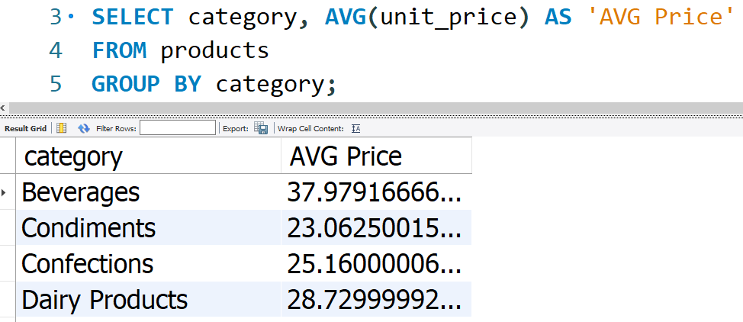
AVG() FUNCTION

Slide 3
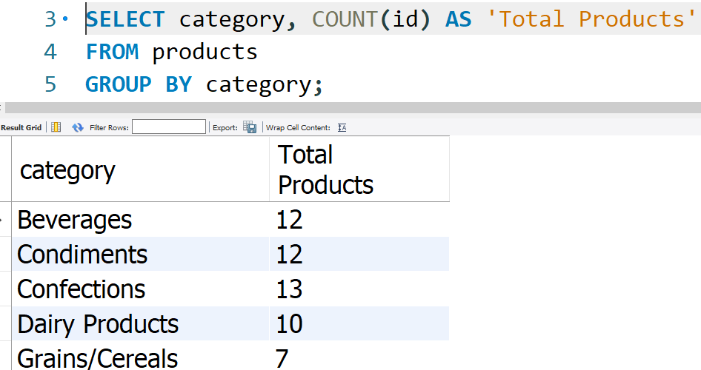
COUNT() FUNCTION

Slide 4
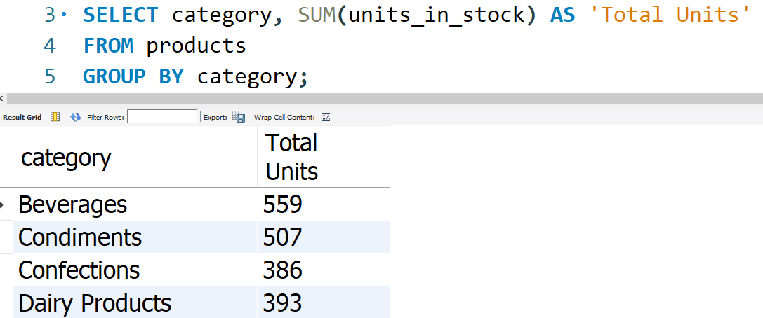
SUM() FUNCTION

Slide 5
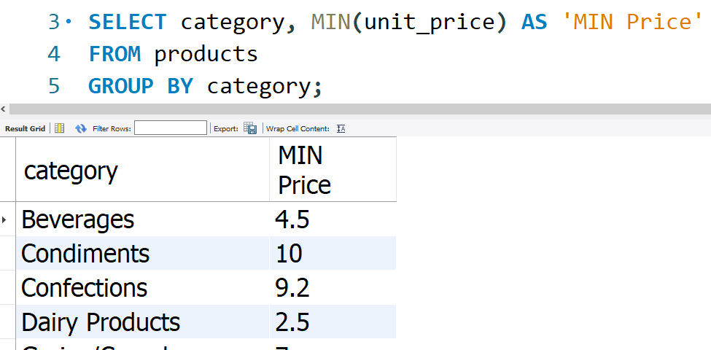
MIN() FUNCTION

Slide 6
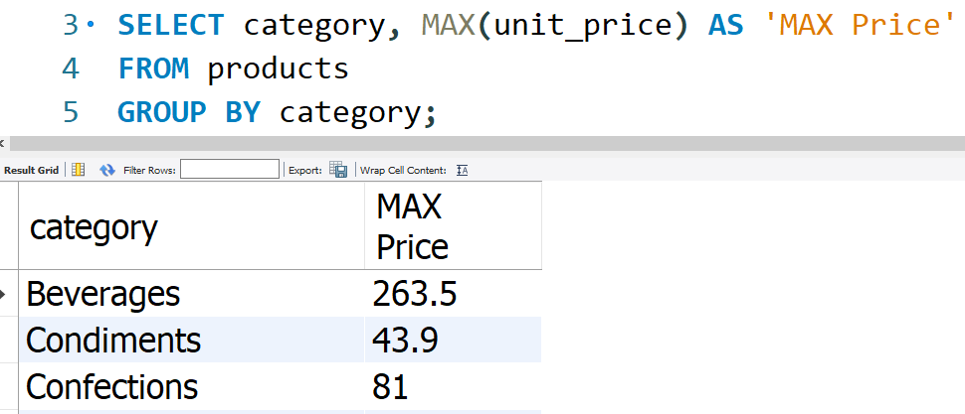
MAX() FUNCTION

Slide 7
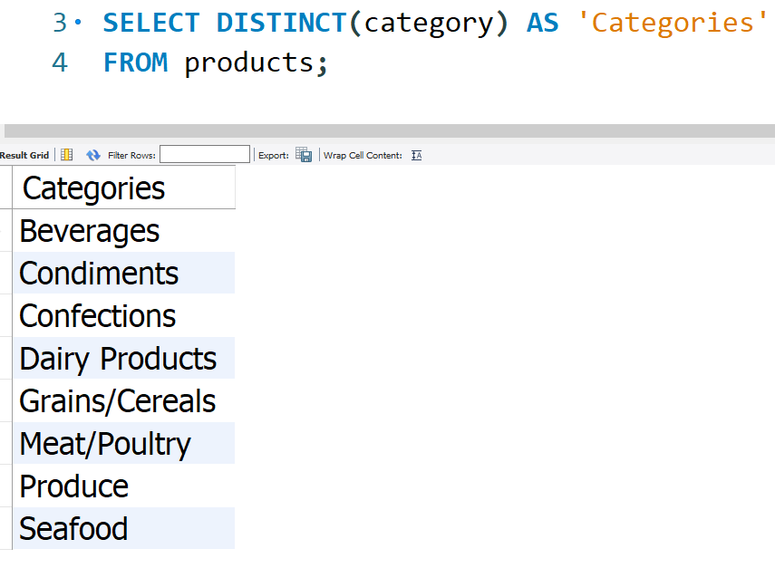
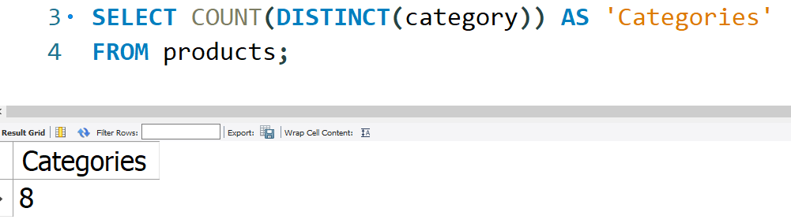
DISTINCT() FUNCTION

Slide 8
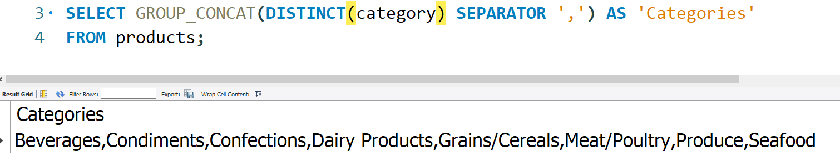
GROUP_CONCAT() FUNCTION

Slide 9
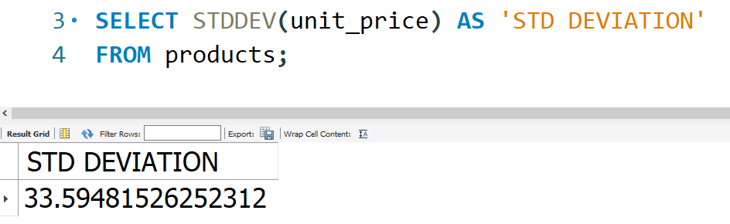
STDDEV() FUNCTION

