Slide 1
MuscleHub

Slide 2
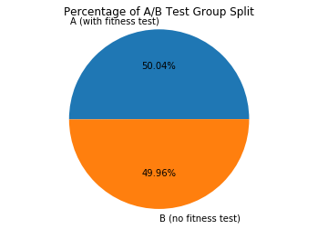
Percentage of A/B Test Group

Slide 3
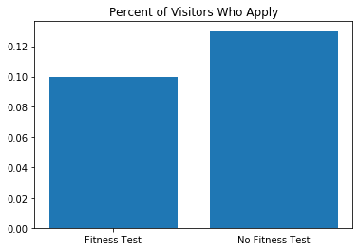
Percentage of Visitors Who Apply
Result is statistically significant (pval < 0.05)

Slide 4
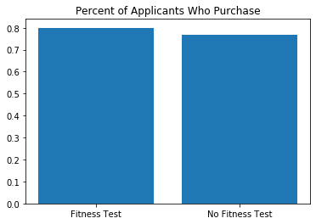
Percentage of Applicants Who Purchase
Result is not statistically significant (pval > 0.05)

Slide 5
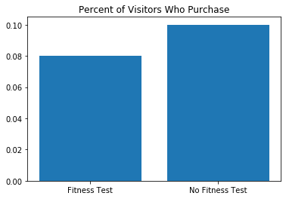
Percentage of Visitors Who Purchase
Result is statistically significant (pval < 0.05)

Slide 6
Recommendation
Our recommendation is to remove the fitness test in order to increase the purchases from people who visit MuscleHub

