Slide 1
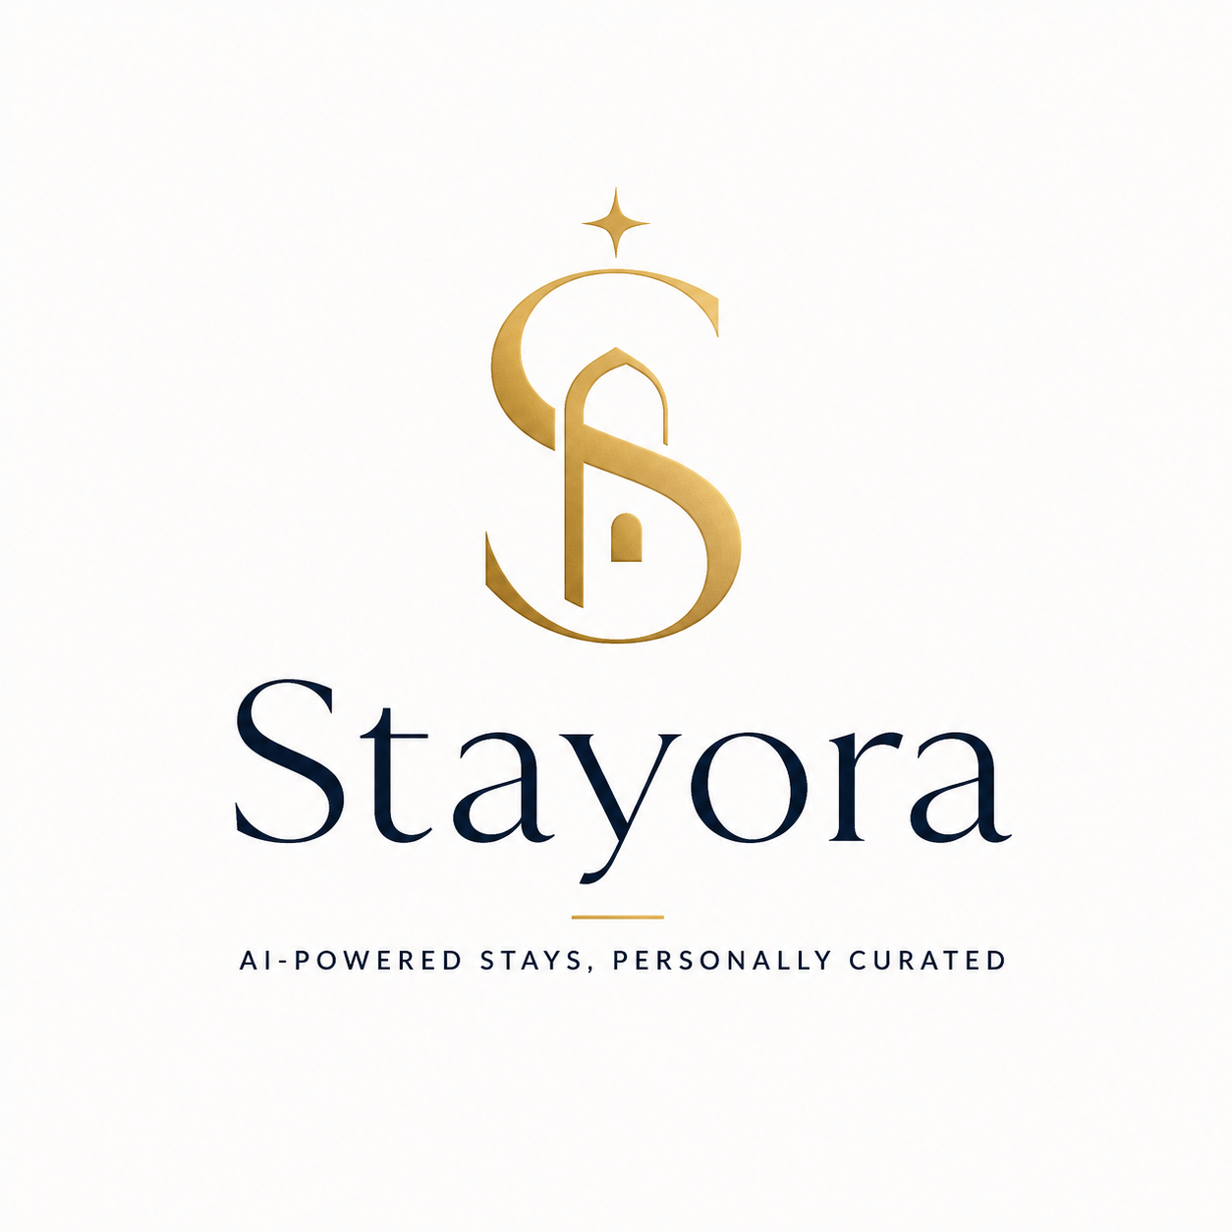
Premium agentic hotel booking assistant that searches, explains, verifies, and reserves in one trusted conversation.

Slide 2
Stayora
Introduction
Stayora turns hotel booking into a premium concierge conversation.
Understands preferences
Compares live inventory
Explains tradeoffs
Confirms before booking
From search to confirmed reservation
Stayora is an AI-powered booking assistant for travelers who want confidence, speed, and personalization — not endless tabs and unclear policies.
Stayora — premium AI hotel concierge

Slide 3
Stayora
Problem
Hotel booking is high-intent, high-friction, and still too manual.
Choice overload
Travelers compare dozens of tabs, filters, reviews, and policy pages.
Trust gap
Prices, availability, taxes, and cancellation rules often change before checkout.
Generic ranking
Traditional OTAs optimize for inventory and ads, not truly personal fit.
Action friction
Most assistants can recommend; few can safely complete the reservation.
The result: travelers spend more time deciding than actually enjoying the trip.
AI-powered stays, personally curated

Slide 4
Stayora
Solution
A trusted agent that curates, verifies, and books.
1
Understand
2
Search
3
Recommend
4
Reserve
Convert natural language into structured travel intent.
Call live hotel inventory and availability through MCP.
Rank options using preferences, RAG knowledge, and policies.
Re-check price, ask for confirmation, then create booking.
Differentiator: Stayora does not stop at “here are options.” It handles the full transaction flow with safety checks.
LLM + Agents + RAG + MCP + RouteStack reservations

Slide 5
Stayora
Market Size
Large travel demand meets rising adoption of AI-assisted discovery.
$492B
$707B
$416B
projected worldwide hotel market revenue in 2026
global online travel booking market projected for 2025
global luxury hotel market forecast by 2034
Beachhead
Premium leisure and business travelers who value curated recommendations, flexible cancellation, and a concierge-like booking experience.
Sources: Statista Hotels Market Forecast 2026; Custom Market Insights Online Travel Booking 2025; Fortune Business Insights Luxury Hotel Market 2026–2034.

Slide 6
Stayora
Tech Stack
A modern full-stack AI system built for dynamic transactions.
Frontend
React + TailwindCSS
Conversational booking UI, hotel comparisons, confirmation flow
Backend
Node.js + PostgreSQL
Auth, sessions, audit trail, reservations, saved preferences
AI Layer
LLM + RAG + Agents
Intent parsing, personalized ranking, policy reasoning, response generation
Tools
MCP Servers + RouteStack
Search hotels, get live rates, verify policies, and create reservations via RouteStack
Designed to show practical LLM, RAG, Agents, and MCP integration

Slide 7
Stayora
Architecture
Agentic orchestration with clear boundaries between knowledge and action.
RAG
Policies, guides,
preferences
Vector DB
→
↗
Agents
Search • Recommend
Policy • Booking
User
travel request
LLM
Orchestrator
→
→
↘
MCP
standard tool layer
RouteStack
→
AI-powered stays, personally curated

Slide 8
Stayora
Business Model
Multiple monetization paths across consumers, partners, and platforms.
Booking commission
Earn affiliate or transaction revenue on completed reservations.
Premium concierge
Monthly subscription for frequent travelers and business users.
B2B white-label
Offer Stayora as an AI booking layer for hotels, agencies, or loyalty programs.
Travel upsells
Attach insurance, airport transfer, activities, and room upgrades.
North star metric: confirmed bookings per active traveler
Revenue scales with successful, trusted booking outcomes

Slide 9
Stayora
Competition
Stayora competes by becoming the intelligent action layer above search.
Booking.com
Inventory depth
Expedia
OTA bundle scale
Google Travel
Search entry point
Hopper
Price prediction
Stayora
Agentic concierge
Positioning
Traditional OTAs are optimized around search results and booking funnels. Stayora is built around traveler intent, explainable recommendations, safety checks, and dynamic reservation execution.
Competitive signals: Booking Holdings reported $186.1B gross travel bookings and 1.2B room nights in 2025; Booking and Expedia together hold ~42% of global OTA gross bookings according to Skift Research.

Slide 10
Stayora
Team
A founder-led capstone combining AI engineering, product thinking, and full-stack execution.
Mousa Ayoubi
Founder • AI Developer • Full-Stack Developer
Stayora is designed and built by Mousa Ayoubi as an end-to-end demonstration of production-style agentic AI systems.
Stayora — premium AI hotel concierge

