Slide 1
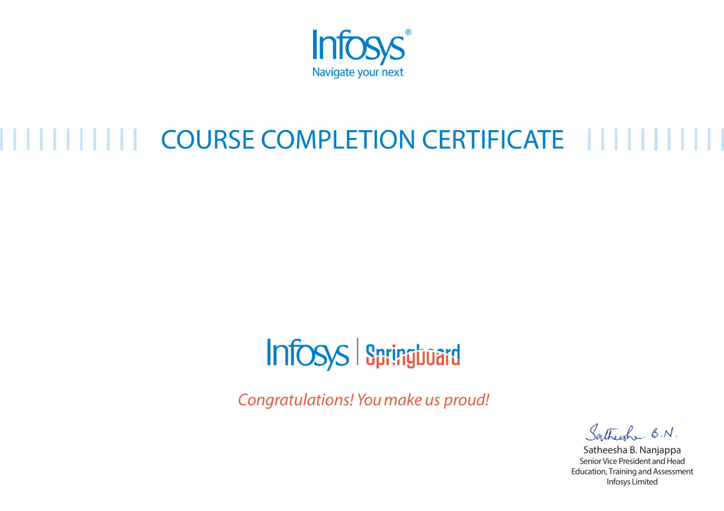

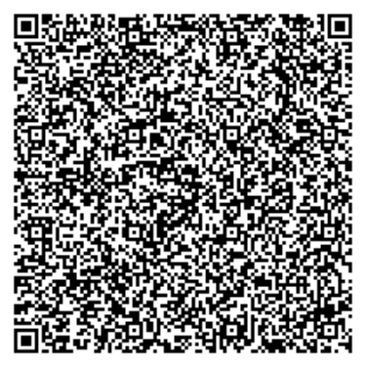
The certificate is awarded to
Mousami Rout
for successfully completing the course
Data Science
on May 21, 2026
Issued on: Thursday, May 21, 2026
To verify, scan the QR code at https://verify.onwingspan.com

