Slide 1
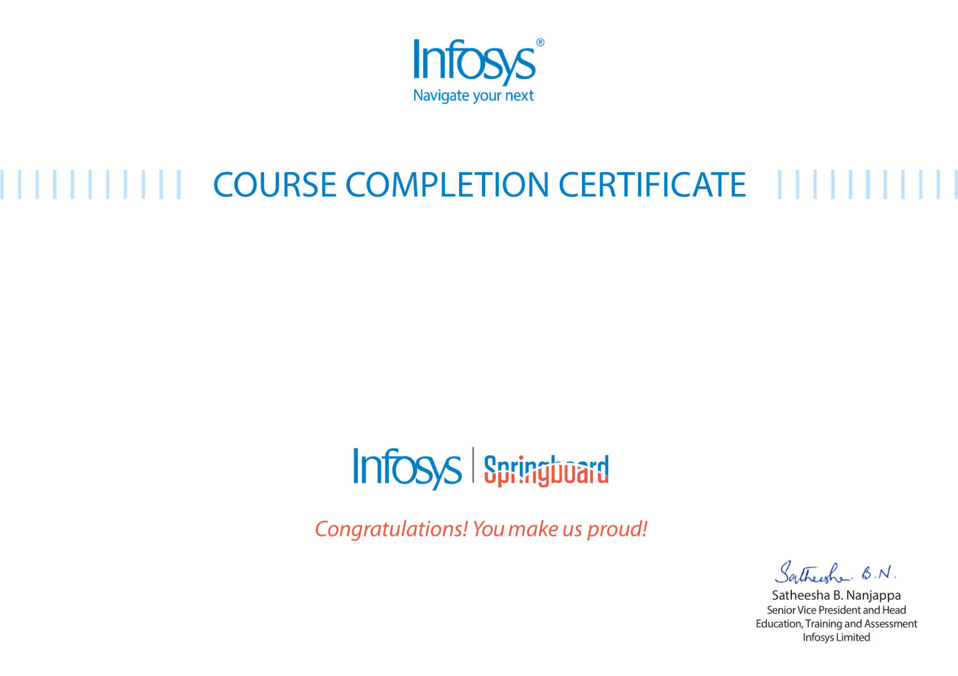

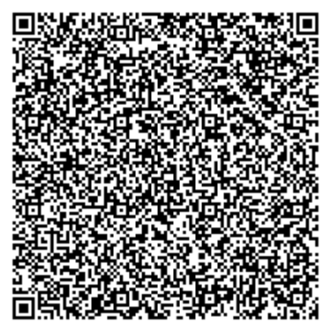
The certificate is awarded to
Mousami Rout
for successfully completing the course
Introduction to OpenAI GPT Models
on May 13, 2026
Issued on: Wednesday, May 13, 2026
To verify, scan the QR code at https://verify.onwingspan.com

