Slide 1
Arizona State University · CNALH / Symbiota Lichen Portal
Taxonomic Data Enhancement
of the Consortium of Lichen Herbaria
(Symbiota)
A Multi-Source Data Integration and Quality Initiative | 2024 – 2026
Mousa Shaya Software Architect & ML Consultant
Shaya Software and Systems LLC · shayaml.com
In collaboration with Dr. Frank Bungartz — Collections Manager, Lichens & Digital Data, ASU
ABLS Consortium Meeting | April 2026

Slide 2
The Problem: A Portal with Growing Data Quality Debt
⚠
🔗
🚫
Taxonomic Drift
Missing Cross-References
Non-Lichen Contamination
Scientific names are not verified, lacking identifiers. As understanding evolves, names change — and the portal's taxonomy has fallen behind authoritative international databases.
Tens of thousands of taxa lacking source identifiers linking them to MycoBank or Index Fungorum, making verification and curation significantly harder for collection managers.
Portal contains a substantial number of non-lichen fungal taxa. Maintenance of accepted names vs. synonyms difficult, non-lichen taxa irrelevant.
Source data scale: Lichen Portal — 132,501 records | MycoBank — 537,509 | Index Fungorum — 630,652

Slide 3
Why This Work Is Hard
01
Bridging Two Very Different Worlds
A lichenologist and a software engineer do not naturally speak the same language. Building this collaboration required sustained effort to understand each other's domain — what Frank knew deeply about taxonomy, and what could be reliably encoded in software. That shared understanding was the foundation for everything that followed.
02
No Single Source of Truth
MycoBank and Index Fungorum are built independently, updated asynchronously, and frequently disagree on accepted names. Conflicts cannot be resolved algorithmically — they require expert scientific judgment.
03
Taxonomy Is a Living System
Synonym chains are deep and sometimes disagree. Concepts of currently accepted names may change. Experts disagree. Resolving these chains requires following pointers through multiple levels of nomenclatural history.
04
Silent Data Corruption
Author names span centuries and languages — diacritics, abbreviations, and spelling variants handled inconsistently across sources create mismatches that are invisible to the eye but distinct to a database.

Slide 4
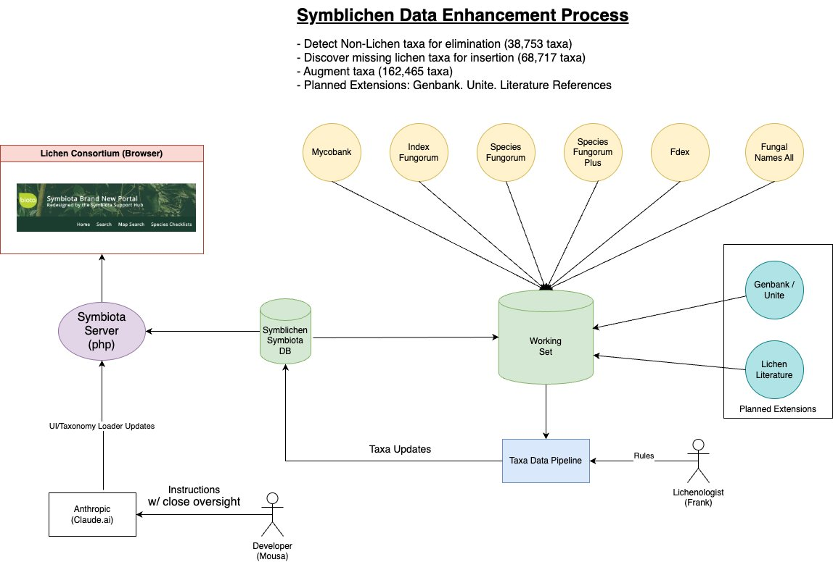
System Architecture: Data Enhancement Process
Six authoritative fungal name databases reconciled into a unified working set, with expert lichenological rules — provided by Dr. Frank Bungartz — governing every update.

Slide 5
Technical Innovation: Cross-Source Record Matching
The requirement: Each record in the Lichen Consortium must be matched to its name records in MycoBank and Index Fungorum, matching on both scientific name and author — but author strings are inconsistent.
Solution: The TaxaKey Algorithm
Author strings with variants = punctuation, initials spacing, name order, parenthetical basionym authors, nomenclatural suffixes like "nom. inval." Normalization algorithm eliminates variations into a canonical form. ⇒ TaxaKey — a reliable cross-source join key, examples below:
Scientific Name
Author (as found in source)
TaxaKey
Peziza quelepidotia
Korf & ODonnell
Peziza quelepidotia-KoOD
Peziza quelepidotia
Korf & O'Donnell
Peziza quelepidotia-KoOD
Arthonia hodgesii
R.C. Harris & Lendemer
Arthonia hodgesii-HaLe
Arthonia hodgesii
Lendemer & R.C. Harris
Arthonia hodgesii-HaLe
Zamenhofia stoechadiana
(F. Rose & Cl. Roux) Clauzade & Cl. Roux
Zamenhofia stoechadiana-CRCl
Zamenhofia stoechadiana
(F. Rose & Cl. Roux) Clauzade & Cl. Roux nom. inval.
Zamenhofia stoechadiana-CRCl
Each pair of rows shows different author representations from different sources — both resolve to the same TaxaKey, enabling reliable cross-source record linkage.

Slide 6
Technical Innovation: The Lichen / Licheniculous Filter
The Challenge
Sample Lichen Taxonomy Hierarchy Reference List
Mycobank/Index Fungorum: hundreds of thousands taxon names — the majority not lichens !!!
⇒ "Contamination with non-lichen taxa"
Phylum
Class
Order
Family
Ascomycota
Lecanoromycetes
Acarosporales
—
Ascomycota
Lecanoromycetes
Candelariales
—
The Solution
Ascomycota
Coniocybomycetes
Coniocybales
—
Authoritative list of lichenized, licheniculous & allied fungi
with taxonomic hierarchy — Phylum through Family — only taxa that match proceed to upload ...
Ascomycota
Dothideomycetes
Eremithallales
Melaspileaceae
Ascomycota
Dothideomycetes
Monoblastiales
—
Ascomycota
Eurotiomycetes
Chaetothyriales
Microtheliopsidaceae
Result
Ascomycota
Eurotiomycetes
Chaetothyriales
Pyrenotrichaceae
38,753 non-lichen taxa identified for removal from the portal — restoring the scientific integrity of the database.
Ascomycota
Sordariomycetes
Xylariales
Requienellaceae
Taxonomy authority provided by Dr. Frank Bungartz (ASU). All classification decisions are his.

Slide 7
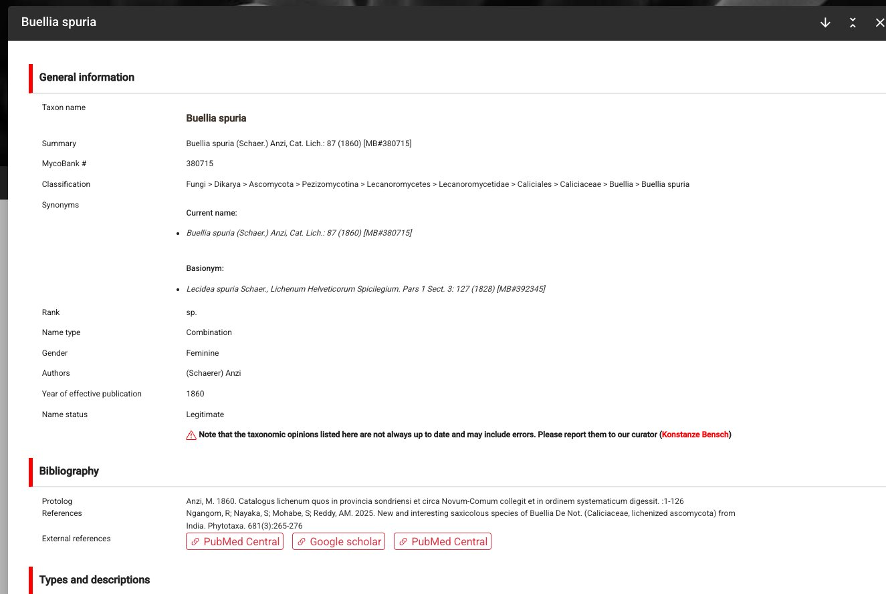
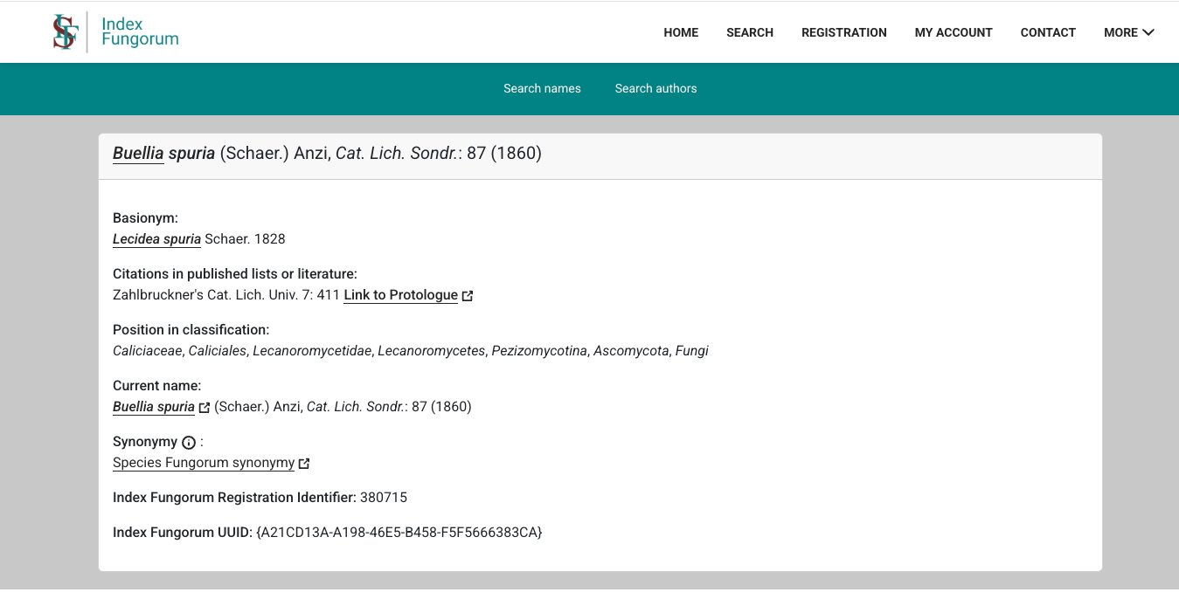
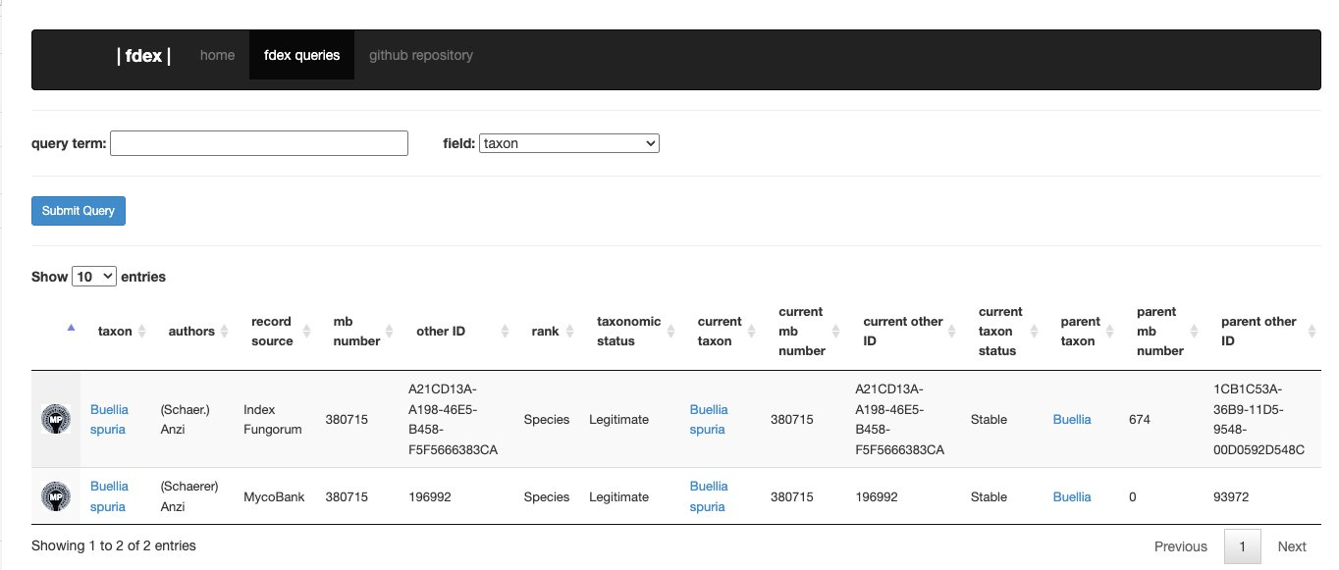
Data Sources: Examples
MycoBank
Index Fungorum
Fdex — Cross-source verification tool

Slide 8
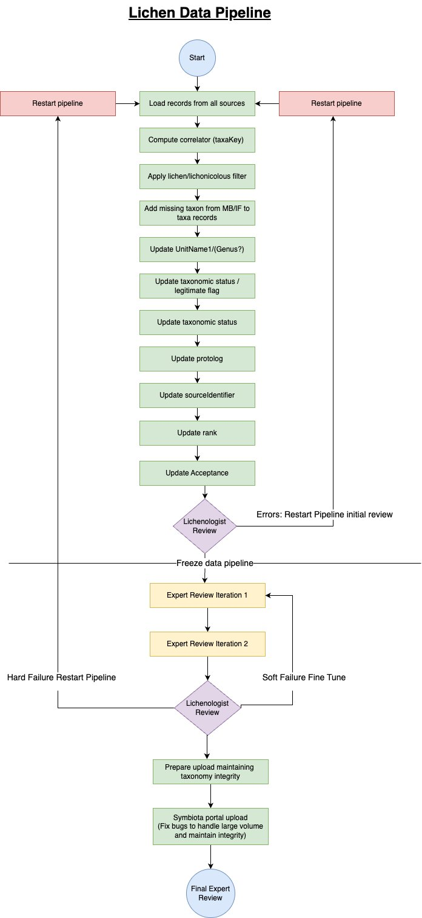
The Data Pipeline: Process Flow
Data Processing Phase
Multi-source load, lichen/licheniculous filter, and nine field updates with expert guidance, producing a candidate dataset.
Pipeline Freeze & Expert Review Gate
At a defined checkpoint, the pipeline is frozen. Dr. Bungartz reviews results. Hard failures restart from the beginning; soft failures proceed to fine-tuning.
Fine-Tuning Iterations (one or more cycles)
One or more structured expert review iterations address edge cases. Each cycle can trigger further refinement before the final upload is prepared.
Portal Upload & Final Expert Review
Data is loaded to the Symbiota portal with integrity safeguards. A final expert validation by Dr. Bungartz closes the cycle.

Slide 9
Results at a Glance
Measurable impact on portal completeness, accuracy, and scientific integrity
68,717
38,753
162,465
Missing lichen taxa
added to portal
Non-lichen taxa
identified for removal
Taxa records
augmented
37,615 from Index Fungorum
31,102 from MycoBank
A major expansion of portal coverage
Restoring scientific
database integrity
Protolog, rank, acceptance,
source identifiers updated
Source data ingested: MyCoBank 537,509 · Index Fungorum 630,652 · Species Fungorum · Fdex 90,191 · Fungal Names All 594,097

Slide 10
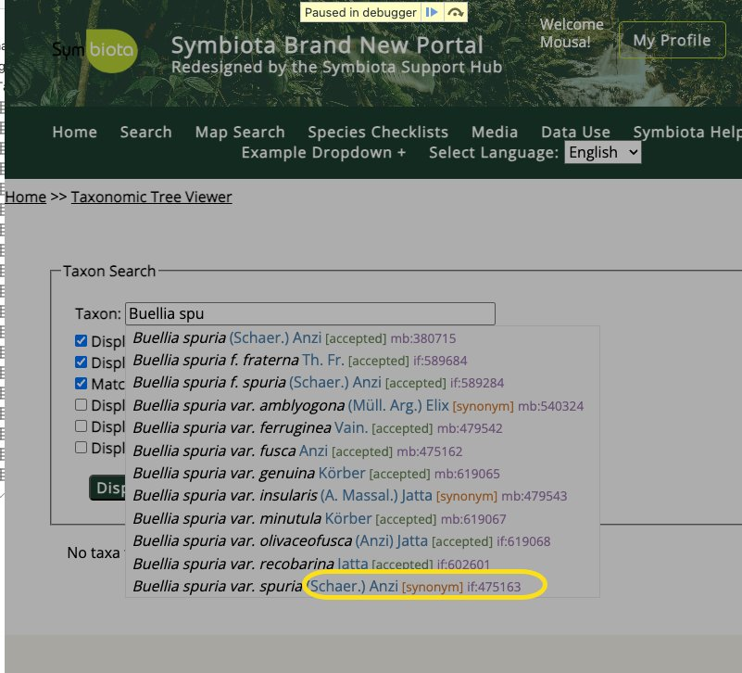
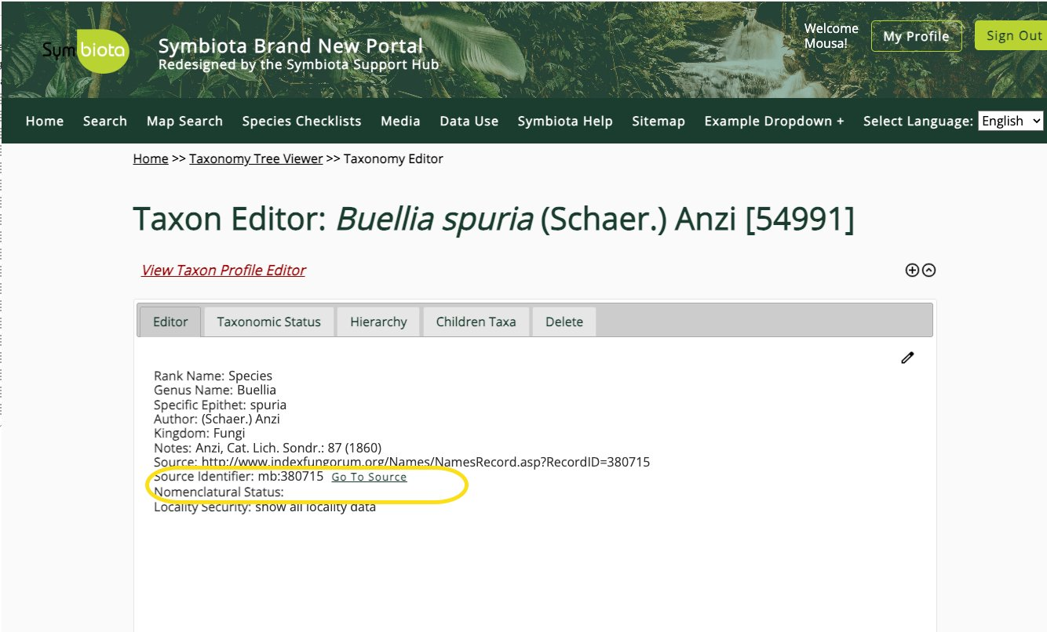
Portal Enhancements: Improving the Curator Experience
Enriched taxon search dropdown — acceptance status, source identifiers, and synonym flags visible at a glance
Taxon Editor showing cross-referenced source identifiers with direct 'Go To Source' links to MycoBank and Index Fungorum
Note: These UI enhancements are candidates for adoption across all Symbiota collections (birds, insects, plants) pending consortium review.

Slide 11
Conclusions & Path Forward
What Was Accomplished
Natural Extensions of This Work
Ingested and reconciled two major fungal name databases (Index Fungorum & MycoBank) into a unified working set
Identified 38,753 non-lichen taxa for removal from the portal
Added 68,717 previously missing lichen taxa — a major expansion of portal coverage
Augmented 162,465 records with authoritative nomenclatural data
Deployed enhanced UI enabling curators to verify and navigate taxa more efficiently
This work requires ongoing expert judgment and adaptation — it is not a fixed process, and the domain knowledge embedded in each decision cannot be replaced by automation
Bryophyte Collections
The pipeline architecture is domain-agnostic by design. Applying this methodology to bryophyte data is a natural and well-grounded next step — each extension requires the same expert-guided approach.
GenBank & UNITE Integration
Linking taxonomy records to molecular sequence data opens the door to phylogenetic validation of the portal's taxonomic backbone.
Literature Cross-Referencing
Connecting taxa to published lichen literature would further enhance the portal's value as a primary research tool.
Broader Symbiota Adoption
UI enhancements and data quality tooling developed here have applicability across all Symbiota-managed collections.

Slide 12
Thank You
Questions and discussion welcome
Mousa Shaya
Dr. Frank Bungartz
Software Architect & ML Consultant
Shaya Software and Systems LLC
Collections Manager, Lichens & Digital Data
Arizona State University
mshaya01.ml@gmail.com
This project was Frank's idea and direction. His vision, domain authority, and sustained scientific guidance made this work possible. I am personally and deeply grateful for his collaboration and trust — without which none of this would have happened.
shayaml.com
linkedin.com/in/mousashaya
github.com/mousashaya (source code)
Presentation & portfolio: shayaml.com

Slide 13
Live Portal Demo
Dr. Frank Bungartz will walk through the updated portal, demonstrating
taxon search, source cross-referencing, and curator workflow improvements.
Taxon search with enriched dropdown
Taxon Editor: source linking & nomenclatural status
Before / after: data quality comparison

