Slide 1
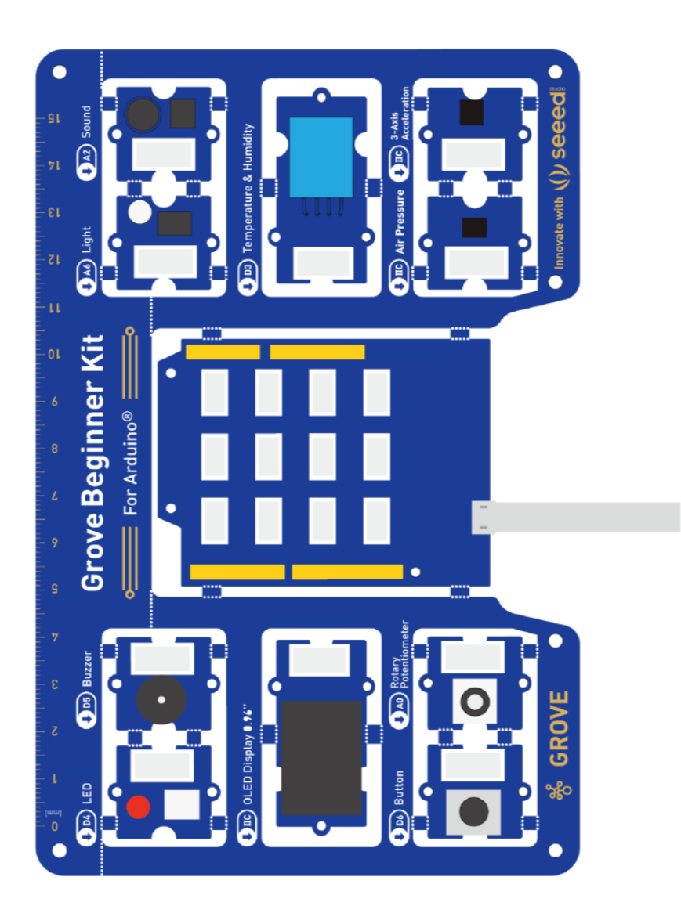
Chaihuo Maker Academy · Smart Hardware Fundamentals (M0)
Sense and Respond
Grove Beginner Kit · IoT Starter Board · M0 Lesson 1
Can't write code? Good. This course doesn't need it.
Grove Beginner Kit for Arduino
Chaihuo Maker Academy · M0 · Sense and Respond | 01 / 28
Notes:
Cover — loops before class. Open with silence, then one welcome line and go straight to the live demo — the cover is not a talking page. Board render on the right (existing kit asset).

Slide 2
Three Sentences, and the Board Sends a Distress Signal
Round 1 "Write a program that makes the Beginner Kit LED blink every 500 ms."
Round 2 "While the LED is on, the buzzer beeps; when the LED is off, stop."
Round 3 "Use Morse code to send a repeating sound-and-light SOS."
SOS = ... --- ... (three short, three long, three short)
Watch closely: he's typing plain English, not code — and all three lines go in the SAME conversation.
Chaihuo Maker Academy · M0 · Sense and Respond | 02 / 28
Notes:
The projector is background; the star is the instructor typing live in front of the class, slowly, so everyone sees plain language going in. Three rounds build in the same conversation (this is the silent first demo of 'add one more line'). Say nothing until the board sends SOS; the laughter and the 'ohhhh' are the point. Nothing Chinese goes on screen — the demo was chosen exactly for this. Demo fails -> cut to the backup recording (video asset on the asset checklist, slide 02) within 30 seconds: 'The board in this video is identical to the ones on your desks — you'll do the real thing yourselves in a minute.' Not an incident.

Slide 3
What Just Happened?
01
I said it in plain English
(a website called Codecraft)
02
AI wrote it as instructions
(that stuff is called code)
03
The instructions moved into the board
(that step is called flashing)
04
The board remembered
(three sentences, and it's sending SOS)
This isn't magic — it's the exact path you'll walk yourself in a minute.
Chaihuo Maker Academy · M0 · Sense and Respond | 03 / 28
Notes:
The most important 30-second 'landing' of the whole session. Say it once, hot off the demo (verbatim from the Teacher's Guide): 'I'm on a website called Codecraft. I told AI in three plain sentences what I wanted. AI wrote it out as instructions the board understands — that stuff is called code. Once, a person had to type every line by hand; today it typed them for me. Then the computer moved the instructions through this cable into the board — that step is called flashing. Once it's in, the board remembers — even unplugged. I wrote zero lines of code. Three sentences, and it's sending a distress signal.' Without this page, students remember 'the teacher does magic'; with it, they remember 'I can do this too.'

Slide 4
Three Questions
1
Did I just write any code?
2
Who in this room knows how to code?
3
Without knowing a single line of code,
could you make that thing I just made?
Chaihuo Maker Academy · M0 · Sense and Respond | 04 / 28
Notes:
The pauses are the soul of this bit. Pause two seconds after each; let the 'yes' come out of their mouths: 'Number one: did I just write any code? (pause) Number two: who in this room knows how to code? (pause — probably no hands) Number three: without knowing a single line of code, could you make that thing I just made? (pause) Yes. That's this course.' Don't rush; don't answer for them.

Slide 5
The Kickoff in 30 Seconds
YOUR ROLE
THE WHOLE MAP
WHAT WE PRACTICE TODAY
Not a programming class — you're the director, AI is the programmer.
House rule: no hand-written code. Say it clearly, watch what happens, tell it to change.
A project takes eight steps: frame the problem, find the user, prototype, code, make trade-offs, test and judge, document, share the value.
Today we take steps 3 and 4.
Two skills: build it — and tell the story of how you built it.
Missed the kickoff? Remember these three lines and you'll keep up today.
Chaihuo Maker Academy · M0 · Sense and Respond | 05 / 28
Notes:
Walk the three cards fast (about 3 min), then the three house rules (30 s, verbatim): 'One: you don't need to understand the code AI writes — your job is to say it clearly, watch what happens, and tell it to change. Two: no hand-written code — not because code doesn't matter, but because this course trains something more valuable than code. Three: when you're stuck, say so — ask your AI first, then your neighbor, then raise your hand.' Then point at the 8-step map on the whiteboard (2 min, names only, no expansion): 'Most people think AI only helps with step four — the code. Not this course: all eight steps, you learn to make AI your partner. Today we take steps three and four.' Hard time-box: 5 min total for map + rules.

Slide 6
What This Course Trains
Today we practice two: Build it — and Tell the story of how you built it.
Spot a problem
Find the user
Build it
Make trade-offs
Judge quality
Tell the story
AI writes the code — these six, it can't do for you.
Chaihuo Maker Academy · M0 · Sense and Respond | 06 / 28
Notes:
'This course trains six skills: spot a problem, find the user, build it, make trade-offs, judge quality, tell the story. AI writes the code — these six, it can't do for you. Today we practice two: build it, and tell the story of how you built it.' Keep it light; all six come back by doing. Two cells highlighted (build it / tell the story) — the pair today's session actually trains.

Slide 7
The One Thing I'd Most Like AI to Do for Me
With your neighbor: 15 seconds each.
The smaller and more real, the better.
Chaihuo Maker Academy · M0 · Sense and Respond | 07 / 28
Notes:
Self-disclose first, one real small thing of your own (I want AI to remind my mom to drink water — swap in your own; the smaller, the better): 'With your neighbor, 15 seconds each — 'the one thing I'd most like AI to do for me'. I'll go first — ...' Dead silence? Self-disclose one more, even smaller ('I want AI to remind me to grab my keys when I leave'), then call directly on the student you know best. Never let silence run past 10 seconds. TA notes the gold answers — reusable in later sessions.

Slide 8
Everyone Logs In
What is Codecraft?
A website — where you talk to AI, and where AI writes
the instructions for your board. That's the site you just saw me use.
codecraft.seeed.cc
1
Open your browser, go to the address above
2
Log in with the account on your seat card — just log in, don't click around yet
The address and your account details are on your seat card.
Chaihuo Maker Academy · M0 · Sense and Respond | 08 / 28
Notes:
'Now — open your browser, go to codecraft.seeed.cc — the site I used in the demo. It's called Codecraft. It's where you talk to AI, and where AI writes the instructions for your board. Log in with the account on your seat card. Just log in — don't click around yet.' Before the next segment starts, login problems must be at zero — TA circulates fixing against the paper seat map.

Slide 9
Name Lighting
Put Your Name on the Screen
Chaihuo Maker Academy · M0 · Sense and Respond | 09 / 28
Notes:
'Demo seen, ideas explained. Next thirty minutes are yours — every single board in this room lights up your own name. No exceptions.' Clean section page — no timing, no handout info.

Slide 10
Meet Your Board
The main board in the middle — its brain (AI has the ideas; you make the decisions)
Screen, light, little speaker — its face and voice
Sensors — its eyes and ears: feels light, feels sound, feels temperature
Button and knob — how you operate it
USB port — plug in here today
It's called a development board —
a tiny computer. Dumber than
your phone, but give it one job
and it'll do it all day, for a year,
without complaining.
The little modules can be snapped off and
used separately later — not today.
Today nothing snaps.
Chaihuo Maker Academy · M0 · Sense and Respond | 10 / 28
Notes:
90 seconds max, no theory. Hold up a real board and point as you go (verbatim from the Teacher's Guide). End with: 'Today you're going to make it speak your name. Now — plug in the USB cable, one end in the computer, one end in the board.'

Slide 11
The Grove Beginner Kit (Overview)
GROVE PORTS
This board's full name: the Grove Beginner Kit for Arduino — in class, just 'the starter kit'.
One of the best Arduino starter kits out there: no soldering, no complicated wiring — your only job is making it do what you say.
Next four pages: meet its parts, fast.
SENSING x5
INTERACTING
BRAIN
SPEAKING
Chaihuo Maker Academy · M0 · Sense and Respond | 11 / 28
Notes:
'This board's full name: the Grove Beginner Kit for Arduino — in class, just 'the starter kit'. One of the best Arduino starter kits out there: no soldering, no complicated wiring — your only job is making it do what you say. Next four pages: meet its parts, fast.'

Slide 12
The Kit — Sensing (its eyes and ears)
GROVE PORTS
light
sound
temperature and humidity
barometer
accelerometer
The dark-detecting light uses that eye — the light sensor.
SENSING x5
INTERACTING
BRAIN
SPEAKING
Chaihuo Maker Academy · M0 · Sense and Respond | 12 / 28
Notes:
'Its eyes and ears.' — 'This one feels light, this one feels sound, this one feels heat and moisture, this one feels air pressure, this one can feel being touched or shaken. The dark-detecting light in a minute uses that 'eye' — the light sensor.'

Slide 13
The Kit — Speaking (its voice and face)
GROVE PORTS
the screen shows words
the light glows
the buzzer beeps
Your name lights up on this little screen today.
SENSING x5
INTERACTING
BRAIN
SPEAKING
Chaihuo Maker Academy · M0 · Sense and Respond | 13 / 28
Notes:
'Its face and voice.' — 'The screen shows words, the light glows, the buzzer beeps. Your name lights up on this little screen today.'

Slide 14
The Kit — Interacting (how you operate it)
GROVE PORTS
a button
a knob
Press, twist — the board can feel both. Build 3 puts them to work.
SENSING x5
INTERACTING
BRAIN
SPEAKING
Chaihuo Maker Academy · M0 · Sense and Respond | 14 / 28
Notes:
'Where you operate it.' — 'These two are for you: a button and a knob. Press, twist — the board can feel both. Build 3 will put them to work.'

Slide 15
The Kit — The Brain and the Grove Ports
GROVE PORTS
The instructions AI writes all live here.
This row of Grove ports is for later: snap a module off, plug it out, build something bigger. Not today — today nothing snaps.
SENSING x5
INTERACTING
BRAIN
SPEAKING
Chaihuo Maker Academy · M0 · Sense and Respond | 15 / 28
Notes:
'Last, the brain — the main board in the middle. The instructions AI writes all live here. This row of Grove ports around the edge is for later: snap a module off, plug it out, build something bigger. Not today — today nothing snaps.'

Slide 16
Connect Codecraft — five steps to lit
1
Pick your board — click Grove Beginner Kit
2
Type your request in the box, click send
3
Click the green button: Connect and Flash
4
Pick the serial port, then Connect
5
It flashes automatically — watch the board
Which serial row? The one with CP2102N / USB — not the Bluetooth row. No popup? Clicked Cancel by accident? Click Connect and Flash again — still stuck, raise your hand: a TA will fix it in 2 minutes.
Chaihuo Maker Academy · M0 · Sense and Respond | 16 / 28
Notes:
Project and lead the whole class in lockstep; don't let fast students run ahead (a fast one connects early — have them wait; don't let the pack scatter). 'This step is called connecting. What's it for? Getting the computer and the board talking — the instructions AI wrote need to travel down this USB cable into the board.' TA watches two things: popup never appearing (browser problem) and accidental Deny clicks (just click connect again). Serial list empty? Nine times out of ten the cable carries power but no data — swap the cable. Fix within 2 minutes, else swap to a spare machine.

Slide 17
Spell 1 | One Thing at a Time
I'm using the Grove Beginner Kit. Please do one thing for me: ___ (just one). It counts as done when ___. Please don't add other features yet.
GOOD
"Display in large text on the screen: Hello, I'm Sam."
BAD
"Set up the lights, the screen and the speaker, make it cool."
— three jobs plus "cool" — AI can only guess.
Chaihuo Maker Academy · M0 · Sense and Respond | 17 / 28
Notes:
'One more pass at spell one: one thing at a time. Not 'set up the lights, screen and speaker'. Say 'display my name in large text on the screen'. One thing, said clearly, and it gets it right.' Write that sentence in a corner of the whiteboard and leave it there all session.

Slide 18
The Two Spells for Talking to AI
One thing at a time.
1
Not "set up the lights, the screen and the speaker" — one thing, said clearly, and it gets it right.
If it's wrong, add one more line.
2
Don't delete the conversation, don't restart — add one line in the same conversation. AI remembers what you talked about.
Both spells are in your Student Workbook — check them whenever you forget.
Chaihuo Maker Academy · M0 · Sense and Respond | 18 / 28
Notes:
The largest type of the deck (36 pt class). Read each spell once, then have the class read it back with you — the standard posture for all of today's conversations. The lines match the Teacher's Guide verbatim (14:30 'The two spells').

Slide 19
Your First Task — Light Your Name
1
Type this sentence (swap in your own name)
2
Click Generate, then wait for compile
3
Click Flash — watch the screen
Display in large text on the screen: Hello, I'm [your name].
generate = AI writes the instructions
compile = translated into what the board understands
flash = moved down the USB cable into the board — unplug it, it still remembers
Raise your hand — a TA will put a flag on your desk.
Chaihuo Maker Academy · M0 · Sense and Respond | 19 / 28
Notes:
Three new words first (20 s): 'Generate — AI is writing the instructions. Compile — it's translating them into what the board understands. Flash — moving the translated instructions down the USB cable into the board. Once they're in, the board remembers. Unplug it — still remembers.' Then demo once slowly, then hand over: your name in English letters (Chinese glyphs are unreliable on this board — light English first, guaranteed; want to try Chinese? If it won't display, switch back to English and teach it Chinese later). You never type for a student — their hands, their success. 10 minutes without lighting up — swap to a spare board, don't fix. TA hands out 'LIT' flags one by one as boards light.

Slide 20
Hold Up Your Boards!
From this moment, you're people who
can make hardware do what you say.
(look at the camera —)
Chaihuo Maker Academy · M0 · Sense and Respond | 20 / 28
Notes:
'Everyone — hold up your boards! (wait for the whole room) From this moment, you're people who can make hardware do what you say. Look at the camera —' TA sweeps first: anyone still dark gets lit before joining the photo — nobody photographs a dark board. Photo is also log material and the end-of-course comparison shot: one landscape, one portrait. Compose around raised boards and screens; backs of heads and hands are fine.

Slide 21
Free Round — It's Yours Now
Add an effect you want — blinking, a beep, an emoji, scrolling. Your pick.
Make the name blink once per second
Make a sound when the name shows
Make the name scroll from right to left
Spell 2 | If it's wrong, add one more line — don't delete, don't restart. AI remembers what you said before.
Chaihuo Maker Academy · M0 · Sense and Respond | 21 / 28
Notes:
'It's yours now. Add an effect you want — blinking name, a beep when it appears, an emoji, make it scroll. Your pick. ... Effect not right? Don't delete, don't restart — add one line in the same conversation, like 'no, I want it to blink faster'. AI remembers what you said before.' After about 3 min, table show and tell: 30 seconds each — what effect did you add, and how did you tell AI? Project the 'broke it, then fixed it' conversations, not the flashiest — the class needs to see that fixing it back is the normal everyday move. Student dumps everything on AI at once? 'Nice appetite. But directors shoot one scene at a time — pick one effect and make it solid, then shoot the next scene.'

Slide 22
Sense → Logic → Output
(the only mental model of the whole course)
SENSE
→
LOGIC
→
OUTPUT
The automatic door: it sees someone → decides whether to open → the door opens
The air conditioner: it measures the temperature → compares → cools
Your mom: she sees you on your phone → decides whether to yell → she calls you
Your board: eyes and ears on this side, face and voice on this side. The logic in the middle — that's your call.
Chaihuo Maker Academy · M0 · Sense and Respond | 22 / 28
Notes:
Examples only, no jargon; give these 5 minutes their full due. Have the class read the six words back with you: 'sense, logic, output.' Keep the 'mom' example — the room laughs every time. Optional local swap: replace the first two examples with something everyone in town has seen (the sensor light at the corner shop, the rice cooker at home); keep 'mom.'

Slide 23
Build 1 | Follow-Along — The Dark-Detecting Light
When the light gets dim, turn on the LED; when it gets bright, turn it off.
1
Type the sentence
2
Generate, compile, flash
3
Cover the light sensor with your hand
All together — three, two, one, cover!
SENSE = light
LOGIC = dark means on
OUTPUT = the LED
Chaihuo Maker Academy · M0 · Sense and Respond | 23 / 28
Notes:
'Build one, we do it together: a light that turns on when it's dark. Tell AI — 'When the light gets dim, turn on the LED; when it gets bright, turn it off.' Send, flash. Now — everyone, cover the light sensor on your board with your hand — (lights come on across the room, one after another) — look at that. A room full of night lights.' Make the cover-test a moment: 'Three, two, one — cover!' Sluggish light = teaching point, loud enough for the room: 'It thinks your spot isn't dark enough. What do you do? Tell AI — 'make it more sensitive.'' — spell two in action, live. Then fill the 3 boxes back in (15:25–15:30): 'What did we just do? Sense — the light. Logic — dark means on. Output — the LED. Fill the boxes, that simple. Now you're going to fill the boxes yourselves — whatever you fill, you build.'

Slide 24
Build 2 | Semi-Free — Pick One Sensor + One Output
Pick one sensor and one output from the table card. Your combination.
Clap light
Shake alarm
Heat alert
hears a sound → decides it's loud enough → light on
feels a shake → decides it's moving → buzzer beeps
measures temperature → decides it's too hot → screen warns
Tell your neighbor your 3 boxes BEFORE you touch the keyboard.
Can't say it, can't code it.
(Your three boxes, out loud, before you touch the keyboard.)
Chaihuo Maker Academy · M0 · Sense and Respond | 24 / 28
Notes:
The first question you ask while circulating is always: 'What are your three boxes?' Can't answer? Use the analogy: 'In your build, which part is the automatic door's eye?' Student only stacks outputs with no sensor? 'Cool — now make it perform only when [some condition] happens.' The moment the class's first error appears — stop the whole room for 1 minute and switch to slide 25.

Slide 25
The Right Way to Handle an Error
An error isn't a broken thing — it's AI talking to you.
1
Copy the full error text
2
Add "here's what I just changed" and throw it all back to AI
Chaihuo Maker Academy · M0 · Sense and Respond | 25 / 28
Notes:
Deliberately no red on this page: the point is to de-dramatize errors. Stop the room for 1 minute, project that student's screen, walk them through the move together: 'See? An error isn't a broken thing. It's AI talking to you. It wrote the problem out — you just forward it back.' Backup if the class somehow produces no error: project the prepared 'make the board fly' conversation from Rehearsal 4 and teach the point anyway.

Slide 26
Build 3 | Fully Free — Make Something That Reacts
One-line brief: make something that reacts. What it reacts to, how it reacts — all yours.
Clap light
Mini alarm
Desk weather station
one clap on, one clap off
shakes → beeps; hold the button 2 seconds to disarm
screen shows temperature, humidity, light — too dark → light on; too hot → beep
Done and bored? Two directions — 1 Tiny game: whack-a-mole / reaction-timer (buttons score, screen shows the score) | 2 Board as controller: the board's buttons and knob drive a little game on the screen.
Done means: it reacts to the thing you chose — and you can say its three boxes.
Chaihuo Maker Academy · M0 · Sense and Respond | 26 / 28
Notes:
'Last build. One-line brief: make something that reacts. What it reacts to, how it reacts — all yours. Wanted to upgrade your earlier build instead? Go for it.' Fast students: only release challenge directions you've rehearsed and run yourself — a fast student crashing with no one to catch them is on you. Still fast? Make them the teacher: they explain their build to a neighbor in 3 boxes; next lesson they officially TA. Build only 'displays' instead of 'reacts'? 'It can already talk. Now give it an eye — it only speaks when ___.'

Slide 27
Flash Show and Tell + Your Full AI Log
Show and tell: in your table, 30 seconds each — demo your build, say its three boxes.
Your log, four sentences:
· Today I made ___
· I got stuck on ___
· Then ___
· Next time I want ___
Say it to your phone, then send it to AI with one more line: "Tidy this into a learning log — only what I said, nothing I didn't say."
Warning
AI will make things up with a straight face. Proofreading is your job.
Chaihuo Maker Academy · M0 · Sense and Respond | 27 / 28
Notes:
First log ever: you model it first with your own four sentences, including where YOU got stuck — you show weakness first, and they'll tell the truth. 'I got stuck on ___' is a required field; 'I didn't get stuck' → 'Went too smoothly? Then write down what you're worried about.' Someone accepts AI's log wholesale? Project the prepared 'AI got caught making stuff up' screenshot and teach the proofreading responsibility on the spot — today's hidden bonus teaching point. Project 2 builds: the cleverest combination + one rescued after a crash.

Slide 28
Next Time
Your logs are saved — that's the growth story of your builds.
By the end of the course, it's worth more than the builds themselves.
Lesson 2: Find a Problem Worth Solving
Start thinking on the way home — what's one small thing in your daily life that annoys you?
Chaihuo Maker Academy · M0 · Sense and Respond | 28 / 28
Notes:
Wrap fast, preview then dismiss: 'Today's logs are all saved — that's the growth story of your builds. By the end of the course it'll be worth more than the builds themselves. Next time, we do something even more important: find the problem worth building all the way to the end. Start thinking on the way home — what's one small thing in your daily life that annoys you? Class dismissed!' Leaving them wanting more is the best way to end.

