Slide 1

Chaihuo Maker Academy · Smart Hardware Fundamentals (M0)
Run the First Lap
Build Your Project's MVP · The Marathon's First Leg · Chaihuo Maker Academy · M0 Lesson 8
Today: from a requirements sheet to a running first version —
and AI becomes a reviewer for the first time.
Chaihuo Maker Academy · M0 · Run the First Lap | 01 / 42
Notes:
Cover page only; students see it as they sit down. No script. When the session starts, go straight to slide 02 — the opener's 30-second look-back is spoken, not projected. Right side: the baton illustration (the CN deck's IMG-01-01 — reused because it carries no Chinese glyphs); yellow rule under the subtitle. Footer: Chaihuo Maker Academy · M0 · Run the First Lap | 08 / 42.

Slide 2
From Today, I Only Circulate
I don't teach
Last session: your project got its brief — the requirements sheet is in your workbook, the core feature is down to one, and what got cut keeps its name.
The session before: your project moved into your own computer — from tenant to owner — and for the first time you saw what lives inside the code AI writes.
THE THREE LEGS
1
LEG 1 (today)
BUILD YOUR PROJECT'S MVP
2
LEG 2 (Lesson 9)
CALL IN REINFORCEMENTS — new modules, new libraries, the MVP grows new abilities
3
LEG 3 (Lesson 10)
Every leg runs the same rhythm — STAND-UP → BUILD → AI REVIEW → DECIDE → HANDOFF. Run all three legs, and your project has grown up.
FINAL POLISH — out to the showcase to meet people
Chaihuo Maker Academy · M0 · Run the First Lap | 02 / 42
Notes:
30-second look-back: last session, your project got its brief — the requirements sheet is in your workbook, the core feature is down to one, and what got cut keeps its name. The session before, your project moved into your own computer — from tenant to owner — and for the first time you saw what lives inside the code AI writes. From today, the course shifts gear. Before, you followed me; from today, I only circulate. I don't teach. What comes next is the marathon — three legs. Leg one (today): build your project's MVP. Leg two (Lesson 9): bring in the help — new modules, new libraries, and the MVP grows new abilities. Leg three (Lesson 10): the final polish — out to the showcase to meet people. Every leg runs the same rhythm: stand-up → build → AI review → decide → handoff. Run all three legs, and your project has grown up. This page is the first golden-line peak — big type, wide white space, the three legs as the visual spine.

Slide 3
Today's Goal — Build Your MVP
MVP = MINIMUM VIABLE PRODUCT — the smallest version you can put on the table and demonstrate.
THE CLOSED LOOP
IT SENSES SOMETHING
(the sensor has a reading)
→
IT REACTS
(light / buzzer / screen)
— start to finish, once.
YES / NO
YES
minimal but one complete loop — it senses, then it reacts, once. Today is lap one of Neil's spiral development.
NOT
every feature on your requirements sheet — the rest sleeps soundly on the "later" list.
NOT
a half-finished thing. Half-finished is "made half of it."
Chaihuo Maker Academy · M0 · Run the First Lap | 03 / 42
Notes:
What's an MVP? It's engineer slang for minimum viable product — the smallest version you can put on the table and demonstrate. Careful: it's not a half-finished thing. Half-finished is 'made half of it.' MVP is 'minimal but one complete loop' — it senses something, then it reacts, start to finish, once. All the features on your requirements sheet? Not today. Today is only the smallest loop. Remember Neil's spiral development? Today is lap one. 'What if I don't finish?' → 'The first version is only the smallest closed loop. Everything else on the sheet is sleeping soundly on the later list.' The two NOT lines sell the definition by contrast — the 'half-finished' line is the commonest misunderstanding.

Slide 4
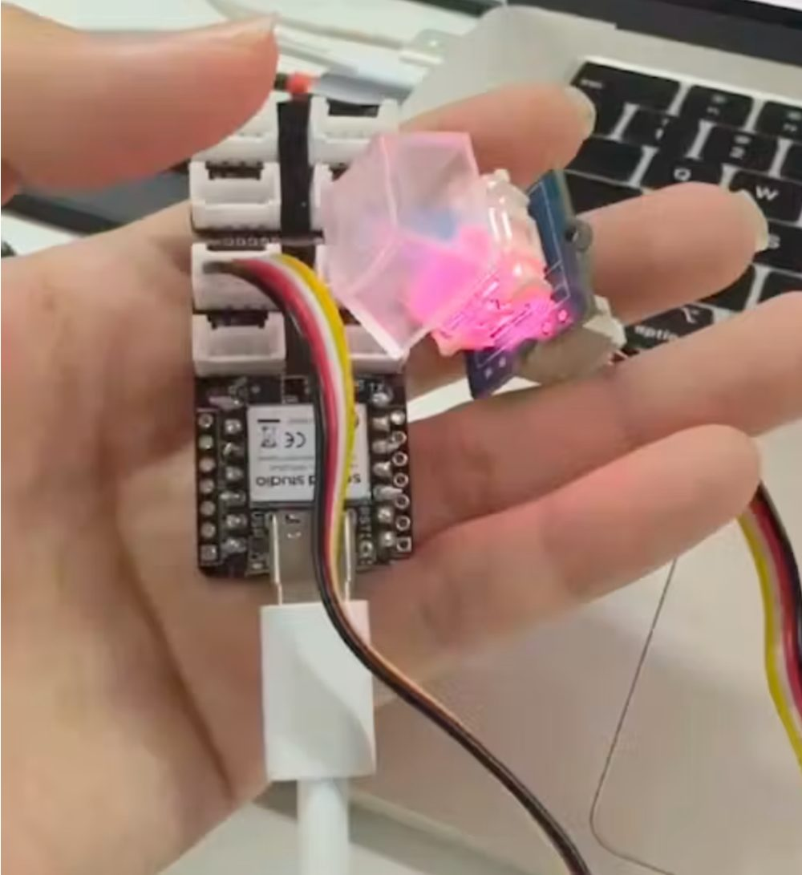
Brandy's First Version? One Key.
Remember Brandy — Seeed's application engineer, the one who built a voice keyboard with ZERO code. Her first version had ONE key. One.
20 presses in a row, not one missed.
Doesn't pass? No new features. Passes? Then the second key goes in. She uses that keyboard every day now.
MINIMAL IS NOT CRUDE — IT'S PROFESSIONAL.
Your first loop is the same: don't grab for more. Walk it through once. Twenty presses, not one missed.
Chaihuo Maker Academy · M0 · Run the First Lap | 04 / 42
Notes:
Remember Brandy from the kickoff session? Li Shiwen, Seeed's application engineer — the one who built a voice keyboard with zero code. Look at her first version — it had one key. One. And the acceptance standard was a single line: 20 presses in a row, not one missed. Doesn't pass? No new features. Passes? Then the second key goes in. She uses that keyboard every day now. That's a professional engineer's MVP: minimal, but a complete loop, with an acceptance standard stated out loud. Minimal is not crude — it's professional. Your first loop is the same: don't grab for more. Walk it through once. Twenty presses, not one missed. 'Does one key really count as a project?' → 'Yes. She verified the hardest segment first — your first loop verifies your hardest segment first, too.' This page is a V4 addition the CN v2 plan never had — the reason Act 1 is 7 pages. Keep it to one minute; the golden line is the payload.

Slide 5
The Three Rules of Build Time
1
Check against your requirements sheet — changing it is allowed, CROSS IT OUT, DON'T ERASE.
2
15 MINUTES WITH NO PROGRESS = RAISE YOUR HAND —
STUCK IS NOT SHAMEFUL; TOUGHING IT OUT SILENTLY IS
3
Code questions go to your AI first — "one step at a time."
Change is allowed — cross it out, don't erase — so everyone can see you changed your mind.
Chaihuo Maker Academy · M0 · Run the First Lap | 05 / 42
Notes:
Three rules. One: check against your requirements sheet — changing it is allowed, cross it out, don't erase. Two: 15 minutes with no progress = raise your hand. Stuck is not shameful; toughing it out silently is. Three: code questions go to your AI first. I and the TAs answer direction only and rescue the stuck only. The red line is the deck's first red — the survival rule. After reading, do NOT flip away — this page stays up for the whole build (115 min); slides 08/09/10/11 are temporary cut-ins that return here. Largest type in the deck — readable from the back row. Rule two is rendered entirely in red. A student quietly changes the sheet and adds features during the build → point at the projected rule, no scolding: 'Change is allowed — cross it out, don't erase. But ask first: does it serve the core feature? No? It goes on the later list.'

Slide 6
The Stand-Up
one sentence each, verifiable
"TODAY I'LL FIRST MAKE ___ RUN."
CONTRAST
NO
"Keep working on my project" — doesn't count
"Make the button light the LED when pressed" — counts
(The moment you finish — what will I be able to see?)
YES
SMALL CLASS: everyone stands — really standing, that's the stand-up's dignity — one by one. | LARGE CLASS: pair up and say it to each other, then write the sentence at the top of your requirements sheet (that's the stand-up's trace).
Chaihuo Maker Academy · M0 · Run the First Lap | 06 / 42
Notes:
The stand-up — the first thing every marathon work session does. The rule: one sentence each, no more: 'Today I'll first make ___ run.' It has to be verifiable — 'keep working' doesn't count; 'make the button light the LED when pressed' counts. Vague goal ('keep working on my project') → push on the spot: 'The moment you finish — what will I be able to see?' Push until it's one verifiable action. The stand-up turns into a report (someone talks over 30 seconds) → raise the hourglass: 'Noted. Details are for build time, one-on-one.' Two ways to run it — pick by headcount (small: everyone stands and says it, you hold the hourglass, 'you first'; large: no going around — pair up, write the sentence at the top of the requirements sheet, you call 3–4 people at random to stand and say it to the class, the rest get a glance at their page as you circulate).

Slide 7
Check Out the Parts
by the sheet, register everything
1
Take only what your requirements sheet's hardware row says — NO TAKING PARTS YOU DON'T NEED (everything you eyed during the tour waits until the sheet changes)
2
Register everything you take — name on your table's sheet
3
Hot part already gone? Write it in the queue area on the board — then find a substitute. Engineer's first lesson: solve the problem with what you have
4
Sheet lists something not in the pool? Change the need on the spot — cross it out, don't erase, write the substitute
At the end of every leg, parts you're not using go back — it's a shared pool; you'll need it next leg.
Chaihuo Maker Academy · M0 · Run the First Lap | 07 / 42
Notes:
Check-out rules: take only what your requirements sheet's hardware row says; register everything you take — name on the sheet on your table. No taking parts you don't need (everything you eyed during the tour waits until the sheet changes). Hot part already gone? Write it in the queue area on the board — then find a substitute. Remember? An engineer's first lesson: solve the problem with what you have. At the end of every leg, parts you're not using go back. It's a shared pool — you'll need it next leg. Check-out bottleneck → TA B calls tables in batches (tables 1 and 3 first); whoever's checked out starts building. A hot part runs out and there's an argument → register in the queue area + the 'make it or not' three questions to coordinate substitutes; no purchase promises. A student's sheet lists something not in the pool → change the need on the spot (cross out, don't erase, write the substitute); TA A helps in 2 minutes. Stand-still while check-out runs.

Slide 8
Start — Cut the Loop in Two
1
MAKE IT SENSE
the sensor has a reading
→
2
MAKE IT REACT
light / buzzer / screen
ONE STEP AT A TIME. Devices stay on; AI conversation windows stay open. Water and bathroom — your call.
Chaihuo Maker Academy · M0 · Run the First Lap | 08 / 42
Notes:
Start. First move: cut the smallest loop into two steps — first make it sense (the sensor has a reading), then make it react (light / buzzer / screen). One step at a time. I do one lap every 15 minutes; raise your hand and I'm there. Water and bathroom — your call. Devices stay on; AI conversation windows stay open. Then immediately back to slide 05. Your circulation rhythm (this lesson's core skill — the shift from teaching to circulating): one lap every 15 minutes, three looks per lap — the screen (chatting with AI, or staring off / browsing?), the requirements sheet (is it on the table? are they building to it?), the face (a frown past 5 minutes — stop and ask one question). Intervention red line: direction only ('Back to your sheet — what's the core feature?'); no writing code, no thinking up solutions, no making decisions; a student asks 'which should I do?' → 'What does your requirements sheet say?'

Slide 9
The Mid-Way Stand-Up
still standing, still one line
WHERE I AM | WHERE I'M STUCK | WHAT I DO NEXT
Anyone who can't say "next" — the TA notes your name; you get rescued first when the second half starts.
Chaihuo Maker Academy · M0 · Run the First Lap | 09 / 42
Notes:
One line: where I am / where I'm stuck / what I do next. Anyone who can't say 'next' — the TA notes your name, and you get rescued first when the second half starts. No unified break; the mid-way stand-up is done standing (a stretch too), hourglass timed. Noting who can't say 'next step' and rescuing them first in the second half is the pace officer's job (TA C) — instructor-side, never on screen.

Slide 10
Second Half — Close the Loop
Whatever segment the loop is still broken on — that's what you fix.
15 MINUTES BEFORE REVIEW, EVERYONE STOPS — WHEREVER YOU ARE, THE REVIEW STARTS ON TIME.
A half-finished thing deserves the faults even more.
The review isn't a reward for finishing — it's how you finish.
Chaihuo Maker Academy · M0 · Run the First Lap | 10 / 42
Notes:
Second half's job: close the loop. Whatever segment the loop is still broken on — that's what you fix. 15 minutes before review, everyone stops. Wherever you are, the review starts on time. Remember: the review isn't something you earn by finishing — a half-finished thing deserves the faults even more. Circulation rhythm same as slide 08's notes; from '15 minutes to review' onward, remind table by table: 'Save your progress. Prepare two lines: my project can ___ now; it still can't ___.' — and flip to slide 11. A student begs 'give me 10 more minutes' at the stop → warm but firm: 'The review 15 is the institutional floor — nobody squeezes it, including me. Write your can't yet clearly — that's the review's first material.' Morale-drained ('everyone else's is so good') → TA C: 'One thing more than yesterday is a win. Is your loop closed? Closed = today's 100.' After the announcement, return to slide 05.

Slide 11
Hands Off — Prepare Two Lines
MY PROJECT CAN ___ NOW.
IT STILL CAN'T ___ YET.
The review must be fed your CURRENT real state — sending the old brief description gets you sent back to rewrite.
A bragging review is no review at all.
Chaihuo Maker Academy · M0 · Run the First Lap | 11 / 42
Notes:
Save your progress. Prepare two lines: my project can ___ now; it still can't ___. The two lines are the review's feeding lines — the review conversation must be fed the current real state; anyone feeding the old brief description gets sent back to rewrite (this is the review's only food). The warning line carries the discipline — bold black on yellow, NOT red (outside the quota). Cut in once at '15 minutes to review'; after the table-by-table reminder, the deck returns to slide 05 until the review actually starts, then on to slide 12.

Slide 12
Hands Off. Review Time.
Before, AI was your colleague. Today, it's a JUDGE — its job is finding faults, not praising you.
JUDGE 1 · THE PICKY USER — the real person from your requirements sheet — 3 FAULTS
JUDGE 2 · QUINN — old friend, the team's test engineer — a 5-ITEM "BREAK IT" LIST
In Lesson 3, it picked ONE fault. From today: the full edition — 3 faults + a 5-item list. Every leg from here runs this size.
Both reviews run in the conversation you already have — NO NEW WINDOWS. A new window = a dropped baton.
THE REVIEW STARTS ON TIME — NOBODY SQUEEZES IT, INCLUDING ME
Chaihuo Maker Academy · M0 · Run the First Lap | 12 / 42
Notes:
Hands off. Review time. Before, you had AI as a colleague. Today, it's a judge — its job is finding faults, not praising you. Two judges: first, the real person from your requirements sheet (the Picky User); second, an old friend — Quinn. A sizing note: in Lesson 3's group build, the Picky User picked one fault. From today it's the full edition — 3 faults + a 5-item list — and every leg from here runs this size. Two review prompts, on screen; keep going in the conversation you already have — no new windows. Note: you must feed the current real state — 'it can do this now, it can't do that' — a bragging review is no review at all. The red line is the deck's second red — the institutional floor. This is the Act 3 gear change ('hands off — review time'); whatever's done, you shift gears on time — that rhythm itself is part of what today teaches.

Slide 13
The Picky User — 3 Faults
Send this in the conversation you already have — no new windows.
You are now my real user (name: ___; their situation: ___ — copy the real
person from my requirements sheet).
My project currently does: ___ (current real state, no bragging).
It still can't: ___.
You are not allowed to praise me. As them, pick 3 faults:
the one they'd care about most, the one most likely to make them not use it,
the one most confusing. One sentence per fault.
AI STARTED PRAISING? PUSH BACK —
"NO PRAISING. FAULTS ONLY — 3, ONE SENTENCE EACH."
The 3 faults + your notes go into your review record in your workbook.
Chaihuo Maker Academy · M0 · Run the First Lap | 13 / 42
Notes:
Send this to AI (project it). You must feed the current real state — what it can do now, what it can't. If it dares to praise you, push the red line back at it — a review that praises you is a review that didn't show up to work. The red line is the deck's third red — the push-back line. The AI review turns into AI praise ('your project is great, may I suggest some features…') → the student pushes back (projected): 'No praising. Faults only — 3, one sentence each.' Project your own pre-rehearsed 'AI praised → I pushed back' demo conversation once. A review item contradicts the requirements sheet (AI pushing a cut feature) → a teaching point: 'It doesn't know your trade-off history. Flip to your later list — this one's already slept there. Original verdict stands.' Stand-still. The prompt box is 6.2 verbatim — shared text with the Teacher's Guide and the workbook; any edit must sync all three documents. The review record template (6.5) is workbook-borne — no projected page; students fill it as they go.

Slide 14
Quinn — the 5-Item "Break It" List
Quinn, still you. Based on the current state: my project can ___ now, and can't ___ yet.
You're a test engineer. Give me a 5-item list of "how to break or fail it,"
specific to how I operate it and what I watch for.
List in hand — PICK 2 ITEMS AND TEST THEM FOR REAL. Record pass / broke in your review record.
Quinn is the BMAD team's test engineer — this conversation needs the team in it.
Ran continuously since Lesson 4 → send it directly. Fresh window → send this background line FIRST, then the prompt above:
This conversation has a BMAD team: John (PM), Sally (UX designer), Winston (architect), Amelia (developer), Quinn (test engineer).
Remember them — I'll call on them directly from now on.
Chaihuo Maker Academy · M0 · Run the First Lap | 14 / 42
Notes:
Quinn, same deal. List in hand — pick 2 items and test them for real. Don't be polite — it's built to be used the wrong way. Record the results in the review record in your workbook. One reminder: Quinn is the BMAD team's test engineer — this conversation window needs the team in it for Quinn to appear. Projects running since Lesson 4's team build can send it directly; a fresh conversation sends the background line first (the small print on screen), then the prompt. Verify Quinn's entrance condition in a fresh window during rehearsal (Section 1.3) — what happens calling Quinn with no background vs. with the background sentence; mention this contrast in one line in class. Offline → human peer review instead (the same 3-faults-5-items frame, executed by the neighbor, swapped) — the review is never canceled, only its executor changes (instructor-side, never on screen). Stand-still. The prompt box is 6.3 verbatim and the entrance line is 6.3's small print — shared text; any edit must sync all three documents.

Slide 15
Decide — Accept or Reject
both need a reason
ACCEPT
fix it now if it's under 5 minutes; can't finish? → the baton sheet, under "first thing next leg"
REJECT
write the reason — rejecting with a reason scores the same as accepting
"First thing next leg" is not "later" — it's the FIRST action of next leg's build time.
ACCEPT EVERYTHING? I'M COMING TO TALK TO YOU —
NO BACKBONE IS MORE DANGEROUS THAN NO CHANGES
Chaihuo Maker Academy · M0 · Run the First Lap | 15 / 42
Notes:
Old rule, item by item: Accept or Reject — and both need a reason. One reminder: rejecting with a reason scores the same as accepting — but if you accept everything, I'm coming to talk to you (no backbone is more dangerous than no changes). Accepted and fixable now — fix it (anything under 5 minutes). Can't finish? Into the handoff sheet under 'first thing next leg' — not 'later,' the first action of next leg's build time. The red line is the deck's fourth red — the decision discipline. Accept-everything → 30-second one-on-one: 'Eight items all in? Can you even finish them? Take the 3 most important; reject the rest — rejecting is a professional decision too.' The sheet's 'first thing next leg' says 'keep going' → send it back: 'Write it as a verifiable action — make ___ work even when ___.' Fixable-now items stay under 5 minutes; anything bigger goes to the handoff sheet — the review's decisions move the project, not stall it.

Slide 16
The Baton Handoff Sheet
your marathon baton
# Baton Handoff Sheet · Leg 1
Name: ______ Date: ______
## Where this leg ended (one verifiable sentence: what it can demo)
## The review fault that matters most + my decision (accept/reject + reason)
## The first thing next leg (specific, verifiable)
Into your workbook. Walk into Lesson 9 — this is how you find today's feeling again. It's also the comeback anchor for anyone who missed class.
Today's "done" line —
MY PROJECT'S FIRST VERSION CAN ___; THE REVIEW PICKED ___ FAULTS; I ACCEPTED ___ AND REJECTED ___.
Chaihuo Maker Academy · M0 · Run the First Lap | 16 / 42
Notes:
Fill the baton handoff sheet (template on screen, into your workbook). It's your marathon baton — the moment you walk into Lesson 9, it's how you find today's feeling again. It's also the comeback anchor for anyone who missed class. Log finish: four-line template; 'done' reads as on screen. The template is 6.4 verbatim — identical to the workbook; any edit must sync all three documents. Stand-still while students fill.

Slide 17
Today, You Ran a Whole Lap
From a requirements sheet, you made a DEMONSTRABLE FIRST VERSION — it really sensed something, it really reacted
You took a full round of faults from two judges — and you're still standing
You made Accept-or-Reject calls with reasons — and you know the first thing next leg
NEXT TIME — the marathon's second leg: BOTH HOMES AT ONCE (aily + the web version), and your project grows new abilities. Bring your baton handoff sheet and your two-views cheat sheet.
Return modules you're not using; main kits in the box; the Brief Wall stickies stay.
Chaihuo Maker Academy · M0 · Run the First Lap | 17 / 42
Notes:
Look back at this leg — three things done. One: from a requirements sheet, you made a demonstrable first version — it really sensed something, it really reacted. Two: you took a full round of faults from two judges, and you're still standing. Three: you made Accept-or-Reject calls with reasons, and you know the first thing next leg. That's one complete engineer's iteration — today, you really ran a whole lap. Next session preview: the marathon's second leg — both homes at once (aily and the web version), and your project grows new abilities. Bring your baton handoff sheet and your two-views cheat sheet. Return modules you're not using; main kits in the box; the Brief Wall stickies stay. This page is the second golden-line peak (same register as slide 02) — it closes the arc and previews the second leg; no ability-card ceremony today.

Slide 18
Who Is Brandy?
Seeed's application engineer
Built a voice keyboard with zero code.
Her method: one closed loop at a time, with an acceptance test.
The appendix walks her two projects end to end.
Chaihuo Maker Academy · M0 · Run the First Lap | 18 / 42
Notes:
Brandy appendix slide 18: Who Is Brandy?. Flexible use — pick pages if time remains, or a full walkthrough after class. See Teacher's Guide Section 6 for script.

Slide 19
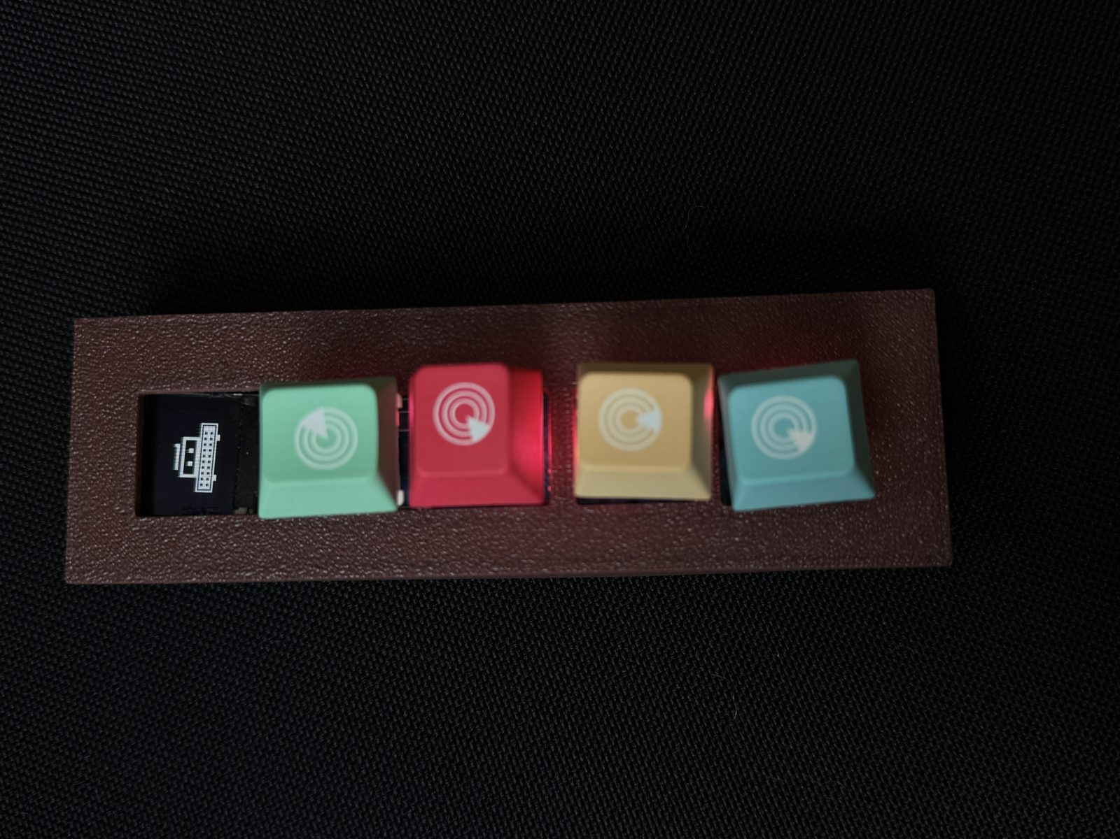
Look Beyond the Finished Product
The polished keyboard is the LAST frame, not the first.
The real story is what the first frame looked like: one key.
Every finished thing you admire started embarrassingly small.
Chaihuo Maker Academy · M0 · Run the First Lap | 19 / 42
Notes:
Brandy appendix slide 19: Look Beyond the Finished Product. Flexible use — pick pages if time remains, or a full walkthrough after class. See Teacher's Guide Section 6 for script.

Slide 20
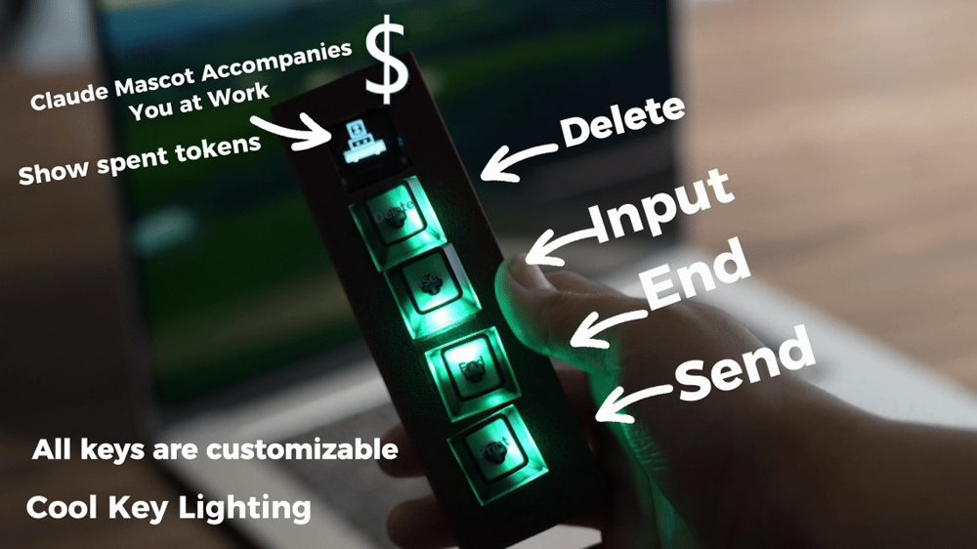
The Big-Picture Before / After
Before: talking into a computer and typing it out by hand.
After: one button press turns speech into text.
The gap is closed by a chain of tiny, tested loops.
Chaihuo Maker Academy · M0 · Run the First Lap | 20 / 42
Notes:
Brandy appendix slide 20: The Big-Picture Before / After. Flexible use — pick pages if time remains, or a full walkthrough after class. See Teacher's Guide Section 6 for script.

Slide 21
90% of Attention Interrupted
Switching windows costs more than you think.
A physical button keeps your eyes on the work that matters.
Good tools remove friction, not add features.
Chaihuo Maker Academy · M0 · Run the First Lap | 21 / 42
Notes:
Brandy appendix slide 21: 90% of Attention Interrupted. Flexible use — pick pages if time remains, or a full walkthrough after class. See Teacher's Guide Section 6 for script.

Slide 22

Two Devices, One Method
Voice keyboard: press → hear → text appears.
Digital hourglass: tilt → sand falls → time shows.
Both start with ONE loop, then grow.
Chaihuo Maker Academy · M0 · Run the First Lap | 22 / 42
Notes:
Brandy appendix slide 22: Two Devices, One Method. Flexible use — pick pages if time remains, or a full walkthrough after class. See Teacher's Guide Section 6 for script.

Slide 23
Where to Start
Don't start with the final enclosure.
Start with the riskiest part: does the input become an output?
Everything else is decoration until that loop works.
Chaihuo Maker Academy · M0 · Run the First Lap | 23 / 42
Notes:
Brandy appendix slide 23: Where to Start. Flexible use — pick pages if time remains, or a full walkthrough after class. See Teacher's Guide Section 6 for script.

Slide 24
The Method Overview
four tools
Input / output contract — write what goes in and what must come out.
One-key first loop — prove the hardest part first.
AI as teammate — generate, fix, explain code one step at a time.
Acceptance test — state what 'good enough' looks like.
Chaihuo Maker Academy · M0 · Run the First Lap | 24 / 42
Notes:
Brandy appendix slide 24: The Method Overview. Flexible use — pick pages if time remains, or a full walkthrough after class. See Teacher's Guide Section 6 for script.

Slide 25
A Live Mini-Exercise
try it now
Name one thing you use every day that has ONE button.
What is its input? What is its output?
That's an I/O contract — and you already understand it.
Chaihuo Maker Academy · M0 · Run the First Lap | 25 / 42
Notes:
Brandy appendix slide 25: A Live Mini-Exercise. Flexible use — pick pages if time remains, or a full walkthrough after class. See Teacher's Guide Section 6 for script.

Slide 26
The Voice Keyboard
breaking the problem
Input: press and hold a button while speaking.
Process: turn speech into text.
Output: paste the text where the cursor is.
Chaihuo Maker Academy · M0 · Run the First Lap | 26 / 42
Notes:
Brandy appendix slide 26: The Voice Keyboard. Flexible use — pick pages if time remains, or a full walkthrough after class. See Teacher's Guide Section 6 for script.

Slide 27
The Voice Keyboard
mind map
Hardware: button, microphone, microcontroller.
Software: speech-to-text service, hotkey simulation.
Experience: one press, one sentence, one less context switch.
Chaihuo Maker Academy · M0 · Run the First Lap | 27 / 42
Notes:
Brandy appendix slide 27: The Voice Keyboard. Flexible use — pick pages if time remains, or a full walkthrough after class. See Teacher's Guide Section 6 for script.

Slide 28
The Voice Keyboard
I/O contract
INPUT: button press + voice.
CONSTRAINTS: hold while talking, release to send.
OUTPUT: text pasted at cursor.
SUCCESS: 20 presses in a row, zero misses.
Chaihuo Maker Academy · M0 · Run the First Lap | 28 / 42
Notes:
Brandy appendix slide 28: The Voice Keyboard. Flexible use — pick pages if time remains, or a full walkthrough after class. See Teacher's Guide Section 6 for script.

Slide 29
The Voice Keyboard
the one-key first loop
Version 1 had exactly one key.
The acceptance test was brutal: 20 presses, no misses.
Only after passing did she add key 2, 3, 4, 5.
Chaihuo Maker Academy · M0 · Run the First Lap | 29 / 42
Notes:
Brandy appendix slide 29: The Voice Keyboard. Flexible use — pick pages if time remains, or a full walkthrough after class. See Teacher's Guide Section 6 for script.

Slide 30
The Voice Keyboard
final interaction
Five keys now: input, end, send, delete, and a custom shortcut.
Each key grew from a loop that was proven first.
The form followed the function.
Chaihuo Maker Academy · M0 · Run the First Lap | 30 / 42
Notes:
Brandy appendix slide 30: The Voice Keyboard. Flexible use — pick pages if time remains, or a full walkthrough after class. See Teacher's Guide Section 6 for script.

Slide 31
The Voice Keyboard
enclosure pitfalls
3D prints warp; keycaps wobble; USB cables snag.
Every enclosure problem was found by using it, not imagining it.
Test the loop first; the box comes last.
Chaihuo Maker Academy · M0 · Run the First Lap | 31 / 42
Notes:
Brandy appendix slide 31: The Voice Keyboard. Flexible use — pick pages if time remains, or a full walkthrough after class. See Teacher's Guide Section 6 for script.

Slide 32
The Voice Keyboard
sketch to 3D
A paper sketch is faster than any CAD tool at the start.
Only lock dimensions after the electronics fit in your hand.
Draw → measure → print → test → redraw.
Chaihuo Maker Academy · M0 · Run the First Lap | 32 / 42
Notes:
Brandy appendix slide 32: The Voice Keyboard. Flexible use — pick pages if time remains, or a full walkthrough after class. See Teacher's Guide Section 6 for script.

Slide 33
The Voice Keyboard
demo checklist
Power on, connect, press button, speak a sentence, text appears.
Repeat three times without failure.
This same checklist protects your Lesson 10 showcase.
Chaihuo Maker Academy · M0 · Run the First Lap | 33 / 42
Notes:
Brandy appendix slide 33: The Voice Keyboard. Flexible use — pick pages if time remains, or a full walkthrough after class. See Teacher's Guide Section 6 for script.

Slide 34
The Digital Hourglass
breaking the problem
Input: tilt the device to start a timer.
Process: count down like falling sand.
Output: LEDs show remaining time.
Chaihuo Maker Academy · M0 · Run the First Lap | 34 / 42
Notes:
Brandy appendix slide 34: The Digital Hourglass. Flexible use — pick pages if time remains, or a full walkthrough after class. See Teacher's Guide Section 6 for script.

Slide 35
The Digital Hourglass
wiring & SOP
One microcontroller, one accelerometer, one LED matrix.
Standard operating procedure: tilt → start, flat → pause, upright → reset.
The behavior was decided before the code was written.
Chaihuo Maker Academy · M0 · Run the First Lap | 35 / 42
Notes:
Brandy appendix slide 35: The Digital Hourglass. Flexible use — pick pages if time remains, or a full walkthrough after class. See Teacher's Guide Section 6 for script.

Slide 36
The Digital Hourglass
decomposing "like sand"
Sand doesn't fall as a block; it falls grain by grain.
An LED matrix can mimic that with small steps.
Break the effect into tiny frames, then loop them.
Chaihuo Maker Academy · M0 · Run the First Lap | 36 / 42
Notes:
Brandy appendix slide 36: The Digital Hourglass. Flexible use — pick pages if time remains, or a full walkthrough after class. See Teacher's Guide Section 6 for script.

Slide 37
The Digital Hourglass
the photo where the logic was wrong
A wrong photo is evidence, not failure.
It tells you which assumption broke — light? angle? timing?
Fix the data, fix the logic, or fix the threshold.
Chaihuo Maker Academy · M0 · Run the First Lap | 37 / 42
Notes:
Brandy appendix slide 37: The Digital Hourglass. Flexible use — pick pages if time remains, or a full walkthrough after class. See Teacher's Guide Section 6 for script.

Slide 38
Two Key Translations
Translation 1: user words → engineering requirements.
Translation 2: engineering requirements → a closed loop.
If you can do both, you can make anything.
Chaihuo Maker Academy · M0 · Run the First Lap | 38 / 42
Notes:
Brandy appendix slide 38: Two Key Translations. Flexible use — pick pages if time remains, or a full walkthrough after class. See Teacher's Guide Section 6 for script.

Slide 39
A Reusable Hardware Prompt
photograph this page
"I have a ___ module. What does it sense or do? Which pin is which?"
Use it whenever you meet a new module in Lesson 9.
The prompt lives in your workbook too.
Chaihuo Maker Academy · M0 · Run the First Lap | 39 / 42
Notes:
Brandy appendix slide 39: A Reusable Hardware Prompt. Flexible use — pick pages if time remains, or a full walkthrough after class. See Teacher's Guide Section 6 for script.

Slide 40
The Five-Step Loop
Say the need in plain language.
Write the input / output / success contract.
Build the smallest closed loop.
Test it with a real failure scenario.
Decide: accept, reject, or make it smaller.
Chaihuo Maker Academy · M0 · Run the First Lap | 40 / 42
Notes:
Brandy appendix slide 40: The Five-Step Loop. Flexible use — pick pages if time remains, or a full walkthrough after class. See Teacher's Guide Section 6 for script.

Slide 41
Closing on the Four-Line Spec
Every new module starts with four lines:
INPUT → CONSTRAINTS → OUTPUT → SUCCESS CRITERIA.
That's the Brandy method. That's your method now.
Chaihuo Maker Academy · M0 · Run the First Lap | 41 / 42
Notes:
Brandy appendix slide 41: Closing on the Four-Line Spec. Flexible use — pick pages if time remains, or a full walkthrough after class. See Teacher's Guide Section 6 for script.

Slide 42
Your Turn
next leg and beyond
Bring a new module into your project in Lesson 9.
Run it through the same four-line spec first.
Minimal, closed, tested — then grow.
Chaihuo Maker Academy · M0 · Run the First Lap | 42 / 42
Notes:
Brandy appendix slide 42: Your Turn. Flexible use — pick pages if time remains, or a full walkthrough after class. See Teacher's Guide Section 6 for script.

