Slide 1

Chaihuo Maker Academy · Smart Hardware Fundamentals (M0)
Call In Reinforcements
Give Your MVP a New Power · The Marathon's Second Leg · Chaihuo Maker Academy · M0 Lesson 9
Today: the hardware store — a library, a decision, a wiring-in —
and a first look for your project.
Chaihuo Maker Academy · M0 · Call In Reinforcements | 01 / 20
Notes:
Cover page only; students see it as they sit down. No script. When the session starts, go straight to slide 02 — the opener's 30-second recap is spoken, not projected. Right side: the toolbox cover illustration reused from the CN deck because it carries no Chinese glyphs. Footer: Chaihuo Maker Academy · M0 · Call In Reinforcements | 01 / 20.

Slide 2
Today, Your MVP Grows a New Power
Last session: you ran the first lap — your project has an MVP. It can be demonstrated, two judges picked at it, and you made Accept-or-Reject calls. Is your baton handoff sheet on the desk? We read it at the opening of the build.
TODAY, YOUR MVP GROWS A NEW POWER.
FIRST HALF: THE HARDWARE STORE — call in reinforcements.
A library: someone else's well-tested, free toolbox.
SECOND HALF: FINISH THE CORE FUNCTION — the leg-two sprint.
Same rhythm as leg one — STAND-UP | BUILD | AI REVIEW | DECIDE | HANDOFF.
Chaihuo Maker Academy · M0 · Call In Reinforcements | 02 / 20
Notes:
30-second recap: last session you ran the first lap — your project has an MVP. It can be demonstrated, two judges picked at it, and you made Accept-or-Reject calls. Did you bring your baton handoff sheet? Put it on the desk — we read it at the opening of the build. Today, two things: first half, the hardware store — call in reinforcements; second half, the leg-two sprint — finish the core function. The rhythm is exactly the same as leg one.

Slide 3
Readable Isn't the Same as Worth Writing
NO REINFORCEMENTS
WITH A LIBRARY
Ask AI to write the driver from scratch — over a hundred lines. Three screens of scrolling.
Three lines.
That hundred-line thing was already written, tested, and given away free — that's OPEN SOURCE. This toolbox is called A LIBRARY.
Chaihuo Maker Academy · M0 · Call In Reinforcements | 03 / 20
Notes:
Look at this complex sensor. No help from anyone — ask AI to write the driver from scratch — over a hundred lines. Three screens of scrolling. Can you read it? By now, yes, you can read it — but being able to read it doesn't mean you should write it. Now: three lines. That hundred-line thing was already written, tested, and given away free — that's open source: engineers all over the world send each other toolboxes. This toolbox is called a library. Today you learn to shop the hardware store: whatever your project needs, someone on earth has probably already built the wheel.

Slide 4
The Three Checks Before Calling in a Library
Three checks before calling in a library (2 of 3 pass — bring it in):
1) When was it last updated? (Nothing in three years — think twice.)
2) Does it have examples? (No examples = no manual.)
3) Is it documented completely?
(Fourth check, for when something breaks: is my board on the
supported-hardware list?)
This page stays up today — install, pick, wire in: come back to it.
Chaihuo Maker Academy · M0 · Call In Reinforcements | 04 / 20
Notes:
Step one, search — find it in the hardware store. Step two, read the page and judge it: the three checks. 1) When was it last updated? Nothing in three years — think twice. 2) Does it have examples? No examples = no manual. 3) Is it documented completely? Two of three pass — bring it in. This page stays up today — install, pick, wire in: anytime you see 'should I install this library?', run the three checks first. Write them into your student document.

Slide 5
One Library for the Whole Class
1
SEARCH — find it in the hardware store
2
CHECK — the three checks (back to slide 04)
3
INSTALL — it moves into YOUR project's tool room
4
RUN — run its built-in example
...stop. How many seconds did that compile take?
The reinforcement you called in is already compiled — that's the second reason to call in help.
Chaihuo Maker Academy · M0 · Call In Reinforcements | 05 / 20
Notes:
Let's call in the same reinforcement together and walk the whole process once. Step one, search. Step two, check — the three checks, back to that page. Step three, install — that's taking the toolbox into your project's tool room. Step four, run its built-in example. Stop. How many seconds did that compile take? Right — the reinforcement you called in is already compiled. That's the second reason to call in help.

Slide 6
Every Project Has Its Own Tool Room
THE TOMATO CLOCK PROJECT
MY PROJECT
the library it called in lives here
the library it called in lives here
One room on fire doesn't burn the next one — each in its own room, they don't fight.
Chaihuo Maker Academy · M0 · Call In Reinforcements | 06 / 20
Notes:
See this — this project's tool room, and that project's tool room: two separate rooms. Why design it this way? One sentence: one room on fire doesn't burn the next one. The library your tomato clock called in and the library your project called in each live in their own room — they don't fight. Write the three checks into your student document — anywhere you ever see 'should I install this library?', run the three checks first.

Slide 7
Importing Is a Trade-off Decision — Not a Default Move
A COMPLEX SENSOR
writing the driver yourself is a hundred lines — IMPORT IT
A LIGHT THAT BLINKS THREE TIMES
three lines does it — DON'T go hunting for a "blink library"
1) IS IT CORE? 2) CAN WE GET IT WORKING TODAY? 3) WHAT IF WE DON'T?
PICK EXACTLY ONE
three picks gets sent back.
Chaihuo Maker Academy · M0 · Call In Reinforcements | 07 / 20
Notes:
The hardware store is fun to browse — but importing is a trade-off decision, not a default move. Two real cases: case one, your project drives a complex sensor; writing the driver yourself is a hundred lines — import it. Case two, you want a light to blink three times; three lines does it — and you go hunting for a 'blink library' — don't. What's the difference? Three questions: is it core? can we get it working today? what happens if we don't import it? Now, against your requirements sheet, let AI be your selection advisor — it lists candidates; you pick exactly one, and that's the one we install today. Three picks gets sent back — greed is today's most common failure.

Slide 8
Let AI Be Your Selection Advisor
This is my requirements sheet's core function: ______.
The board I'm using: ______.
Be my selection advisor: recommend 3 external libraries that might help,
one line each — what it does and why it fits me — ranked by fit.
Reminder: only recommend libraries that really exist and support my board.
It lists candidates — YOU pick exactly one.
AI will confidently invent libraries; the hardware store only stocks real ones.
Chaihuo Maker Academy · M0 · Call In Reinforcements | 08 / 20
Notes:
Against your requirements sheet, send this prompt in the same chat window you've been using — don't open a new one. It lists candidates; you pick exactly one, and that's the one we install today. AI recommends a library you can't find? It invents things — what's searchable in the hardware store is what counts. If no library fits: writing 'why not import' with your reason is a valid trade-off — it scores the same as importing.

Slide 9
Example Code Is Not Your Feature
THE EXAMPLE = "here's what this library can do" YOUR FEATURE = "my core function"
1
Ask AI: "what is this code doing?" — your translator, built for code that wasn't written for you
2
Have AI reshape it to your need — one minimal change at a time
Building on our last round: I installed the library ______; its example
can ___ (one line).
My core function is: ______.
Reshape the example into my feature: change only the smallest piece first —
let it run, then I'll ask for the next piece.
THE BAR: installed + example runs. If you don't finish the wiring, it moves into the build block — that's fine.
Chaihuo Maker Academy · M0 · Call In Reinforcements | 09 / 20
Notes:
The last step is the hardest: example code is not your feature. The example demonstrates what the library can do; what you want is your core function. Two steps: one, ask AI 'what is this code doing?' — it's your translator, built for code that wasn't written for you; two, have AI reshape it to your need — one minimal change at a time. The bar: installed + example runs. If you don't finish the wiring, it moves into the build block this afternoon — that's fine.

Slide 10
One Line Each
WHAT I IMPORTED — AND WHAT IT SAVED ME
WHY I DIDN'T — SAME APPLAUSE
Big class: desk-pairs report to each other; the teacher calls a few to the whole room.
Chaihuo Maker Academy · M0 · Call In Reinforcements | 10 / 20
Notes:
One line each: what I imported, and what it saved me. No-import students report: why I didn't — and they get the same applause. The code reinforcement is in the door. But help isn't only one kind — your project is still wearing nothing. Next twenty minutes: the second reinforcement — a look.

Slide 11
Help Isn't Only Code — an MVP Has Two Faces
IT WORKS (the inside)
IT LOOKS LIKE SOMETHING (the outside)
the function runs — loose parts and a nest of wires
you can tell what it is at a glance — and you'd dare to touch it
On demo day, people see the outside first — then they get to the inside. Trash is the hardware store for looks.
Chaihuo Maker Academy · M0 · Call In Reinforcements | 11 / 20
Notes:
Help isn't only code. Look at your project — the function runs, but it's still a table of loose parts and a nest of wires. An MVP has two faces: it works (the inside), and it looks like something (the outside). On demo day, people see the outside first — then they get to the inside. The look costs nothing and gets printed nothing — trash is the hardware store for looks.

Slide 12
The Four Moves
1
GIVE IT A SHELL
2
HOLD IT STILL
a cardboard box, a takeout box, an old toy shell; it is what it is, so make it look like what it is
tape, rubber bands, zip ties; wires don't dangle, demos don't wobble
3
LABEL IT
4
HIDE THE MESS
marker the button names, tape an arrow; someone can touch it without reading a manual
tuck the wiring into the box; only the "face" shows
LOOKS SERVE THE DEMO — it exists for a 30-second demonstration. Looks take no more than a third of your build time; if you disappear into it, the teacher pulls you back.
Scissors and knives live with the teacher — take them on demand, return when done.
Chaihuo Maker Academy · M0 · Call In Reinforcements | 12 / 20
Notes:
Four moves: one, give it a shell — a cardboard box, a takeout box, an old toy shell; it is what it is, so make it look like what it is. Two, hold it still — tape, rubber bands, zip ties; wires don't dangle, demos don't wobble. Three, label it — marker the button names, tape an arrow; someone can touch it without reading a manual. Four, hide the mess — tuck the wiring into the box; only the 'face' shows. One rule: looks serve the demo — it exists for a 30-second demonstration. Looks take no more than a third of your build time; if you disappear into it, I'll pull you back. Scissors and knives live with me — take them on demand, return them when done.

Slide 13
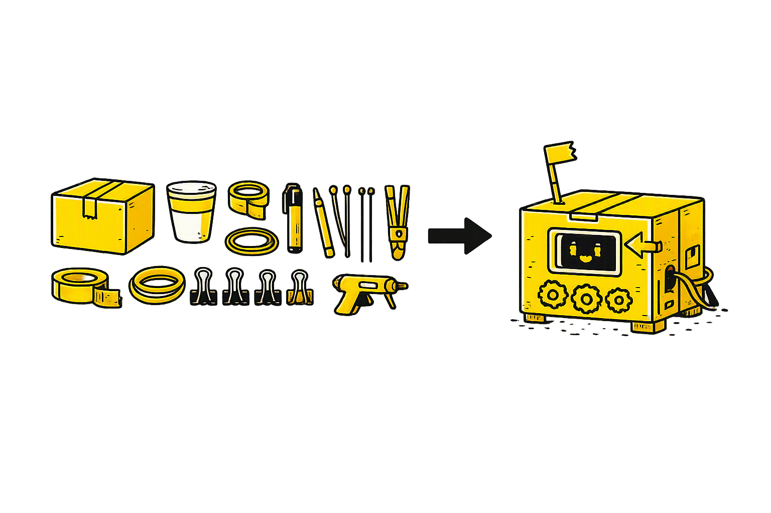
The Materials Wall — Pick, Don't Buy
FIND MATERIAL | BUILD THE STRUCTURE | ADD THE LOOK | READY TO DEMO
Cardboard boxes · takeout boxes · bottle caps · old toy shells · tape · rubber bands · zip ties
Chaihuo Maker Academy · M0 · Call In Reinforcements | 13 / 20
Notes:
The materials wall — everything here is clean junk brought from home or picked from the public pool. Pick, don't buy. Find material → build the structure → add the look → ready to demo.

Slide 14
Leg-Two Stand-Up
READ YOUR BATON SHEET — what did last leg say is the first thing this leg?
"TODAY I'LL GET THE CORE FUNCTION TO ___."
"DONE" IS NOT EVERYTHING YOU CAN IMAGINE — it's the core function on your requirements sheet. Say it against the sheet; anything beyond it gets pulled back.
You may add half a sentence: "...and give it a (shell / label)" — no fit, skip it. Looks are optional; function is the required question.
Chaihuo Maker Academy · M0 · Call In Reinforcements | 14 / 20
Notes:
Stand-up. First read your baton sheet — what did last leg say is the first thing this leg? Then one sentence: 'Today I'll get the core function to ___.' Definition check: 'done' is not everything you can imagine — it's the core function on your requirements sheet. Say it against the sheet; anything beyond it gets pulled back. You may add half a sentence: '...and give it a (shell / label)' — no fit, skip it. Looks are optional; function is the required question.

Slide 15
Go — Rules as Leg One
1
CHECK AGAINST YOUR REQUIREMENTS SHEET — change it, cross it out, don't delete
2
15 MINUTES NO PROGRESS = RAISE YOUR HAND — stuck is no shame; grinding alone is
3
CODE QUESTIONS GO TO AI FIRST — one step at a time
aily unsure? Flip your two-views cheat sheet — it was written for today.
THE LAST 10 MINUTES ARE THE QUICK SHELL — function runs first, then the scissors: shell, still, label, hide. Land as many of the four as you can. Function is always the required question.
15 MINUTES BEFORE REVIEW, HANDS OFF EVERYWHERE
get ready with two lines: "right now it can ___; it still can't ___."
Chaihuo Maker Academy · M0 · Call In Reinforcements | 15 / 20
Notes:
Go. Rules as leg one: check against your requirements sheet; 15 minutes no progress — raise your hand; code questions go to AI first. One thing new today: aily unsure? Flip your two-views cheat sheet — it was written for today. The last 10 minutes are the quick shell: once the function runs, then the scissors — shell, still, label, hide; land as many of the four as you can. Not getting one in is no shame — function is always the required question. 15 minutes before review, table by table: get ready with two lines — 'right now it can ___; it still can't ___.' Review starts on time — nobody squeezes it out.

Slide 16
Hands Off. Review Time — How Sturdy Is It?
Last leg's reviewer asked "does it look right?" THIS leg's reviewer checks "how sturdy is it?" — the 5-point sturdiness checklist, tested one by one.
Quinn, still you. Based on the current state: my project can ___ now,
and can't ___ yet.
You're a test engineer. Give me a 5-point "sturdiness checklist":
use it 10 times in a row? leave it alone 5 minutes, then touch it?
a different person tries it? press fast, press slow, press randomly?
— make each one specific: exactly how to operate it, and what to watch for.
Quinn is the BMAD team's test engineer — this conversation needs the team in it. The project conversation has run since Lesson 8 — send the prompt directly. A fresh conversation sends the background line first: "This conversation has a BMAD team: John (PM), Sally (UX designer), Winston (architect), Amelia (developer), Quinn (test engineer). Remember them — I'll call on them directly from now on."
THE REVIEW STARTS ON TIME
NOBODY SQUEEZES IT OUT, NOT EVEN ME.
Chaihuo Maker Academy · M0 · Call In Reinforcements | 16 / 20
Notes:
Hands off. Review time — last leg's reviewer asked 'does it look right?'; this leg's reviewer checks 'how sturdy is it?' The lead is old friend Quinn: a 5-point sturdiness checklist, tested one by one — this leg upgrades, no more picking two. The Picky User drops to a single most-lethal fault. Prompts up, same old rules: feed the real current state, no bragging; and keep going in the same chat window — don't open a new one.

Slide 17
The Picky User — This Leg, One Fault
You are now my real user (___). My project currently does: ___,
and still can't: ___.
No praise allowed. As them, pick only 1 fault — the single most lethal one.
AI starts praising? Push back — "No praise. Faults only."
All five pass? Congratulations, it's sturdy — have your desk-mate try it the barbarian way.
Chaihuo Maker Academy · M0 · Call In Reinforcements | 17 / 20
Notes:
The Picky User, this leg downgraded: pick only 1 fault — the single most lethal one. AI starts praising? Push back — 'No praise. Faults only.' All five pass? Congratulations, it's sturdy — have your desk-mate try it the barbarian way.

Slide 18
Review Record · Leg 2 — Write It Down as You Go
# Review Record · Leg 2
## Quinn's 5-point sturdiness checklist (test every one, note the result)
1. ______ tested: passed/broke ______
2. ______ tested: passed/broke ______
3. ______ tested: passed/broke ______
4. ______ tested: passed/broke ______
5. ______ tested: passed/broke ______
## The Picky User's 1 fault
______ -> my decision: accept/reject, reason: ______
Same chat window as the review — don't open a new one.
Chaihuo Maker Academy · M0 · Call In Reinforcements | 18 / 20
Notes:
This page is the EN structural delta — the CN v2.2 plan has no review-record projected page, but the EN Teacher's Guide's zero-print rule names the review record explicitly: all projected. The template is identical to the student document — the page exists so the room fills the same grid the workbook carries. The five tested lines are filled for real as they go. The decision line feeds slide 18's decide block. Stand-still during fill-in.

Slide 19
Decide One by One — Fill the Leg-Two Baton Sheet
ACCEPT OR REJECT — BOTH NEED A REASON. Heads-up: next leg is the sprint leg — FIX-ONLY, NO ADDING. Anything you can't finish today, think hard before you write it as "first thing next leg": that's your last chance to fix it.
# Baton Handoff Sheet · Leg 2
Name: ______ Date: ______
## Where this leg ended (one verifiable sentence: what it can demo)
## I called in ___ (no library? write: "I didn't import, because ___")
## What the look is now (one line: what it looks like now; no shell? write: "still loose parts")
## The review point that matters most + my decision (accept/reject + reason)
## The first thing next leg (specific, verifiable — next leg is fix-only, think it through)
ACCEPT EVERYTHING? I'M COMING TO TALK TO YOU
no backbone is more dangerous than no changes.
"DID" — I called in ___ and it saved me ___; the look used ___ (materials); sturdiness passed ___ checks.
Chaihuo Maker Academy · M0 · Call In Reinforcements | 19 / 20
Notes:
One by one: accept or reject — and both need a reason. Heads-up: next leg is the sprint leg — fix-only, no adding. Anything you can't finish today, think hard before you write it as 'first thing next leg': that's your last chance to fix it. Fill the leg-two baton handoff sheet — into your student document. Log, four lines as usual — 'did' reads: I called in ___ and it saved me ___; the look used ___ (materials); sturdiness passed ___ checks.

Slide 20
The Capstone — Nine Lessons, and Here We Are
Lesson 1 — you lit your first lamp
Lesson 2 — you found a question worth doing
Lesson 3 — your project grew a screen
Lesson 4 — you got an AI team
Lesson 5 — you taught hardware to see
Lesson 6 — you moved your project home
Lesson 7 — you briefed it
Lesson 8 — you ran the first lap
TODAY — you called in reinforcements
From daring, to reading, to calling in help — your function has capped out, and it has a face for the first time.
(Pause one second — look at it.)
NEXT LESSON: THE LAST LEG + THE ROADSHOW. Sprint discipline in four words: FIX-ONLY, NO ADDING. Bring your baton sheet, your project, and the side of it you most want to show.
Chaihuo Maker Academy · M0 · Call In Reinforcements | 20 / 20
Notes:
Lesson one, you lit your first lamp; two, you found a question worth doing; three, your project grew a screen; four, you got an AI team; five, you taught hardware to see; six, you moved your project home; seven, you briefed it; eight, you ran the first lap; today, you called in reinforcements — code help and look help — from daring, to reading, to calling in help. Your project's function has capped out, and it has a face for the first time. (Pause one second — look at it.) This is what nine lessons look like. Next lesson: the last leg + the roadshow. Sprint discipline in four words: fix-only, no adding. Bring your baton sheet, your project, and the side of it you most want to show.

