Slide 1
Chaihuo Maker Academy · Smart Hardware Fundamentals (M0)
Give Your Project a Screen
Wio Terminal · HMI (Human-Machine Interface) board · M0 Lesson 3
From today, your builds have a real interface.
HELLO
Wio Terminal (screen lit)
Chaihuo Maker Academy · M0 · Give Your Project a Screen | 01 / 19
Notes:
Cover — loops before class. Open with one welcome line and go straight to slide 02 — the cover is not a talking page. Wio Terminal photo on the right (screen lit, 45-degree angle — line-art placeholder until the photo shoot), yellow rule under the subtitle.

Slide 2
First, Let's Collect Last Session's Work
1
Hand in your work — online doc? send the link.
Handwritten? send a photo. Not in yet? Note it down — finish before you leave today.
2
Look at the Project Wall — everyone's manifesto is up there.
It's the north star for every big project after this.
Open your Student Workbook (or notebook) —
everything produced today continues in your own document.
Chaihuo Maker Academy · M0 · Give Your Project a Screen | 02 / 19
Notes:
Before we start, let's collect last session's work: if you used an online doc, send me the link; if you wrote by hand, send a photo — if it's not in yet, make a note of it and finish before you leave today. (point at the Project Wall) Look — last session's wall: everyone's manifesto is up there. Last time you set your topic and learned the five rules; today we hand out new gear — your project gets a real interface from today. Keep your manifesto and three-box design sheet at hand — we won't touch them today, but they're the north star for every big project after this. Hard 5-minute timebox on the collection — no per-item feedback; the not-yet-in list goes to the TA to register, don't haggle. Output anchor: last session's four outputs are in (manifesto / design sheet / review & trade-off / log). [Project Wall photo: select from Lesson 2's TA shot — wall only, no faces.]

Slide 3
New Gear — From Board to Handheld
Meet the Wio Terminal: a handheld little computer
Color screen
Three buttons + a five-way joystick
WIO
Sensors built in
BEFORE YOU FLASH: slide the switch on the side — slide, slide.
That tells the board: "get ready for new instructions."
No response? Slide it. — Everyone, drill it with me twice.
Chaihuo Maker Academy · M0 · Give Your Project a Screen | 03 / 19
Notes:
(hold up the Wio) New gear. It's called the Wio Terminal — think of it as a handheld little computer: a color screen, three buttons, a five-way joystick, and sensors built in. One thing is different from the old board: (hold it up, point at the switch) before you flash, slide the switch on the side — slide, slide — that's how you tell the board 'get ready for new instructions.' Everyone: drill it with me twice. The switch drill happens NOW, and the problems surface NOW — that saves 20 minutes of rescue attempts during coding. The mantra card goes on every desk: 'No response? Slide it.' [Switch close-up photo: yellow circle marking the switch — to photograph.]

Slide 4
Switch the Board Type — Same Old Flow, Same Old Line
Display in large text on the screen:
HELLO and my name (pinyin or English): ___
[ success
screenshot ]
the screen showing HELLO
Confidence anchor:
New hardware — and everything you already know still works.
Nothing is wasted. And the letters are prettier now.
Chaihuo Maker Academy · M0 · Give Your Project a Screen | 04 / 19
Notes:
Switch the board type in Codecraft — choose Wio Terminal, same old flow. Then send the line you've known since your first lesson: 'Display in large text on the screen: HELLO and my name (pinyin or English): ___.' (wait for the room to light up) See — new hardware, and everything you already know still works. Nothing is wasted. Why English on screen — this board's Chinese font library is unreliable; all screen display today is English / numbers / graphics (course-wide rule from Lesson 1). 'Switching hardware costs zero learning' is today's confidence anchor — point at the color screen and add: 'and the letters are prettier now.' Serial-port problems follow the old plan: swap cable -> swap machine -> pair up. [Warm-up success screen: Rehearsal-1 backup.]

Slide 5
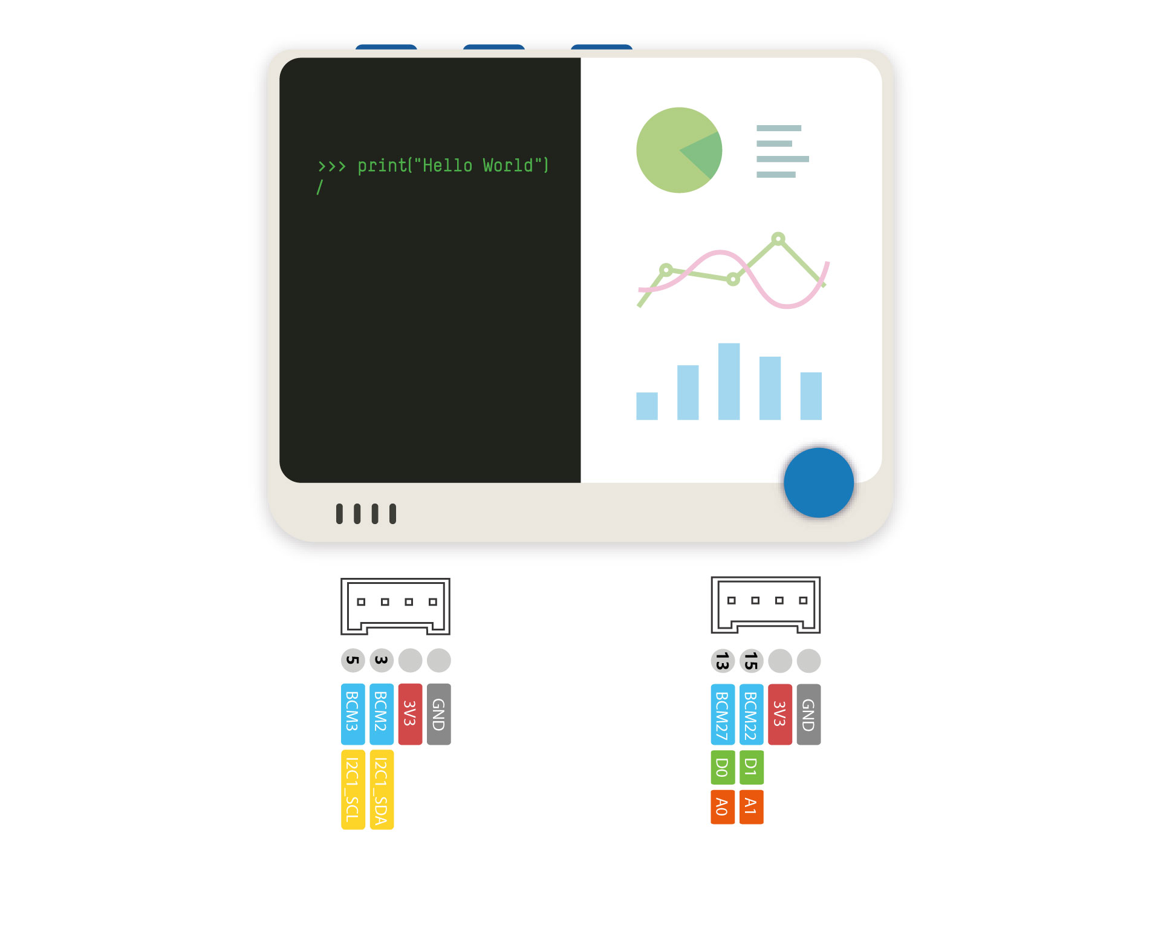
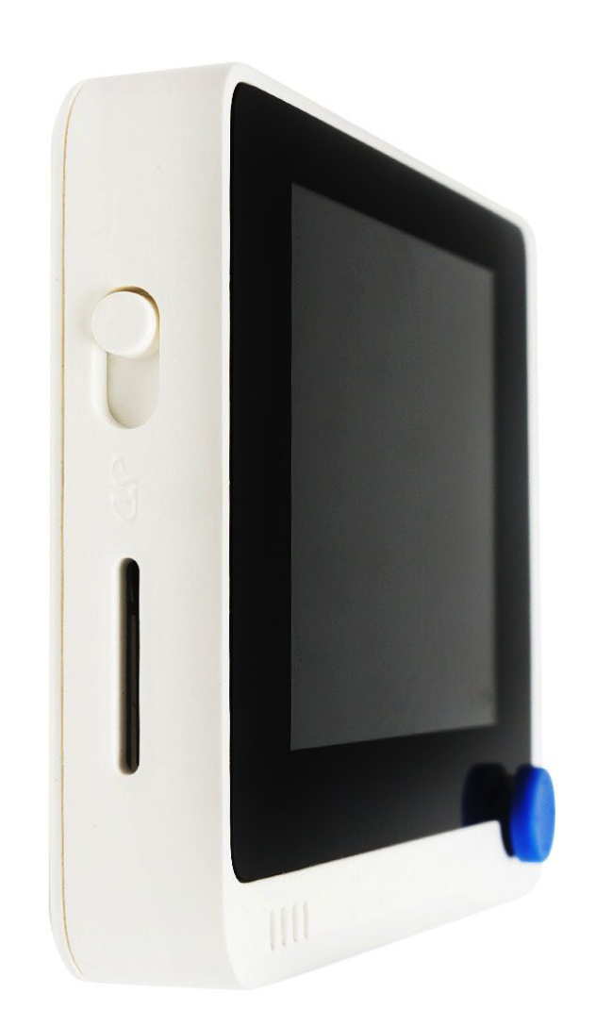
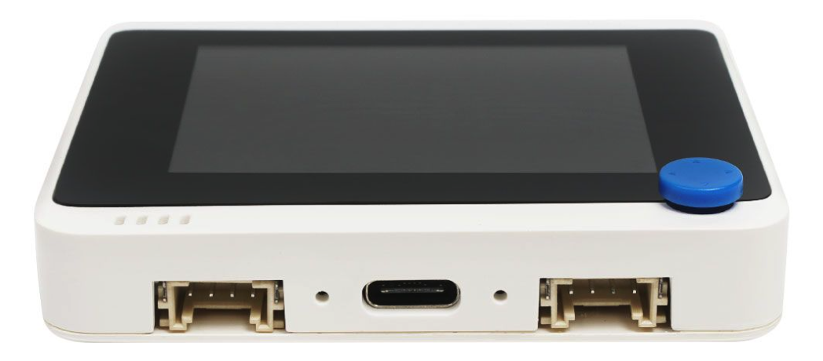
Walk Around — Meet Your New Partner
3 programmable buttons
(WIO_KEY_A, B, C)
Color screen
your project's face: interfaces, numbers, graphics live here
Three buttons
Reset the slider switch
the human's hand: press, and give your project commands
320 x 240
Color screen
Five-way joystick
the human's hand: nudge, and game consoles & menus run on it
Microphone
microSD card slot
it hears things: clap to switch, a sound-level meter
5-way joystick
Light sensor
it knows light from dark: a light that turns on by itself at night
Accelerometer
Microphone and buzzer
it knows moving & tilting: shake detection, fall alarms
Buzzer
it makes sound: reminders, alarms
SD card slot (small)
it can store things; just know it exists
Grove port (small)
Grove interface
Type-C
Grove interface
the door for new modules later; just know it exists
Green LED
Blue LED
Every time I name a part, find it on your board with your finger — and touch it.
Chaihuo Maker Academy · M0 · Give Your Project a Screen | 05 / 19
Notes:
Let's walk around and meet your new partner. (hold up the Wio and label as you go, one sentence each) The color screen — your project's face. Three buttons plus a five-way joystick — the human's hand. The light sensor — it knows light from dark. The microphone — it hears things. The accelerometer — it knows whether it's moving and which way it's tilted. The buzzer — it can make sound. Two small things over here, ears only today: the SD card slot — it can store things; the Grove port — the door for adding new modules later. These two, just know they exist. The walk-around never becomes a manual read — every time you name a part, students find it on their own board with a finger and touch it. A student presses on internet? 'It can — that's a later lesson. Today, just remember it exists.' [Annotated tour diagram to be made: base = top-down photo, nine 2px leader lines + yellow dots; line-art placeholder until then.]

Slide 6
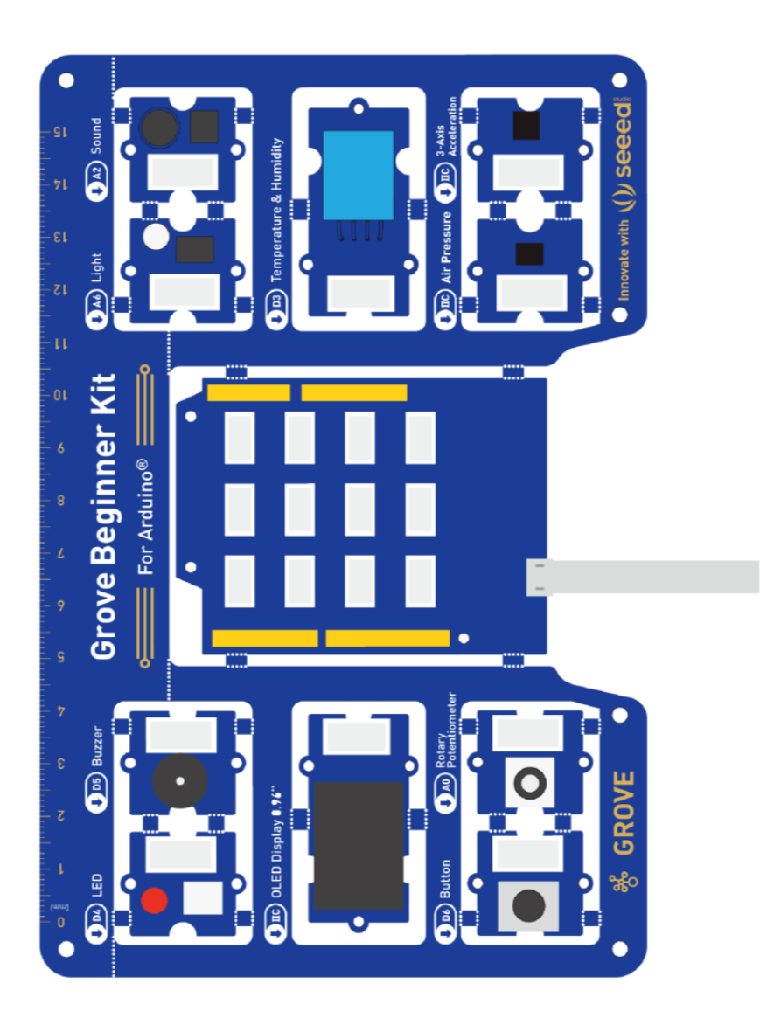
Why New Gear? Your Project Has a Face and Hands
OLD BOARD (Grove Beginner Kit)
NEW HANDHELD (Wio Terminal)
Write in your workbook: "Wio has ___ more than the old board (at least 3)" · "the first thing I want to make with it is ___"
->
Strong at sensing the world — sensors soldered on, plug and play
Adds a color screen, joystick and wireless — strong at letting people interact with your project
Use both boards — that one senses the world; this one lets people interact with your project.
Chaihuo Maker Academy · M0 · Give Your Project a Screen | 06 / 19
Notes:
Now compare with the old board: the old one's strength is sensing the world — sensors soldered on, plug and play. This one adds a color screen, a joystick and wireless — its strength is letting people interact with your project. One sentence: why did we change gear? From today, your project has a face and hands. Then the two workbook lines. Output anchor: the two lines written in everyone's workbook.

Slide 7
Touching Isn't Knowing — Lighting It Up Is
Buttons
Joystick
Microphone
Light
Accelerometer
Five micro-experiments, one line each —
I send mine first, then you send yours.
Don't just watch me — send a line and try it yourself.
The lines are printed in your Student Workbook — follow me on the screen. Lit one up? Tick the box in your workbook.
Chaihuo Maker Academy · M0 · Give Your Project a Screen | 07 / 19
Notes:
Touching isn't knowing — lighting it up is. Five micro-experiments, one line each, watch it come alive. The lines are printed in your Student Workbook — follow me on the screen. The rhythm: I send mine first, then you send yours — don't just watch me, send a line and try it yourself. Flip fast — this page is the round's instructions, not a talking page.

Slide 8
Micro-Experiment 1/5 · Buttons
The Three-Key Piano
I'm using the Wio Terminal. Please make this work:
Press buttons A/B/C to play do, mi, sol.
Show DO / MI / SOL in large text on the screen.
[ success
screenshot ]
DO in large text
this is what success looks like
Press it, and it answers you — A, B, C: a little piano.
Chaihuo Maker Academy · M0 · Give Your Project a Screen | 08 / 19
Notes:
The first one, the three-key piano. Watch me send it — (send) press A: DO; press B: MI; press C: SOL. Your turn — send it, try it. Can play a little tune? Raise your hand. New line counts only if it ran in rehearsal — a line that won't run falls back to the original 'number-report' version; a single dead unit gets swapped, not fixed. One experiment stuck more than 2 minutes is too long — protect the round's rhythm.

Slide 9
Micro-Experiment 2/5 · Joystick
Push the Ball
I'm using the Wio Terminal. Please make this work:
Draw a small ball in the center of the screen.
Push the joystick and the ball moves that way.
[ success
screenshot ]
the ball pushed off-center
this is what success looks like
Nudge it, and the ball listens.
The joystick presses in too — found it? Raise your hand.
Chaihuo Maker Academy · M0 · Give Your Project a Screen | 09 / 19
Notes:
The second one, push the ball. Push the joystick and the ball runs that way. (demo) Your turn — see who can park the ball steadily in the corner. A student discovers the joystick also presses in (it has a button)? Affirm the discovery — it goes on the list of usable inputs for the free round. Line won't run -> fall back to the number-report version (UP / DOWN / LEFT / RIGHT).

Slide 10
Micro-Experiment 3/5 · Microphone
Blow Out the Candle
I'm using the Wio Terminal. Please make this work:
Draw a lit candle in the center of the screen.
Blow at the microphone and the flame goes out; after 2 seconds it lights again.
[ success
screenshot ]
the flame out (or relit)
this is what success looks like
One blow, the candle goes out.
Sound doesn't need to report a number — it just needs to do the job.
Chaihuo Maker Academy · M0 · Give Your Project a Screen | 10 / 19
Notes:
The third one, blow out the candle. Send it — blow at the microphone, the flame goes out; after 2 seconds it lights again. Your turn. A student asks how it knows they blew? One sentence: 'Blow hard enough and it counts as blowing out the candle; the exact units don't matter.'

Slide 11
Micro-Experiment 4/5 · Light
The Board Afraid of the Dark
I'm using the Wio Terminal. Please make this work:
Draw two open eyes on the screen.
When the light gets dim, close the eyes and show ZZZ;
when it gets bright, open them again.
[ success
screenshot ]
eyes closed, ZZZ showing
this is what success looks like
Cover it, and it falls asleep.
Last lesson's dark-detecting light — in a new costume.
Chaihuo Maker Academy · M0 · Give Your Project a Screen | 11 / 19
Notes:
The fourth one, the board afraid of the dark. Send it — cover the board with your palm, the eyes close, ZZZ appears; take your hand away, it wakes up. This is last lesson's 'dark-detecting light' skill, in a new costume. Point back to Lesson 1 as you go — the Sense -> Logic -> Output model is still the engine under every one of these toys.

Slide 12
Micro-Experiment 5/5 · Accelerometer
The Balance Ball
I'm using the Wio Terminal. Please make this work:
Draw a square frame with a small ball inside.
Tilt the board and the ball rolls toward the low side.
[ success
screenshot ]
the ball rolled to one side
this is what success looks like
Tilt it, and the ball rolls downhill.
Shake detection, fall alarms — this is the one.
"I lit up: [ ] buttons [ ] joystick [ ] microphone [ ] light [ ] accelerometer; what surprised me most was ___ because ___."
Chaihuo Maker Academy · M0 · Give Your Project a Screen | 12 / 19
Notes:
The last one, the balance ball. Send it — tilt the board, and the ball rolls downhill. It can feel how you move it. All five tried? Open your workbook, tick the boxes, and write one line: what surprised me most, and why. Fast students add a free line on top of the current experiment ('make the ball a different color' / 'beep when the ball touches the edge'); slow students pass by keeping the first three. Output anchor: the ticks + one line in everyone's workbook.

Slide 13
One Idea, Two Ways of Saying It
"Make a counter screen."
"Show a number in the largest text
in the center of the screen; show
COUNTER in small text at the top-
left; make the number red."
-> the precise result
-> what AI freely gives you
<-
[ screenshot: vague result ]
POSITION · SIZE · COLOR
How to describe a screen:
At [position], show [content] in [size/color]; when [action], [change].
Chaihuo Maker Academy · M0 · Give Your Project a Screen | 13 / 19
Notes:
Hardware's all lit up — now lesson one of using it well: how do you get AI to give you a good screen? An experiment, one idea two ways of saying it. First way: (send) 'Make a counter screen.' — see what it gives you. (show the result) Second way: (send) 'Show a number in the largest text in the center of the screen; show COUNTER in small text at the top-left; make the number red.' — now see what it gives you. (project side by side) What's the difference? Describing a screen means saying three things clearly: position, size, color. Land the extension line: 'Logic says do this when that happens. Screens say what something is, where it sits, what it looks like. Two ways of speaking — you need both.' If AI does well both times: 'Today it guessed your mind right — but your project is ten times more complex. You can't afford the wrong guess.' NON-NEGOTIABLE: really send both lines live in the same conversation — the screenshots are backups only; live authenticity can't be faked.

Slide 14
Follow-Along: The Button Counter — Two Steps on Purpose
STEP 1 · The screen only:
Show the number 0 in the largest text in the center of the screen, and COUNTER in small text at the top-left. -> Flash it, look at it.
STEP 2 · The behavior:
When I press button A, add one to the number; when I press B, reset to zero.
-> Flash again — then one more line: "Every time the count reaches 10, the buzzer beeps once to celebrate."
First describe the looks, then the actions — it doesn't get confused.
Buttons not responding? "No response? Slide it."
Chaihuo Maker Academy · M0 · Give Your Project a Screen | 14 / 19
Notes:
Follow along, and we say it in two steps on purpose. Step one, the screen only: 'Show the number 0 in the largest text in the center of the screen, and COUNTER in small text at the top-left.' Flash it, look at it. Step two, the behavior: 'When I press button A, add one to the number; when I press B, reset to zero.' Flash again — then one more line to the whole class: 'Every time the count reaches 10, the buzzer beeps once to celebrate.' (the room fills with button presses; count to 10 and hear the beep) See? First describe the looks, then the actions — two ways of speaking, two separate lines, and it doesn't get confused. Wrong? Add one more line. That's also the old Five-Rules rule: one thing at a time. The number-one reason buttons don't respond: flash mode never exited — 'No response? Slide it (back to run mode).' The TA checks this first. Text overflowing / color not showing? One sentence: 'This is exactly the precision problem of describing looks — add one more line of description and have it change.' Someone already making a joystick game? Don't forbid: 'Fine to play — but the two-screens requirement stays.' Stays fixed during follow-along.

Slide 15
Free Round — Make Something With Two Screens
Switch between them with a button or the joystick.
Buttons · Joystick · Microphone · Light · Accelerometer — pick what's comfortable.
Clock
Mood display
Stopwatch
Your own menu
Reaction tester
(screen turns green -> press A -> shows your milliseconds — naturally two screens; content in English, numbers or graphics)
Old discipline:
Tell your neighbor what your two screens each look like — position, size, color, said clearly — BEFORE you talk to AI.
Write in your workbook — "the sentence I said to AI about my screen": your proudest description.
Chaihuo Maker Academy · M0 · Give Your Project a Screen | 15 / 19
Notes:
Free build, one-line brief: make something with two screens, and switch between them with a button or the joystick. A clock / a mood display / a stopwatch / a menu of your own / a reaction tester (the screen turns green, you press A, it shows your milliseconds — naturally two screens) — anything works (screen content in English, numbers or graphics). You now have five inputs in your hands — pick what's comfortable. Old discipline: tell your neighbor what your two screens each look like BEFORE you touch the keyboard — position, size, color, said clearly — then talk to AI. Collect 1-2 'described unclearly -> AI drifted off' cases (the drift gallery needs them next). Fast students: add a sensor link to the two-screen project. Slow students' bar: the counter + one custom change. A student dumps the whole job on AI at once? 'Directors shoot one scene at a time. Get the first screen described beautifully, then the second, and only at the end how to switch.' Two screens degrade to one? Lower the bar to 'counter + one custom change' and have them log 'where I got stuck trying to make two screens.' Someone's screen looks great and people gather? Invite them to project it — but push one question: 'What exactly did you say to AI?' Output anchor: everyone copies one line into the workbook. Stays fixed during the free round.

Slide 16
Whole Room — Come Look at a Treasure
[ drift case
screenshot ]
a screen that went off the rails
(a student volunteers, or the
pre-made Rehearsal-5 case)
They said ___ -> AI made ___
-> which sentence went wrong?
Thank this student — they stepped in the pit so the whole class doesn't have to. A crash isn't a joke; it's teaching material.
Chaihuo Maker Academy · M0 · Give Your Project a Screen | 16 / 19
Notes:
Whole room, come look at a treasure. (project) See: they said ___, AI made ___. Which sentence went wrong? (lead the class to find it) There — they forgot to say where. Thank this student — they stepped in the pit so the whole class doesn't have to. A crash isn't a joke; it's teaching material. The volunteer is always voluntary; no volunteer -> use the pre-made case from Rehearsal 5; once someone volunteers, the pre-made case is dropped. The tone is set: the volunteer is the hero — anyone snickering, take the line back on the spot: 'They stepped in the pit for the whole class. That's a hero.'

Slide 17
Three Takeaways for Using It Well
1
Describe a screen with position, size and color
2
Make state visible — have the screen show where you are in its steps
3
Many inputs? Try combinations — button, joystick, microphone, light, accelerometer
Circle one takeaway — "the one I used most today was #___". The log goes into your workbook proofread.
Your log, four sentences:
Today I made ___
I got stuck on ___ (today: name it — position, size, or color?)
Then ___
Next time I want ___
Say it, then send it to AI: "Tidy this into a learning log — only what I said, nothing I didn't say."
Warning — AI will make things up with a straight face. Proofreading is your job.
Chaihuo Maker Academy · M0 · Give Your Project a Screen | 17 / 19
Notes:
Last question: what's different between describing a screen to AI and describing logic? (lead them to: logic says 'do this when that happens'; screens say 'what something is, where it sits, what it looks like') — so, three takeaways for using this handheld well. First: describe a screen with position, size and color — you saw it with your own eyes; say the three things or don't, and you get two different things. Second: make state visible — the board has a screen; have it show you where it is in its steps, so you always know what it's doing. Third: with many inputs, try combinations — the best projects often come from trying 'which input feels most natural.' Then the log: take a photo of the screen project, say thirty seconds, the usual four sentences — today's 'stuck on' must be specific: position, size, or color. Send to AI with the tidy line; when it's done, read it: 'AI will make things up with a straight face. Proofreading is your job — nobody can do it for you.' The TA takes extra build photos (hands only, no faces); students without phones get photos taken by the TA, filed by table number. Output anchor: circled takeaway + the proofread four-sentence log in the workbook.

Slide 18
FINISH TO STANDARD (everyone crosses this line)
Counter runs + one two-screen project.
30
CHALLENGE TASKS (fast lane)
Electronic dice — shake it (or flick the joystick once), the screen shows a random 1-6.
Or: balance-ball hole-in-one — micro-experiment 5 plus a target hole; the buzzer beeps when the ball drops in.
minutes
Standard first, then fast.
HELP A NEIGHBOR + ADD A SENSOR LINK
Give your two-screen project a sensor link (e.g., auto-switch to a night screen when it gets dark).
The buffer is part of the lesson, not early dismissal.
Did a challenge? Write in your workbook — "I used ___ (which input) to make ___ (what little thing)."
Chaihuo Maker Academy · M0 · Give Your Project a Screen | 18 / 19
Notes:
Set the tone at the start (announce today's exit per your pre-class choice): 'Next 30 minutes work like this: if your two-screen project isn't done, finish it — that's the line everyone must cross today. Crossed it? [announce today's plan: take a challenge task / help your neighbor / add a sensor link to your project].' Circulation order: first sweep who hasn't crossed the line (the TA watches these), then lead the fast ones through challenges. Challenge tasks: only the ones you rehearsed — unrehearsed tasks don't go out; if none of them run, the buffer keeps only 'finish to standard' and 'help a neighbor.' Challenge done? Steer toward one line: 'You've got the joystick down — later it becomes a controller for your computer. That's the road ahead.' A student says 'I'm done, can I leave / play on my phone?' — point to the three exits. Everyone clears the bar with 20 minutes left? Don't drag — move into the show & tell early and finish the wrap at a relaxed pace. Output anchor (challenge students): the 'I used ___ to make ___' line in the workbook. Stays fixed during the buffer.

Slide 19
Flash Show & Tell + Next Time
In your table, 30 seconds each — demo your project, say one line: "which input I used, and how I switch screens."
Two things you take away today:
1
You met the new gear — screen, buttons, joystick, three sensors — every one lit up by your own hand
2
You learned lesson one of using it — position, size, color — your project has a real interface from today
NEXT TIME
Lesson 4: Give AI a Team
One complete project end to end: your own smart Pomodoro timer.
It runs on this very color screen — today's screen skills get used all the way through. Bring your topic.
Chaihuo Maker Academy · M0 · Give Your Project a Screen | 19 / 19
Notes:
In your table, 30 seconds each: demo your project, say one line — 'which input I used, and how I switch screens.' (after the show & tell) Last two minutes — take stock. One: you met the new gear — the Wio has a screen, buttons, a joystick and three sensors, and you lit every one of them up yourself. Two: you learned lesson one of using it: describe a screen — position, size, color — and your project has a real interface from today. Next session is a big day: we give AI a team — so it's more than one person working for you — and build one complete project end to end: your own smart Pomodoro timer. It runs on this very color screen, so today's screen skills get used all the way through. Bring your topic. Class dismissed! Localize the Pomodoro explanation if needed: 'a Pomodoro = a focus timer — 25 minutes focused, 5 minutes off, that kind of thing.' After class: collect today's work (links or photos), note what's missing; leave the mantra cards on the desks and collect them — reusable next session.

