Slide 1
Java Programming Course Regular Expression

Slide 2

Session objectives
Introduction
Pattern match in Java
Simple patterns
Character classes
Boundary matchers
Types of quantifiers
Capturing Groups
Others problem

Slide 3
Regular Expressions
A regular expression is a kind of pattern that can be applied to text (Strings in Java)‏
A regular expression either matches the text (or part of the text), or it fails to match
If a regular expression matches a part of the text, then you can easily find out which part
If a regular expression is complex, then you can easily find out which parts of the regular expression match which parts of the text
With this information, you can readily extract parts of the text, or do substitutions in the text
Regular expressions are an extremely useful tool for manipulating text
Regular expressions are heavily used in the automatic generation of Web pages

Slide 4
A first example
The regular expression "[a-z]+" will match a sequence of one or more lowercase letters
[a-z] means any character from a through z, inclusive
+ means “one or more”
Suppose we apply this pattern to the String "Now is the time"
There are three ways we can apply this pattern:
To the entire string: it fails to match because the string contains characters other than lowercase letters
To the beginning of the string: it fails to match because the string does not begin with a lowercase letter
To search the string: it will succeed and match ow
If applied repeatedly, it will find is, then the, then time, then fail

Slide 5
Pattern match in Java
First, you must compile the pattern
import java.util.regex.*;
Pattern p = Pattern.compile("[a-z]+");
Next, you must create a matcher for a specific piece of text by sending a message to your pattern
Matcher m = p.matcher("Now is the time");
Points to notice:
Pattern and Matcher are both in java.util.regex
Neither Pattern nor Matcher has a public constructor; you create these by using methods in the Pattern class
The matcher contains information about both the pattern to use and the text to which it will be applied.

Slide 6
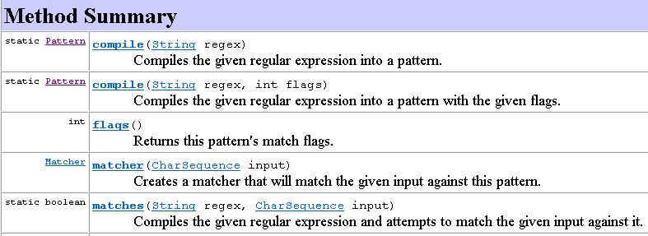
Methods of Pattern class

Slide 7
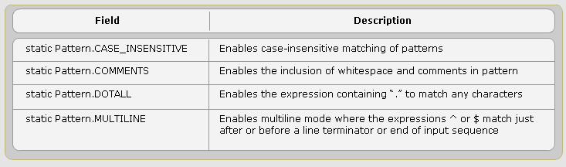
Patterns Flags
Call compile method with/without flag value to defines the way the pattern is matched.
Notes:
import java.util.regex.Matcher; import java.util.regex.Pattern; public class Main { public static void main(String[] argv) throws Exception { CharSequence inputStr = "Abc\ndef"; String patternStr = "abc$"; // Compile with multiline and case-insensitive enabled Pattern pattern = Pattern.compile(patternStr, Pattern.MULTILINE | Pattern.CASE_INSENSITIVE); Matcher matcher = pattern.matcher(inputStr); boolean matchFound = matcher.find(); } }

Slide 8
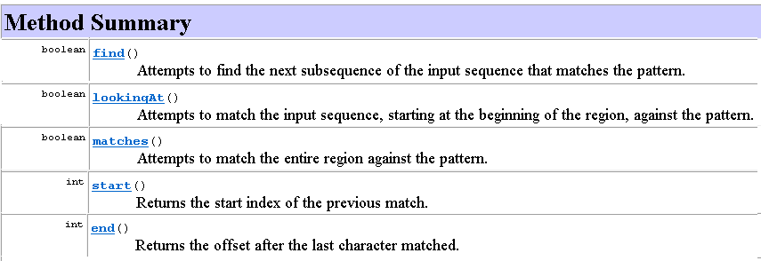
Methods of Matcher class

Slide 9
Matchcer methods
Now that we have a matcher m,
m.matches() returns true if the pattern matches the entire text string, and false otherwise
m.lookingAt() returns true if the pattern matches at the beginning of the text string, and false otherwise
m.find() returns true if the pattern matches any part of the text string, and false otherwise
If called again, m.find() will start searching from where the last match was found
m.find() will return true for as many matches as there are in the string; after that, it will return false
When m.find() returns false, matcher m will be reset to the beginning of the text string (and may be used again)‏
m.reset() reset the searching point to the start of the string.

Slide 10
Finding what was matched
After a successful match,
m.start() will return the index of the first character matched
m.end() will return the index of the last character matched, plus one
If no match was attempted, or if the match was unsuccessful, m.start() and m.end() will throw an IllegalStateException
This is a RuntimeException, so you don’t have to catch it
It may seem strange that m.end() returns the index of the last character matched plus one, but this is just what most String methods require
For example, "Now is the time".substring(m.start(), m.end()) will return exactly the matched substring

Slide 11
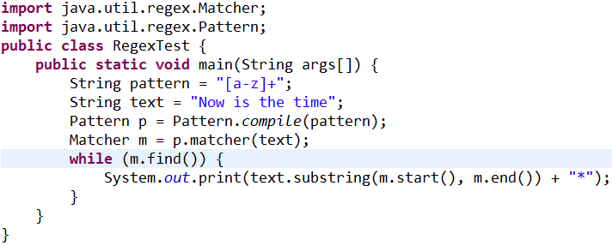

A complete example

Slide 12
Additional methods
If m is a matcher, then
m.replaceFirst(replacement) returns a new String where the first substring matched by the pattern has been replaced by replacement
m.replaceAll(replacement) returns a new String where every substring matched by the pattern has been replaced by replacement
m.find(startIndex) looks for the next pattern match, starting at the specified index
m.reset() resets this matcher
m.reset(newText) resets this matcher and gives it new text to examine (which may be a String, StringBuffer, or CharBuffer)‏

Slide 13
Metacharacters
Special characters which affect the way a pattern is matched.
Special characters which behave as metacharacter and supported by the API are: ( [ {\ ^ - $ I ] } ) ? * + .
Special characters can be ordinary character by:
precede the metacharacter with a backslash (\)
enclose the metacharacter by specifying \Q at the beginning and \E at the end

Slide 14
Some simple patterns
Pattern | Description
abc | exactly this sequence of three letters
[abc] | any one of the letters a, b, or c
[^abc] | any character except one of the letters a, b, or c (immediately within an open bracket, ^ means “not,”but anywhere else it just means the character ^)
[ab^c] | a, b, ^ or c.
[a-z] | any one character from a through z, inclusive
[a-zA-Z0-9] | any one letter or digit

Slide 15
Character Classes
Set of characters enclosed within square brackets
[abc] | a, b, or c (simple class)
[^abc] | Any character except a, b, or c (negation)
[a-zA-Z] | a through z or A through Z, inclusive (range)
[a-d[m-p]] | a through d, or m through p: [a-dm-p] (union)
[a-z&&[def]] | d, e, or f (intersection)
[a-z&&[^bc]] | a through z, except for b and c: [ad-z] (subtraction)
[a-z&&[^m-p]] | a through z, and not m through p: [a-lq-z](subtraction)

Slide 16
Sequences and alternatives
If one pattern is followed by another, the two patterns must match consecutively
For example, [A-Za-z]+[0-9] will match one or more letters immediately followed by one digit
The vertical bar, |, is used to separate alternatives
For example, the pattern abc|xyz will match either abc or xyz
Notes:
Consecutively: liên tiếp

Slide 17
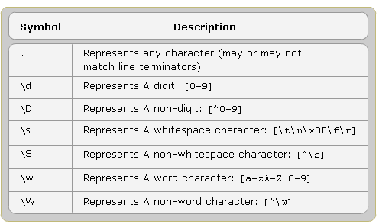
Some predefined Character Classes

Slide 18
Boundary matchers
These patterns match the empty string if at the specified position:
^ the beginning of a line
$ the end of a line
\b a word boundary
\B not a word boundary
\A the beginning of the input (can be multiple lines)
\Z the end of the input except for the final terminator, if any
\z the end of the input
\G the end of the previous match
Notes:
The following examples demonstrate the use of boundary matchers ^ and $. As noted above, ^ matches the beginning of a line, and $ matches the end.
Enter your regex: ^dog$
Enter input string to search: dog
I found the text "dog" starting at index 0 and ending at index 3.
Enter your regex: ^dog$
Enter input string to search: dog
No match found.
Enter your regex: \s*dog$
Enter input string to search: dog
I found the text " dog" starting at index 0 and ending at index 15.
Enter your regex: ^dog\w*
Enter input string to search: dogblahblah
I found the text "dogblahblah" starting at index 0 and ending at index 11.
The first example is successful because the pattern occupies the entire input string. The second example fails because the input string contains extra whitespace at the beginning. The third example specifies an expression that allows for unlimited white space, followed by "dog" on the end of the line. The fourth example requires "dog" to be present at the beginning of a line followed by an unlimited number of word characters.
To check if a pattern begins and ends on a word boundary (as opposed to a substring within a longer string), just use \b on either side; for example, \bdog\b
Enter your regex: \bdog\b
Enter input string to search: The dog plays in the yard.
I found the text "dog" starting at index 4 and ending at index 7.
Enter your regex: \bdog\b
Enter input string to search: The doggie plays in the yard.
No match found.
To match the expression on a non-word boundary, use \B instead:
Enter your regex: \bdog\B
Enter input string to search: The dog plays in the yard.
No match found.
Enter your regex: \bdog\B
Enter input string to search: The doggie plays in the yard.
I found the text "dog" starting at index 4 and ending at index 7.
To require the match to occur only at the end of the previous match, use \G:
Enter your regex: dog
Enter input string to search: dog dog
I found the text "dog" starting at index 0 and ending at index 3.
I found the text "dog" starting at index 4 and ending at index 7.
Enter your regex: \Gdog
Enter input string to search: dog dog
I found the text "dog" starting at index 0 and ending at index 3.
Here the second example finds only one match, because the second occurrence of "dog" does not start at the end of the previous match.

Slide 19
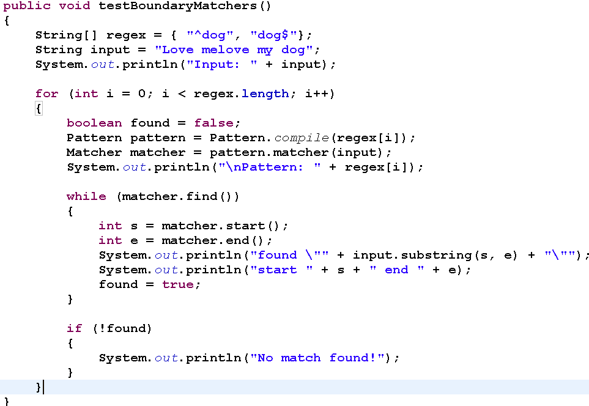
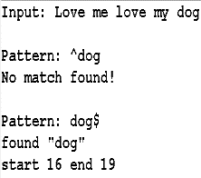
Example of Boundary Matchers
Output
19/28

Slide 20
Greedy quantifiers
Assume X represents some pattern
X? | optional, X occurs zero or one time
X* | X occurs zero or more times
X+ | X occurs one or more times
X{n} | X occurs exactly n times
X{n,} | X occurs n or more times
X{n,m} | X occurs at least n but not more than m times
Note that these are all postfix operators, that is, they come after the operand

Slide 21
Types of quantifiers
A greedy quantifier [longest match first] (default) will match as much as it can, and back off if it needs to
A reluctant quantifier [shortest match first] will match as little as possible, then take more if it needs to
You make a quantifier reluctant by appending a ?: X?? X*? X+? X{n}? X{n,}? X{n,m}?
A possessive quantifier [longest match and never backtrack] will match as much as it can, and never let go
You make a quantifier possessive by appending a +: X?+ X*+ X++ X{n}+ X{n,}+ X{n,m}+
Notes:
Reluctant: miễn cưỡng, bất đắc dĩ, không thích, không sẵn lòng
Possessive: sở hữu, chiếm hữu
back- off: move backwards from a certain position

Slide 22
Quantifiers examples
Suppose your text is succeed
Using the pattern suc*ce{2}d (c* is greedy):
The c* will first match cc, but then ce{2}d won’t match
The c* then “backs off” and matches only a single c, allowing the rest of the pattern (ce{2}d) to succeed
Using the pattern suc*?ce{2}d (c*? is reluctant):
The c*? will first match zero characters (the null string), but then ce{2}d won’t match
The c*? then extends and matches the first c, allowing the rest of the pattern (ce{2}d) to succeed
Using the pattern au c*+ce{2}d (c*+ is possessive):
The c*+ will match the cc, and will not back off, so ce{2}d never matches and the pattern match fails.
Notes:
Quantifiers
Quantifiers allow you to specify the number of occurrences to match against. For convenience, the three sections of the Pattern API specification describing greedy, reluctant, and possessive quantifiers are presented below. At first glance it may appear that the quantifiers X?, X?? and X?+ do exactly the same thing, since they all promise to match "X, once or not at all". There are subtle implementation differences which will be explained near the end of this section.
GreedyReluctantPossessiveMeaningX?X??X?+X, once or not at allX*X*?X*+X, zero or more timesX+X+?X++X, one or more timesX{n}X{n}?X{n}+X, exactly n timesX{n,}X{n,}?X{n,}+X, at least n timesX{n,m}X{n,m}?X{n,m}+X, at least n but not more than m times
Let's start our look at greedy quantifiers by creating three different regular expressions: the letter "a" followed by either ?, *, or +. Let's see what happens when these expressions are tested against an empty input string "":
Enter your regex: a? Enter input string to search: I found the text "" starting at index 0 and ending at index 0. Enter your regex: a* Enter input string to search: I found the text "" starting at index 0 and ending at index 0. Enter your regex: a+ Enter input string to search: No match found.
Zero-Length Matches
In the above example, the match is successful in the first two cases because the expressions a? and a* both allow for zero occurrences of the letter a. You'll also notice that the start and end indices are both zero, which is unlike any of the examples we've seen so far. The empty input string "" has no length, so the test simply matches nothing at index 0. Matches of this sort are known as a zero-length matches. A zero-length match can occur in several cases: in an empty input string, at the beginning of an input string, after the last character of an input string, or in between any two characters of an input string. Zero-length matches are easily identifiable because they always start and end at the same index position.
Let's explore zero-length matches with a few more examples. Change the input string to a single letter "a" and you'll notice something interesting:
Enter your regex: a? Enter input string to search: a I found the text "a" starting at index 0 and ending at index 1. I found the text "" starting at index 1 and ending at index 1. Enter your regex: a* Enter input string to search: a I found the text "a" starting at index 0 and ending at index 1. I found the text "" starting at index 1 and ending at index 1. Enter your regex: a+ Enter input string to search: a I found the text "a" starting at index 0 and ending at index 1.
All three quantifiers found the letter "a", but the first two also found a zero-length match at index 1; that is, after the last character of the input string. Remember, the matcher sees the character "a" as sitting in the cell between index 0 and index 1, and our test harness loops until it can no longer find a match. Depending on the quantifier used, the presence of "nothing" at the index after the last character may or may not trigger a match.
Now change the input string to the letter "a" five times in a row and you'll get the following:
Enter your regex: a? Enter input string to search: aaaaa I found the text "a" starting at index 0 and ending at index 1. I found the text "a" starting at index 1 and ending at index 2. I found the text "a" starting at index 2 and ending at index 3. I found the text "a" starting at index 3 and ending at index 4. I found the text "a" starting at index 4 and ending at index 5. I found the text "" starting at index 5 and ending at index 5. Enter your regex: a* Enter input string to search: aaaaa I found the text "aaaaa" starting at index 0 and ending at index 5. I found the text "" starting at index 5 and ending at index 5. Enter your regex: a+ Enter input string to search: aaaaa I found the text "aaaaa" starting at index 0 and ending at index 5.
The expression a? finds an individual match for each character, since it matches when "a" appears zero or one times. The expression a* finds two separate matches: all of the letter "a"'s in the first match, then the zero-length match after the last character at index 5. And finally, a+ matches all occurrences of the letter "a", ignoring the presence of "nothing" at the last index.
At this point, you might be wondering what the results would be if the first two quantifiers encounter a letter other than "a". For example, what happens if it encounters the letter "b", as in "ababaaaab"?
Let's find out:
Enter your regex: a? Enter input string to search: ababaaaab I found the text "a" starting at index 0 and ending at index 1. I found the text "" starting at index 1 and ending at index 1. I found the text "a" starting at index 2 and ending at index 3. I found the text "" starting at index 3 and ending at index 3. I found the text "a" starting at index 4 and ending at index 5. I found the text "a" starting at index 5 and ending at index 6. I found the text "a" starting at index 6 and ending at index 7. I found the text "a" starting at index 7 and ending at index 8. I found the text "" starting at index 8 and ending at index 8. I found the text "" starting at index 9 and ending at index 9. Enter your regex: a* Enter input string to search: ababaaaab I found the text "a" starting at index 0 and ending at index 1. I found the text "" starting at index 1 and ending at index 1. I found the text "a" starting at index 2 and ending at index 3. I found the text "" starting at index 3 and ending at index 3. I found the text "aaaa" starting at index 4 and ending at index 8. I found the text "" starting at index 8 and ending at index 8. I found the text "" starting at index 9 and ending at index 9. Enter your regex: a+ Enter input string to search: ababaaaab I found the text "a" starting at index 0 and ending at index 1. I found the text "a" starting at index 2 and ending at index 3. I found the text "aaaa" starting at index 4 and ending at index 8.
Even though the letter "b" appears in cells 1, 3, and 8, the output reports a zero-length match at those locations. The regular expression a? is not specifically looking for the letter "b"; it's merely looking for the presence (or lack thereof) of the letter "a". If the quantifier allows for a match of "a" zero times, anything in the input string that's not an "a" will show up as a zero-length match. The remaining a's are matched according to the rules discussed in the previous examples.
To match a pattern exactly n number of times, simply specify the number inside a set of braces:
Enter your regex: a{3} Enter input string to search: aa No match found. Enter your regex: a{3} Enter input string to search: aaa I found the text "aaa" starting at index 0 and ending at index 3. Enter your regex: a{3} Enter input string to search: aaaa I found the text "aaa" starting at index 0 and ending at index 3.
Here, the regular expression a{3} is searching for three occurrences of the letter "a" in a row. The first test fails because the input string does not have enough a's to match against. The second test contains exactly 3 a's in the input string, which triggers a match. The third test also triggers a match because there are exactly 3 a's at the beginning of the input string. Anything following that is irrelevant to the first match. If the pattern should appear again after that point, it would trigger subsequent matches:
Enter your regex: a{3} Enter input string to search: aaaaaaaaa I found the text "aaa" starting at index 0 and ending at index 3. I found the text "aaa" starting at index 3 and ending at index 6. I found the text "aaa" starting at index 6 and ending at index 9.
To require a pattern to appear at least n times, add a comma after the number:
Enter your regex: a{3,} Enter input string to search: aaaaaaaaa I found the text "aaaaaaaaa" starting at index 0 and ending at index 9.
With the same input string, this test finds only one match, because the 9 a's in a row satisfy the need for "at least" 3 a's.
Finally, to specify an upper limit on the number of occurances, add a second number inside the braces:
Enter your regex: a{3,6} // find at least 3 (but no more than 6) a's in a row Enter input string to search: aaaaaaaaa I found the text "aaaaaa" starting at index 0 and ending at index 6. I found the text "aaa" starting at index 6 and ending at index 9.
Here the first match is forced to stop at the upper limit of 6 characters. The second match includes whatever is left over, which happens to be three a's — the mimimum number of characters allowed for this match. If the input string were one character shorter, there would not be a second match since only two a's would remain.
Capturing Groups and Character Classes with Quantifiers
Until now, we've only tested quantifiers on input strings containing one character. In fact, quantifiers can only attach to one character at a time, so the regular expression "abc+" would mean "a, followed by b, followed by c one or more times". It would not mean "abc" one or more times. However, quantifiers can also attach to Character Classes and Capturing Groups, such as [abc]+ (a or b or c, one or more times) or (abc)+ (the group "abc", one or more times).
Let's illustrate by specifying the group (dog), three times in a row.
Enter your regex: (dog){3} Enter input string to search: dogdogdogdogdogdog I found the text "dogdogdog" starting at index 0 and ending at index 9. I found the text "dogdogdog" starting at index 9 and ending at index 18. Enter your regex: dog{3} Enter input string to search: dogdogdogdogdogdog No match found.
Here the first example finds three matches, since the quantifier applies to the entire capturing group. Remove the parentheses, however, and the match fails because the quantifier {3} now applies only to the letter "g".
Similarly, we can apply a quantifier to an entire character class:
Enter your regex: [abc]{3} Enter input string to search: abccabaaaccbbbc I found the text "abc" starting at index 0 and ending at index 3. I found the text "cab" starting at index 3 and ending at index 6. I found the text "aaa" starting at index 6 and ending at index 9. I found the text "ccb" starting at index 9 and ending at index 12. I found the text "bbc" starting at index 12 and ending at index 15. Enter your regex: abc{3} Enter input string to search: abccabaaaccbbbc No match found.
Here the quantifier {3} applies to the entire character class in the first example, but only to the letter "c" in the second.
Differences Among Greedy, Reluctant, and Possessive Quantifiers
There are subtle differences among greedy, reluctant, and possessive quantifiers.
Greedy quantifiers are considered "greedy" because they force the matcher to read in, or eat, the entire input string prior to attempting the first match. If the first match attempt (the entire input string) fails, the matcher backs off the input string by one character and tries again, repeating the process until a match is found or there are no more characters left to back off from. Depending on the quantifier used in the expression, the last thing it will try matching against is 1 or 0 characters.
The reluctant quantifiers, however, take the opposite approach: They start at the beginning of the input string, then reluctantly eat one character at a time looking for a match. The last thing they try is the entire input string.
Finally, the possessive quantifiers always eat the entire input string, trying once (and only once) for a match. Unlike the greedy quantifiers, possessive quantifiers never back off, even if doing so would allow the overall match to succeed.
To illustrate, consider the input string xfooxxxxxxfoo.
Enter your regex: .*foo // greedy quantifier Enter input string to search: xfooxxxxxxfoo I found the text "xfooxxxxxxfoo" starting at index 0 and ending at index 13. Enter your regex: .*?foo // reluctant quantifier Enter input string to search: xfooxxxxxxfoo I found the text "xfoo" starting at index 0 and ending at index 4. I found the text "xxxxxxfoo" starting at index 4 and ending at index 13. Enter your regex: .*+foo // possessive quantifier Enter input string to search: xfooxxxxxxfoo No match found.
The first example uses the greedy quantifier .* to find "anything", zero or more times, followed by the letters "f" "o" "o". Because the quantifier is greedy, the.* portion of the expression first eats the entire input string. At this point, the overall expression cannot succeed, because the last three letters ("f" "o" "o") have already been consumed. So the matcher slowly backs off one letter at a time until the rightmost occurrence of "foo" has been regurgitated, at which point the match succeeds and the search ends.
The second example, however, is reluctant, so it starts by first consuming "nothing". Because "foo" doesn't appear at the beginning of the string, it's forced to swallow the first letter (an "x"), which triggers the first match at 0 and 4. Our test harness continues the process until the input string is exhausted. It finds another match at 4 and 13.
The third example fails to find a match because the quantifier is possessive. In this case, the entire input string is consumed by .*+, leaving nothing left over to satisfy the "foo" at the end of the expression. Use a possessive quantifier for situations where you want to seize all of something without ever backing off; it will outperform the equivalent greedy quantifier in cases where the match is not immediately found.

Slide 23
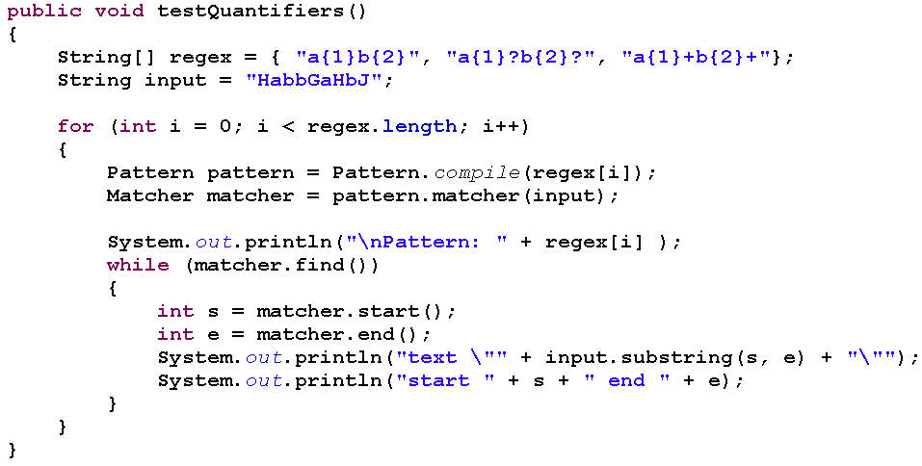
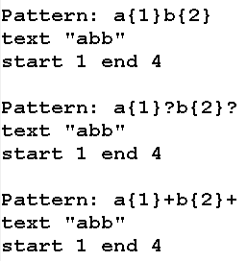
Example of Quantifiers
Output

Slide 24
Capturing Groups - 1
In regular expressions, parentheses are used for grouping, but they also capture (keep for later use) anything matched by that part of the pattern
Example: ([a-zA-Z]*)([0-9]*) matches any number of letters followed by any number of digits
If the match succeeds, \1 holds the matched letters and \2 holds the matched digits
In addition, \0 holds everything matched by the entire pattern
Capturing groups are numbered by counting their opening parentheses from left to right:
( ( A ) ( B ( C ) ) ) 1 2 3 4 \0 = \1 = ((A)(B(C))), \2 = (A), \3 = (B(C)), \4 = (C)‏
Example: ([a-zA-Z])\1 will match a double letter, such as letter

Slide 25
Capturing Groups - 2
If m is a matcher that has just performed a successful match, then
m.group(n) returns the String matched by capturing group n
This could be an empty string
This will be null if the pattern as a whole matched but this particular group didn’t match anything
m.group() returns the String matched by the entire pattern (same as m.group(0))‏
This could be an empty string
If m didn’t match (or wasn’t tried), then these methods will throw an IllegalStateException

Slide 26
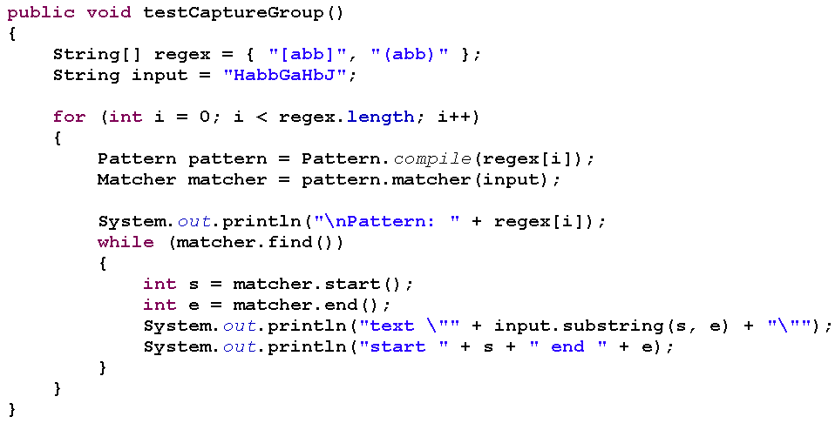
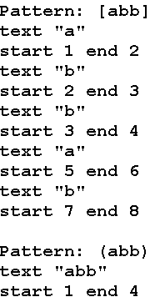
Example of Capturing Groups
Output

Slide 27
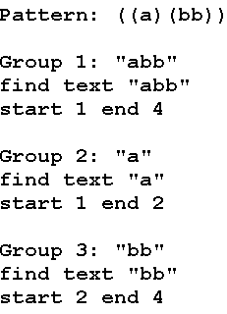
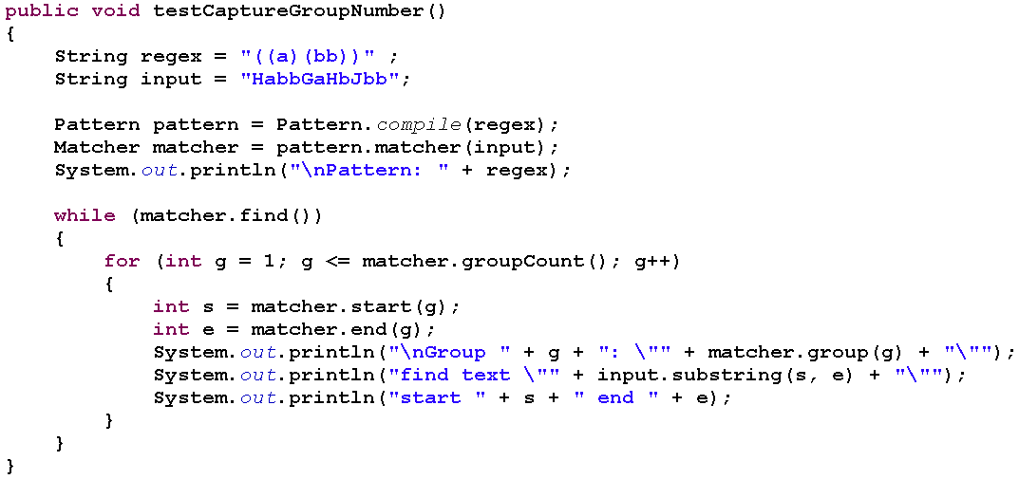
Example of Numbering Capture Group
Output
27/28

Slide 28
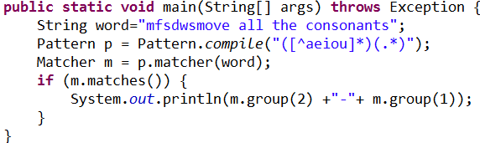
Example use of capturing groups
Suppose word holds a word in English
Also suppose we want to move all the consonants at the beginning of word (if any) to the end of the word (so string becomes ingstr)‏
Note the use of (.*) to indicate “all the rest of the characters”

Slide 29
Double backslashes
Backslashes have a special meaning in regular expressions; for example, \b means a word boundary
Backslashes have a special meaning in Java; for example, \b means the backspace character
Java syntax rules apply first!
If you write "\b[a-z]+\b" you get a string with backspace characters in it--this is not what you want!
Remember, you can quote a backslash with another backslash, so "\\b[a-z]+\\b" gives the correct string
Note: if you read in a String from somewhere, this does not apply--you get whatever characters are actually there

Slide 30
Escaping metacharacters
A lot of special characters--parentheses, brackets, braces, stars, plus signs, etc.--are used in defining regular expressions; these are called metacharacters
Suppose you want to search for the character sequence a* (an a followed by a star)‏
"a*"; doesn’t work; that means “zero or more as”
"a\*"; doesn’t work; since a star doesn’t need to be escaped (in Java String constants), Java just ignores the \
"a\\*" does work; it’s the three-character string a, \, *
Just to make things even more difficult, it’s illegal to escape a non-metacharacter in a regular expression

Slide 31
Spaces
There is only one thing to be said about spaces (blanks) in regular expressions, but it’s important:
Spaces are significant!
A space stands for a space--when you put a space in a pattern, that means to match a space in the text string
It’s a really bad idea to put spaces in a regular expression just to make it look better
Ex:
Pattern.compile("a b+").matcher("abb"). matches()
⇨ return false.
Notes:
Significant: quan trong, có ý nghĩa

Slide 32
Additions to the String class
All of the following are public
public boolean matches(String regex)‏
public String replaceFirst(String regex, String replacement)‏
public String replaceAll(String regex, String replacement)‏
public String[ ] split(String regex)
public String[ ] split(String regex, int limit)‏
If the limit n is greater than zero then the pattern will be applied at most n - 1 times, the array's length will be no greater than n, and the array's last entry will contain all input beyond the last matched delimiter.
If n is non-positive then the pattern will be applied as many times as possible

Slide 33
Thinking in regular expressions
Regular expressions are not easy to use at first
It’s a bunch of punctuation, not words
The individual pieces are not hard, but it takes practice to learn to put them together correctly
Regular expressions form a miniature programming language
It’s a different kind of programming language than Java, and requires you to learn new thought patterns
In Java you can’t just use a regular expression; you have to first create Patterns and Matchers
Java’s syntax for String constants doesn’t help, either
Despite all this, regular expressions bring so much power and convenience to String manipulation that they are well worth the effort of learning
Notes:
miniature : bức tiểu họa (thu nhỏ lại)

Slide 34


Slide 35
That’s all for this session!
Thank you all for your attention and patient !
35/27

