Slide 1
XML Processing with Java
Java Programming Course

Slide 2

Session objectives
Introduction
XML, DTD, XSD
XPath, XQuery
XSLT
Parsing XML document
Using SAX
StAX
Using DOM
XML transformation

Slide 3
XML Introduction
Evolution of markup languages:
GML → SGML → HTML.
Features
SGML ensures to represent the data in its own way.
HTML allows the user to use any text editor
The eXtensible Markup Language (XML) was created in order to address the issues raised by earlier markup languages
XML is a set of rules for defining semantic tags that
Break a document into parts
And identify the different parts of the document

Slide 4
XML Features
XML is a markup language much like HTML
XML was designed to describe data
XML tags are not predefined. You must define your own tags
XML uses a Document Type Definition (DTD) or an XML Schema to describe the data
XML with a DTD or XML Schema is designed to be self-descriptive
A document consists of one outermost element, called root element that contains all the other elements, plus some optional administrative information at the top, known as XML declaration.

Slide 5
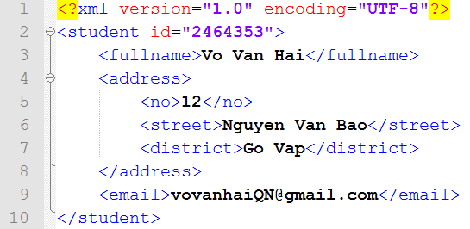
Sample XML Document

Slide 6
Benefits of XML
Data independence: separates the content from its presentation.
Easier to parse: frameworks for data exchange.
Reducing server load: using DOM to manipulate the data.
Easier to create: it is text-based.
Web site content: transforms to HTML using XSLT and CSS.
Remote procedure call: allows distributed computing.
E-commerce: sends data from one company to another.

Slide 7
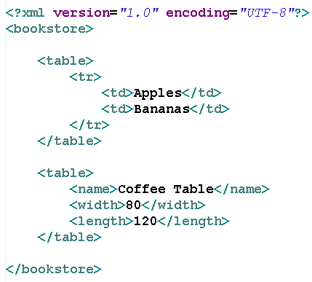
XML Namespace
In XML, element names are defined by the developer.
This often results in a conflict when trying to mix XML documents from different XML applications.
XML Namespaces Provide a method to avoid element name conflicts.

Slide 8
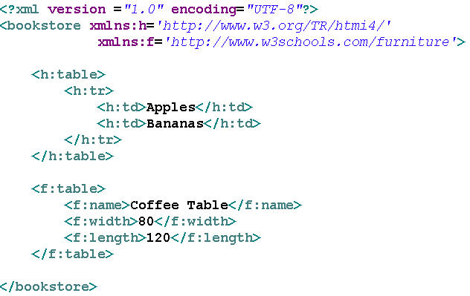
XML Namespace example

Slide 9
Well Formed XML Documents
A "Well Formed" XML document has correct XML syntax.
XML documents must have a root element
XML elements must have a closing tag
XML tags are case sensitive
XML elements must be properly nested
XML attribute values must be quoted

Slide 10
Document Type Definition (DTD)
DTD document is a non XML document made up of element, attribute and entity declarations.
A DTD document defines:
The legal building blocks of an XML document.
The document structure with a list of legal elements and attributes,
The way elements relate to one another within the document’s tree structure
A DTD can be declared:
Inline inside an XML document
External reference.

Slide 11
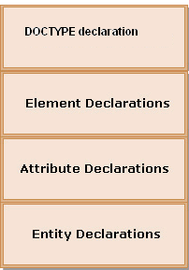
Structure of a DTD
DOCTYPE declaration
Specifies name of that DTD and either its content or location
ELEMENT declaration
Specifies the name of the element, the content which that element can contain
ATTRIBUTE declaration
Specifies the element that owns the attributes, the attribute name, its type and its default values (if any)
ENTITY declaration
Specifies the name of the entity and either its value or location of its values.

Slide 12
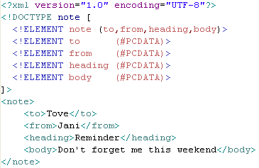
Example of Internal DTD Declaration
If the DTD is declared inside the XML file, it should be wrapped in a DOCTYPE definition
Syntax:
<!DOCTYPE root-element [element-declarations]>

Slide 13
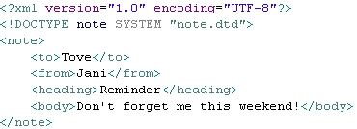

Example of External DTD Declaration
If the DTD is declared in an external file, it should be wrapped in a DOCTYPE definition
Syntax:
<!DOCTYPE root-element SYSTEM "filename“>

Slide 14
DTD limitations and XML Schema
DTDs are written in a non-XML syntax.
DTDs are not extensible.
They have no support for namespaces.
They only offer extremely limited data typing.
XML schema has been introduced, with an objective to overcome the drawbacks of DTDs.
The purpose of an XML Schema is to define the legal building blocks of an XML document, just like a DTD.
The XML Schema language is referred as XML Schema Definition (XSD).

Slide 15
XML Schema
Defines elements that can appear in a document
Defines attributes that can appear in a document
Defines which elements are child elements
Defines the order of child elements
Defines the number of child elements
Defines whether an element is empty or can include text
Defines data types for elements and attributes
Defines default and fixed values for elements and attributes

Slide 16
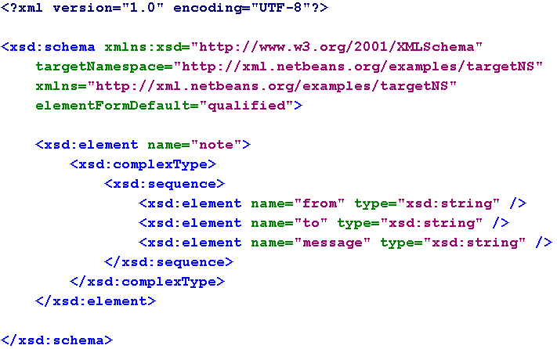
Example of XML Schema

Slide 17
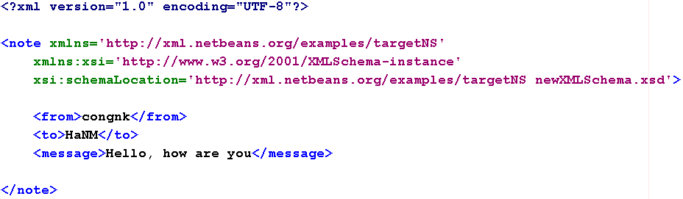
Referencing a Schema in an XML Document

Slide 18
Read more:
http://www.w3schools.com/xml/default.asp
…

Slide 19
JAXP
Java API for XML Processing

Slide 20
Parsing anh Parser
Parsing is a process XML data by using programs (parsers)
These programs are able to extract and manipulate data in XML documents.
Parsers are software program that check the syntax used in an xml file.
Types of Parser
Event-Based Parsers: generate events while traversing through an XML document. (SAX)
Object-Based Parsers: arrange XML document in a tree-like structure. (DOM).

Slide 21
JAXP – Java API for XML Processing
JAXP is a collection of APIs that you can use in your Java applications to process and translate XML documents
Consists of three APIs:
Simple API for XML (SAX): Allows you to use a SAX parser to process the XML documents serially.
Document Object Model (DOM): Allows you to use a DOM parser to process the XML documents in an object-oriented manner.
XML Stylesheet Language for Transformation (XSLT): Allows you to transform XML documents in other formats, such as HyperText Markup Language (HTML)

Slide 22
XML API Styles
Push: SAX, XNI
Pull: XMLPULL, StAX, NekoPull
Tree: DOM, JDOM, XOM, ElectricXML, dom4j, Sparta
Data binding: Castor, Zeus, JAXB
Transform: XSLT, TrAX, XQuery
Notes:
Push APIs
Read-only
Fast
Streamable
Memory efficient
Complete
Essentially correct
Client programs can get quite complex and confusing
Pull APIs
Read-only
Fast
Streamable
Memory efficient
Client programs can be much simpler than SAX
Data Binding APIs
Map XML documents to Java classes
Read/Write
Allow in-memory manipulation
Hide the XML details
Common assumptions:
Documents have schemas
Documents are valid.
Structures are fairly flat and definitely not recursive.
Narrative documents aren't worth considering.
Mixed content doesn't exist.
Choices don't exist.
Order doesn't matter.
Sees the world through object-colored glasses
Tree APIs
Model an XML document using classes that represent nodes
Composition builds a tree
Read/Write
Allow in-memory manipulation
The simplest arbitrary XML API
Tend to be profligate with memory

Slide 23
SAX
Simple API for XML

Slide 24
Parsing an XML Document
Callback
Method/Event
Parser
XML
document
Content/Default
Handler
Input
...
The three steps followed for parsing an XML document are:
Application supplies a SAX content handler to the parser.
Application tells parser to start parsing a document.
Parser calls back the ContentHandler / DefaultHandler

Slide 25

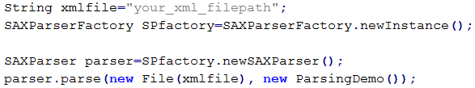
Parsing an XML Document (cont)
Steps for processing of parsing in code are:
An instance of SAXParserFactory is generated by the parser to initialize the working of SAX.
The parser encloses a SAXReader object.
The parser() method of the SAXParser class is invoked.
The SAXReader invokes a callback method

Slide 26
Callback interface
SAX is used with XMLReader as the Subject and org.xml.sax.ContentHandler/ org.xml.sax.helpers.DefaultHandler as an Observer (is similar to define the event Listener to subject – button in AWT)
Callback in SAX parser
<?xml version=1.0”?>
<library>
<book>
<title>
Harry Porter
</title>
<price>
35.0
</price>
</book>
....
</library>
startDocument()
startElement(“library”, attr)
startElement(“book”, attr)
startElement(“title”, attr)
characters(char[], start, length)
endElement(“title”)
...
endElement(“library”)
endDocument()

Slide 27
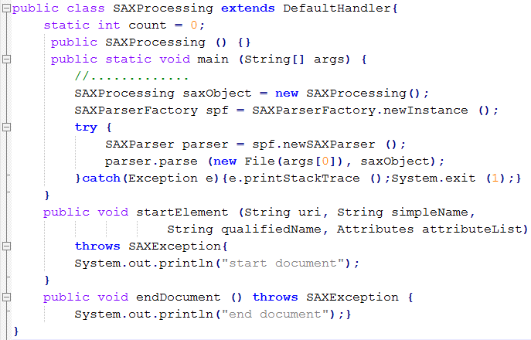
Parsing example

Slide 28
Content parsing API (1)
Used for parsing the XML content and returning a SAX parsed document
The org.xml.sax.ContentHandler interface:
Receives notifications of the logical content of the document being parsed
Application can implement this interface and register an instance with the SAX parser using the setContentHandler() method.
The parser uses this instance to report events
The order of events in this interface is very important and it mirrors the order of information in the document itself.
The different methods must be implemented

Slide 29
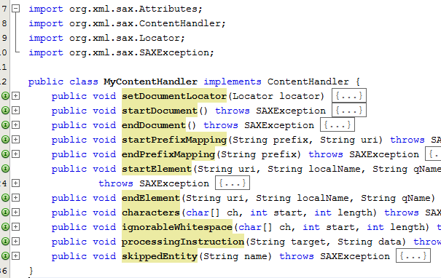
Content parsing API (2)

Slide 30
Content parsing API (3)
The org.xml.sax.helpers.DefaultHandler class:
Is default base class for SAX2 event handlers.
Provides default implementations for all of the callbacks in the four core SAX2 handler classes: ContentHandler, DTD Handler, Error Handle, Entity Resolver.
Provided as a convenience base class for SAX2 applications. Thus, the application developer will need to override only those for which additional or custom functionality is desired.

Slide 31
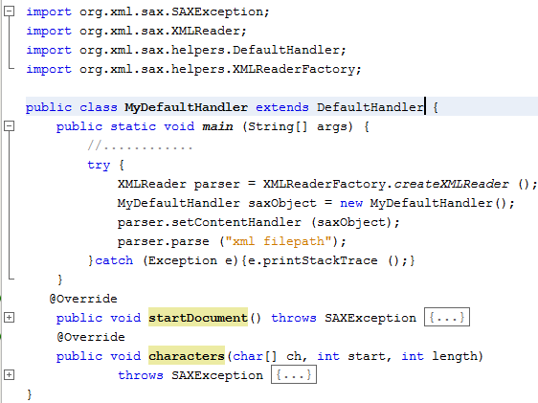
Content parsing API (4)

Slide 32
Attributes interface
Provides access to a list of attributes present in an XML document
Methods | Descriptions
getLength | - Returns the number of attributes present in a list
getURI | - Refers to an attribute’s Namespace URI by an index
getLocalName | - Refers to an attribute’s local name by an index
getQName | - Refers to an attribute’s XML 1.0 qualified name by an index.
getType | - Refers to an attribute’s type by an index
getValue | - Refers to an attribute’s value by an index
getIndex | - Refers to the index of an attribute by a Namespace name

Slide 33
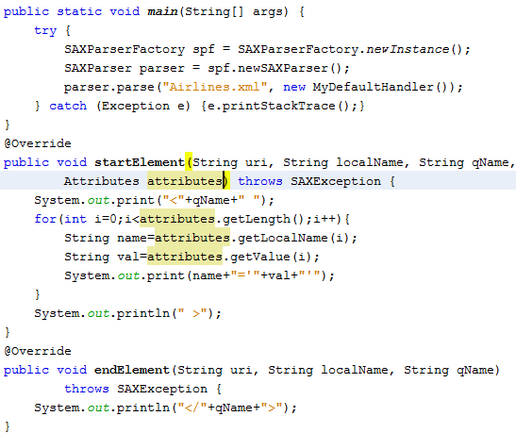
Attributes interface example

Slide 34
Errors in processing with XML
Fatal Errors
Occur in the SAX parser
XML document is not well-formed
XML document cannot be processed because it terminates the execution
Non-Fatal Errors
Validation errors in SAX parser are termed
An XML document is not valid.
A declaration specified by an XML version, which cannot be handled by the parser
Warnings
Are generated when a DTD contains duplicate definitions
Generated during XML validation are not errors but the user needs to be informed about it

Slide 35
Read more
http://www.cafeconleche.org/slides/sd2000east/sax/

Slide 36
StAX
Streaming API for XML

Slide 37
Streaming API for XML
JSR-173, proposed by BEA Systems:
Two recently proposed JSRs, JAXB and JAX-RPC, highlight the need for an XML Streaming API. Both data binding and remote procedure calling (RPC) require processing of XML as a stream of events, where the current context of the XML defines subsequent processing of the XML. A streaming API makes this type of code much more natural to write than SAX, and much more efficient than DOM.
Goals:
Develop APIs and conventions that allow a user to programmatically pull parse events from an XML input stream.
Develop APIs that allow a user to write events to an XML output stream.
Develop a set of objects and interfaces that encapsulate the information contained in an XML stream.

Slide 38
Major Classes and Interfaces
XMLStreamReader:
an interface that represents the parser
XMLInputFactory:
the factory class that instantiates an implementation dependent implementation of XMLStreamReader
XMLStreamException:
the generic class for everything other than an IOException that might go wrong when parsing an XML document, particularly well-formedness errors
XMLStreamWriter
An event based API for creating XML documents

Slide 39
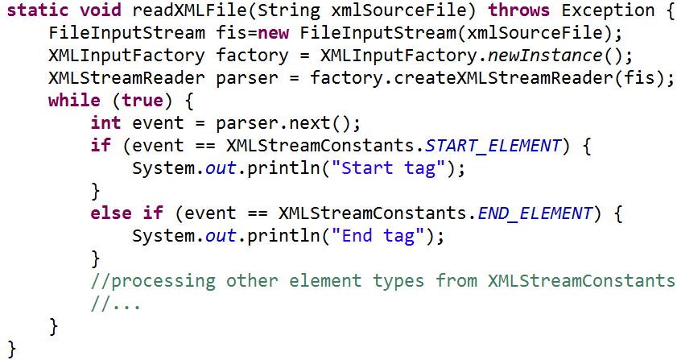
Reading document example

Slide 40
StAX methods on states (1/2)
Event Type | Valid Methods
START_ELEMENT | next(), getName(), getLocalName(), hasName(), getPrefix(), getAttributeCount(), getAttributeName(int index), getAttributeNamespace(int index), getAttributePrefix(int index), getAttributeQName(int index), getAttributeType(int index), getAttributeValue(int index), getAttributeValue(String namespaceURI, String localName), isAttributeSpecified(), getNamespaceContext(), getNamespaceCount(), getNamespacePrefix(int index), getNamespaceURI(), getNamespaceURI(int index), getNamespaceURI(String prefix), getElementText(), nextTag()
ATTRIBUTE | next(), nextTag(), getAttributeCount(), getAttributeName(int index), getAttributeNamespace(int index), getAttributePrefix(int index), getAttributeQName(int index), getAttributeType(int index), getAttributeValue(int index), getAttributeValue(String namespaceURI, String localName), isAttributeSpecified()
NAMESPACE | next(), nextTag(), getNamespaceContext(), getNamespaceCount(), getNamespacePrefix(int index), getNamespaceURI(), getNamespaceURI(int index), getNamespaceURI(String prefix)
END_ELEMENT | next(), getName(), getLocalName(), hasName(), getPrefix(), getNamespaceContext(), getNamespaceCount(), getNamespacePrefix(int index), getNamespaceURI(), getNamespaceURI(int index), getNamespaceURI(String prefix), nextTag()

Slide 41
StAX methods on states (2/2)
Event Type | Valid Methods
CHARACTERS | next(), getText(), getTextCharacters(), getTextCharacters(int sourceStart, char[] target, int targetStart, int length), getTextLength(), nextTag()
CDATA | next(), getText(), getTextCharacters(), getTextCharacters(int sourceStart, char[] target, int targetStart, int length), getTextLength(), nextTag()
COMMENT | next(), getText(), getTextCharacters(), getTextCharacters(int sourceStart, char[] target, int targetStart, int length), getTextLength(), nextTag()
SPACE | next(), getText(), getTextCharacters(), getTextCharacters(int sourceStart, char[] target, int targetStart, int length), getTextLength(), nextTag()
START_DOCUMENT | next(), getEncoding(), next(), getPrefix(), getVersion(), isStandalone(), standaloneSet(), getCharacterEncodingScheme(), nextTag()
END_DOCUMENT | close()
PROCESSING_INSTRUCTION | next(), getPITarget(), getPIData(), nextTag()
ENTITY_REFERENCE | next(), getLocalName(), getText(), nextTag()
DTD | next(), getText(), nextTag()

Slide 42
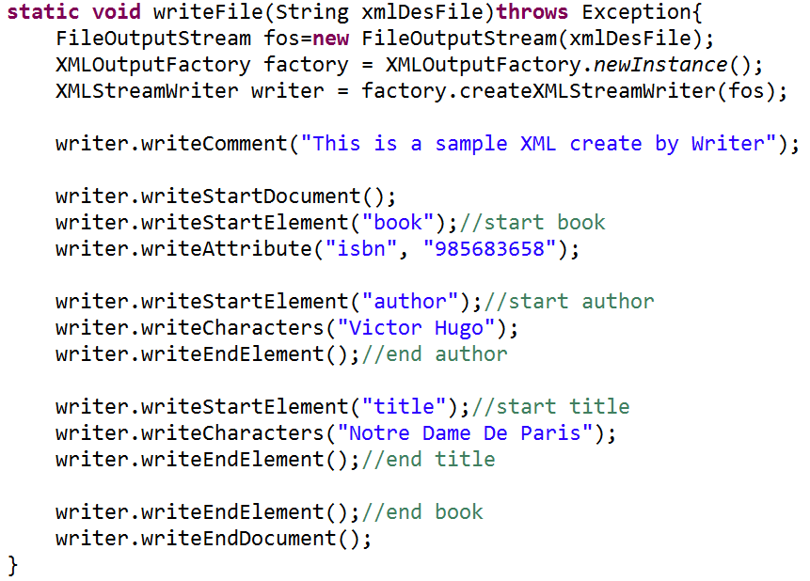
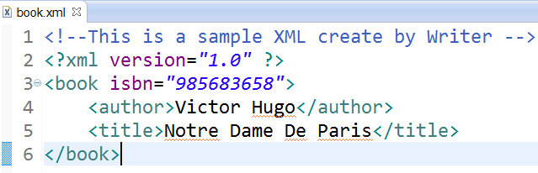
Creating document example

Slide 43
Read more
http://www.cafeconleche.org/slides/sd2004west/stax/index.html

Slide 44
DOM
Document Object Model

Slide 45
DOM
Provides reference of the complete tree structure of an XML document and stores it in memory
Benefits
Provides Access to Multiple Documents: DOM creates the whole tree structure of XML documents while processing
Manages Complex Data Structures: DOM creates a structures document-tree for an XML document having complex cross references
Allows Modification of Documents: it allows both reading and modifying a parsed XML document
Allows Many Methods to Access a Document Simultaneously: As the entire document is available in memory after it is parsed, you may use any of the DOM API calls multiple times to access, update, and delete document contents and structure

Slide 46
DOM components
DOM is an API for HTML and XML documents
A Java implementation of the DOM model defines the logical structure of XML documents and the way a document is accessed and manipulated
DOM acts as a language-independent interface between programs to access and modify data in a document. This provides the retrieved data in XML document a logical structure and style of representation. XML presents data in a tree format so DOM also presents the XML data in the same way
DOM creates a tree structure of the XML document with each XML element represented as a node
DOM more effective to act as an interface between an application written in Java and XML data because both Java and DOM are platform independent

Slide 47
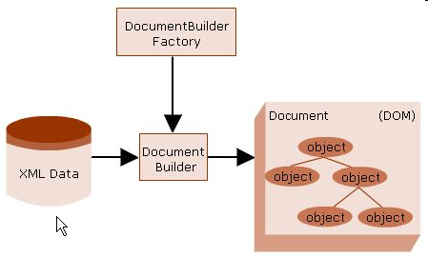
Working of DOM
The DOM works with the following steps:
The methods of DocumentBuilder class in the DOM API create a tree structure of the XML document and represent each element as a node.
The methods contained in various interfaces in the DOM API provide access to the document and its nodes to add, modify, or delete nodes or elements in the document.

Slide 48
DocumentBuilderFactory
A class defines a factory API. This API is used for creating objects of similar design pattern
Enables the application to obtain the parser needed to produre DOM object tree from the XML document
The DocumentBuilderFactory performs the following steps to parse an XML document:
The DocumentBuilderFactory creates its instance by the newInstance() method:
The factory instance then creates the DOM parser for parsing the XML document using the newDocumentBuilder() method.

Slide 49
DocumentBuilder
The class defines the API necessary to obtain the instance of a DOM document from an XML document
An instance of this class can be obtained by the newDocumentBuilder() method of the DocumentBuilderFactory class
After obtaining an instance of the class, the XML document is parsed from input sources such as InputStreams, files, URLs, and SAX input sources

Slide 50
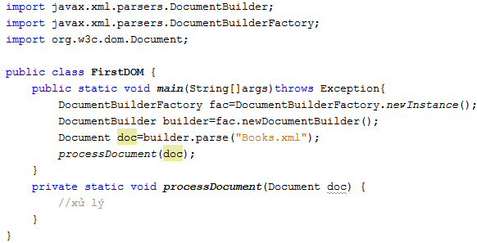
Working of DOM example

Slide 51
Node interface
Acts as the primary data type for the whole DOM model
Contains various methods to access and manipulate the nodes in a DOM document
Methods | Descriptions
getNodeName | - Returns the name of the node depending on its type.
getNodeValue | - Returns the value of the node depending on its type. - Throws the DOMException for the DOMString_SIZE_ERR error when the method returns more characters than allowed by the DOMString variable on the implementation platform. - It also throws this exception to indicate that the node is read-only by raising the error NO_MODIFICATION_ALLOWED_ERR
setNodeValue | - Assigns a value to the specific node depending on its type. It throws the DOMException due to the DOMSTRING_SIZE_ERR and NO_MODIFICATION_ALLOWED_ERR error
getChildNodes | - Returns an instance of the NodeList interface containing all the child nodes of the node
getAttributes | - Returns an instance of the NameNodeMap interface containing the attributes of the node. - Returns null if the node is not an element.

Slide 52
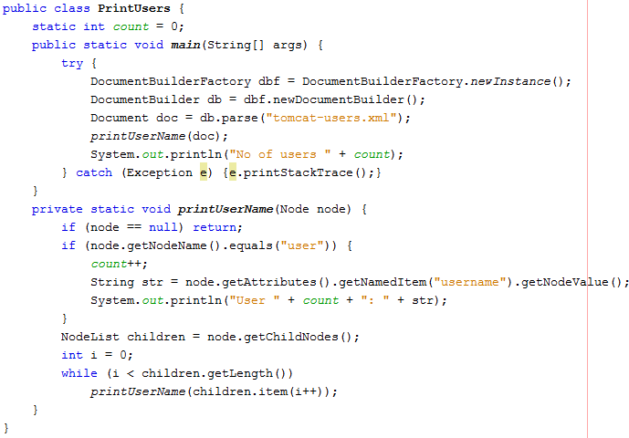
Node interface example (1)

Slide 53
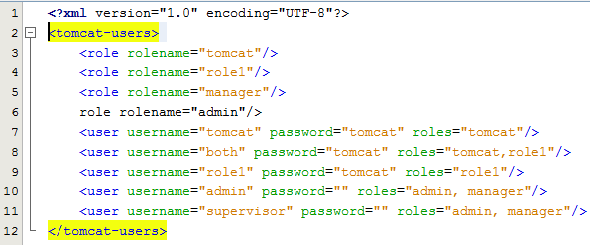
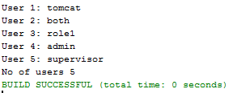
Node interface example (2)

Slide 54
Document interface
Represents the entire XML document
Is the root of the DOM tree, which provides access to the data in the XML document
Contains factory methods to create the elements, text nodes, comments, and processing instructions
Methods | Descriptions
getDocType | Returns the document type associated with the document. Returns null if the XML document is without a document type.
getDocumentElement | - Returns the attribute that allows direct access to the root element of the XML document
createElement | - Created an element of the specified type. - Throws the DOMException by raising INVALID_CHARACTER_ERR when an illegal character is encountered in the specified name
createTextNode | - Creates a Text node with the string specified as the argument
createAttribute | - Creates an Attr in the given name. The instance of the attribute then can be set to an element using the setAttributeNode() method. - Throws the DOMException by raising INVALID_CHARACTER_ERR for encountering an illegal character in the specified name.
getElementsByTagName | - Returns an instance of the NodeList interface of all the elements with a given tag name in the order in which they are encountered in a pre order traversal of the document tree

Slide 55
NodeList & Element interface
NodeList Interface
Provides an instance of the interface
Defines the only method, item() that returns the specific item the node list identified by its index number. If the specified index number is greater than the number of nodes in the node list then this method returns null
public Node item(int index)
The NodeList object represents an abstract presentation of all the Node objects in a document. So any change to the Node objects in a NodeList is reflected in the list
This collection of ordered nodes facilitates indexed access to individual nodes. As the list is ordered, iterative traversing through the list is possible
Element Interface
Provides an instance of the interface
The Element object is a type of node encountered in a document tree
Provides several useful methods to handle the properties of the elements

Slide 56
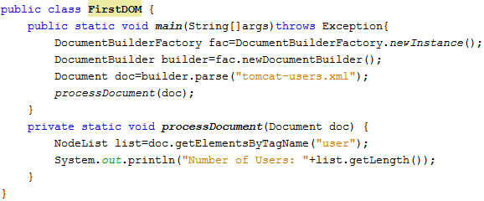

NodeList example

Slide 57
Attr interface
The Attr interface represents an attribute in an Element object. Typically the allowable values for the attribute are defined in a schema associated with the document.
Attr objects inherit the Node interface, but since they are not actually child nodes of the element they describe, the DOM does not consider them part of the document tree.
Attr att=doc.createAttribute("name");
att.setValue("value”);

Slide 58
Text interface
The Text interface inherits from CharacterData and represents the textual content (termed character data in XML) of an Element or Attr.
No lexical check is done on the content of a Text node and, depending on its position in the document, some characters must be escaped during serialization using character references:
e.g. the characters "<&" if the textual content is part of an element or of an attribute, the character sequence "]]>" when part of an element, the quotation mark character " or the apostrophe character ' when part of an attribute.

Slide 59
DOMException
Can be understood by analyzing the code.
Has no method of its own. It inherits methods from the Throwable class
Some Errors
WRONG_DOCUMENT_ERR.
NOT_SUPPORTED_ERR.
NO_MODIFICATION_ALLOWED_ERR.
INDEX_SIZE_ERR

Slide 60
Manipulating DOM

Slide 61
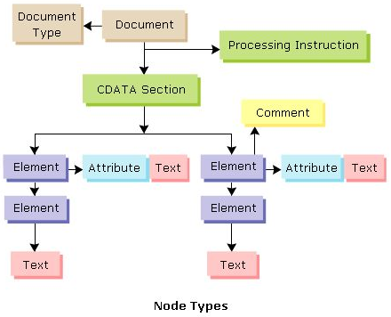
Node

Slide 62
Nodes in DOM tree
Document
Represents the entire DOM document. Is the root node of the XML document.
The Document interface then manipulates the Document node through the methods defined in it. This type of node can contain only a single child node. Its child nodes can be a processing instruction element, a document type element or a comment element.
Document Fragment
Holds a portion of a complete document.
Is created by the methods present in the Document interface.
Can have processing instruction, comment, text, CDATA section, and entity reference as its child nodes.
Document Type
Each document has a DOCTYPE attribute. It can have value as null or an object of the DocumentType interface.
Provides an interface to the entities defined for the document.
Processing Instruction
This is just a processor specific instruction kept in the XML document.
The Document interface creates a Processing Instruction node.

Slide 63
Types of Node
A CDATA section starts with “<![CDATA[" and ends with "]]>":
<script> <![CDATA[ function matchwo(a,b){ if (a < b && a < 0) then { return 1; } else { return 0; } } ]]> </script>
Entity
Entity Reference
Element
Attribute
Text
CDATA Section
Comment
Notation
The notation element describes the format of non-XML data within an XML document. A common use of notations is to describe MIME types such as image/gif, image/jpeg.
Notes:
Multipurpose Internet Mail Extensions
A CDATA section starts with "<![CDATA[" and ends with "]]>":
<script> <![CDATA[ function matchwo(a,b) { if (a < b && a < 0) then { return 1; } else { return 0; } } ]]> </script>

Slide 64
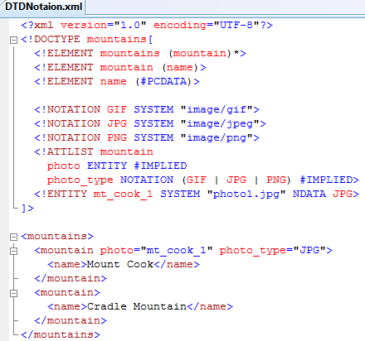

Slide 65
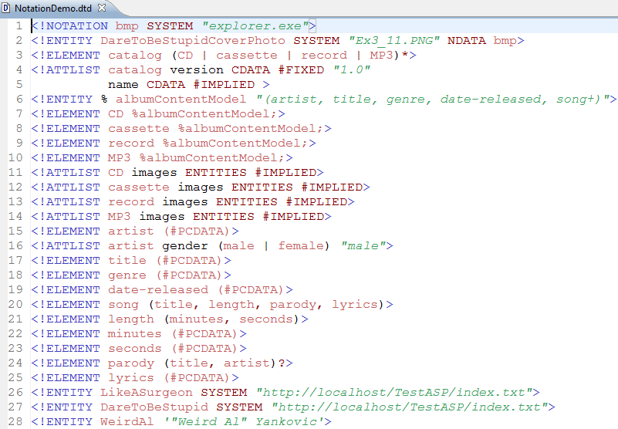

Slide 66
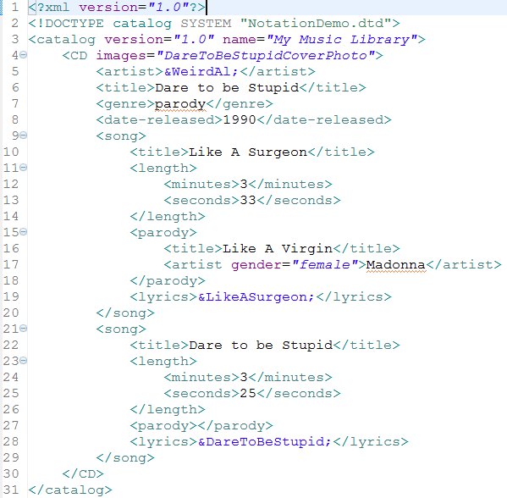

Slide 67
Creating Nodes
Creating an Element Node
public Element createElement(String tagName) throws DOMException
Creating an Attribute Node
public Attr createAttribute(String Name) throws DOMException
Creating a Text Node
public Text createTextNode(String data)
Creating a CDATA Section Node
public CDATASection createCDATASection(String data) throws DOMException
Creating a Comment Node
public Comment createComment(String data)

Slide 68
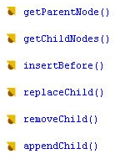
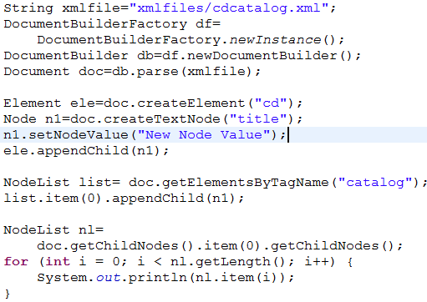
Modifying Nodes
Example

Slide 69
Deleting Nodes
Remove an Element
element.getParentNode().removeChild(element);
Remove an Attribute
element.removeAttribute("attribute name");

Slide 70
Appending Nodes
Add a Node to the End of a Node List
public Node appendChild(Node newChild) throws DOMException
Insert a Node Before a specific Node
public Node insertBefore(Node newChild, Node refChild) throws DOMException
Set a New Attribute and Attribute Value
public void setAttribute(String name, String value) throws DOMException
Insert Data Into a Text Node
public void insertData(int offset, String arg) throws DOMException

Slide 71
Seeking Nodes
getParentNode
getChildNode
getFirstChild
getLastChild
getNodeName

Slide 72
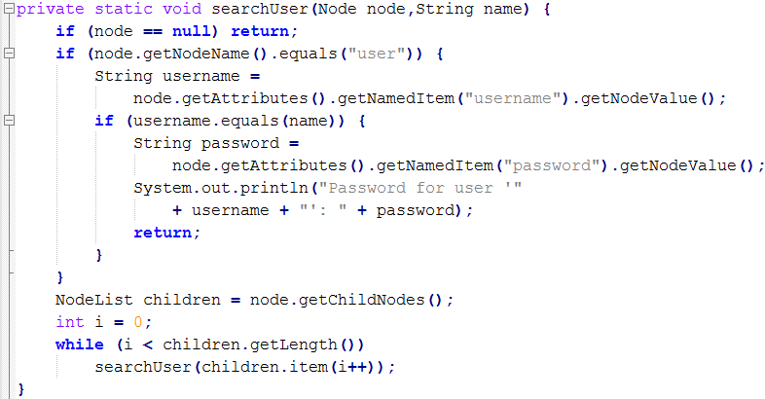
Seeking Elements
getElementsByTagName
getElementsByTagNameNS
getTagName
getAttributeNode

Slide 73
Modifying a documents
Methods | Descriptions
createDocumentFragment | public DocumentFragment createDocumentFragment() - Creates an empty DocumentFragment object and returns it. - You may then add elements, nodes, and so on to this fragment just the way you create a tree under the root node
createCDATASection | public CDATASection createCDATASection(String data) throws DOMException - Creates a CDATA Section node whose value is the specified string passed as an argument. - Throws the DOMException for encountering NOT_SUPPORTED_ERR error condition. This error is raised when the document is an HTML document.

Slide 74
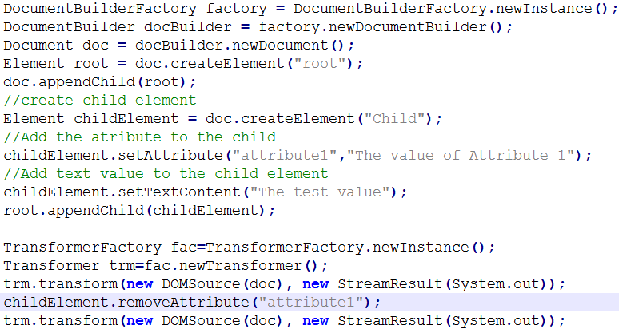
Modifying an Attribute
removeAttribute
removeAttributeNode
setAttributeNode

Slide 75
DOM Level 2 Modules

Slide 76
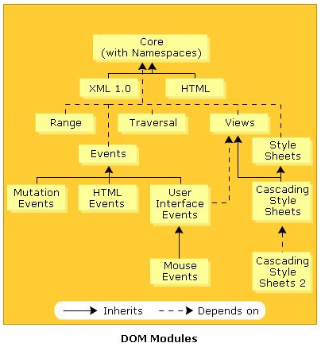
The DOM Level 2 (DOM2)
DOM 2 modules:
Core
Views
Style
Event
Traversal
Range
HTML
CSS

Slide 77
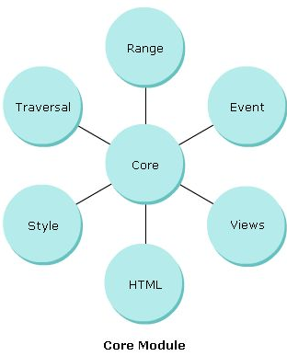
Core Module
Is the fundamental specification or module.
Defines a set of objects and interfaces to access and manipulate parsed XML content.
Has incorporated new ways to traverse and manipulate the XML documents through other optional modules.
Facilitates creating and populating a Document object through the DOM API calls.
Extends the functionality of the DOM core 1 with some added features.

Slide 78
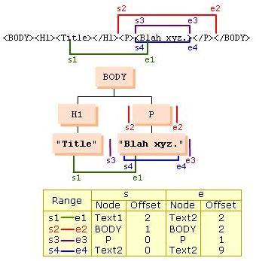
Range Module(1)
The Range object represents a fragment of a document, or attribute.
Allows update a range of content in elements.
Can be defined as a set of values of similar type with specific boundary points.
Contains interfaces to extract a Range object from a complete document.
The content in a range is contiguous with specific boundary points.

Slide 79
Range Module (2)
Useful Methods in the Range Class
cloneContents() | Duplicates the contents of a range
deleteContents() | Deletes the contents of a range
getCollapsed() | Returns TRUE is the range is collapsed
getEndContainer() | getEndContainer() Obtains the node within which the range ends
getStartContainer() | Obtains the node within which the range begins
selectNode() | Selects a node and its contents
selectNodeContents() | Selects the contents within a node
setEnd() | Sets the attributes describing the end of a range
setStart() | Sets the attributes describing the beginning of a range

Slide 80
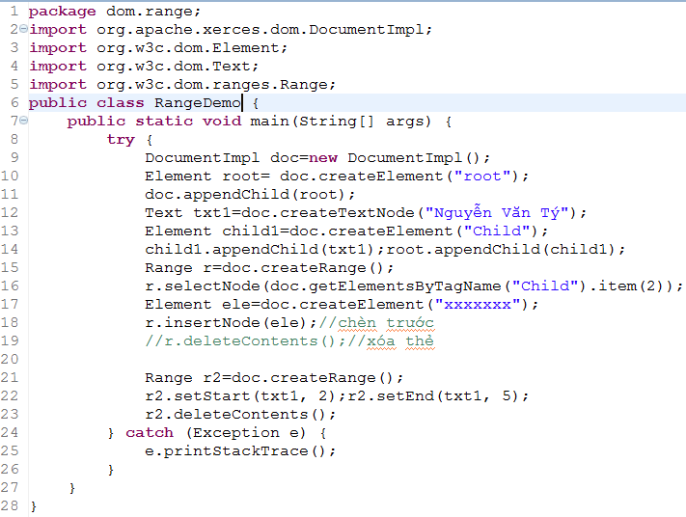

Slide 81
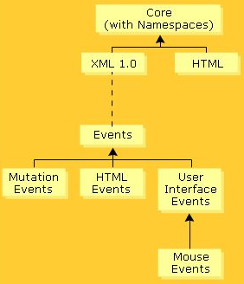
Event Module (1)
Design a general event system that allows registration of event handlers, defines event flow through a tree structure, and provides basic contextual information for each event.
Develop compatibility between the current event systems used in DOM Level 0 browsers and DOM Level 2 browsers.

Slide 82
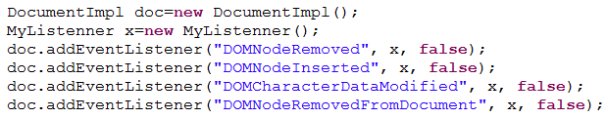
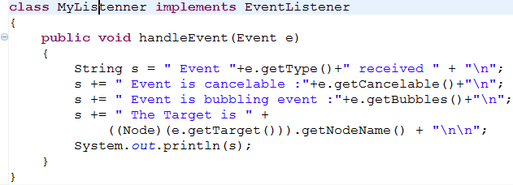
Event Module (2)
Example:

Slide 83
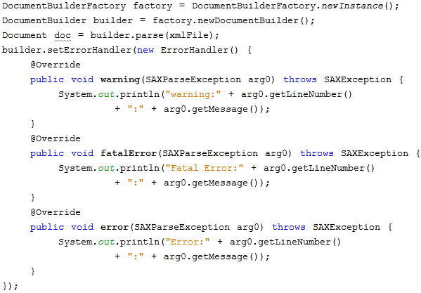
Error event

Slide 84
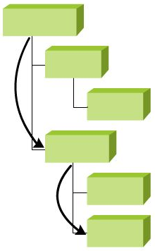
Traversal Module (1)
Allows programs and scripts to traverse through a DOM tree and identify a range of content in the document dynamically.
Allows the traversing the DOM tree to access the content in it.
Contains the TreeWalker, NodeIterator, and NodeFilter interfaces to facilitate easy traversal through the document content.

Slide 85
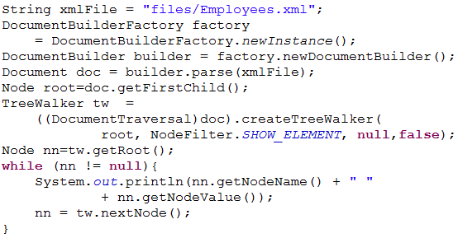
Traversal Module (2)
Using TreeWalker

Slide 86
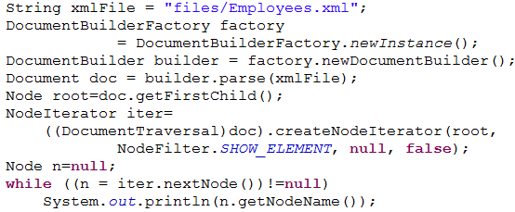
Traversal Module(3)
Using NodeIterator

Slide 87
Using NodeFilter
Facilitates the creation of the object that will filter out specific nodes present in a NodeIterator or TreeWalker.
The filter object has a user defined function to decide whether or not a node should be part of the traversal’s logical view of the document.
Override the acceptNode() method that return these constants:
FILTER_ACCEPT: indicates that the node will be a part of the logical view of the sub-tree.
FILTER_SKIP:
Indicates that the node is not a part of the logical view of the sub-tree.
In this case, the current node is considered as absent in the logical view, but its child not can be part of the logical view.
FILTER_REJECT: indicates that the node and its descendants cannot be present in the logical view of the sub-tree

Slide 88

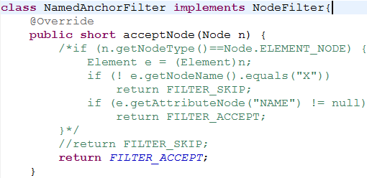
Traversal Module(4)
Using NodeFilter

Slide 89
CSS Module
Is an optional module in the DOM. Its implementation requires the implementation of the Core module.
To support its implementation, the hasFeature(feature, version) method needs to pass the feature as CSS and the version as 2.0.
It defines interface to provide a mechanism to access and manipulate the CSS documents dynamically
Interfaces | Descriptions
CSSStyleSheet | - Allows accessing a collection of rules within a CSS style sheet. - Contains methods, such as deleteRule() and insertRule(), to modify this collection of rules
CSSRuleList | - Provides a collection of rules, in the order they appear in the CSS. - Defines the item() method
CSSMediaRule | - Represents a specific media rule in a CSS style sheet to support that specific medium for presentation. - Defines methods such as deleteRule() and insertRule().
CSSStyleDeclaration | - Provides an instance of a block of CSS declaration. The blosk contains all the style properties that are used in the XML document through the CSS. - Defines methods such as getPropertyCSSValue(), getPropertyPriority(), removeProperty(), and setProperty().
Notes:
http://cssparser.sourceforge.net/
http://www.w3.org/Style/CSS/SAC/

Slide 90
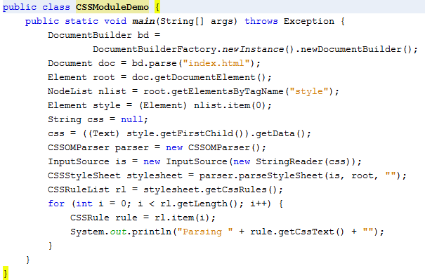
CSS Module demo
Needed of cssparser and Simple API for CSS(SAC)

Slide 91
Other Modules
View Module
Provides interfaces to facilitate the presentation of XML documents.
Is optional in nature. Its implementation requires the implementation of the DOM 2 Core module.
Style Module
Provides interfaces to enable programmers to dynamically access and manipulate style sheets.
Is optional in nature. Its implementation requires the implementation of the DOM 2 Core module.
HTML Module
Allows programs and scripts to access and modify the content and structure of HTML documents dynamically.
Extends the interfaces defined in the DOM 1 HTML module.

Slide 92
XSLT

Slide 93
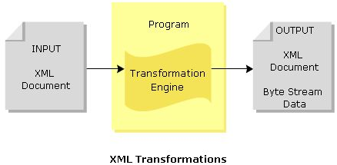
Intro to XML Transformations
XML to XML: The output is an XML document
XML to Data: The output is a byte stream document.

Slide 94
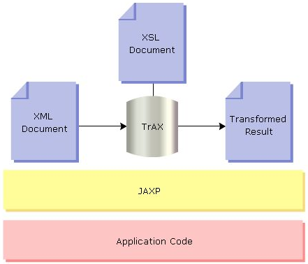
TrAX API (1)

Slide 95
TrAX API (2)
Packages | Descriptions
javax.xml.transform | - Implements the generic APIs for transformation instructions and executing the transformation, starting from source to destination. - The interfaces present in this package are ErrorListener, Result, Source, SourceLocator, Templates, URIResolver. - The classes present in this package are OutputKeys, Transformer, TransformerFactory
javax.xml.transform.stream | - Implements streams and URI specific transformation APIs. - The classes present in this package are StreamResult, StreamSource
javax.xml.transform.dom | - Implements DOM-related transformation APIs. - The interface present in this package is DOMLocator
javax.xml.transform.sax | - Implements SAX-related transformation APIs. - The interfaces present in this package are TemplateHandler, TransformerHandler

Slide 96
XSLT Stylesheet (1)
Is a language used for transforming XML documents into XHTML documents for Web pages.
Uses XPath language to navigate between XML documents and XHTML documents.
Defines the source documents, which will be matched with a predefined set of templates in transformation process. If XSLT gets the same document, it transforms the matching part of the source document into the output document.

Slide 97
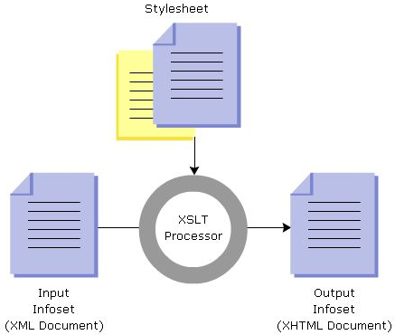
XSLT Stylesheet (2)
XML
html
Book
XSLT
head
body
title
author
price
h1
h2
p
<html>
<head>
<title>abc</title>
</head>
...
</html>
Serialization
text
...

Slide 98
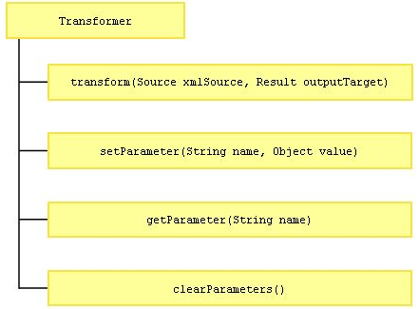
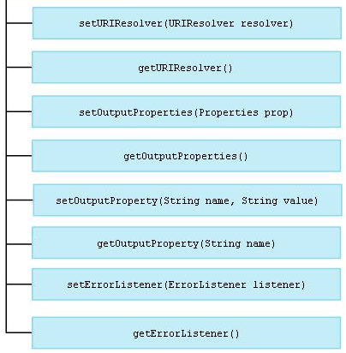
Transformer

Slide 99
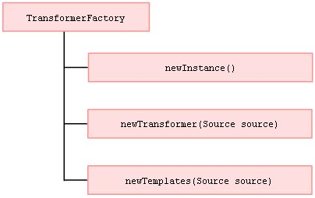
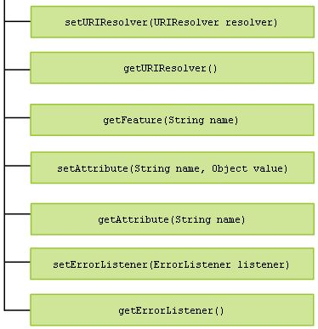
TransformerFactory

Slide 100


Source and Result

Slide 101

Template
The object, which implements the Template interface, is the runtime result of transformation instructions.
Can be called from multiple threads for a particular instance.

Slide 102

Transforming XML Document

Slide 103

Example
You can display the output in console by using System.out instead of using outfile.
Using transformer.setOutputProperty(OutputKeys.INDENT, "yes") to display result with indentation
Notes:
static String CDATA_SECTION_ELEMENTS
cdata-section-elements = expanded names.
static String DOCTYPE_PUBLIC
doctype-public = string.
static String DOCTYPE_SYSTEM
doctype-system = string.
static String ENCODING
encoding = string.
static String INDENT
indent = "yes" | "no".
static String MEDIA_TYPE
media-type = string.
static String METHOD
method = "xml" | "html" | "text" | expanded name.
static String OMIT_XML_DECLARATION
omit-xml-declaration = "yes" | "no".
static String STANDALONE
standalone = "yes" | "no".
static String VERSION
version = nmtoken.

Slide 104


Transform with parameter

Slide 105
JAXP API For XPath Processing

Slide 106

JAXP API For XPath Processing(1)
Define in the javax.xml.xpath package.
Has 2 interfaces and 2 classes as picture:

Slide 107
JAXP API For XPath Processing(2)
The XPath interface gives syntax for traversing through the nodes in an XML document.
The XPathExpression interface deals with location path and predicates.
The XPathFactory class is used for creating XPath objects.
The XPathConstants class defines the data types such as Boolean, NodeSet, number, and string for working with nodes in and XML document

Slide 108

XPath Example

Slide 109

Processing Namespace Context
NamespaceContext interface establishes the namespace relationship when an XPath expression is evaluated.

Slide 110

Namespace Context
The NamespaceContext interface is used for reading the XML namespace context processing.
The Namespace URI can be bound to more than one prefixes in the current scope.

Slide 111


Namespace Context Example

Slide 112


Processing Namespace Context Example

Slide 113
Schema Validation Framework

Slide 114

Definition and Purpose
An XML document is considered valid if it conforms to a schema.
The process of checking the conformity to schema is called validation

Slide 115

Validation API
Enables to parse only the schema and check the syntax and semantics on the basis of the imposed schema language.
The javax.xml.validation API helps to validate the XML document.
Introduced since JAXP 1.3, are schema-independent Validation Frameworks.

Slide 116






XML Validation against a DTD

Slide 117

DOM validation against DTD Ex

Slide 118

Schema Compilation

Slide 119


Slide 120

XML Validation against a Compiled Schema

Slide 121

Validating SAX & DOM Source

Slide 122


Slide 123

Validating DOM Source Example

Slide 124

Validating SAX Source Example

Slide 125
XML Validation After Transformation

Slide 126

Validating SAX Stream

Slide 127

Validating Transformed DOM
The transformed result from Transformation APIs can be obtained as a DOM object.
Schema can be used to validate this DOM object in the memory. Since there is no parsing involved when validating a transformed XML document, this approach boosts performance

Slide 128

Data Security

Slide 129

XML schema to java type mapping

Slide 130
JAXB
Java API for XML Binding

Slide 131
JAXB
JAXB simplifies access to an XML document from a Java program by presenting the XML document to the program in a Java format. The first step in this process is to bind the schema for the XML document into a set of Java classes that represents the schema.
A schema is an XML specification that governs the allowable components of an XML document and the relationships between the components.
An XML document does not have to have a schema, but if it does, it must conform to that schema to be a valid XML document.
JAXB requires the XML document you want to access has a schema

Slide 132

JAXB working diagram

Slide 133
JAXB Architecture
The JAXB API, defined in the javax.xml.bind package, is a set of interfaces and classes through which applications communicate with code generated from a schema.
The center of the JAXB API is the javax.xml.bind.JAXBContext class.
JAXBContext is an abstract class that manages the XML/Java binding.
It can be seen as a factory because it provides:
An Unmarshaller class that deserializes XML into Java and optionally validates the XML (using the setSchema method).
A Marshaller class that serializes an object graph into XML data and optionally validates it.

Slide 134
JAXB Architecture
First of all, JAXB can define a set of classes into an XML schema by using a schema generator.
It also enables the reverse action, allowing you to generate a collection of Java classes from a given XML schema through the schema compiler.
The schema compiler takes XML schemas as input and generates a package of Java classes and interfaces that reflect the rules defined in the source schema.
These classes are annotated to provide the runtime framework with a customized Java-XML mapping.

Slide 135
JAXB Architecture
JAXB also can generate a Java object hierarchy from an XML schema using a schema generator, or give an object Java hierarchy to describe the corresponding XML schema.
The runtime framework provides the corresponding unmarshalling, marshalling, and validation functionalities.
That is, it lets you transform an XML document into an object graph (unmarshalling) or transform an object graph into XML format (marshalling).

Slide 136
JAXB Architecture
These capabilities are why JAXB is often associated with web services.
Web services use the API to transform objects into messages that they then send through SOAP.
This isn't a web services article, however. Using an example address book application for a fictional music company called Watermelon, it focuses on JAXB's XML binding features for round-tripping XML to Java.

Slide 137
demo
Generate class using xjc tool
Generate Schema using schemagen tool
Using JAXB to read xml file and generate objects
Using JAXB to generate xml file from objects

Slide 138



JAXB Demo: Object to XML

Slide 139

JAXB Demo: XML to Object
First, generate code using xjc tool:
xjc –p teo.com cdcatalog.xsd
Copy generated code folder to project

Slide 140

Questions

Slide 141
That’s all for this session!
Thank you all for your attention and patient !
141/27

