Slide 1
Reflection API
Java Programming Course
Faculty of Information Technologies
Industrial University of Ho Chi Minh City

Slide 2

Session objectives
Introduction
The Class object
Getting Constructors
Getting Fields
Getting Methods
Array Object
Invoke methods dynamically

Slide 3
Java looking at Java
One of the unusual capabilities of Java is that a program can examine itself
You can determine the class of an object
You can find out all about a class: its access modifiers, superclass, fields, constructors, and methods
You can find out what what is in an interface
Even if you don’t know the names of things when you write the program, you can:
Create an instance of a class
Get and set instance variables
Invoke a method on an object
Create and manipulate arrays

Slide 4
What is reflection for?
In “normal” programs you don’t need reflection
You do need reflection if you are working with programs that process programs
Typical examples:
A class browser
A debugger
A GUI builder
An IDE, such as BlueJ, Netbeans oe eclipse
A program to grade student programs

Slide 5
Reflection
Reflection là kĩ thuật rất cần thiết để lấy các thông tin của một kiểu dữ liệu.
Dựa vào đó ta có thể kích hoạt (như các phương thức) hoặc tạo thể hiện của kiểu dữ liệu đó

Slide 6
Kiến trúc của Java Reflection API
Các lớp được dùng trong reflection nằm trong hai package là java.lang và java.lang.reflect.
Package java.lang.reflect bao gồm ba lớp chính cần biết là Constructor, Field và Method

Slide 7
Kiến trúc của Java Reflection API
Class<T>: lớp này đại diện cho các lớp, interface và chứa các phương thức dùng để lấy các đối tượng kiểu Constructor, Field, Method,…
AccessibleObject: các kiểm tra về phạm vi truy xuất (public, private, protected) của field, method, constructor sẽ được bỏ qua. Constructor: chứa các thông tin về một constructor của lớp.
Field: chứa các thông tin về một field của lớp, interface.
Method: chứa các thông tin về một phương thức của lớp, interface.

Slide 8
Tạo đối tượng Class<>
Đối tượng kiểu này được tạo ra bằng cách sử dụng phương thức static Class.forName():
Class<?> cls = Class.forName("demo.NhanVien");
==> ClassNotFoundException
Class cls = demo.NhanVien.class;

Slide 9
The Class class
To find out about a class, first get its Class object
If you have an object obj, you can get its class object with Class c = obj.getClass();
You can get the class object for the superclass of a Class c with Class sup = c.getSuperclass();
If you know the name of a class (say, Button) at compile time, you can get its class object with Class c = Button.class;
If you know the name of a class at run time (in a String variable str), you can get its class object with Class c = class.forName(str);

Slide 10
Getting the class name
If you have a class object c, you can get the name of the class with c.getName()
getName returns the fully qualified name; that is, Class c = Button.class; String s = c.getName(); System.out.println(s); will print java.awt.Button
Class Class and its methods are in java.lang, which is always imported and available

Slide 11
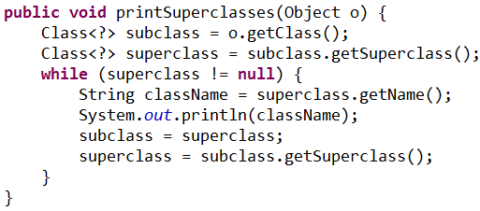
Getting all the superclasses
getSuperclass() returns a Class object (or null if you call it on Object, which has no superclass)
Example

Slide 12
Getting the class modifiers I
The modifiers (e.g., public, final, abstract etc.) of a Class object is encoded in an int and can be queried by the method getModifiers().
To decode the int result, we need methods of the Modifier class, which is in java.lang.reflect, so: import java.lang.reflect.*;
Then we can do things like:
if (Modifier.isPublic(m)) System.out.println("public");
Or
String modifier= Modifier.toString(cls.getModifiers())
System.out.println(modifier);

Slide 13
Getting the class modifiers II
Modifier contains these methods (among others):
public static boolean isAbstract(int)
public static boolean isFinal(int)
public static boolean isInterface(int)
public static boolean isPrivate(int)
public static boolean isProtected(int)
public static boolean isPublic(int)
public static String toString(int)
This will return a string such as "public final synchronized strictfp"

Slide 14
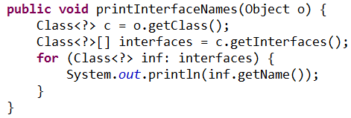
Getting interfaces
A class can implement zero or more interfaces
getInterfaces() returns an array of Class objects
Ex:

Slide 15
Examining classes and interfaces
The class Class represents both classes and interfaces
To determine if a given Class object c is an interface, use c.isInterface()
To find out more about a class object, use:
getModifiers()
getFields() // "fields" == "instance variables"
getConstructors()
getMethods()
isArray()

Slide 16
Getting Fields
public Field[] getFields() throws SecurityException
Returns an array of public Fields (including inherited fields).
The length of the array may be zero
The fields are not returned in any particular order
Both locally defined and inherited instance variables are returned, but not static variables.
public Field getField(String name) throws NoSuchFieldException, SecurityException
Returns the named public Field
If no immediate field is found, the superclasses and interfaces are searched recursively

Slide 17
Using Fields (1)
If f is a Field object, then
f.getName() returns the simple name of the field
f.getType() returns the type (Class) of the field
f.getModifiers() returns the Modifiers of the field
f.toString() returns a String containing access modifiers, the type, and the fully qualified field name
Example: public java.lang.String Person.name
f.getDeclaringClass() returns the Class in which this field is declared
note: getFields() may return superclass fields.

Slide 18
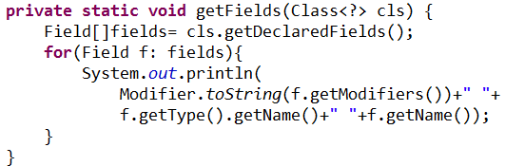
Using Fields (2)
The fields of a particular object obj may be accessed with:
boolean f.getBoolean(obj), int f.getInt(obj), double f.getDouble(obj), etc., return the value of the field, assuming it is that type or can be widened to that type
Object f.get(obj) returns the value of the field, assuming it is an Object
void f.set(obj, value), void f.setBoolean(obj, bool), void f.setInt(obj, i), void f.getDouble(obj, d), etc. set the value of a field

Slide 19
Getting Constructors of a class
if c is a Class, then
c.getConstructors() : Constructor[] return an array of all public constructors of class c.
c.getConstructor( Class … paramTypes ) returns a constructor whose parameter types match those given paramTypes.
Ex:
String.class.getConstructors().length
> 15;
String.class.getConstructor( char[].class, int.class, int.class).toString()
> String(char[], int,int).

Slide 20
Constructors
If c is a Constructor object, then
c.getName() returns the name of the constructor, as a String (this is the same as the name of the class)
c.getDeclaringClass() returns the Class in which this constructor is declared
c.getModifiers() returns the Modifiers of the constructor
c.getParameterTypes() returns an array of Class objects, in declaration order
c.newInstance(Object… init_args) creates and returns a new instance of class c
Arguments that should be primitives are automatically unwrapped as needed

Slide 21
Example
Constructor c = String.class.getConstrucor( char[].class, int.class, int.class).toString()
String(char[], int,int).
String s = c.newInstance(
new char[] {‘a’,’b’,’c’,’d’ }, 1, 2 );
assert s == “bc”;

Slide 22
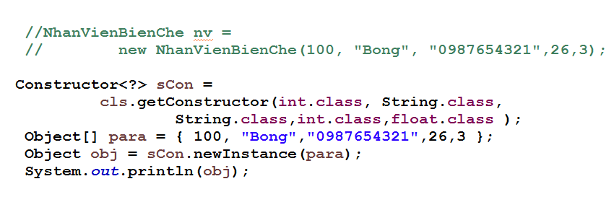
Example

Slide 23
Methods
public Method[] getMethods() throws SecurityException
Returns an array of Method objects
These are the public member methods of the class or interface, including inherited methods
The methods are returned in no particular order
public Method getMethod(String name, Class… parameterTypes) throws NoSuchMethodException, SecurityException

Slide 24
Methods
getDeclaringClass()
Returns the Class object representing the class or interface that declares the method represented by this Method object
getName()
Returns the name of the method represented by this Method object, as a String
getModifiers()
Returns the Java language modifiers for the method represented by this Method object, as an integer
getParameterTypes()
Returns an array of Class objects that represent the formal parameter types, in declaration order, of the method represented by this Method object

Slide 25
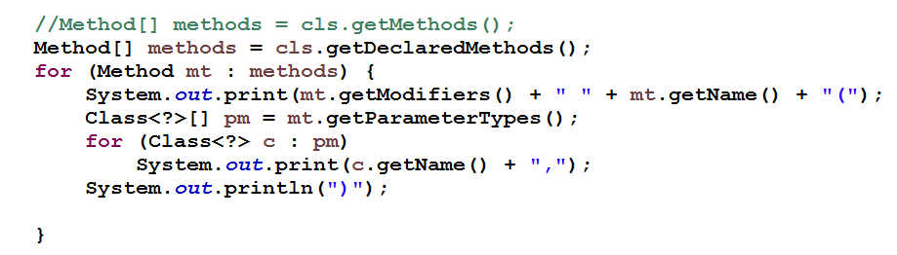
Methods

Slide 26
Methods
getReturnType()
Returns a Class object that represents the formal return type of the method represented by this Method object
toString()
Returns a String describing this Method (typically pretty long)
public Object invoke(Object obj, Object… args)
Invokes the underlying method represented by this Method object, on the specified object with the specified parameters
Individual parameters are automatically unwrapped to match primitive formal parameters

Slide 27
Examples of invoke()
“abcdefg”.length()
> 7
Method lengthMethod = String.class.getMethod(“length”) ;
lengthMethod.invoke(“abcdefg”)
> 7
“abcdefg”.substring(2, 5)
> cde
Method substringMethod = String.class.getMethod ( “substring”, int.class, Integer.TYPE ) ;
substringEMthod.invoke( “abcdefg”, 2, new Integer(5) )
> cde

Slide 28
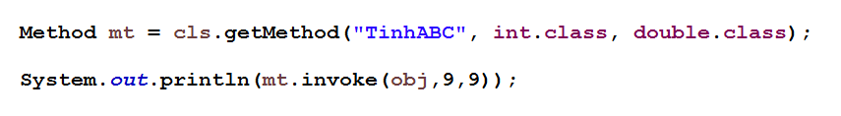
Examples of invoke()

Slide 29
Arrays I
To determine whether an object obj is an array,
Get its class c with Class c = obj.getClass();
Test with c.isArray()
To find the type of components of the array,
c.getComponentType()
Returns null if c is not the class of an array
Ex:
int[].class.isArray() == true ;
int[].class.getComponentType() == int.class

Slide 30
Arrays II
The Array class in java.lang.reflect provides static methods for working with arrays
To create an array,
Array.newInstance(Class componentType, int size)
This returns, as an Object, the newly created array
You can cast it to the desired type if you like
The componentType may itself be an array
This would create a multiple-dimensioned array
The limit on the number of dimensions is usually 255
Array.newInstance(Class componentType, int… sizes)
This returns, as an Object, the newly created multidimensional array (with sizes.length dimensions)

Slide 31
Examples
The following two objects are of the same type:
new String[10]
Array.newInstance(String.class, 10)
The following two objects are of the same type:
new String[10][20]
Array.newInstance(String.class, 10, 20)

Slide 32
Arrays III
To get the value of array elements,
Array.get(Object array, int index) returns an Object
Array.getBoolean(Object array, int index) returns a boolean
Array.getByte(Object array, int index) returns a byte
etc.
To store values into an array,
Array.set(Object array, int index, Object value)
Array.setInt(Object array, int index, int i)
Array.setFloat(Object array, int index, float f)
etc.

Slide 33
Examples
a = new int[] {1,2,3,4};
Array.getInt(a, 2) // → 3
Array.setInt(a, 3, 5 ) // a = {1,2,3, 5 }.
s = new String[] { “ab”, “bc”, “cd” };
Array.get(s, 1 ) // → “bc”
Array.set(s, 1, “xxx”) // s[1] = “xxx”

Slide 34
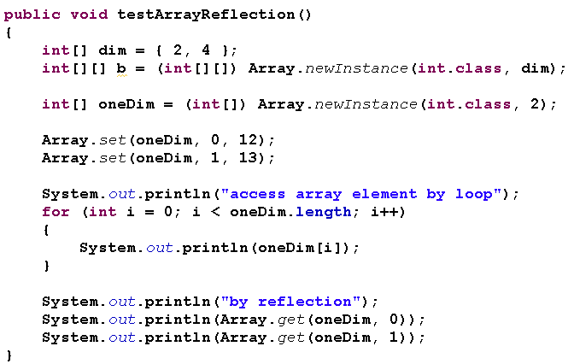
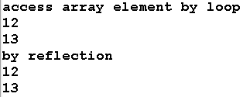
Array example
Output

Slide 35
Getting non-public members of a class
All getXXX() methods of Class mentioned above return only public members of the target (as well as ancestor ) classes, but they cannot return non-public members.
There are another set of getDeclaredXXX() methods in Class that will return all (even private or static ) members of target class but no inherited members are included.
getDeclaredConstructors(), defDeclaredConstrucor(Class…)
getDeclaredFields(),
getDeclaredField(String)
getDeclaredmethods(),
getDeclaredMethod(String, Class…)

Slide 36
Example
String.class.getConstructors().length
> 15
String.class.getDeclaredConstructors().length
> 16.
Constructor[] cs = String.class.getDeclaredConstructors();
for(Constructor c : cs)
if( ! (Modifier.isPublic(c.getModifiers())))
out.println(c);
> java.lang.String(int,int,char[]) // package

Slide 37
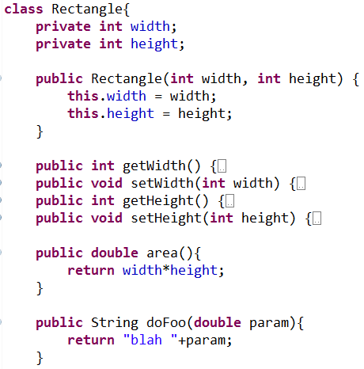
Create object at runtime
Example class

Slide 38
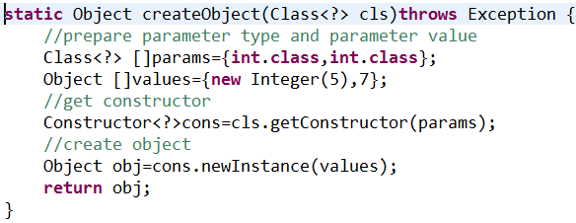
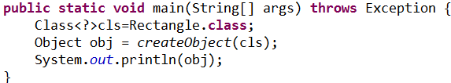

Create object dynamically

Slide 39
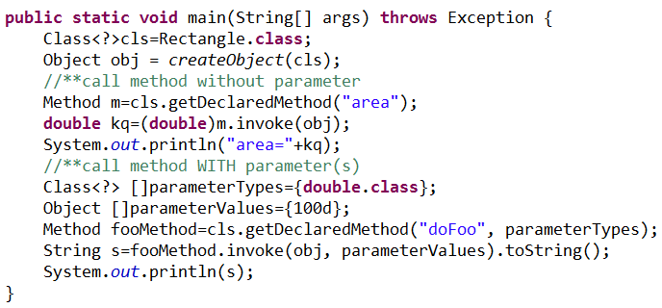

Call method dynamically

Slide 40
ClassLoader
Dùng URI để đọc nội dung class lên 1 mảng bytes
Subclassing lớp ClassLoader để tạo đối tượng Class
Xử lý

Slide 41
Concluding comments
Many of these methods throw exceptions not described here
For details, see the Java API
Reflection isn’t used in “normal” programs, but when you need it, it’s indispensable
Studying the java reflection package gives you a chance to review the basics of java class structure.
Notes:
Indispensable: rất cần thiết, không thể thiếu được

Slide 42

FAQ

Slide 43
That’s all for this session!
Thank you all for your attention and patient !
43/27

