Slide 1

MouseVille
Curtis Wilson Nayan Khodke Ben Ng Neha Choudhari Abhang Sonawane
Notes:
Hello, we are developing an iOS app called Mouseville. <Introduction roll call>

Slide 2

Introduction
David Taffany (sponsor)
Currently records data in unorganized excel spreadsheet
App will provide an organized, intuitive way to input mouse data
Developing the app for iOS, specifically the iPad
Notes:
Just a brief review of what our app is, and why we’re making it… David Taffany, our sponsor, works in the med center in their breast cancer research department. His job calls to record lots of data on mice, and currently records that data in a really unorganized spreadsheet.
Our app will eliminate that by providing an organized, intuitive way to input and view said mouse data.

Slide 3
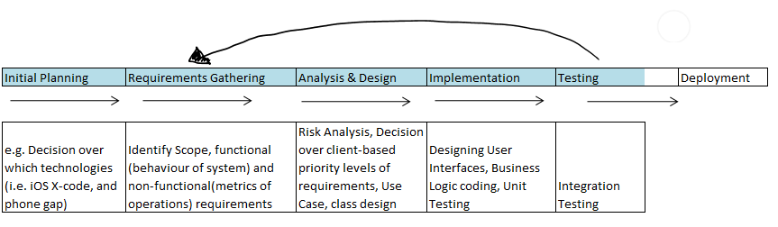
Project Status

Slide 4
How We Did It?
Meeting with Sponsors
Objective C
XCode 5
Core Data
Github
Weekly meetings

Slide 5
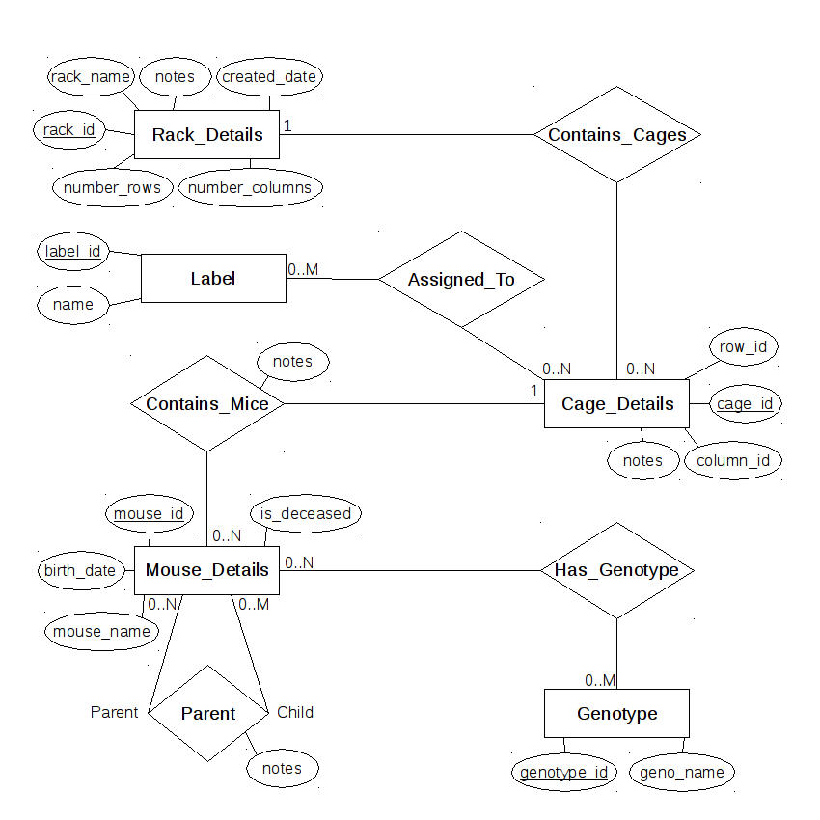
ER-Diagram

Slide 6
Our Expectations
The application will meet all requirements and be ready for deployment on time.
Once completed we will explore extra features such as:
Multiple users
Remote database
Share data between users within the application

Slide 7
What We Learned?
New Technology
Team Work
Documentation
Effective Communication
Source Control

Slide 8
Demo

Slide 9
Questions?

