Slide 1


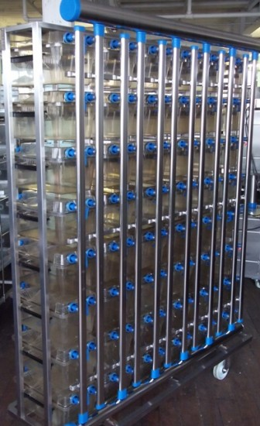
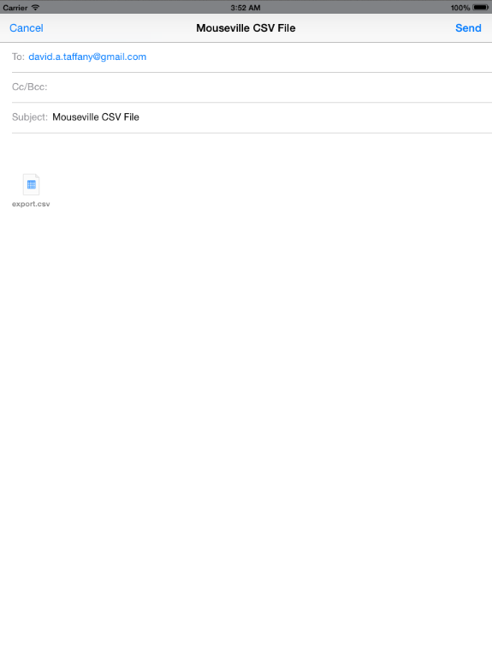
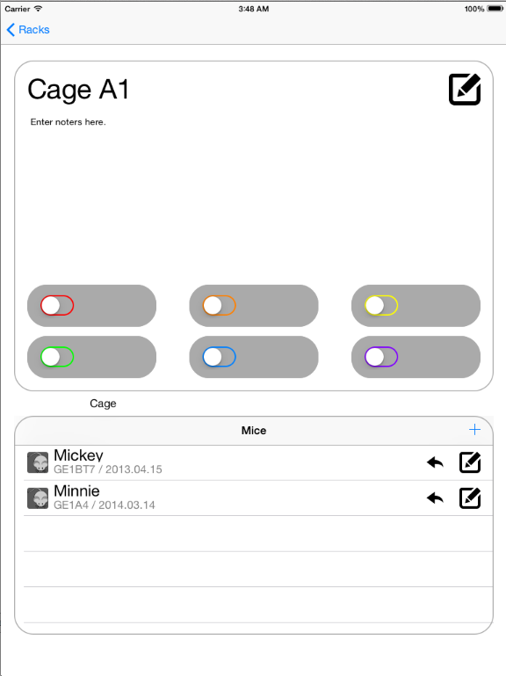
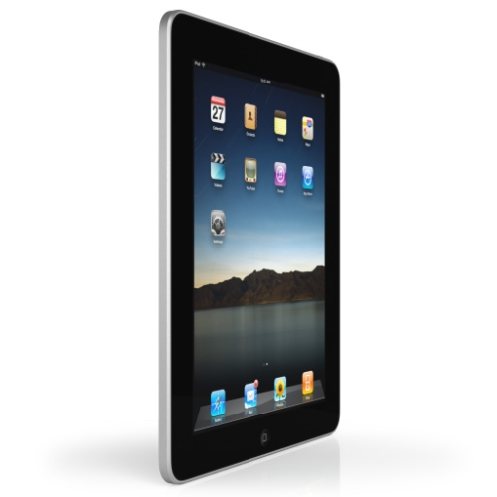
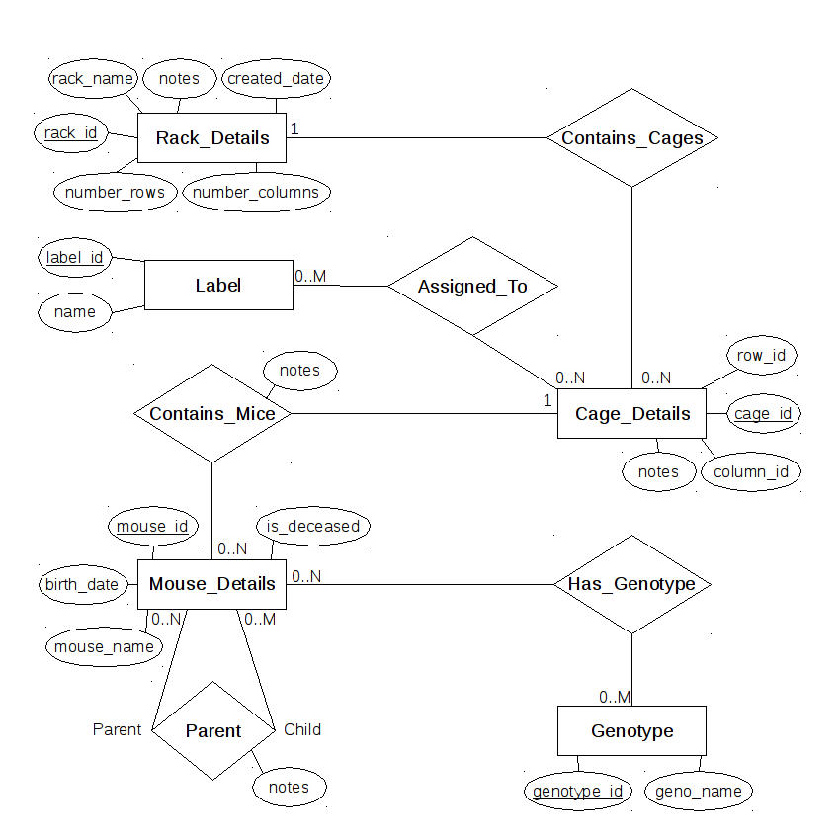
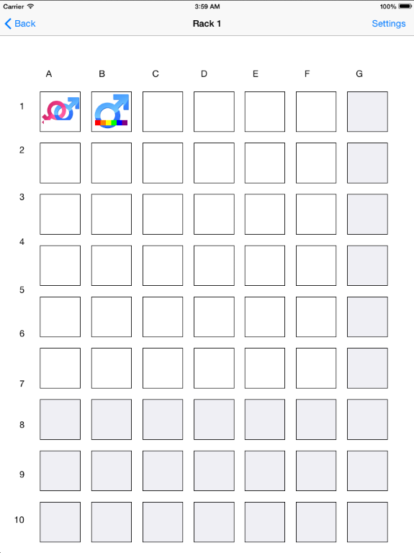
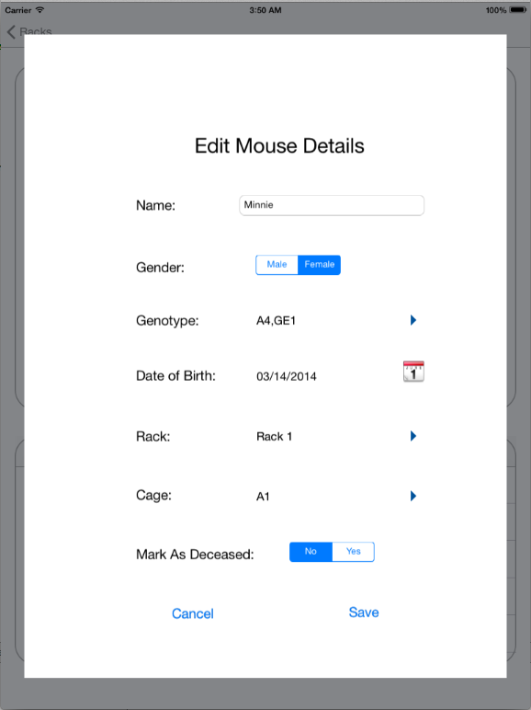

Mouseville
Mouse Data Management Application
Abhang Sonawane, Ben Ng, Neha Choudhari, Curtis Wilson, Nayan Khodke
Introduction
Main Features (continued)
Facts
Receiving Assets
Each breast cancer researcher handles hundreds of mice.
Data is currently recorded in a notebook, then transferred to an unorganized excel spreadsheet at a later time.
Export Mouse Data
Users can export their current database to a CSV file via email.
Easily View Cage Details
Using the easy to use cage labels, users are able to label cages to view notes about each respective cage.
Problem
Researcher has to record data in a two step process, which is slow, tedious, and liable for mistakes.
To avoid mistakes being made, extra time has to be taken to ensure no errors were made in data recording and transport—time better spent on higher priority issues.
Project Goals
Figure 1: Example mouse rack
Provide an intuitive app designed for the Apple iPad that will allow the user to quickly record and view mouse data.
Reduce the amount of time the researcher is using on menial tasks and free up more time for real research.
Create a better way for researchers to organize their data in a way that when they share it, the data will be easily readable by another user.
Figure 5: Easily export data into a CSV file via the native email app
Figure 6: View and edit cage notes, labels, and mice
Figure 2: Platform app is developed for—the iPad
Architecture
Current Mouse Data Recording
There is currently no standardized way of recording mouse data. This app will hopefully create a standardized method of recording and sharing mouse data.
Native Apple iPad app developed specifically for iOS 7.0 or higher
Main Features
Managing Existing Assets
Locating Mice
Users can either navigate to the desired mouse through the rack and cage views, or skip straight there by searching for the mouse by an array of identifiers.
Viewing Mice
The app can be viewed from a number of different screens—the rack view, cage view, and mouse view. Each displays a different selection and allows the user to quickly see useful information and navigate between the different views.
Editing Mouse Data
Users can edit information using easy to use settings screens.
Currently uses an on-device SQLite database for storing the various data the users stores about each rack, cage, and mouse.
Significance
Working initial release that allows the user to begin porting his data over and input new data into the app.
Well-designed code base that lays groundwork for continued development.
Future Work
Features
Interface
Handle orientation changes better
Deal with other form factors such as the iPhone or iPad Mini
Extend to other operating systems like Android and Windows 8
Add individual notes for each mouse
Increase optional search parameters
Implement import functionality
Add multi-user support
Have app automatically upload data to the cloud
Figure 3: View cage details via easy to use labels
Figure 4: Edit mouse details

