Slide 1
Best Areas to Open New Shopping malls and Shopping plazas in Texas
By: Moushumi Zaman

Slide 2
Introduction
Business problem:
In Texas, USA, if a developer is looking to open a new shopping mall, where would be your recommendation to open it?
Target Audience:
property developers and investors looking to open new shopping malls and plazas in the state of Texas, USA.

Slide 3
Data
Data Needed
List of cities in Texas, USA. This defines the scope of the project.
Latitude, longitude coordinates of the cities. This is required in order to plot the map and to get the venue data.
Venue data, specially data related to shopping malls and shopping plazas. I used this data to perform clustering on the cities.

Slide 4
Data (Continued…)
Data sources
List of Texas cities ranked by population from the Wikipedia page https://en.wikipedia.org/wiki/List_of_cities_in_Texas_by_population
Geographical coordinates of the cities by using Pyhton Geocoder package
Foursquare API to get the venue data for those cities

Slide 5
Methodology
Getting the list of the cities
https://en.wikipedia.org/wiki/List_of_cities_in_Texas_by_population
Getting the coordinates of the cities
Python Geocoder package
Foursquare API to get the venue data

Slide 6
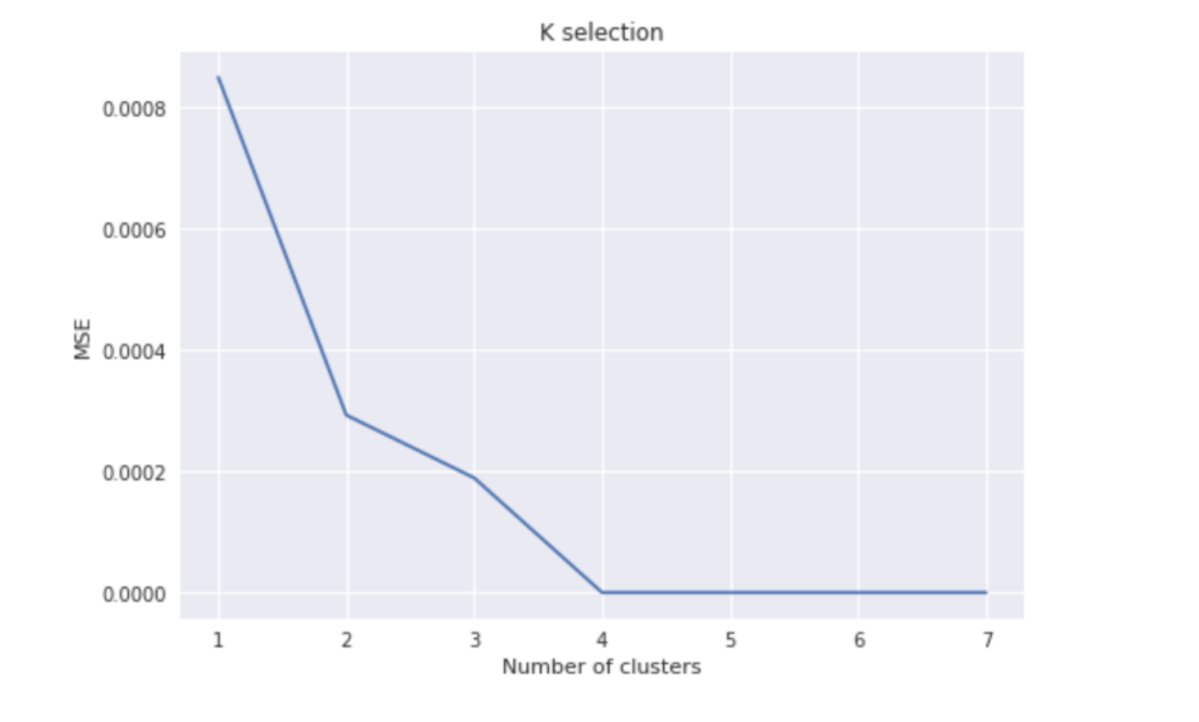
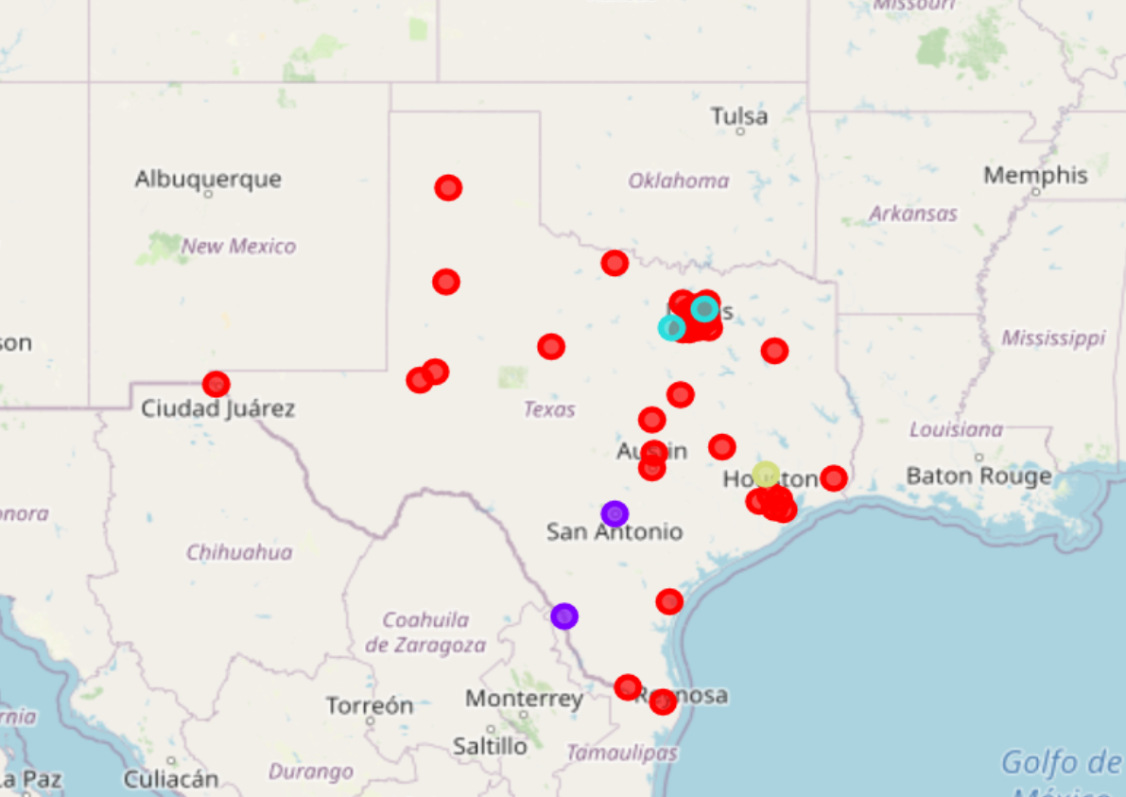
Methodology (Continued…)
Finding the number of clusters
4 clusters is the best option
Clustering

Slide 7
Results
Cluster 1: This cluster has the most number of shopping malls and plazas and the best one to invest
Cluster 2: This cluster has the moderate number of shopping malls.
Cluster 3: This cluster also has a moderate number of shopping plazas.
Cluster 4: This cluster has the least number of shopping facilities

Slide 8
Discussion
The high cluster area means there are so many shopping facilities already established in this area, which makes it more competitive and less appropriate for new investments. Thus cluster 1 in this project is recommended to be avoided
Cluster 4 is a low cluster area. That means in this area there are very few shopping facilities, which makes it more attractive for new investments. Cluster 1 is recommended to be invested in

Slide 9
Conclusion
Answer to the question: The cities in cluster 4 are preferred to invest for new shopping facilities
Findings of this project will help relevant stakeholders to capitalize on the opportunities on high potential locations while avoiding overcrowded areas in their decisions to open a new shopping facility.

