Slide 1

Binary classifiers for
cardiac arrythmia detection
Mously Diaw
November 24, 2020
Statistics for high dimensional data
Project presentation

Slide 2
Presentation outline
Project aim
Workflow
Data visualization
Models and results
Final models

Slide 3
Project aim
Arrhythmia: heart beats too slowly, too quickly or with an irregular pattern
High false arrhythmia alarm rates in Intensive care units (88.8%)¹
Goal: Detect absence or presence of arrhythmia using ECG parameters and patient information
[1] Drew, B. J., et al. "Insights into the problem of alarm fatigue with physiologic monitor devices: a comprehensive observational study of consecutive intensive care unit patients." PloS one 9.10 (2014): e110274

Slide 4
Workflow
278 predictors
452 patients
142 predictors
Data cleaning
& preprocessing
Model training
&
optimization
Arrhythmia dataset²
Model
evaluation
Outliers
Missing values
Zero-variance
High correlation
70/30 split
Model tuning with
5 repeats of 10-fold CV
Metric: AUC
[2] Guvenir, H. A., et al. "Arrhythmia data set in UCI machine learning repository." UC Irvine (1998)

Slide 5
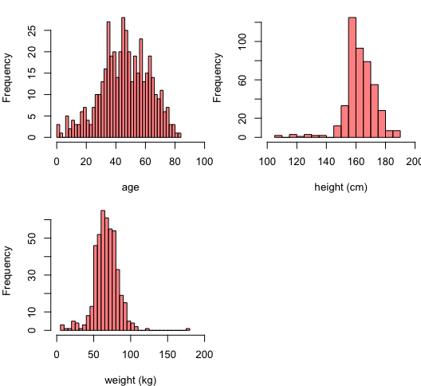
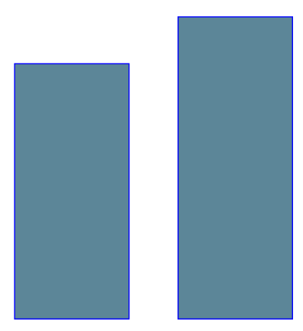
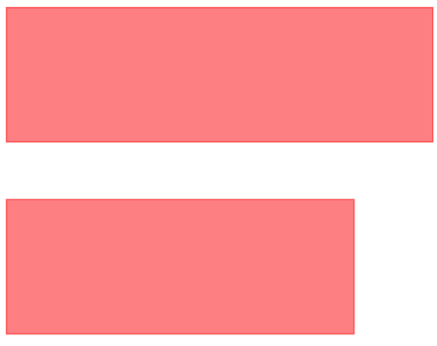
Class attribute and patient information
Class attribute
245
207
F
249
Anormal
Normal
M
203
sex

Slide 6
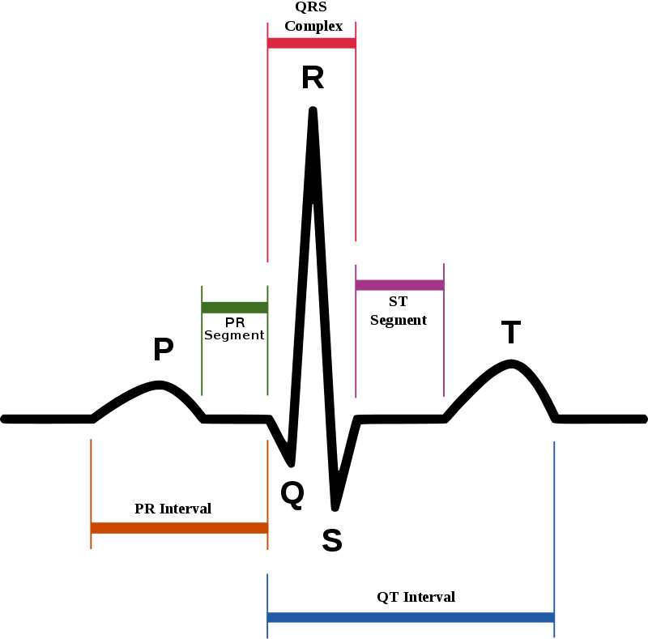
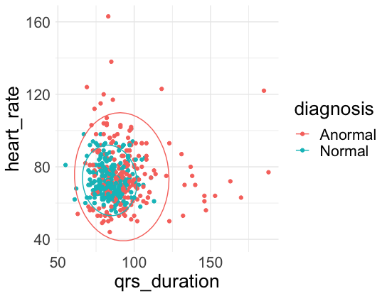
ECG Parameters (138 predictors)
© Wikimedia Commons

Slide 7
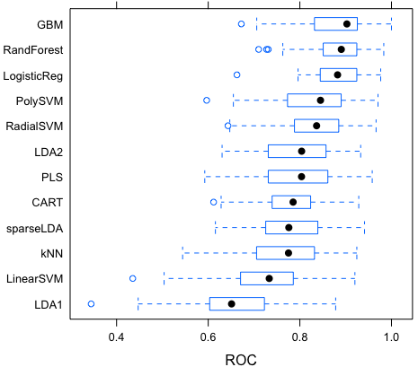
Model training
^{No significant difference}
^{in average AUC}
AUC resampling estimates
(50 resamples)
Center-scaling for all models
except classification trees
Forward stepwise selection
applied before logistic regression
LDA2: PCA + LDA

Slide 8
Performance of the final models
^{Logistic Regression}
^{Random Forest}
^{AUC = 0.77}
^{Accuracy = 71.85 %}
^{AUC = 0.86}
^{Accuracy = 76.3 %}
Confusion matrix
Confusion matrix
 | Reference
Prediction | Anormal | Normal
Anormal | 39 | 15
Normal | 23 | 58
 | Reference
Prediction | Anormal | Normal
Anormal | 45 | 14
Normal | 17 | 59
Top predictors:
HA , DD , HT , BN
Top predictors:
heart_rate, qrs_duration, DD, LE

Slide 9
Thank you !

