Slide 1
DEF file generator
Mini project 1
DIGITAL DESING 2

Slide 2
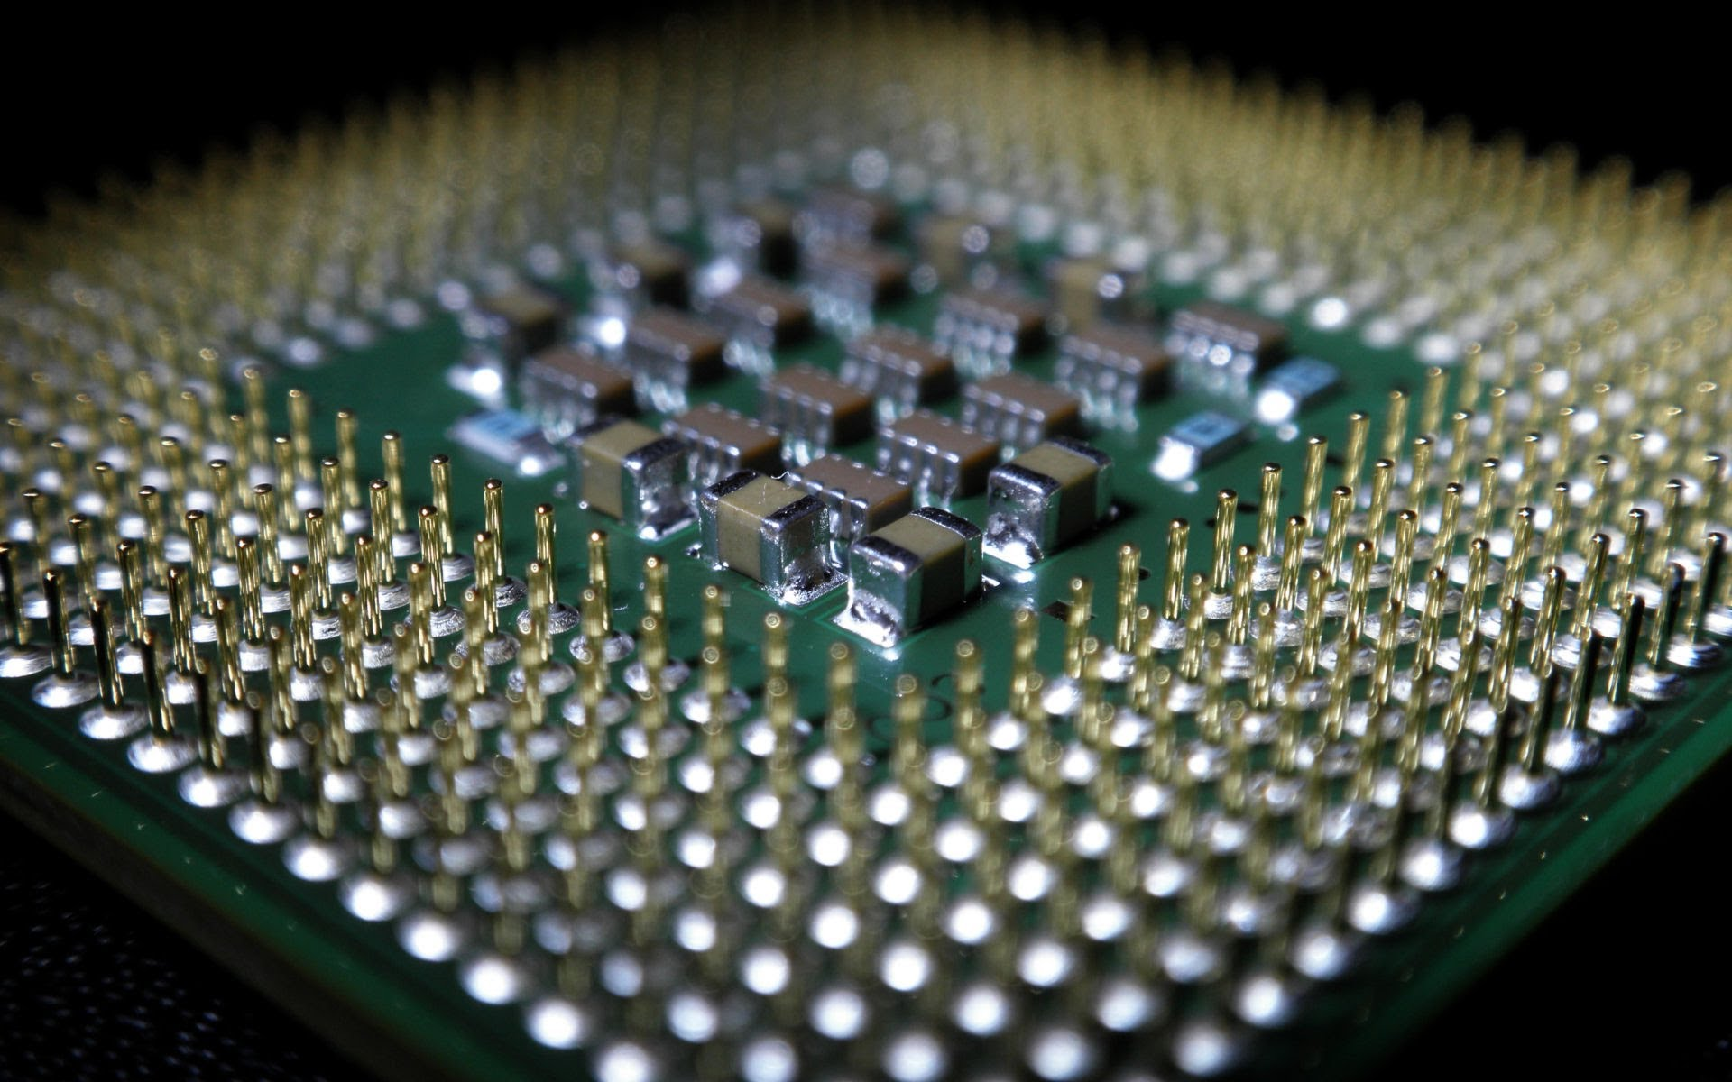
What is .DEF
Design Exchange Format (DEF) is an open specification for representing physical layout of an integrated circuit in an ASCII format. It represents the netlist and circuit layout. DEF is used in conjunction with Library Exchange Format (LEF) to represent complete physical layout of an integrated circuit while it is being designed.

Slide 3
Target ?
The target of this project is to develop a converter to convert the Verilog and .lef file into .def file
I chose python to develop this project
The def file shall contain only the following :
Die area definition
Row definitions
PINS, COMPONENTS
NETS sections
Power rings

Slide 4
Design and Implementation
The first step is to develop a parser that could parse and defragment the components of the Verilog and .lef file to be used for calculations and outputs
The parser for the Verilog file was straight forward as we assumed as it is in json format
The .lef file parser used the nested dictionaries in the python and some logic
Then after all the components are separated and stored in the dictionary data structure it is pulled out to output the needed components in the DEF file accordingliny

