Slide 1
GERAS
Abdelmounaim DEBIECHE

Slide 2
Agenda
IOT layer
Our position
Use case
Activity diagrams
Métamodel
Conclusion
Notes:
I will provide a broad overview of ThingML, present some challenges and interesting features that are missing in ThingML and suggest some potential contributions of our own.

Slide 3
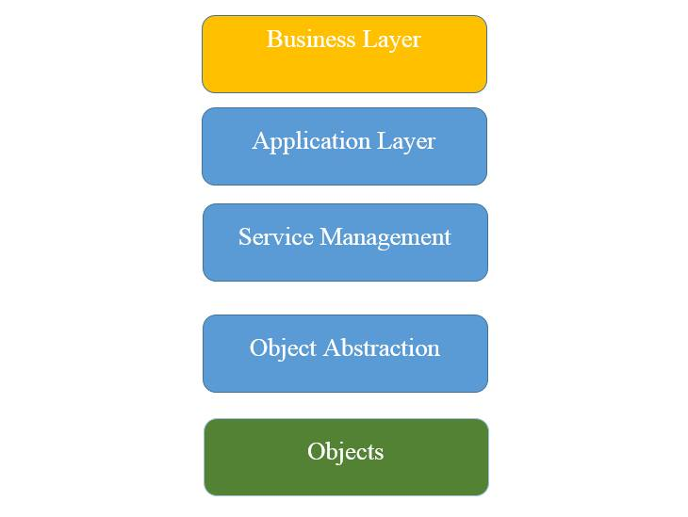
1. IOT Layer

Slide 4
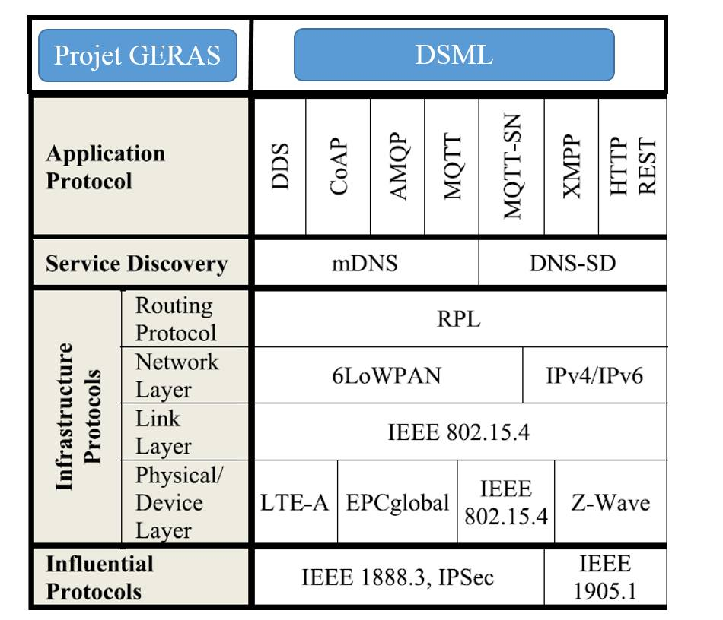
2. Our Position

Slide 5
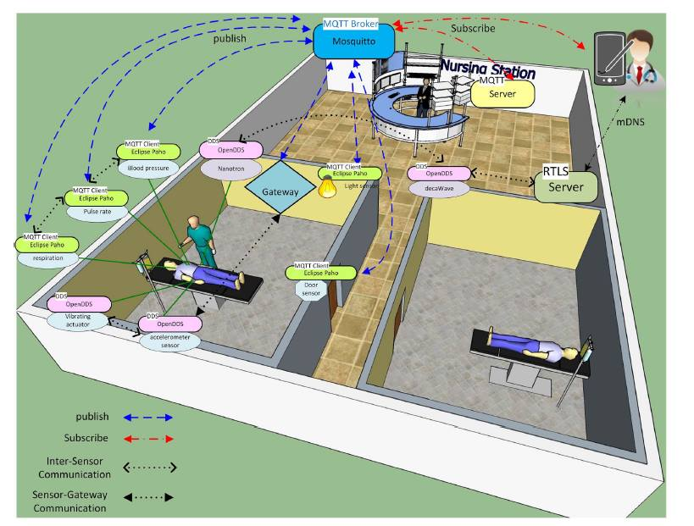
3. Use Case

Slide 6
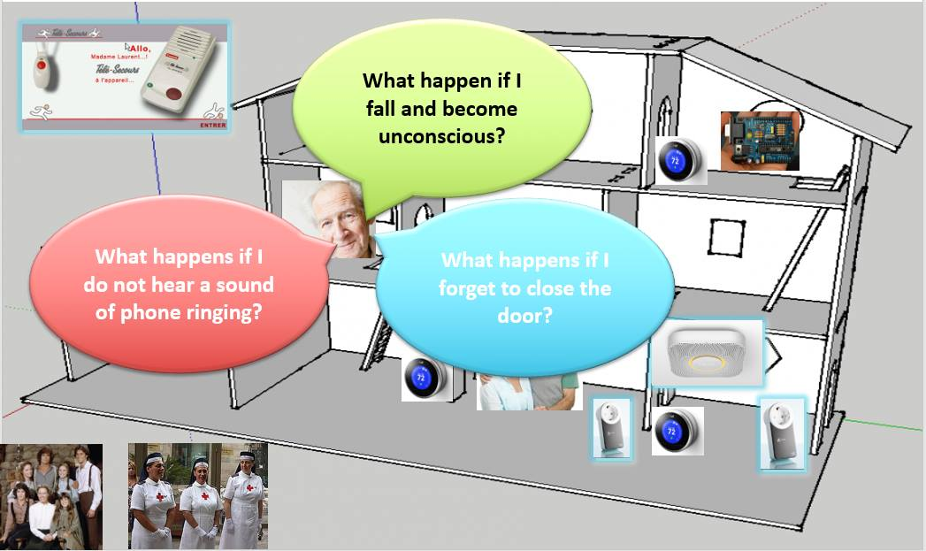
3. Use Case

Slide 7
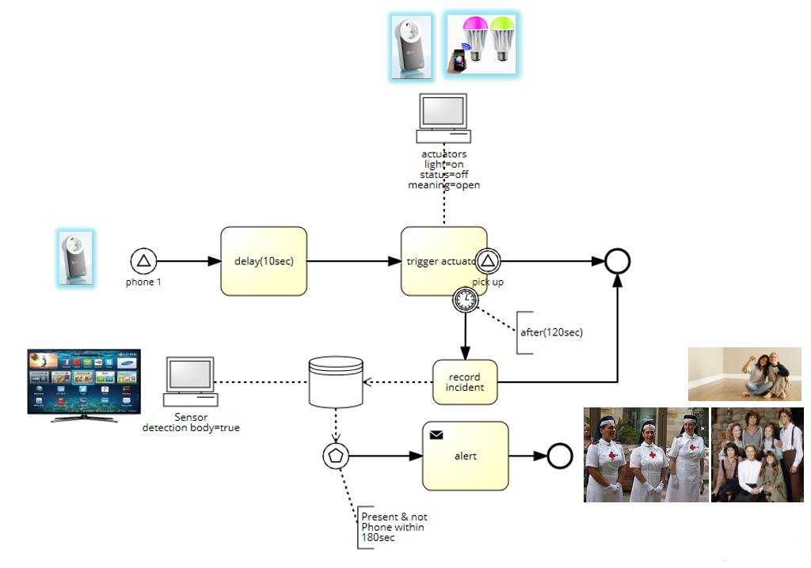
4. Activity diagrams

Slide 8
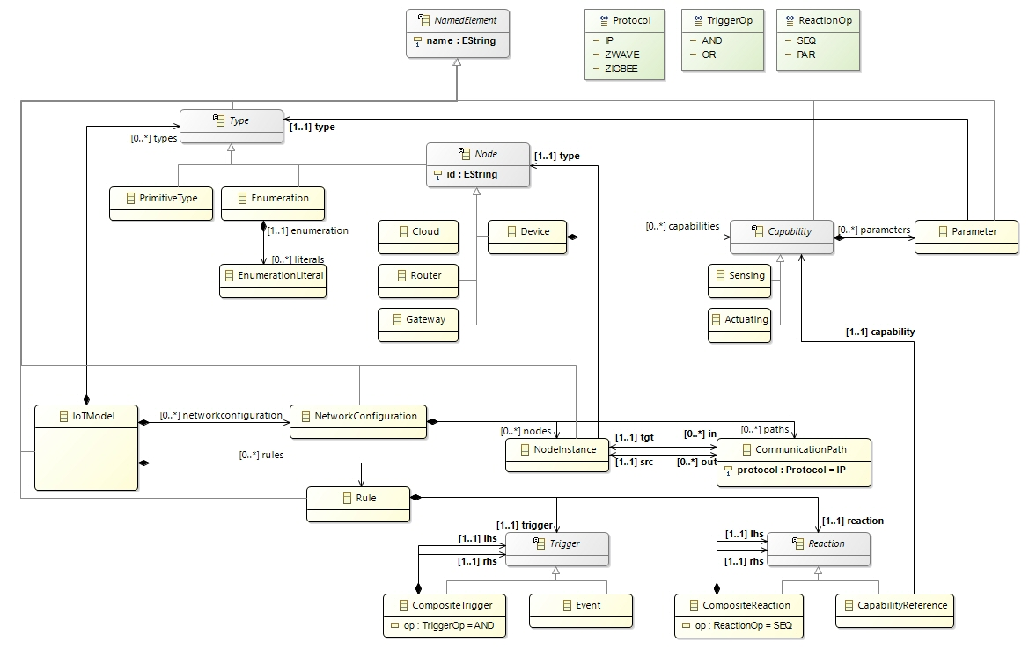
5. Metamodel

Slide 10
Conclusion
Level of abstraction
Scenario

Slide 11
Research Axis
Scenario
DSL
Prototype

