Slide 1

Data-Science-Advanced-Analytics
In Energy Sector

Slide 2
Today's agenda
Project recap
Problem
Process
Insights
Summary

Slide 3
PowerCo is a major gas and electricity utility that supplies to corporate, SME (Small & Medium Enterprise), and residential customers. The power-liberalization of the energy market in Europe has led to significant customer churn, especially in the SME segment. They have partnered with BCG to help diagnose the source of churning SME customers.
Project Recap

Slide 4
Context
Client is a major gas and electricity utility
• Supplies to corporate, SME and residential customers Significant churn problem
• Driven by power-liberalization of the energy market in Europe
• Problem is largest in the SME segment
Has engaged BCG to help with the SME segment
Problem
Client's hypothesis
It is possible to predict customers likely to churn using a predictive model
Hypothesis that churn is driven by customer
price sensitivity Client wants to try discounting strategy
• SME division head suggests that offering customers at high propensity to churn a 20% discount might be effective

Slide 5



1
Data Understanding
Process
2
Data Clean
3
Data Modeling
Data Analyzing
4
5
Uncover Insights

Slide 6
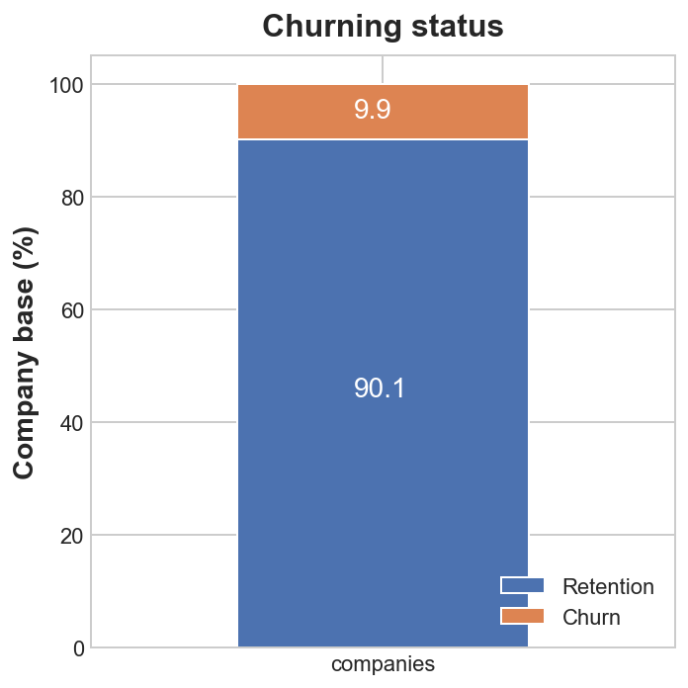
Churn is indeed high in the SME division • 9.9% between January 2016 and March 2016

Slide 7
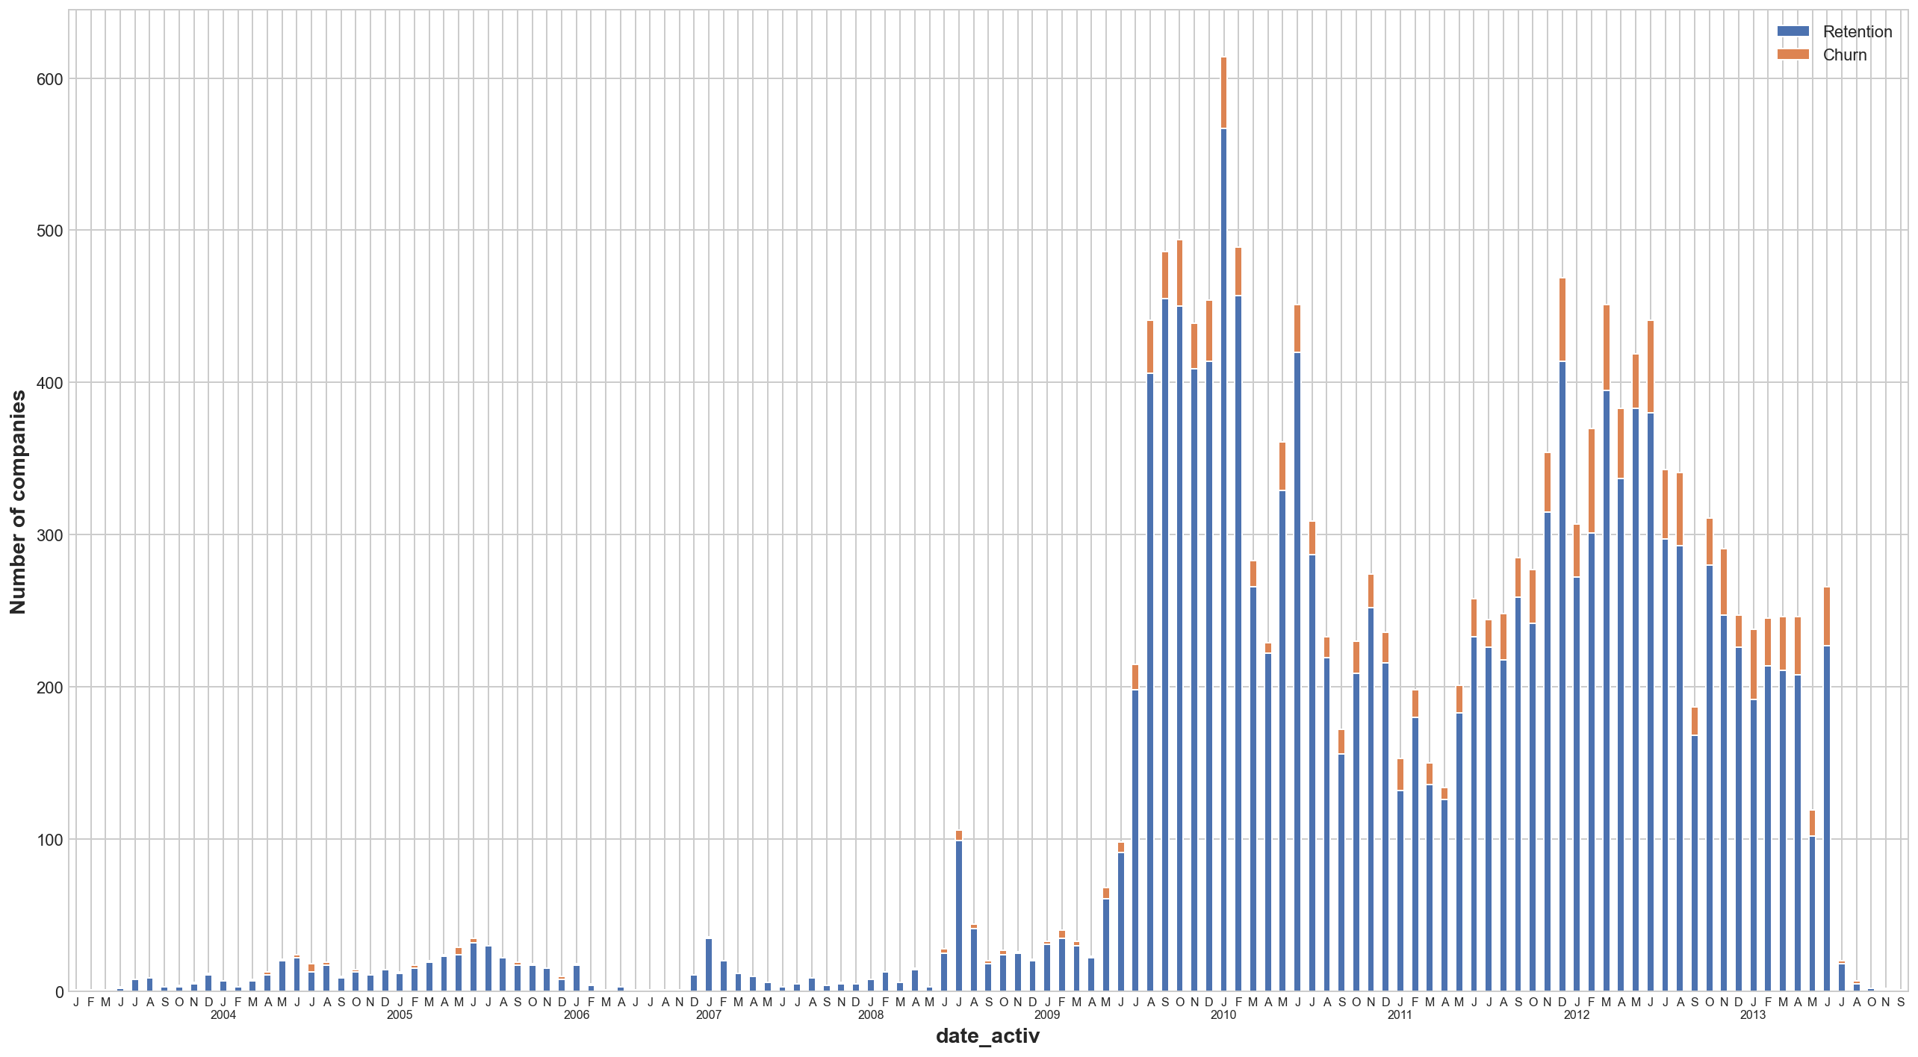
date of activation of the contract

Slide 8
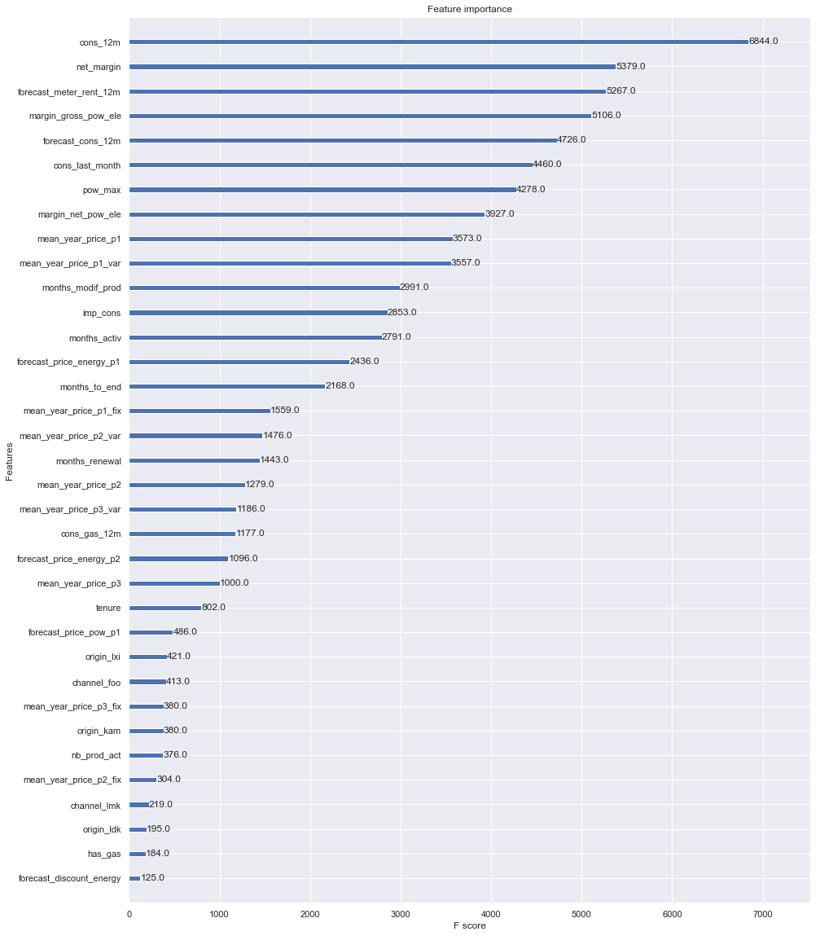
Predictive model able to predict churn but main driver is not customer price sensitivity • Yearly consumption, net margin, and forecasted consumption are the 3 largest drivers

Slide 9


Executive summary template
Churn is indeed high in the SME division
• 9.9% between January 2016 and March
2016
Predictive model able to predict churn but main driver is
not customer price sensitivity
• Yearly consumption, net margin, and
forecasted consumption are the 3 largest
drivers
Discount strategy of 20% is effective but only if
targeted appropriately
• Offer discount only to high-value
customers with high churn probability

