Slide 1
Should J.P.Morgan Keep Its Sponsorship Position?
Hive AI Prompt for Business Analyst Position
Moustafa Makhlouf // Oct 24, 2020

Slide 2
All Code For This Prompt Can Be Viewed At
https://github.com/moustafa19m/HivePrompt.git

Slide 3
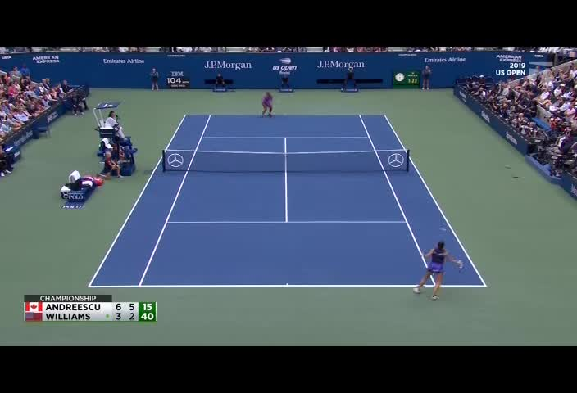
J.P.Morgan’s Current Position
J.P.Morgan’s logo appears 1317 in 1920 frames
highest number of appearances of any logo throughout the game
J.P.Morgan’s logo is close to the center of the image
being centered in the screen is big advantage as it attracts more attention
J.P.Morgan’s logo is takes up a bigger area than the average logo on screen

Slide 4
Premises
All polygons that contain logos are rectangles.
Determined by analyzing the shapes formed by vertices of each logo polygon.
Each logo polygon has only ONE class
Determined by asserting that each polygon has a classes list whose length is ONE.
The structure of each JSON object response from the API is Identical.
The height of each image is 480 and the width is 704.
Determined by asserting that the size of every image.

Slide 5
THE METHOD: What makes a GOOD Position?
Frequency of appearance {
the number of times the logo has appeared on screen, disregarding the number of frames it appears on
},
Clarity of the logo {
the clarity of the logo determined by the API.
},
Area taken up by the logo {
the area of the logo calculated from the vertices of the polygon logo.
},
Centrality of the logo {
a rating that determines how close to the center of the image the logo is
},
Shared Logos {
the number of unique logos that share the screen with a given logo
}

Slide 6
THE METHOD: Calculating the Parameters
Frequency
Extraction :
Counting the total number of appearance of the logo
Usage :
Normalizing the frequency for all logos in the range [0, 1] relative to the maximum
logo frequency.
Clarity
Extraction :
Collecting the clarity value from all the instances of a particular logo
Usage :
- Averaging all of the clarity values per logo
- Calculating the standard deviation for the clarity of each logo
Area
Extraction :
Calculating the width and height of the polygon from of its vertices normalized in the
range [0, 1]
Usage :
- Averaging all of the areas occupied by each logo
- Calculating the standard deviation for the area of each logo
Centrality
Extraction :
Given the shape of a polygon, determining how far that polygon is from an imaginary polygon
of the same size located in the center of the image. The rating ranges between 0 and 1.
Usage :
Averaging all of the centrality rating for each logo
Shared Logos
Extraction :
Counting the number of unique logos in the image by analyzing the API response, normalized
in the range [0, 1]
Usage :
Averaging the number of shared logos for a given logo across all images; centrality and
the num of shared logos are codependent: the more logos there are, the higher the
importance of centrality

Slide 7
THE METHOD: More on Centrality
Centrality
Extraction :
Given the shape of a polygon, determining how far that polygon is from an imaginary polygon
of the same size located in the center of the image. The rating ranges between 0 and 1.
Usage :
- Averaging all of the centrality rating for each logo
- Calculating the standard deviation for the centrality of each logo
The PINK line maps the Mercedes logo from its position to an
imaginary box in the center of the image
The GREEN line maps the J.P.Morgan logo from its position to an
imaginary box in the center of the image
A to-scale representation of the lengths of the PINK and GREEN lines.
This shows us that the J.P.Morgan logo is less central than the Mercedes logo.

Slide 8
THE METHOD: WHY These Parameter?
Frequency of appearance {
A logo is more likely to be seen by the viewer and more likely for the viewer to remember it the more times the logo appears.
},
Clarity of the logo {
The clearer the logo, the easier it is to see it and the better it is to identify it
},
Area taken up by the logo {
A bigger logo is more likely to catch the attention of the user than a smaller logo.
},
Centrality of the logo {
A more central logo is more likely to catch the viewer’s attention
},
Shared Logos {
The fewer the number of logos that appear on the screen along side our logo, the more our logo stands out.
}

Slide 9
THE METHOD: How Important Are Each of The Parameters*
Frequency should be valued the highest because the main point of
placing the logo is to get more viewership.
@
30%
Area and Clarity both have equal importance
@
25%
Centrality and Shared Logos have the least significance in comparison to other parameters.
@
20%
Total 100%
rating(logo) = 0.3 * frequency
+ 0.25 * mean(area) * (1-std(area))
+ 0.25 * mean(clarity) * (1-std(clarity))
+ 0.20 * (mean(centrality) * mean(shared_logos))
The idea behind multiplying the mean with 1-std is that we want to select for logos that has a high average and a low standard deviation.
* These calculations are based on my personal opinion on the importance of the each parameter.

Slide 10
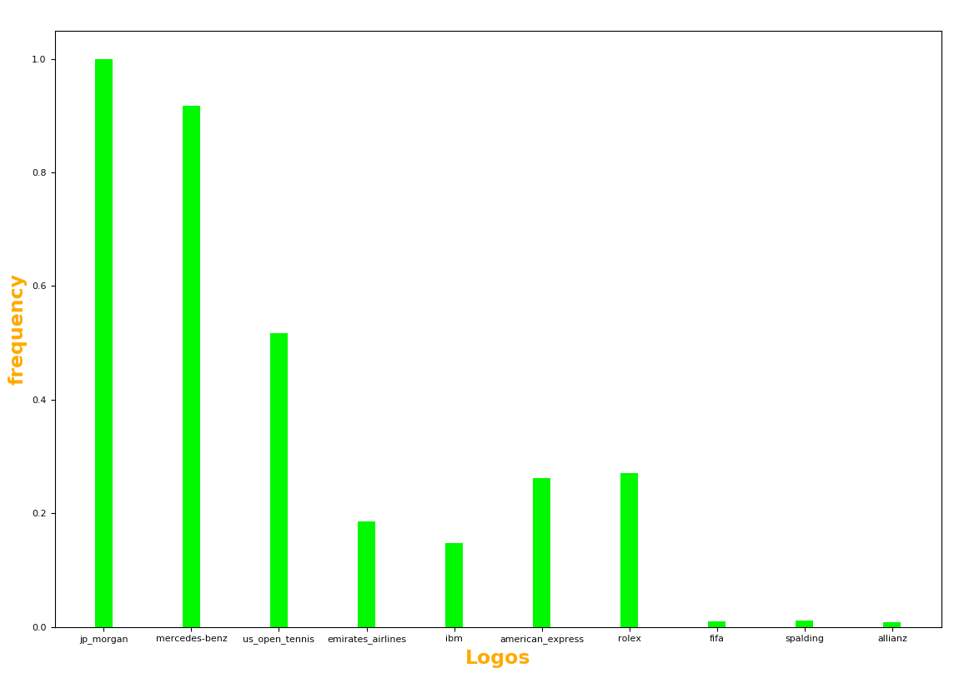
Findings: Highest Average Frequency
J.P.Morgan
has the highest average frequency throughout the images.
Closely followed by Mercedes and then US Open Tennis
The data is normalized by the maximum frequency so that
the range is limited between 0 and 1

Slide 11
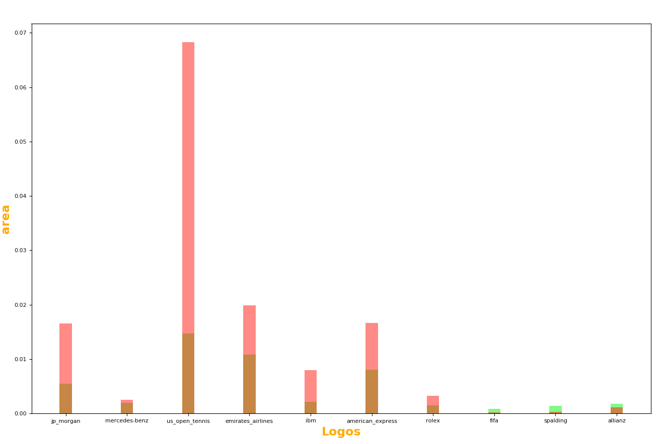
Findings: Highest Average Area
average
standard deviation
US Open Tennis
has the highest average frequency throughout the images,
But also the highest standard deviation.
J.P.Morgan has a high standard deviation as well relative to the mean
The data is normalized by the maximum area so that
the range is limited between 0 and 1
NOTE : The data for the area is skewed probably because of the appearance of
A big US Open Tennis logo in a very big area a few times.

Slide 12
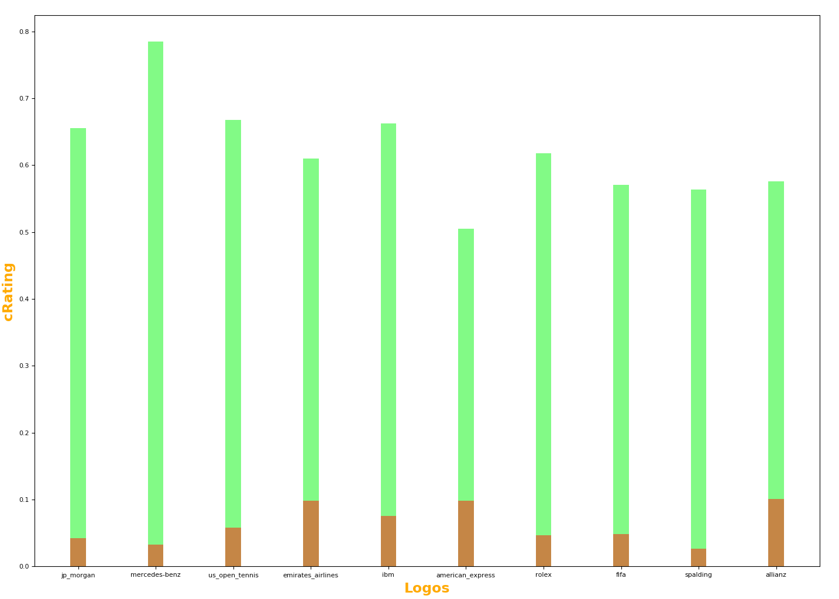
Findings: Highest Average Centrality
average
standard deviation
Mercedes
has the highest average centrality throughout the images,
And a low relative standard deviation.
Closely followed by US Open Tennis and then J.P.Morgan

Slide 13
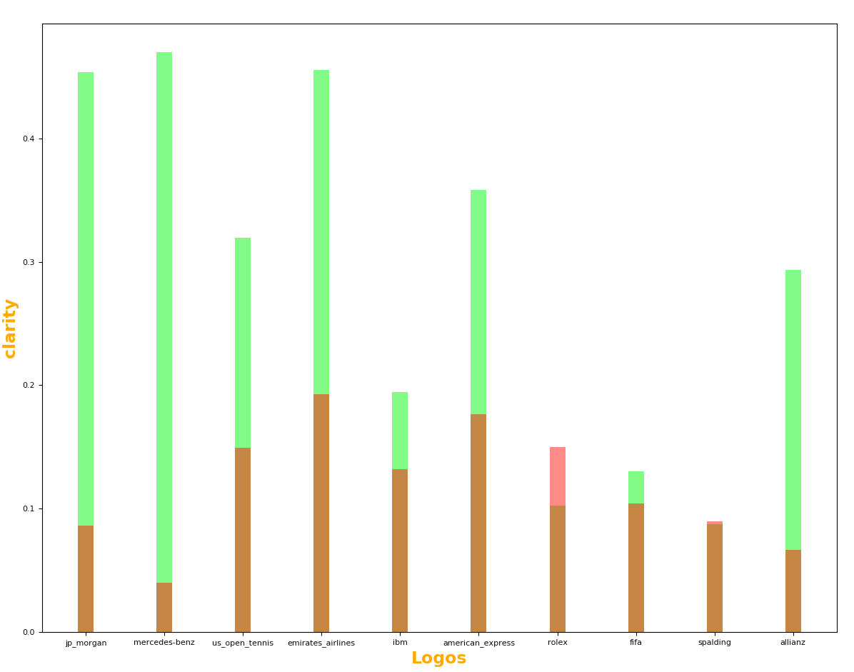
Findings: Highest Average Clarity
average
standard deviation
Mercedes
has the highest average clarity throughout the images,
And also the lowest relative standard deviation.
Closely followed by J.P.Morgan which has a high average and low standard deviation

Slide 14
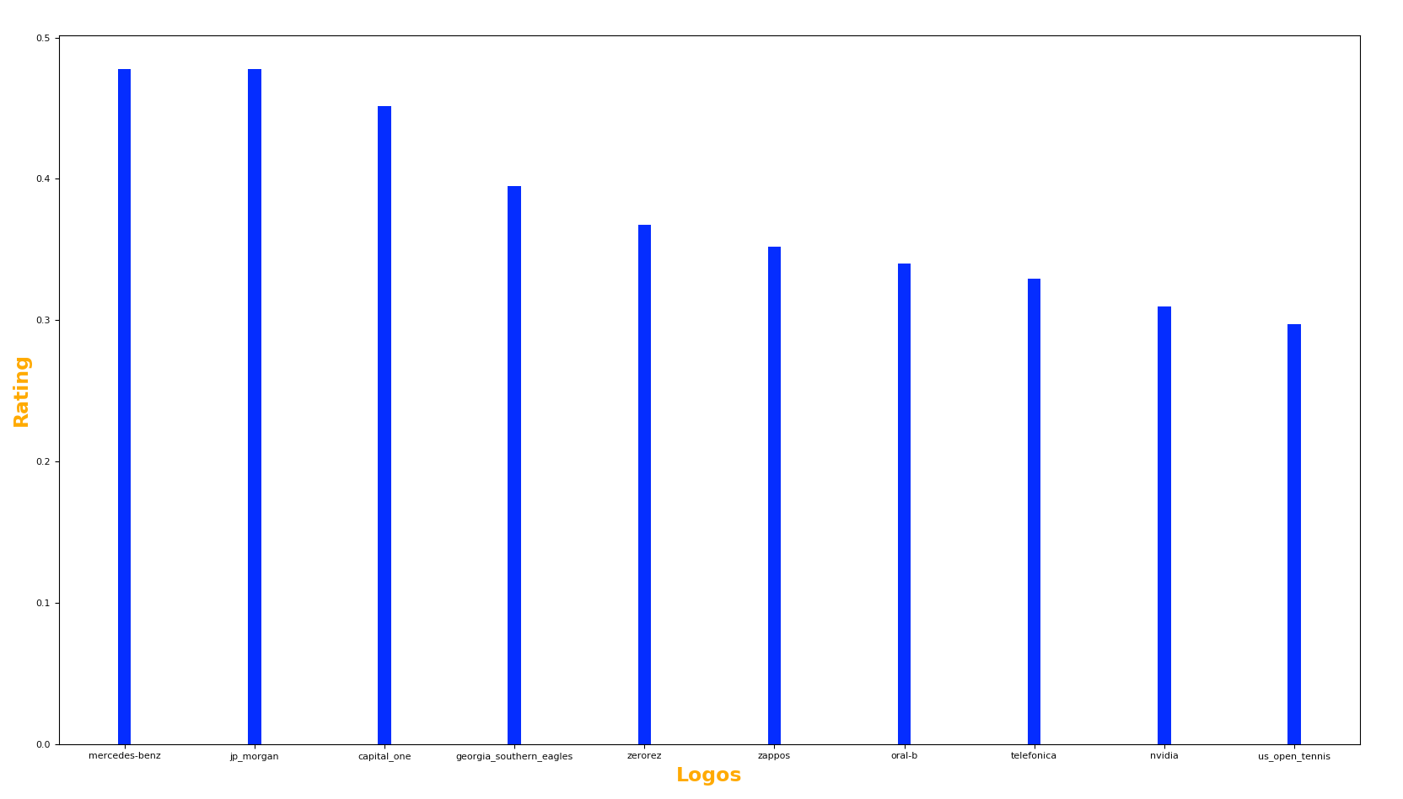
Findings: The Final Ratings
Mercedes
has the highest overall rating
Closely followed by J.P.Morgan
Overall Mercedes scored very well on centrality and clarity,
getting the highest scores in both. It also had a very high frequency score
which was only beaten by JP Morgan.
Mercedes and JP Morgan are very close in their final rating due to the
Increased weight placed on the frequency.

Slide 15
RECOMMENDATION
Even though the difference between the final ratings of both JP Morgan and Mercedes is very small, Mercedes has a more ideal score than
JP Morgan in two ratings (clarity and centrality) while JP Morgan has only one ideal score overMercedes in frequency. Mercedes also
had a much smaller standard variation in area than JP Morgan and a very similar average. This means that Mercedes had a better
overall area rating than JP Morgan. Both positions are very good, but Mercedes’ has an edge over JP Morgan’s.
Therefore, JP Morgan should make the switch to Mercedes’ position
Switch logo sponsorship positions with Mercedes

