Slide 1

SOC Home Lab: Offensive & Defensive Operations
A hands-on project documenting the design, implementation, and evaluation of a simulated Security Operations Center — executing controlled cyber-attacks against a monitored Windows endpoint using Wazuh SIEM.
CYBERSECURITY LAB
WAZUH SIEM
MITRE ATT&CK

Slide 2
Team Members
Abdelrhman Ahmed
Huda Ayman
Nourhan Elsayed
Moustafa Abdelfatah
Ahmed Essam
Mahmoud Abdelfatah

Slide 3
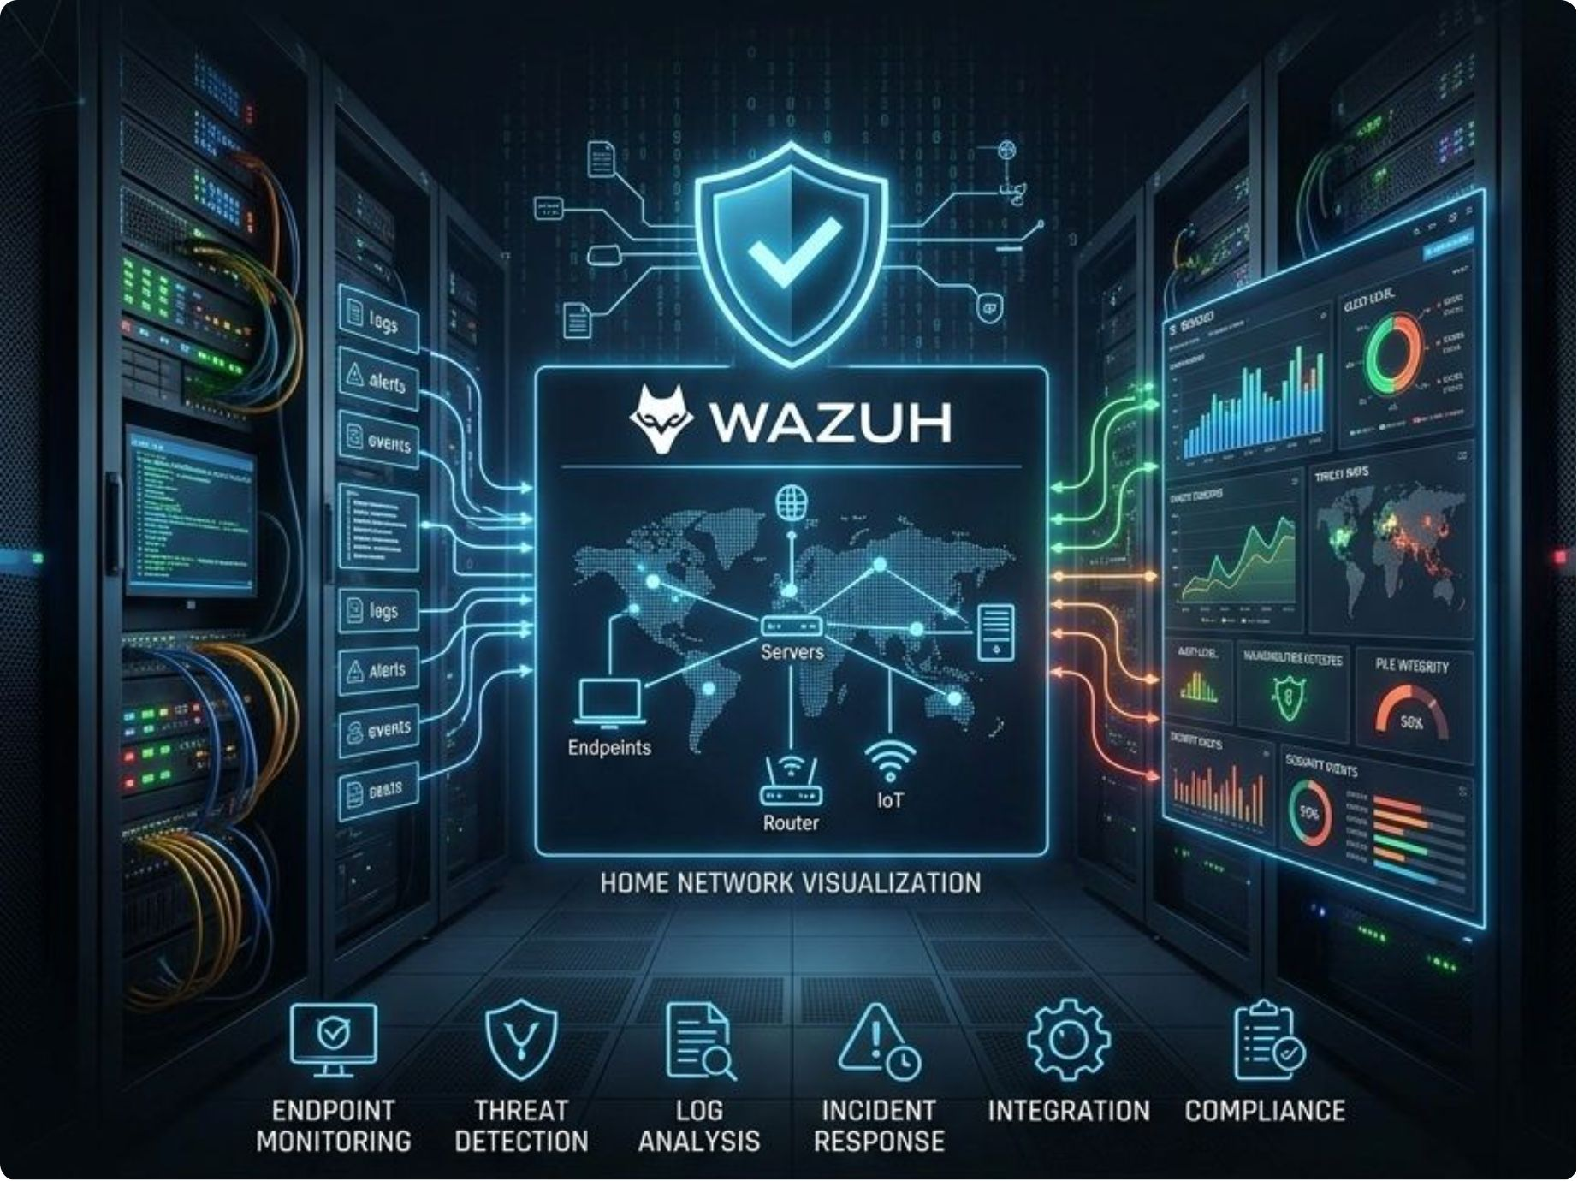

Executive Summary
This project documents a hands-on SOC home lab simulating real-world offensive and defensive operations. The lab leverages a Kali Linux instance to execute controlled cyber-attacks against a monitored Windows endpoint equipped with a Wazuh Agent and Sysmon.
The environment validates custom detection rules, attack simulation, and incident triage workflows end-to-end.

Slide 4

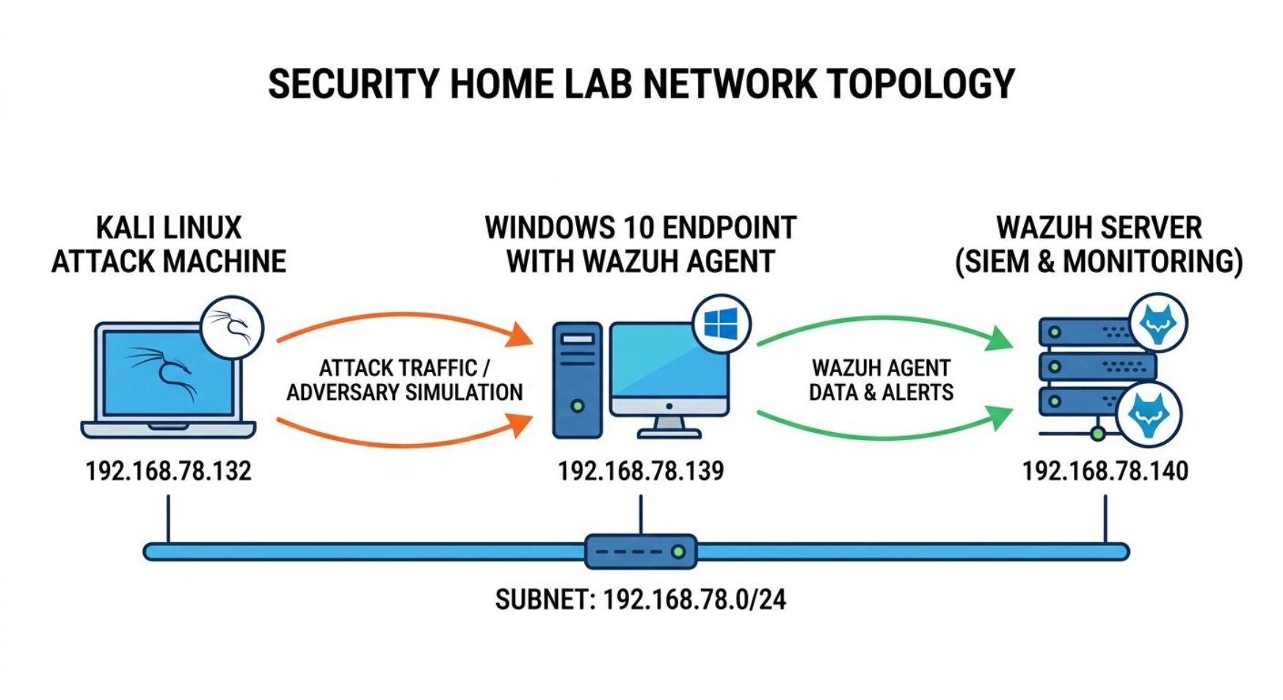

Lab Architecture & Network Topology
🔴 Adversary — Kali Linux 192.168.78.132
Red Team node generating offensive traffic: port scans, brute-force attempts, payload execution.
🎯 Target — Windows 10 192.168.78.139
Victim endpoint monitored by Wazuh Agent, observing system state, network connections, and process executions.
🛡️ SIEM — Wazuh Server 192.168.78.140
Central brain ingesting encrypted telemetry, correlating logs against detection rules, surfacing actionable alerts.

Slide 5
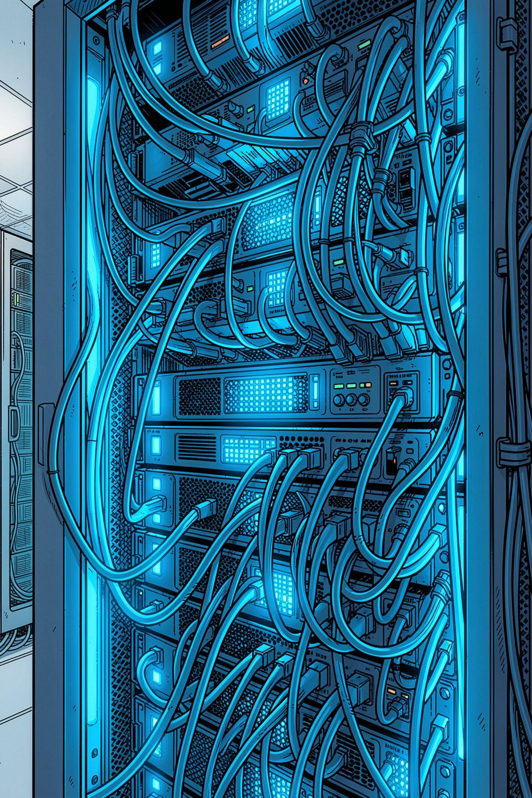



Wazuh SIEM Deployment
The Wazuh server uses an all-in-one deployment architecture tailored for lab environments. Three core components operate concurrently on the main node:
Wazuh Manager
Central correlation engine receiving agent telemetry in real-time, parsing raw logs, and evaluating them against threat detection rules.
Wazuh Indexer
Highly scalable search and analytics engine that securely indexes and stores parsed security data for high-speed querying.
Wazuh Dashboard
Web-based UI for real-time data visualization, custom dashboard creation, and incident alert triage.

Slide 6
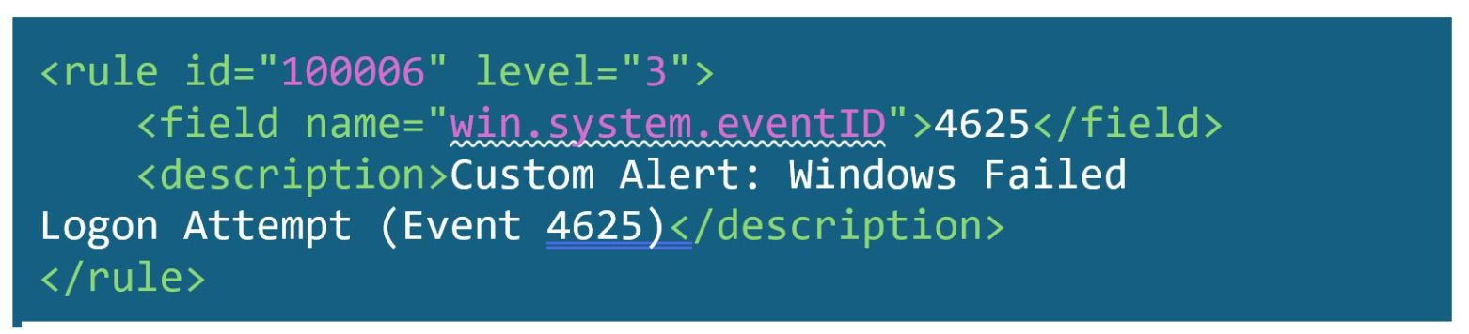
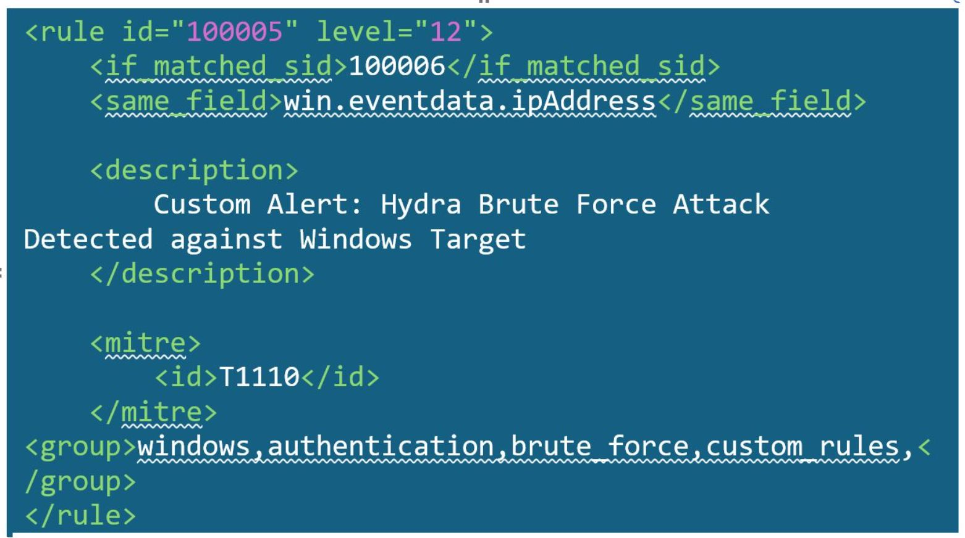
Custom Rule: Brute-Force Detection
Rule 100005 — Composite Alert (Level 12)
Aggregates base findings using temporal thresholds. Requires 3 failed logins within 60 seconds from the same IP. Mapped to MITRE T1110.001 (Password Guessing). Triggers Active Response mitigation.
Rule 100006 — Base Tripwire (Level 3)
Tags Windows failed logon attempts (Event ID 4625) for downstream correlation. Low severity prevents dashboard flooding from simple typos.

Slide 7
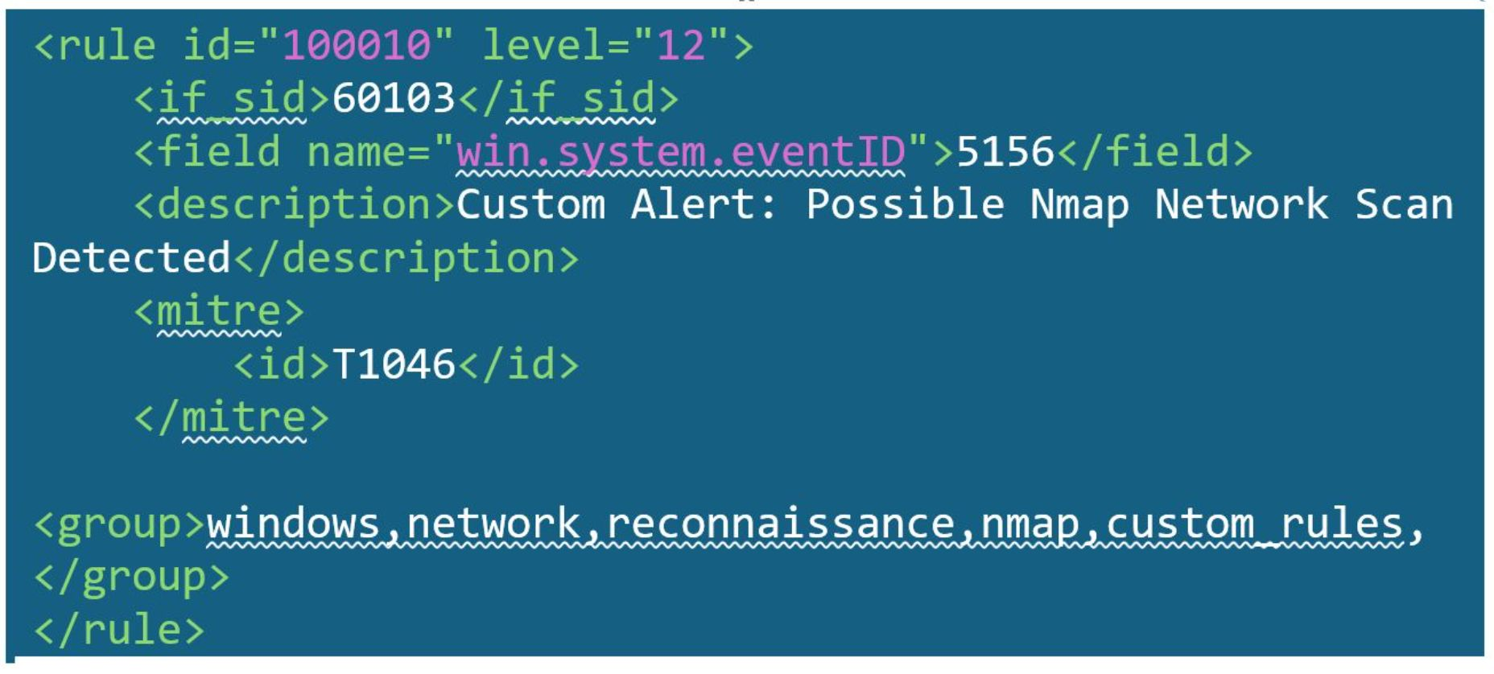
Custom Rule: Nmap Reconnaissance Detection
Rule 100010 — Network Scan Detection (Level 12)
Detects Nmap scanning activity by monitoring Event ID 5156 (Windows Filtering Platform allowed connections). Nmap generates massive spikes in 5156/5157 events across hundreds of ports.
Dependency
MITRE T1046
Group Tags
Evaluates only if baseline rule 60103 (network connection events) is triggered.
Network Service Discovery — adversarial service enumeration technique.
windows, network, reconnaissance, nmap — enables fast dashboard filtering.

Slide 8

Attack Simulation & Threat Hunting
1
2
Simulation 1: SMB Brute-Force
Simulation 2: Basic Nmap Scan
Controlled brute-force attack executed from Kali Linux against the Windows 10 endpoint. High-frequency failure pattern triggers Rule 100005 (Level 12), validating detection of lateral movement and credential access (MITRE T1110.001).
Active reconnaissance conducted from Kali Linux against the target. High-volume, multi-port log generation triggers Rule 100010 (Level 12), flagging MITRE T1046 (Network Service Discovery) violations.

Slide 9
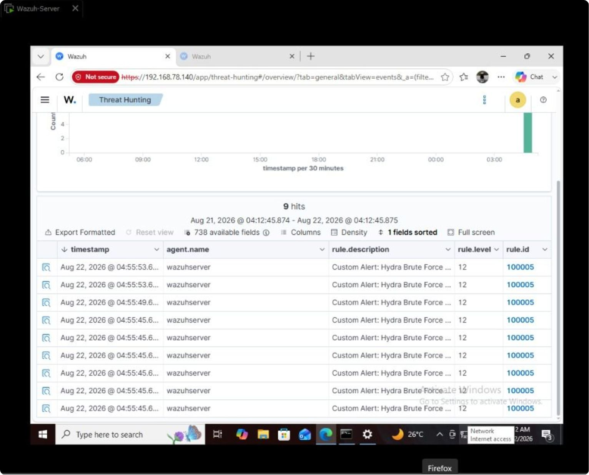
Brute-Force Detection Validation
01
Logtest Verification
Raw JSON simulating Event ID 4625 successfully triggered Rule 100006 (Level 3) through decoding phase.
02
Correlation Trigger
Repeated logs fulfilled frequency threshold, triggering Rule 100005 (Level 12) with MITRE T1110.001 mapping.
03
Alert Stream Confirmed
cat and jq against alerts.json confirmed continuous Rule 100005 alert generation.
04
Threat Hunting Dashboard
Querying rule.id: 100005 revealed a dense cluster of hits matching the Hydra execution timeframe.

Slide 10
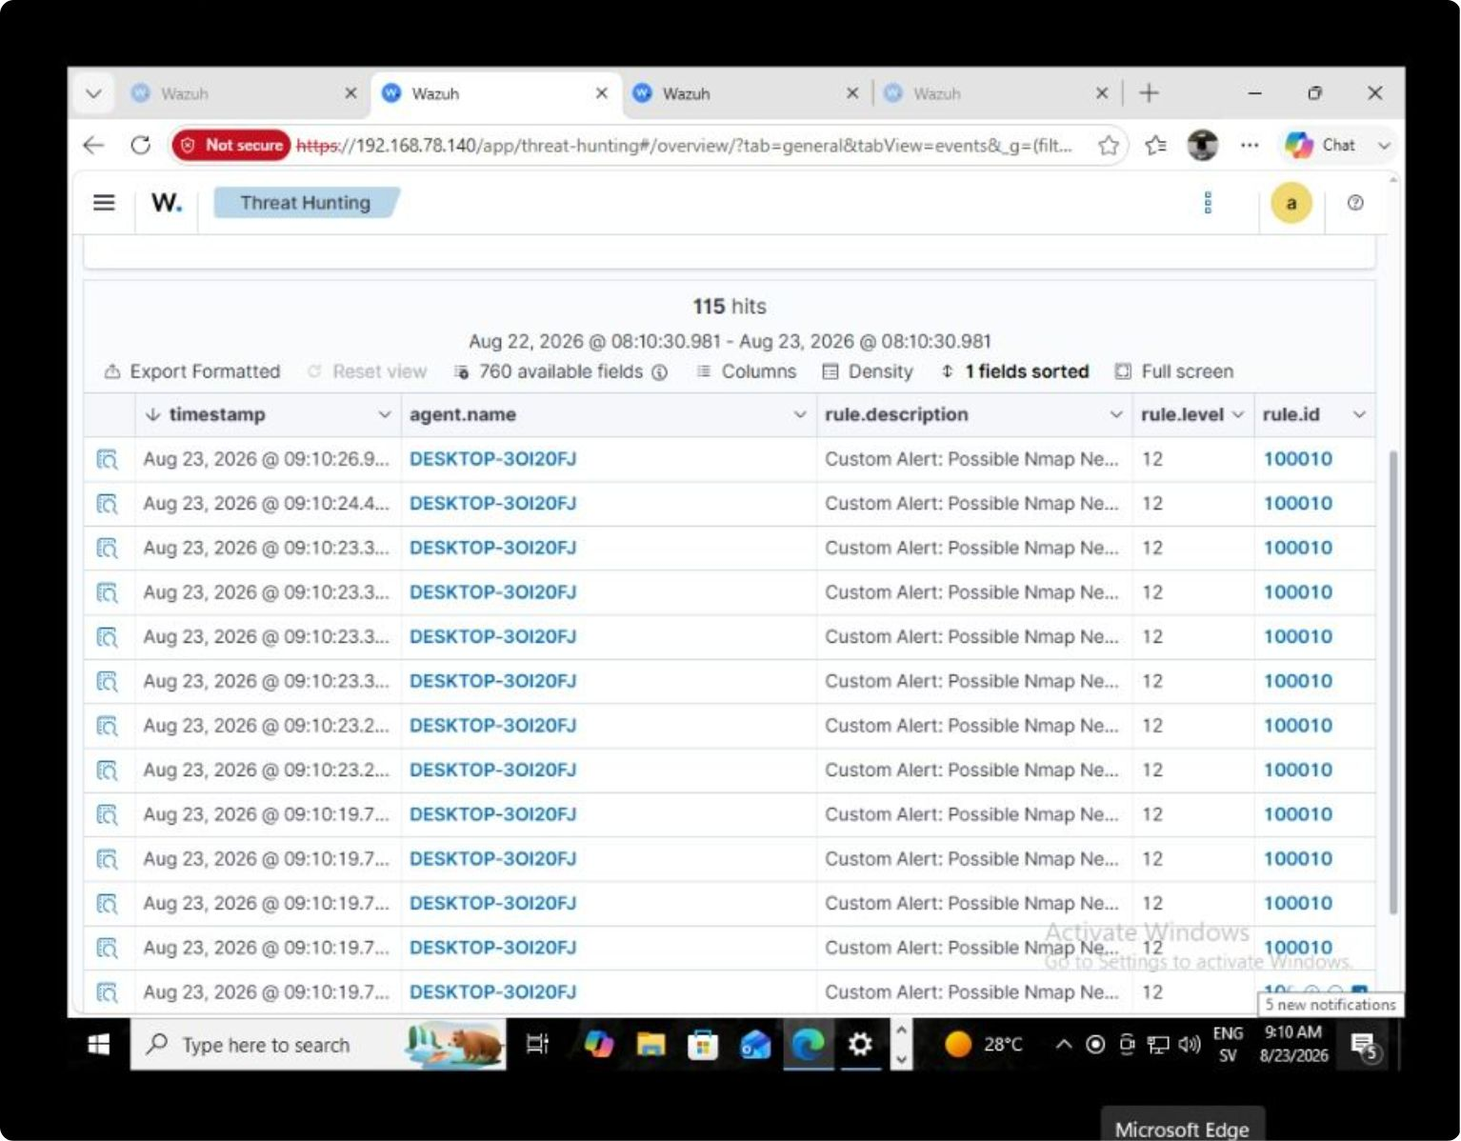

Nmap Detection Validation & Key Takeaways
Validation Results
wazuh-manager restarted to load updated XML rules. wazuh-logtest confirmed correct parsing of Event ID 5156 with Source Address and Destination Port metadata. jq filter on alerts.json revealed continuous Rule 100010 alerts.
115 distinct hits generated within a 2.46-second scan window — confirming critical-severity reconnaissance detection.
✅ Architecture Validated
✅ Rules Operational
✅ MITRE Mapped
3-node lab (Kali, Windows, Wazuh) successfully simulated real-world attack/defense.
Custom XML rules (100005, 100010) detected both attack types at Level 12 severity.
T1110.001 (Brute-Force) and T1046 (Reconnaissance) properly enriched alert metadata.

