Slide 1

MENOUFIA UNIVERSITY
FACULTY OF ENGINEERING, SHEBIN EL-KOM
ELECTRICAL ENGINEERING DEPARTMENT
ENHANCEMENT OF DISTRIBUTION SYSTEMS PERFORMANCE USING MODERN OPTIMIZATION TECHNIQUES
Supervised by:
Dr. Mohamed Taha Mouwafi

Slide 2
Team work
Moustafa Mohamed Abdelghani Abdalla Shahin
Mohamed Khaled Ahmed Soltan
Mohamed Rabie Abdelhamid Mohamed Elshiekh
Moustafa Mohamed Abdelghani Nada
Mohamed Fekry Mohamed Abdelwareth Zahran
Mohamed EmadAldean Abdelnabi Abdallah
Mohamed Ali Elsayed Abdelgleil
Mohamed Eldesoky Ahmed Halema
Mohamed Ragab Abdelmoati Khafaga
Moustafa Ahmed Sabry Alashmawi
Islam Gamal Hussien Alagha

Slide 3
Project outlines
CHAPTER 1 Introduction
CHAPTER 2 Distributed Generations and Capacitors Technologies
CHAPTER 3 Problem Formulation
CHAPTER 4 Archimedes Optimization Algorithm
CHAPTER 5 Applications and Results
CHAPTER 6 Conclusions

Slide 4
CHAPTER 1
INTRODUCTION

Slide 5
INTRODUCTION
The optimization can be defined as a part of the applied or numerical mathematics or a method for system design by computer in accordance with either one stress theoretical aspect (existence of the optimum solution conditions) or the practical aspect (procedures for obtaining the optimum solution).
Archimedes Optimization Algorithm is based on Archimedes’ principle. AOA emulates the behavior of many objects, which have different densities and volumes, immersed in the same fluid and each one tries to reach equilibrium state.
Capacitor banks are commonly used in a distribution system to provide reactive power locally, resulting in reduced maximum kVA demand, improved voltage profile, reduced line/feeder losses and decreased payments for the energy.

Slide 6
INTRODUCTION
DG generates electricity from many small energy sources located close to the load being served.
DG can lower costs, enhance efficiency, improve reliability, reduce emissions, or expand their energy options.
The backward/forward sweep (BFS) algorithm is one of the most common ways used for load flow calculations in distribution system , involves mainly an iterative three basic steps based on Kirchhoff's current law (KCL) and Kirchhoff's voltage law (KVL).

Slide 7
CHAPTER 2
DISTRIBUTED GENERATIONS AND
CAPACITORS TECHNOLOGIES

Slide 8
Distributed Generations
DG generally applies to relatively small generating units sited at or near customer sites to meet specific customer needs or to support economic, operation of the existing distribution grid, or both.
Types of DGs
Conventional fossil fuel based combustion engines.
Renewable energy including wind, photovoltaic cells, micro turbines, combined heat and power (CHP) or hybrid.

Slide 9
Applications of DGs
Standby power
Combined heat and power
Peak shaving
Grid support
Stand alone
Capacitor Banks
Capacitor banks applied to distribution systems can be fixed or switched depending on the load conditions.
Fixed capacitor banks for minimum load condition. While, Switched capacitor banks for load levels above the minimum load and up to the peak load.

Slide 10
Benefits of capacitor banks
Reactive power support.
Voltage profile improvements.
Line and transformer loss reduction.
Release of power system capacity.
Savings due to reduced energy losses.

Slide 11
CHAPTER 3
PROBLEM FORMULATION

Slide 12
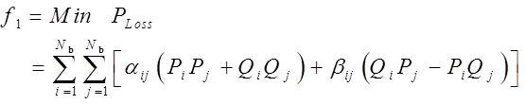
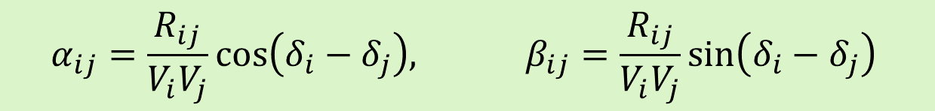
Objective functions
Total power loss minimization
$$α_{ij}=\frac{R_{ij}}{V_{i}V_{j}}cos\left(δ_{i}−δ_{j}\right), β_{ij}=\frac{R_{ij}}{V_{i}V_{j}}sin\left(δ_{i}−δ_{j}\right)$$
where,
P_{Loss} is the total real power loss to be minimized
P_{i} and Q_{i} are the net active and reactive power at bus i
V_{i} and V_{j} are the voltage magnitudes at buses i and j
δ_{i} and δ_{j} are the phase angle of the voltages at buses i and j
R_{ij} is the line resistance between buses i and j
N_{b} is the number of system buses.

Slide 13
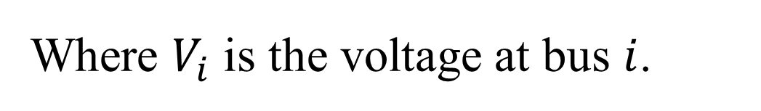
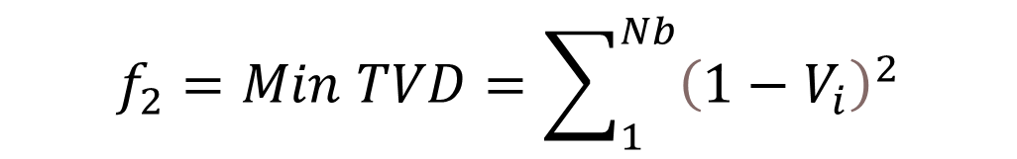
Objective functions
Total voltage deviation (TVD) minimization
$$f_{2}=Min TVD=\sum_{1}^{Nb}{{\left(1−V_{i}\right)}^{2}}$$
Where $V_{i}$ is the voltage at bus $i$.

Slide 14
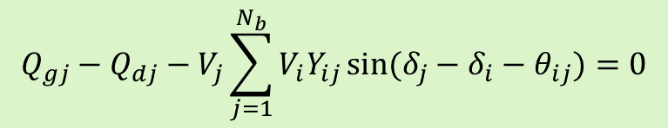
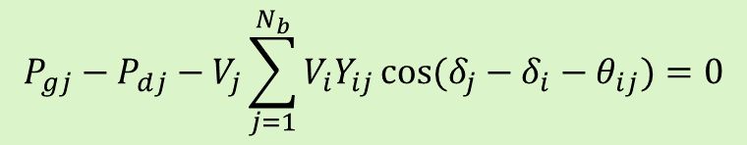
Load balancing constraint
System constraints
Equality constraint
$$P_{gj}−P_{dj}−V_{j}\sum_{j=1}^{N_{b}}{V_{i}Y_{ij}}cos(δ_{j}−δ_{i}−θ_{ij})=0$$
$$Q_{gj}−Q_{dj}−V_{j}\sum_{j=1}^{N_{b}}{V_{i}Y_{ij}}sin(δ_{j}−δ_{i}−θ_{ij})=0$$
P_{gj} and Q_{gj} are the active and reactive power output from the generator at bus j
P_{dj} and Q_{dj} are the active and reactive power demand at bus j
V_{i} and V_{j} are the voltages at sending end i and receiving end j
Y_{ij} and θ_{ij} are the admittance magnitude and angle between buses i and j
δ_{i} and δ_{j} are the phase angles of voltages at buses i and j

Slide 15




Inequality constraints
Bus voltage constraint
Overall Power factor constraint
Number of DGs constraint
Number of capacitors constraint

Slide 16





Capacitor size constraint
DG size constraint
Total active and reactive power constraints

Slide 17
CHAPTER 4
Archimedes Optimization ALGORITHM

Slide 18
Archimedes Optimization Algorithm
Archimedes Optimization Algorithm (AOA) is based on Archimedes’ principle which states that “Any object, totally or partially immersed in a fluid or liquid, is buoyed up by a force equal to the weight of the fluid displaced by the object.”. AOA emulates the behavior of many objects, which have different densities and volumes, immersed in the same fluid and each one tries to reach equilibrium state.

Slide 19
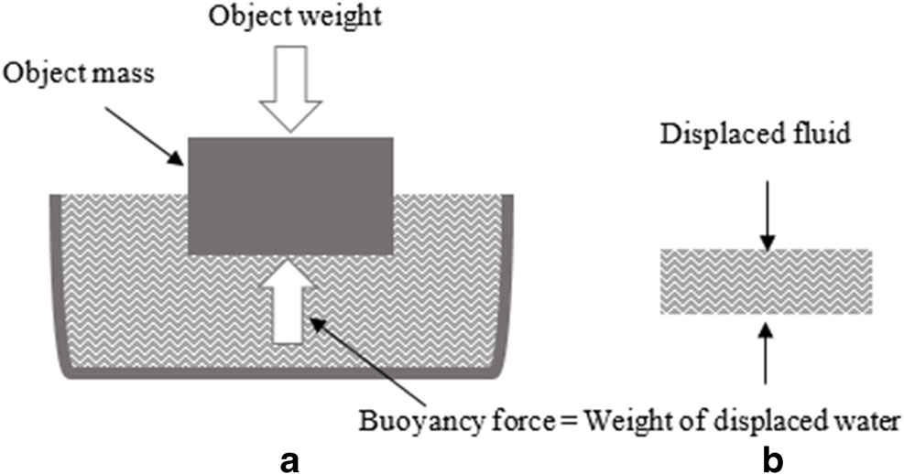
AOA Theory

Slide 20
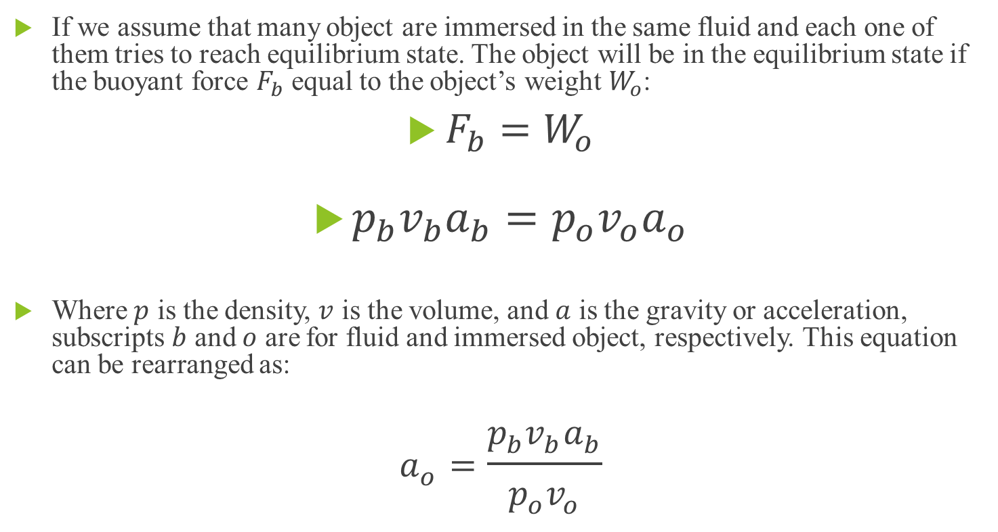
AOA Theory
If we assume that many object are immersed in the same fluid and each one of them tries to reach equilibrium state. The object will be in the equilibrium state if the buoyant force $F_{b}$ equal to the object’s weight $W_{o}$:
$F_{b}=W_{o}$
$p_{b}v_{b}a_{b}=p_{o}v_{o}a_{o}$
Where $p$ is the density, $v$ is the volume, and $a$ is the gravity or acceleration, subscripts $b$ and $o$ are for fluid and immersed object, respectively. This equation can be rearranged as:
$$a_{o}=\frac{p_{b}v_{b}a_{b}}{p_{o}v_{o}}$$

Slide 21
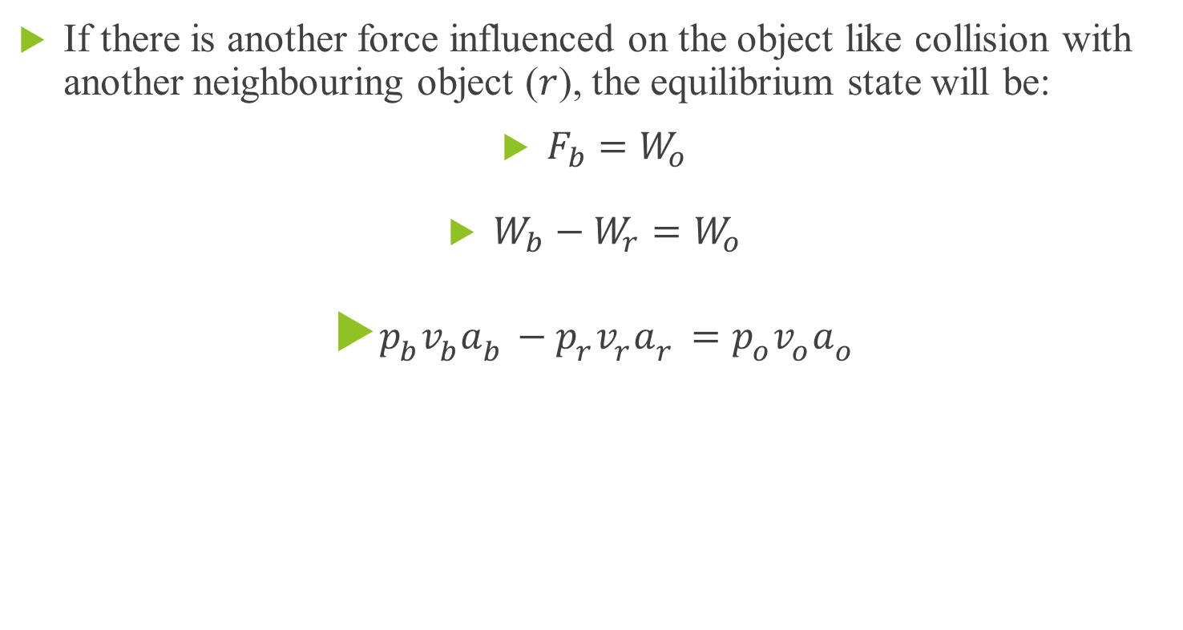
AOA Theory
If there is another force influenced on the object like collision with another neighbouring object ($r$), the equilibrium state will be:
$F_{b}=W_{o}$
$W_{b}−W_{r}=W_{o}$
$p_{b}v_{b}a_{b}−p_{r}v_{r}a_{r}=p_{o}v_{o}a_{o}$

Slide 22
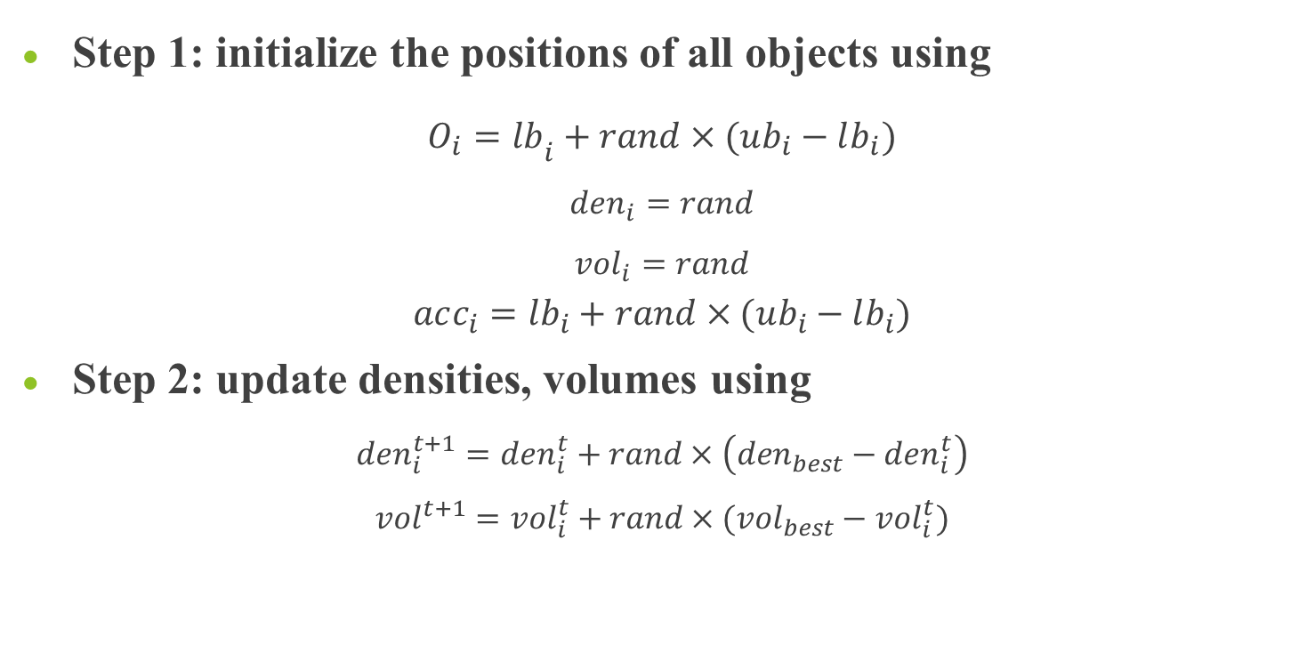
AOA algorithmic steps
Step 1: initialize the positions of all objects using $O_{i}=lb­_{i}+rand×(ub_{i}−lb_{i})$
$$den_{i}=rand$$
$$vol_{i}=rand$$
$$acc_{i}=lb_{i}+rand×(ub_{i}−lb_{i})$$
Step 2: update densities, volumes using $den_{i}^{t+1}=den_{i}^{t}+rand×\left(den_{best}−den_{i}^{t}\right)$
$$vol^{t+1}=vol_{i}^{t}+rand×(vol_{best}−vol_{i}^{t})$$

Slide 23
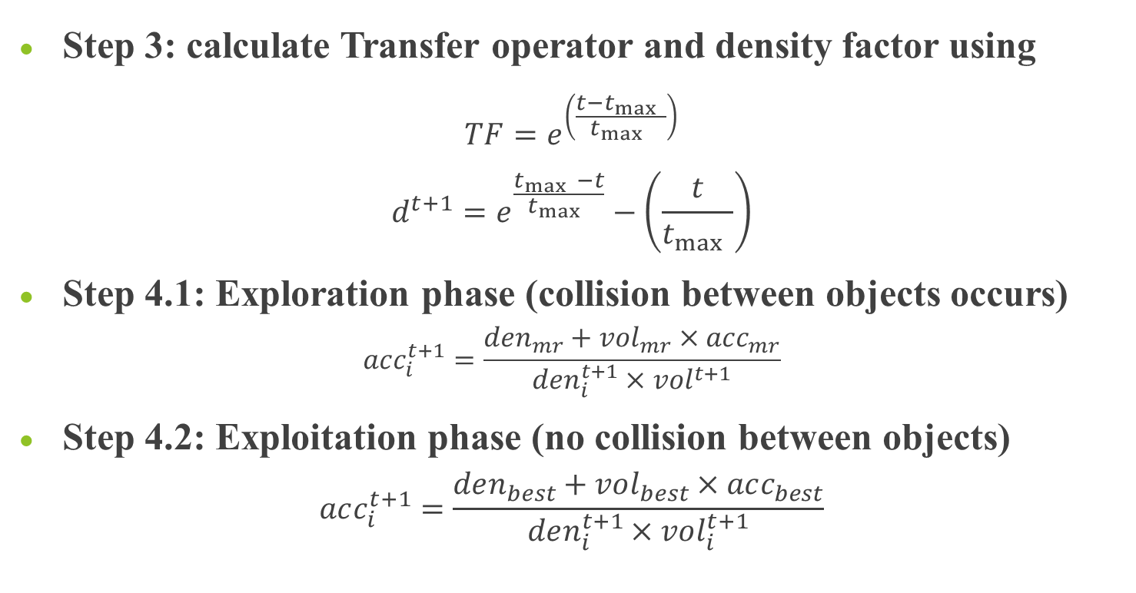
AOA algorithmic steps
Step 3: calculate Transfer operator and density factor using
$$TF=e^{\left(\frac{t−t_{\max{ }}}{t_{\max{ }}}\right)}$$
$$d^{t+1}=e^{\frac{t_{\max{ }}−t}{t_{\max{ }}}}−\left(\frac{t}{t_{\max{ }}}\right)$$
Step 4.1: Exploration phase (collision between objects occurs)
$$acc_{i}^{t+1}=\frac{den_{mr}+vol_{mr}×acc_{mr}}{den_{i}^{t+1}×vol^{t+1}}$$
Step 4.2: Exploitation phase (no collision between objects)
$$acc_{i}^{t+1}=\frac{den_{best}+vol_{best}×acc_{best}}{den_{i}^{t+1}×vol_{i}^{t+1}}$$

Slide 24
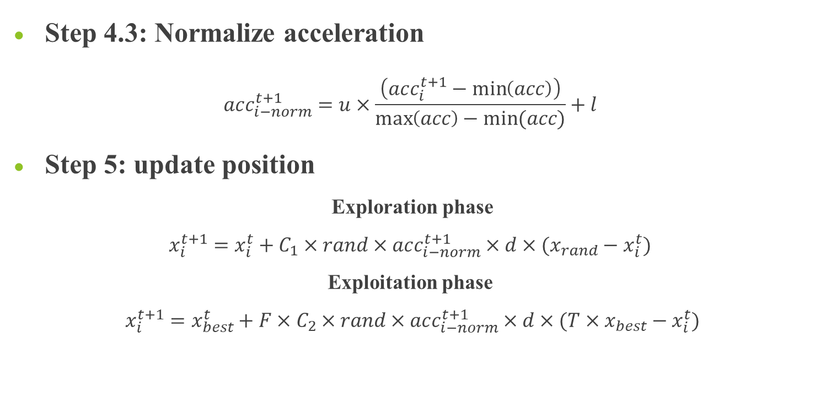
AOA algorithmic steps
Step 4.3: Normalize acceleration
$$acc_{i−norm}^{t+1}=u×\frac{\left(acc_{i}^{t+1}−\min\left(acc\right)\right)}{\max\left(acc\right)−min⁡(acc)}+l$$
Step 5: update position
Exploration phase
$$x_{i}^{t+1}=x_{i}^{t}+C_{1}×rand×acc_{i−norm}^{t+1}×d×(x_{rand}−x_{i}^{t})$$
Exploitation phase
$x_{i}^{t+1}=x_{best}^{t}+F×C_{2}×rand×acc_{i−norm}^{t+1}×d×(T×x_{best}−x_{i}^{t})$

Slide 25
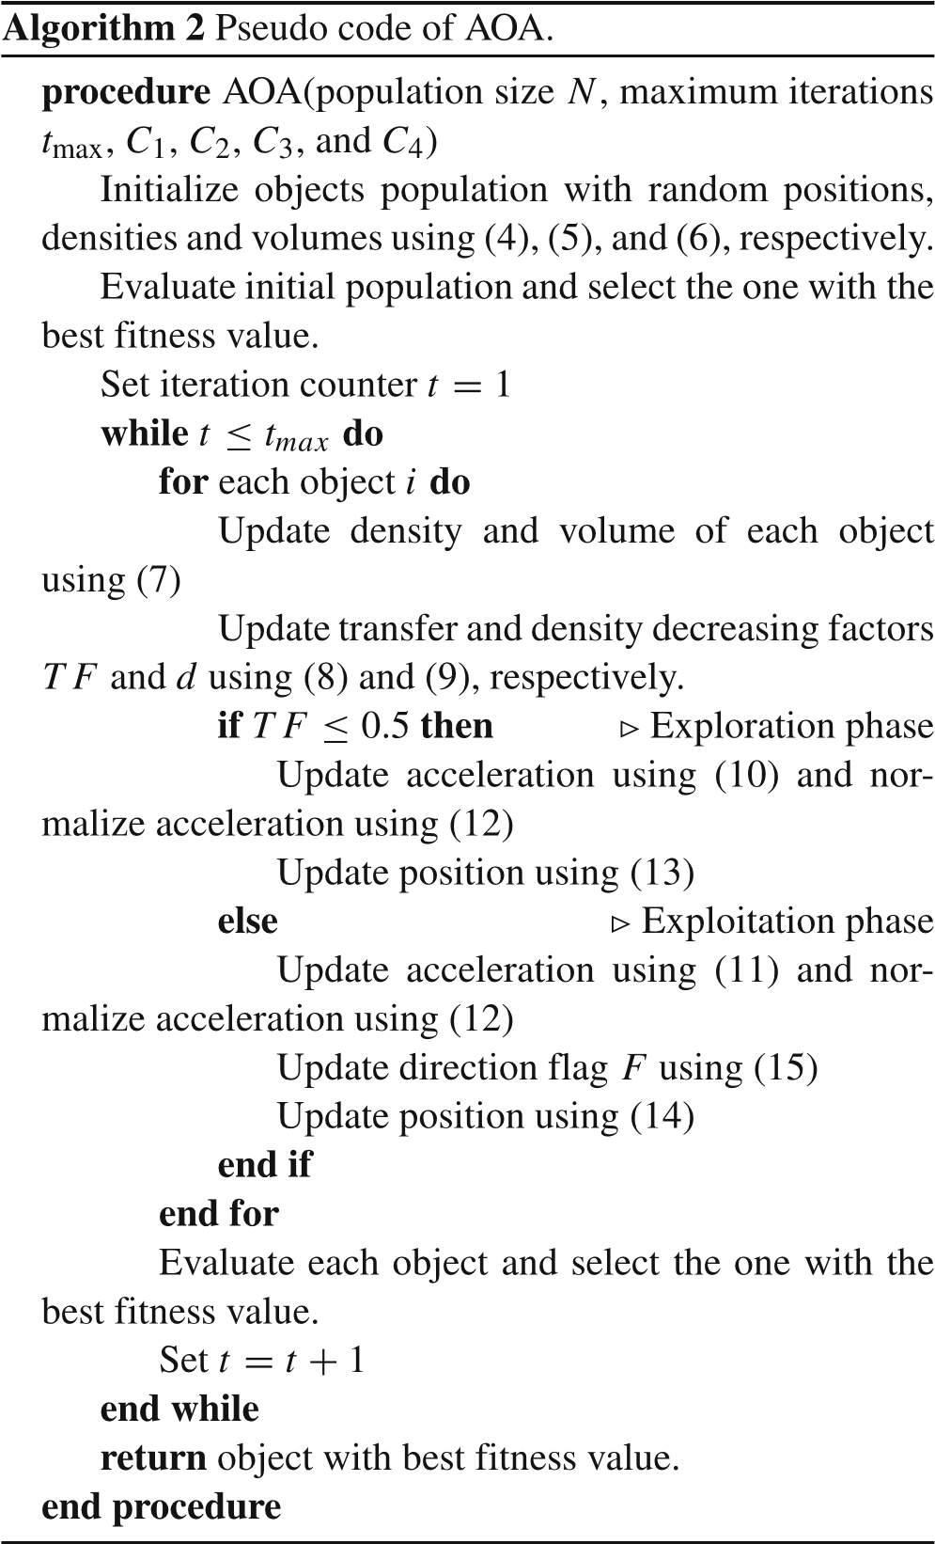
Pseudo code of AOA

Slide 26
CHAPTER 5
APPLICATIONS AND RESULTS

Slide 27
APPLICATIONS AND RESULTS
Test systems
34-bus standard radial distribution system .
East Delta Network (EDN) radial distribution system as a part of the Unified Egyptian Network (UEN).
Objective functions
Total power loss minimization
Total voltage deviation minimization

Slide 28
APPLICATIONS AND RESULTS
Case Studies
Case 0: Without DGs and capacitors (i.e., the BFS algorithm results).
Case 1: With only DGs operating at unity power factor (p.f.)
Case 2: With only DGs operating at p.f. = 0.9, means that active and reactive power injections.
Case 3: With only capacitors, means that only reactive power injections.
Case 4: with both DGs at unity power factor and capacitors.
Case 5: with DGs at power factor .9 and capacitors

Slide 29
APPLICATIONS AND RESULTS
Assumption and limits
The minimum and maximum limits of DG active power are 500 and 2000 kW, respectively.
The minimum and maximum limits of capacitors are 150 and 2000 kVAR, respectively.
The operating p.f. of DGs is unity in case 1, while it is 0.9 in cases 2 and 5.
The minimum and maximum limits of voltage magnitude are 0.95 and 1.05 p.u., respectively.
The maximum number of DGs possible locations (N_{DG}^{max}) is 4.
The maximum number of capacitors possible locations (N_{C}^{max}) is 4.
The maximum limit of the power of all DGs is 4000 kW
The maximum limit of the power of all capacitors is 4000 kVAR

Slide 30
Results and Comments
Total power loss minimization for IEEE-34 system (case 1)
Items | Un-compensated (Case 0) | Compensated (Case 1)
 |  | DPS [10] |  | Analytical Method [11] |  | MBFO [12] |  | GA [13] |  | Proposed procedure
Optimal locations and sizes of DGs (kW) | - | 27 | 2500 | 21 | 2884.8 | 21 | 2951.7 | 4 | 500 | 23 | 1847.5
 |  | - | - | - | - | - | - | 7 | 500 | 31 | 1152.5
 |  | - | - | - | - | - | - | 17 | 500 | - | -
 |  | - | - | - | - | - | - | 21 | 500 | - | -
 |  | - | - | - | - | - | - | 25 | 500 | - | -
 |  | - | - | - | - | - | - | 28 | 500 | - | -
Total size | - | 2500 |  | 2884.8 |  | 2951.7 |  | 3000 |  | 3000
Total losses (kW) | 221.752 | 118.8 |  | 93.838 |  | 93.751 |  | 83.84 |  | 74.416
TVD | 0.0483 | 0.0086 |  | 0.0079 |  | 0.0074 |  | 0.0108 |  | 0.0046
Minimum bus voltage(p.u.) | 0.9417 (#27) | 0.9750 (#34) |  | 0.9773 (#34) |  | 0.9777 (#34) |  | 0.9723 (#27) |  | 0.9832 (#27)
Maximum bus voltage(p.u.) | 0.9941 (#2) | 1.0034 (#27) |  | 0.9971 (#2) |  | 0.9971 (#2) |  | 0.9972 (#2) |  | 0.9972 (#2)
Overall power factor | 0.85 | 0.5967 |  | 0.5205 |  | 0.5058 |  | 0.4949 |  | 0.4949

Slide 31
Results and Comments
Total power loss minimization for IEEE-34 system (case 2)
Items | Un-compensated (Case 0) | Compensated (Case 2)
 |  | Analytical Approach [18] |  |  | Proposed procedure
Optimal locations and sizes of DGs (kW, kVAR) | - | Locations | DG Size (kW) | - | Locations | DG size (kW)
 |  | 20 | 3231.8 | - | 23 | 1863.3
 |  | - | - | - | 10 | 1136.7
 |  | - | - | -
Total size | - | - | 3231.8 | - | - | 3000
Total losses (kW) | 221.752 | 49.415 |  |  | 25.348
TVD | 0.0483 | 0.004 |  |  | 0.0023
Minimum bus voltage(p.u.) | 0.9417 (#27) | 0.9832 (#34) |  |  | 0. 9888 (#27)
Maximum bus voltage(p.u.) | 0.9941 (#2) | 1.0015 (#20) |  |  | 0.9978 (#2)
Overall power factor | 0.85 | 0.85 |  |  | 0. 7552

Slide 32
Results and Comments
Total power loss minimization for IEEE-34 system (case 3)
Items | Un-compensated (Case 0) | Compensated (Case 3)
 |  | PGSA [14] |  | BFA [15] |  | GA [16] |  | APSO [17] |  | Proposed procedure
Optimal locations and sizes of capacitors (kVAR) | - | 19 | 1200 | 9 | 600 | 7 buses | 1629 | 19 | 1050 | 18 | 896.88
 |  | 20 | 200 | 22 | 900 |  |  | 25 | 750 | 9 | 758.562
 |  | 22 | 639 | - | - |  |  | - | - | 24 | 862.755
Total size | - | 2039 |  | 1500 |  | 1629 |  | 1800 |  | 2482.5
Total losses (kW) | 221.752 | 169.167 |  | 169.07 |  | 168.955 |  | 168.023 |  | 160.4252
TVD | 0.0483 | 0.0368 |  | 0.0394 |  | 0.0408 |  | 0.0375 |  | 0.0344
Minimum bus voltage(p.u.) | 0.9417 (#27) | 0.9492 (#27) |  | 0.9503 (#27) |  | 0.9491 (#27) |  | 0.9416 (#27) |  | 0.9503 (#27)
Maximum bus voltage(p.u.) | 0.9941 (#2) | 0.995 (#2) |  | 0.9948 (#2) |  | 0.9948 (#2) |  | 0.9949 (#2) |  | 0.9952 (#2)
Overall power factor | 0.85 | 0.9842 |  | 0.9588 |  | 0.9658 |  | 0.9738 |  | 0.9965

Slide 33
Results and Comments
Total power loss minimization for IEEE-34 system (case 4)
Items | Un-compensated (Case 0) | Compensated (Case 4)
 |  | Proposed procedure
Optimal locations and sizes of DGs (KW) | - | 9 |  | 952.8
 |  | 21 |  | 1125.5
 |  | 25 |  | 921.6
Total DGs size |  | 3000
Optimal locations and sizes of capacitors (KVAR) |  | 7 | 1110.4
 |  | 24 | 816.6
Total capacitors size | - | 1927
Total losses (kW) | 221.752 | 18.15
TVD | 0.0483 | 0.0023
Minimum bus voltage(p.u.) | 0.9417 (#27) | 0.9892 (#33)
Maximum bus voltage(p.u.) | 0.9941 (#2) | 0.998 (#2)
Overall power factor | 0.85 | 0.8656

Slide 34
Results and Comments
Total power loss minimization for IEEE-34 system (case 5)
Items | Base case | Case 5
 |  | FPA [9] | Proposed method
DG size (kW, kVAR) and location | - | 2086, 1292.8 (#26) | 799.3, 387.09 (#31), 946.5, 458.37 (#24), 1254.2, 607.39 (#21)
Capacitor size (kVAR) and location | - | 1250 (#26) | 365.568 (#8)
Total size of DGs (kW, kVAR) | - | 2086, 1292.8 | 3000, 1452.86
Total size of capacitors (kVAR) | - | 1250 | 1112.9
f₁ [Loss (kW)] | 221.752 | 58.8298 | 17.1153
TVD | 0.0483 | 0.007 | 0.0021
Min. voltage (p.u.) | 0.9417 (#27) | 0.9751 (#34) | 0.99 (#12)
Overall p.f. | 0.85 | 0.8436 | 0.8405

Slide 35
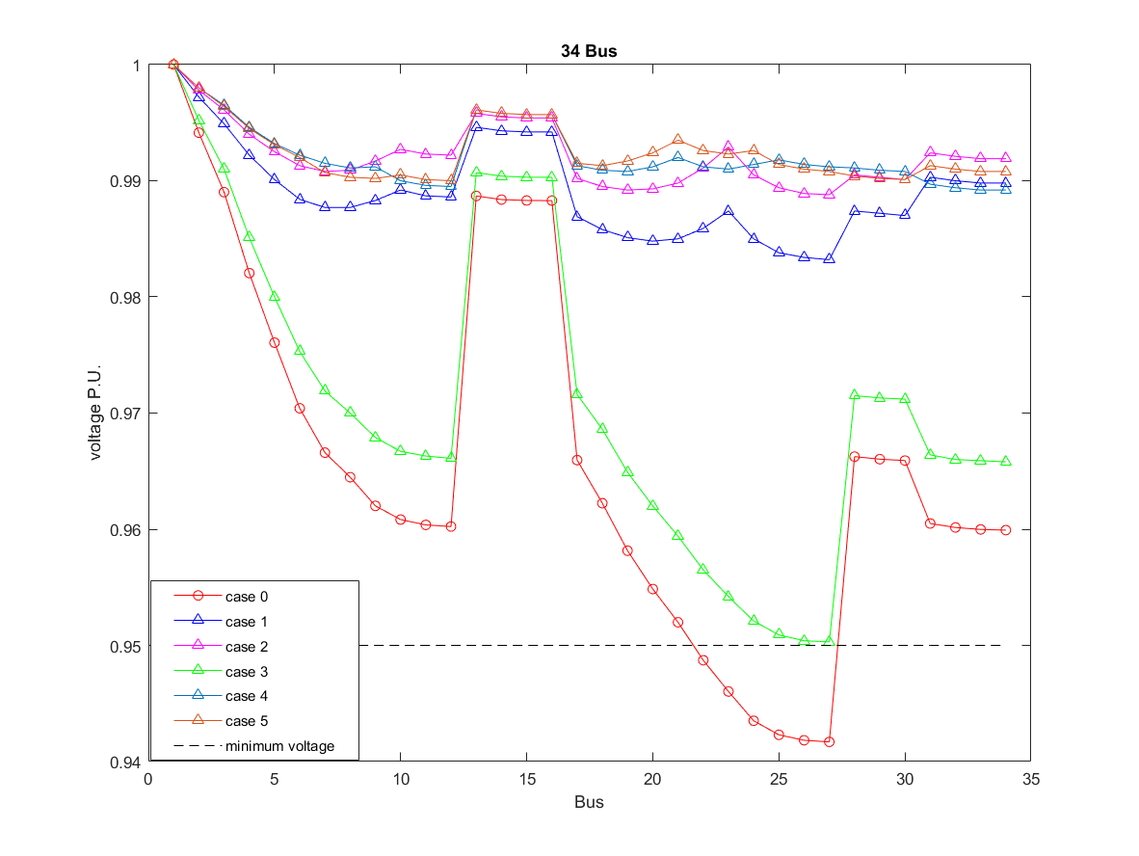
Results and Comments
Total power loss minimization for IEEE-34 system (Voltage profile)

Slide 36
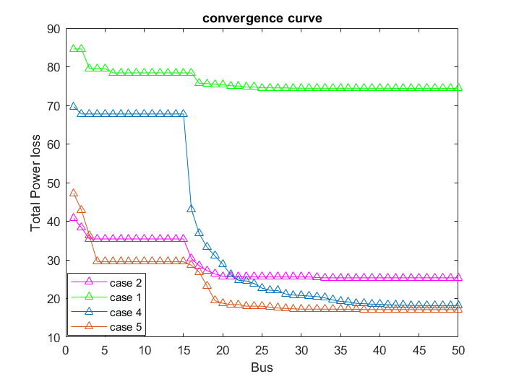
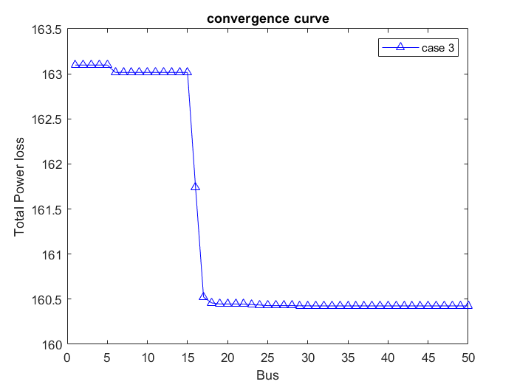
Results and Comments
Total power loss minimization for IEEE-34 system (convergence curves)

Slide 37
Results and Comments
Total power loss minimization for EDN system (case 1)
Items | Un-compensated (Case 0) | Compensated (Case 1)
Optimal locations and sizes of DGs (kW) | - | 21 | 1999.9
 |  | 25 | 2000
Total size | - | 3999.9
Total losses (kW) | 805.73 | 542.459
TVD | 0.0439 | 0.0225
Minimum bus voltage(p.u.) | 0.9463 (#30) | 0.9669 (#23)
Maximum bus voltage(p.u.) | 0.9854 (#2) | 0.9874 (#2)
Overall power factor | 0.8457 | 0.7932

Slide 38
Results and Comments
Total power loss minimization for EDN system (case 2)
Items | Un-compensated (Case 0) | Compensated (Case 2)
Optimal locations and sizes of DGs (kW) | - | Locations | DG size (kW)
 |  | 25 | 2000
 |  | 21 | 2000
Total size | - | - | 4000
Total losses (kW) | 805.73 | 458.85
TVD | 0.0439 | 0.0193
Minimum bus voltage(p.u.) | 0.9463 (#30) | 0. 9699 (#23)
Maximum bus voltage(p.u.) | 0.9854 (#2) | 0.9879 (#2)
Overall power factor | 0.8457 | 0.8335

Slide 39
Results and Comments
Total power loss minimization for EDN system (case 3)
Items | Un-compensated (Case 0) | Compensated (Case 3)
Optimal locations and sizes of capacitors (kVAR) | - | 26 | 963.8
 |  | 21 | 1198.9
 |  | 8 | 782.9
 |  | 18 | 1054.4
Total size | - | 4000
Total losses (kW) | 805.73 | 673.69
TVD | 0.0439 | 0.036
Minimum bus voltage(p.u.) | 0.9463 (#30) | 0.9521 (#30)
Maximum bus voltage(p.u.) | 0.9854 (#2) | 0.9865 (#2)
Overall power factor | 0.8457 | 0.9108

Slide 40
Results and Comments
Total power loss minimization for EDN system (case 4)
Items | Un-compensated (Case 0) | Compensated (Case 4)
 |  | Proposed procedure
Optimal locations and sizes of DGs (KW) | - | 22 |  | 1458.3
 |  | 25 |  | 1374.3
 |  | 18 |  | 1167.4
Total DGs size |  | 4000
Optimal locations and sizes of capacitors (KVAR) |  | 11 | 495.3
 |  | 25 | 1162.6
Total capacitors size | - | 1657.9
Total losses (kW) | 805.73 | 474.879
TVD | 0.0439 | 0.0208
Minimum bus voltage(p.u.) | 0.9463 (#30) | 0.9682 (#24)
Maximum bus voltage(p.u.) | 0.9854 (#2) | 0.9879 (#2)
Overall power factor | 0.8457 | 0.8277

Slide 41
Results and Comments
Total power loss minimization for EDN system (case 5)
Items | Base case | Case 5
 |  | Proposed method
DG size (kW, kVAR) and location | - | 687.7, 333.05 (#23), 1873.1, 907.19 (#21), 1439.2, 697.02 (#26)
Capacitor size (kVAR) and location | - | 1200 (#18) 630.8 (#4)
Total size of DGs (kW, kVAR) | - | 4000, 1937.156
Total size of capacitors (kVAR) | - | 1830.8
f₁ [Loss (kW)] | 805.73 | 411.4659
TVD | 0.0439 | 0.0180
Min. voltage (p.u.) | 0.9463 (#30) | 0.9714 (#24)
Overall p.f. | 0.8457 | 0.8711

Slide 42
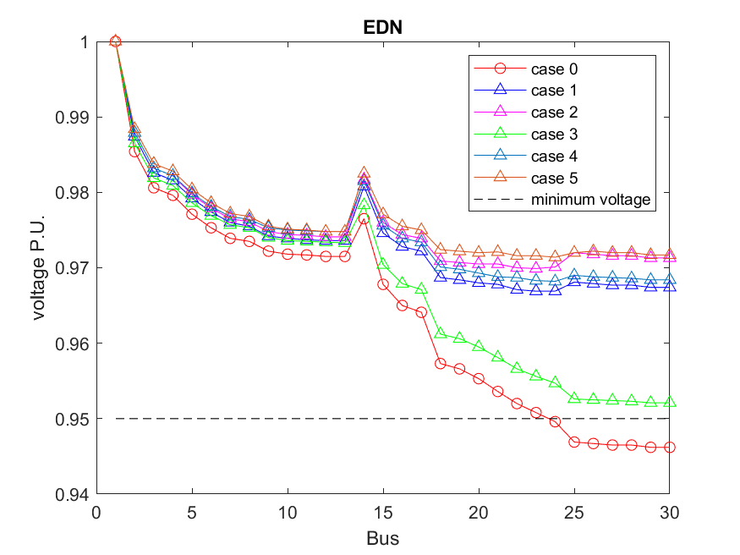
Results and Comments
Total power loss minimization for EDN system (voltage profile)

Slide 43
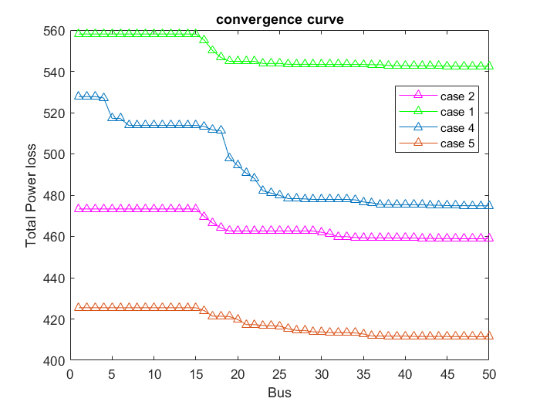
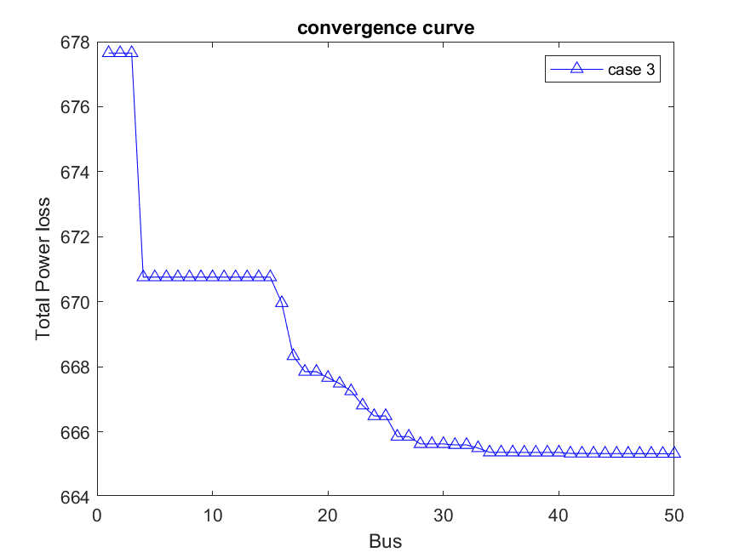
Results and Comments
Total power loss minimization for EDN system (convergence curves)

Slide 44
Results and Comments
TVD minimization for IEEE-34 system (case 1)
Items | Un-compensated (Case 0) | Compensated (Case 1)
 |  | Proposed procedure
Optimal locations and sizes of DGs (kW) | - | 26 | 1951.4
 |  | 32 | 1548.6
Total size | - | 3500
Total losses (kW) | 221.752 | 82.9864
TVD | 0.0483 | 0.0017
Minimum bus voltage(p.u.) | 0.9417 (#27) | 0.9883 (#20)
Maximum bus voltage(p.u.) | 0.9941 (#2) | 0.9977 (#2)
Overall power factor | 0.85 | 0.3678

Slide 45
Results and Comments
TVD minimization for IEEE-34 system (case 2)
Items | Un-compensated (Case 0) | Compensated (Case 2)
 |  | Proposed procedure
Optimal locations and sizes of DGs (kW, kVAR) | - | Locations | DG size (kW)
 |  | 31 | 1500.1
 |  | 24 | 1999.9
Total size | - | - | 3500
Total losses (kW) | 221.752 | 24.32
TVD | 0.0483 | 0. 000496
Minimum bus voltage(p.u.) | 0.9417 (#27) | 0. 9932 (#19)
Maximum bus voltage(p.u.) | 0.9941 (#2) | 1.0013 (#24)
Overall power factor | 0.85 | 0. 6942

Slide 46
Results and Comments
TVD minimization for IEEE-34 system (case 3)
Items | Un-compensated (Case 0) | Compensated (Case 3)
 |  | Proposed procedure
Optimal locations and sizes of capacitors (kVAR) | - | 11 | 1200
 |  | 10 | 1199
 |  | 26 | 1200
Total size | - | 3599.9
Total losses (kW) | 221.752 | 202.691
TVD | 0.0483 | 0.0295
Minimum bus voltage(p.u.) | 0.9417 (#27) | 0.9532(#27)
Maximum bus voltage(p.u.) | 0.9941 (#2) | 0.9956 (#2)
Overall power factor | 0.85 | 0.9879

Slide 47
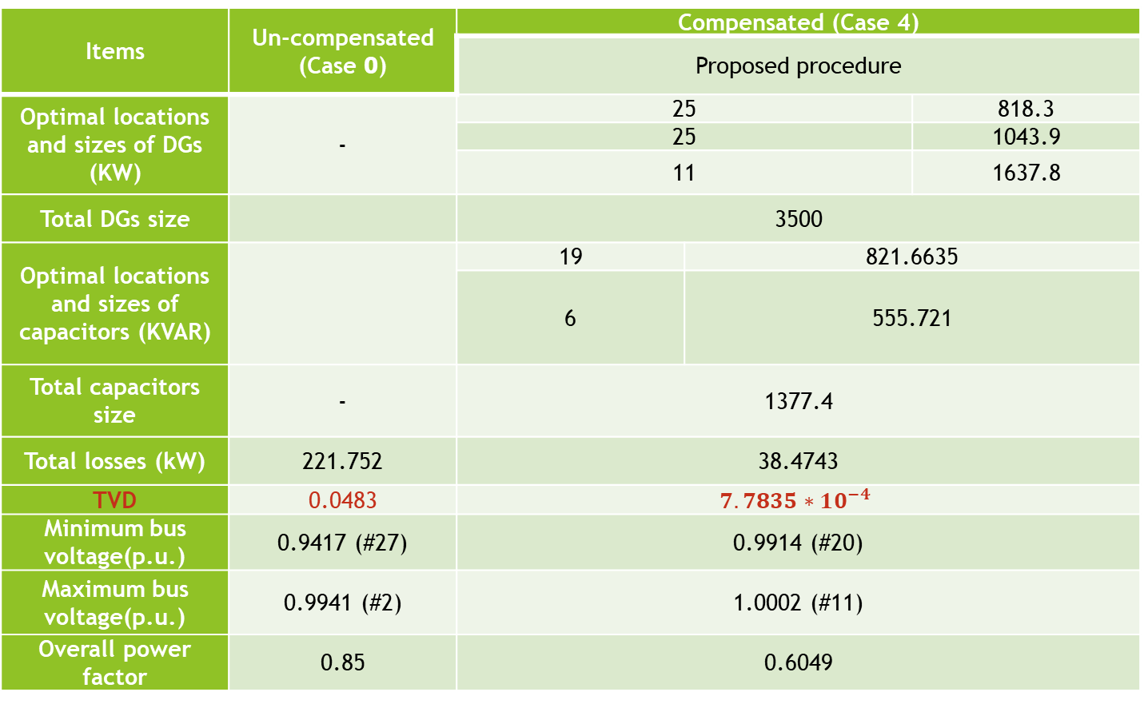
Results and Comments
TVD minimization for IEEE-34 system (case 4)
Items | Un-compensated (Case 0) | Compensated (Case 4)
 |  | Proposed procedure
Optimal locations and sizes of DGs (KW) | - | 25 |  | 818.3
 |  | 25 |  | 1043.9
 |  | 11 |  | 1637.8
Total DGs size |  | 3500
Optimal locations and sizes of capacitors (KVAR) |  | 19 | 821.6635
 |  | 6 | 555.721
Total capacitors size | - | 1377.4
Total losses (kW) | 221.752 | 38.4743
TVD | 0.0483 | $$7.7835∗10^{−4}$$
Minimum bus voltage(p.u.) | 0.9417 (#27) | 0.9914 (#20)
Maximum bus voltage(p.u.) | 0.9941 (#2) | 1.0002 (#11)
Overall power factor | 0.85 | 0.6049

Slide 48
Results and Comments
TVD minimization for IEEE-34 system (case 5)
Items | Base case | Case 5
 |  | Proposed method
DG size (kW, kVAR) and location | - | 1166.4, 564.8893 (#10), 993.1, 480.9892(#20), 1340.5, 649.2350 (#25)
Capacitor size (kVAR) and location | - | 1059.4 (#17)
Total size of DGs (kW) | - | 3500
Total size of capacitors (kVAR) | - | 1059.4
f1 [Loss (kW)] | 221.752 | 9.2909
TVD | 0.0483 | 2.3238e-04
Min. voltage (p.u.) | 0.9417 (#27) | 0.9955(#30)
Overall p.f. | 0.85 | 0.9946

Slide 49
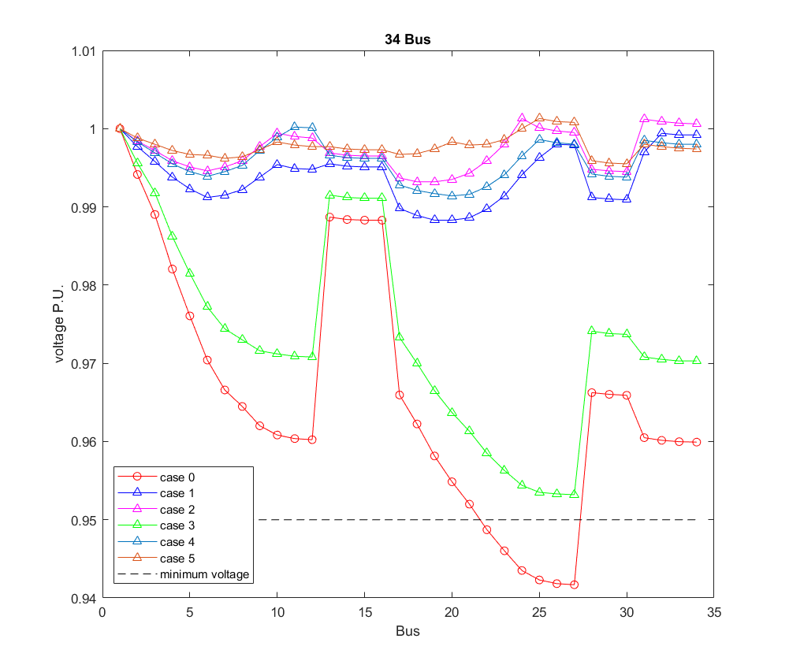
Results and Comments
TVD minimization for IEEE-34 system (voltage profile)

Slide 50
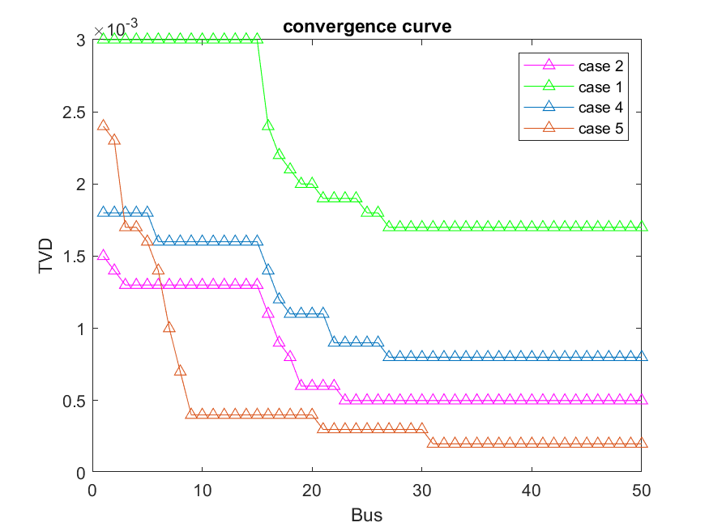
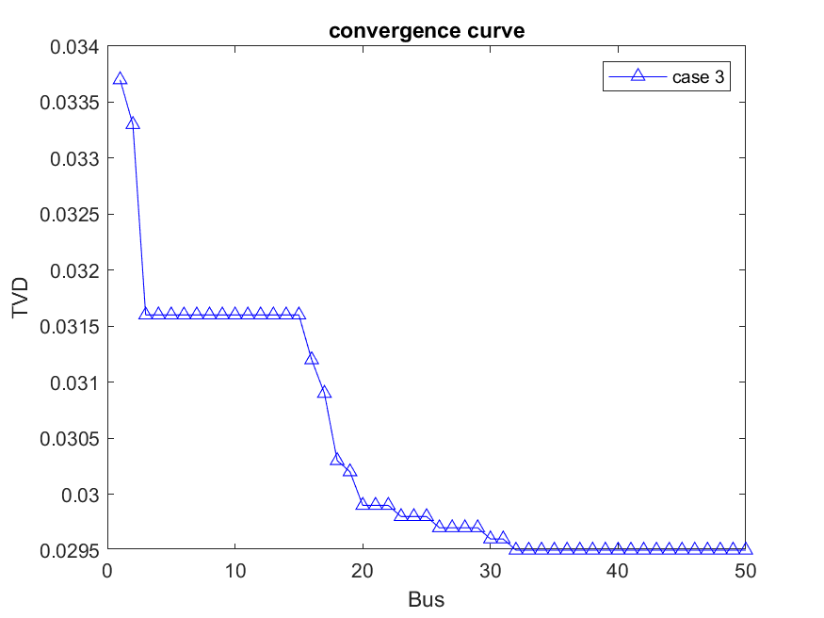
Results and Comments
TVD minimization for IEEE-34 system (convergence curves)

Slide 51
Results and Comments
TVD minimization for EDN system (case 1)
Items | Un-compensated (Case 0) | Compensated (Case 1)
Optimal locations and sizes of DGs (kW) | - | 26 | 1999.9
 |  | 29 | 2000
Total size | - | 3999.9
Total losses (kW) | 805.73 | 572.0918
TVD | 0.0439 | 0.0193
Minimum bus voltage(p.u.) | 0.9463 (#30) | 0.9677 (#21)
Maximum bus voltage(p.u.) | 0.9854 (#2) | 0.9874 (#2)
Overall power factor | 0.8457 | 0.7932

Slide 52
Results and Comments
TVD minimization for EDN system (case 2)
Items | Un-compensated (Case 0) | Compensated (Case 2)
Optimal locations and sizes of DGs (kW) | - | Locations | DG size (kW)
 |  | 28 | 1999.7
 |  | 28 | 1999.3
Total size | - | - | 3999
Total losses (kW) | 805.73 | 491.164
TVD | 0.0439 | 0.0163
Minimum bus voltage(p.u.) | 0.9463 (#30) | 0. 9703 (#20)
Maximum bus voltage(p.u.) | 0.9854 (#2) | 0.9879 (#2)
Overall power factor | 0.8457 | 0.8335

Slide 53
Results and Comments
TVD minimization for EDN system (case 3)
Items | Un-compensated (Case 0) | Compensated (Case 3)
Optimal locations and sizes of capacitors (kVAR) | - | 25 | 441.5
 |  | 26 | 1198.3
 |  | 29 | 1194.8
 |  | 29 | 1165.4
Total size | - | 4000
Total losses (kW) | 805.73 | 712.8063
TVD | 0.0439 | 0.0326
Minimum bus voltage(p.u.) | 0.9463 (#30) | 0.9572 (#24)
Maximum bus voltage(p.u.) | 0.9854 (#2) | 0.9865 (#2)
Overall power factor | 0.8457 | 0.9108

Slide 54
Results and Comments
TVD minimization for EDN system (case 4)
Items | Un-compensated (Case 0) | Compensated (Case 4)
 |  | Proposed procedure
Optimal locations and sizes of DGs (KW) | - | 29 | 1143.6
 |  | 29 | 1221
 |  | 27 | 1635.3
Total DGs size |  | 4000
Optimal locations and sizes of capacitors (KVAR) |  | 9 | 839.864
 |  | 27 | 467.45
Total capacitors size | - | 1307
Total losses (kW) | 805.73 | 531.637
TVD | 0.0439 | 0.0177
Minimum bus voltage(p.u.) | 0.9463 (#30) | 0.9686 (#21)
Maximum bus voltage(p.u.) | 0.9854 (#2) | 0.9877 (#2)
Overall power factor | 0.8457 | 0.8204

Slide 55
Results and Comments
TVD minimization for EDN system (case 5)
Items | Base case | Case 5
 |  | Proposed method
DG size (kW, kVAR) and location | - | 730.3, 353.722 (#23), 1026.6, 497.208 (#25), 2000, 968.62 (#29)
Capacitor size (kVAR) and location | - | 419.131 (#7) 382.583 (#24)
Total size of DGs (kW) | - | 3756.9
Total size of capacitors (kVAR) | - | 801.7141
f1 [Loss (kW)] | 805.73 | 469.8317
TVD | .0439 | 0.017
Min. voltage (p.u.) | 0.9463 (#30) | 0.9701 (#20)
Overall p.f. | 0.8457 | 0.8508

Slide 56
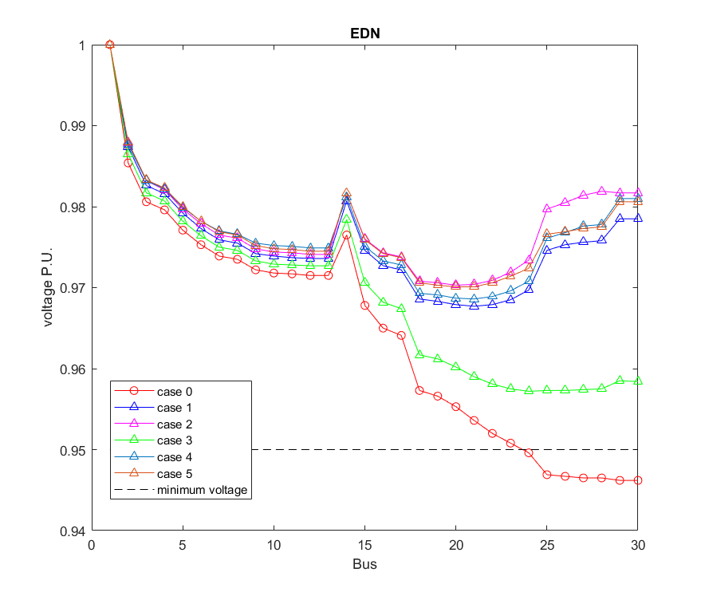
Results and Comments
TVD minimization for EDN system (voltage profile)

Slide 57
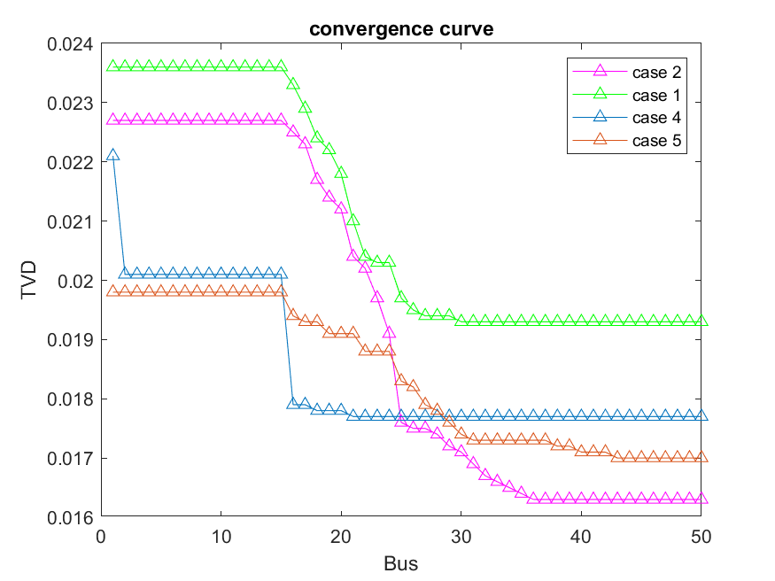
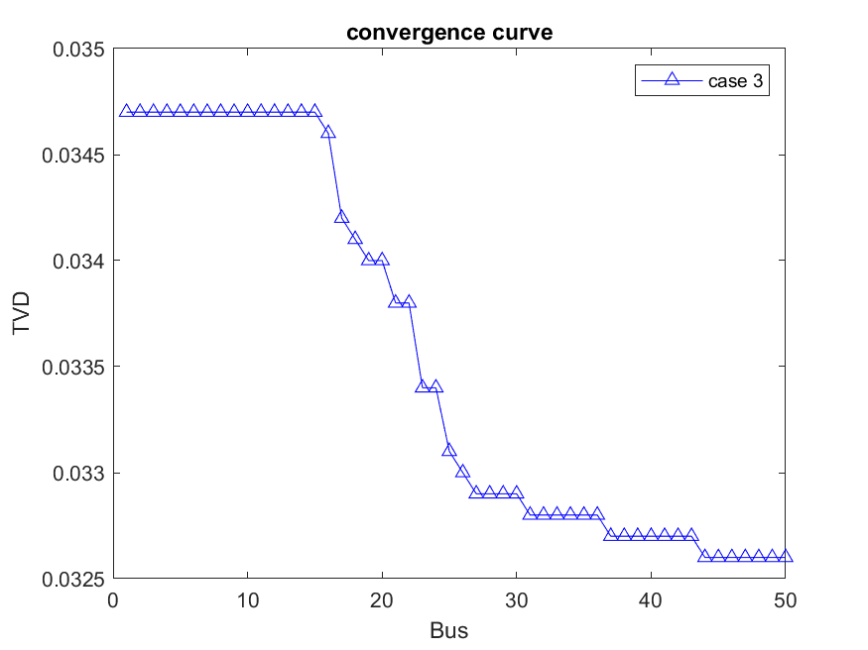
Results and Comments
TVD minimization for EDN system (convergence curve)

Slide 58
CONCLUSIONS

Slide 59
CONCLUSIONS
Efficient and accurate proposed procedure has been introduced to find the optimal placement of DGs and capacitors using AOA compared with other techniques.
The optimal results using the proposed procedure have been compared with other methods and have proved the capability of the proposed procedure to find the optimal solution of the objective function with voltage profile and power factor improvement.
AOA gives convergence curve with more accurate and efficient optimal placement of DGs and capacitors in distribution systems.
The proposed AOA mathematical model is very simple since it has few parameters.
The BFS load flow algorithm has been used successfully for the load flow calculations.
The proposed procedure represents a potential tool to reduce the system losses and improve the voltage profile.

Slide 60
CONCLUSIONS
The proposed procedure has been tested on 34-bus radial distribution system. Moreover, a real distribution system of the East Delta Network (EDN) as a part of the UEN has been used to show the capability of proposed procedure.
the proposed procedure represents a potential tool to improve the distribution system performance as well as help the system operators.

Slide 61
APPENDIX - A
TEST SYSTEMS

Slide 62
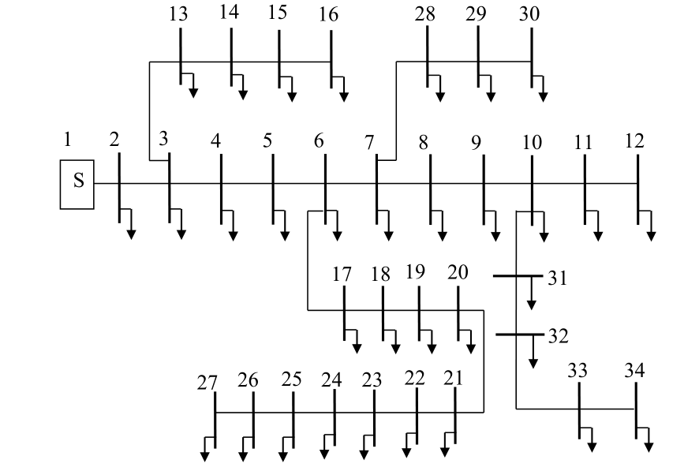
TEST SYSTEMS
34-Bus Distribution System

Slide 63
Lines data for 34-bus distribution system
Line No. | Sending bus | Receiving bus | R (Ω) | X (Ω)
1 | 1 | 2 | 0.1170 | 0.0480
2 | 2 | 3 | 0.1073 | 0.0440
3 | 3 | 4 | 0.1645 | 0.0457
4 | 4 | 5 | 0.1495 | 0.0415
5 | 5 | 6 | 0.1495 | 0.0415
6 | 6 | 7 | 0.3144 | 0.0540
7 | 7 | 8 | 0.2096 | 0.0360
8 | 8 | 9 | 0.3144 | 0.0540
9 | 9 | 10 | 0.2096 | 0.0360
10 | 10 | 11 | 0.1310 | 0.0225
11 | 11 | 12 | 0.1048 | 0.0180
12 | 3 | 13 | 0.1572 | 0.0270
13 | 13 | 14 | 0.2096 | 0.0360
14 | 14 | 15 | 0.1048 | 0.0180
15 | 15 | 16 | 0.0524 | 0.0090
16 | 6 | 17 | 0.1794 | 0.0498
17 | 17 | 18 | 0.1645 | 0.0457
18 | 18 | 19 | 0.2079 | 0.0473
19 | 19 | 20 | 0.1890 | 0.0430
20 | 20 | 21 | 0.1890 | 0.0430
21 | 21 | 22 | 0.2620 | 0.0450
22 | 22 | 23 | 0.2620 | 0.0450
23 | 23 | 24 | 0.3144 | 0.0540
24 | 24 | 25 | 0.2096 | 0.0360
25 | 25 | 26 | 0.1310 | 0.0225
26 | 26 | 27 | 0.1048 | 0.0180
27 | 7 | 28 | 0.1572 | 0.0270
28 | 28 | 29 | 0.1572 | 0.0270
29 | 29 | 30 | 0.1572 | 0.0270
30 | 10 | 31 | 0.1572 | 0.0270
31 | 31 | 32 | 0.2096 | 0.0360
32 | 32 | 33 | 0.1572 | 0.0270
33 | 33 | 34 | 0.1048 | 0.0180

Slide 64
Bus data for 34-bus distribution system
Line No. | P (kW) | Q (kVAR)
1 | 0 | 0
2 | 230 | 142.5
3 | 0 | 0
4 | 230 | 142.5
5 | 230 | 142.5
6 | 0 | 0
7 | 0 | 0
8 | 230 | 142.5
9 | 230 | 142.5
10 | 0 | 0
11 | 230 | 142.5
12 | 137 | 84
13 | 72 | 45
14 | 72 | 45
15 | 72 | 45
16 | 13.5 | 7.5
17 | 230 | 142.5
18 | 230 | 142.5
19 | 230 | 142.5
20 | 230 | 142.5
21 | 230 | 142.5
22 | 230 | 142.5
23 | 230 | 142.5
24 | 230 | 142.5
25 | 230 | 142.5
26 | 230 | 142.5
27 | 137 | 85
28 | 75 | 48
29 | 75 | 48
30 | 75 | 48
31 | 57 | 34.5
32 | 57 | 34.5
33 | 57 | 34.5
34 | 57 | 34.5

Slide 65
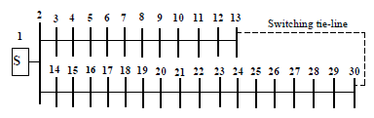
East Delta Network (EDN) System
Single line diagram of the EDN distribution system

Slide 66
Buses and lines data for EDN distribution system
Line No. | Sending bus | Receiving bus | R (Ω) | X (Ω) | Load at Receiving bus
 |  |  |  |  | P (kW) | Q (kVAR)
1 | 1 | 2 | 0.05630 | 0.031500 | 2875 | 1814
2 | 2 | 3 | 0.07155 | 0.025974 | 1100 | 695
3 | 3 | 4 | 0.01855 | 0.006734 | 1058 | 669
4 | 4 | 5 | 0.05565 | 0.020202 | 899 | 568
5 | 5 | 6 | 0.05300 | 0.019240 | 770 | 486
6 | 6 | 7 | 0.05300 | 0.019240 | 668 | 423
7 | 7 | 8 | 0.02120 | 0.007696 | 598 | 378
8 | 8 | 9 | 0.10070 | 0.036556 | 546 | 345
9 | 9 | 10 | 0.04505 | 0.016354 | 380 | 240
10 | 10 | 11 | 0.03975 | 0.014430 | 210 | 132
11 | 11 | 12 | 0.11130 | 0.040404 | 94.586 | 59.368
12 | 12 | 13 | 0.01325 | 0.004810 | 34.423 | 21.518
13 | 2 | 14 | 0.06360 | 0.023088 | 1772 | 1118
14 | 14 | 15 | 0.07155 | 0.025974 | 1640 | 1035
15 | 15 | 16 | 0.02650 | 0.009620 | 1452 | 915
16 | 16 | 17 | 0.01060 | 0.003848 | 1434 | 904
17 | 17 | 18 | 0.09275 | 0.033670 | 1212 | 765
18 | 18 | 19 | 0.01060 | 0.003848 | 1086 | 685
19 | 19 | 20 | 0.02650 | 0.009620 | 953 | 602
20 | 20 | 21 | 0.04505 | 0.016354 | 827 | 521
21 | 21 | 22 | 0.05300 | 0.019240 | 716 | 452
22 | 22 | 23 | 0.05300 | 0.019240 | 550 | 347
23 | 23 | 24 | 0.0663 | 0.0240 | 434 | 273
24 | 24 | 25 | 0.2253 | 0.0818 | 346 | 218
25 | 25 | 26 | 0.0265 | 0.0096 | 316 | 199
26 | 26 | 27 | 0.0265 | 0.0096 | 184 | 116
27 | 27 | 28 | 0.0133 | 0.0048 | 139 | 87.911
28 | 28 | 29 | 0.1723 | 0.0625 | 113 | 71.734
29 | 29 | 30 | 0.0080 | 0.0029 | 34.25 | 21.734

Slide 67
APPENDIX - B
BACKWARD/FORWARD
SWEEP ALGORITHM

Slide 68
The BFS algorithm involves mainly an iterative three basic steps
The three steps
the nodal current calculation,
the backward sweep
the forward sweep
The BFS algorithm
Step 1: Initialization
The distribution system line and load data.
The base power and base voltage.
Calculate the base impedance.
Calculate the per unit values of line and load data.
Take the voltage for all buses flat voltage (1 p.u.).
Set convergence tolerance Є=0.0001 and ΔV_{max} = 0.

Slide 69


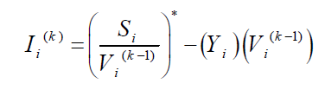
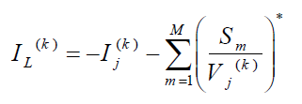
Step 2: Radial distribution system numbering scheme
Step 3: Nodal current calculation
Step 4: Backward sweep

Slide 70


Step 5: Forward sweep
Step 6: Check the voltage mismatches
Step 7: Check stopping criterion
Step 8: Power loss calculation

Slide 71
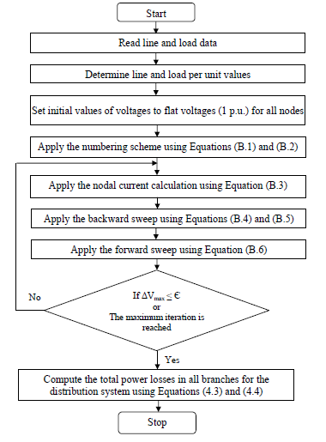
Flow chart of BFS algorithm

Slide 72
Thank You

