Slide 1


PROJECT 2 · EXCEL & POWER PIVOT
Global Sales &
Financial Performance
A Business Analytics Dashboard Project
Egyptian Russian University · Faculty of Management, Economics and Business Technology
Dr. Rowaida Ali · TA: Nouran Amr
01 / 17

Slide 2








OVERVIEW
What We'll Cover
01
02
Business Problem & Objectives
Business Questions
03
04
Dataset Overview
Data Cleaning & Preparation
05
06
Data Modeling · Power Pivot
The Dashboard
07
08
Key Findings
Insights & Recommendations
02 / 17

Slide 3
BUSINESS PROBLEM
One Company, Many Signals — No Single View of Profit
Adidas' retail performance is spread across multiple regions, retailers, sales channels, and product lines. Sales, marketing, and finance teams can each see a piece of the picture — but no one has a single, reliable view of which products, regions, and channels actually drive profit, not just revenue.
6
5
6
3
2020–2021
Product Categories
Regions
Retailers
Sales Channels
Years of Data
03 / 17

Slide 4
OBJECTIVES & BUSINESS QUESTIONS
What We Set Out to Answer
Objective: Build an interactive Excel dashboard using Power Pivot and PivotTables to analyze Adidas' sales, profit, and margin performance — and turn that analysis into clear, actionable recommendations.
1
Which product category generates the highest sales and profit?
2
Which region and retailer perform best — and worst?
3
How does performance change from month to month?
4
Which sales channel (Online, Outlet, In-Store) is most profitable?
5
What factors are associated with higher profit margin?
6
Where should management focus improvement efforts?
04 / 17

Slide 5
DATASET OVERVIEW
9,641 Transactions Across the US Retail Network
9,641
14
2 yrs
Dataset Source: Kaggle — Adidas US Sales Dataset
Rows
Columns
Jan 2020 – Dec 2021
FIELD TYPES
Categorical
Retailer, Region, State, City, Product, Sales Method
Numerical
Price per Unit, Units Sold, Total Sales, Operating Profit, Profit Margin, COGS
Date / ID
Invoice Date, Retailer ID
05 / 17

Slide 6

DATA CLEANING & PREPARATION
From Raw Export to Analysis-Ready Table
0
2
9,641
4
Duplicate Records
Missing Values Fixed
Clean Rows Retained
New Date Fields Added
Converted the dataset into a structured Excel Table for consistent referencing
Standardized category text across Region, Retailer, Product, and Sales Method
Verified and corrected data types — dates as Date, currency fields as Number
Extracted Year, Month, Month Name, and Day from Invoice Date for trend analysis
Checked for duplicate records — none found
Removed unnecessary helper columns before loading into the Data Model
Identified 2 missing "Price per Unit" values and handled them
06 / 17

Slide 7
DATA MODELING
Power Pivot Measures Behind Every KPI
The cleaned table was loaded into the Excel Data Model (Power Pivot). Four core DAX measures were built once, then reused across every KPI card and PivotTable in the workbook.
Total Sales Measure
Total Operating Profit
= SUM( Total Sales )
= SUM( Operating Profit )
Total COGS
Average Profit Margin
= SUM( COGS )
= AVERAGE( Profit Margin )
Single fact table — the Dataset is flat and self-contained, so no additional relationships were required.
07 / 17

Slide 8

ANALYSIS
Six PivotTables, One Consistent Set of Measures
PT-KPI
PT-Trend
PT-Product
Overall KPI totals — sales, profit, COGS, margin
Month-by-month trend analysis
Sales, profit & margin by product category
PT-Retailer
PT-Region
PT-TopBottom
Performance breakdown by retailer
Performance breakdown by region
Top & bottom categories by sales, profit, COGS, margin
08 / 17

Slide 9
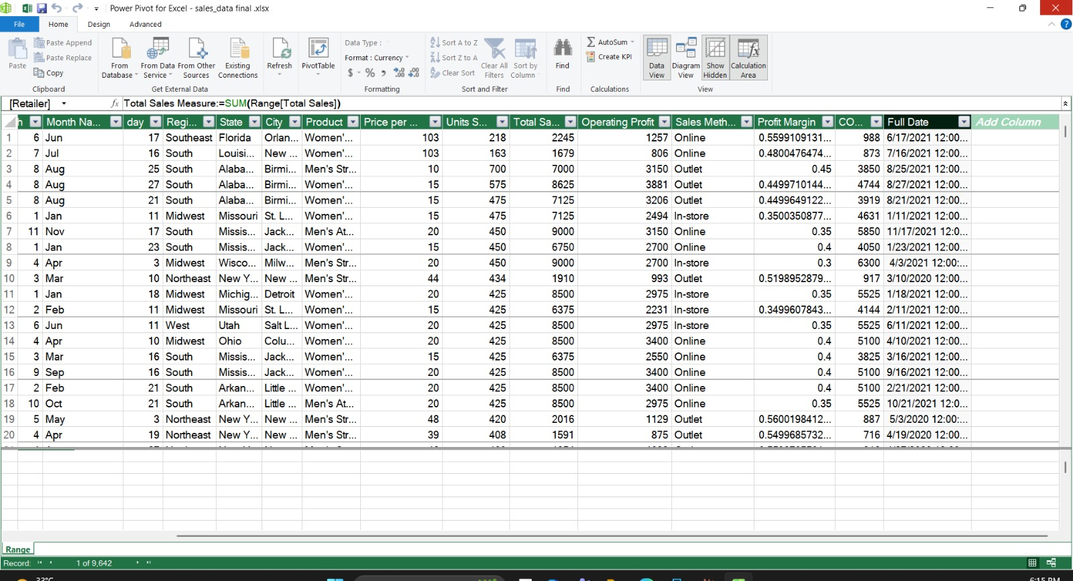
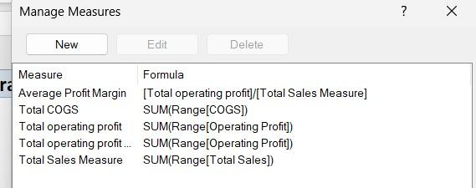
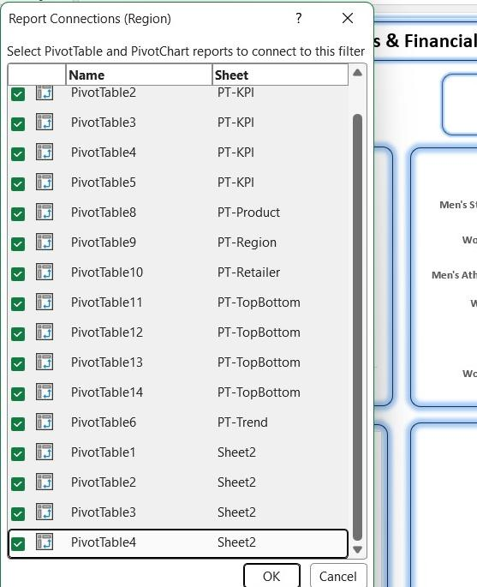
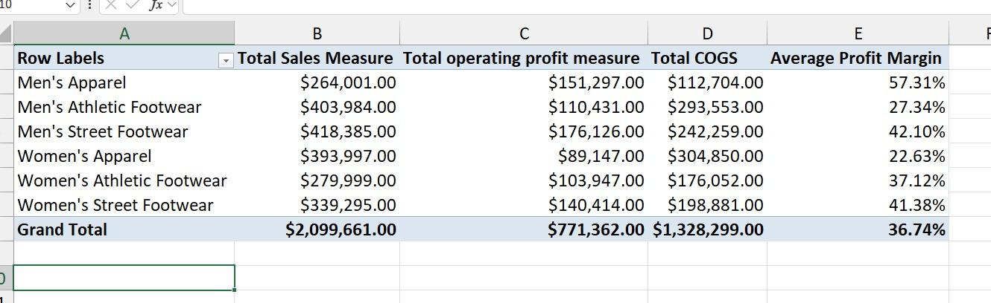
PROOF OF WORK
Inside the Workbook
Power Pivot Data Model
DAX Measures
9,642 transactions loaded into the Data Model with the Total Sales Measure live in the formula bar.
The 4 core measures — Total Sales, Operating Profit, COGS, and Average Profit Margin — built once in Manage Measures.
Slicers Connected Workbook-Wide
PT-Product Output
The Region slicer alone is wired to 16 PivotTables and PivotCharts across every sheet in the workbook.
The actual PivotTable behind our product insights — these are the real numbers, not estimates.
09 / 17

Slide 10
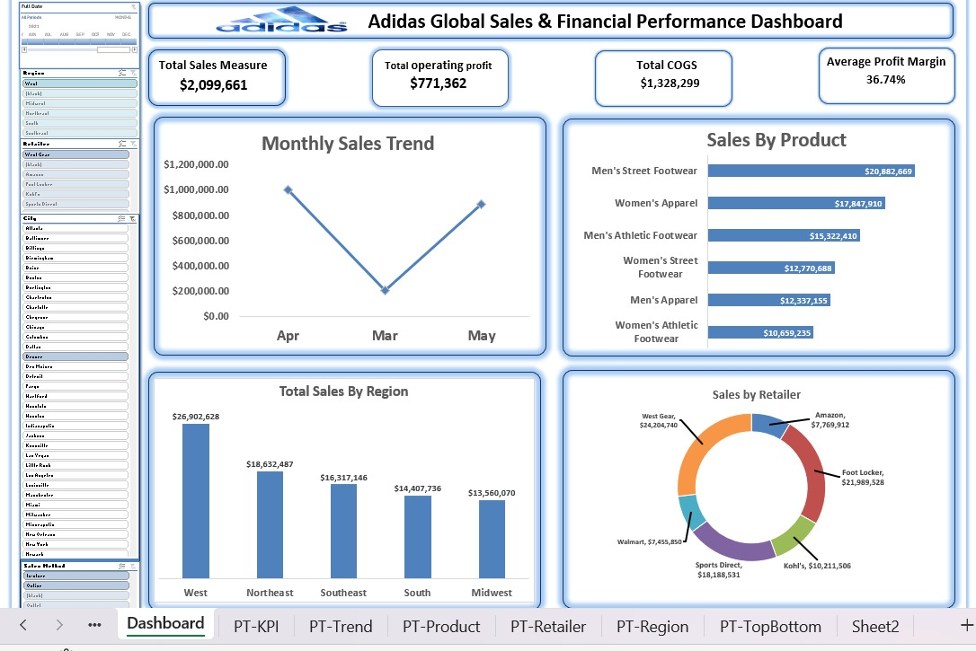
THE DASHBOARD
One Interactive View of Sales & Profit
$2,099,661
Total Sales (Mar–May)
$771,362
Operating Profit
$1,328,299
Total COGS
36.7%
Avg. Profit Margin
KPI cards & trend reflect the Mar–May 2021 filter; product, region & retailer views show full 2020–21 totals.
10 / 17

Slide 11
KEY FINDING · PRODUCT
Footwear Leads Revenue — Apparel Leads Margin
MARGIN LEADERS
Men's Street Footwear
$20.9M sales · #1 in both revenue and profit
Men's Apparel
Only $12.3M in sales, but the highest margin at 57.3%
Women's Apparel
2nd-highest revenue ($17.8M) but the lowest margin, 22.6%
11 / 17

Slide 12
KEY FINDING · REGION & RETAILER
Sales Are Concentrated in the West
West generates $26.9M — nearly double the Midwest's $13.6M. West Gear and Foot Locker together account for over half of all retail sales, while Walmart and Amazon lag well behind.
12 / 17

Slide 13
KEY FINDING · SALES CHANNEL
Volume and Profitability Don't Move Together
In-Store drives the most revenue ($35.7M), but Online carries the best margin (46.4%) — the highest-volume channel isn't the most profitable one.
13 / 17

Slide 14




BUSINESS INSIGHTS
What the Numbers Are Telling Us
Footwear is the growth driver
Men's Street Footwear leads every category in both revenue ($20.9M) and profit — the collection's single strongest performer.
Margin doesn't follow revenue
Men's Apparel earns the highest margin (57.3%) on modest sales, while Women's Apparel — 2nd in revenue — has the lowest margin (22.6%).
Sales are regionally concentrated
The West region alone generates $26.9M, almost double the Midwest's $13.6M, signaling an uneven national footprint.
Two retailers dominate distribution
West Gear and Foot Locker together account for over half of total sales, while Walmart and Amazon underperform.
Online is the most efficient channel
Online carries the highest average margin (46.4%) despite generating the least total revenue of the three channels.
14 / 17

Slide 15
RECOMMENDATIONS
Turning Analysis Into Action
01
02
Double down on top footwear lines
Fix Women's Apparel profitability
Prioritize Men's and Women's Street Footwear in marketing and inventory planning — they combine strong revenue with healthy margins.
Review pricing and cost structure for Women's Apparel; its 22.6% margin trails every other category despite being the #2 revenue line.
→ from Footwear growth-driver insight
→ from margin-vs-revenue insight
03
04
Shift incremental spend to Online
Target underperforming markets
Online already delivers the best margin (46.4%). Growing its share ahead of In-Store volume can lift profit faster than chasing more revenue.
Investigate the Midwest, Walmart, and Amazon to see whether the gap is demand- or execution-driven, then pilot a focused regional promotion.
→ from sales-channel insight
→ from region & retailer insight
15 / 17

Slide 16
CONCLUSION
Growth Isn't Just About More Sales — It's About Better Margin
Adidas' performance is strong in footwear and concentrated in the West, but profitability is uneven across categories and channels. By focusing on high-margin opportunities — Men's Apparel pricing, Online channel growth, and top-performing footwear lines — management can grow profit without simply chasing more revenue.
16 / 17

Slide 17

TEAM & SOURCES
Who Built This
Youssef Kamal
Mohamed Sherif
Moustafa Mahmoud
Data & Power Pivot
Analysis & PivotTables
Dashboard & Insights
Dataset understanding, cleaning, Data Model setup, relationships & calculated columns/measures
Business questions, calculations & analysis, KPI extraction, category/region/customer trends
Dashboard design, PivotCharts, slicers, KPI cards, insights & recommendations
Data Source: Kaggle — Adidas US Sales Dataset
17 / 17

