Slide 1

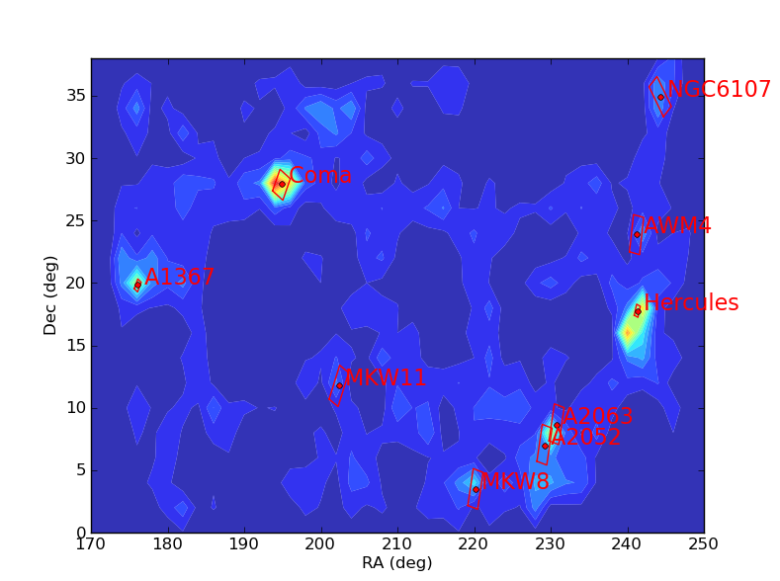
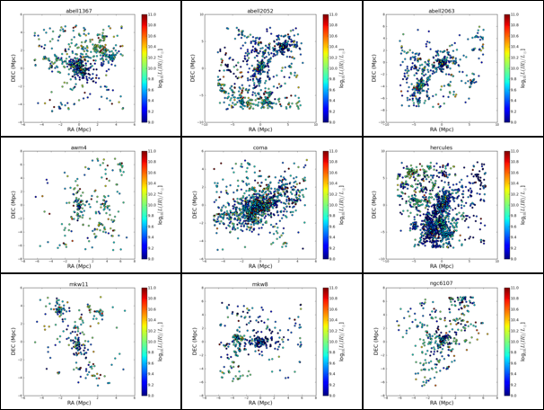
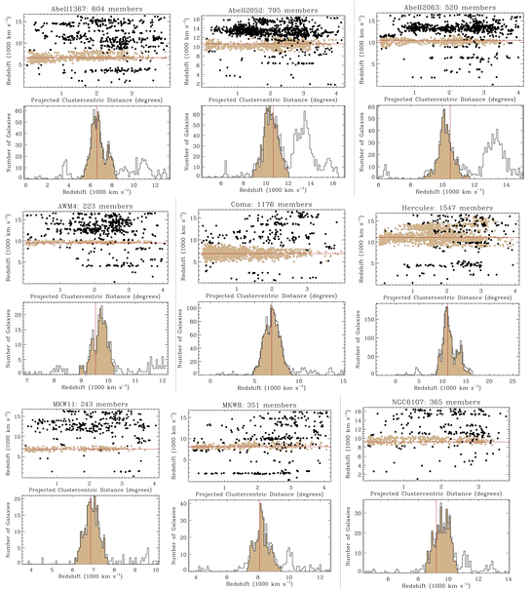
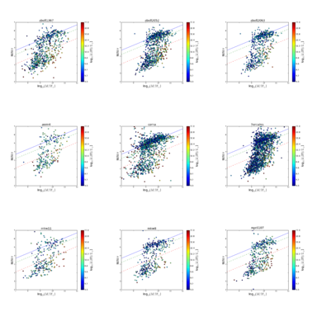
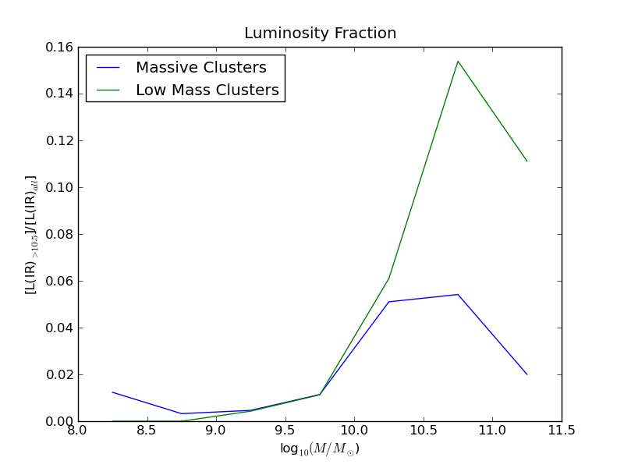
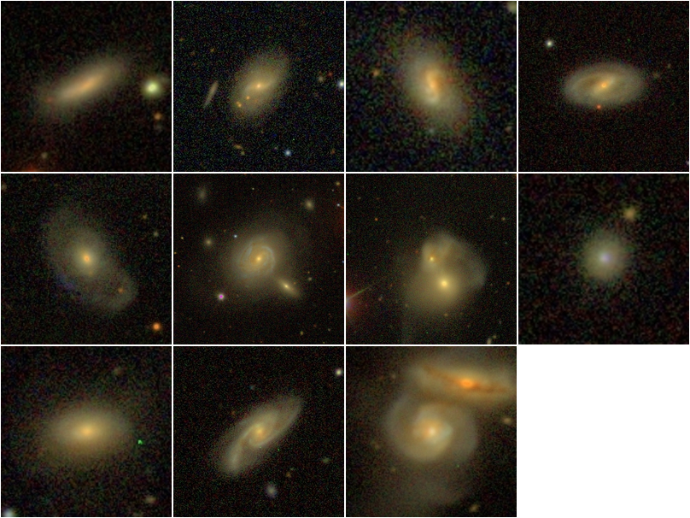
The Incidence of Dust-Obscured
Star Formation in Nearby Galaxy Clusters
Amy McCann, Dr. John Moustakas, Dr. Rose Finn
Department of Physics & Astronomy, Siena College
Abstract
Galaxy clusters are massive gravitational potential wells containing thousands of galaxies and large amounts of dark matter. Most galaxies within clusters have depleted their gas supply---star formation
has ceased---and are therefore ‘red and dead,’ whereas star formation in galaxies outside of clusters is widespread. What causes galaxies in the cluster environment to stop forming stars? To investigate
this question, we are studying a sample of nine low-redshift clusters drawn from the Local Clusters Survey with multi-wavelength observations from the ultraviolet to the infrared. Our goal is to determine
whether galaxies experience one final burst of enhanced, dust enshrouded star formation before falling into the cluster potential and ‘dying.’
The Local Cluster Survey
Multi-wavelength Observations
Cluster Membership
NASA – Sloan Atlas (NSA): High-fidelity catalog of galaxies observed
by the GALEX, WISE and SDSS surveys. See http://nsatlas.org for details.
Galaxy Evolution Explorer (GALEX): All – sky survey which observed
galaxies at ultraviolet wavelengths. GALEX’s mission was to trace star
formation in galaxies.
Wide Field Infrared Survey Explorer (WISE): WISE was an infrared
space telescope which detected infrared light emission from dust. The WISE
survey allows for mapping of star formation within dust enshrouded galaxies.
Sloan Digital Sky Survey (SDSS): SDSS was an optical imaging and
spectroscopic survey which imaged extragalactic objects over 35% of the sky.
The objective of The Local Cluster Survey is to determine the impact of environment on the evolution of star-forming galaxies in the local universe. Specifically, this survey will determine how a galaxy's gas supply is affected by environment.
Figure 3:
Membership plots
which distinguish
between galaxies
within the cluster
and field galaxies.
A “friends-of-friends”
algorithm was used
to distinguish cluster
galaxies from field
galaxies.
Figure 1: The position of
each of the nine galaxy clusters in
the Local Cluster Survey.
Figure 2: Spatial distribution of galaxies in each of the nine clusters from the LCS sample
NUV-R vs. Stellar Mass plots
Incidence of dust enshrouded star-forming galaxies
Infrared-Luminous Galaxies
F
Figure 3: NUV-r vs. stellar
mass distinguishes between
the galaxies in the blue cloud
and the red sequence. The green
and red dashed lines distinguish between the green-valley
galaxies and red and blue
galaxies.
Massive Cluster | Low Mass Cluster
Coma | MKW 11
Hercules | MKW 8
Abell 1367 | AWM4
Abell 2052 | Abell 2063
 | NGC6107
Table 1: Specifies which clusters are defined as massive or low mass. Designation is based on the cluster’s velocity dispersion.
Figure 5: SDSS images of galaxies within the sample set that have infrared luminosities greater than 10¹¹
Figure 4: Plot showing the fraction of infrared luminous galaxies with L(IR)>10.5 divided by all galaxies within the sample.
Summary
On Going Work
The objective of this project was to determine whether galaxies experience one final burst of dust-enshrouded star formation
before dying and falling into the cluster potential. Thus far it has been determined that the LCS sample is deficient in
luminous infrared galaxies with only 13 galaxies (depicted in Figure 6) having an L(IR) > 10¹¹ L_{sun}. Of these 13 galaxies
there are two interacting pairs (one pair in Coma and one pair in MKW 8) within about 1 Mpc of one another. The luminosity
Fraction plot indicates that low mass galaxies have negligible dust enshrouded star formation within both the low mass and
high mass cluster environments. However, at higher masses, galaxies within the low mass cluster have a more significant
incidence of dusty star-formation than those high mass galaxies found within the massive cluster environment.
In conjunction with the Local Cluster Survey, data was obtained at Kitt Peak National Observatory where the 0.9m
telescope was used to image 10 clusters in the broad band filters: R, r, and the narrowband filter: H alpha.
Two of the clusters within the imaged sample where MKW11 and MKW8. The objective is to reduce the data for
MKW11 in order to determine the star formation rates and star formation spatial distributions of MKW11
from the images obtained at Kitt Peak.

