Slide 1

Bangladesh Army University of Science and Technology
Project Presentation
Department: computer science and engineering
course title: software development project
course code:2200
Submitted By: Submitted To:
Md. Toukir Ahmed Name: Mousumi Akter
Dept of CSE Roll :180201072
BAUST level :2 term : ll
Saidpure Cantonment, Saidpure , Nilphamari Batch:8th Group: B

Slide 2
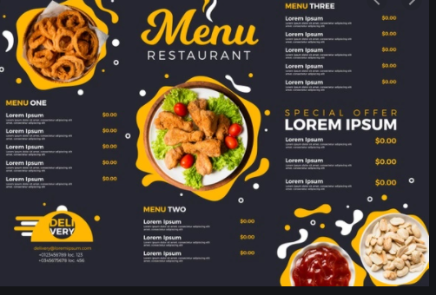
Restaurant Menu System

Slide 3
Introduction:
The project titled “restaurant menu system” is a management program for the monitoring and controlling the transactions in a restaurant .
The project “Restaurant menu system” is developed by in C++,which mainly focused on basic operation in a restaurant like food price ,order system and price system.

Slide 4
Objectives:
Use the project source code and create a app for a restaurant.
Methodology:
The program restaurant menu system has a three main modules.
First path to see the user the price off food in available in the restaurant .
Second path of program see the order system to the user.
Last path of program see the total price on the order.

Slide 5
Software Requirement:
Operating system: Windows.
Language : C++.
IDE: Code Blocks.
System facilities:
System maintains all the required information of the customer, vendor , payment details .
The system allows the user to calculate any sort of payment related calculations.
Total bills are also generated automatically.

Slide 6
Future work
Allows customers to customize food order.
Allows to save payment details for future use.
Allows to process an order as a quest.
Integrate with in store touch screen device like iPod.

Slide 7
Conclusion:
The restaurant menu system needs to be computerized to reduce human errors and to increase the efficiency. The proposed restaurant menu system in the proposal will be computerized management system development to maintain all the daily work of restaurant .
The main focus of this project is to lessen human effort and encourage efficient record keeping.
https://github.com/mousumi72/Food-Menu.git

Slide 8
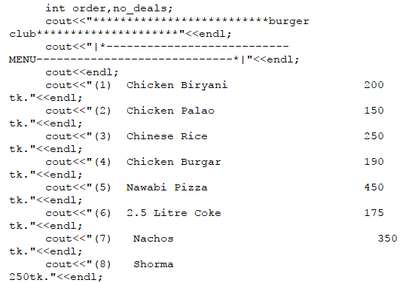
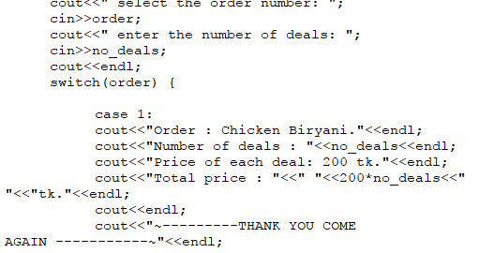
code screenshot

Slide 9
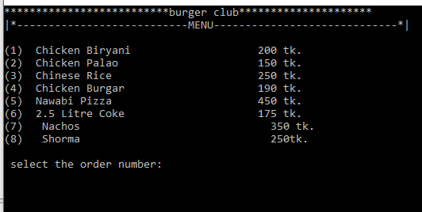
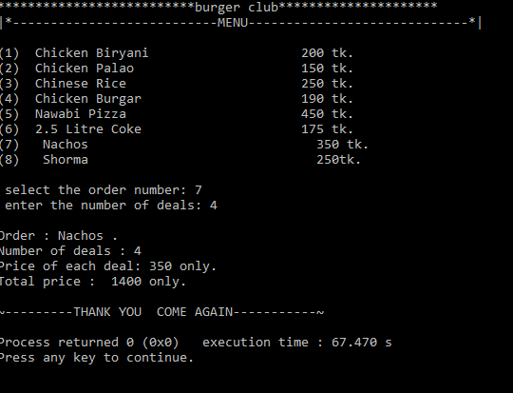
output screenshot

Slide 10
Thank you

