Slide 1
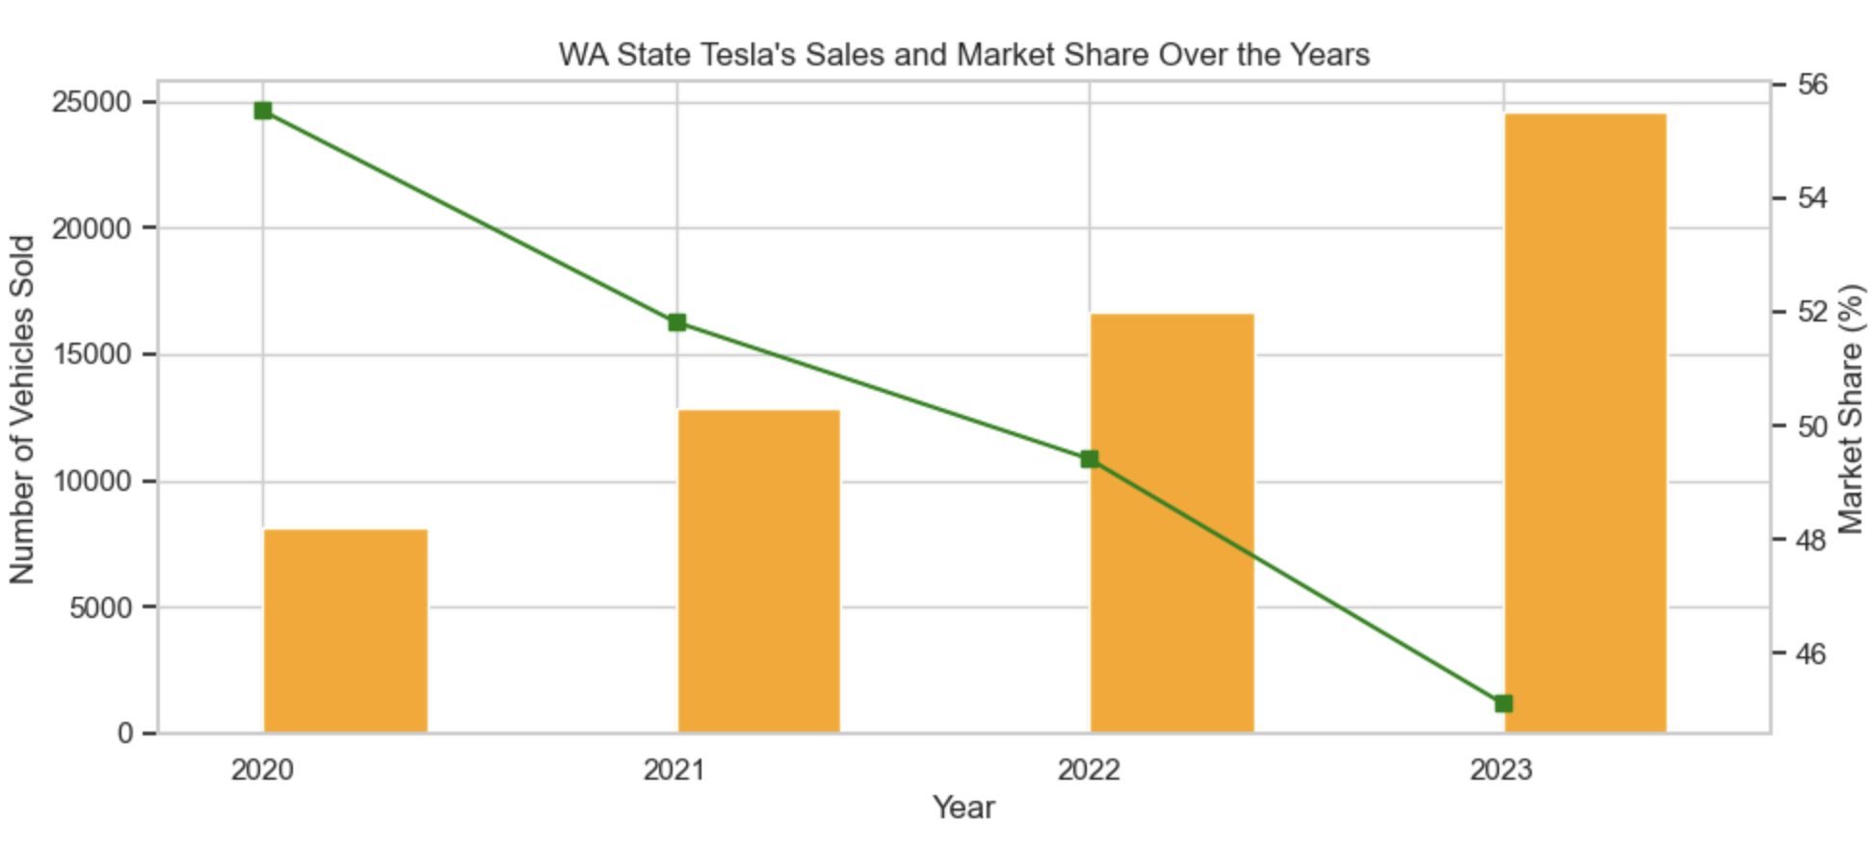
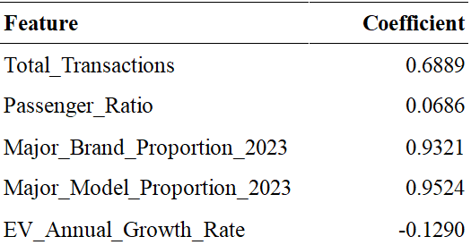
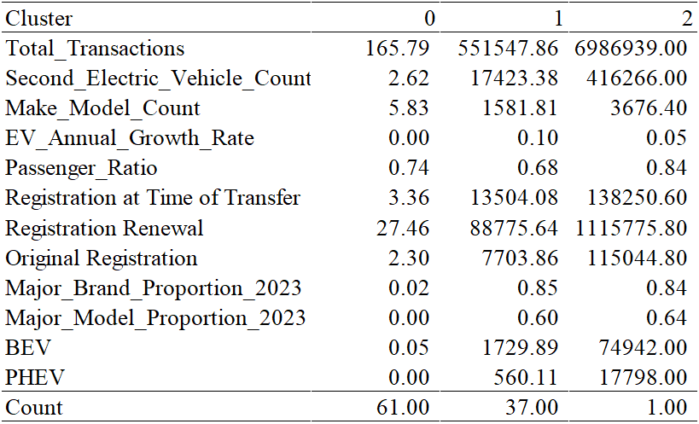
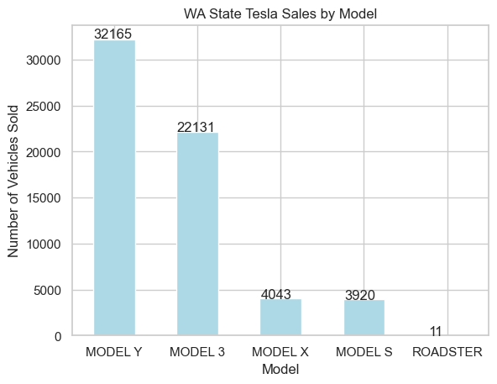
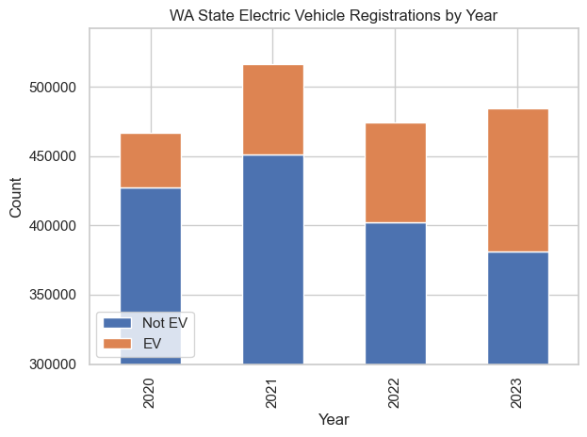
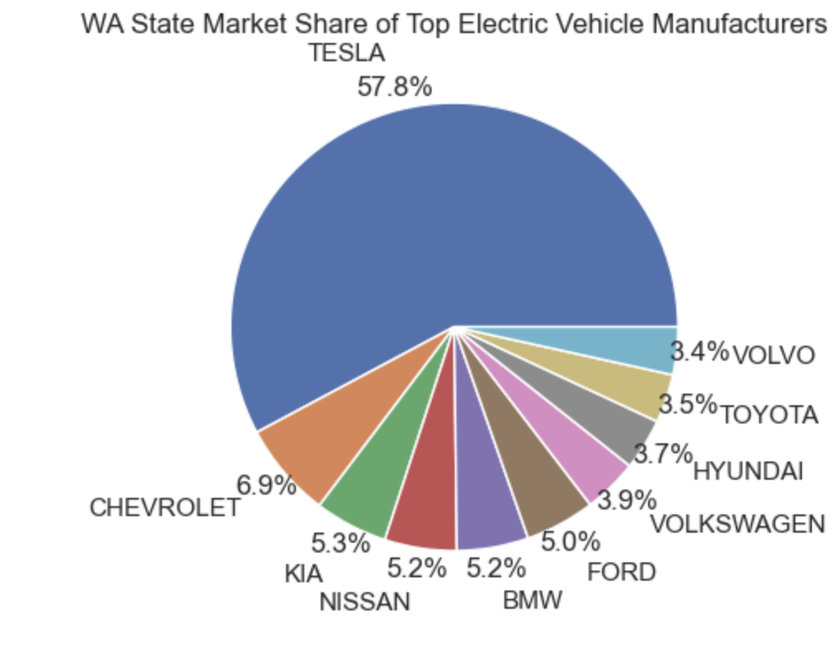
Electric Vehicle Market and Tesla Sales in Washington State
5300 Group 16
Frank Dong, Qiu Jingxi, Di Ziyan
Abstract
Tesla's Competitive Stance
Method
Result
In the past four years, the electric vehicle (EV) market has experienced significant growth, with Tesla Inc. leading this surge. Highlighting its market dominance, Tesla's stock value peaked at twenty times its lowest point in 2019, reflecting strong investor confidence in the EV sector and Tesla's innovative capabilities. Our analysis delves into electric vehicle trends from 2020 to 2024, focusing on overall sales increases, Tesla's market position, its competition with other EV manufacturers, the popularity of Tesla models, and the geographical distribution of EV sales. The study uses SVM prediction and K-means clustering to analyze the processed data of vehicle holdings and transactions in Washington State, to identify the characteristics of different markets and their influencing factors. We have identified the important features of the Unpopular Market, Rapidly Developing Market, and Highly Developed Market, as well as important indicators for determining the level of electric vehicle development in the region. Through this result, decision-makers can understand the characteristics of transportation and automobile markets in different counties, thereby more effectively positioning policies and resources.
Figure 1 provides a stark visual of electric versus non-electric vehicle registrations over the years. It depicts a growth trajectory for EV registrations, with Tesla vehicles playing a substantial role in this increase. As Tesla models like the Model Y and Model 3 gain popularity, they reflect the company's successful penetration into the market, offering models that align with consumer demand for affordability and sustainability.
With Figure 2, we can easily find out Tesla's supremacy in the EV space is accentuated by sales and market share data, with the brand commanding a majority of the market. This eclipses other key players like Chevrolet, Kia, and Ford, whose presence, while notable, remains overshadowed by Tesla's market saturation.
While Tesla's annual sales have surged, a nuanced examination reveals a marginal dip in market share amidst intensifying competition, followed by a slight resurgence in 2024. Despite these fluctuations, Tesla's robust sales growth affirms its entrenched market leadership and its pivotal role in propelling the EV industry forward.
In the visualization, we found that different counties have different electric vehicle preferences. Therefore, we plan to analyze the preferences of different counties with SVM and clustering method, and discuss the potential problems electric vehicles still face in the market.
We can consider the following variables for analysis:
1. Electric vehicle holdings
Electric vehicles count: The total number of registered electric vehicles in each county, which shows the popularity of electric vehicles in the county.
Electric vehicles ratio: The ratio between electric and total vehicle transactions
2. Preferences for electric vehicle models
Manufacturer preferences: Which electric vehicle manufacturers are favored by each county (such as Tesla, Ford, etc.)
Model preference: The popularity of specific models, such as which specific models (such as Tesla Model 3, Nissan LEAF, etc.) are more popular in various counties.
Vehicle Type Distribution: The distribution proportion of different types of electric vehicles (such as pure electric vehicles (BEVs) and plug-in hybrid electric vehicles (PHEVs)).
3. Transaction
Transaction Velocity: Since we do not have detailed transaction data related to each specific car, the transaction velocity can be defined as the average number of transactions of vehicles within a specific time period. For the data of the entire county, we can calculate the average value of all vehicle transactions as the flow speed of the county.
Transaction Type: This includes the number of transactions per year in each county and the type of transactions (such as new registration, transfer, or renewal).
Model independent and dependent variables
After processing the data, we finally obtained the data processing results containing the following variables:
———————————————————————————————————————
'County', 'Total_Transactions', 'Electric_Vehicle_Count', 'Second_Electric_Vehicle_Count', 'Make_Model_Count', 'EV_Annual_Growth_Rate', 'Passenger_Ratio', 'Registration at Time of Transfer', 'Registration Renewal', 'Original Registration', 'Major_Brand_Proportion_2023', 'Major_Model_Proportion_2023', 'BEV', 'PHEV'
———————————————————————————————————————
SVM Analysis:
Support Vector Machine (SVM) is a powerful supervised learning model used to solve classification and regression problems, optimizing model performance by constructing decision boundaries with maximum spacing between categories.
In this part, we will use SVM will L2 regularization to regress the data. We first do a train-test split with an 80-20 ratio, and given the hyper-parameter of cv=5, penalty=”l2”, solver=”lbfgs”.
K-means Clustering:
K-means clustering is a widely used unsupervised learning algorithm that divides data points into K clusters to minimize the sum of distances from each point to its designated cluster center for data grouping.
We have determined the optimal number of clusters based on elbow law as 3, which serves as a hyperparameter for clustering analysis of the data.
SVM:
The SVM results show that "Total Transactions," "MajorBrand-Proportion_2023," and "Major-Model-Proportion_2023" significantly influence local electric vehicle adoption.
Higher transaction volumes, indicative of larger or economically vibrant counties, correlate positively with electric vehicle popularity. Similarly, a strong presence of major brands and models boosts electric vehicle popularity.
"EV-Annual_Growth-Rate" is negatively correlated, suggesting that regions with an established base of electric vehicles experience slower growth rates, while areas with fewer electric vehicles, despite higher growth rates, still struggle to achieve significant penetration.
Clustering:
The clustering results categorize counties into three electric vehicle markets: unpopular, rapidly developing, and highly developed.
Unpopular Market: Comprises 61 counties with an average electric vehicle growth of zero, likely reflecting remote or sparsely populated areas with minimal new car purchases, none of which include mainstream brands or models.
Rapidly Developing Market: Includes 37 counties, characterized by a high growth rate in electric vehicle adoption and a larger volume of new car purchases compared to the other types, predominantly of mainstream brands.
Highly Developed Market: Consists of only King County, where electric vehicles are widely accepted and have a significant existing base. Similar to the rapidly developing market, this category primarily purchases mainstream brands.
Feature | Coefficient
Total_Transactions | 0.083077878
Second_Electric_Vehicle_Count | 0.04193516
Make_Model_Count | 0.338877109
EV_Annual_Growth_Rate | 0.284871736
Passenger_Ratio | -0.055293517
Registration at Time of Transfer | 0.097988115
Registration Renewal | 0.083618083
Original Registration | 0.066184287
Major_Brand_Proportion_2023 | 0.515108002
Major_Model_Proportion_2023 | 0.435046343
BEV | 0.020257439
PHEV | 0.031426951
EV_Proportion | 0.231650918
EV_High_Low | 0.231381388
Introduction
In the dynamic landscape of the electric vehicle (EV) market, Tesla has emerged as a beacon of innovation and growth. The company's stock valuation has soared, showcasing a staggering peak at twenty times above its lowest in 2019. This remarkable ascent reflects a robust investor confidence mirrored in the broader EV market trends.
An analysis of vehicle registration data from 2020 to 2024 highlights the expansion of the EV segment. A notable year-over-year increase in electric vehicle registrations showcases the burgeoning consumer shift towards eco-friendly transport options. Tesla has been instrumental in this shift, consistently holding a significant slice of the market share. Despite a competitive environment, Tesla's dominance is evident in its market presence and sales performance.
This study is based on two publicly available datasets, Electric Vehicle Population Data and Vehicle Registration Transactions by the Department of Licensing, from the official Washington state open data portal (data.wa.gov). The first dataset shows Battery Electric Vehicles (BEVs) and Plug-in Hybrid Electric Vehicles (PHEVs) currently registered through the Washington State Department of Licensing (DOL). And the second dataset is a listing of transactions associated with authorizing vehicles to be used on public roads, commonly referred to as “buying tabs” or “buying tags”.
Figure 3
Table 1: Coefficient of SVM Result
The preferential consumer tilt towards Tesla's Model Y and Model 3, as indicated by sales data, highlights the allure of Tesla's blend of innovation with affordability. The lesser sales of the premium Model X and S iterations suggest a market that values Tesla's more recent entries that balance performance with cost-effectiveness.
Table 2: Cluster Centers
Conclusion
This study provides analysis of the electric vehicle (EV) market from 2020 to 2024, with a particular focus on Tesla Inc.'s role in shaping the industry. By using SVM prediction and K-means clustering techniques on car ownership and transaction data in Washington State, this study effectively mapped the electric vehicle market patterns in different counties.
Tesla's market leadership position: The company stands out for its rapid growth in stock value, reflecting the high confidence of investors and its role in driving growth in the electric vehicle market.
Market segmentation insights: Different segmented markets have been identified in Washington State - less affluent markets, rapidly developing markets, and highly developed markets - each with unique characteristics.
Geographical distribution: The analysis of electric vehicle sales in each county provides key data for targeted marketing strategies and business expansion.
Key factors for development: automobile trading, brand awareness, and regional economic activities are the key to shaping the pattern of electric vehicles.
Strategic significance: To provide actionable insights for decision-makers and businesses to optimize resource allocation and enhance policy effectiveness in the emerging electric vehicle industry.
Figure 1
Figure 2
Figure 4
References:
[1] https://data.wa.gov/Transportation/Electric-Vehicle-Population-Data/f6w7-q2d2/about_data
[2] https://data.wa.gov/Transportation/Vehicle-Registration-Transactions-by-Department-of/brw6-jymh/about_data

