Slide 1


The Innovation Urban | A proposed sister journal of The Innovation
The Innovation Urban
Background
Vision
Mission
Topics
Editorial Board
SEE THE CITY · CHANGE THE CITY
The
The Innovation Urban
Innovation
URBAN
Linking Infrastructure, Technology, Governance, and Climate Action for Sustainable Urban Transition
01
Infrastructure
02
Technology
03
Governance
04
Climate Action
Open access
An interdisciplinary journal for scientific innovation in cities

Slide 2




The Innovation Urban | A proposed sister journal of The Innovation
02
The Innovation Urban
Background
Vision
Mission
Topics
Editorial Board
WHY A NEW JOURNAL
Background
Cities are among humanity’s most complex creations and a critical frontier for scientific and technological innovation, yet face the urgent imperative to respond to infrastructure failures, disruptive technologies, climate change, and geopolitical and economic polycrises worldwide.
Infrastructure failures
Disruptive technologies
Ageing networks under rising demand
AI, sensing and automation reshaping cities
Climate change
Polycrises
Heat, flooding and the need to decarbonize
Geopolitical and economic shocks worldwide

Slide 3



The Innovation Urban | A proposed sister journal of The Innovation
03
The Innovation Urban
Background
Vision
Mission
Topics
Editorial Board
WHERE WE AIM TO BE
Vision
A world-class international journal based in China, led by an international, interdisciplinary, and intergenerational team of leading scholars, and dedicated to advancing scientific discovery and technological innovation to diagnose and dissect urban challenges and devise innovative solutions for cities worldwide.
FROM DISCOVERY TO SOLUTIONS
01
Diagnose urban challenges
International
Interdisciplinary
Intergenerational
02
Dissect their causes and interactions
Editors and authors from leading institutions worldwide
Engineering, technology, governance and climate science
Leading scholars together with emerging researchers
03
Devise innovative solutions for cities

Slide 4
The Innovation Urban | A proposed sister journal of The Innovation
04
The Innovation Urban
Background
Vision
Mission
Topics
Editorial Board
WHAT WE WILL DO
Mission
The journal’s mission is to establish a distinctive and authoritative international forum for pioneering interdisciplinary scholarship on the interdependent challenges of urban infrastructure, technological transformation, governance, and climate action.
01
02
03
04
Advance interdisciplinary scientific understanding of cities
Promote innovation in urban infrastructure and engineering
Enable technological transformation of urban systems
Advance urban climate action and environmental resilience
05
06
07
08
Understand how governance enables or constrains urban innovation
Generate comparative evidence and contextually responsive solutions
Accelerate translation from discovery to application
Build a global community for urban innovation

Slide 5
The Innovation Urban | A proposed sister journal of The Innovation
05
The Innovation Urban
Background
Vision
Mission
Topics
Editorial Board
WHAT WE PUBLISH
Topics of Interest
Topics | Examples
Urban Infrastructure and Engineering | Renewal of aging urban infrastructure; engineering solutions for dense urban environments; coordinated design and operation of urban infrastructure networks
Urban Technologies and Intelligent Systems | City-scale sensing and digital twins; AI and robotics for urban services and infrastructure operations; development and validation of technologies in urban settings
Climate Action and Urban Resilience | Urban heat and flood risks; adaptation through urban design, infrastructure, and nature-based solutions; decarbonization pathways for cities
Buildings, Energy, and the Built Environment | Effects of urban form and climate on building energy use; Building–neighbourhood–city energy interactions; urban retrofits; urban indoor–outdoor environmental quality
Urban Mobility and Transportation | Interactions between urban form and mobility; integration of multimodal urban transport networks; effects of mobility innovations on accessibility, energy use, and emissions
Urban Environment, Resources, and Health | Urban water–energy–waste linkages; circular resource flows within and across cities; relationships between urban form, environmental exposure, and health
Urban Systems, Complexity, and Transformation | Urban scaling and metabolism; cascading failures across interconnected urban networks; technological and infrastructural pathways of urban transformation
Governance, Planning, and Policy for Urban Innovation | Planning and regulation for urban technology deployment; governance of integrated infrastructure systems; evaluation and adaptation of innovations across diverse cities

Slide 6

Editor-in-Chief & Working group
Prof. Shenjing He
Prof. Xiang Yan
Prof. Tianzuo Wen
Dr. Yutian Lu

Slide 7




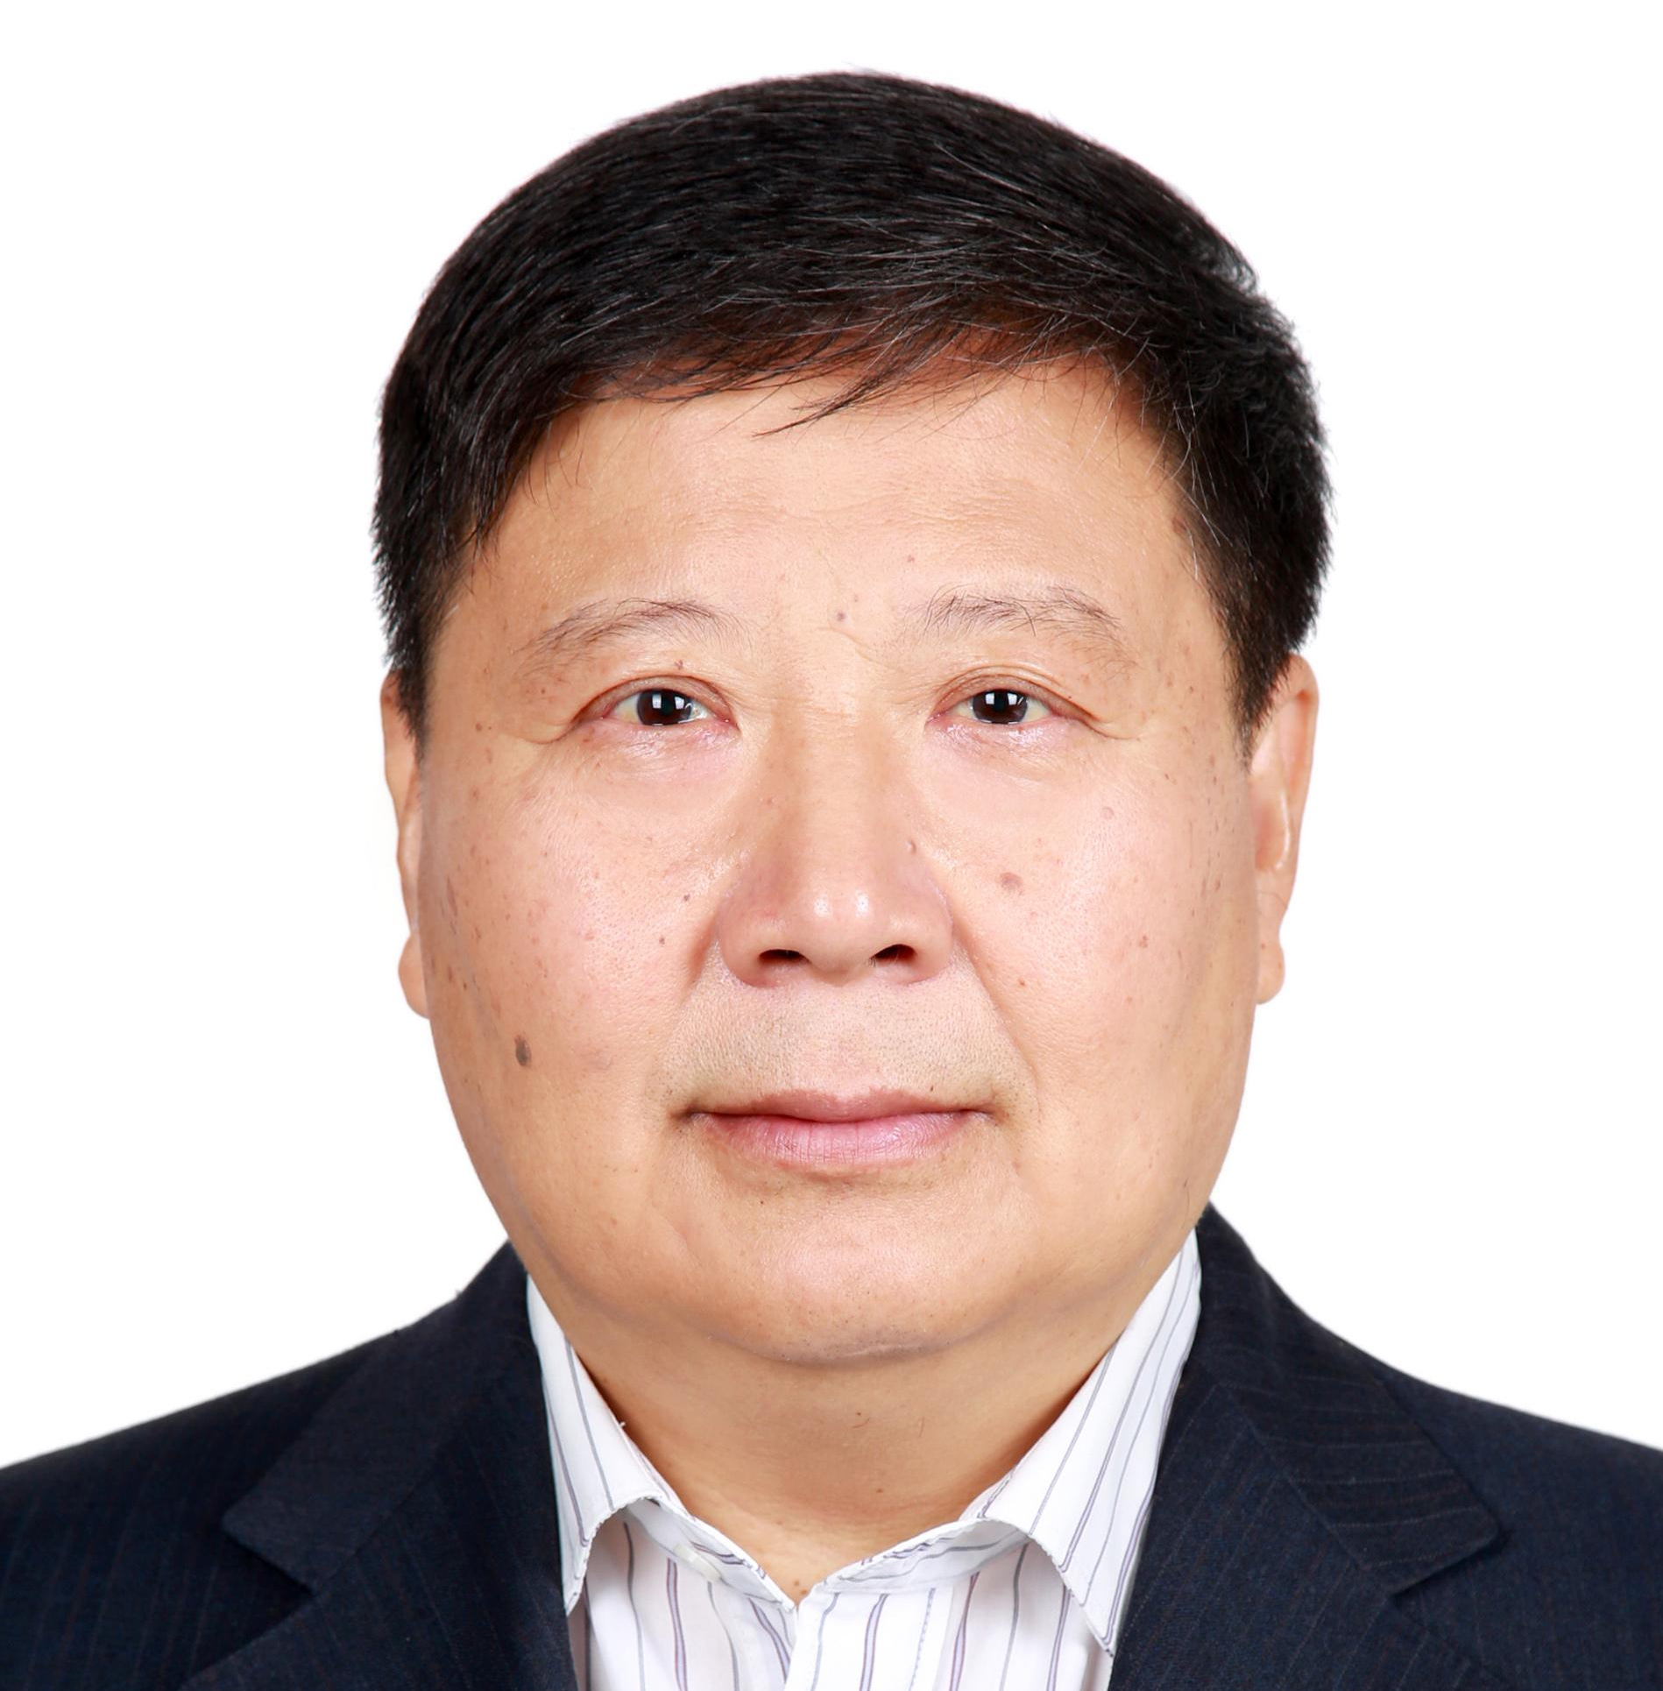




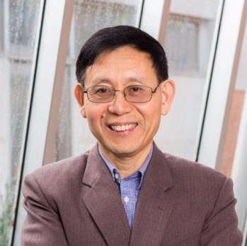




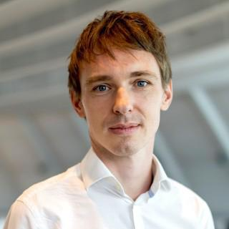
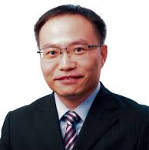
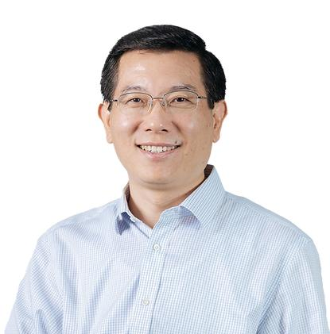
The Innovation Urban | A proposed sister journal of The Innovation
07
The Innovation Urban
Background
Vision
Mission
Topics
Editorial Board
EDITORIAL BOARD MEMBERS
Editorial Board
More prospective Editorial Board members to be invited …
ACADEMICIANS 院士
叶嘉安
HKU
智慧城市，地理信息系统，城市规划
William Clark
UCLA
城市地理，城市空间，人口迁移
吴缚龙
UCL
城市规划，城市治理
傅伯杰
中国科学院生态环境研究中心
景观生态、生态系统服务
樊杰
中科院地理所
国土空间规划、区域发展
院士
院士
院士
院士
院士
宫鹏
HKU
遥感，全球环境变化，城市化与健康
陈德亮
瑞典哥德堡大学
地球系统科学、全球环境变化、气候动力学与数值模拟
申作军
HKU
供应链设计与管理、数据驱动物流优化
刘丛强
天津大学
地球关键带过程与生态功能
蔡文炬
澳大利亚联邦科学与工业研究组织 CSIRO
气候科学、全球变化
院士
院士
院士
院士
院士
DISTINGUISHED SCHOLARS 国际知名学者
Patrick Roberts
Luis Bettencourt
Rebecca Bentley
Emma Baker
Orlando Woods
刘春华
黄波
马克斯·普朗克地球人类学研究所
考古科学、古生态、土地利用与城市化协同演化
芝加哥大学
城市复杂系统、网络、城市尺度理论
墨尔本大学
住房与建成环境、流行病学、城市健康
阿德莱德大学
城市健康与居住环境
新加坡管理大学
智慧城市，数字平台治理
香港城市大学
智慧能源、电动交通
HKU
地理信息科学、遥感和空间数据分析

Slide 8







International Academic Leadership & Networks

Slide 9
Timeline
November–December 2026 | Editorial Board Formation & Strategic Planning
Convene the inaugural Editorial Board meeting.
Finalize the journal’s vision, scope, editorial structure, and launch strategy.
February 2027 | APNHR–AHRC Conference, Melbourne
Introduce the journal to international research networks.
Engage potential editors, contributors, and institutional partners.
April 2027 | UAA Conference, New York
Expand international networking and raise awareness of the journal.
Invite prospective submissions and explore special issue opportunities.
August 2027 | IGU Urban Commission Meeting
Official Launch of The Innovation Urban.
Announce the editorial team, journal scope, and call for papers.

