Slide 1


The Innovation Urban
Background
Vision
Mission
Topics
Editorial Board
Networks
Timeline
SEE THE CITY · CHANGE THE CITY
The
The Innovation Urban
Innovation
URBAN
Linking Infrastructure, Technology, Governance, and Climate Action for Sustainable Urban Transition
01
Infrastructure
02
Technology
03
Governance
04
Climate Action
Open access
An interdisciplinary journal for scientific innovation in cities

Slide 2


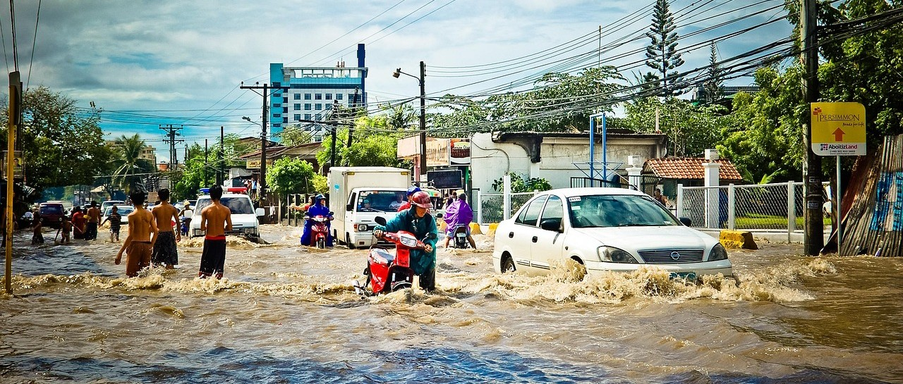
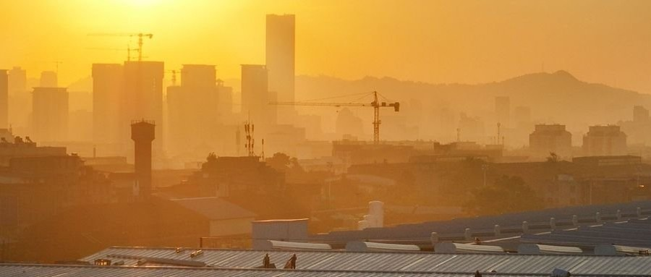
The Innovation Urban
Background
Vision
Mission
Topics
Editorial Board
Networks
Timeline
WHY A NEW JOURNAL
Background
Cities are among humanity’s most complex creations and a critical frontier for scientific and technological innovation, yet face the urgent imperative to respond to infrastructure failures, disruptive technologies, climate change, and geopolitical and economic polycrises worldwide.
Infrastructure failures
Disruptive technologies
Ageing networks under rising demand
AI, sensing and automation reshaping cities
Climate change
Polycrises
Heat, flooding and the need to decarbonize
Geopolitical and economic shocks worldwide
02

Slide 3



The Innovation Urban
Background
Vision
Mission
Topics
Editorial Board
Networks
Timeline
WHERE WE AIM TO BE
Vision
A world-class international journal based in China, led by an international, interdisciplinary, and intergenerational team of leading scholars, and dedicated to advancing scientific discovery and technological innovation to diagnose and dissect urban challenges and devise innovative solutions for cities worldwide.
FROM DISCOVERY TO SOLUTIONS
01
Diagnose urban challenges
International
Interdisciplinary
Intergenerational
02
Dissect their causes and interactions
Editors and authors from leading institutions worldwide
Engineering, technology, governance and climate science
Leading scholars together with emerging researchers
03
Devise innovative solutions for cities
03

Slide 4
The Innovation Urban
Background
Vision
Mission
Topics
Editorial Board
Networks
Timeline
WHAT WE WILL DO
Mission
The journal’s mission is to establish a distinctive and authoritative international forum for pioneering interdisciplinary scholarship on the interdependent challenges of urban infrastructure, technological transformation, governance, and climate action.
01
02
03
04
Advance interdisciplinary scientific understanding of cities
Promote innovation in urban infrastructure and engineering
Enable technological transformation of urban systems
Advance urban climate action and environmental resilience
05
06
07
08
Understand how governance enables or constrains urban innovation
Generate comparative evidence and contextually responsive solutions
Accelerate translation from discovery to application
Build a global community for urban innovation
04

Slide 5
The Innovation Urban
Background
Vision
Mission
Topics
Editorial Board
Networks
Timeline
WHAT WE PUBLISH
Topics of Interest
Topics | Examples
Urban Infrastructure and Engineering | Renewal of aging urban infrastructure; engineering solutions for dense urban environments; coordinated design and operation of urban infrastructure networks
Urban Technologies and Intelligent Systems | City-scale sensing and digital twins; AI and robotics for urban services and infrastructure operations; development and validation of technologies in urban settings
Climate Action and Urban Resilience | Urban heat and flood risks; adaptation through urban design, infrastructure, and nature-based solutions; decarbonization pathways for cities
Buildings, Energy, and the Built Environment | Effects of urban form and climate on building energy use; Building–neighbourhood–city energy interactions; urban retrofits; urban indoor–outdoor environmental quality
Urban Mobility and Transportation | Interactions between urban form and mobility; integration of multimodal urban transport networks; effects of mobility innovations on accessibility, energy use, and emissions
Urban Environment, Resources, and Health | Urban water–energy–waste linkages; circular resource flows within and across cities; relationships between urban form, environmental exposure, and health
Urban Systems, Complexity, and Transformation | Urban scaling and metabolism; cascading failures across interconnected urban networks; technological and infrastructural pathways of urban transformation
Governance, Planning, and Policy for Urban Innovation | Planning and regulation for urban technology deployment; governance of integrated infrastructure systems; evaluation and adaptation of innovations across diverse cities
05

Slide 6

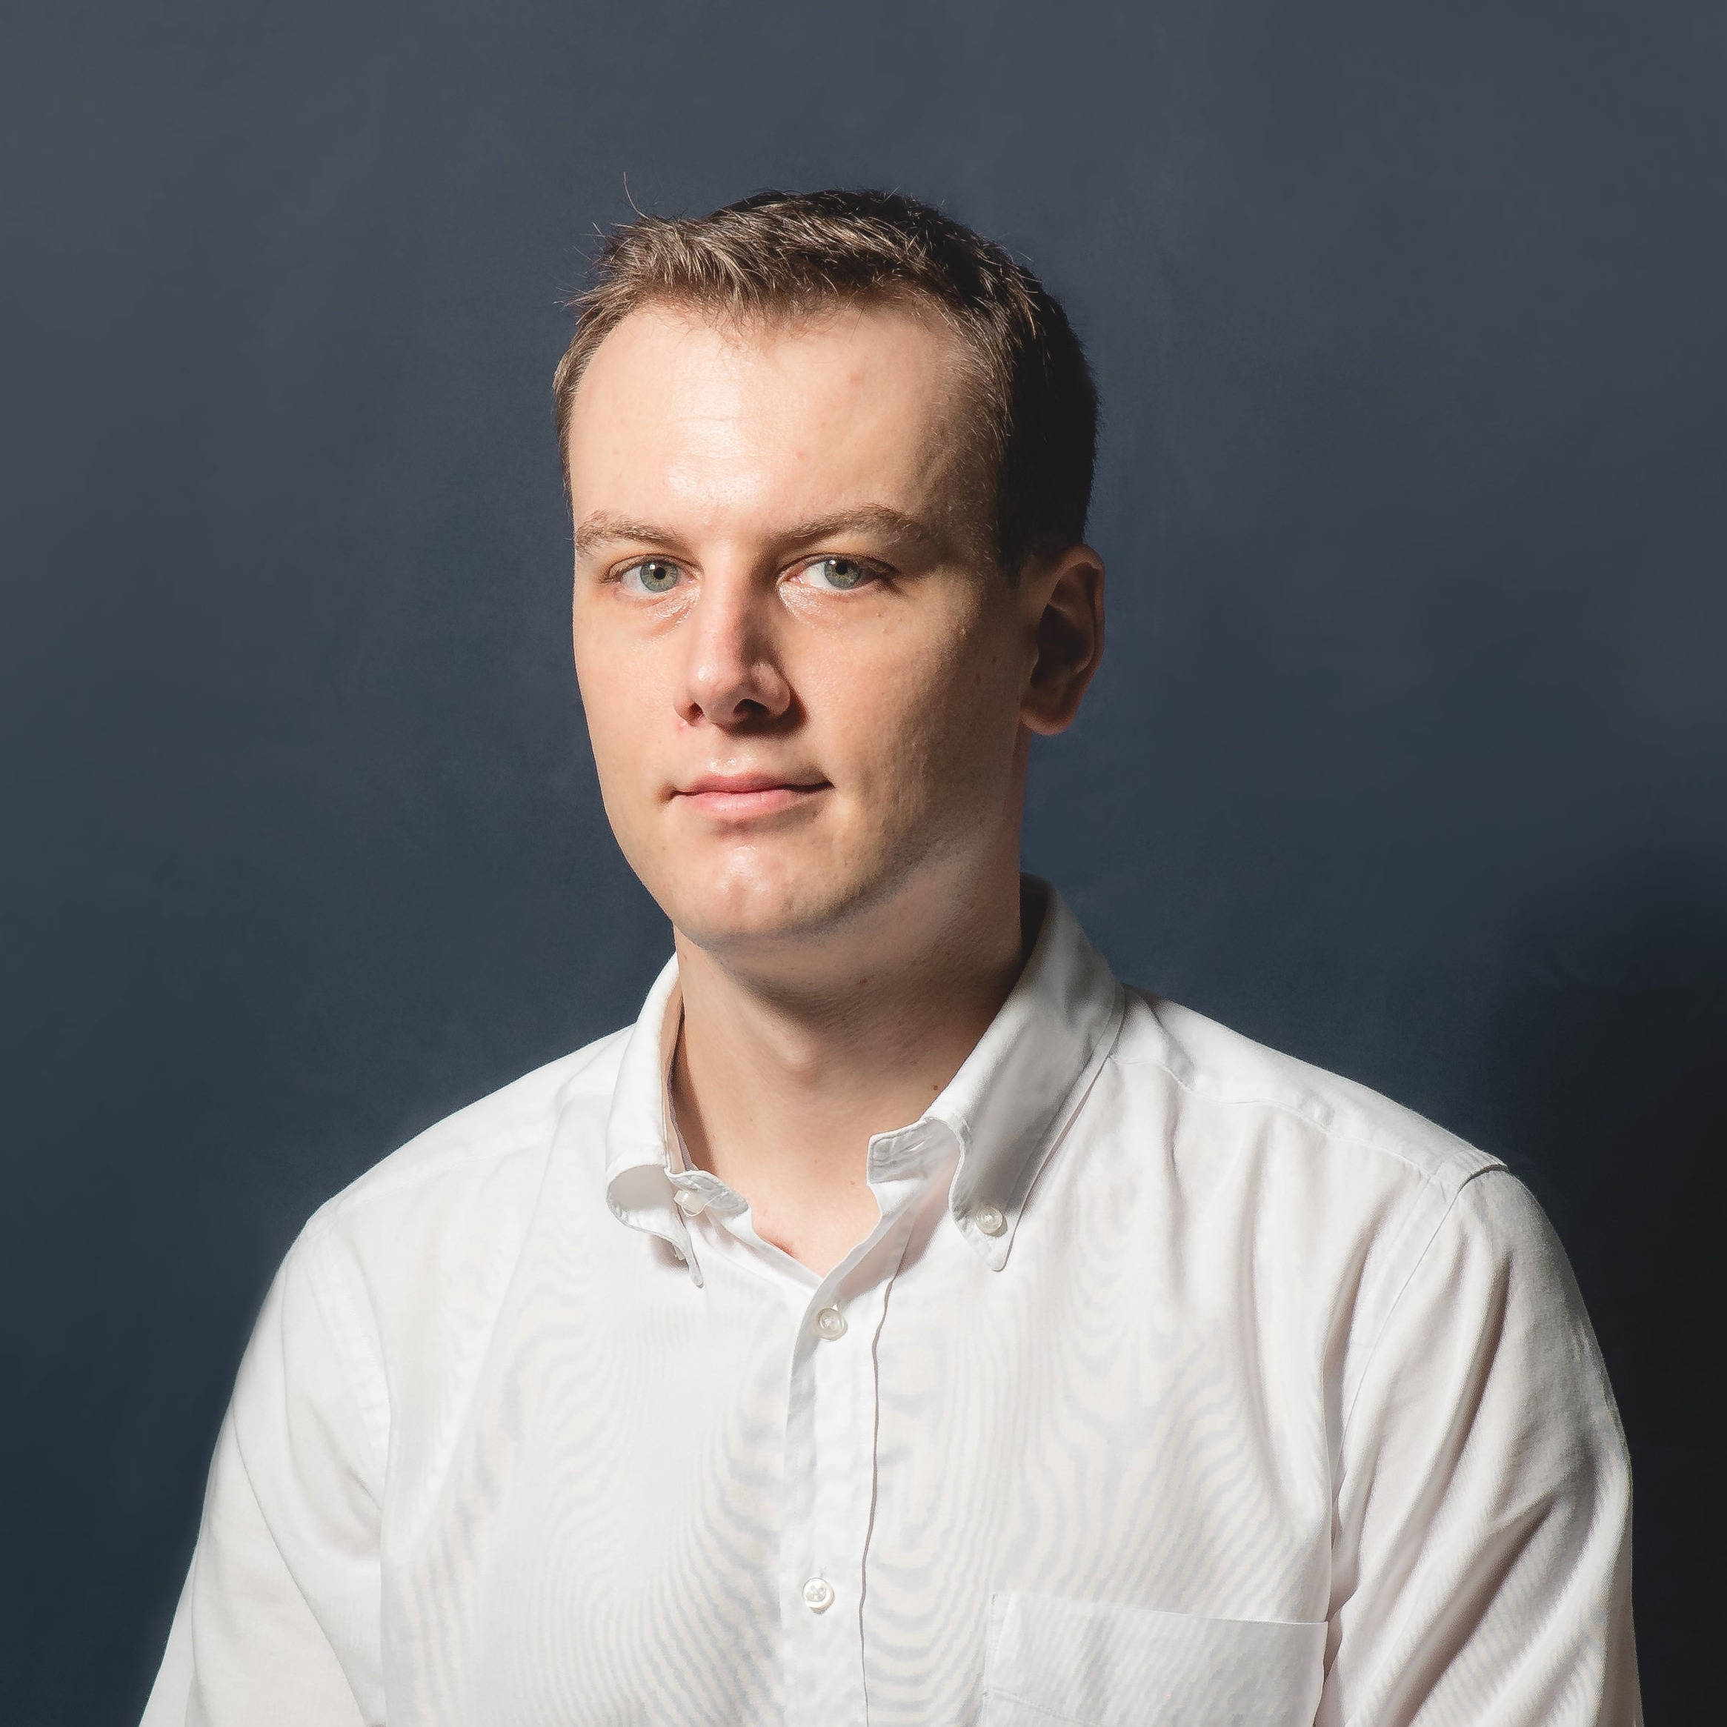



The Innovation Urban
Background
Vision
Mission
Topics
Editorial Board
Networks
Timeline
EDITORIAL LEADERSHIP
Editor-in-Chief & Managing Editors
EDITORS-IN-CHIEF 主编
Prof. Shenjing He
The University of Hong Kong
Prof. Filip Biljecki
National University of Singapore
MANAGING EDITORS 执行编辑
Prof. Xiang Yan
Sichuan University
Prof. Tianzuo Wen
The Chinese University of Hong Kong, Shenzhen
Dr. Yutian Lu
The University of Hong Kong
06

Slide 7

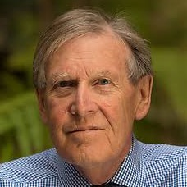

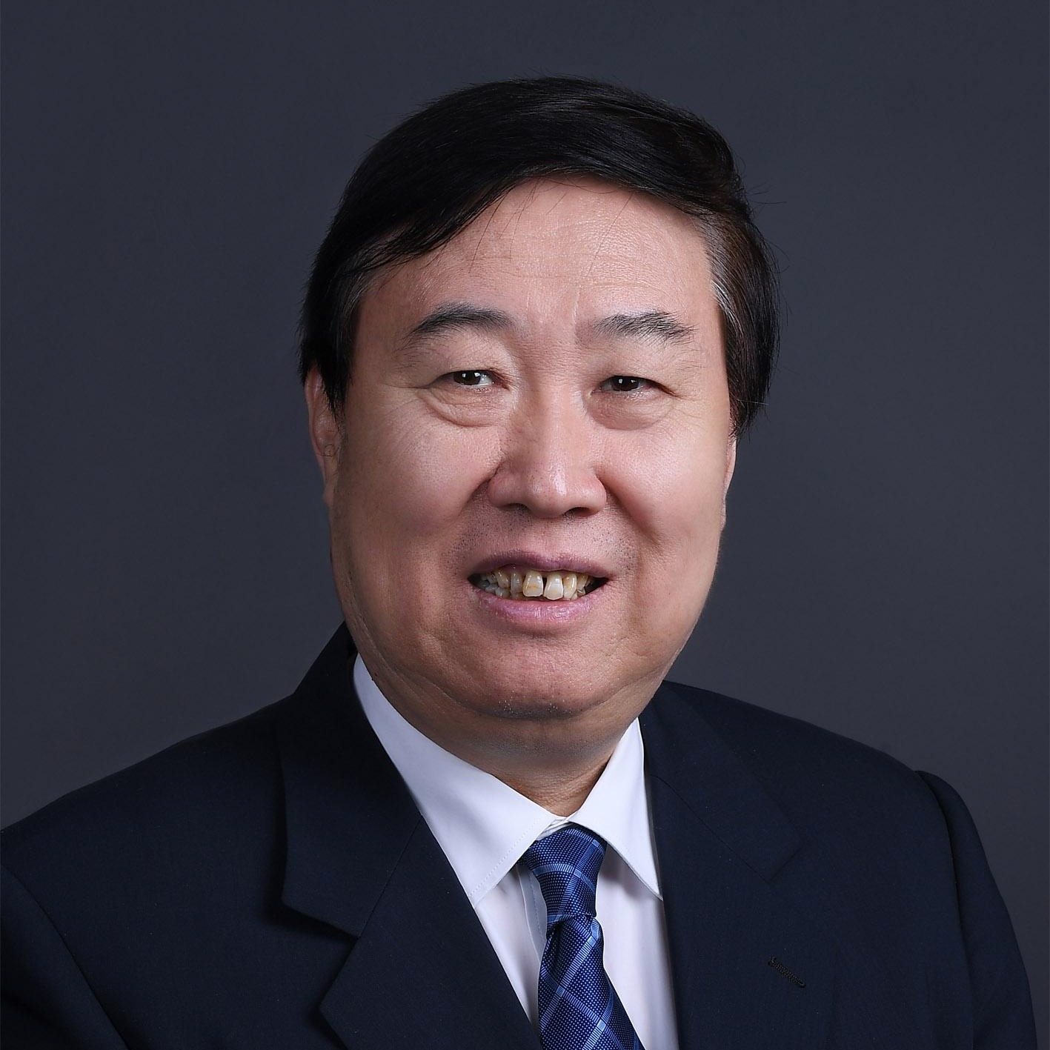
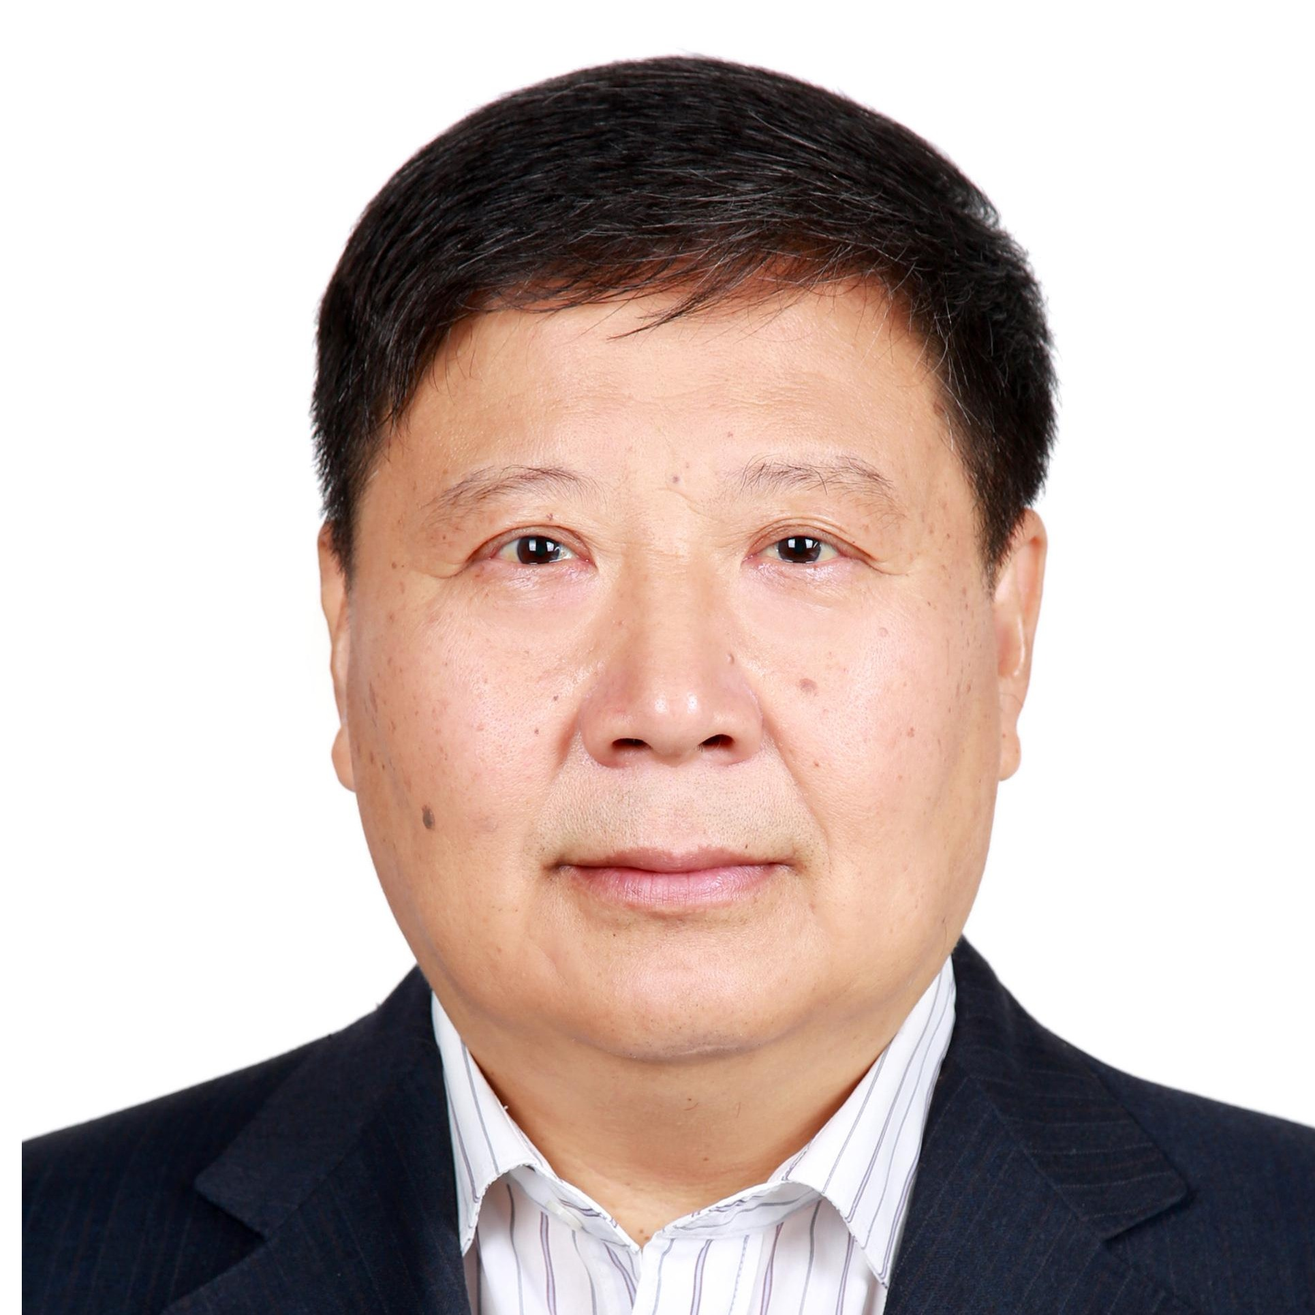

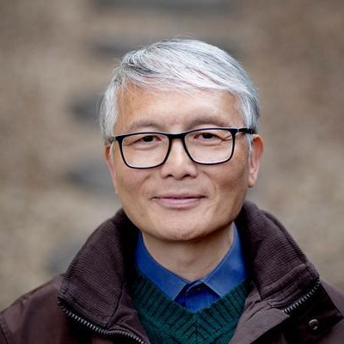


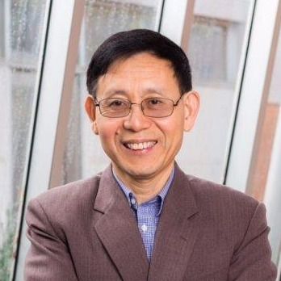

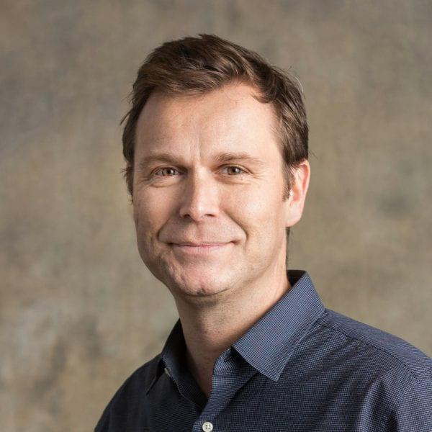


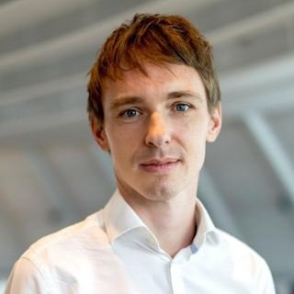
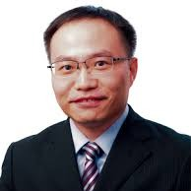
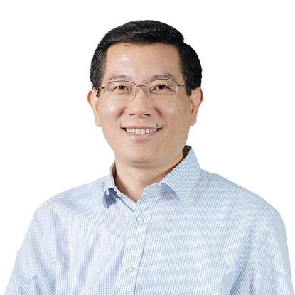
The Innovation Urban
Background
Vision
Mission
Topics
Editorial Board
Networks
Timeline
EDITORIAL BOARD MEMBERS
Editorial Board
More prospective Editorial Board members to be invited …
ACADEMICIANS 院士
叶嘉安
HKU
智慧城市 · 城市规划
地理信息系统
William Clark
UCLA
城市地理 · 城市空间
人口迁移
吴缚龙
UCL
城市规划 · 城市治理
傅伯杰
中国科学院
生态环境研究中心
景观生态
生态系统服务
樊杰
中科院地理所
国土空间规划
区域发展
院士
院士
院士
院士
院士
宫鹏
HKU
遥感 · 全球环境变化
城市化与健康
陈德亮
瑞典哥德堡大学
地球系统科学
全球环境变化
气候动力学与数值模拟
申作军
HKU
供应链设计与管理
数据驱动物流优化
刘丛强
天津大学
地球关键带过程
与生态功能
蔡文炬
澳大利亚联邦科学
与工业研究组织 CSIRO
气候科学 · 全球变化
院士
院士
院士
院士
院士
DISTINGUISHED SCHOLARS 国际知名学者
Patrick Roberts
Luis Bettencourt
Rebecca Bentley
Emma Baker
Orlando Woods
刘春华
黄波
马克斯·普朗克
地球人类学研究所
考古科学 · 古生态
土地利用与城市化协同演化
芝加哥大学
城市复杂系统 · 网络
城市尺度理论
墨尔本大学
住房与建成环境 · 流行病学
城市健康
阿德莱德大学
城市健康与居住环境
新加坡管理大学
智慧城市 · 数字平台治理
香港城市大学
智慧能源 · 电动交通
HKU
地理信息科学
遥感和空间数据分析
07

Slide 8









The Innovation Urban
Background
Vision
Mission
Topics
Editorial Board
Networks
Timeline
GLOBAL REACH
International Academic Leadership & Networks
Urban Affairs Association
城市事务协会
Royal Geographical Society
英国皇家地理学会
Regional Studies Association
区域研究协会
Hong Kong Base of State Key Laboratory of Subtropical Building and Urban Science
亚热带建筑与城市科学
全国重点实验室香港基地
American Association of Geographers
美国地理学家协会
Asia-Pacific Network of Housing Research
亚太住房研究网络
International Geographical Union
国际地理学联合会
Urban China Research Network
中国城市研究网络
The University of Hong Kong Urban Systems Institute
香港大学城市系统研究院
08

Slide 9
The Innovation Urban
Background
Vision
Mission
Topics
Editorial Board
Networks
Timeline
ROADMAP TO LAUNCH
Timeline
PHASE 01
PHASE 02
PHASE 03
PHASE 04
November–December 2026
February 2027
April 2027
August 2027
Editorial Board Formation & Strategic Planning
Convene the inaugural Editorial Board meeting.
Finalize the journal’s vision, scope, editorial structure, and launch strategy.
APNHR–AHRC Conference, Melbourne
Introduce the journal to international research networks.
Engage potential editors, contributors, and institutional partners.
UAA Conference, New York
Expand international networking and raise awareness of the journal.
Invite prospective submissions and explore special issue opportunities.
IGU Urban Commission Meeting
Official Launch of The Innovation Urban.
Announce the editorial team, journal scope, and call for papers.
09

